Slide 1
AIMS K-12 Marketing and Communications Department
April 2023 Board Meeting Presentation
By Suzen Chu - Director of Marketing and Communications

Slide 2
March/April 2023 Social Media Fast Facts
 | Reach
Facebook | 775 reaches
Instagram | 516 reaches
YouTube | 774 views
AIMS website | 5.1K visits
AIMS Intranet | 51 visits

Slide 3
March/April 2023 Wrap Up
Boosting Enrollment
Created marketing materials in English, Chinese and Spanish.
Boosted enrollment posts on social media.
Invited local Preschools, Elementary, and Middle Schools to allow us to place flyers in their locations and do a informational presentation to their families.
Engaged with foster family agencies, and homeless/refugee/community centers.
Placed flyers in local businesses and community centers.
Placed ad on Oakland Post.
Sent postcard to homes within 5 miles of 94607 via USPS Direct Mail.
Used WhatsApp SMS marketing via El Timpano to reach Hispanic and Mayan families.
Supported school sites to host informational nights & school tours.
Supported Enrollment Department on public lottery and to understand their needs.

Slide 4
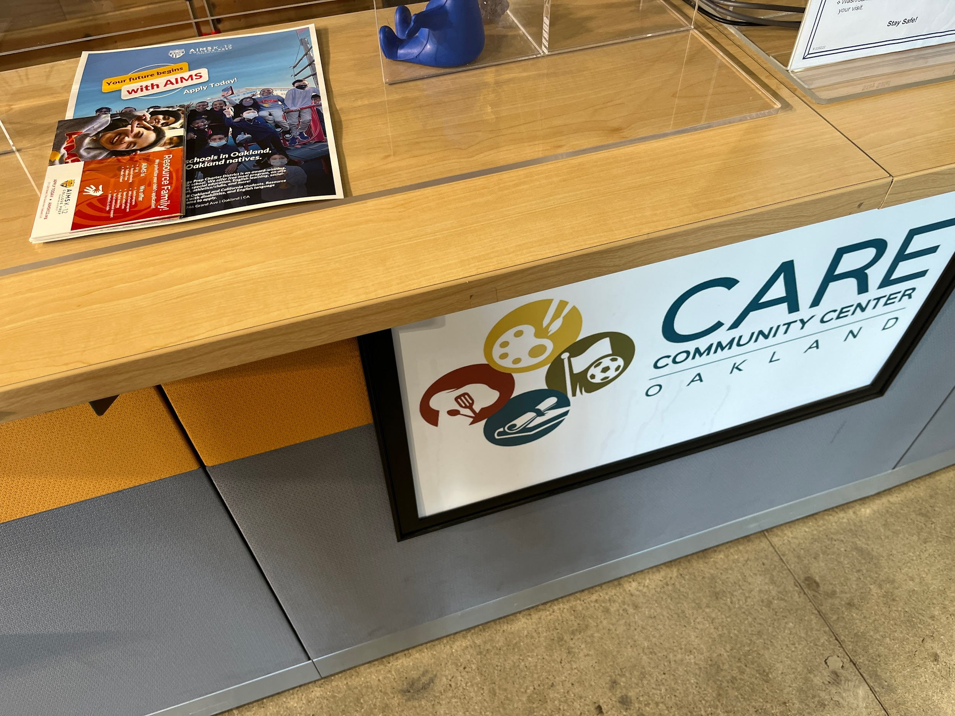
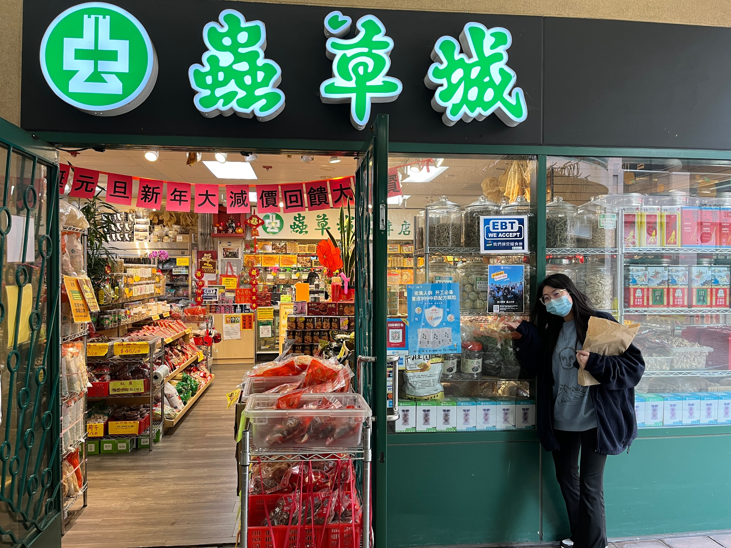
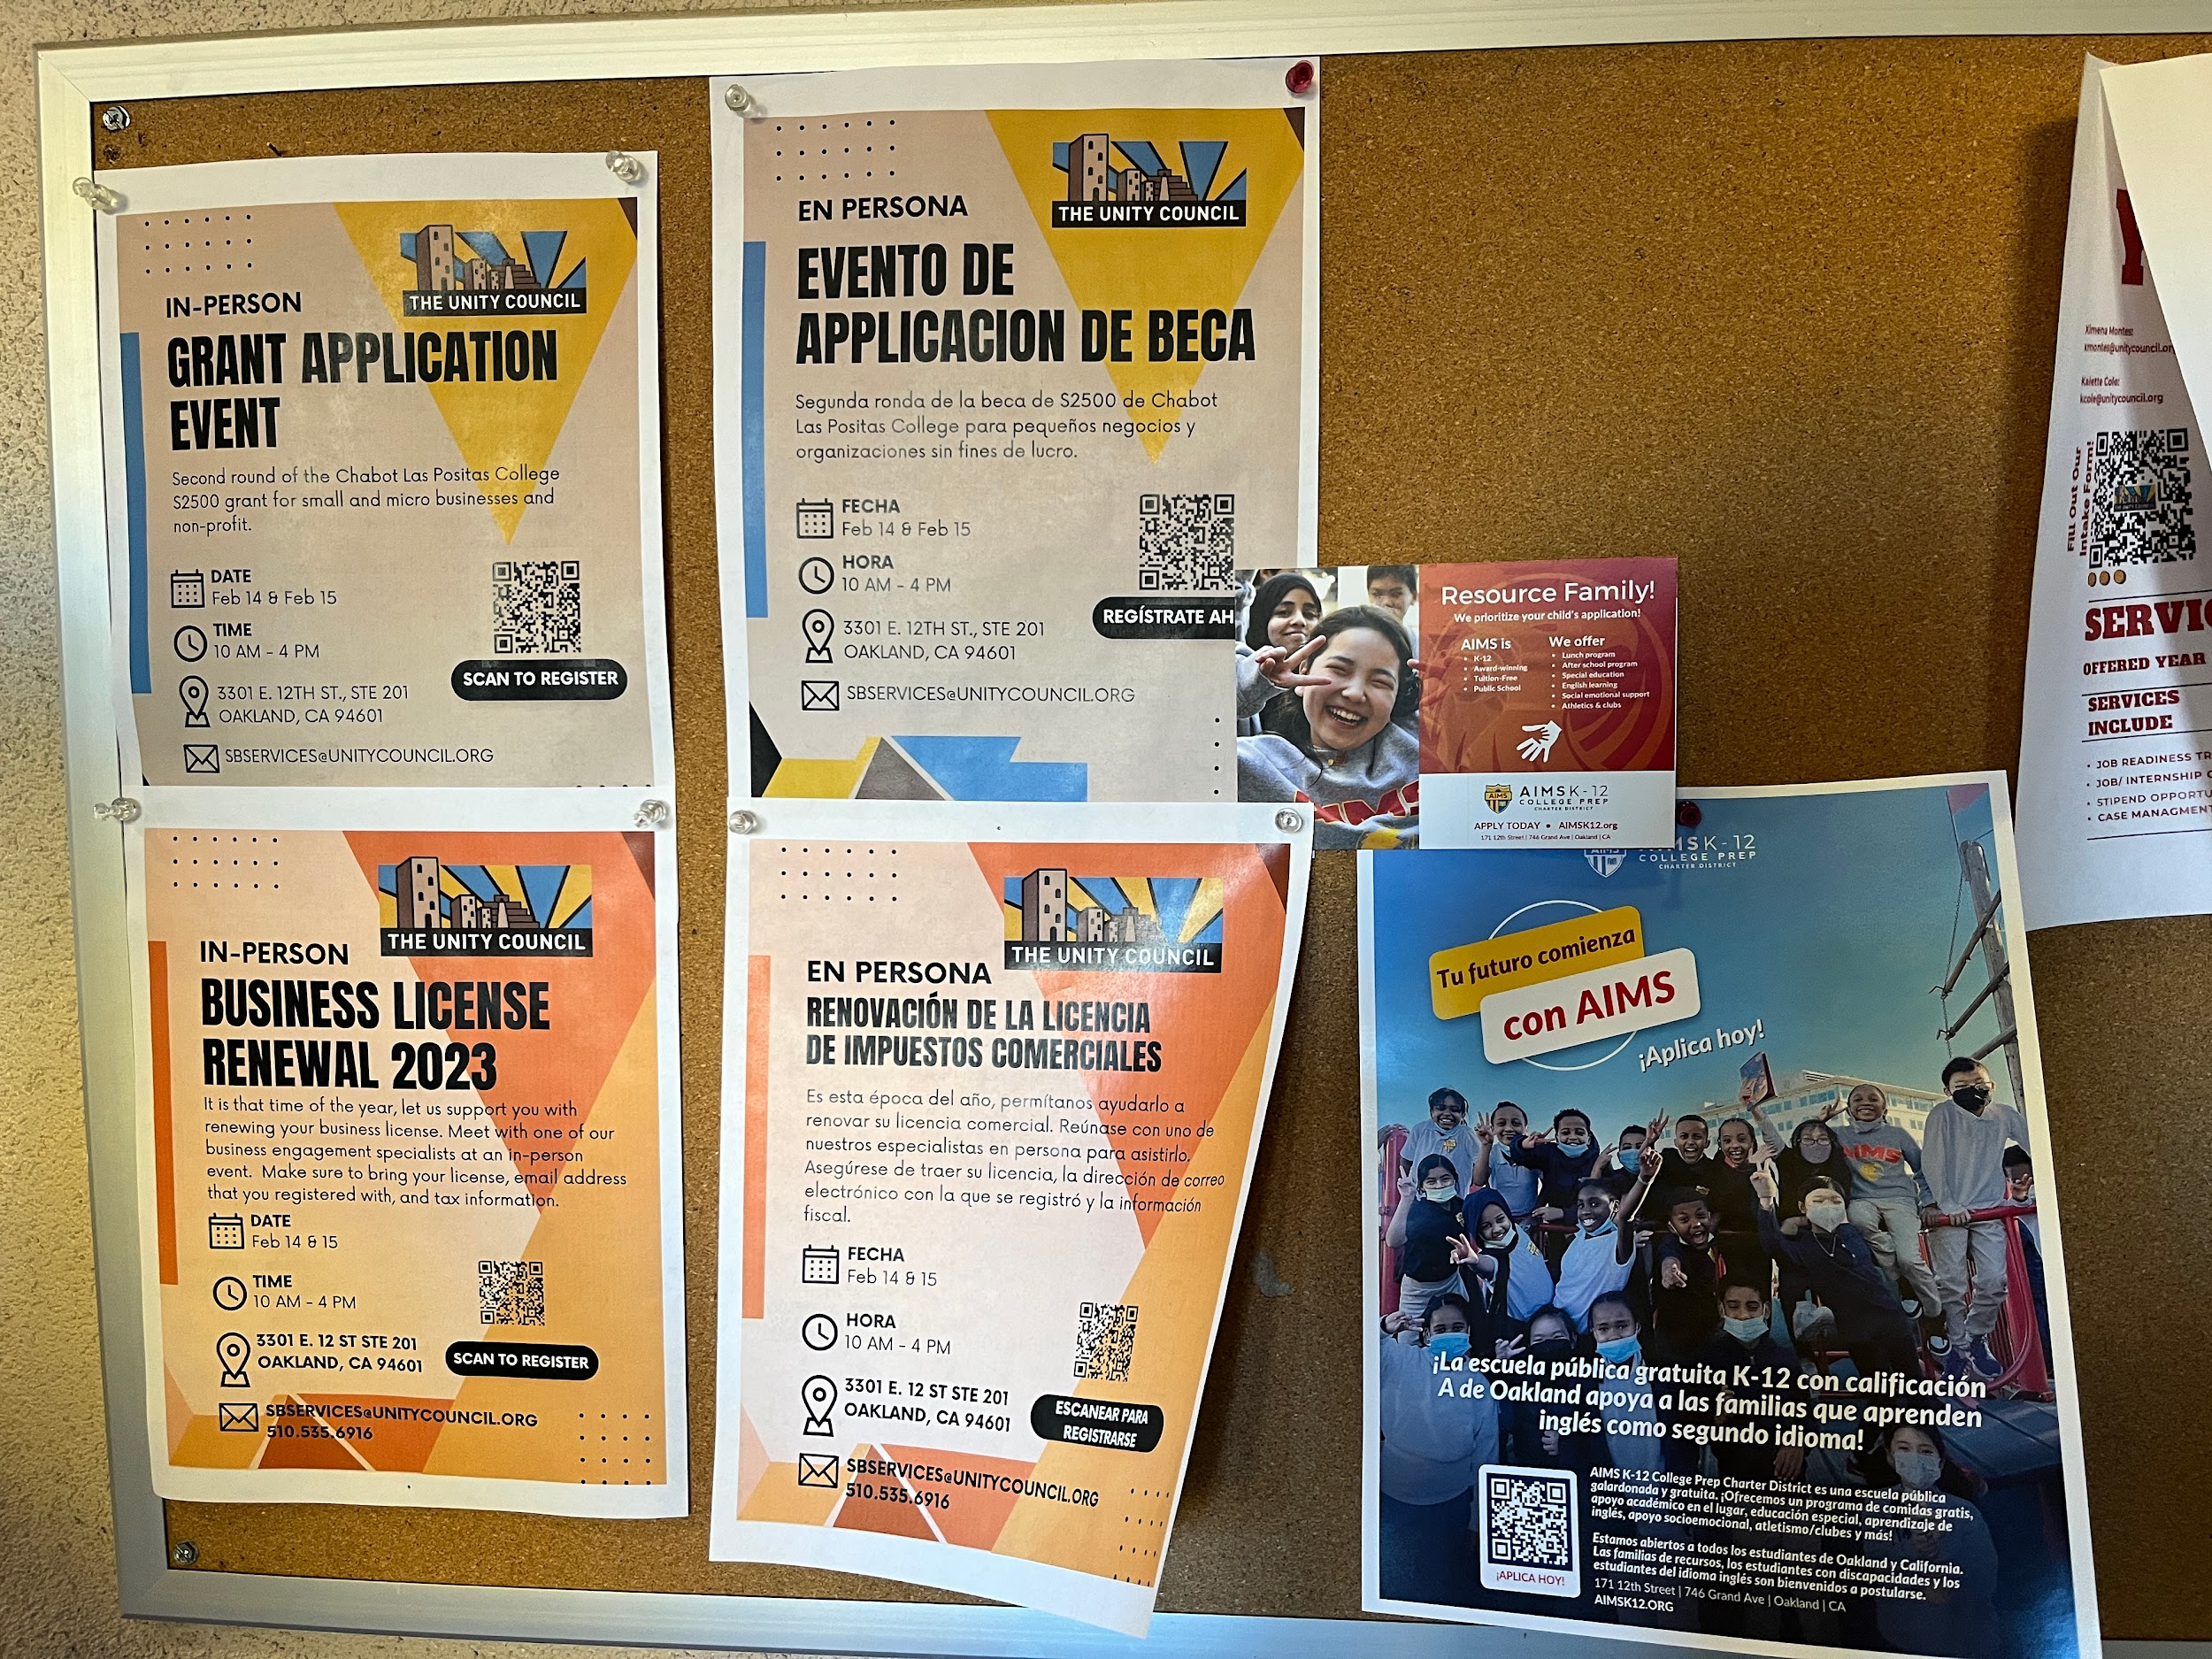
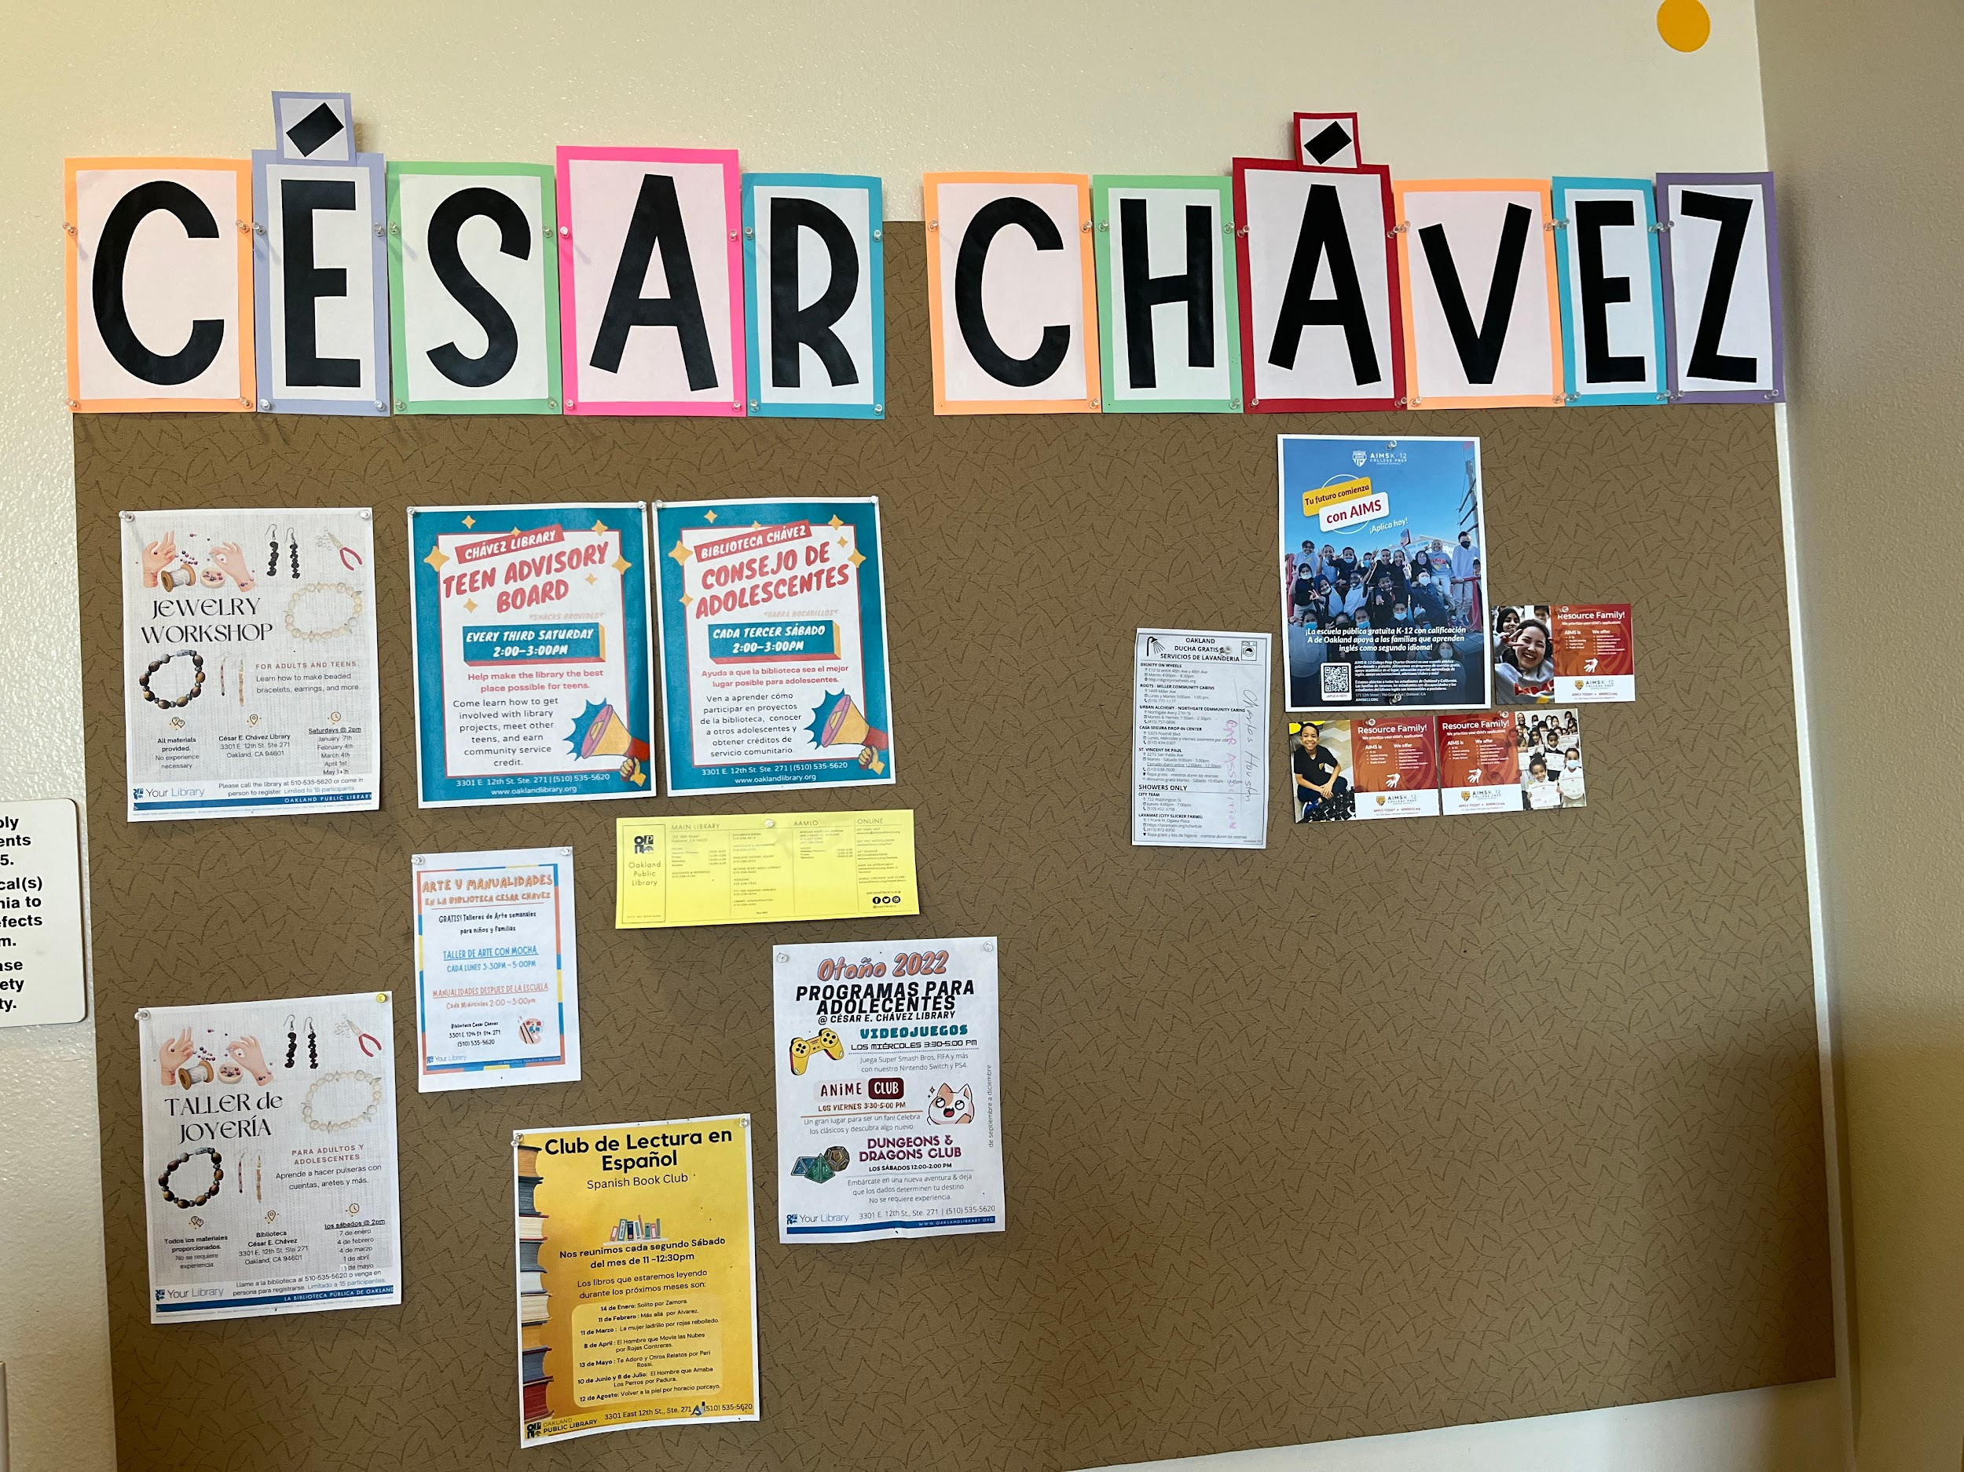
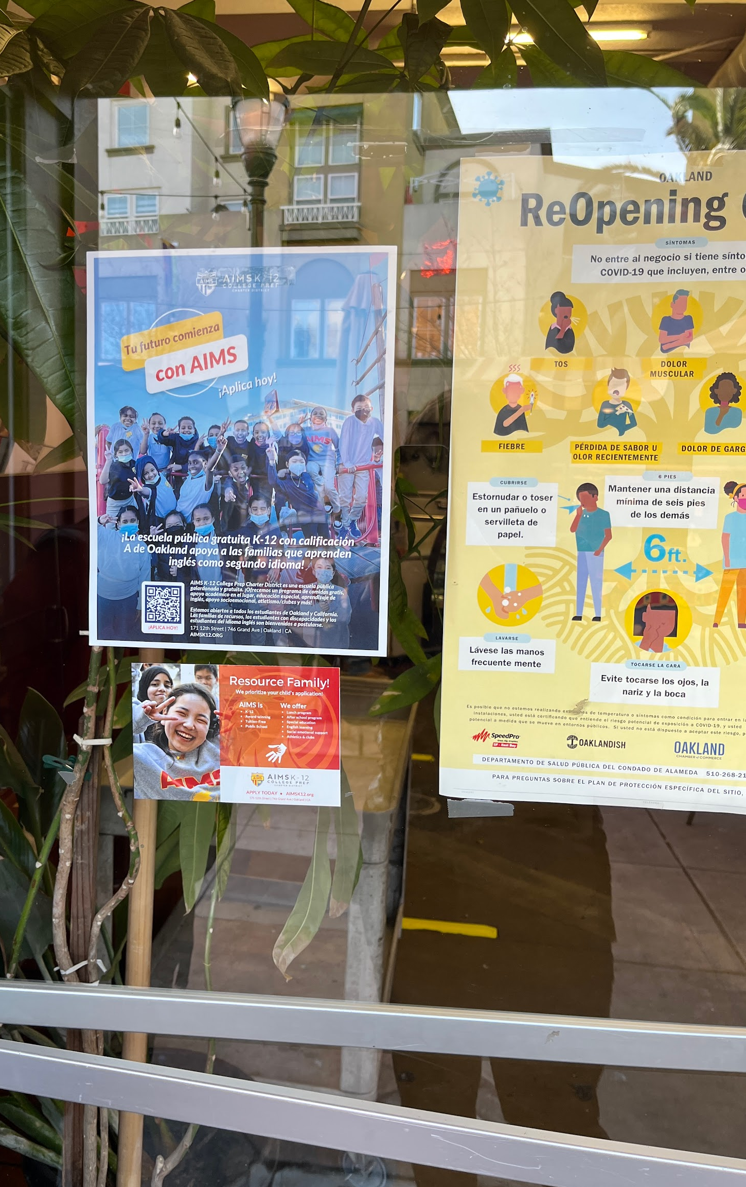

Slide 5
Chinese
Oakland Post Full-Page Ad
Spanish

Slide 6
March/April 2023 Wrap Up
Boosting Recruitment
Created marketing materials for outreach.
Social media posts promoting working at AIMS on LinkedIn, Facebook, and Instagram.
Posted about job openings on EdJoin, Handshake, TFA.
Co-hosted in-house in-person job fair with ES, MS, and HS.
AIMS email campaign to Holy Names University, University of San Francisco, Reach Institute, Cal State East Bay, Academy of Arts University, UC Berkeley, Peralta Colleges, San Jose State, UC Merced, Santa Clara University, California Baptist University, and local Job Centers.
Brought fliers to Cal State East Bay, UC Berkeley, University of San Francisco, and San Francisco State education departments, campus libraries, student centers, coffee shops, and local businesses.
Job Postings to Holy Names Job Board, Academy of Arts Job Board, University of San Francisco Newsletter, and Reach University Email Campaign.
Encouraged current AIMS teachers to reach out to their personal circles and had two successful interviews for the upcoming school year.

Slide 7
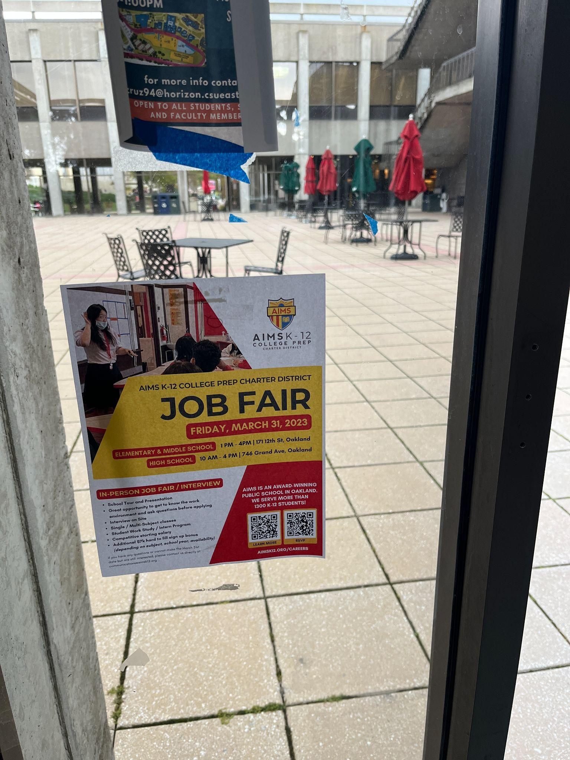
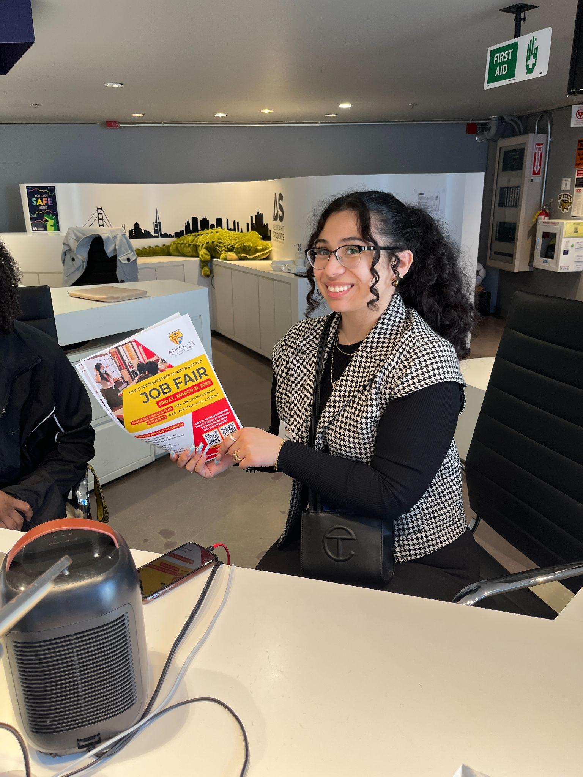
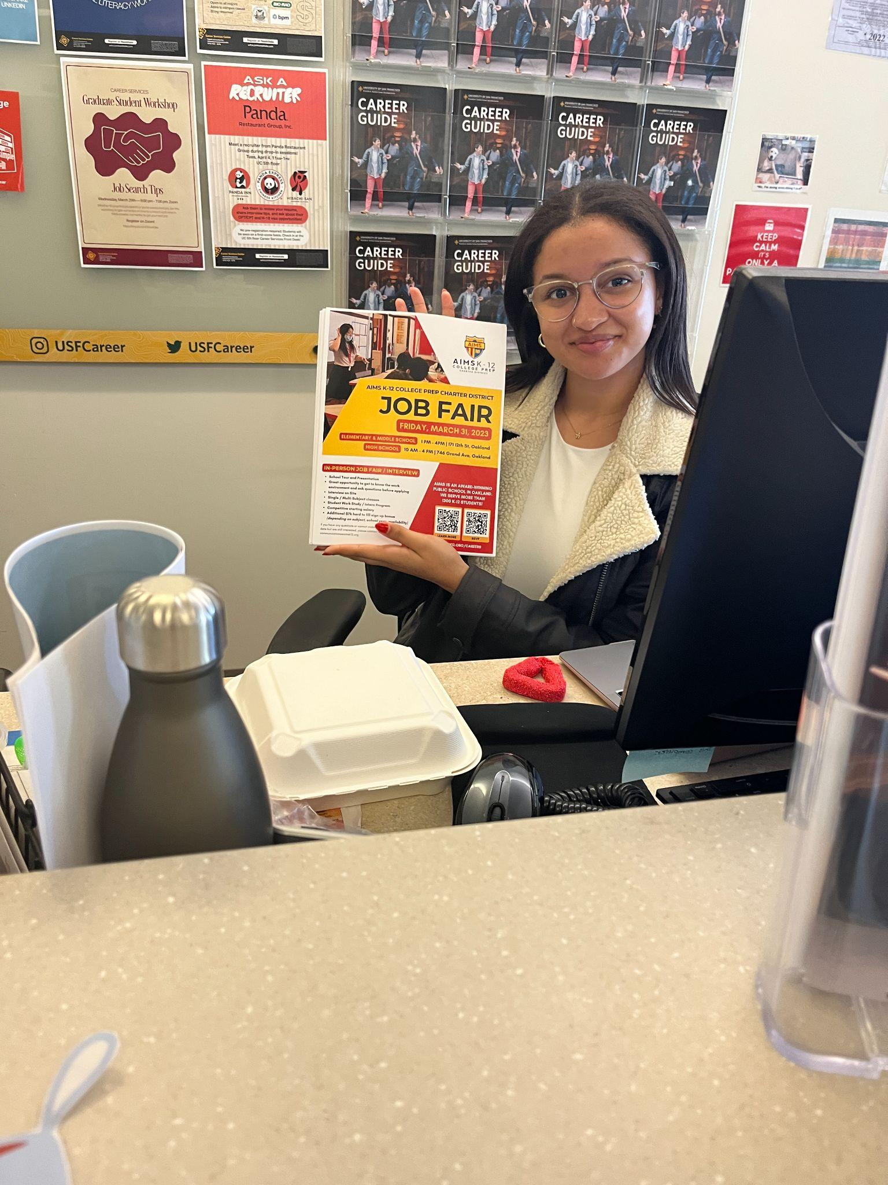
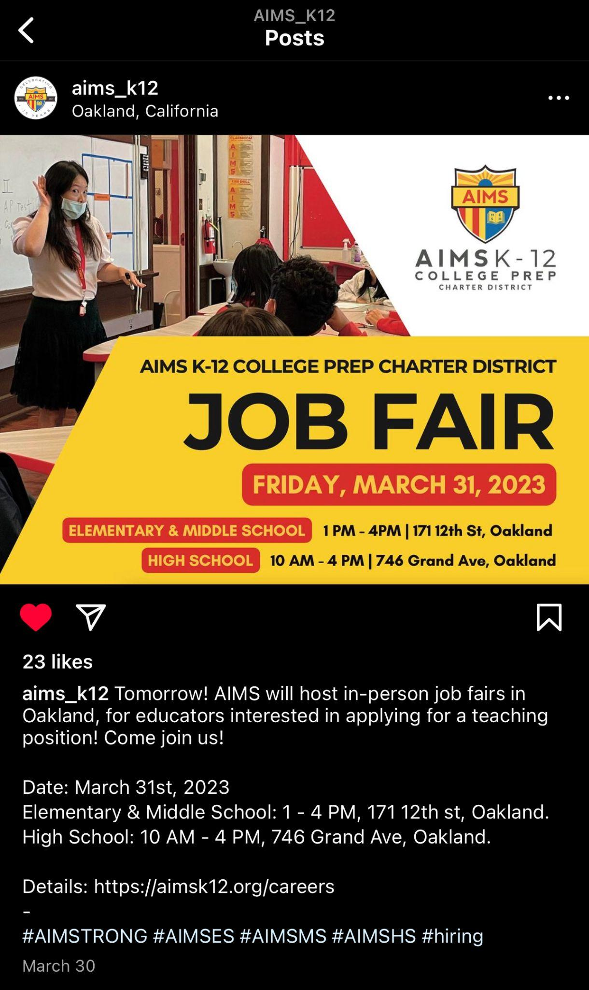
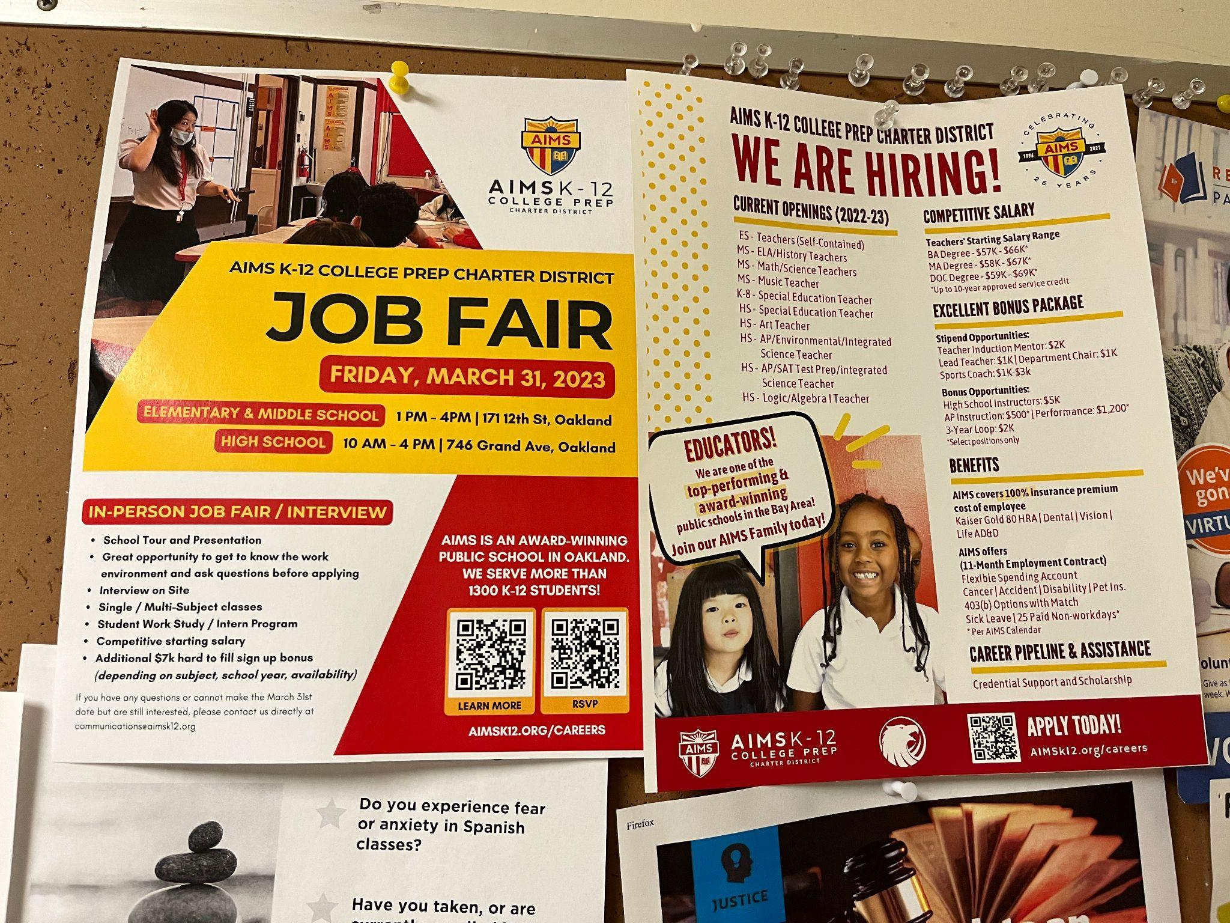
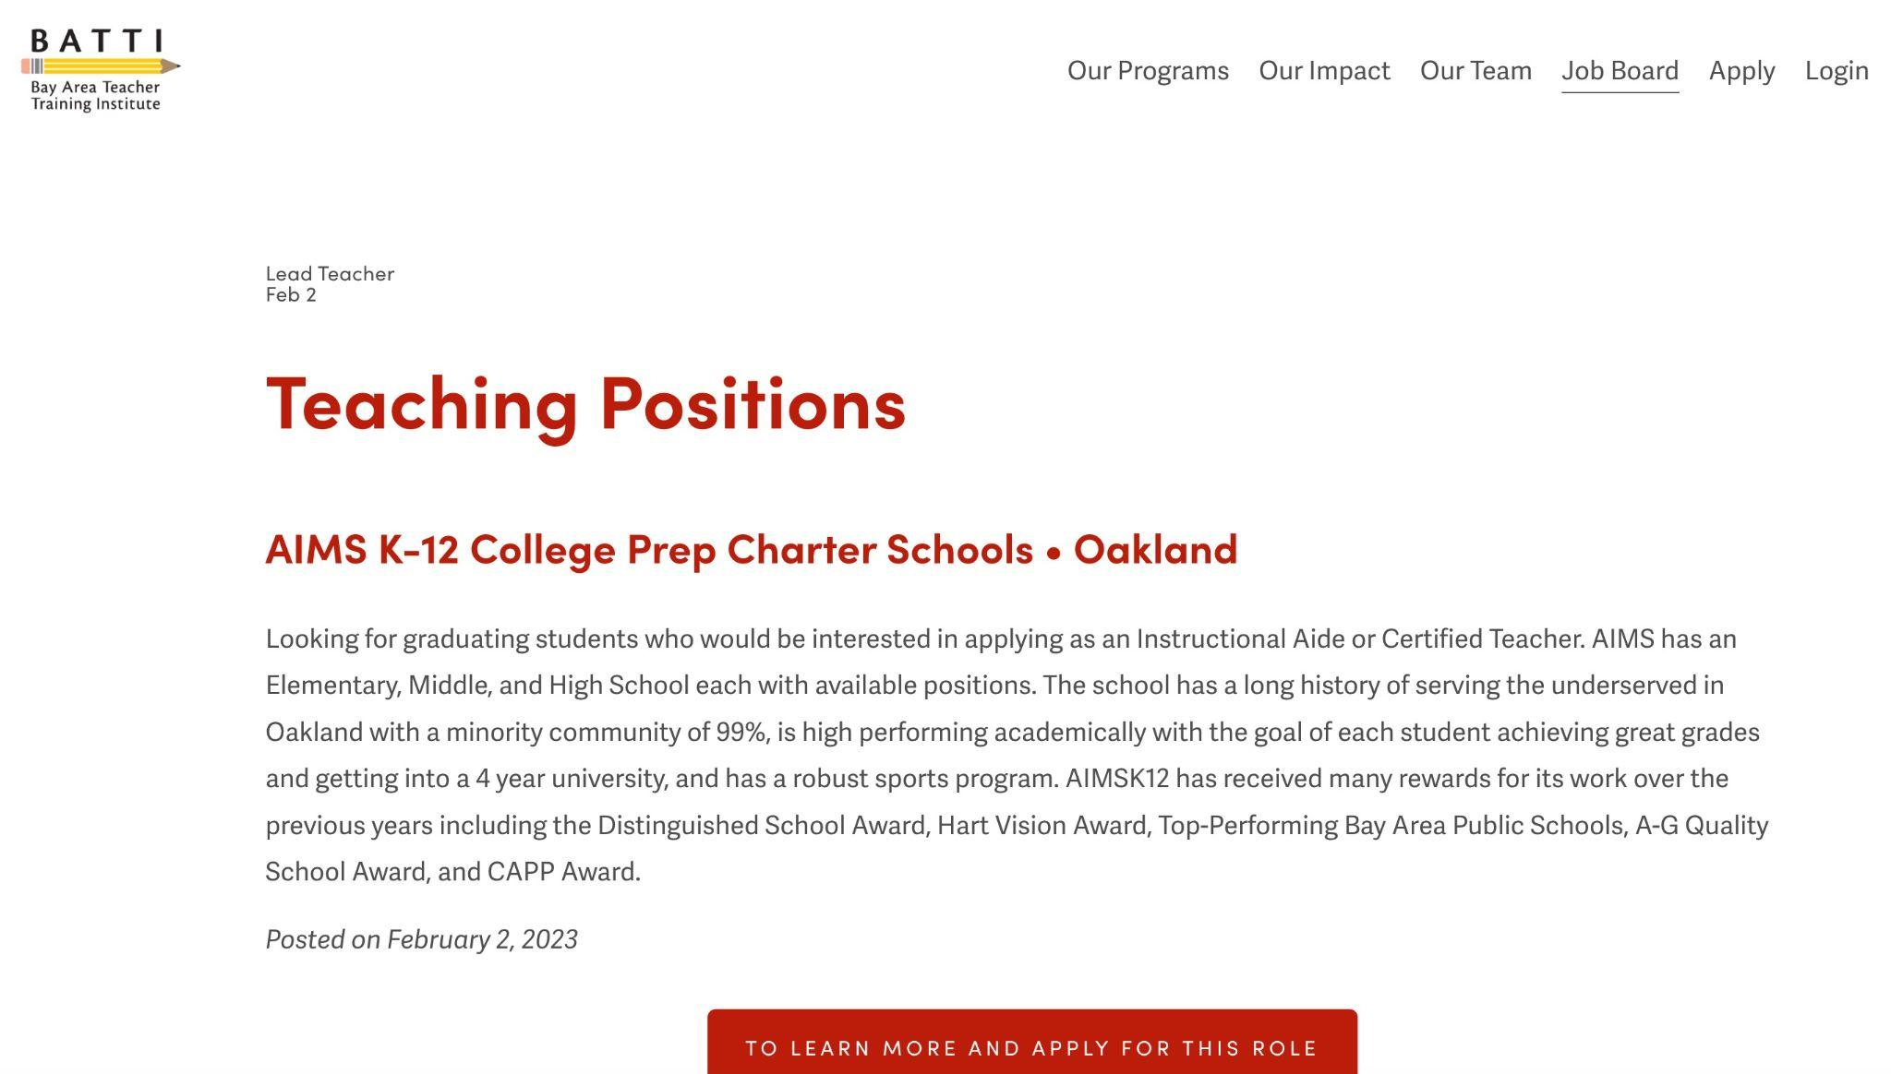

Slide 8
March/April 2023 Current Projects
For Enrollment
Join-school billboard/out-of-home marketing campaign with Baytech, LPS Oakland and maybe Yu Ming.
Closely working with Enrollment Department about available seats and waitlist numbers.
For Recruitment
Transitioning career site to Paycom from BambooHR.
Setting up “Request to Post” on Paycom and messaging templates.
Working with current recruiters StrateGenius.
Researching new ways to support recruitment.
Continue to support school sites, departments, and central with any Marketing and Communications needs.

Slide 9
March/April 2023 Moving Forward
For Enrollment
Another round of boosting in June/July, especially for the grades that do not have a healthy waitlist.
For Recruitment
Continue working with sites regarding staff recruitment needs.
For Internal and others
Support school sites with graduation ceremonies and end-of-year events.
Support AIPCS II charter renewal.
Build a “Support Us” page to receive support/donations from the public.
Rebuild AIMS public-facing website.*
Student online store to sell AIMS swag items.*
Seek out possible K-12 campus locations.*
Research for new school opportunities outside of Oakland.* *non-priority

