Slide 1
( Data and Academic Performance) Board Report March 2023
(Christopher Ahmad and Adria Bani)

Slide 2
Assessment Schedule
Elementary School:
Scholastic Math Inventory: Completed February 21-24
Scholastic Reading Inventory: Completed February 21-24
Illuminate Benchmark: Green Benchmark Completed, next one in April
Middle School:
Scholastic Math Inventory: TBD
Scholastic Reading Inventory: TBD
Illuminate Benchmark: 3/6-3/10
High School:
Scholastic Math Inventory: Completed in February
Scholastic Reading Inventory: Completed in February
Illuminate Benchmark: Completed in January

Slide 3
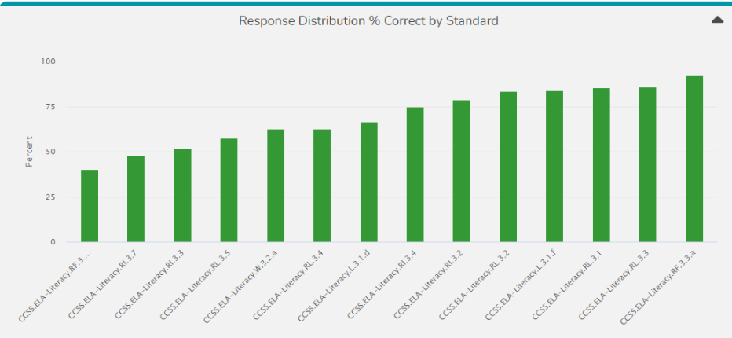
Failing Standards
Schools received a list of standards that were commonly failed on benchmark exams for ELA and math. These lists were given to Heads of Schools so that they can share the information with their teachers and so the teachers can review those standards.

Slide 4
CBK UPDATE
Jose Kabeer is the new College Bound Kids Coordinator.
He will start on March 13th, 2023

Slide 5
ELD UPDATE
ELPAC:
95% complete for 3rd-5th grade Listening, Reading and Writing Domains
Currently focused on all one-on-one test sessions: K-2 all domains, 3rd - 8th Speaking Domain
6th-8th grade Listening, Reading and Writing Domains will be complete by 3/15/23
Reclassification:
Reclassification process for 72 candidates is 85% complete - many parent responses are still pending after 3+ contacts from AIMS
ELD department is planning a Reclassification Ceremony; currently discussing with Communications
ELAC/DELAC
Meetings held for ELAC and DELAC on 11/18/22, 12/09/22, 1/20/23
Parent chairpersons have been elected for 2 out of 3 committees under the AIMS ELAC umbrella; secretary has been elected for all 3
ELD department is trying many techniques like in-person and Zoom hybrid meetings with interpreters, having refreshments/food, etc. to increase parental involvement and fill open positions in these committees
Title III Funding
Purchases completed for new ELD materials including iPads with cutting-edge language learning apps (currently being set up by Technology dept.)
Title III funded interpreter service being utilized by over 70% of teaching staff to communicate better with non-English-speaking parents

