Slide 1
AIMS K-12 COLLEGE PREP CHARTER DISTRICT
Recruitment Calendar 2022

Slide 2
GOALS:
Recruit Highly-Qualified Teachers (Credentialed)
Hire candidates that will contribute to the existing AIMS culture & standards
Create a pool of qualified candidates for all positions
Ensure that all vacancies have been filled before the start of the 2022-2023 school year.

Slide 3
Recruitment Strategies:
Host Virtual Job Fairs
Develop relationships with local college/university Teacher Preparation programs
Attend Job Fairs hosted by local colleges/universities
Post Eligibility Pools for all positions beginning in February (Edjoin, Indeed, Glassdoor, LinkedIn & ZipRecruiter)
Conduct interviews with Eligibility Pool candidates every 3-4 weeks
Maintain weekly contact with candidates placed in Eligibility Pools

Slide 4
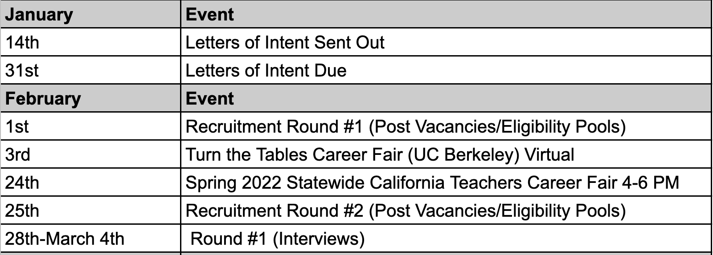
January/February Recruitment

Slide 5
March Recruitment

Slide 6
April Recruitment
Notes:
Event is left out

Slide 7
QUESTIONS?

