Slide 1
“At CSMC We Rise by Lifting Others”
Financials through December 31, 2021
Monthly Financial Board Report
Prepared for: American Indian Model Schools
Prepared by School's CSMC ASBM –Karen Peters

Slide 2
Financial Summary
Actual to Budget:
This report is as of Dec 31, 2021 compared against the board-approved budget.
YTD Revenues Through Dec 31, 2021 are $7,832,689. This is approximately 41% of total revenue budgeted.
YTD Expenses Through Dec 31, 2021 are $9,635,189. This is approximately 44% of total expenses budgeted.
Therefore, net income YTD is ($1,802,501). It is important to note that substantial amounts of revenue are based on reimbursements. Reports of these reimbursable expenses were completed in both December and January (based on CDE reporting windows).
Balance Sheet:
As of Dec 31, 2021, we had total cash of $5,817,488, short-term liabilities of $1,147,017, and long-term liabilities of $8,922,372. The ending fund balance is $4,520,290. Short-term liabilities include deferred revenue of $617,577 which will be used as expenses are posted to those resources.
www.csmci.com
Report created on 4/29/2021 8:10:07 AM for American Indian Model Schools

Slide 3
Cash On Hand
TOTAL CASH | $5,817,488 | Cash Balances as of 8/31/2021
CD | $ (356,403) | Funds held as requirement for East/West Bank Loan
Total Current Liabilities* | $ (1,147,017) | includes Accounts Payable & Accrued Salaries/taxes/benefits
Restricted Net Assets (in fund balance) | $ (515,484) | Includes Measure N funds (HS) received that may be returned
Scholarship Fund Balance | $ (299,003)
Restricted Current Year Revenue | $ (897,988) | Title I/II/III, Restricted Lottery, Nutrition, Prop 39 Clean Energy
Restricted Scholarship Current Year Revenue | $ (22,182) | Funds received YTD, not yet encumbered
OUSD Required Reserve (3%)** | $ (545,996) | 3% of annual expenditures
East West Bank DTI Reserve Requirement | $ (756,107) | Projected year-end surplus equivalent to 1.5x Debt Service
AVAILABLE CASH | $ 1,823,274
*Current liabilities include deferred revenue from previous year
** OUSD Required reserve of 3% is always met as long as the DTI reserve requirement for East West Bank is met. These liabilities do not stand as individual liabilities but are required to stay in fiscal and debt compliance.
www.csmci.com
Report created on 4/29/2021 8:10:08 AM for American Indian Model Schools

Slide 4
Supplemental Information
Loan Covenant Calculation
AIMS loan covenant reads as follows: Maintain a debt coverage ratio (defined as net operating income divided by current portion of long term debt plus interest expenses) of not less than 1.35 to 1 for the fiscal years ended June 30th, 2020 and June 30th, 2021 and 1.5 to 1 thereafter. AIMS current calculation (based on budget) is as follows:
AIMS LOAN COVENANT CALCULATION
Net Operating Income | $1,178,191
Current Portion of Loan | $210,504.00
Interest To be Paid next 12 months | $354,720.00
12 Mos Princ and Int | $565,266.00
Ratio | 2.08
www.csmci.com
Report created on 4/29/2021 8:10:08 AM for American Indian Model Schools

Slide 5
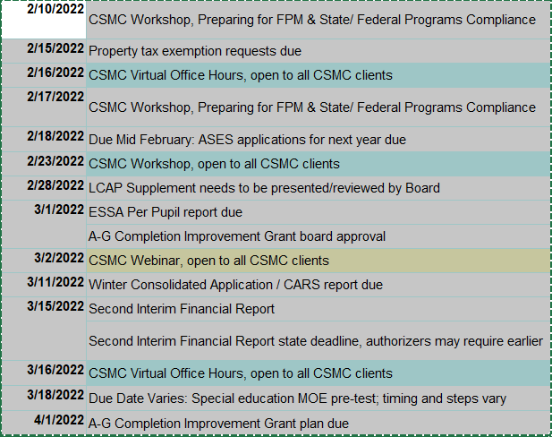
Looking Ahead
www.csmci.com
Report created on 4/29/2021 8:10:08 AM for American Indian Model Schools

Slide 6
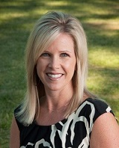
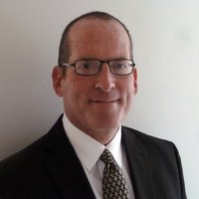
CSMC Charter School Support Team
 | Executive VP of Client Services Tom Nichols |  | tnichols@csmci.com
 | Regional SBM Director Susan Lefkowitz |  | slefkowitz@csmci.com
 | Associate SBM Karen Peters |  | kpeters@csmci.com
 | Regional AM Director Brenda Olson |  | bolson@csmci.com
www.csmci.com
Report created on 4/29/2021 8:10:07 AM for American Indian Model Schools

Slide 7
HELPING THE CHARTER MOVEMENT SUCCEED ONE SCHOOL AT A TIME
info@csmci.com Office: 888.994.CSMC 43460 Ridge Park Dr., Ste. 100 Temecula, Ca 92590
POWERED BY:
Charter Vision
www.csmci.com
Report created on 4/29/2021 8:10:08 AM for American Indian Model Schools

