Slide 1
Oakland Chinatown Community Benefit District 2021
Oakland Chinatown Steering Committee
April 2021

Slide 2
Community benefit Districts (CBD)
A CBD formation and operation is governed and monitored by State and City of Oakland laws. The formation process is guided by a Steering Committee comprised of various stakeholders (property owners, residents, community service organizations including churches, government, businesses, community leaders and elected officials). The governance is by a Board of Directors.
The Oakland City Council takes two actions in the formation process: A Resolution of Intention and a Resolution of Formation, if property owners approve the district by a Petition and later a Mail Ballot.
All Property Owners in the designated area have a right to vote to form the Chinatown CBD. If the Chinatown CBD is formed, all property owners within the district boundaries must pay a special assessment fee for the 10-year term.

Slide 3
What Value does a CBD BRING TO the COMMUNITY?
CBDs require that commercial and residential property owners pay an assessment to fund supplemental services that benefit them, tenants, surrounding community members, businesses, institutions, employees, customers and visitors. The Assessment fee for each property is calculated by various factors including: Benefit Zone, Linear Frontage, Lot Size and Building Square Footage.
CBDs have ongoing oversight and capacity to do what an individual property owner might not have the resources to achieve; CBDs have dedicated full-time staff to manage and provide services that are focused on improving and advocating for the area. The area is improved versus just one property.
CBDs also bring residents, visitors, employees, families and elders, additional support by enhancing the street appearance through trash removal, graffiti abatement, beautification and a Community Ambassador Program to provide additional safety and hospitality services.
The Chinatown Committee values promoting Oakland’s Chinatown as a safe and clean location for its residents, children, families, businesses, and visitors by leading cultural placemaking, enhancing public spaces and marketing Chinatown to retain and encourage businesses and other employers.
A CBD helps foster community by ensuring a walkable, safe and attractive environment for all.

Slide 4
Oakland’s Chinatown
One of Oakland’s oldest neighborhoods and one of the largest Chinatowns in the country
The combination of COVID-19 shutdowns, economic downturns and crime negatively impacted Oakland’s Chinatown, and its severe effects continue to be felt by struggling merchants and residents.
Oakland Chinatown drives city tax revenues, yet approximately 30% of its businesses remain closed--many permanently. Oakland Chinatown needs the continued support and funding for crucial programs that keep this community thriving.
Action is needed now.

Slide 5
Chinatown CBD Vision
The Chinatown Steering Committee representative of the Chinatown community is dedicated to revitalizing Oakland’s Chinatown neighborhood. Their goal is to return the Chinatown neighborhood to be reflective of its rich historic boundaries and vibrant economy.
The Vision is "To enhance the physical, economic and cultural wellbeing of the greater Oakland Chinatown area; to improve the environment in which people live, shop, and work; to encourage public and private partnerships and commitment through supplemental physical and economic improvements; to maintain physical, economic, cultural and social improvements through a long term operations strategy; and to maintain an organization to oversee the promotion, design, maintenance, appearance and economic and cultural viability of the Chinatown area.“

Slide 6
Why Now?
A Community Benefit District, especially during this economic recovery period, can help create and support the development of a more sustainable, vibrant Chinatown area by:
Producing a consistently clean, welcoming, and attractive community through Cleaning Ambassador Services (litter removal, graffiti removal, pressure washing)
Help to create a safer walking environment for residents, employees, visitors, children, families, students, through a Community Ambassador Safety Program
Supporting Business Retention, Attraction & Promotion efforts
Supporting and enhancing Arts, Culture, Education and Entertainment assets in Chinatown
Promoting business, residential and recreation opportunities
Improving Community Public Spaces through art, signage, positive programming and supplemental safety services
The most appealing aspect of a Community benefit District is that the assessment funds are only used in the approved District and services do not replace City services but instead, offer special benefits to the area.
The CBD can serve as a platform for community outreach and involvement; and acts as a liaison to the City, County, and other government agencies.

Slide 7
Oakland Chinatown community benefit district 2021
The Chinatown community has discussed the formation of a business improvement district for many years. The Oakland Chinatown Improvement Initiative was formed to demonstrate how a district could help improve the neighborhood with services, art, and ambassadors.
A Business Improvement District is a property-owner special assessment district. Because Chinatown is a mixed use community comprised of single family homes, non-profit organizations, government agencies, businesses, churches, and condo land uses, it is called a Community Benefit District (CBD), because all land users will benefit.
A CBD is an economic development tool that allows a geographic cluster of property owners, in partnership with other users, to collectively invest in activities that improve economic and community vitality.
These activities enhance – not replace - City services, and may range from safety and sanitation, to placemaking and branding, to business retention, attraction and promotion.

Slide 8
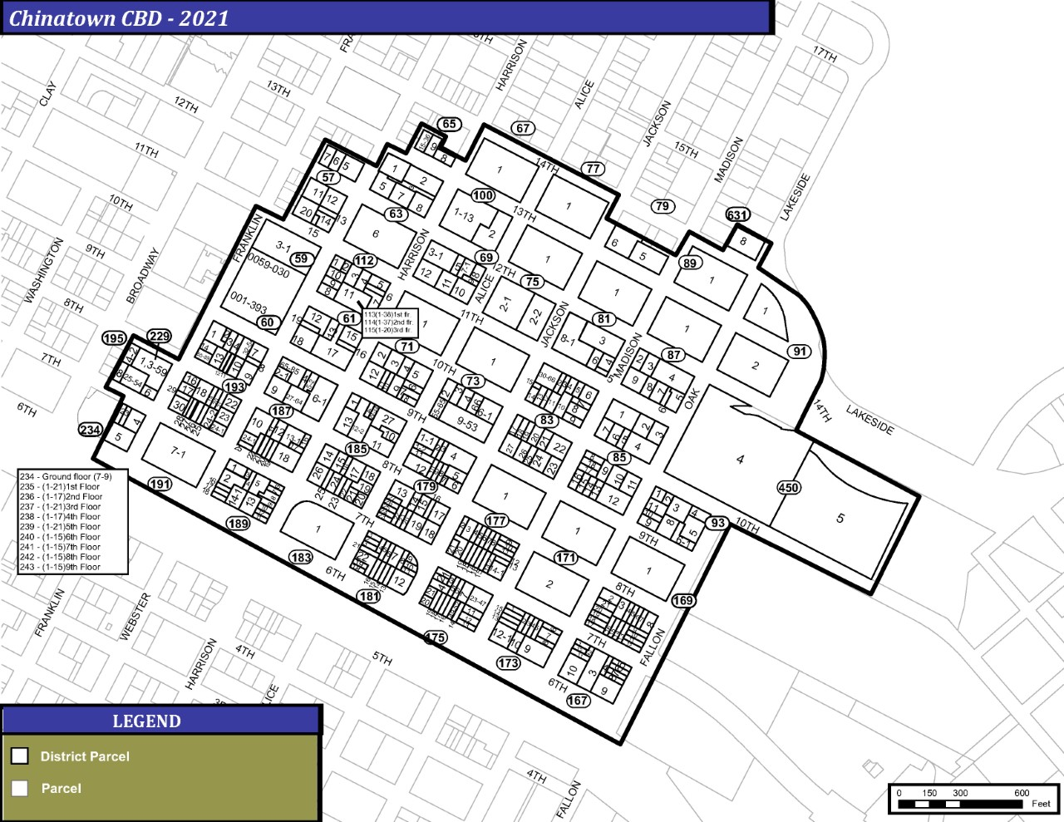
Proposed Chinatown Community benefit district 2021
1,033 Property Owners
1,293 Parcels
Proposed CBD includes*
County of Alameda
City of Oakland
EBMUD
AIMS College Prep Elementary & Middle School
Oakland Museum of California
Lake Merritt BART area
Henry J Kaiser Center (Oakland Civic)
Asian Health Services
EBALDC
Salvation Army
Webster 11
Chinatown Business area
OUSD Lincoln School
OUSD Yuk Yau Child Development Center
Oakland Consolidated Chinese Association
Lincoln Park Recreation Center
Oakland Hotel
Oakland Chinese Garden Center
Family Bridges, Inc.
Pacific Renaissance Plaza
Madison Park
Light of the Buddha Temple
American Indian Public Charter Model Schools
Wang Family Trust
Satellite Housing properties
BALCO properties
* Partial listing

Slide 9
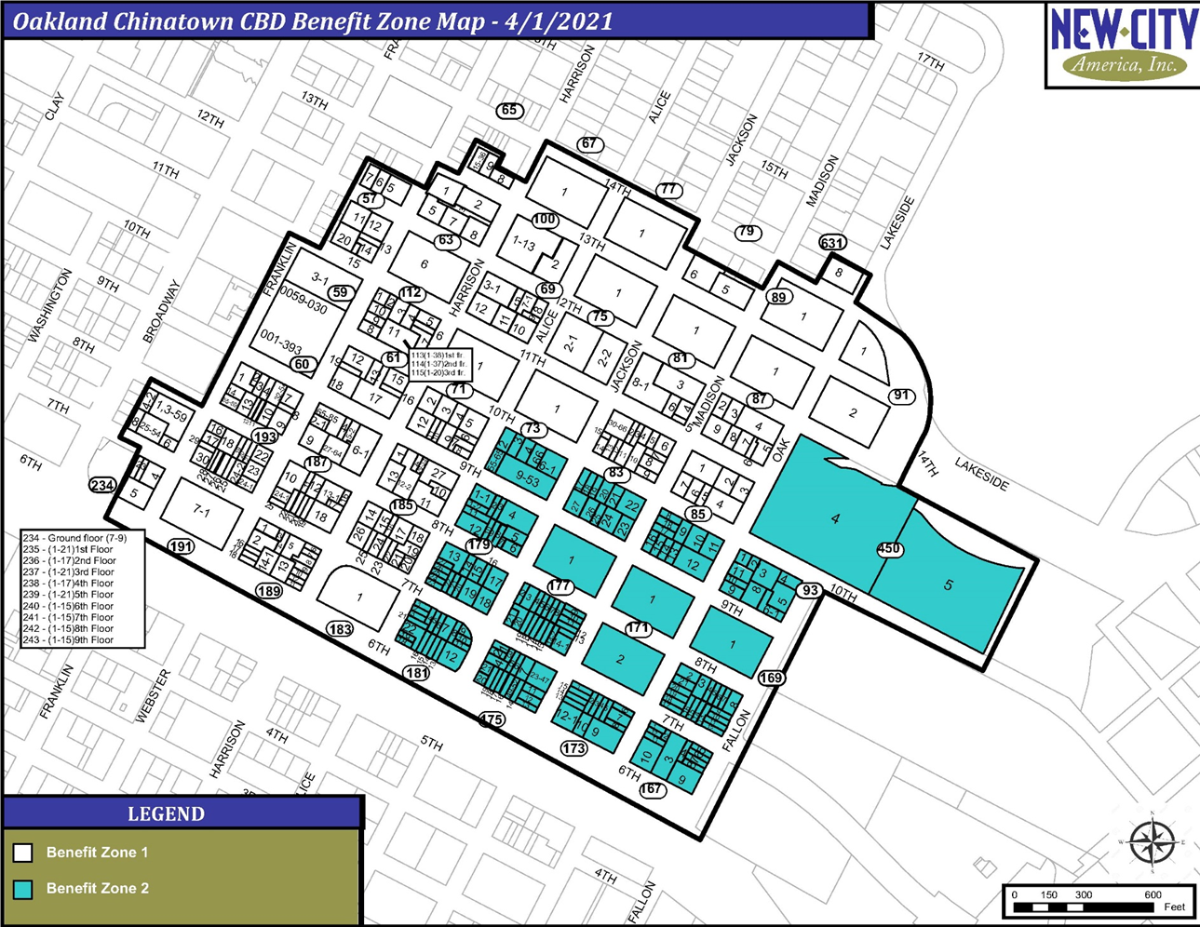

Slide 10
Proposed Chinatown cbd management plan
To form the CBD, a District Management Plan, along with the Engineer’s Assessment Report is approved by City of Oakland, and then must be approved by property owners. All property owners can vote with a Ballot.
Based on an earlier Property Owner’s Survey, owners supported a District Management Plan that prioritized funding the following Services:
District Beautification & Cleanliness Services
District Community Safety Ambassadors
Cultural Events, Street Festivals, promotion of Cultural Institutions and other key community resources
Response services for homelessness, loitering and panhandling
Chinatown Business & District promotion and marketing

Slide 11
Chinatown CBD Formation Timeline
UPCOMING!
April
Property owners within the designated area will receive a Petition that must be returned to the Oakland Chinatown Chamber.
May – City Council review and direct that Ballots are mailed to all property owners.
July – City Council tabulates ballots and if 50%+1 of the weighted property owners do not protest the formation of the District, the district is approved.
January 2022 – the Chinatown CBD begins operation for a 10-year term.
July 2022- Plans are to expand the Chinatown CBD to include additional Chinatown properties not able to be included in the 2021 Chinatown District, but interested in joining.

Slide 12
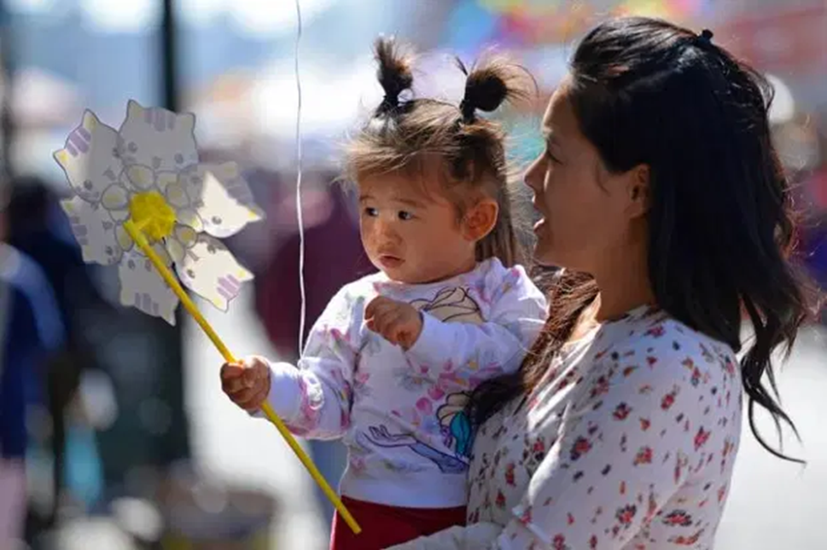
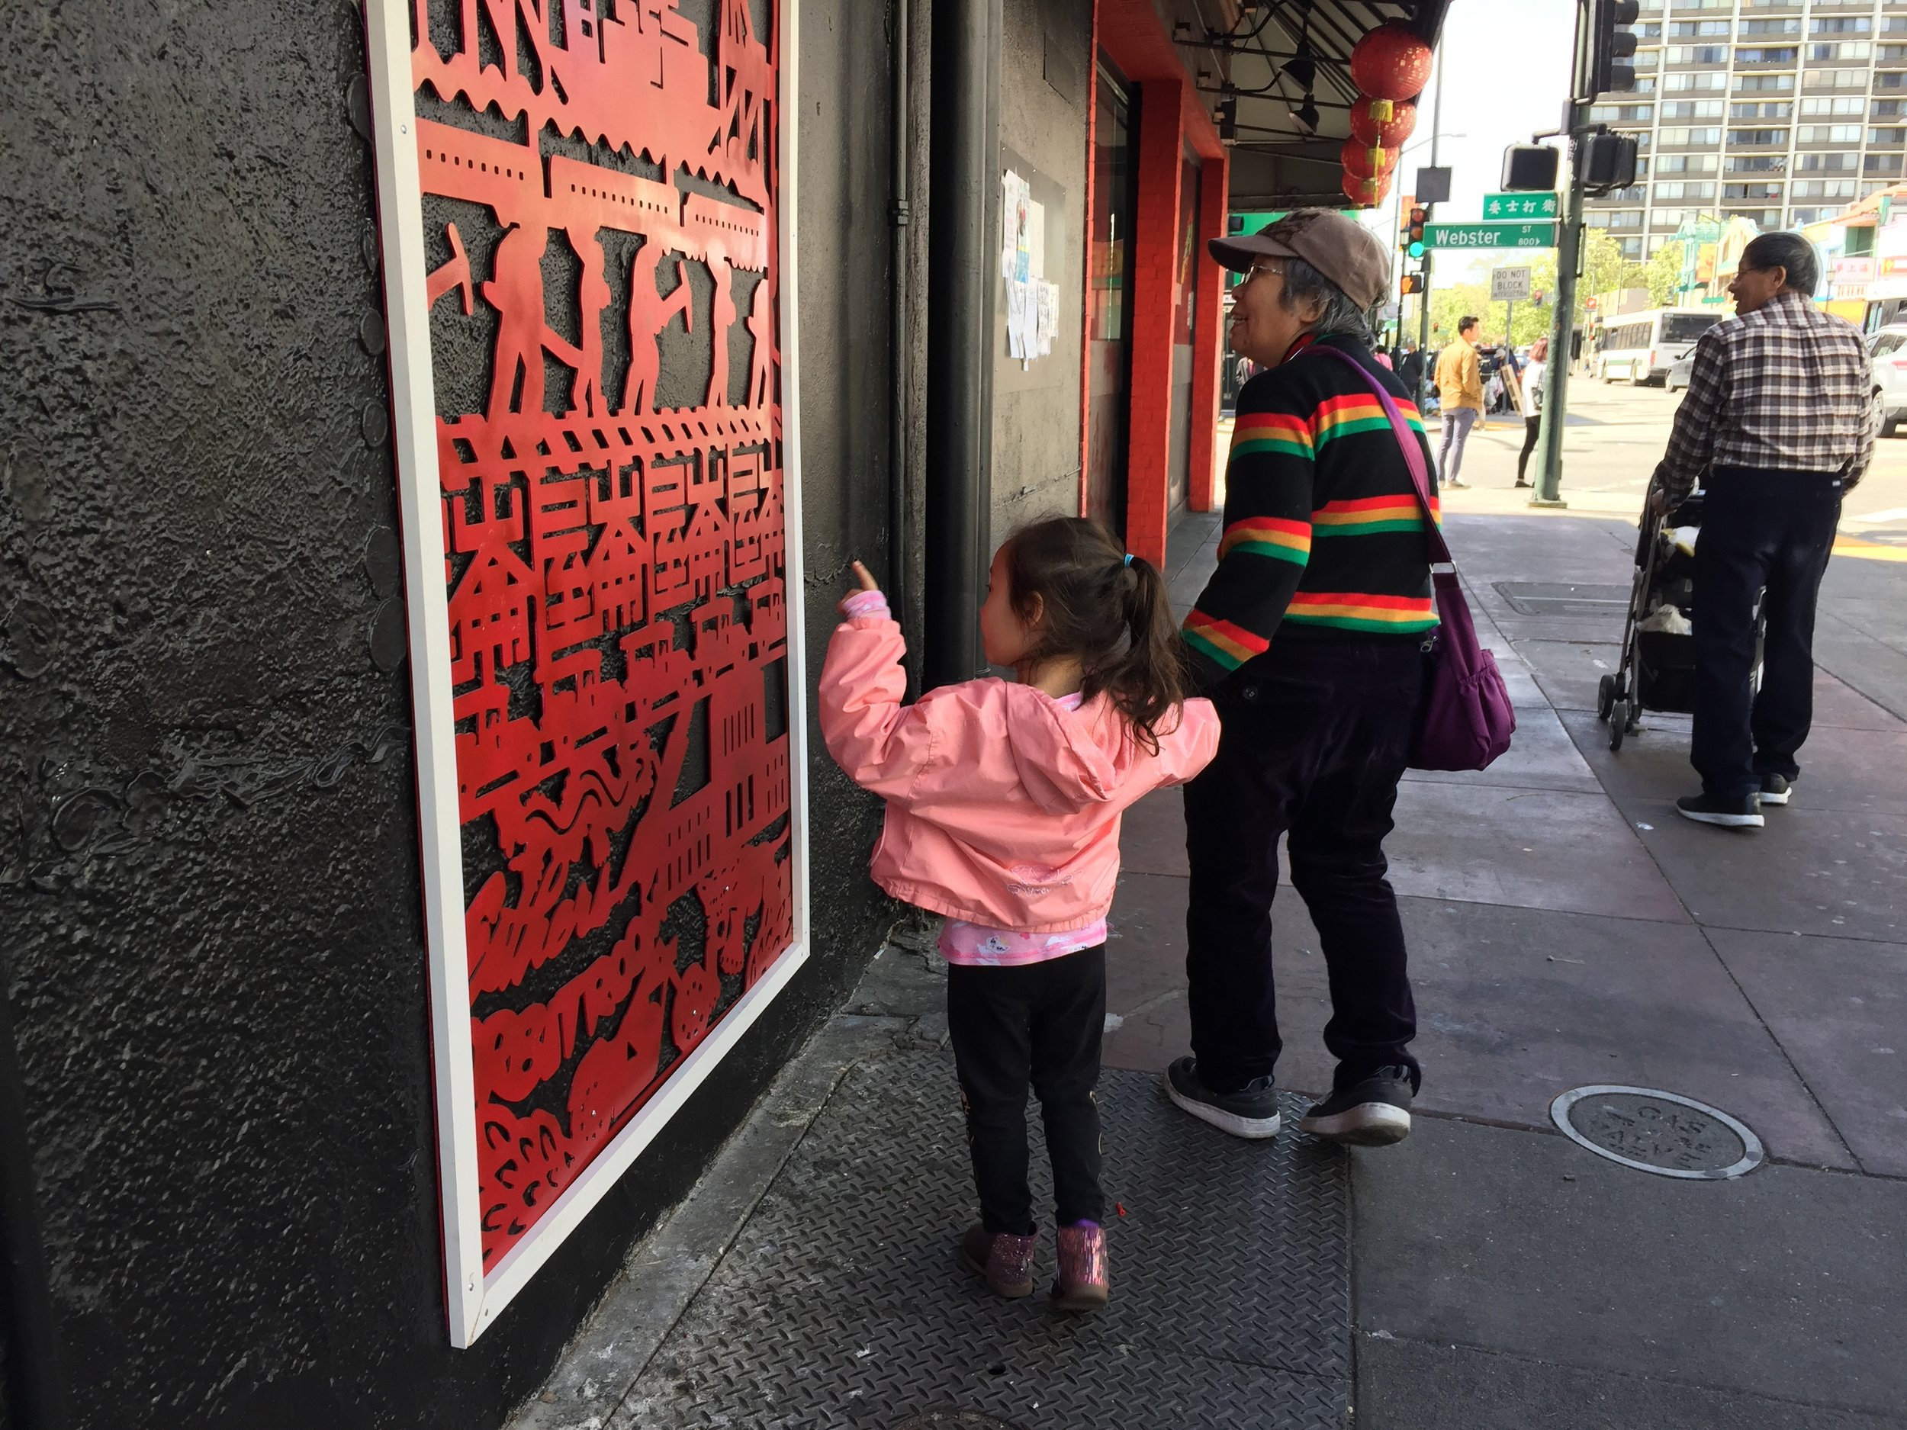
Vote Yes for the Chinatown cbd! vote yes for Chinatown's future!
Petitions Due By May 14, 2021
Ballots Due By July 20, 2021

