Slide 1
AIMS K-12 College Bound Kids March 2021 Reporting Period
Matthew Gordan, College Bound Kids Coordinator

Slide 2
Introduction
This slide deck contains information about the College Bound Kids initiative. It will not be read to the board. In the interest of time, the board will receive this presentation in advance, and will have questions ready for the coordinator. The Coordinator may take a short time ( 5 minutes Max) to highlight any Items that may be of specific interest to the board.

Slide 3
Complete List of Colleges Applied To Per Request
UC Berkeley | UC Davis | UC Irvine | UCLA | UC Merced | UC Riverside | UC San Diego | UC Santa Barbara | UC Santa Cruz
CSU Bakersfield | CSU Channel Islands | CSU Chico | CSU East Bay | CSU Fresno | CSU Fullerton | CSU Humboldt | CSU Long Beach | CSU LA
CSU Maritime | CSU Monterey Bay | CSU Northridge | CSU Sacramento | CSU San Bernardino | CSU San Diego | CSU San Francisco | CSU SJ | CSU San Marcos
CSU Sonoma | CSU Stanislaus | Cal Poly Pomona | Cal Poly San Luis Obispo | Benedict | Miles | Fisk | Xavier | Tuskegee
Talladega | Grambling | Harris-Stowe | Lincoln | Stillman | Hampton | Dillard | Maryland Eastern Shores | Clinton
Kentucky State | Morgan State | Langston | Paul Quinn | Clafin | NC A&T | Johnson C. Smith | Jackson State | Alabama State
Morehouse | Clark Atlanta | Norfolk State | Charles Drew | Howard | Boston University | Mills College | Seton Hall | Chapman
Clarkson | Skidmore | USF | Brown | Harvard | Pepperdine | Caltech | Dartmouth | U of Lynchburg
Hawaii Pacific | USC | Columbia | NYU | Stanford | Carnegie Mellon | Duke | Penn College of Tech | Fl. Institute of Tech

Slide 4
Complete List of Colleges Continued...
Pacific | Cornell | Northwestern | Yale | Case Western | Johns Hopkins | Washington U (St. Louis) | LSU | Pomona College
Pitzer | Scripps | Princeton | UPenn | Williams College | Rice | Fordham | St. Mary’s | U of San Diego
University of Virginia | Suffolk University | U of Portland | Sewanee | Reed College | Hendrix College | Holy Names | Puget Sound | University of Oregon
Dominican | Rensselaer Polytech | Hofstra | Albany College of Pharmacy Sciences | Benedictine College | Whitman | Concordia | UMass | Union College
The New School

Slide 5
College Acceptances So Far… (I’ve obviously have had a hard time gleaning information from students, and most UCs and privates are still to be released)
UC Santa Cruz (37 acceptances) | UC Riverside (21) | UC Merced (9) | Cal Poly Pomona (18) | CSU East Bay (32) | CSU San Diego (9) | CSU San Francisco (25)
CSU Fresno (7) | CSU Long Beach (9) | CSU LA (12) | Cal Poly SLO (10) | CSU Sacramento (5) | CSU San Jose (27) | CSU Chico (2)
CSU Monterey Bay (5) | CSU Maritime | Humboldt | Stanislaus | San Marcos | Whitman | Morehouse
Benedict (3) | Langston (3) | Holy Names (3) | UMass | Morgan State (3) | Clark Atlanta (2) | Pacific (5)

Slide 6
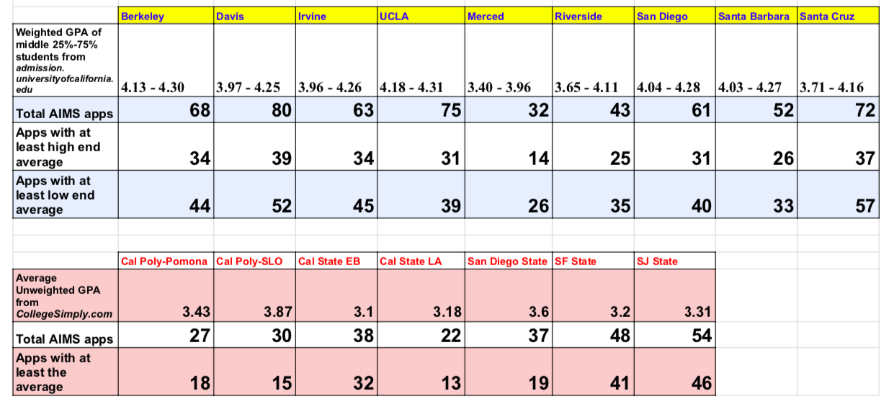
Highlights I Want The Board To Know: Below is the requested chart detailing GPAs of schools in relation to AIMS student GPAs. Please note schools use their own GPA formula, not ours, when reviewing apps.

Slide 7
Non-UC/CSU School Applications
USF (11) | Brown (6) | Harvard (5) | Pepperdine (3) | Caltech (4) | Dartmouth | U of Lynchburg | Hawaii Pacific (3)
USC (19) | Columbia (2) | NYU (6) | Stanford (12) | Carnegie Mellon (2) | Duke (2) | Penn College of Tech | Fl. Institute of Tech
Pacific (10) | Cornell (4) | Northwestern (3) | Yale (4) | Case Western (3) | Johns Hopkins (2) | Washington U (St. Louis) | LSU
Pomona College (5) | Pitzer (2) | Scripps | Princeton (2) | UPenn (3) | Williams College (2) | Rice | Fordham
St. Mary’s (2) | U of San Diego (3) | University of Virginia | Suffolk University | U of Portland | Sewanee | Reed College (2) | Hendrix College
Holy Names (3) | Puget Sound (3) | University of Oregon | Dominican | Rensselaer Polytech | Hofstra | Albany College of Pharmacy Sciences | Benedictine College
Whitman | Concordia | UMass | Union College (2) | The New School | Skidmore | Clarkson | Chapman
Seton Hall | Mills College | Boston University | Howard (7) | Charles Drew (19) | Norfolk State (9) | Clark Atlanta (2) | Morehouse (2)

Slide 8
...Continued from previous page...
Paul Quinn (7) | Langston (10) | Morgan State (2) | Kentucky State (8)
Clinton (20) | Maryland Eastern Shores (5) | Dillard (3) | Hampton
Stillman (8) | Lincoln (22) | Harris-Stowe | Grambling
Talladega | Tuskegee | Xavier (3) | Fisk (2)
Miles (1) | Benedict (8)

Slide 9
Why are more students not applying to non-UC/CSU schools? Results from survey where I asked them to choose whichever options apply to them:
*46.3% said they only want to attend a UC or CSU or California community college
*39% said they don’t want to leave California for school
*34.1% said private schools are too expensive
*30.5% said after applying to UC/CSUs and maintaining current classes, they’re just too tired to apply to private
schools
*28% said COVID-19 makes them want to stay near family
*25.6% said private schools are too hard to get into
*7.3% said they don’t know anything about private schools
*7.3% said private schools aren’t diverse enough
*3.7% said private schools are too small

Slide 10
Established College Bound Priorities
Current Priorities:
*Guide Seniors through college application process, currently:
-Submitting application updates to schools
-Submitting supplemental paperwork
-Submitting letters of rec for schools and/or scholarships
*Provide awareness and help with current scholarship opportunities
*Scheduling future meetings with AIMS alumni and financial literacy folks
*Ensure Seniors complete financial aid paperwork (FAFSA, Dream Act, CSS, Cal Grant)
*Keep track of and nag Seniors in regards to completing credit recovery in order to graduate this year
*Begin meeting with Juniors and acclimating them to the college process.

Slide 11
Established Daily/Weekly Schedule for Communicating With Seniors, Juniors
*In terms of Juniors, I communicate when there is news or opportunities to share. They receive a group email from me once a week, sometimes more. But I have begun going into the Junior SAT/AP Prep classes and presenting to them.
*In terms of Seniors, I have 3 class periods with all of them. Our communication is all day everyday, with communication occurring in a variety of ways: group emails to the entire grade, group emails to specific class periods, emails and messages to individual students, updates posted to the Schoology class wall, lecture time during class, 1-on-1 virtual meetings that take place throughout the day, and in a couple instances, over the phone.

Slide 12
Established Daily/Weekly Schedule for Working With Elementary and Middle School
For the first semester there is minimal contact between myself and the other schools because all my time and focus needs to be with the Seniors. I have however communicated with Mr. Ahmad and Mr. Holmquist and formulated plans to work with their schools during the 2nd semester:
Elementary School: Will provide elementary-friendly worksheets and activities to do with the students so they can familiarize themselves with the idea of college (think word searches and such) while also taking them on virtual tours of colleges so they can view images and try to anchor themselves in what’s an abstract idea for them.
Middle School: Kind of like “Choose Your Own Adventure,” the students will be presented a few different narratives centered around a fictional student and the different roads they can take to reach their goals in terms of colleges and careers. Example: The narrative will follow what John Doe needs to do-- and the different ways to accomplish it all-- in order to become an engineer. Virtual tours of colleges will also be used.

Slide 13
Scholarship Searches and Results
This is an ongoing process…
*6 applied to QuestBridge, 7 to Bill Gates, 5 to Coca-Cola
*1 recipient of the Posse Scholarship (full tuition to University of Puget Sound). 5th year in a row we’ve had a winner!
*1 recipient of the Triple-Impact Scholarship (Bay Area scholar athlete award)
*2 recipients of Oakland Promise Black Excellence grant (and counting)
*1 recipient of Black College Expo scholarship
Scholarships are now a main component of the 2nd semester of College Planning class. We’ve already had 5 scholarship assignments, including area scholarships:
>Marcus Foster Scholarship
>Oakland Promise
>Chevron Bay Area
>Asian and Pacific Islander Scholarship
Students are being assigned a mixture of “easy” scholarships that can be completed in class, along with more competitive scholarships, like the ones above, that require essays and letters of rec.
So far Seniors have applied to over 500 scholarships that require an essay (essay = more money).
Juniors have been alerted to a couple scholarships they are eligible for as well.

Slide 14
Number of Juniors and Seniors Contacted During The Reporting Period; and The Means of Communication
*When necessary, 9th-11th graders individually receive communication from me in regards to credit recovery (10th-11th) and AP registration (9th-11th).
*The entire Junior class receives information from me once a week on opportunities they should look into (examples: internships, college tours) and/or updates that affect them (like SAT requirements).
*The 100 Seniors hear and read my words everyday via our classes together (lecture time), group emails to the entire grade, group emails to specific class periods, emails and/or messages to individual students, updates posted to the Schoology class wall, 1-on-1 virtual meetings that take place throughout the day, and in a couple instances, over the phone.

Slide 15
Qualitative and Quantitative Results for Response to Student and Parent Inquiry
Main Inquiry Topics:
Credit recovery
Graduation requirements
Any and every matter relating to the college application process
I have communicated on a personal basis with every Senior. In terms of how often, I’m connecting with at least 45 Seniors a day between class time, 1-on-1 meetings, and personal email/messaging correspondence.
Every Senior had a 1-on-1 UC application meeting with me the week before Thanksgiving break.

