Slide 1
AIMS HS Board Report Reporting Period March 2021
Head of School Maurice Williams Jr., AIMS College Prep High School

Slide 2
Introduction
This slide deck contains information about AIMS College Prep High School. It will not be read to the board. In the interest of time, the board will receive this presentation in advance, and will have questions ready for the coordinator. The Head may take a short time ( 5 minutes Max) to highlight any Items that may be of specific interest to the board.

Slide 3
Highlights I Want The Board To Know
1. Mental Health 101 Workshop : On Friday, March 5, AIMS HS teachers received a training from Mental Health 101 co-author Tom Thelen to help prepare HS teachers with the implementation of Mental Health Fridays. Mr. Thelen has graciously gifted all HS parents and students with digital access to his new book.
Mental Health Fridays will officially begin on March 19. One topic from Mr. Thelen’s book will be covered each month. The following topics of focus are as follows:
Month 1: What is Mental Health? (Chapter 2)
Month 2: TBD
Month 3: Resiliency (Chapter 26)
All incoming 2021-22 freshmen students will review the entirety of Mental Health 101 during their Freshmen Health Class.

Slide 4
Highlights Of The Month
AIMS HS National Honor Society: On April 1, AIMS HS will induct 5 AIMS HS students as its first ever inductees in the AIMS HS National Honor Society. Annie Chiu, Calvin Duong, Samantha Li, Faben Tesfazion, and Christopher Wali. A second induction of NHS members will be installed in June 2021.
AIMS HS Athletics has Begun: On March 4, 2021, AIMS HS officially began its athletics season, beginning first with Boys and Girls Cross Country. The first meets are slated to begin during the week of March 15 - 20. Cross Country meets during the regular season are ran virtually on various days during the week and times are reported to the league. The League championship will be held in person. All meets and practices are held in accordance with COVID-19 standards.

Slide 5
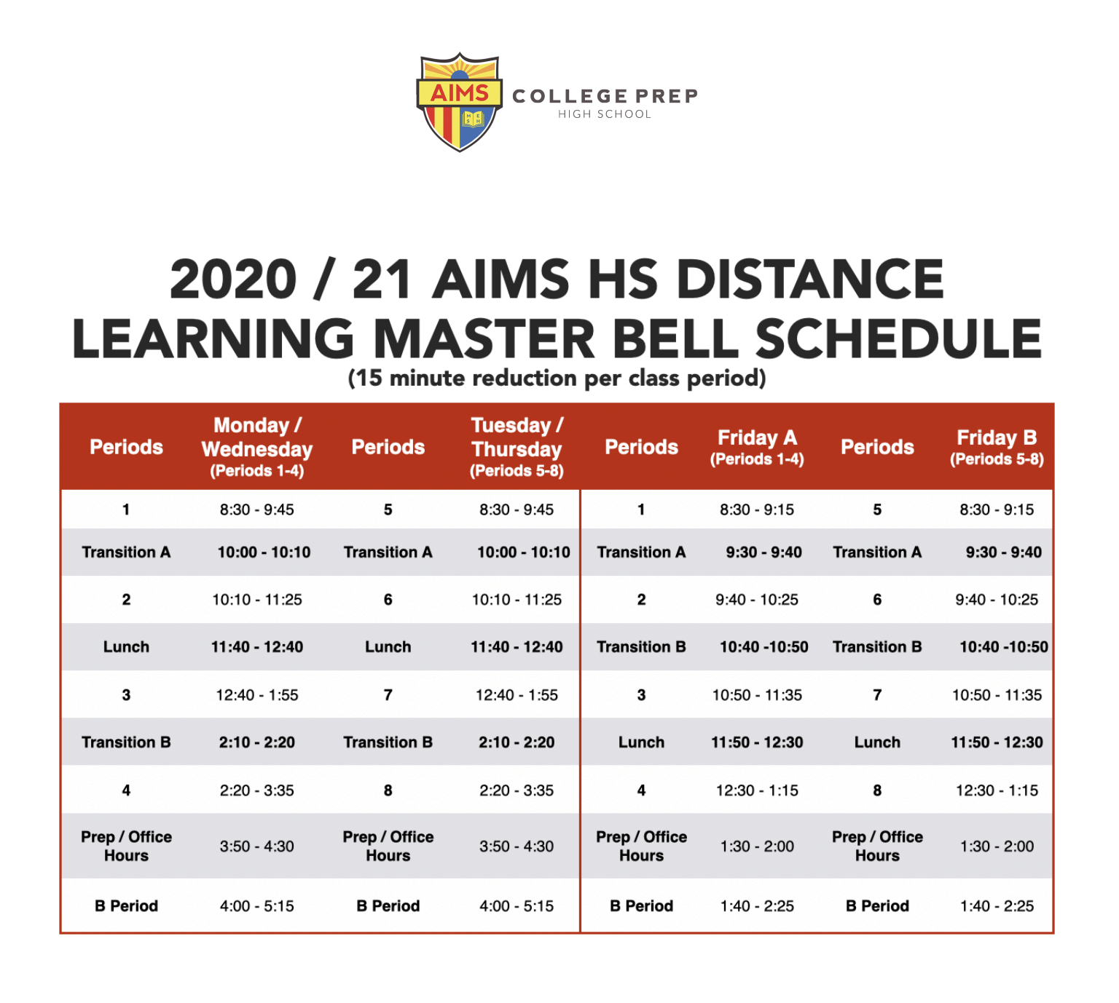
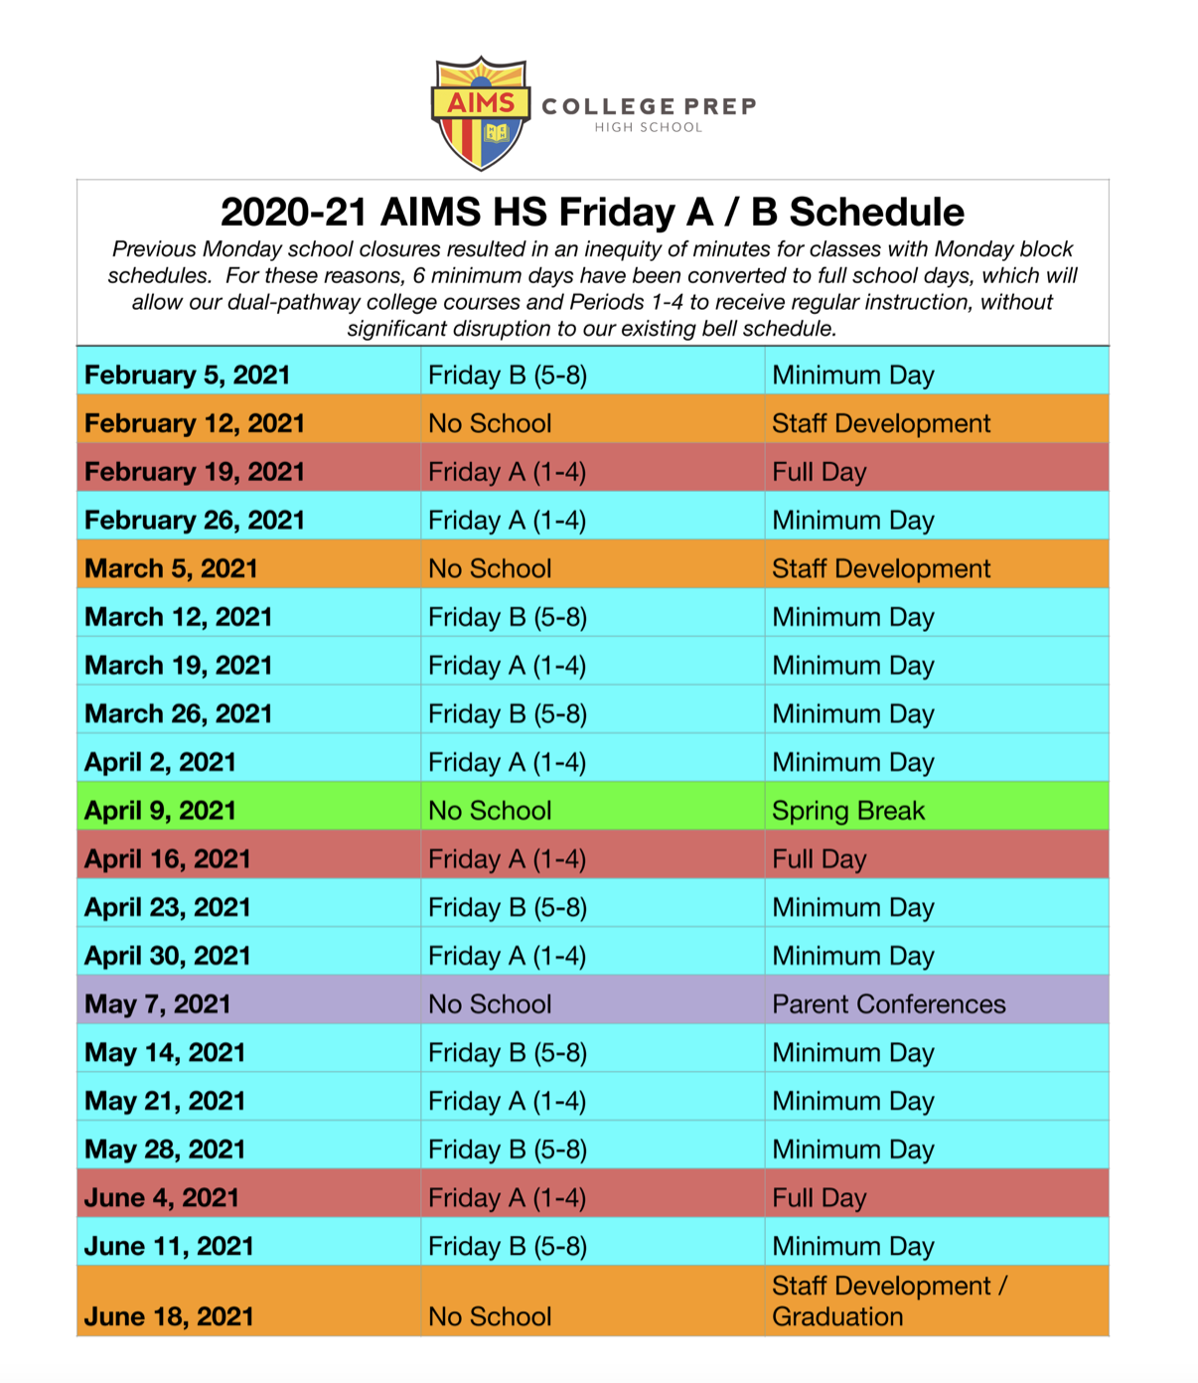
High School Instructional Schedule In March

Slide 6
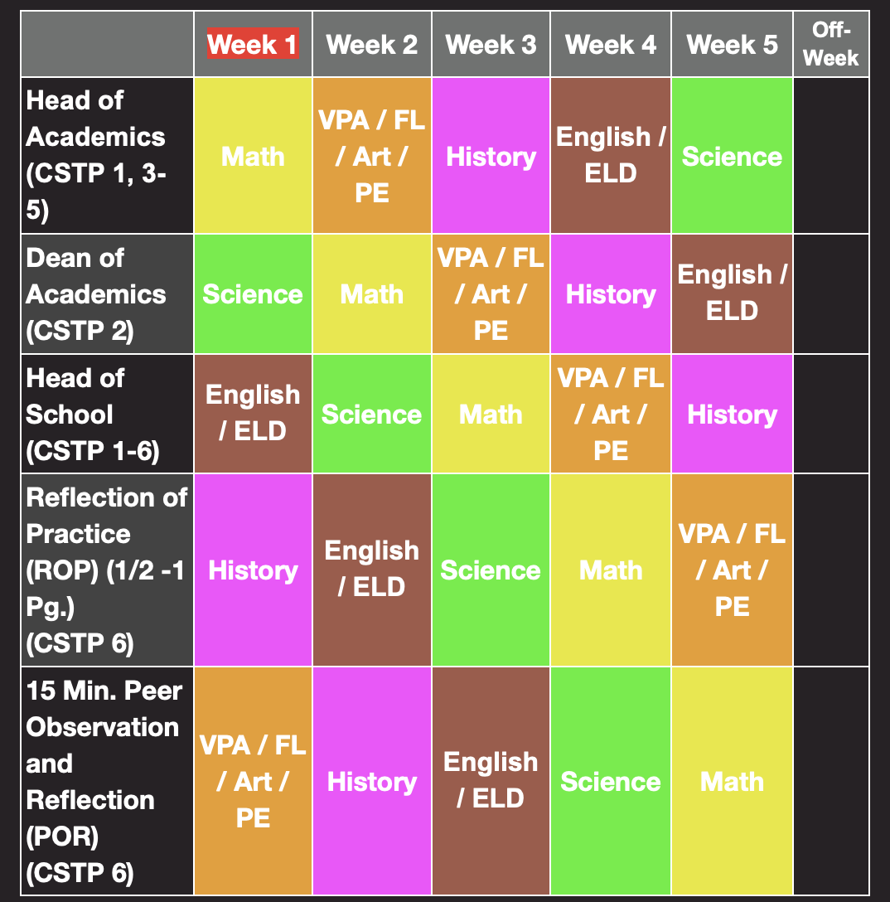
AIMS HS Evaluation Cycle 3
Each Observation Cycle involves the following for teachers in each Department:
Observation for CSTP Standards 1, 3, 4, 5 by Head of Academics
Observations for CSTP Standard 2 by Academic Deans.
Reflection of Teaching Practice
Peer Observation and reflection of peer observation
Conference with Head of School for CSTP Standards 1 - 6
The Reflection of Teaching Practice includes the use of The Distance Learning Playbook by Douglas Fisher, Nancy Frey and John Hattie. The reflection prompt for the staff is: “Using the Distance Learning Playbook, reflect on 1 – 3 strategies that you have used. Cite the module and page number for each strategy.” Teacher Self Reflection Form:
The Peer Observation Reflection includes the prompt: “In your ROP, reflect and write about what steps you’ve taken to address the needs of the English Learners and how this is reflected in your curriculum planning. Note some of your successes to date.” Peer Observation Reflection Form:
During Week 6 of each Cycle, the Administrative Team meets with teachers of need to support them with a Performance Improvement Plan, discussing suggestions which may help to improve their teaching practice.

