Slide 1
AIMS 6-8 Board Report Reporting Period March, 2021
Head of School Peter Holmquist, AIMS College Prep Middle School

Slide 2
Introduction
This slide deck contains information about AIMS College Prep Middle School. It will not be read to the board. In the interest of time, the board will receive this presentation in advance, and will have questions ready for the coordinator. The Head may take a short time ( 5 minutes Max) to highlight any Items that may be of specific interest to the board.

Slide 3
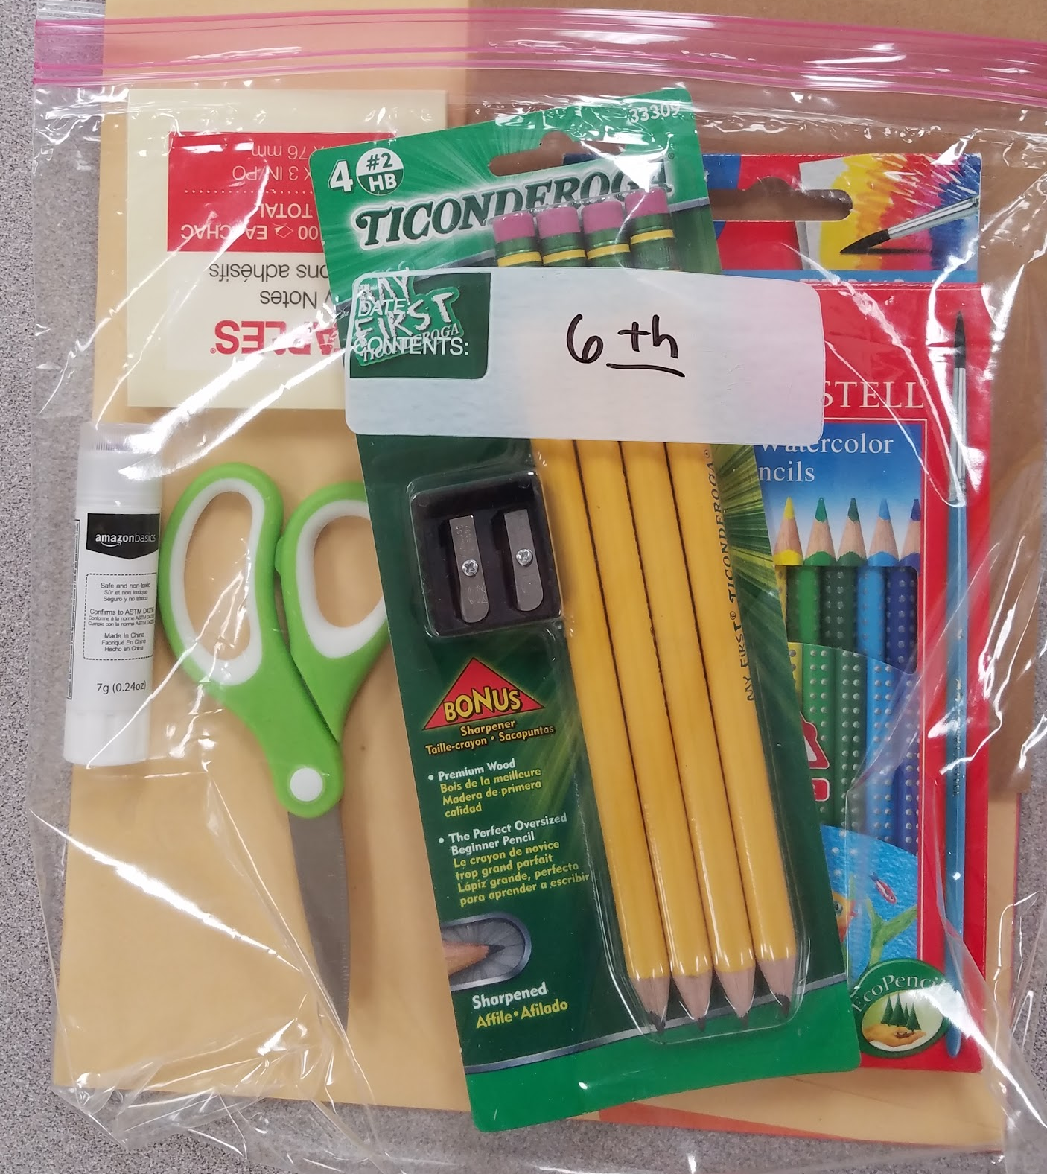
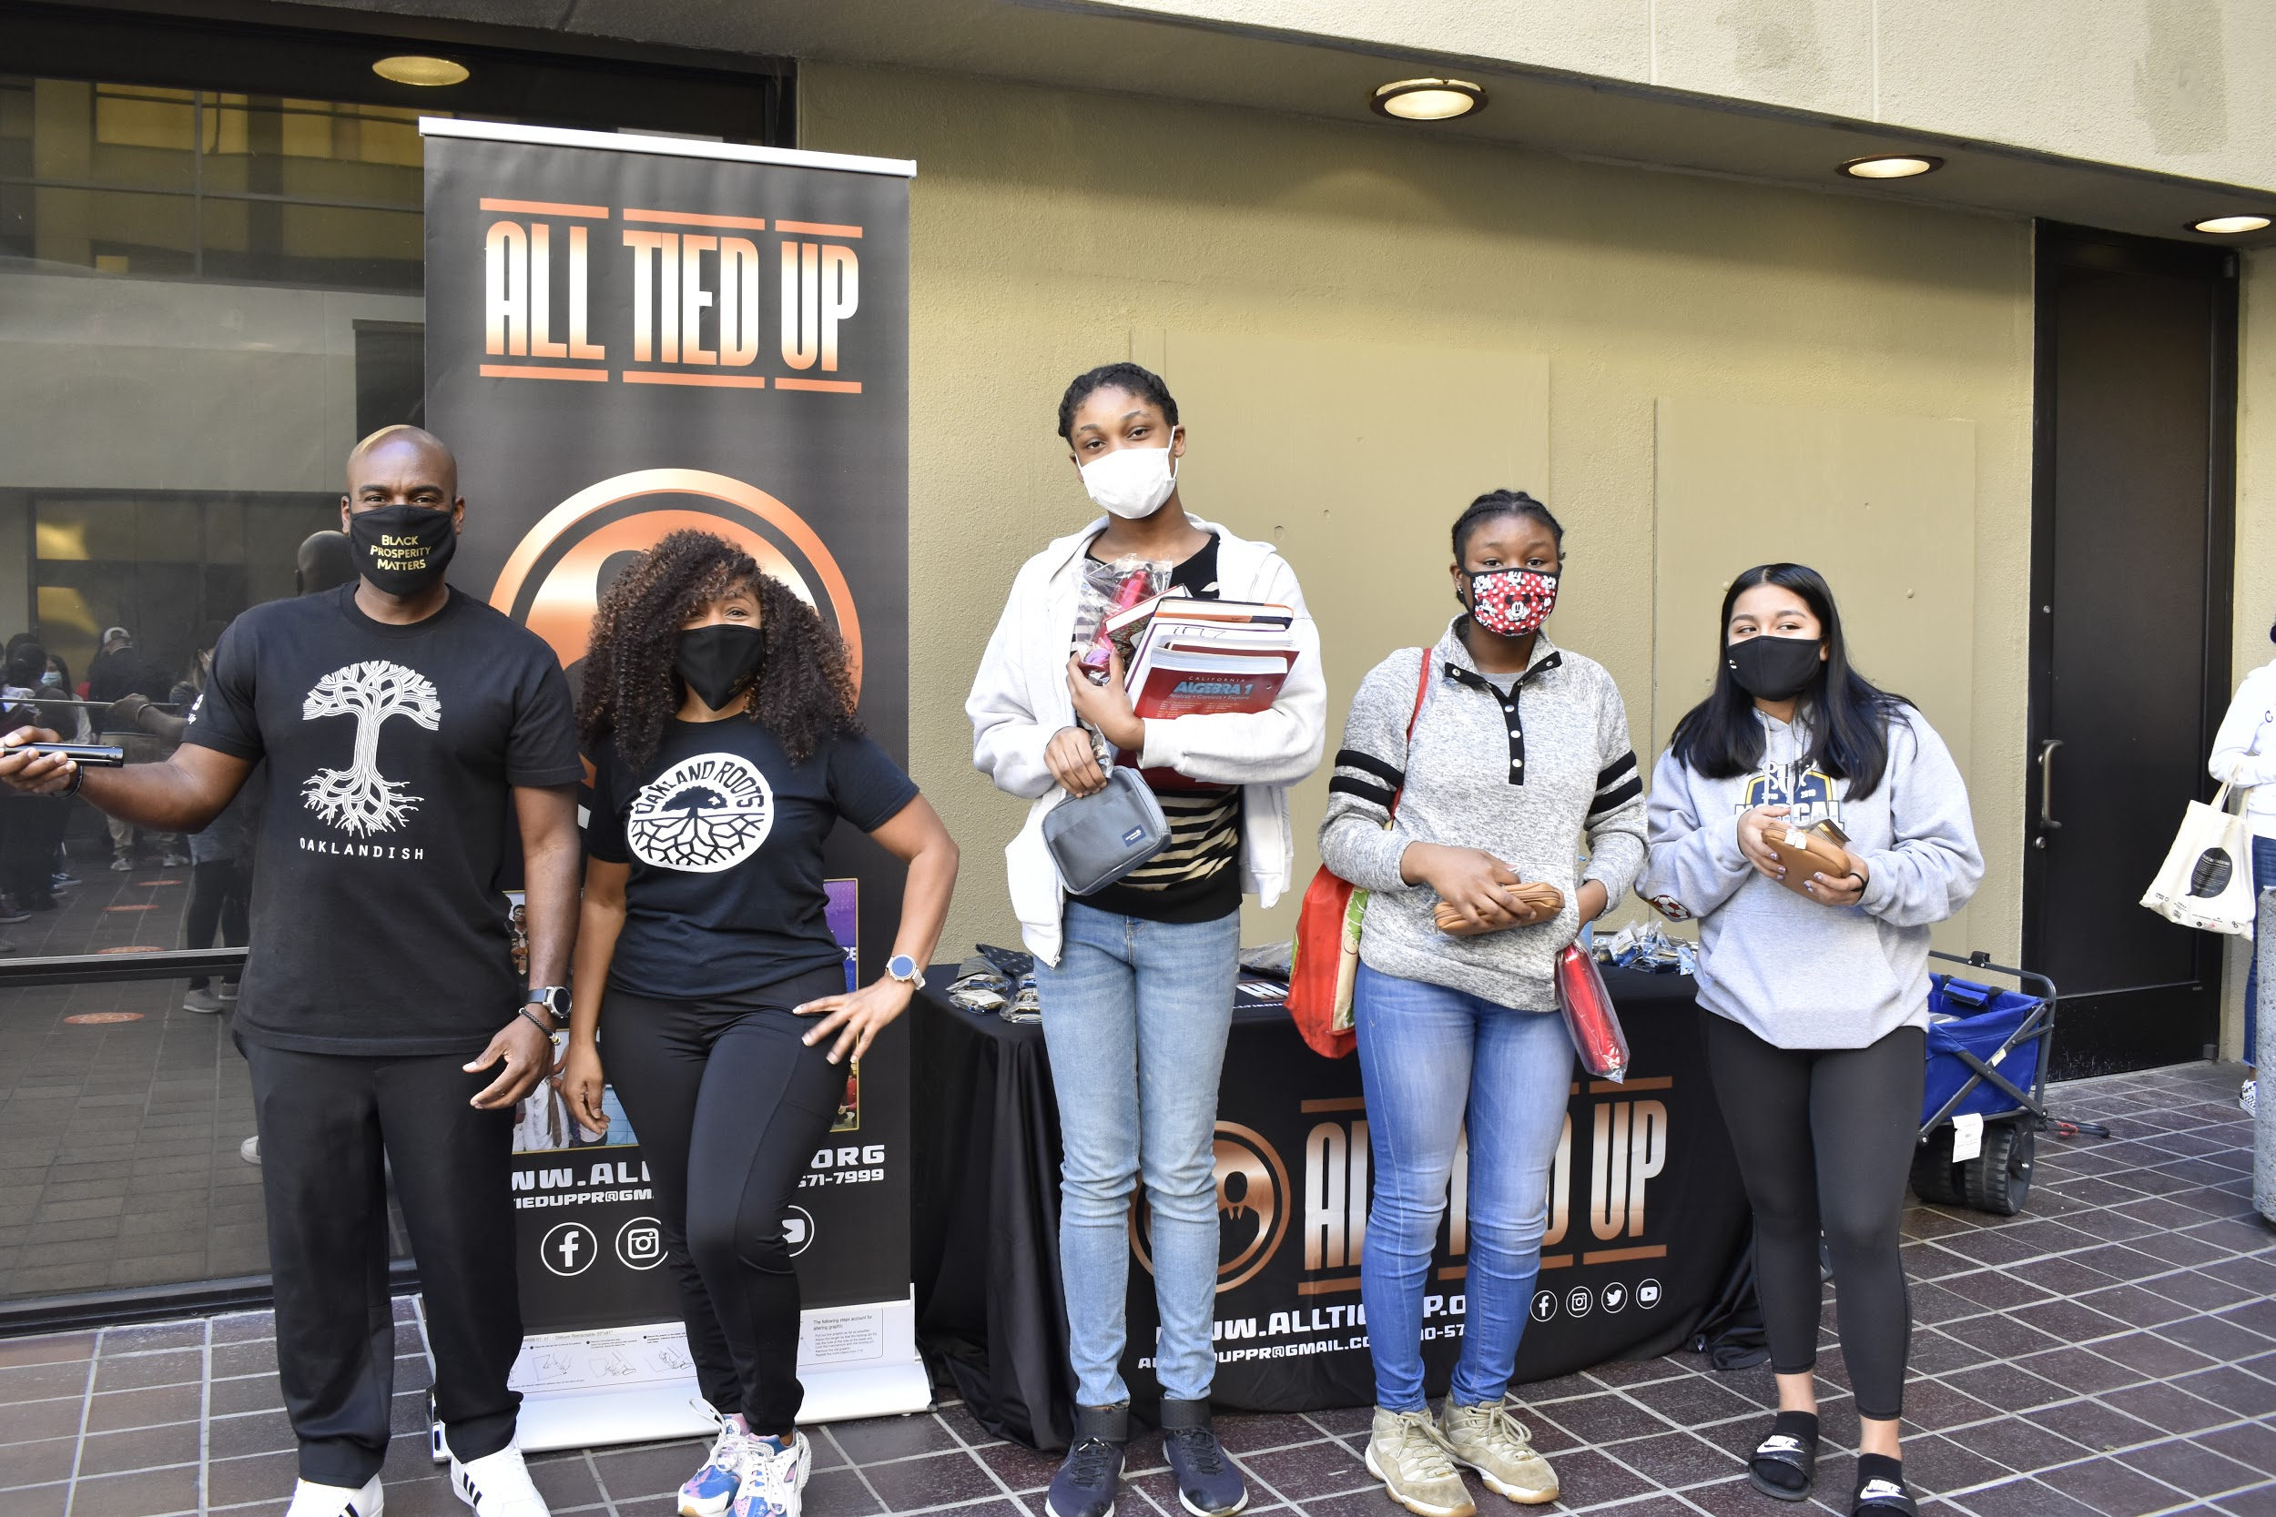
Highlights I Want The Board To Know
Renewal of Measure G1 grant
All Tied Up continues
Computer repair
Preparation for re-opening (details)
Distribution Days for Q4 are coming

Slide 4
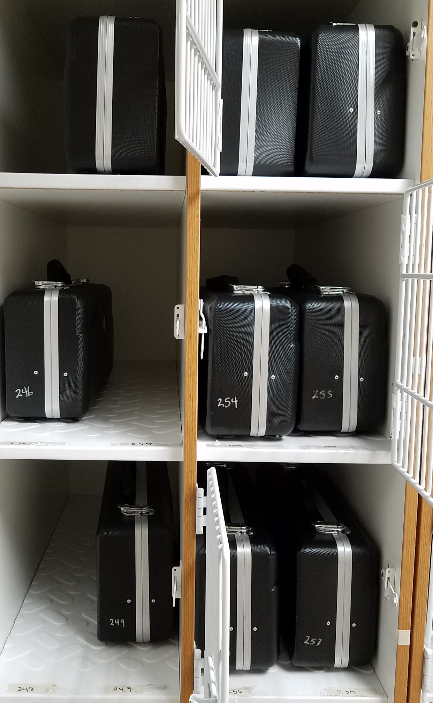
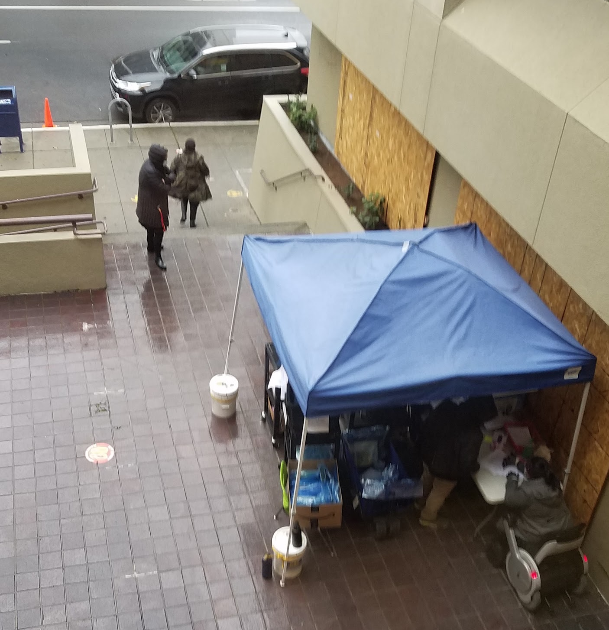
Highlights Of The Month
3rd 3-day “Distribution Days” of School supplies and packets from Teachers March 30, 31, April 1st
Preparations for various testing is going well - both technology needs and academic scaffolding/support
Computer repair for items that are within our scope

Slide 5
Computer and Chromebook Repair
The Middle School is currently in a ratio of 1-to-1 on Chromebooks-to-students.
We also have extra chromebooks in case there needs to be a replacement. (Many of those in need of repair are put back in service.)
There are 90 chromebooks that are currently back-ordered. There is currently no ETA for them.
An additional 54 Chromebooks were ordered and should arrive earlier than the 90 back-ordered Chromebooks.

Slide 6
Middle School Instructional Schedule In March
 | USC & Stanford (Ms.Jone & Ms. Bakheit)
 |  |  | Monday |  | Tuesday |  | Wednesday |  | Thursday |  | Friday
 | Block 1 (90 min) | 9:00 - 10:30 | USC (ELA) | Stanford (Math) | USC (Math) | Stanford (ELA) | USC (ELA) | Stanford (Math) | USC (Math) | Stanford (ELA) | USC (ELA & Hist Assessment & Evaluation) | Stanford (Math & Sci Assessment & Evaluation)
 |  | 10:30 - 11:00 | Break
Week 1 | Block 2 (90 min) USC/Stanford | 11:00 - 12:30 | P.E. (Mike) | P.E. (Tina) | USC Art (Frost) | Stanford Music (Hammer) | USC World Language (Spanish) | Stanford World Language (Mandarin) | P.E. (Mike) | P.E. (Tina) | USC (Math & Sci Assessment & Evaluation) | Stanford (ELA & Hist Assessment & Evaluation)
Week 2 | Block 2 (90 min) USC/Stanford | 11:00 - 12:30 | P.E. (Mike) | P.E. (Tina) | USC Art (Frost) | Stanford Music (Hammer) | USC World Language (Spanish) | Stanford World Language (Mandarin) | USC Art (Frost) | Stanford Music (Hammer)
Week 3 | Block 2 (90 min) USC/Stanford | 11:00 - 12:30 | P.E. (Mike) | P.E. (Tina) | USC Art (Frost) | Stanford Music (Hammer) | USC World Language (Spanish) | Stanford World Language (Mandarin) | USC World Language (Spanish) | Stanford World Language (Mandarin)
 |  | 12:30 - 1:00 | Lunch
 | Block 3 (90 min) | 1:00 - 2:30 | USC (Math) | Stanford (ELA) | USC (ELA) | Stanford (Math) | USC (Math) | Stanford (ELA) | USC (ELA) | Stanford (Math)
 | Block A (60 min) | 2:30 - 3:30 | USC Science | Stanford History | USC History | Stanford Science | USC Science | Stanford History | USC History | Stanford Science
 |  | 3:30 - 4:30 | Tutoring | Tutoring | Tutoring | Tutoring | Tutoring | Tutoring | Tutoring | Tutoring

Slide 7
Hybrid Learning Grouping In (the future)
Hybrid grouping has begun, coordinating:
Equitable student groups on campus ⅓ of class, Supported video conference meetings for ⅔ of class
Rotation of the three groups, each group on campus for one day on, two days off
Groups coordinated with different grade siblings, etc.
Teacher input on the groups has been received

Slide 8
Middle School Method for Monitoring Instruction For Hybrid Learning
Weekly PLC interactions:
grade level meetings
subject matter meetings
Syllabus oversight and Lesson Plan review
Visitation of online classrooms
using district evaluation program
focused on California Standards for the Teaching Profession (CSTP)
Teacher peer visitations should be completed in March
Review of Zoom & Schoology class recordings
Grade checks and oversight through Powerschool and Schoology

Slide 9
Middle School Strategy for Communicating With Students and Parents Regarding Re-Opening
ParentSquare messages from Middle School Administrators to families
Parent Information meetings and tutorials around technology
Middleschool@aimsk12.org and Teaching staff are the main conduit for communicating with students
Phone calls and emails from staff for attendance (clerical, faculty, & administrators)
Progress Reports and Report Cards
Phone calls and emails from teachers for attendance, behavior, and grades
Parent Square and Zoom meetings for resource pickup & scheduling
Continuing technical help, including hardware exchange

Slide 10
Middle School Strategy for Addressing Concerns From Parents and Students
Specific parent addresses a concern, usually through email or phone call, although sometimes in person at the front desk
Staff (usually clerical or faculty) respond as best they can in the moment
If there is no resolution in first contact, then the student’s teachers are invited to weigh in with their information, or intervene for their student.
If there is still no resolution, a MS administrator or other staff (ELD, SpEd) may become involved. If this is the first contact, step 3 will be enacted.
If there is not resolution and no clear policy, there may be a meeting between stakeholders.

Slide 11
Middle School Challenges/Concerns and Method for Resolution
Support of teachers and students in the distance learning environment
skills, practices, relationships
continuing to highlight and support SEL activities - both for teachers and for students
“Educator Resiliency Blueprint” program for teachers is being offered during PLC time
Professional Development continually addressed through
unit/lesson planning for Semester Two/Quarter Three and beyond
vendor, peer teacher, and administrator offering training

