Slide 1
AIMS HS Board Report Reporting Period February 2021
Head of School Maurice Williams Jr., AIMS College Prep High School

Slide 2
Introduction
This slide deck contains information about AIMS College Prep High School. It will not be read to the board. In the interest of time, the board will receive this presentation in advance, and will have questions ready for the coordinator. The Head may take a short time ( 5 minutes Max) to highlight any Items that may be of specific interest to the board.

Slide 3
Highlights I Want The Board To Know
AIMS HS Virtual Campus Tours: AIMS HS will held 5 engagements (3 Student; 1 AIMS HS Families; 1 General Community) to encourage all students to apply or attend AIMS HS for the 2021-22 Academic School year. Both the family and community meetings were hosted in Cantonese and Spanish translations.
Mental Health Fridays Begin in March: As part of our effort to increase Mental Health awareness at our campus, our teachers will meet once a month with their homeroom classes to discuss topics from the new book Mental Health 101 For Teens. Mental Health topics will be determined by AIMS Administration and teachers. AIMS Socioemotional Counselor Anthony Castellano will help support AIMS HS administration with the mental health days.
AP / Statewide Exam Prep Begins March 1: Effective March 1, all AIMS HS AP teachers will reduce their academic course loads to begin preparing exclusively for all AP / Statewide exams.

Slide 4
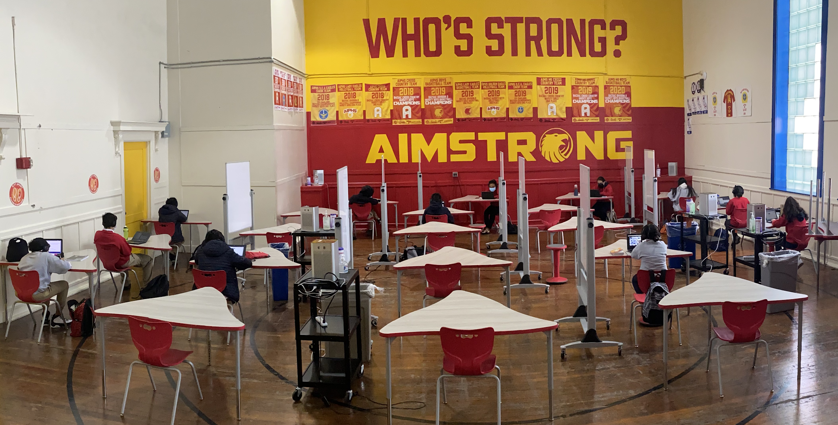
Highlights Of The Month
1. On-Campus Small Group Instruction has resumed at AIMS HS: Nearly 42 students have participated in on-campus learning (Freshmen / Sophomores - Monday/Tuesday and Juniors / Seniors - Wednesday / Thursday). More students are expected to attend small group instruction in the coming weeks.
2. AIMS HS Begins PBIS Rewards for Virtual Learning: PBIS Rewards is an digital awards program in which students can earn points (E-Bucks) by exhibiting the following AIMS positive behavior traits during virtual learning:
1 Pt. - Be Accountable, on time, and ready to learn (with face on camera) 1 Pt - Have Integrity, honest participation, and be involved throughout class 1 Pt. - Be Mindful of work quality and submit assignments on time 1 Pt - Be Safe, respectful, and responsible during class
Students can use their earned points to purchase items from the AIMS HS PBIS student store.

Slide 5
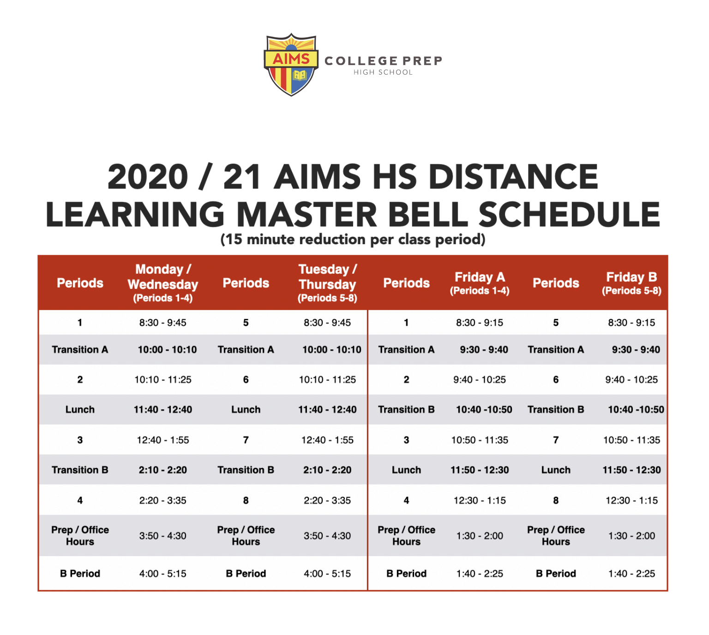
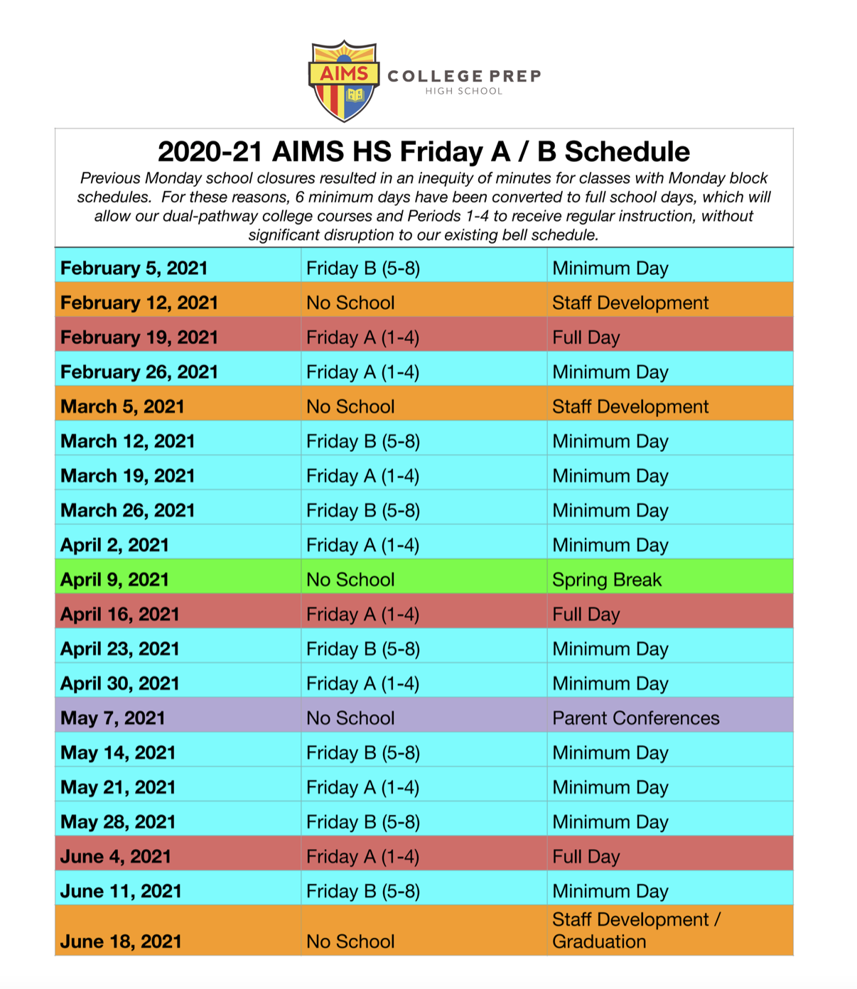
High School Instructional Schedule In February

Slide 6
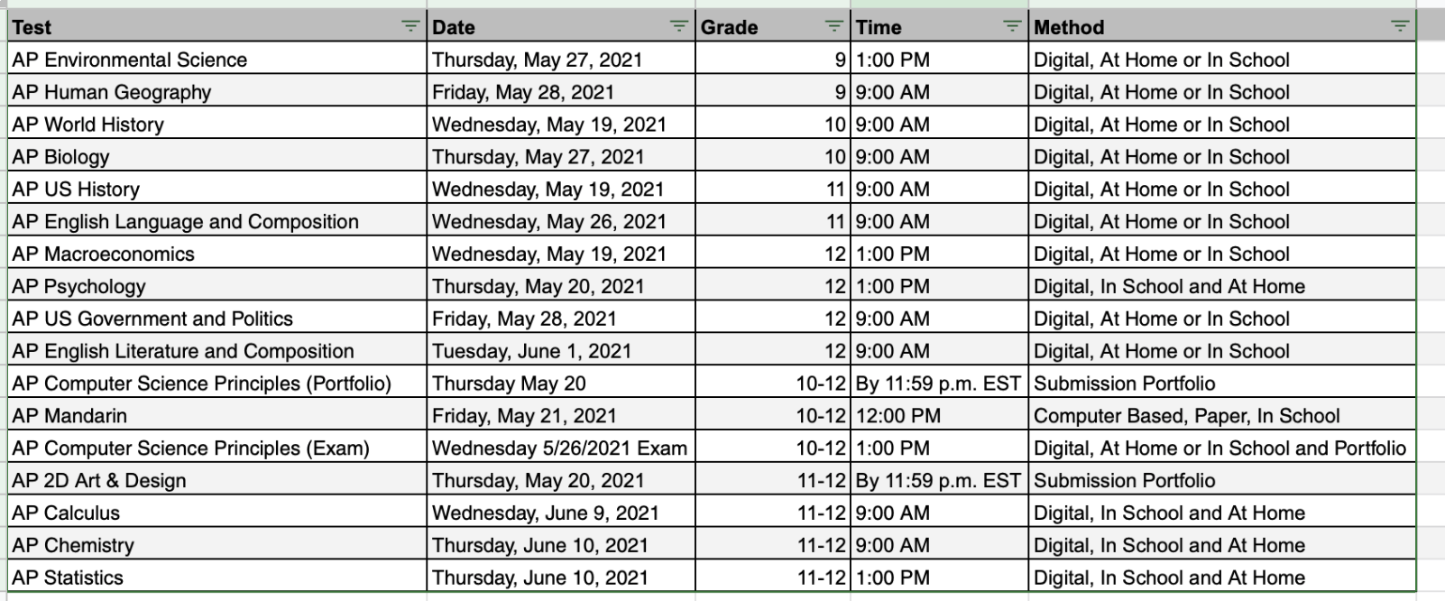
2020-21 AIMS HS AP Testing Schedule
New 2020-21 AP Testing Format: Rather than offering a single testing approach that would serve only some students and educators well, College Board is offering a variety of testing options that reflect the unique characteristics of each exam.
Most subjects are full-length digital exams only, administered in school or taken at home due to coronavirus precautions.
This year’s AP Mandarin exams will
be computer based and in-person.
Unlike last year, Collegeboard will not modify its AP tests. AIMS HS administration has required to use of AP classroom and other AP prep strategies since the start of the school year, to help improve AP scores, despite distance-learning procedures.

Slide 7
2020-21 AIMS HS State Testing Schedule
New CAASPP Format: CDE has modified this year’s statewide testing to one test per ELA and Math subject, which should take approximately an hour for students to take. Only 11th graders are permitted to take the exams.
Because students did not take their statewide exams during the 2019-20 academic school year, AIMS HS set aside some time in the academic calendar for test review and sample tests based upon the new format.
New Statewide Science Tests: Beginning this year, all high school students must take the new statewide science exam before they graduate from high school. All 12th grade students will be required to take the science test, and we are opting for 11th grade students to take the exam to receive baseline data / test readiness.

Slide 8
AIMS HS Mental Health Survey
AIMS HS Mental Health Survey: On Friday, February 5, AIMS HS administered an anonymous mental health survey to it’s 5th period students before the start of class.
The AIMS HS Mental Health survey questions were designed by Mental Health America’s website and were adapted by Head of School Williams, Student Affairs Specialist Jasmine Raines, and AIMS Socioemotional Counselor Anthony Castellano.
The survey took approximately 10 minutes for respondents to complete.
366 out of 445 students completed the survey (82.2%).
Following the survey, students were prompted to contact Mr. Anthony Castellano if they wished to speak or meet with a mental health professional for support.
AIMS HS Mental Health Survey results will be released to the AIMS HS community during next month’s AIMS HS Newsletter.

Slide 9
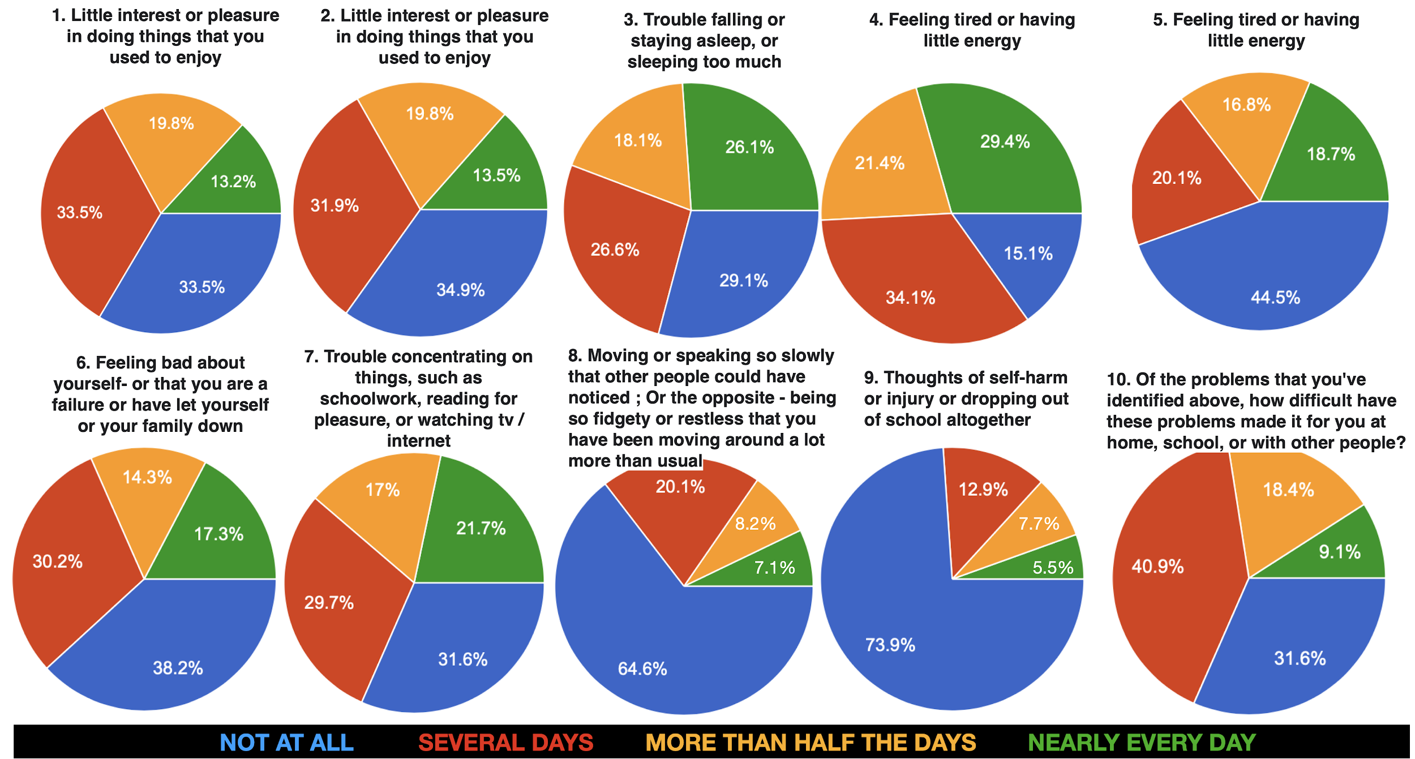
AIMS HS Mental Health Survey Results

Slide 10
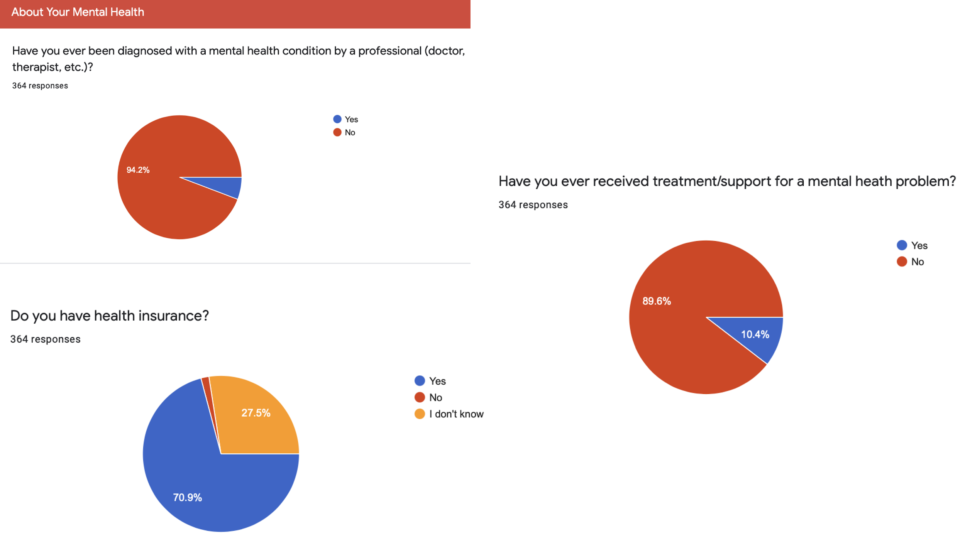
AIMS HS Mental Health Survey Results

Slide 11
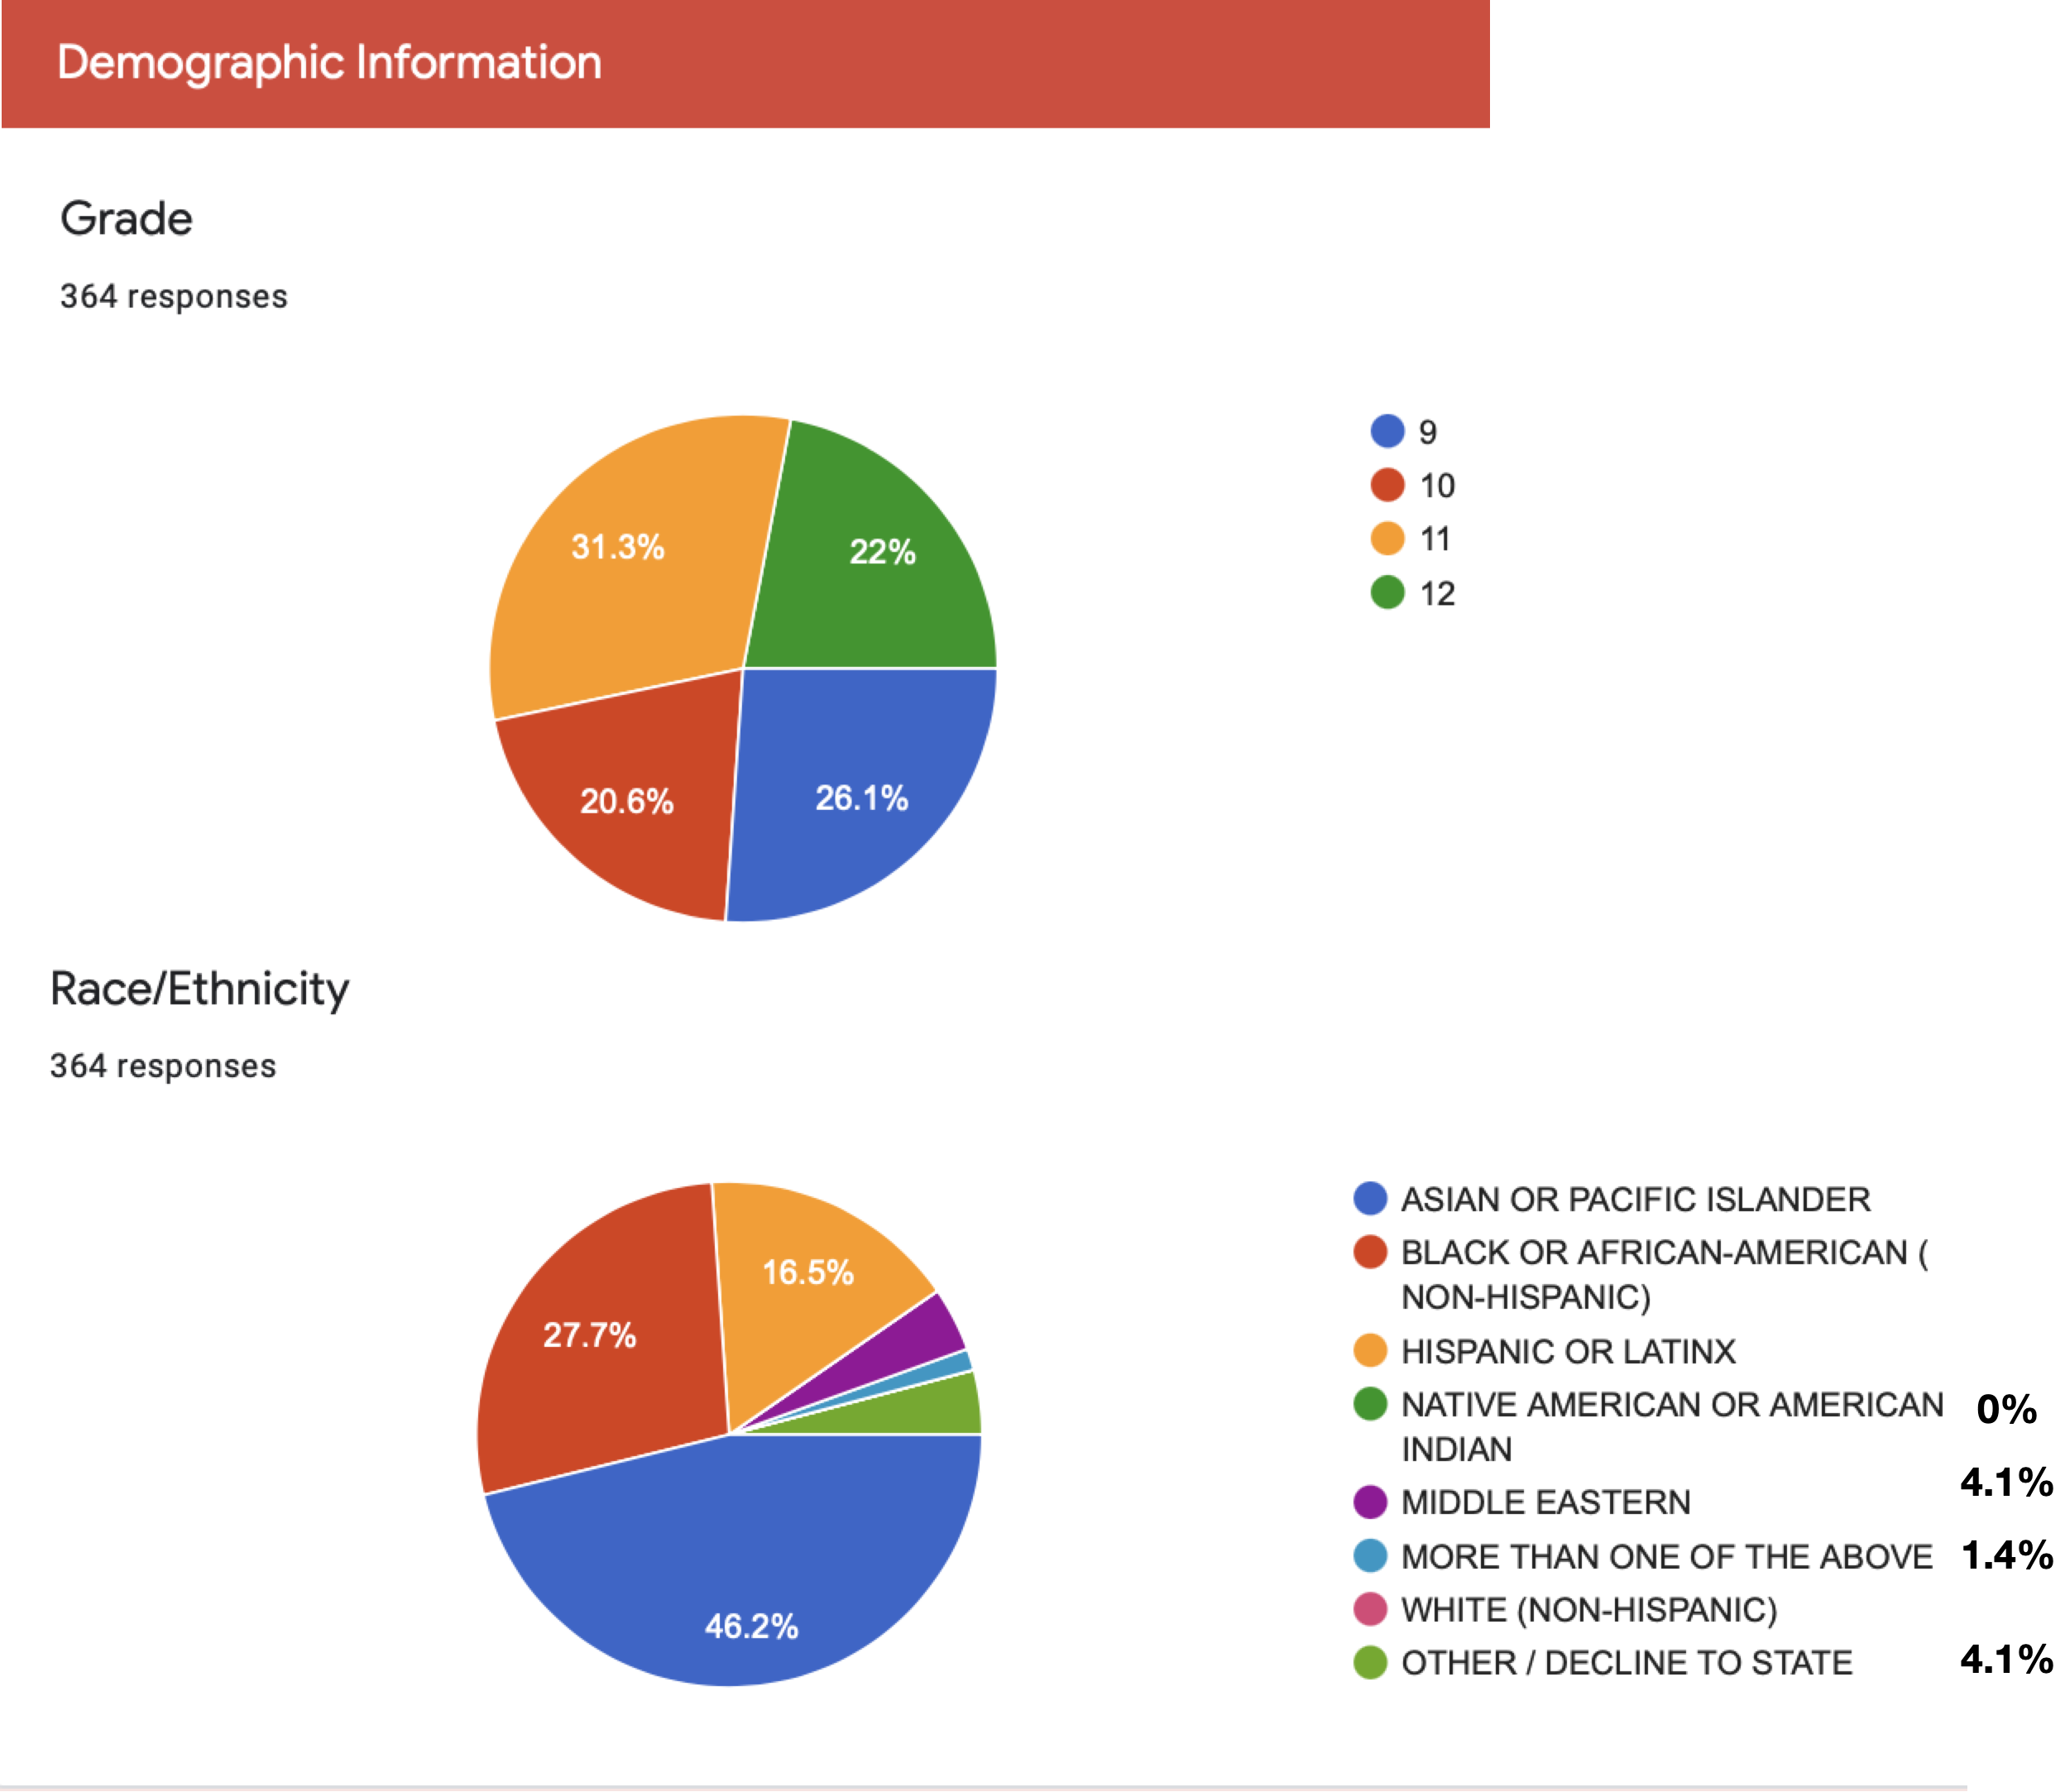
AIMS HS Mental Health Survey Results

Slide 12
High School Challenges/Concerns and Method for Resolution
Deeper analysis is needed
Causality v. Correlation
Determine whether the issues are general in nature or exasperated by Coronavirus / distance learning
Demographic trends
Create related survey of students that are attending on-campus learning
What mechanisms do students have / unable to utilize to deal with these issues
Friends, allies, activities
Counselor / Mental Health Professional
Student resilience
What can AIMS do to help mitigate these issues
Review of Academic Course load, without compromising AIMS quality and standards
Mental Health Fridays / Mental Health 101 Book
Kaiser Ghosted Programs
Student Government, Activities, Sports, PBIS, etc.
Top 5 Issues Contributing to AIMS HS Student Mental Health Problems
1. Academic Pressure
2. Loneliness / Social Isolation
3. Coronavirus / Fear of the Unknown
4. Relationship Problems (Family / Peers)
5. Being Away From School / Distance Learning

