Slide 1
AIMS K-5 Board Report Reporting Period February, 2021
Head of School Christopher Ahmad, AIMS College Prep Elementary School

Slide 2
Highlights I Want The Board To Know
-We completed a full 5-week cycle of evaluations
-Most of the teachers did extremely well
-Students were all well behaved, attentive, and engaged
-Teachers were making great use of technology
-The rigor was still present

Slide 3
SPECIAL GUEST
Olympic Bobsledder Cherrelle Garrett will be coming to one of our first grade classes on February 19th to talk to our students. She will be interacting with the students via Zoom.

Slide 4
Black History Month
Niya Kemal (3rd grade) memorized this poem for Black History Month
*Play Video

Slide 5
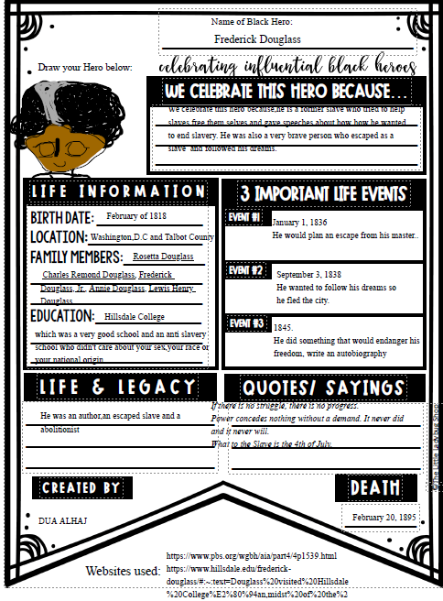
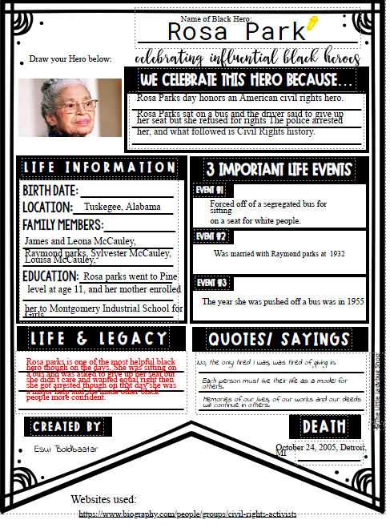
Black History Month Projects

Slide 6
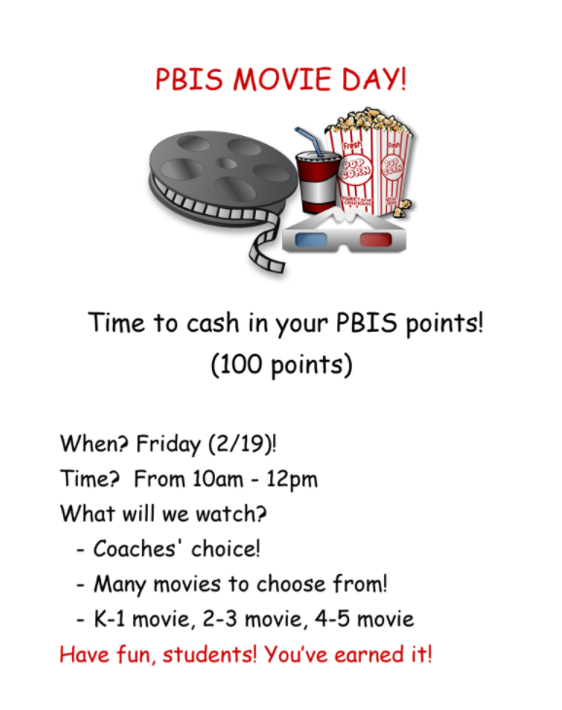
PBIS MOVIE DAY!!!!

Slide 7
Highlights Of The Month
-K-2 Students are getting a “Buddy Bag.”
This is a bag to replenish items that students need for learning
crayons
scissors
whiteboard markers
whiteboards
lined paper
pencils
erasers
rulers

Slide 8
Elementary School Instructional Schedule In January
8:45-3:30 K-2 Friday 8:45-2:00
8:30-3:30 2-5 Friday 8:30-2:00

Slide 9
Elementary School Method for Monitoring Instruction For January Hybrid Learning
Daily observations
Lesson Plans
Benchmarks
Reading Assessments

Slide 10
Elementary School Strategy for Communicating With Students and Parents Regarding January Opening
Parent Square
Zoom Meetings
Phone Calls

Slide 11
Elementary School Strategy for Addressing Concerns From Parents and Students
Zoom Meetings
Phone Calls

Slide 12
Elementary School Challenges/Concerns and Method for Resolution
Deciding whether or not to retain certain students during virtual learning

