Slide 1
AIMS K-12 12th Street Bathroom Renovation Permit

Slide 2
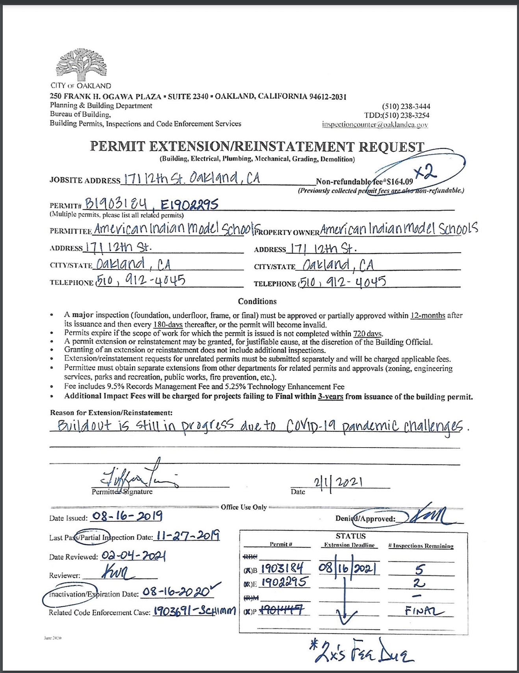
12th Street Permit Status
Construction Permit Expires 8/16/21
Need to finish the 3rd floor buildout
Received an extension

Slide 3
Work to be done
3rd Floor Bathroom extension (Need to prepare RFP document)
Toilets and sinks
Bathroom flooring (6 bathrooms)
Bathroom Stall dividers for all three floors
Staff lounge cabinetry
Painting
Electrical Update/HVAC

Slide 4
Estimated Pricing
3rd Floor Bathroom Renovation - $160,000 - $220,000
Bathroom Partitions - Magnum Drywall $70,053
Bathroom Partitions - Service Metal Products $79,410
Sink troughs - $24,000 - $36,000
Bathroom flooring - Luxor Flooring $36,000
*Listed prices were obtained on December 2019

Slide 5
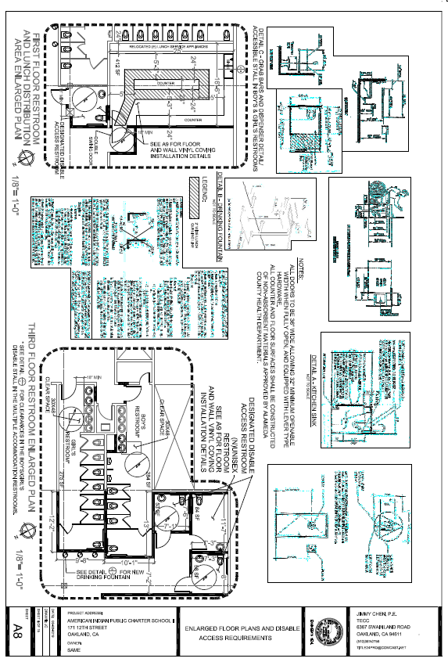
3rd Floor Bathroom Extension Plan

