Slide 1
AIMS K-12 Facilities Update

Slide 2
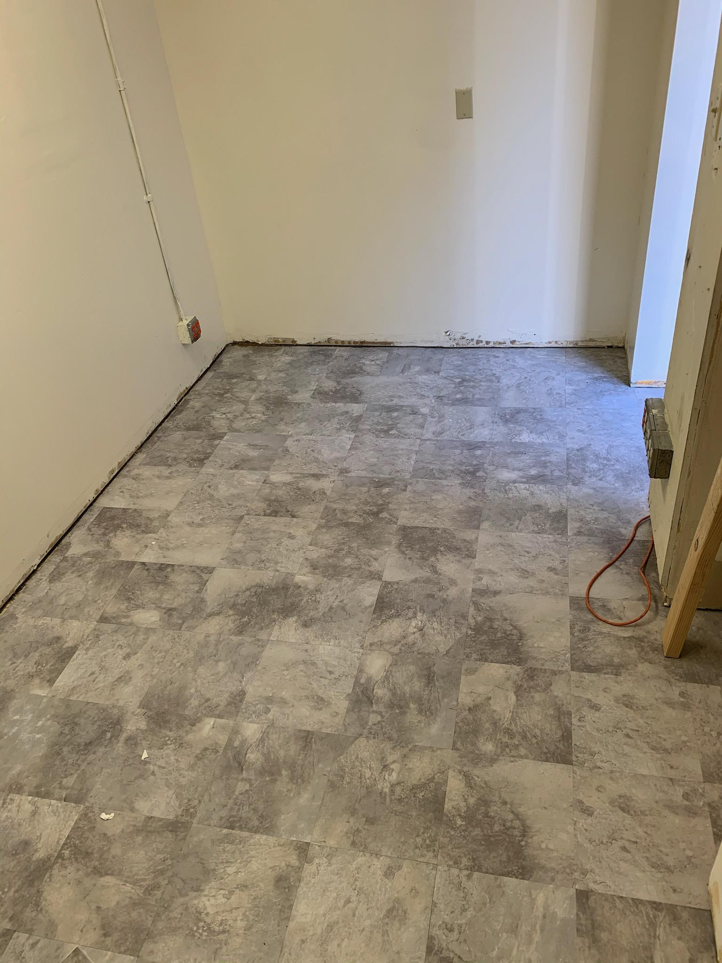
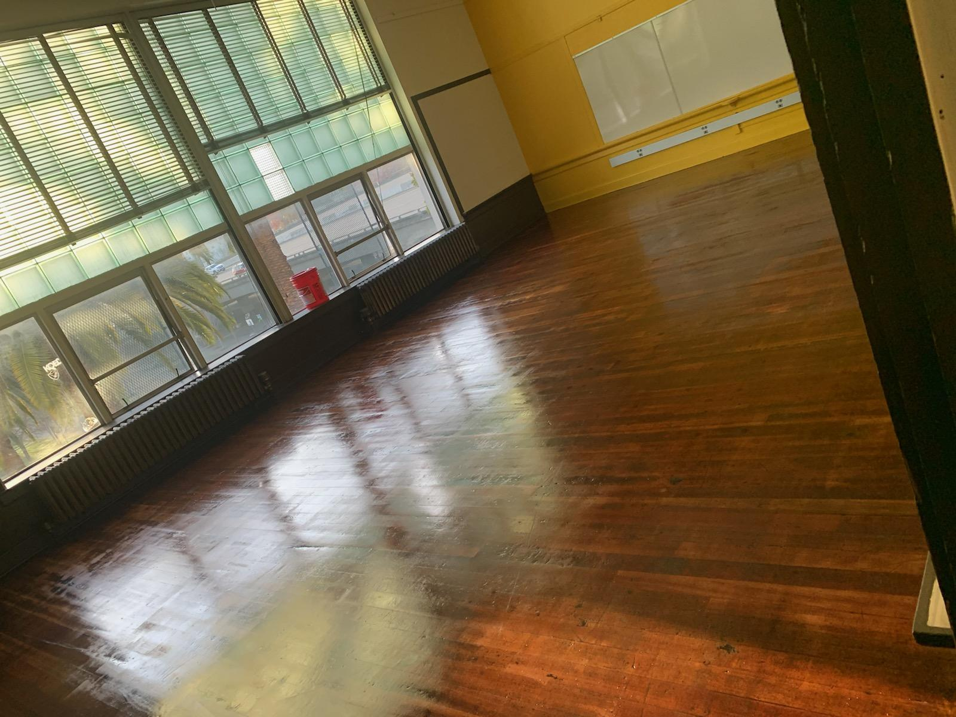
Facilities
12th Street
Clearing out garage
Moving items to storage
Nurse’s office. Remaining work - windows, painting wall where windows will be installed
Continue to set up classrooms for in person instruction
Lakeview
Maintenance at the school site
Continue to set up classrooms for in person instruction
Classrooms floors were waxed
Facilities Grant
Mid year certification for AIPCS/AIPCS II due 2/26/21
There is a possibility that we might receive a 19 month grant for AIPHS. Documents requested have been submitted.

Slide 3
Prop 39 Update
Prop 39 Timeline
11/1/2020 - Facilities Request forms were submitted for American Indian Public Charter, American Indian Public Charter School II and American Indian Public High School.
12/1/2020 - Received letter from OUSD regarding no objection to enrollment projection for American Indian Public Charter, American Indian Public Charter School II and American Indian Public High School.
2/1/2021
Received Prop 39 Preliminary Offer Letters
School | AIPCS | AIPCS II | AIPHS
Location | Franklin Elementary School 915 Foothill Blvd, Oakland, CA 94606 | McClymonds 2607 Myrtle St, Oakland, CA 94607 Montera 5555, Oakland, CA 94611 | Lakeview 746 Grand St, Oakland, CA 94610
Classrooms | 9 classrooms | 12 classrooms 14 classrooms | 15 classrooms

Slide 4
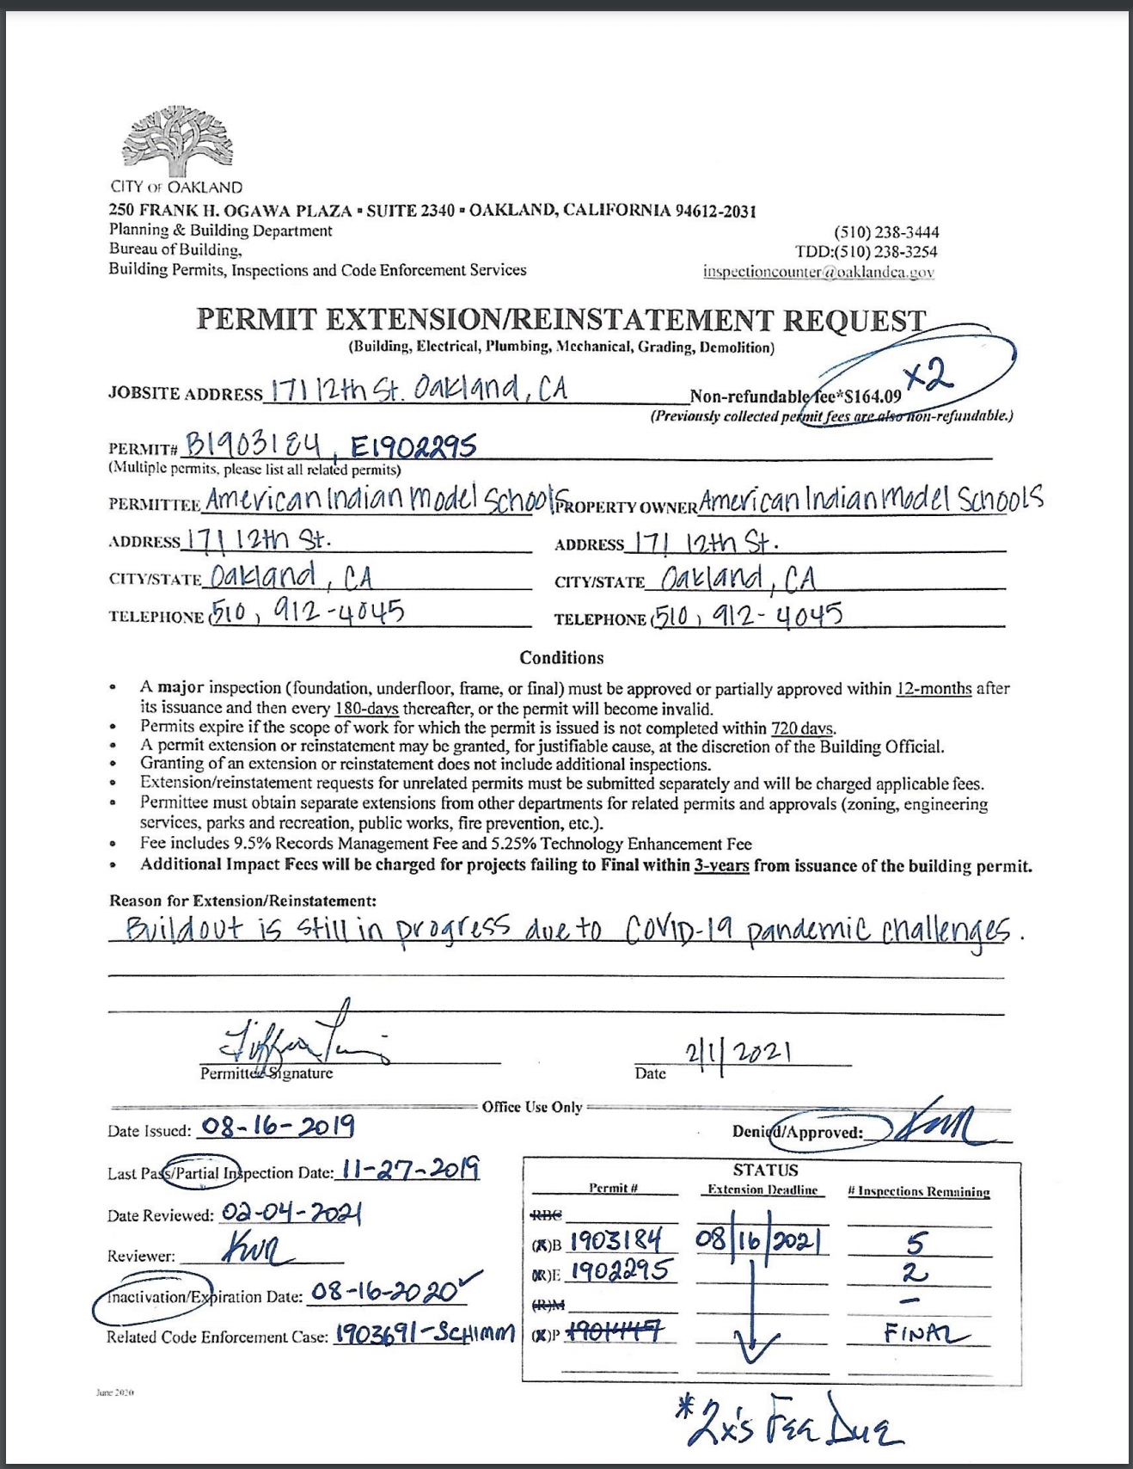
12th Street Permit Status
Construction Permit Expires 8/16/21
Need to finish the 3rd floor buildout
Currently applying to get an extension

