Slide 1
AIMS HS Board Report Reporting Period January 2021
Head of School Maurice Williams Jr., AIMS College Prep High School

Slide 2
Introduction
This slide deck contains information about AIMS College Prep High School. It will not be read to the board. In the interest of time, the board will receive this presentation in advance, and will have questions ready for the coordinator. The Head may take a short time ( 5 minutes Max) to highlight any Items that may be of specific interest to the board.

Slide 3
Highlights I Want The Board To Know
AIMS HS Virtual Campus Tours: AIMS HS will hold 7 engagements (3 Student; 2 AIMS HS Families; 2 General Community) to encourage all students to apply or attend AIMS HS for the 2021-22 Academic School year. Both the family and community meetings will be host Cantonese and Spanish speakers:
8th Grade Classroom Meetings (February 1, 2021 @ 2PM)
Mr. Williams (2 Classes)
Ms. Li (2 Classes)
Ms. Chaniel (2 Classes)
AIMS 8th Grade Parent Meetings
Monday, January 25 @ 6:30PM
Saturday, January 30 @ 3PM
AIMS HS General Public Meetings (Invites were sent to all OUSD Public and Charter Middle Schools)
Thursday, January 28 @ 6:30PM
Saturday, January 30 @ 6:30PM
Mental Health 101 For Teens: As part of our commitment to Mental Health, AIMS HS has purchased the new book, Mental Health 101 for Teens, which will be distributed to all AIMS HS students, teachers, and staff. No Bullying Schools founder and author Tom Thelen (staunch supporter of AIMS) and his team is finalizing its curriculum that will be shared with teachers in order to help cover pertinent topics within the book.

Slide 4
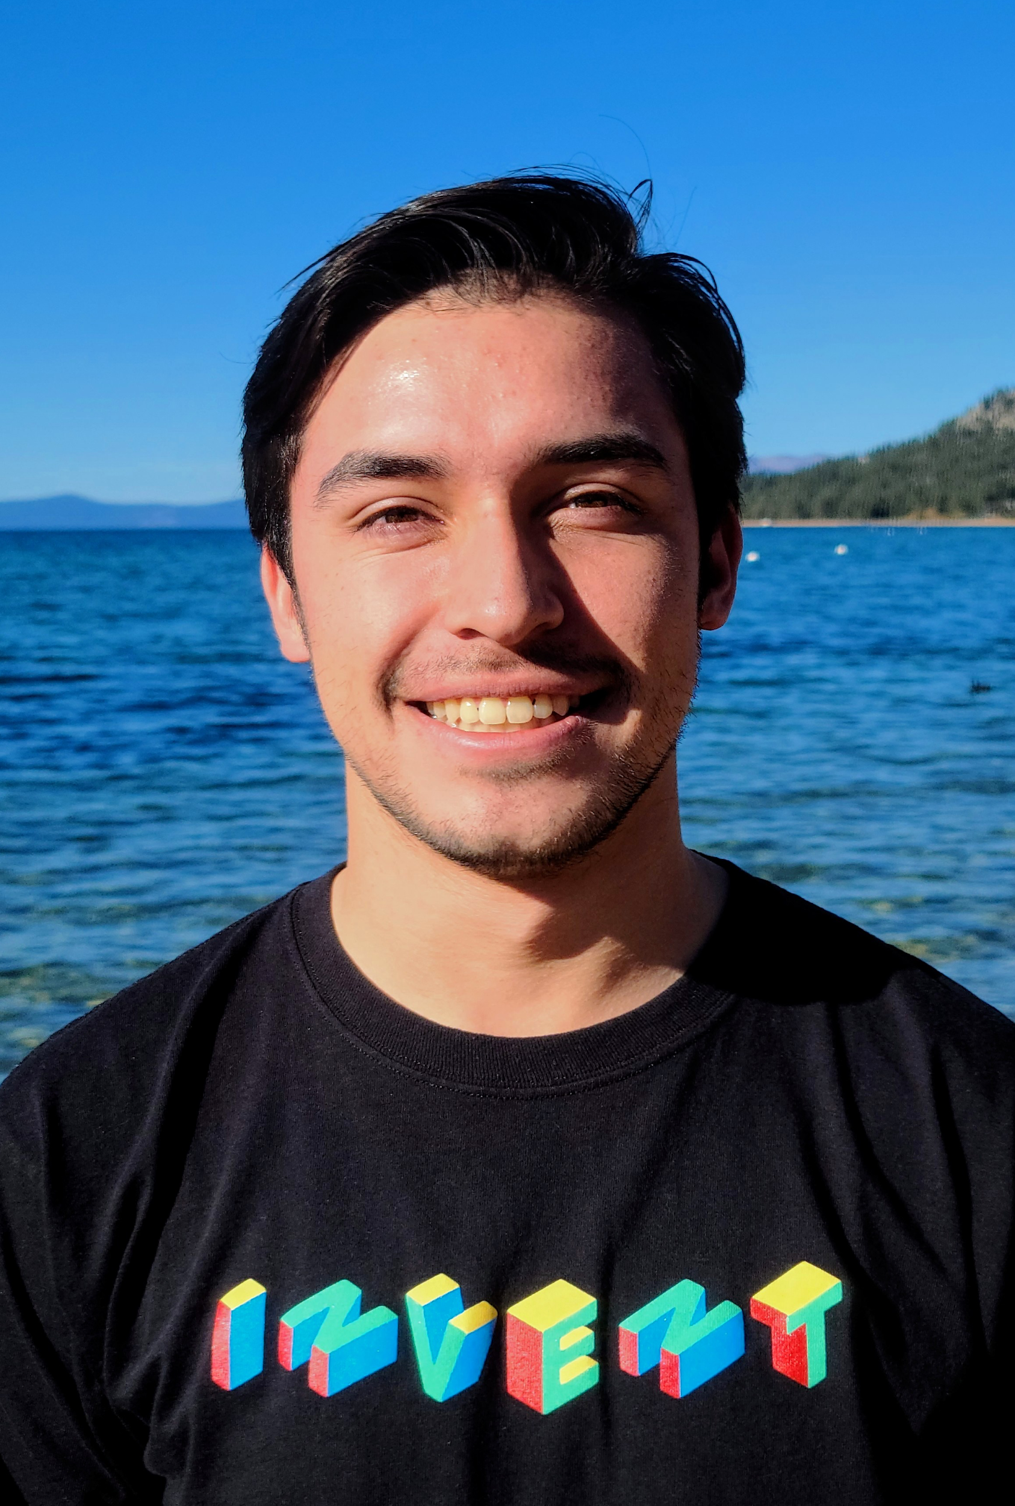
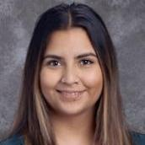
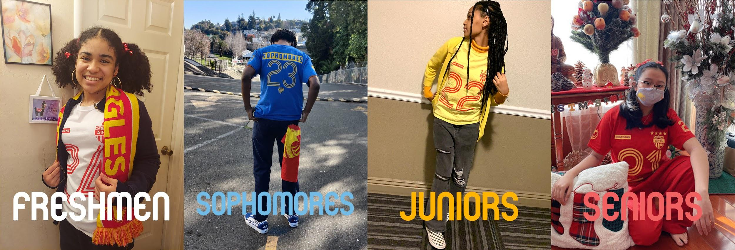
Highlights Of The Month
1. New AIMS HS Staff
Mr. Carlos Lopez-Tenorio was recently on-boarded as a semester-long intern to help lead the new AIMS HS Innovation and Design Thinking course for Freshmen. Mr. Lopez-Tenorio is a Junior at UC Berkeley and his role may help facilitate an MOU between the UC Berkeley’s d.School and AIMS HS for future student-internship placements.
Ms. Evelin Palacios is an Administrative Assistant with nearly 3 years at AIMS. She will be tasked with assisting in the academic counseling department at AIMS HS. Ms. Palacios will complete her MA in Counseling (Academic) and will obtain her preliminary PPS credential for the purposes of becoming and academic counselor at AIMS HS during the 2021-22 academic school year.
2. AIMS HS SGA ‘Tis The Spirit Week’
One lucky AIMS student won a $100 Visa gift card for their participation in the AIMS HS Winter Spirit Week.

Slide 5
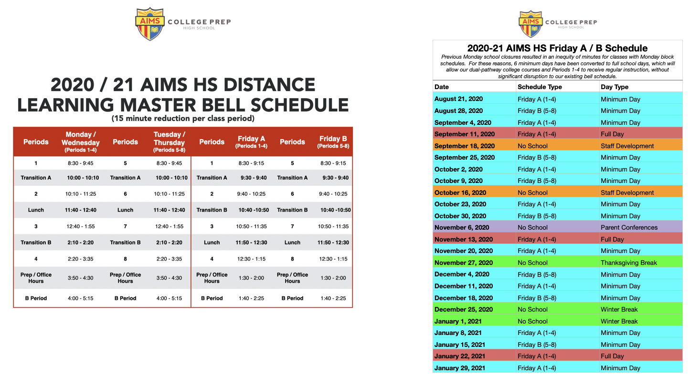
High School Instructional Schedule In January

Slide 6
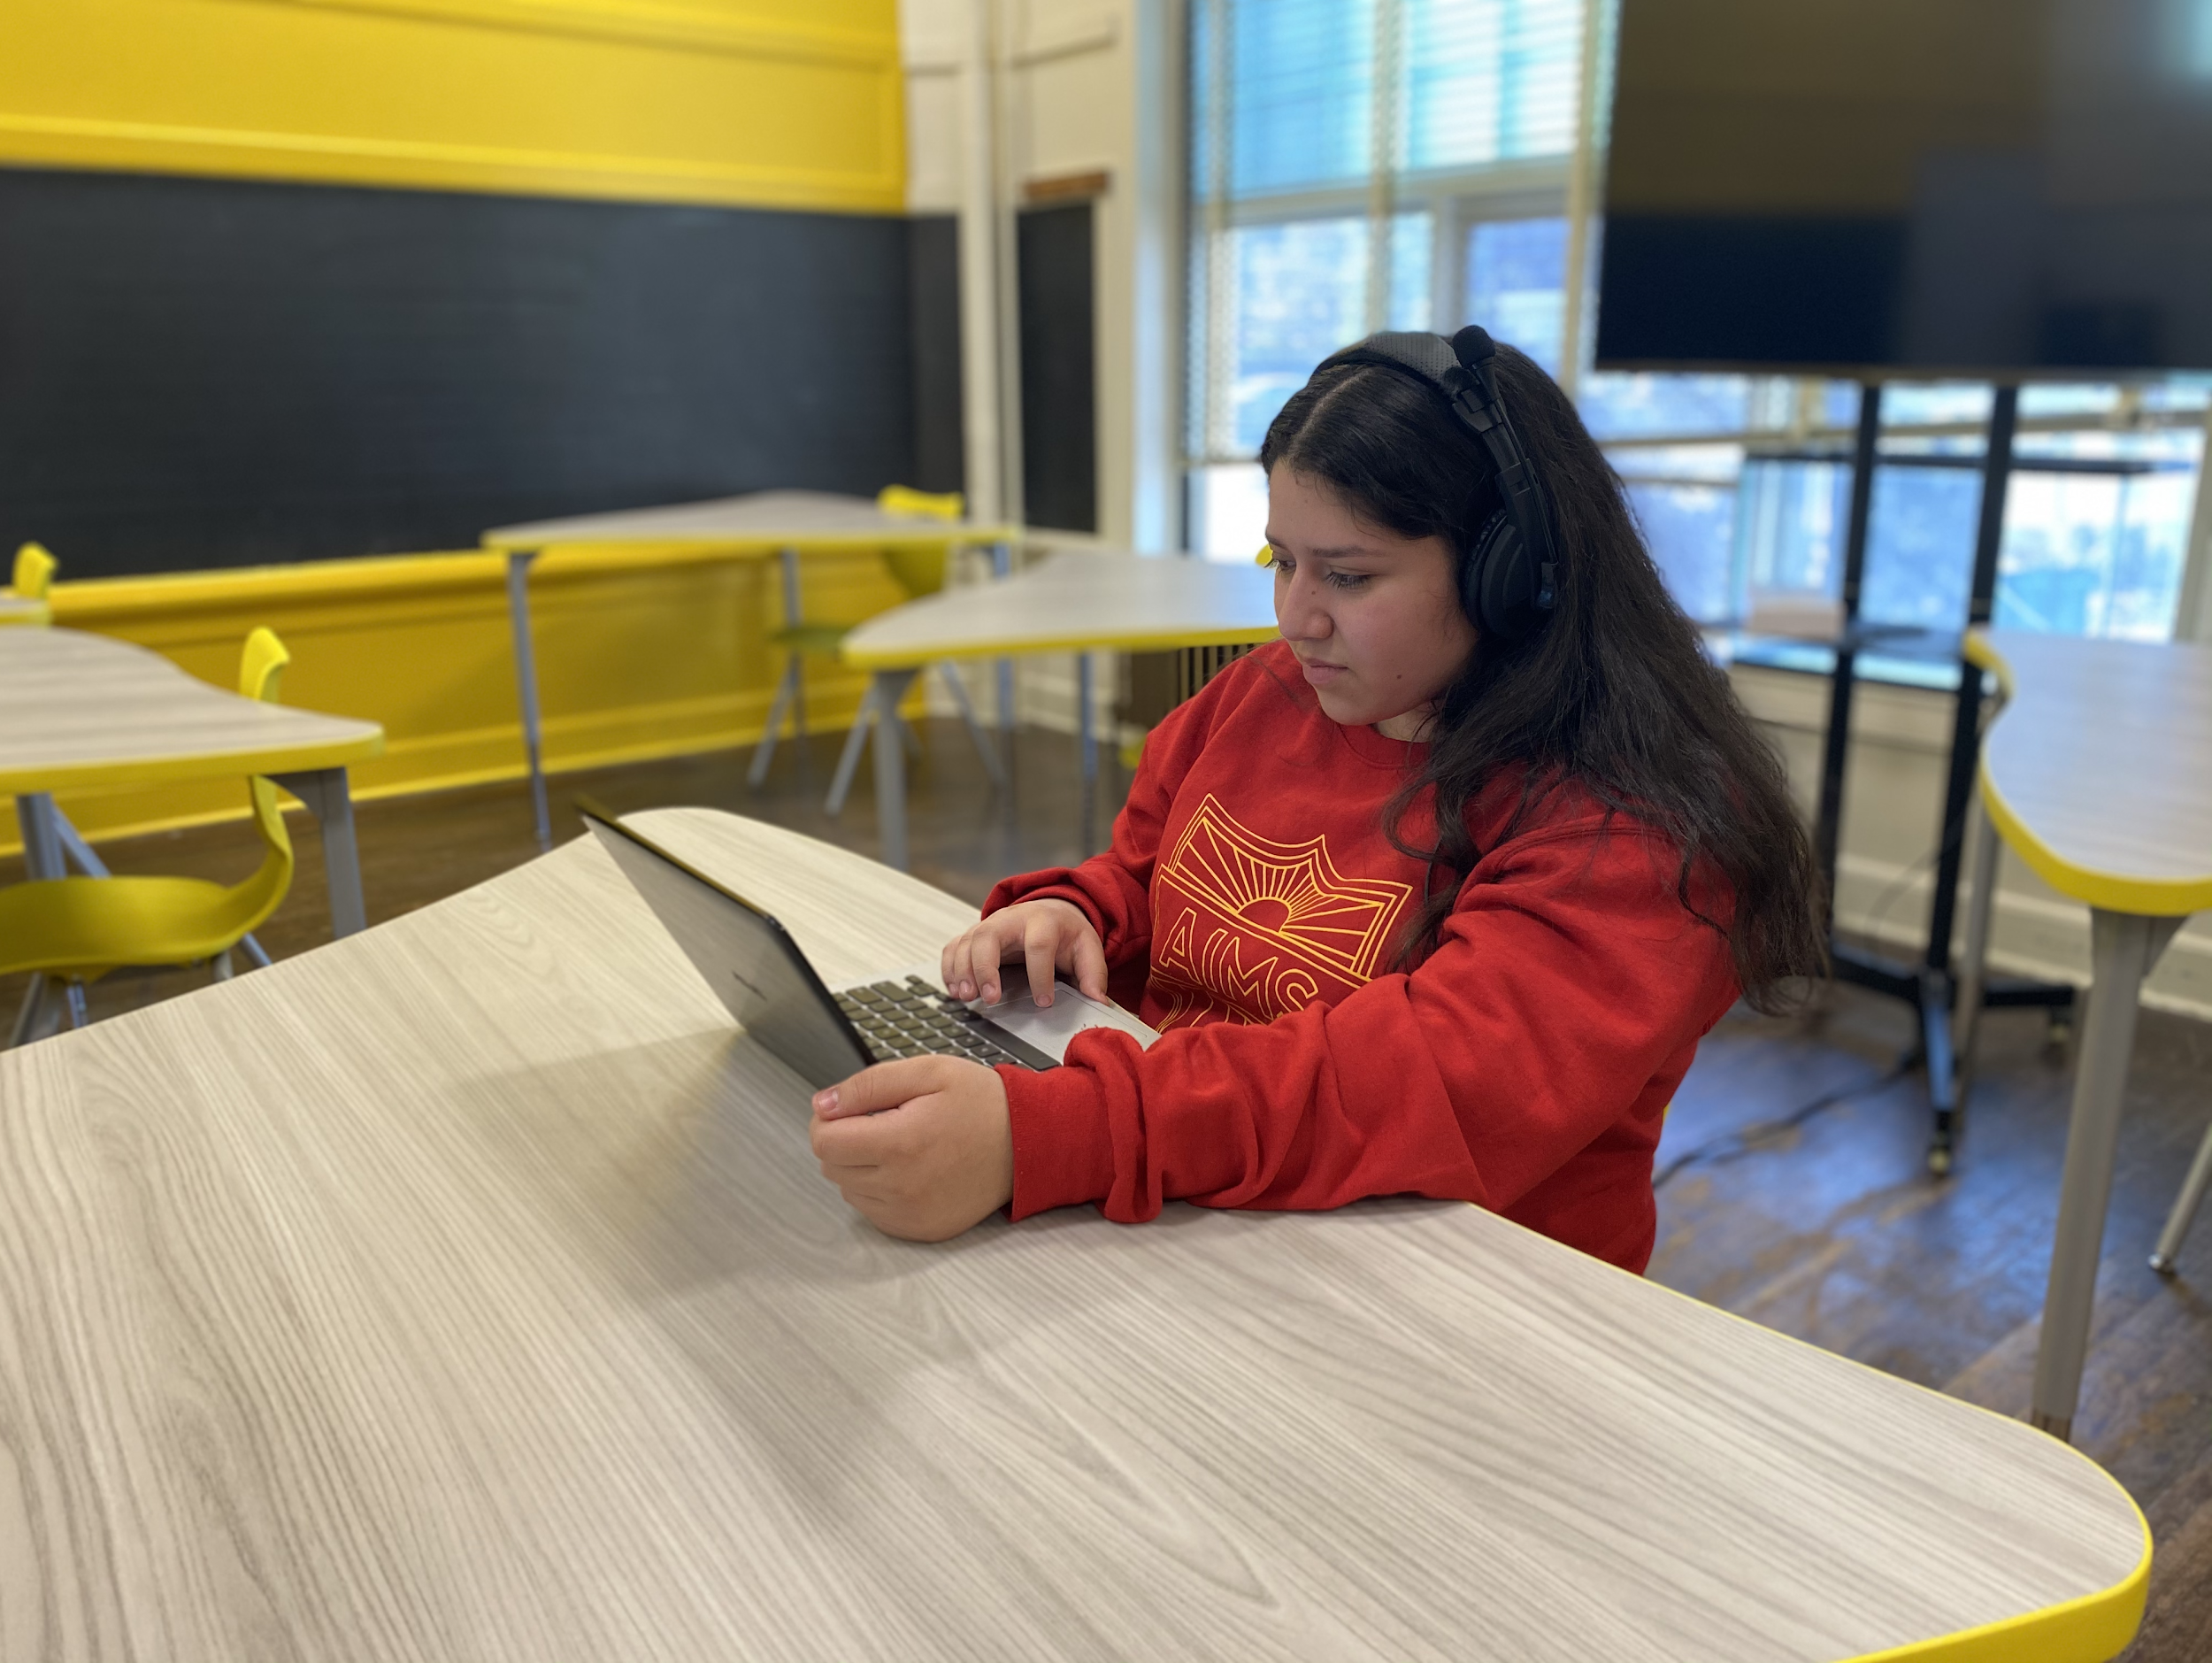
Small Group Learning At AIMS HS Begins In February
AIMS HS will restart its small group learning communities, beginning February 1. Student The learning groups are as follows:
(A) Freshmen / Sophomores: Mondays and Tuesdays
(B) Juniors and Seniors: Wednesdays and Thursdays
Fridays: No students
Based upon parent survey results, families will be notified on all AIMS Communication platforms of their child’s A / B track listing.

Slide 8
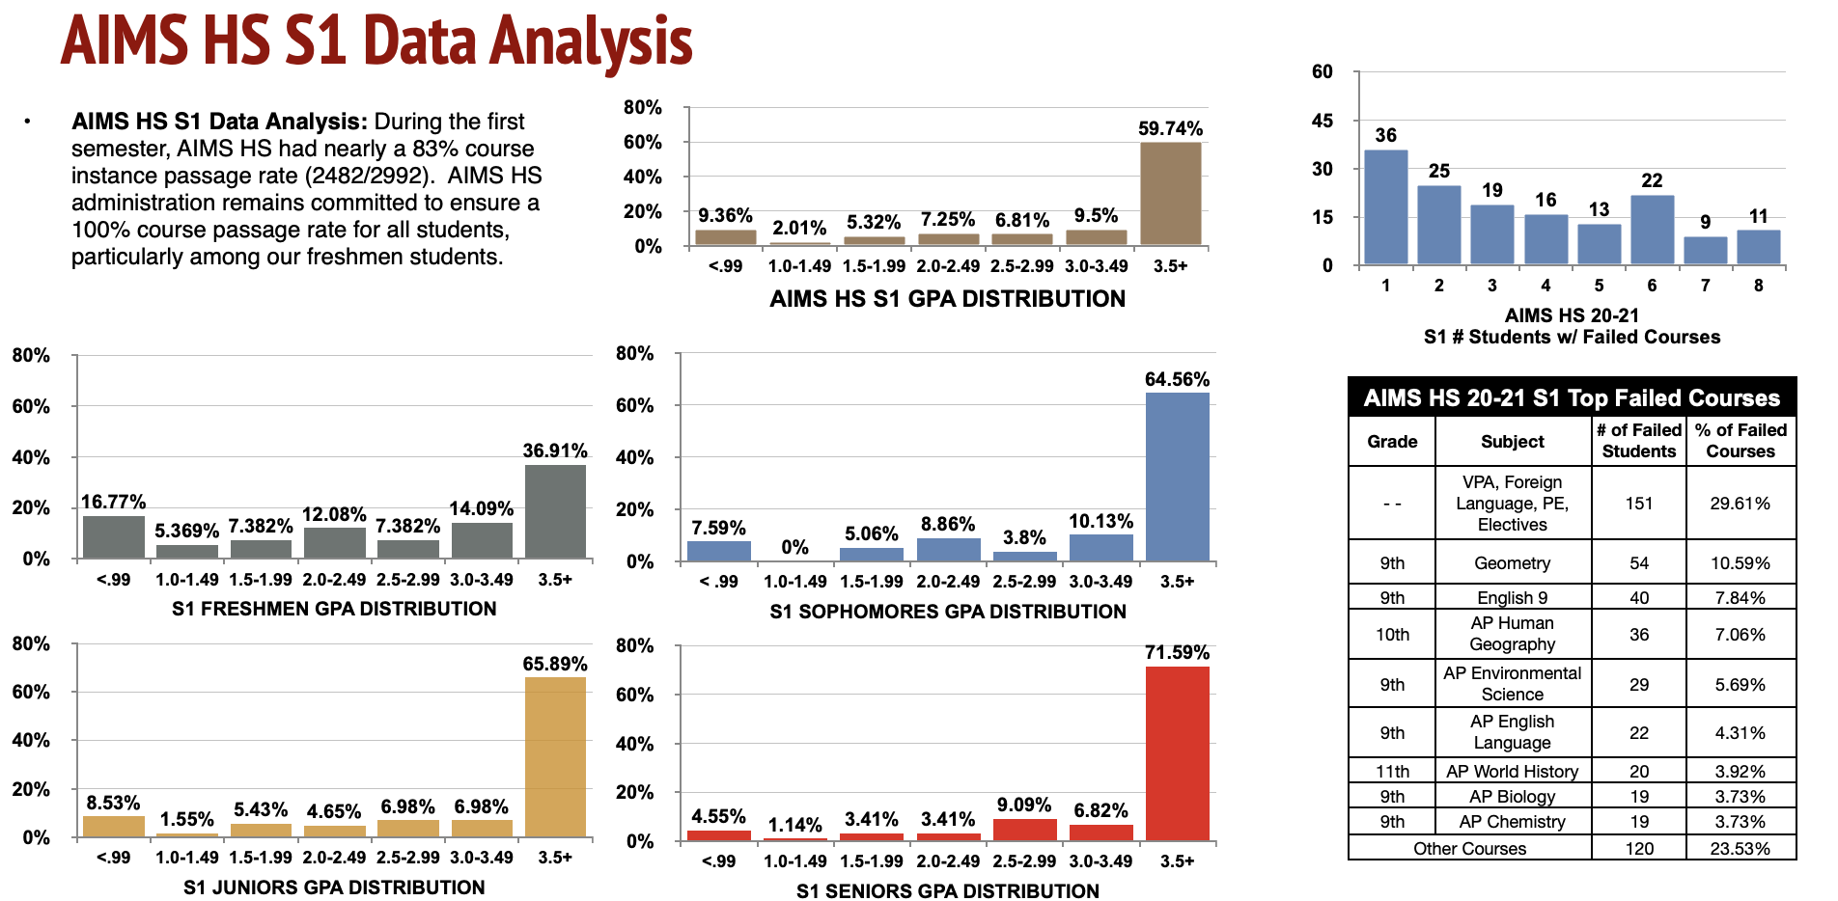

Slide 9
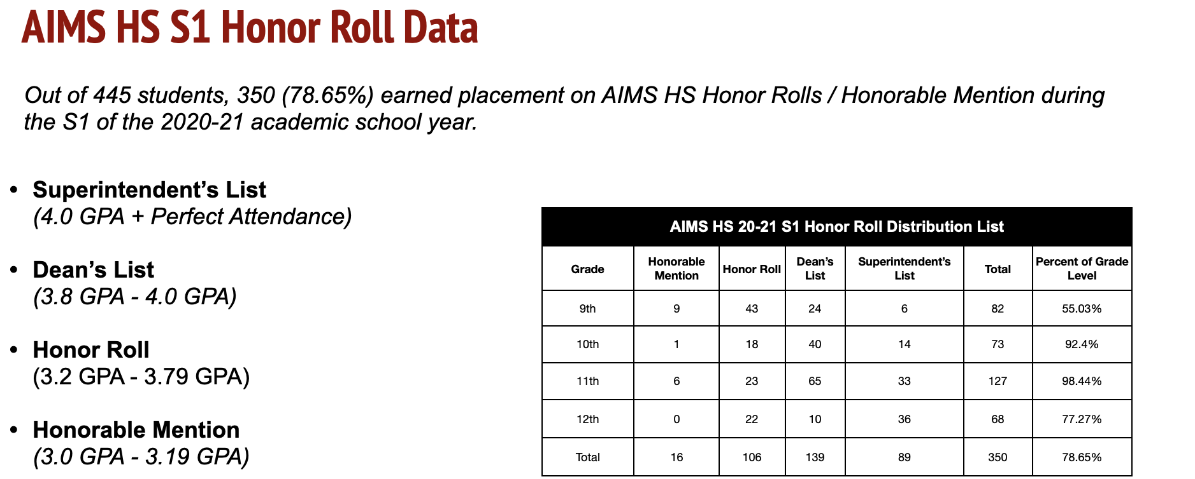

Slide 10
High School Challenges/Concerns and Method for Resolution
1. Failed Grades During AIMS S1 Grading Term
Concern: While the vast majority of AIMS students are passing their courses, many freshmen students are failing multiple classes. This is largely due to COVID-19 school related closures, and the fact that Freshmen were not properly oriented to the challenges and rigors of high school.
Resolution: Aside from Saturday School, SSTs, and increased tutoring, students will be able to begin credit recovery during the start of S2.
Survey teachers of most frequently failed classes to diagnose common problems with failed students.
Assess for potential learning disabilities, as needed.
Provide small group learning opportunities on campus for chronically failing students.

