Slide 1
Superintendent Board Report Reporting Period January 2021
Superintendent Maya Woods-Cadiz., AIMS K-12 College Prep Charter District

Slide 2
Highlights of The Month: Leadership
State of Black Education Oakland (SoBEO) recognized AIMS leaders for our success in education. These Leaders were nominated and chosen by SoBEO.
President Toni Cook was recognized for her decades of success in service to quality education for students.
Superintendent Woods-Cadiz was recognized for the overall success of AIMS Schools, and her work in Education in Oakland.
Head of Highschool Williams were recognized for the strong academic performance of AIMS High School and his work in Oakland for school choice.
A copy of the ceremony can be viewed on the SoBEO Facebook change.

Slide 3
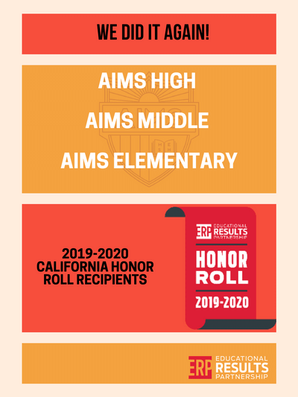
Highlight of The: Month Academic Performance
AIMS K-12 is proud to be named an ERP Honor Roll district ( all of our schools are Honor Roll schools). ERP which recognizes high-performing, achievement gap-closing schools across the nation. The Educational Results Partnership Honor Roll, sponsored by CBEE.The Honor Roll is a valuable resource for all schools to identify successful peers and learn about best practices that are improving student achievement. Congratulatoins to our wonderful teachers and leaders. whose work made this recognition possible.

Slide 4
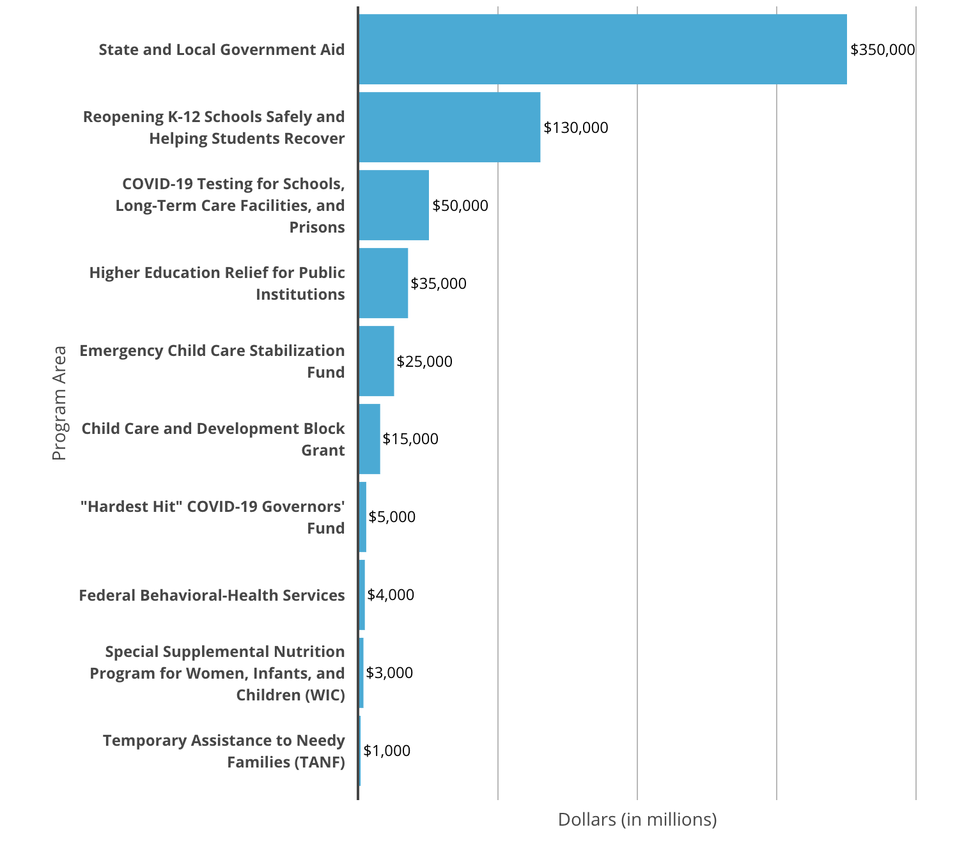
Highlight of The Month: Federal Funding
President Joe Biden unveiled his "American Rescue Plan" for the coronavirus pandemic in mid-January before he took office. The $1.9 trillion plan includes dedicated money for K-12 schools to help them reopen safely and address the various impacts of COVID-19, but there are other parts of the plan that would help schools, educators, and children.
1. "Reopening K-12 Schools Safely and Helping Students Recover." This funding could be put to use in a variety of ways, from boosting internet access for students and hiring more school nurses, to helping more students access summer school and improve ventilation in buildings. A portion of this funding would be reserved for "equity challenge grants" designed to "advance equity- and evidence-based policies to respond to COVID-related educational challenges and give all students the support they need to succeed."
2. "COVID-19 Testing for Schools, Long-Term Care Facilities, and Prisons." This would support the purchase of rapid tests and help schools and other institutions implement "regular testing protocols."
3. "'Hardest Hit' COVID-19 Governors' Fund." This money could be spent on K-12 education, higher education, and early-childhood services.
4. "Federal Behavioral-Health Services." This $4 billion would be earmarked for the Substance Abuse and Mental Health Services Administration and the Health Resources and Services Administration. Both agencies are at the Department of Health and Human Services and deal with child health.

Slide 5
Highlight of The Month: State Funding
Governor Newsoms Proposed K-14 Education Budget
The Budget reflects the state’s highest-ever funding level for K-14 schools – approximately $90 billion total, with $85.8 billion under Proposition 98.
Targeted investments in special education include $545 million in ongoing funds
The Budget also reflects key investments targeted to address the impacts of the pandemic on students, especially those inequitably impacted.
$2 billion is proposed for immediate action to support and accelerate safe returns to in-person instruction beginning in February, based on a phased-in approach that starts with our youngest students.
$400 million is proposed for school-based mental health. All of these funds will prioritize students and communities disproportionately impacted by the pandemic, with funds strongly weighted toward schools serving students from low-income families, foster youth, homeless students, English learners and others disproportionately impacted by the pandemic.
The Budget also directs a significant portion of additional funding to paying down nearly two-thirds of the deferrals implemented last year and provides a 3.84-percent cost-of-living adjustment to the Local Control Funding Formula.
The Governor’s Budget version will be available at: https://www.fcmat.org/lcff.

Slide 6
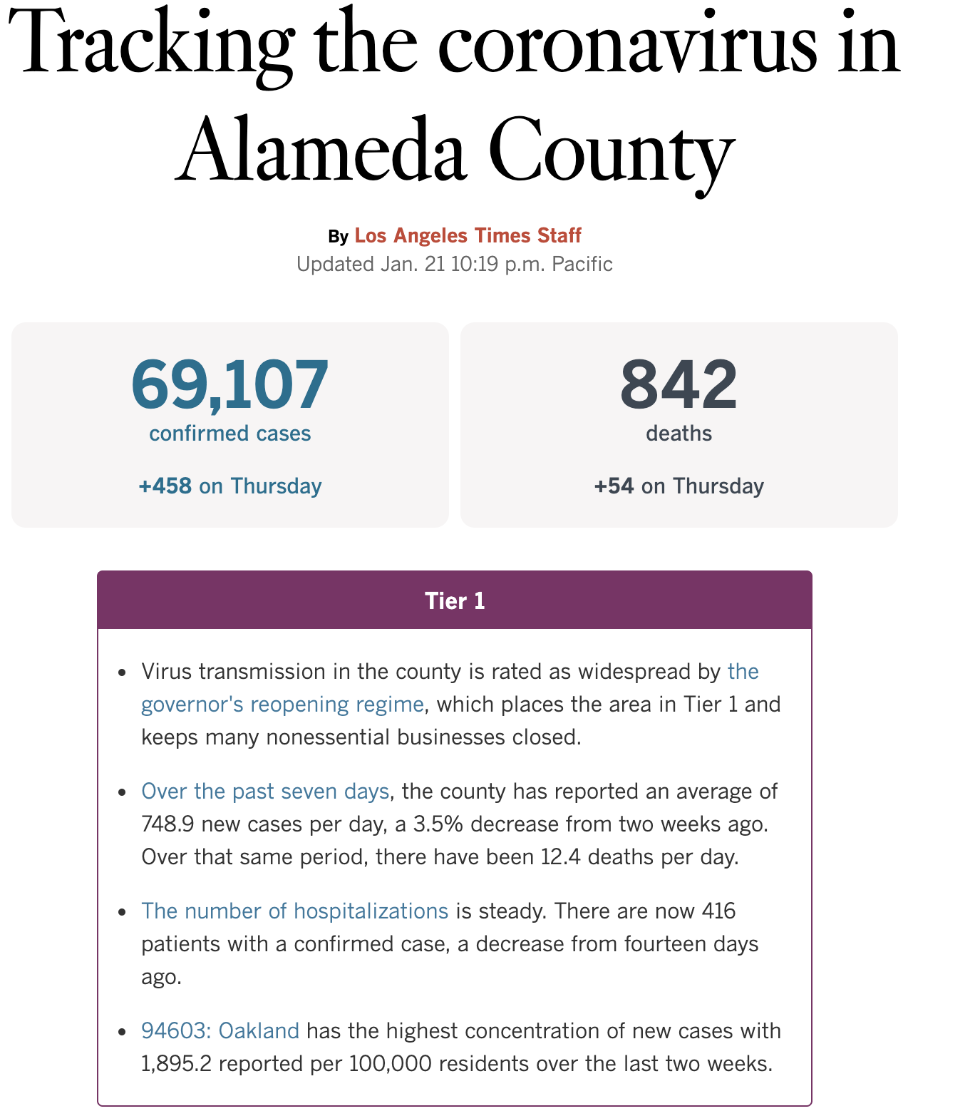
Highlight of The Month: Return to In Person Learning
K-6 schools in counties in Purple Tier with County Case Rate (CR) >25: Schools serving students in grades K-6 may not reopen for in-person instruction in counties with adjusted CR above 25 cases per 100,000 population per day. They may post and submit a Covid School Safety Plan (CSP), but they are not permitted to resume in-person instruction until the adjusted CR has been less than 25 per 100,000 population per day for at least 5 consecutive days. This case rate reflects recommendations from the Harvard Global Health Institute analysis of safe school reopening policy.
Schools may not reopen for grades 7-12 if the county is in Purple Tier
Alameda County is on Purple Tier
Oakland has one of the highest rates in Alameda County
Over the past three years Alameda County has on average 748.9 new cases
AIMS schools will not open for in person learning for the 2020-2021 school year, unless directed to do so by the State of California
AIMS opening plan is in alignment with parent and staff survey responses

Slide 7
HAPPY BIRTHDAY FROM AIMS!

