Slide 1
Superintendent’s Report
Superintendent Maya Woods-Cadiz
November, 2020

Slide 2
Table of Contents
AIMS High School and Middle School Charter Renewal
School Reopening (State Color Tiers)
School Reopening Plans-Timeline
School Reopening Plans-Logistics
Oakland WiFi Map
Oakland WiFi Logistics
2021 Projects

Slide 3
AIMS High School and Middle School Charter Renewal
AIMS College Prep High School
Successful Submission on October 1, 2020
Year Request
Over 1000 Pages
November 4, 2020- Successful Hearing
December 2, 2020 - OUSD Decision
OUSD Staff Recommendation
Renewal for 5 years
AIMS College Prep Middle School
Successful Submission on October 1, 2020
7 Year Request
Over 1000 Pages
November 4, 2020- Successful Hearing
December 2, 2020 - OUSD Decision
OUSD Staff Recommendation
Renewal for 5 years

Slide 4
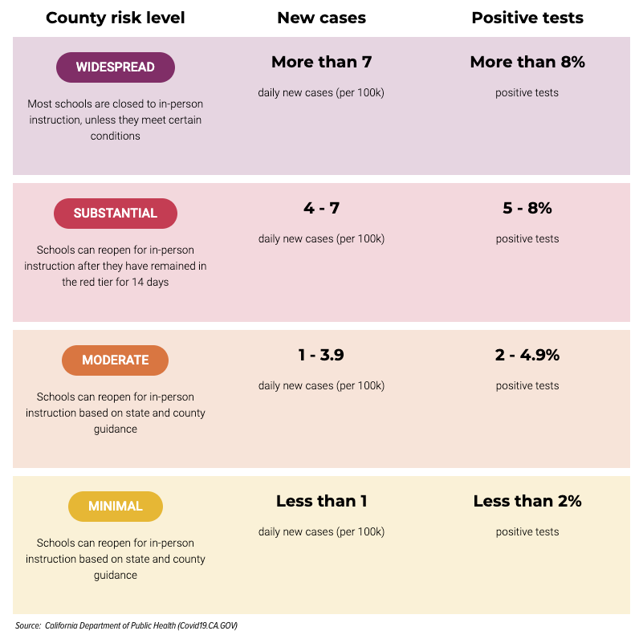
School Reopening (State Color Tiers)

Slide 5
School Reopening Plans-Timeline
Red Tier for > 14 days by December 18, 2020
If Alameda county is in the Red Tier for 14 days or more by December 18, 2020, AIMS Schools will open for Hybrid Learning on January 4, 2021.
Purple Tier On December 18, 2020
If Alameda county is not in the Red Tier for 14 days or more by December 18, 2020, AIMS Schools will open for Hybrid Learning on January 4, 2021. The Superintendent will reassess opening date and make a recommendation to the board regarding opening in person learning at all for the 20-21 school year at the February board meeting.

Slide 6
School Reopening Plans-Logistics
Facilities
Lakeview and 12th Street Campuses are equipped and ready in the event we open for hybrid learning
Staffing
Both campuses have staff present on a rotating schedule
Time accounting is being used to track the hours and work of at home staff
Curriculum
Students have materials and curriculum to complete their work, and surveys have gone out regarding the satisfaction with provision
Social Emotional Support
Students affinity counseling groups, PBIS, and student social activities are happening.
Technology
Students are being provided with technology
The city of Oakland has started city wide internet in November

Slide 7
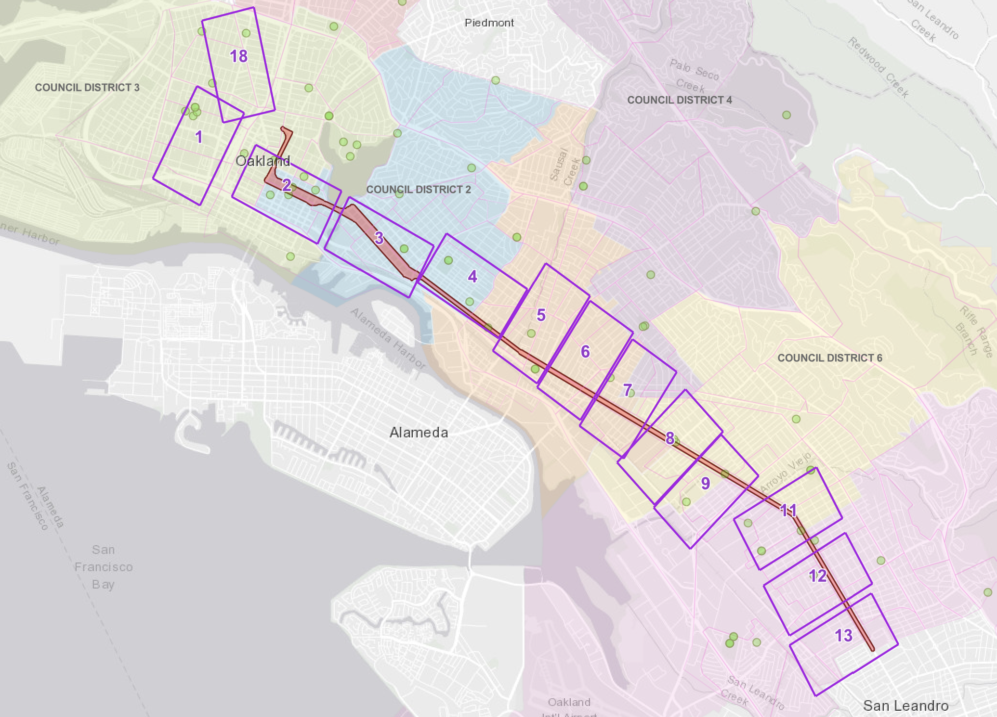
Oakland WiFi Map
OAK WiFi Coverage Area
OAK WiFi already has live hotspots throughout the City; this initiative will greatly expand the coverage to parts of West Oakland, Downtown Oakland, and East Oakland along the International Blvd corridor to the San Leandro border. The first zones (1, 2, & 18), located in West Oakland, Downtown, and Uptown, using existing fiber, will begin coming online starting in mid-November 2020. The remaining Zones (3, 4, 5, 6, 7, 8, 9, 11, 12, & 13) will come online as they are completed shortly thereafter.

Slide 8
Oakland WiFi Logistics
How to Connect
Easy, just go into the wifi settings on your mobile phone, laptop, or desktop computer, select OAK-WIFI and get connected!
Communication Plan
Parent square communication
FAC, LCAP Advisory and ELAC Meetings
Social Media Postings
Website Postings
School Notifications

Slide 9
2021 Projects
Onboarding New PR Firm
Finalizing Reopening Plans
5 year Strategic Plan Recommendations (Based on Charter)
AIMS Elementary Renewal
Facilities Plan
2021-2022 Budget
2021-2022 Staffing Plan
2021-2022 Contracts
Construction Completion

Slide 10
Thank you!

