Slide 1
AIMS HS Board Report Reporting Period November, 2020
Head of School Maurice Williams Jr., AIMS College Prep High School

Slide 2
Introduction
This slide deck contains information about AIMS College Prep High School. It will not be read to the board. In the interest of time, the board will receive this presentation in advance, and will have questions ready for the coordinator. The Head may take a short time ( 5 minutes Max) to highlight any Items that may be of specific interest to the board.

Slide 3
Highlights I Want The Board To Know
AIMS HS Held its WASC Mid-Cycle Visit on October 28-29. The visit and its report was overwhelmingly positive of the recent changes at AIMS HS. A full copy of the report can be found here: https://tinyurl.com/aims-hs-midcycle20
Key Strengths Cited In Mid-Cycle Summary
Robust instructional program, with high expectations and a focus on College Prep.
Dedicated teaching staff and strong administrative leadership with a vision of a program that challenges students to become self-directed learners and ensures that students function academically and emotionally at their highest capacity.
A strong sense of family, a positive school culture and support for students’ academic and social emotional learning.
2. Areas of Growth: The Action Plan cites 29 areas for growth, broken down by the five WASC categories. Many of these are cited to have been completed, others are in progress or ongoing. While most of these were at one time of high priority, the positive changes that were made since the new administration has been in place, many items have been adequately addressed and could now be retired to make room for newly emerging challenges:
Strengthen the system for continuous stakeholder engagement and involvement in decision making, including ongoing involvement in the WASC school improvement process, and ownership of the school’s Mission, Vision, Schoolwide Learner Outcomes, and Critical Learner Needs.
Expand the Leadership Team to include other stakeholders beside administrators.
Create a coherent system of support with culturally responsive pedagogy to help those students who are not successful, the majority of whom are Latino.
Provide staff training on how to use the findings from the analysis of student performance data to further strengthen instruction and to personalize and differentiate instruction in an effort to ensure that all students succeed at AIMS
Prioritize areas in need of improvement and refine the Action Plan by focusing on critical areas so that the plan has a chance to succeed, considering the school’s capacity for implementation--human, financial and time.

Slide 4
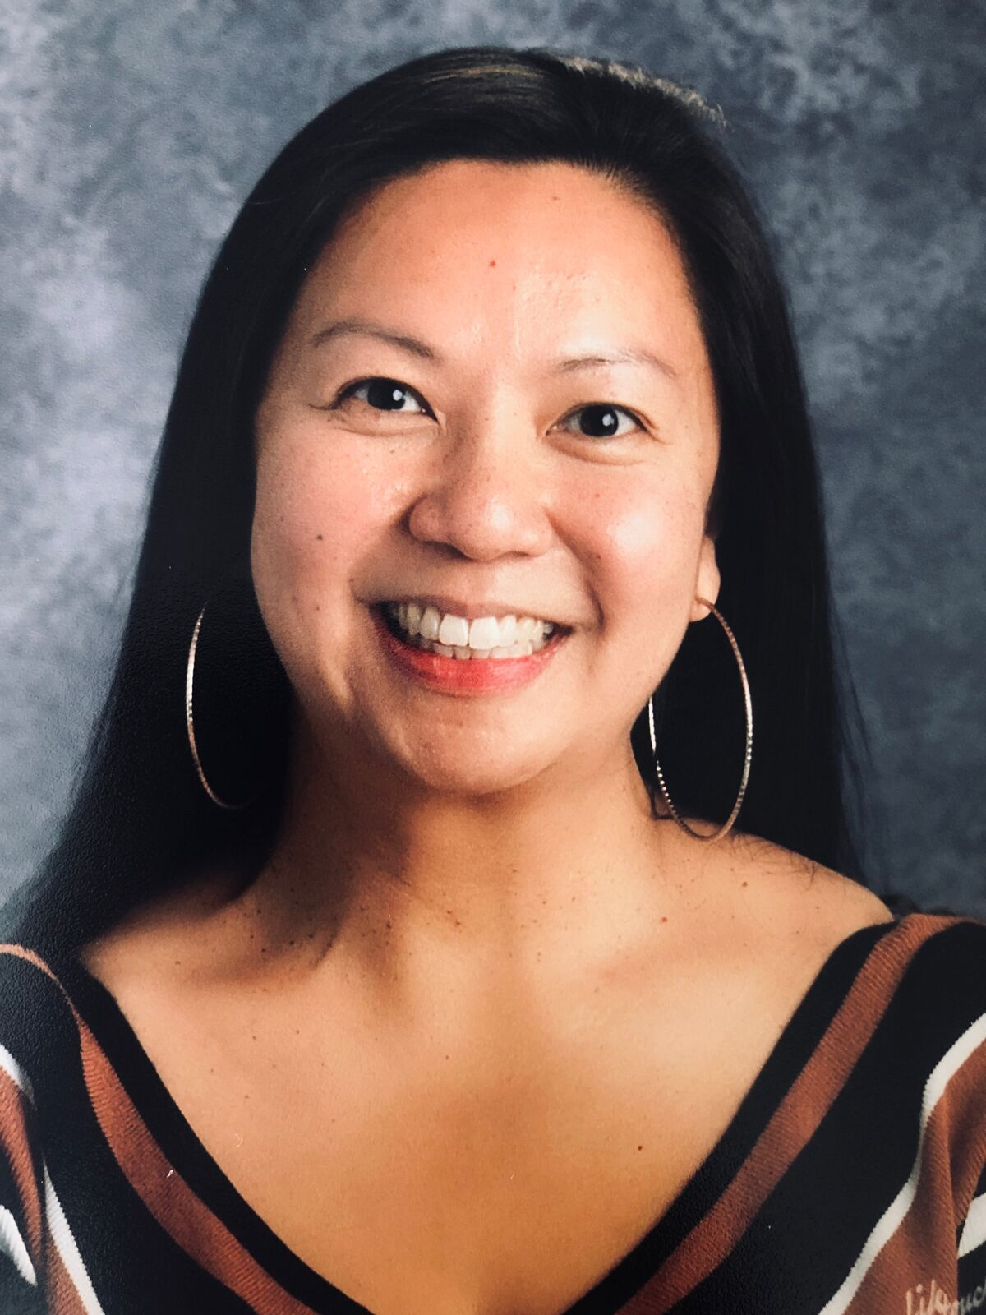
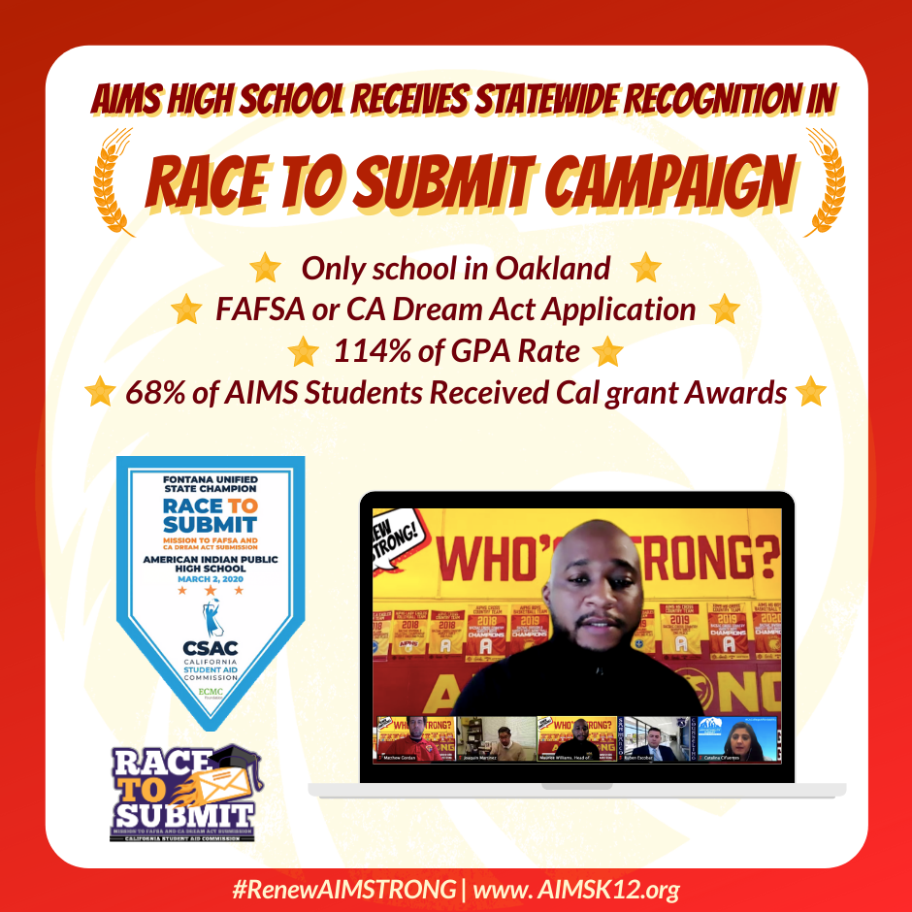
Highlights Of The Month
Ms. Julia Li was recently hired as the new High School Head of Division. With a background in Chemistry and SPED, Ms. Li has previously served as a Charter School instructor and administrator in Delaware.
AIMS HS Received Statewide Recognition for California Student Aid Commission Race To Submit Campaign: On Tuesday, November 17, AIMS HS was recognized as one of 24 high schools in the state for its FAFSA and Dream Act Rate Completion during a virtual awards ceremony.
The AIMSTRONG! Student of the month will recognize student of the month winners based on the letter that corresponds to the AIMSTRONG Acronym. For October’s theme, Integrity, 20 students were student of the Month, and freshman Arianna Khalaf was selected amongst the 20 students of the Month to win a free letterman jacket. November’s theme is MENTORSHIP.

Slide 5
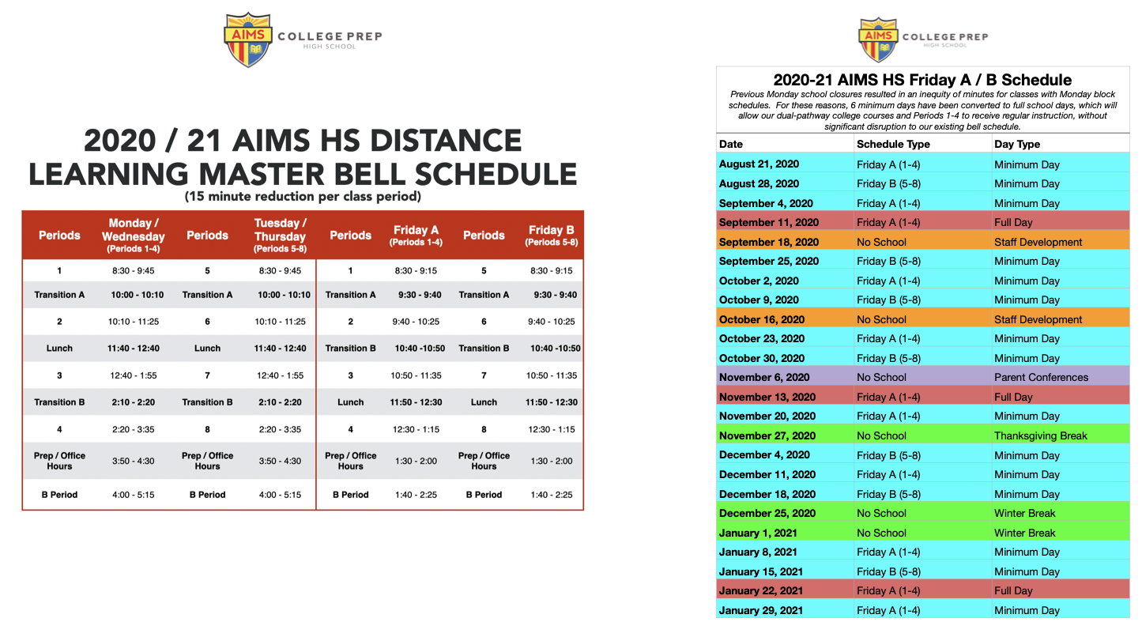
High School Instructional Schedule In January

Slide 6
Hybrid Learning Grouping In January
Families will be notified on all AIMS Communication platforms of their child’s A, B, or C track listing.

Slide 7
High School Strategy for Addressing Concerns From Parents and Students
Daily calls to all AIMS HS and incoming AIMS HS students to confirm Fall Enrollment
Multiple Summer Parentsquare and Email Communications from AIMS Staff Regarding Upcoming School Year / ‘19-’20 School Year Highlights
Required Summer Novel Readings for all AIMS HS students (students stopped by campus to pick up summer reading materials over the summer)
Required Math ALEKS for all incoming AIMS students
Held 8 parent engagement meetings and 4 student orientations (one per grade level) Parent meetings were held in Mandarin only and Spanish breakout rooms
Held Junior / Senior and Freshman / Sophomore drive-in pickups of school supplies, textbooks, and class shirts
Multiple student engagements to complete Dual-Enrollment forms for AIMS U College Pathways Program in the Fall
Make-Up pickup dates will be ongoing throughout the school week

Slide 8
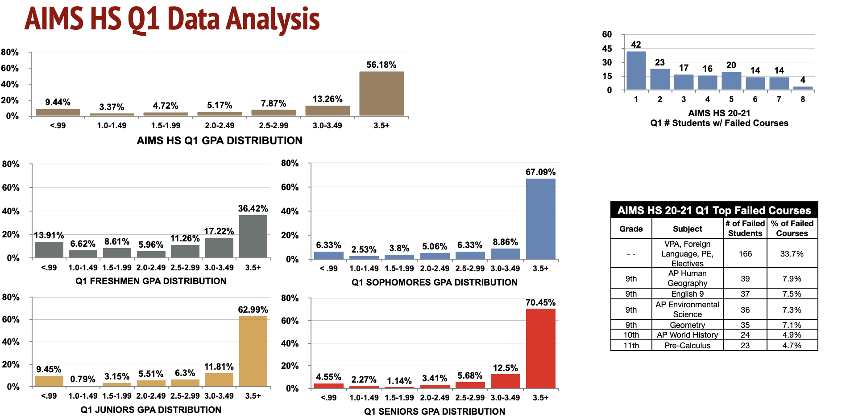

Slide 9
High School Challenges/Concerns and Method for Resolution
1. Failed Grades During AIMS Q1 Grading Term
Concern: While the vast majority of AIMS students are passing their courses, many freshmen students are failing multiple classes. This is largely due to COVID-19 school related closures, and the fact that Freshmen were not properly oriented to the challenges and rigors of high school.
Resolution: Aside from Saturday School, SSTs, and increased tutoring, students will be able to begin credit recovery during the start of S2.
Increased conversations / strategies with teachers with high rates of failed students.
There is a significant need for increased coordination across the AIMS district level to implement consistent practices and standards to ensure that students are prepared for the rigors of high school.
2. Academic Progress of AIMS Dual Enrollment Students

