Slide 1
AMERICAN INDIAN MODEL SCHOOLS
COVID FUNDING EXPENSE AND BUDGET PROPOSAL
Presented by: Katema Ballentine, Chief Business Officer
In partnership with school leaders
Finance Committee Meeting: Monday, November 23,2020
Board Meeting: Monday, November 30, 2020

Slide 2
CARES COVID FUNDING REVIEW
COVID FUNDING TYPES AND COMPLIANT EXPENSES
AIPCS EXPENSE SUMMARY
AIPCS BUDGET PROPOSAL
AIPCS BUDGET RATIONALE
AIPCS II EXPENSE SUMMARY
AIPCS II BUDGET PROPOSAL
AIPCS II BUDGET RATIONALE
AIPHS EXPENSE SUMMARY
AIPHS BUDGET PROPOSAL
AIPHS BUDGET RATIONALE
APPENDICES: PROPOSED QUOTES

Slide 3
CARES COVID PROPOSAL
American Indian Models Schools(AIMS) has been awarded $1.3M in Covid support funding for the 2020-21 fiscal year.
As of 1st Interim (October 31, 2020), AIMS has expensed $378,370.
American Indian Model Schools has prepared a proposed budget for the remaining $1,004,697.

Slide 5
RESTRICTOR 32
COMPLIANT EXPENSES

Slide 6
RESTRICTOR 71

Slide 7
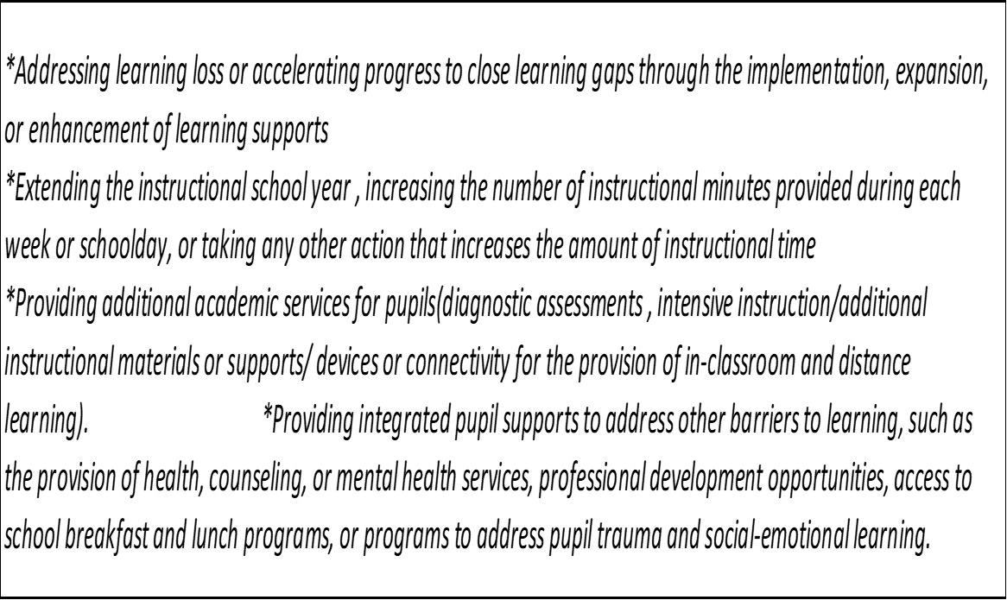
RESTRICTOR 72
COMPLIANT EXPENSES

Slide 8
RESTRICTOR 74
COMPLIANT EXPENSES

Slide 9
COVID FUNDING SUMMARY AND PROPOSAL AMERICAN INDIAN PUBLIC CHARTER AIPCS 6-8

Slide 10
COVID FUNDING SUMMARY AIPCS
For 2020-21 AIPCS has received $236,540 in Covid support funding. As of 1st Interim (October 31, 2020), AIPCS has expensed $50,802 leaving a balance of $185,738 to expense. As of November 19, 2020 AIPCS had encumbered an additional $1,382 in expenses in our Purchase Order system. After deducting those expenses. AIPCS has prepared a proposed budget for the remaining $165,455.
The two highlighted budgets require the expenses to incur on or before December 30,2020

Slide 11
COVID FUNDING SUMMARY AIPCS

Slide 12
COVID FUNDING BUDGET PROPOSAL AIPCS
For the 2020-2021 school year it is recommended to carryover the remaining funds to the 2021-2022 fiscal year

Slide 13
COVID FUNDING BUDGET PROPOSAL AIPCS
For the 2020-2021 school year it is recommended to carryover the remaining funds to the 2021-2022 fiscal year

Slide 14
COVID FUNDING BUDGET PROPOSAL AIPCS

Slide 15
COVID FUNDING BUDGET PROPOSAL AIPCS

Slide 16
COVID FUNDING BUDGET RATIONALE

Slide 17
COVID FUNDING SUMMARY AND PROPOSAL AMERICAN INDIAN PUBLIC CHARTER II AIPCS II K-8

Slide 18
COVID FUNDING SUMMARY AIPCS II
For 2020-21 AIPCS II has received $723,443 in Covid support funding. As of 1st Interim (October 31, 2020), AIPCS II has expensed $164,179 leaving a balance of $559,264 to expense. As of November 19, 2020 AIPCS II had encumbered an additional $20,283 in expenses in our Purchase Order system. After deducting those expenses. AIPCS II has prepared a proposed budget for the remaining $538,981.
The two highlighted budgets require the expenses to incur on or before December 30,2020

Slide 19
COVID FUNDING SUMMARY AIPCS II

Slide 20
COVID FUNDING BUDGET PROPOSAL AIPCS II

Slide 21
COVID FUNDING BUDGET PROPOSAL AIPCS II

Slide 22
COVID FUNDING BUDGET PROPOSAL AIPCS II

Slide 23
COVID FUNDING BUDGET PROPOSAL AIPCS II

Slide 24
COVID FUNDING AIPCS II BUDGET RATIONALE

Slide 25
COVID FUNDING AIPCS II BUDGET RATIONALE

Slide 26
COVID FUNDING SUMMARY AND PROPOSAL AMERICAN INDIAN PUBLIC HIGH SCHOOL AIPHS 9-12

Slide 27
COVID FUNDING SUMMARY AIPHS
For 2020-21 AIPHS has received $423,083 in Covid support funding. As of 1st Interim (October 31, 2020), AIPHS has expensed $100,520 leaving a balance of $322,564 to expense. As of November 19,2020 AIPHS had encumbered an additional $41,204 in expenses in our Purchase Order system. After deducting those expense. AIPHS has prepared a proposed budget for the remaining $281,360.
The two highlighted budgets require the expenses to incur on or before December 30,2020

Slide 28
COVID FUNDING SUMMARY AIPHS

Slide 29
COVID FUNDING: BUDGET PROPOSAL AIPHS
For the 2020-2021 school year it is recommended to carryover the remaining funds to the 2021-2022 fiscal year

Slide 30
COVID FUNDING: BUDGET PROPOSAL AIPHS
For the 2020-2021 it is recommended to carryover the funds into the 2021-2022 fiscal year

Slide 31
COVID FUNDING: BUDGET PROPOSAL AIPHS

Slide 32
COVID FUNDING: BUDGET PROPOSAL AIPHS

Slide 33
AIPHS COVID FUNDING RATIONALE

Slide 34
Associated Quotes for Items over $8,000 are attached to the addendum

