Slide 1
A New Year & An Established Mission and Purpose
Superintendent Woods-Cadiz
Board Report
September 2020

Slide 2
Objective:
The purpose of this month’s report is to remind ourselves of our mission and the impact of our work.
AIMS school have been back at full instruction one full month.Although learning is virtual. 2020-2021 has been unlike any year we have experienced, yet we have been able to maintain the AIMS Standard of Education. We have had to innovate in order to maintain our quality, and we have developed new skills in the process.
Things are slowly moving back to the familiar. Next week we will begin small learning clusters ( county guideline) for our most vulnerable students, and if Alameda county stays in the red tier through Winter Break, we will be opening for hybrid learning in January.
We have truly stronger together, and together we are AIMStrong!

Slide 3
AGENDA
Our Story
AIMS Tenets
AIMS Framework
AIMS Slogan
AIMS Framework
AIMS Mission Statement
AIMS Credo
AIMS Values
AIMStrong
The AIMS Difference

Slide 4
Our Story
Founded in 1996
Originally One Middle School
Expended to HIgh School and Elementary
First Blue Ribbon Public School In Oakland
2014 Hired First Superintendent.
Renewal of all Characters 2016
Reorganization 2016
New Logo and Branding Guide 2016
Sports at AIMS 2016
Musical Theater 2017
Band 2018
Name Change 2019
Shift to Virtual 2020

Slide 5
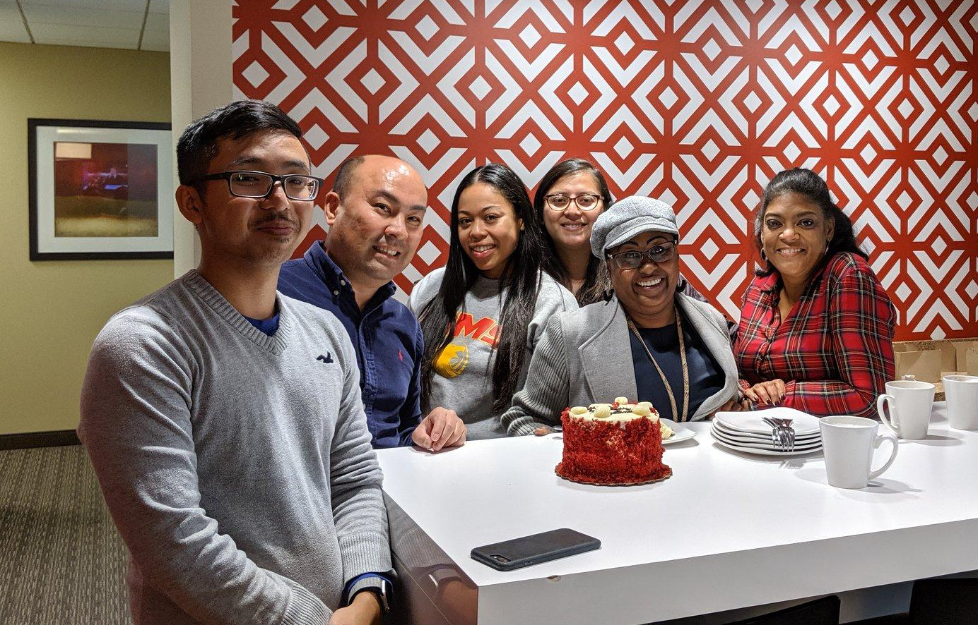
AIMS Tenets
Family
Accountability
HIgh Expectations
Free Market Capitalism

Slide 6

AIMS Framework
High Expectations + High Support
=Success

Slide 7

AIMS Slogan
Whose Strong?! AIMStrong!

Slide 8

AIMS Mission Statement
AIMS K12 College Prep Charter District offers a rigorous program designed for academic excellence with the goal of closing the achievement gap while raising the bar. Our ultimate mission is to have all of our students be accepted to a four-year college or university

Slide 9
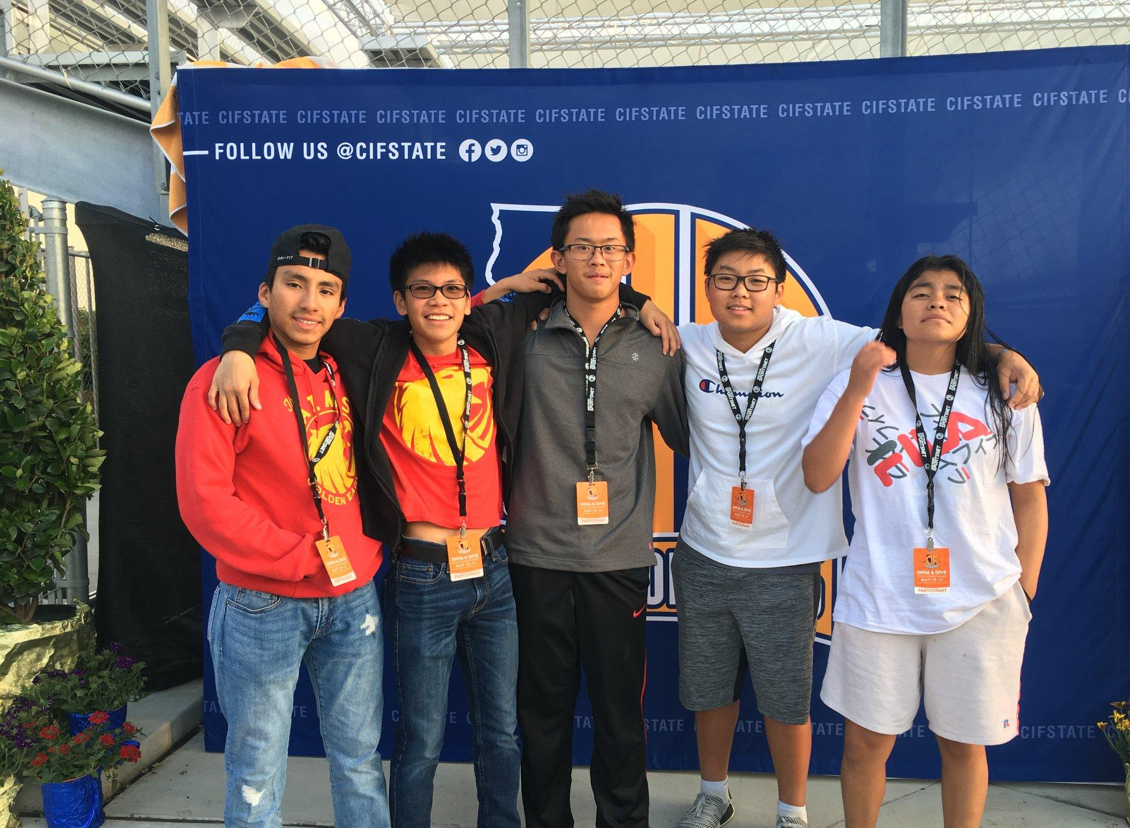
AIMS Credo
The Family: We are a family at AIM Schools.
The Goal: We are always working for academic and social excellence.
The Faith: We will prosper by focusing and working toward our goals.
The Journey: We will go forward, continue working, and remember we will always be a part of the AIM Schools family

Slide 10
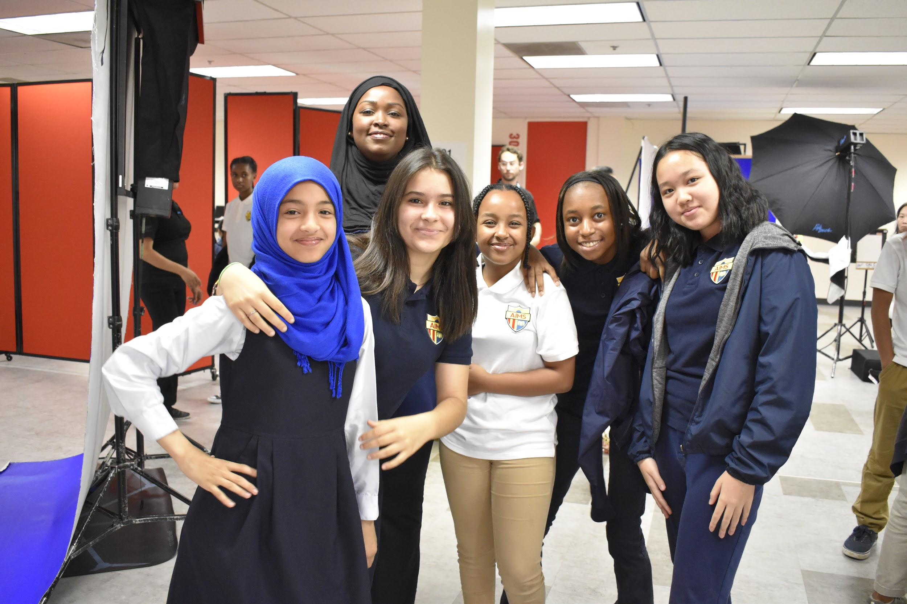
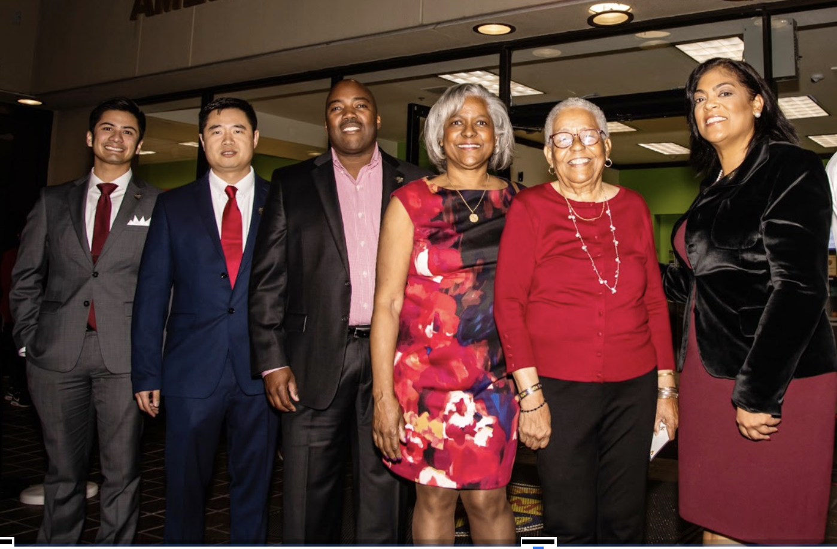

AIMS Values
At AIMS we value:
Excellence - Commitment to excellence in all that we do
Wisdom and Knowledge - Pursuit of wisdom and knowledge as intrinsically valuable
Empathy - Recognition of dignity and worth of every human being
Family and Community - Building of family and community
Equity - Social awareness and justice that leads to action
Legacy - The continued preservation and development of AIMS methodologies for 21st century learners and educators

Slide 11

AIMSTRONG!
Academics: Academics is the first word in AIMSTRONG and is the cornerstone to future success. Academics means developing and growing our scholarship, our grades, our inquiry, our brains.
Integrity: Being honest and possessing strong moral principles. Integrity means being true to our best selves consistently.
Mentorship: Providing guidance, influence, and direction to your AIMS community. Mentorship is serving our neighbors, community and families, especially with our strengths.
Strength: The influence or power possessed by you to combat the rigors of academic and real-life while resisting being moved or broken. Strength is both physical growth and the will power to complete the work we begin.

Slide 12
AIMSTRONG!
Teamwork: The combined action of each group member doing their part selflessly to benefit the whole. Teamwork is being part of a group which has an agreed goal.
Responsibility: Moral, legal, or mental accountability and taking ownership for one's actions. Responsibility is when we own our real part of getting teamwork, family, and planning done.
Organization: Preparation and efficiency when coordinating and carrying out activities. Organization is both how we plan and what we do to get things done systematically.
Nerve: Displaying courage, power, control and steadiness under pressure. Nerve knows when to step out to make a change in a situation or plan.
Grit: Unyielding courage in the face of hardship or danger that exemplifies your strength and courage. Grit is the way we set our plans and keep going to accomplish them, even when there are strong obstacles.

Slide 13

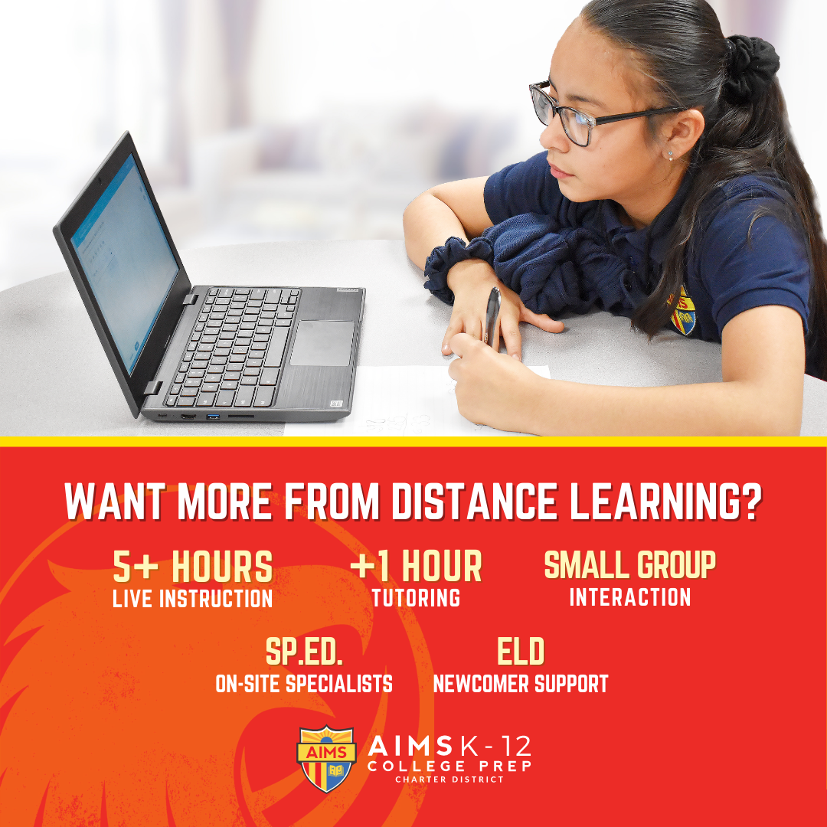
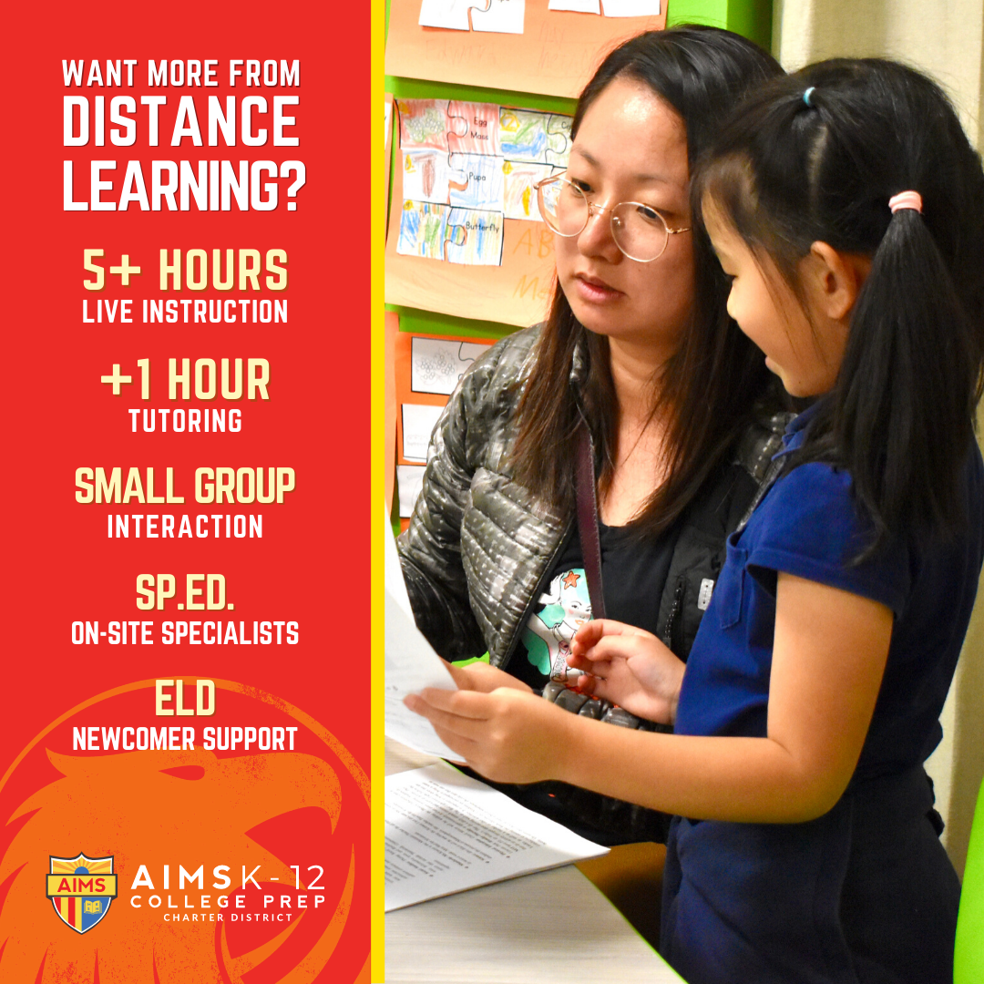
The AIMS Difference

