Slide 1
AIMS K-12 Board Report Reporting Period September 2020
Head of School Maurice Williams Jr., AIMS College Prep High School
l

Slide 2
Introduction
This slide deck contains information about AIMS College Prep HIgh School. It will not be read to the board. In the interest of time,the board will receive this presentation in advance, and will have questions ready for the coordinator. The Head may take a short time ( 5 minutes Max) to highlight any Items that may be of specific interest to the board.

Slide 3
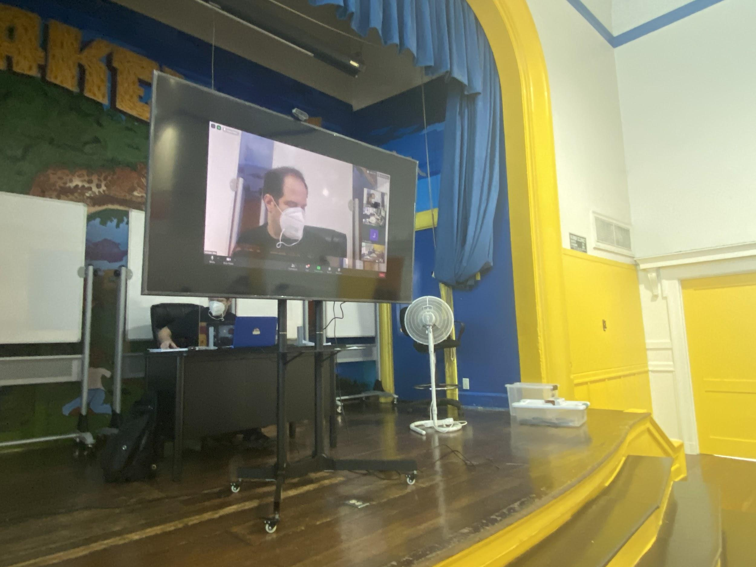
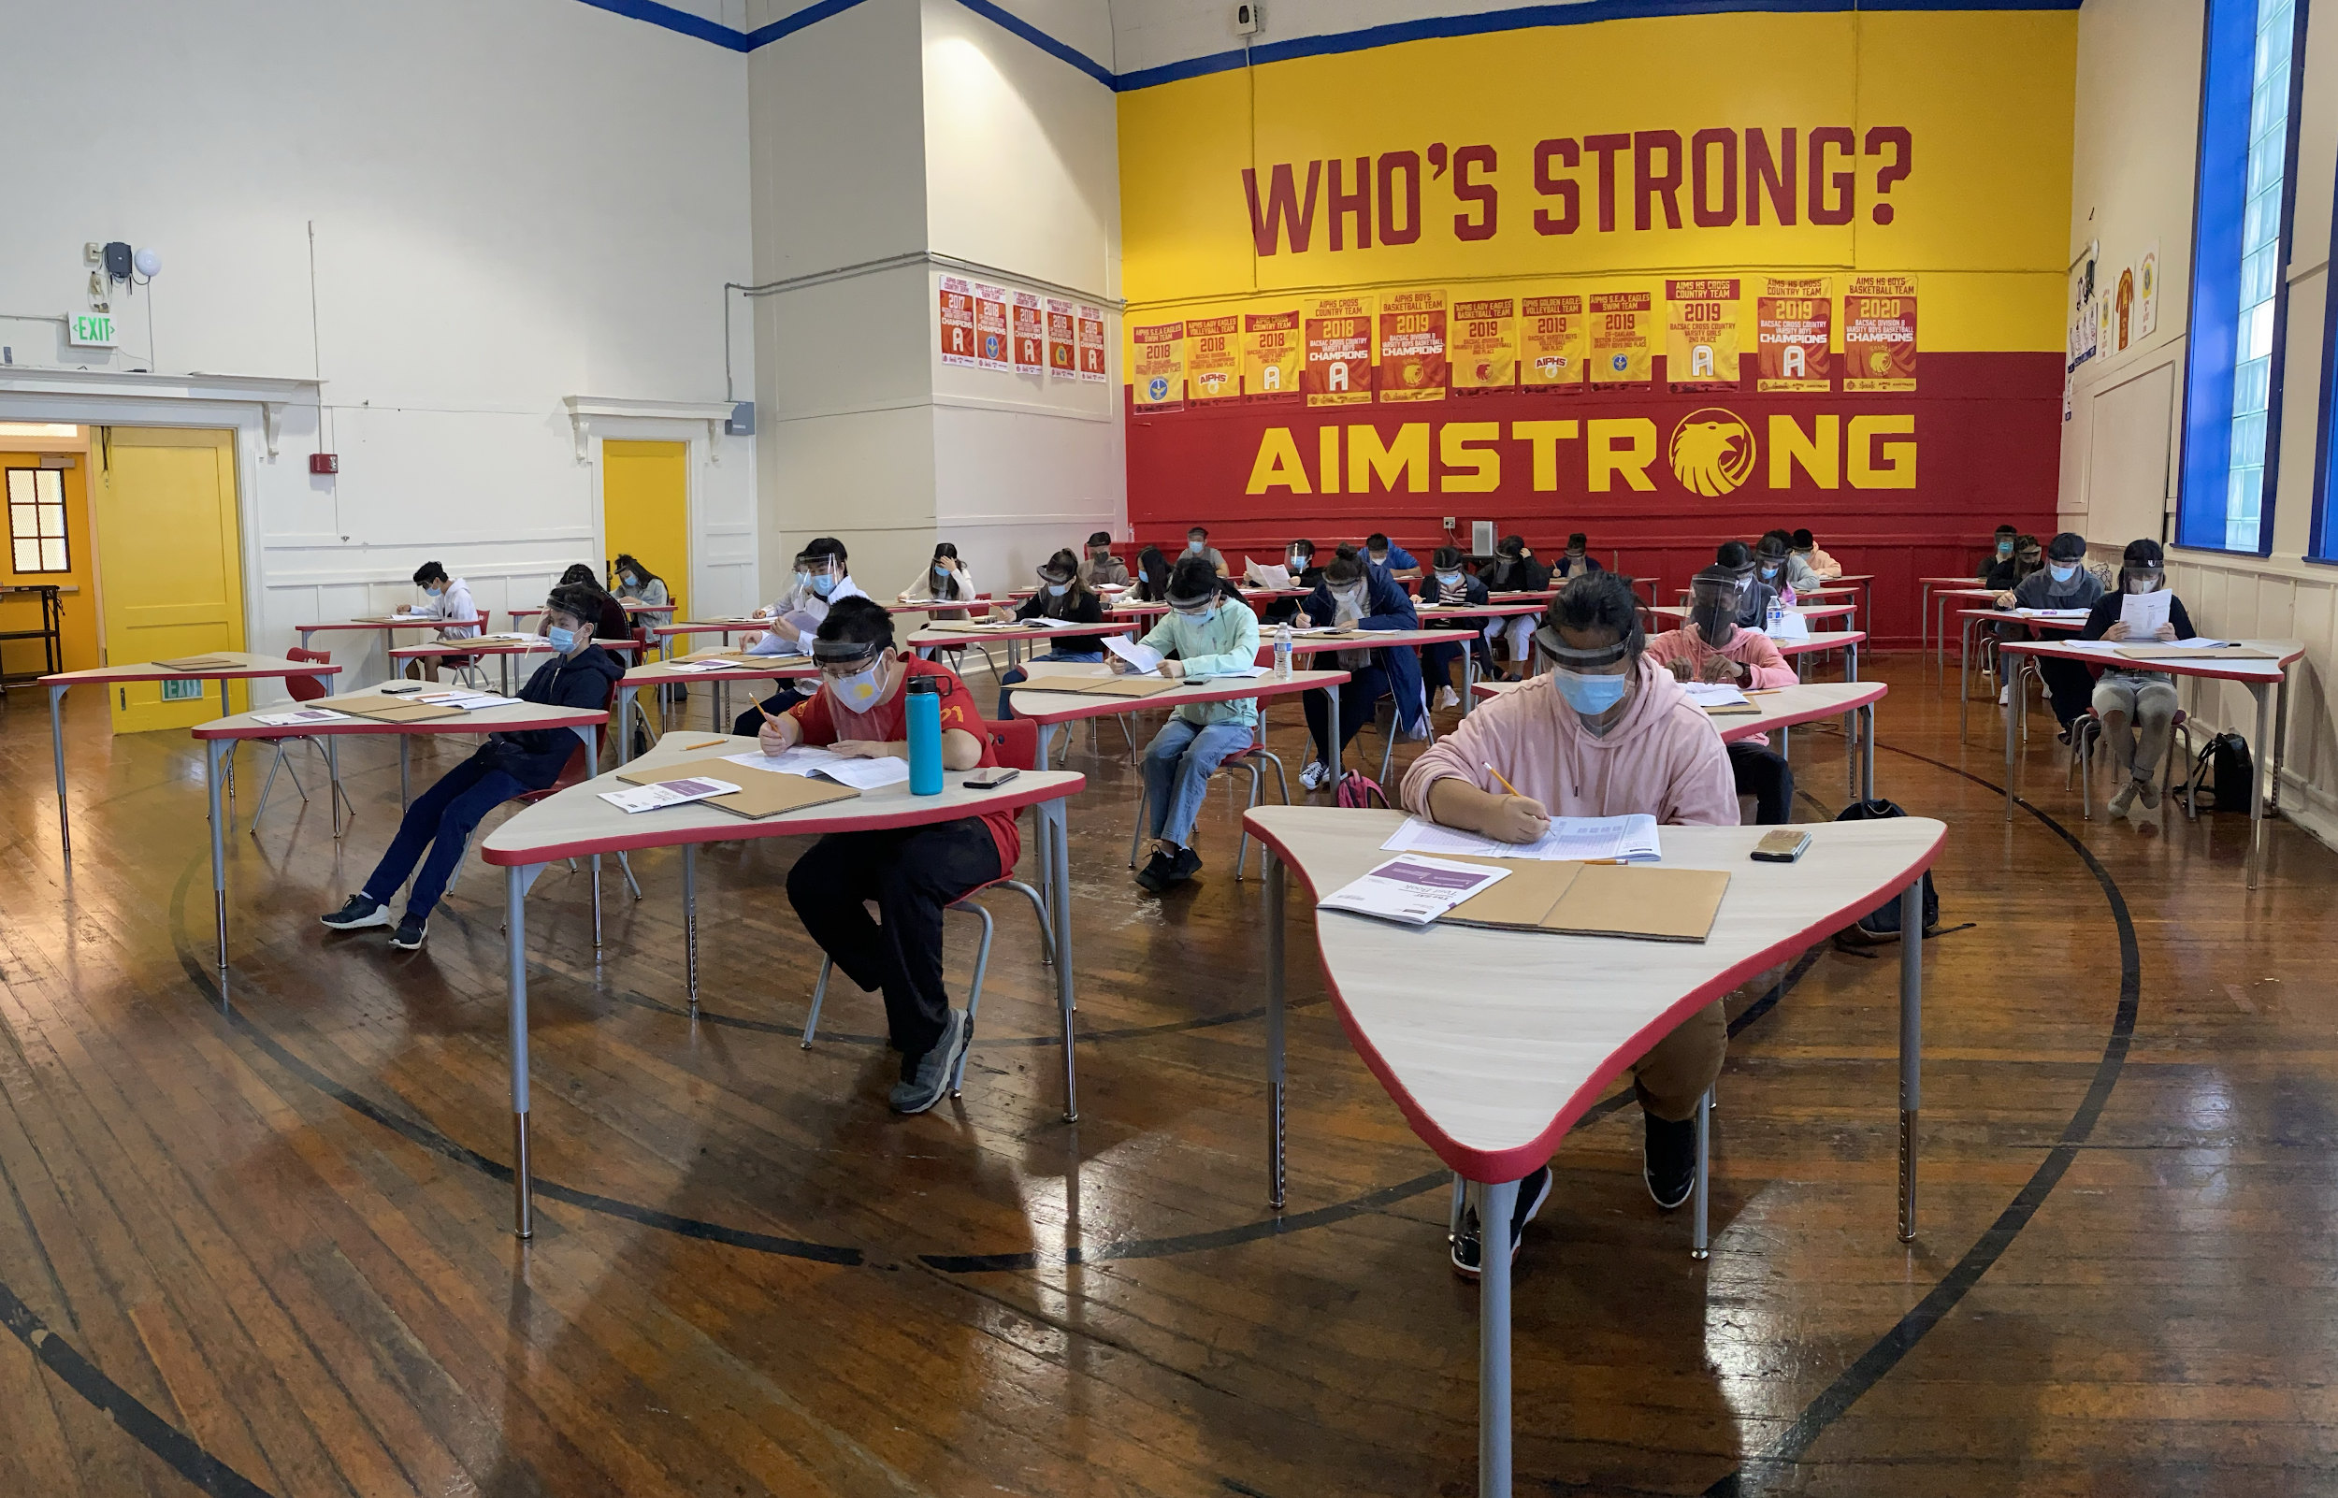
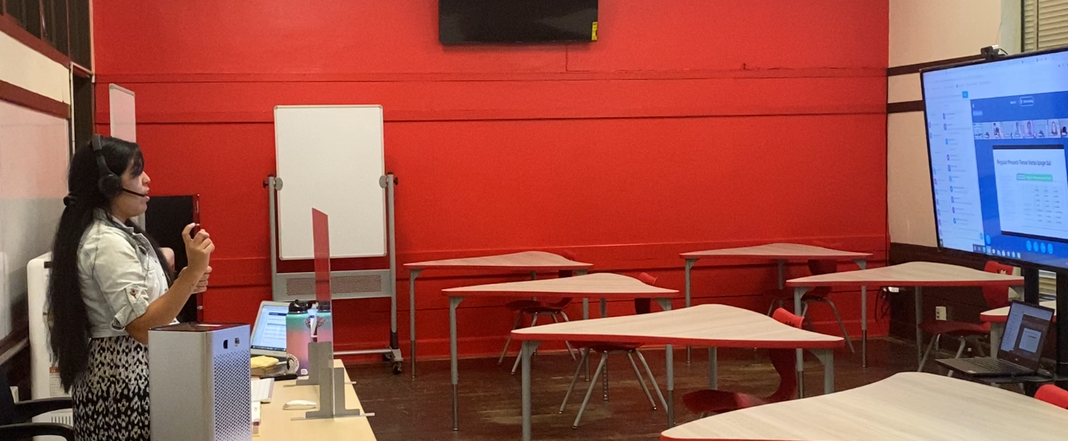
Highlights I Want the Board To Know
AIMS U College Pathways Program: The first college pathways program in AIMS HS’s 14 year history, began in late August. Featured pathways are Pre-Law, Pre-Med, Pre-Design / Engineering, and Pre-Business. Over 260 AIMS students are enrolled in 9 College Pathways courses from Berkeley City College and Laney Community College.
National Honor Society: AIMS HS is an official member of the National Honor Society, the first chapter in its 14 year history. The installation of its inaugural members is slated to occur by November / December.
42 AIMS HS students successfully participated in on-campus SAT’s on Wednesday, September 24.
Two AIMS HS teachers are teaching from their classrooms, with more slated to teach on campus in the coming weeks

Slide 4
Highlights Of The Month
SGA Elections: Executive Council and Senate Elections. Virtual campaigns and voting was held online. Senior Annie Chiu Elected SGA President
Start of AIMS U College Pathways Program
National Honor Society Charter
SAT’s Held on Campus
2 AIMS HS Teachers Are Teaching on Campus
2 AIMS HS Students are Receiving Instruction on Campus: HS Staff worker’s students are attending classes virtually from an empty AIMS HS classroom, in AIMS Uniform.
AIMS HS students receive Chromebooks / Internet Hotspots from Oakland Undivided Campaign
Charter, WASC, and Related Document Submissions

Slide 5
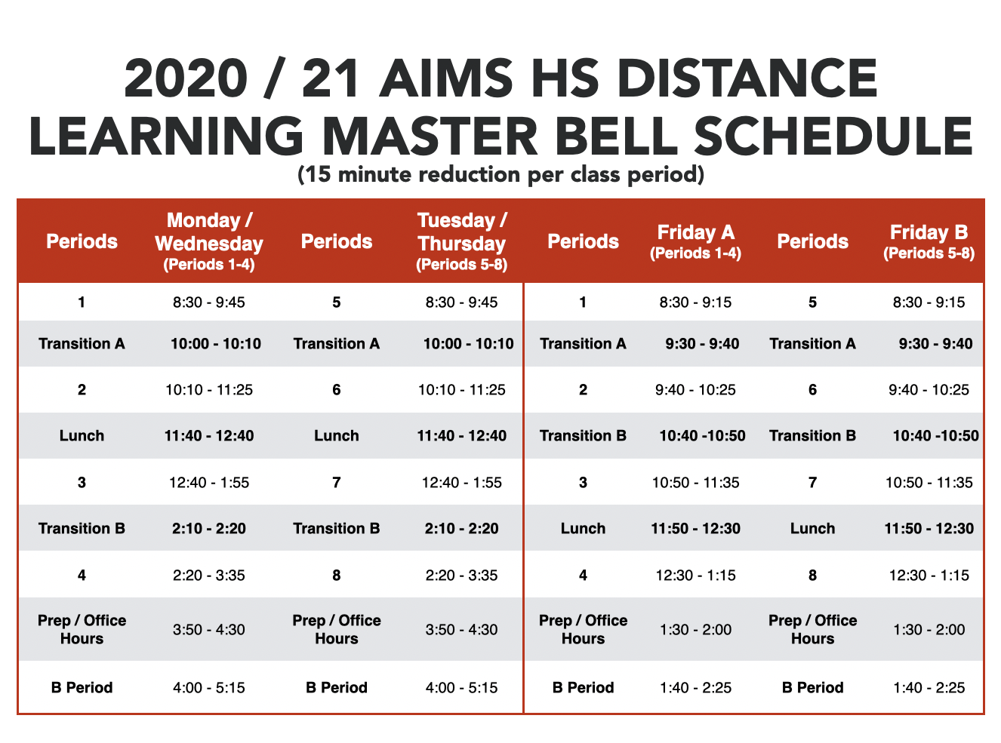
High School Instructional Schedule
2020-21 AIMS HS Friday A / B Schedule Previous Monday school closures resulted in an inequity of minutes for classes with Monday block schedules. For these reasons, 6 minimum days have been converted to full school days, which will allow our dual-pathway college courses and Periods 1-4 to receive regular instruction, without significant disruption to our existing bell schedule.
Date | Schedule Type | Day Type
August 21, 2020 | Friday A (1-4) | Minimum Day
August 28, 2020 | Friday B (5-8) | Minimum Day
September 4, 2020 | Friday A (1-4) | Minimum Day
September 11, 2020 | Friday A (1-4) | Full Day
September 18, 2020 | No School | Staff Development
September 25, 2020 | Friday B (5-8) | Minimum Day
October 2, 2020 | Friday A (1-4) | Minimum Day
October 9, 2020 | Friday B (5-8) | Minimum Day
October 16, 2020 | No School | Staff Development
October 23, 2020 | Friday A (1-4) | Minimum Day
October 30, 2020 | Friday B (5-8) | Minimum Day
November 6, 2020 | No School | Parent Conferences
November 13, 2020 | Friday A (1-4) | Full Day
November 20, 2020 | Friday A (1-4) | Minimum Day
November 27, 2020 | No School | Thanksgiving Break
December 4, 2020 | Friday B (5-8) | Minimum Day
December 11, 2020 | Friday A (1-4) | Minimum Day
December 18, 2020 | Friday B (5-8) | Minimum Day

Slide 6
High School Strategy for Staff Communication
Staff Meetings (Twice a Month)
Weekly Email Announcements
Weekly / Daily Slack Communications
Parentsquare / Schoology

Slide 7
High School Online Tools and Portals
Schoology
Zoom (As Backup Option)
ALEKS (Math, AP Chemistry)
Scholastic Reading Inventory (SRI)
Quill Writing
AP Classroom
Study.com
Edhesive
Rosetta Stone

Slide 8
High School Method for Monitoring Instruction
Department Chairs: To facilitate communication within each department, and to establish the collaboration needed to provide for consistency for students, this year at AIMS High School, Department Chairs were named. These Department Chairs are responsible for conducting monthly meetings with their department members and providing feedback to the Head of School and Academic Deans regarding decisions made and/or questions or concerns to be addressed. Department Chairs are paid an extra stipend for their additional responsibilities.
Department Meetings: Led by the Department Chair, each department meets monthly to coordinate efforts to align instruction with agreed upon guidelines, discuss current issues or concerns, raise questions, and offer possible recommendations. Minutes of department meetings are provided to the Head of School and Academic Deans.
Additional professional development opportunities: Teachers have been given choices for AP professional development courses, as well as yearlong AP Mentoring for courses selected by AP College Board. Non-AP teachers can enroll in the AP workshops as well in order to get a better sense of what the AP courses entail. All staff can also seek out professional development workshops of their choice.
Increased Teacher Preparation Time: Teachers need adequate preparation time for their planning and researching materials. More prep time has been included with the new eight-block scheduling this year and teachers are now receiving an additional 8-10 hours of preparation time than was provided in past years.
Lesson Plan Review / Feedback: Teachers prepare and submit lesson plans for each of their courses at the beginning of each week. They receive written feedback on those plans, with guidance given and particular attention made to the utilization of the adaptive learning technologies
Development of Pacing Guides / Syllabi:Teachers have developed a syllabus and pacing guide for each of their courses. The syllabus for AP classes is aligned with the AP College Board course expectations. The syllabus for non-AP courses reflects the Common Core State Standards for the subject matter taught. The Pacing Guide allows for allocating adequate time to cover the required content.
GoGuardian
Classroom Observations

Slide 9
High School Strategy for Communicating With Students and Parents
Daily calls to all AIMS HS and incoming AIMS HS students to confirm Fall Enrollment
Multiple Summer Parentsquare and Email Communications from AIMS Staff Regarding Upcoming School Year / ‘19-’20 School Year Highlights
Required Summer Novel Readings for all AIMS HS students (students stopped by campus to pick up summer reading materials over the summer)
Required Math ALEKS for all incoming AIMS students
Held 8 parent engagement meetings and 4 student orientations (one per grade level) Parent meetings were held in Mandarin only and Spanish breakout rooms
Held Junior / Senior and Freshman / Sophomore drive-in pickups of school supplies, textbooks, and class shirts
Multiple student engagements to complete Dual-Enrollment forms for AIMS U College Pathways Program in the Fall
Make-Up pickup dates will be ongoing throughout the school week

Slide 10
High School Strategy for Addressing Concerns From Parents and Students
Pre-Emptive: Emphasis on Customer Service
Emails Replied to within 5 Mins or less, or within 30 mins on the next available business day
Additional Staff Trainings are forthcoming / Staff Evaluations
Follow Chain of Command
Parents / Students must communicate with teachers first on academic issues and concerns
Teachers need to feel empowered and reminded of their responsibility to handle in classroom issues / concerns, including communicating with parents (without ceding much of their power to AIMS HS staff.)
Timely Communication Whenever Problems Arise
Communicate with parents / students when significant concerns arise
Address concerns as quickly as possible to mitigate any potential issues with public perception
As part of communication strategy, cite the problem and indicate the steps taken to fix the concern / prevent its recurrence, and the length of time of resolution

Slide 11
The Wellness Practices That High School Students Are Encouraged to Employ To Promote Overall Mental and Physical Healthy Well-Being
During the week of September 14 - 18, all AIMS HS Freshmen participated virtually in Ghosted, a 2-day Kaiser Permanente presentation / workshop on Mental Health. Students learned how to identify potential mental health stressors and were given techniques and resources to help deal with stress.
On Thursday, September 24, all-AIMS HS students attended a virtual Club Rush assembly to learn about 8 organizations / clubs that students can participate in this upcoming school year.

Slide 12
High School Challenges / Concerns and Method for Resolution
Schoology LMS
Concern: Several issues with Schoology has occurred. Data syncing from Powerschool, and Schoology errors are infrequent, but enough to cause concerns from HS teacher staff. Customer service is not responsive to fix concerns.
Resolution: Coordinate with MS to explore a new LMS for the 2021-22 school year.

