Slide 1
AIMS K-12 Superintendent’s Report Reporting Period August 2020
Superintendent Maya Woods-Cadiz

Slide 2
August School Opening
All AIMS schools will remain virtual until January of 2021
AIMS students will receive at minimum 5 hours of virtual instruction daily Monday-Friday
AIMS saturday school and virtual restorative justice will be starting the first Saturday of school
Parent trainings are taking place the first week of school
“All Tied Up” will start AIMS manhood and womanhood development programs in September
AIMS virtual clubs and extracurricular activities will begin in September
Parent and student orientations are taking place
Lunches are being provided for students
Teachers will have the option of working from home or from a classroom
Central office will be working from home
Site essential staff will be working from campus
PPE Equipment has been received and is in use
Custodial contracted staff is using Covid 19 abatement protocols

Slide 3
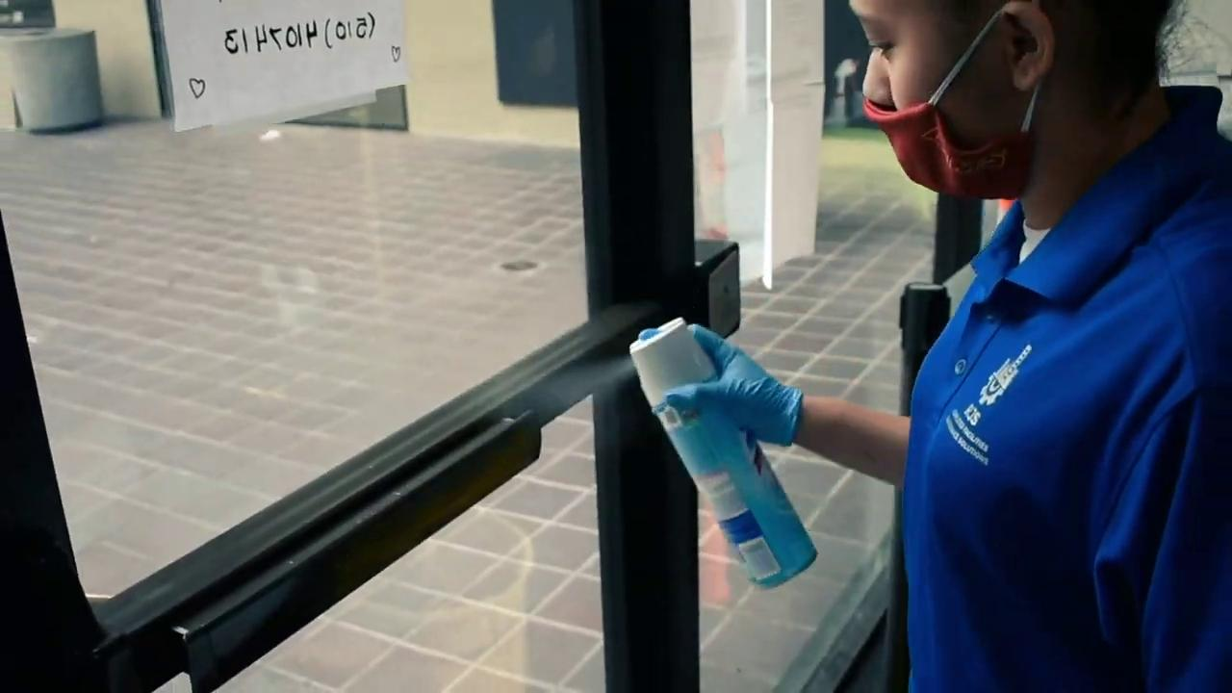
Sample Cleaning Procedures

