Slide 1
AIMS K-12 Board Report Reporting Period August 2020
Head of School Maurice Williams Jr., AIMS College Prep High School
Head of Schools Peter Holmquist, AIMS College Prep Middle School
Head of School Christopher Ahmad, AIMS College Prep Elementary School

Slide 2
Elementary School Highlights: I Want the Board To Know...
We have a full roster of teachers, no vacancies.
Every teacher returned but 2. One retired and the other is going to school in Sacramento for a master’s program.
Teachers have all of their supplies and what they need
Multiple online programs were purchased to accommodate virtual learning
Laptops were passed out this week to all families who needed them. The package also included composition books and writing material.
All core curricula were converted to digital copies only.

Slide 3
Elementary School Instructional Schedule
K-2: 8:45-3:00
3-5: 8:30-3:30
Tutoring will be for an hour each day after school.

Slide 4
Elementary School Strategy for Staff Communication
-Open Door Policy via Email
-Daily Check ins
-Daily Observations
-Daily Summaries

Slide 5
Elementary School Online Tools and Portals
K-2 - Seesaw + Zoom
3-5 Zoom + Google Classroom

Slide 6
Elementary School Method for Monitoring Instruction
-End-of-the-week assessments
-Benchmarks every 6 weeks
-Standards-based tests after every unit on Learning Farm
-Administration Pop-ins to Zoom

Slide 7
Elementary School Strategy for Communicating With Students and Parents and Disbursement of Materials and Supplies
ParentSquare messages + Emails were sent out on August 10th for materials distribution
Over 150 laptops were passed out on day 1
Day 2 and Day 3 numbers TBD

Slide 8
The Wellness Practices That Elementary Students Are Encouraged to Employ To Promote Overall Mental and Physical Healthy Well-Being
Teacher/Parent orientation taking place Friday, 8/14
Students will eat lunch together on camera
Brain breaks every hour
Physical Activity during PE class at home
Social Emotional Learning component introduced during PD

Slide 9
Elementary School Challenges/Concerns and Method for Resolution
Outdated teacher laptops - Making a large purchase but many are backordered until September
Parents not knowing how to navigate through online programs - Teachers are instructed to spend the first week or two showing parents and students how to navigate through programs

Slide 10
Orientation and Bootcamp Highlights
-All new online programs had a presenter come out and do PD with the teachers
-We created bonding activities and had ice-breakers for staff to get to know each other
-Everyone was present
-Teachers gave good feedback about PD

Slide 11
Middle School Highlights: I Want the Board To Know...
Over 200 computers loaned to students for distance learning
Great group of Middle School teachers, ready to go and participating in orientation
Skill up teachers for online classes - practicing before using with students

Slide 12
Middle School Instructional Schedule
Example 6th grade schedule
 | USC & Stanford (Ms.Jone & Ms. Bakheit)
 |  |  | Monday |  | Tuesday |  | Wednesday |  | Thursday |  | Friday
 | Block 1 (90 min) | 9:00 - 10:30 | USC (ELA) | Stanford (Math) | USC (Math) | Stanford (ELA) | USC (ELA) | Stanford (Math) | USC (Math) | Stanford (ELA) | USC (ELA & Hist Assessment & Evaluation) | Stanford (Math & Sci Assessment & Evaluation)
 |  | 10:30 - 11:00 | Break
Week 1 | Block 2 (90 min) USC/Stanford | 11:00 - 12:30 | P.E. (Mike) | P.E. (Tina) | USC Art (Frost) | Stanford Music (Hammer) | USC World Language (Spanish) | Stanford World Language (Mandarin) | P.E. (Mike) | P.E. (Tina) | USC (Math & Sci Assessment & Evaluation) | Stanford (ELA & Hist Assessment & Evaluation)
Week 2 | Block 2 (90 min) USC/Stanford | 11:00 - 12:30 | P.E. (Mike) | P.E. (Tina) | USC Art (Frost) | Stanford Music (Hammer) | USC World Language (Spanish) | Stanford World Language (Mandarin) | USC Art (Frost) | Stanford Music (Hammer)
Week 3 | Block 2 (90 min) USC/Stanford | 11:00 - 12:30 | P.E. (Mike) | P.E. (Tina) | USC Art (Frost) | Stanford Music (Hammer) | USC World Language (Spanish) | Stanford World Language (Mandarin) | USC World Language (Spanish) | Stanford World Language (Mandarin)
 |  | 12:30 - 1:00 | Lunch
 | Block 3 (90 min) | 1:00 - 2:30 | USC (Math) | Stanford (ELA) | USC (ELA) | Stanford (Math) | USC (Math) | Stanford (ELA) | USC (ELA) | Stanford (Math)
 | Block A (60 min) | 2:30 - 3:30 | USC Science | Stanford History | USC History | Stanford Science | USC Science | Stanford History | USC History | Stanford Science
 |  | 3:30 - 4:30 | Tutoring | Tutoring | Tutoring | Tutoring | Tutoring | Tutoring | Tutoring | Tutoring
 |  | 4:30 - 5:00 | Home Work Time - Please complete your daily assignments and turn in your work on Schoology Students’ homework time will match that which is in the AIMS handbook.

Slide 13
Middle School Strategy for Staff Communication
Staff Orientation (Boot Camp)
Weekly Professional Learning Community meetings
Weekly Memo - collection of information and announcements
Group Emails as required beyond weekly memo
Individual emails as need arises
Responses to staff emails usually within 3 hours (often immediately)

Slide 14
Middle School Online Tools and Portals
Resource | URL
Gmail | www.gmail.com
Schoology | aims.schoology.com
Illuminate | aimschools.illuminatehc.com/
Powerschool | https://americanindian.powerschool.com/public/
ALEKS | aleks.com
McGrawHill (Science) | my.mheducation.com/login
Standards Plus | https://digital.standardsplus.org/student-login
SRI | https://h100006768.education.scholastic.com
Quill | https://www.Quill.org
Rosetta Stone | https://Aimsk12.rosettastoneclassroom.com
This is the main list of resources for everyday use by the Middle School

Slide 15
Middle School Method for Monitoring Instruction
Weekly PLC interactions:
grade level meetings
subject matter meetings
Syllabus oversight and Lesson Plan review
Visitation of online classroom
Request for and review of Zoom class recordings
Grade checks and oversight of Powerschool and Schoology

Slide 16
Middle School Strategy for Communicating With Students and Parents and Disbursement of Materials and Supplies
Weekly ParentSquare messages from Head of School to families (minimum)
Parent Information meetings about ReOpening - translated into Spanish and Chinese
Middleschool@aimsk12.org and Teaching staff are the main conduit for communicating with students
Phone calls and emails from staff for attendance
Phone calls and emails from teachers for attendance, behavior and grades
Parent Square and Zoom meetings for resource pickup & scheduling
182 computers loaned to students in two days (of the three)

Slide 17
The Wellness Practices That Middle Students Are Encouraged to Employ To Promote Overall Mental and Physical Healthy Well-Being
Teachers ask an emotional check-in question to begin the classroom interaction
Teachers include “icebreaker” activities to build community, trust, and care in the classroom
Administrators begin their meetings with faculty with a brief emotional check-in.
Phone calls, zoom meetings, among staff interactions, often include this emotional check-in.
SEL Counseling for individuals and groups
(These were taught/practiced in the “boot camp.”)

Slide 18
Middle School Challenges/Concerns and Method for Resolution
Resource distribution
How to get to school - what do we need?
How do we get it to teachers or students?
Ongoing resource distribution days - alternating weeks until things stabilize, monthly after we get going?
Engagement of students in online learning (any learning, even in classrooms)
skills, practices, relationships

Slide 19
Orientation and Bootcamp Highlights
Online Parent Zoom ReOpening meetings with Q&A
On time and engaged participation
9 pages of highlights from teachers of SEL strategies, sub-group supports, How to do online classes and technology, as well as safety procedures
3C+M - clean, cool, checked, wearing a mask

Slide 20
High School Highlights: I Want the Board To Know...
Engaged teachers - on time, interactive, covering a completing workshops and trainings. Power-Users/Peers leading some workshops.
Padlet responses to the “Daily Learning Count” - It is said what you count matters, so we counted these things:
Safety procedures being covered
How to lead online classes
How to use technology
How to use activities/strategies for Socio-emotional learning/support
Sub-group strategies and activities

Slide 21
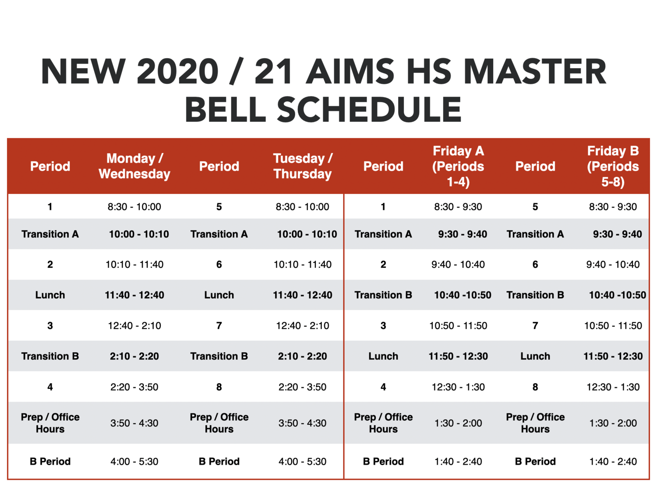
High School Instructional Schedule
Following recent California legislation that prohibits all public high schools from starting no earlier than 8:30 AM in 2021, this fall, AIMS HS will officially start its classes at 8:30 AM.
During virtual or hybrid learning, classes will end 15 minutes earlier to allow for sanitizing of classrooms and / or breaks away from the computer.

Slide 22
High School Strategy for Staff Communication
Optional Teacher Meeting Regarding Updated Teaching Guidelines
7-Day AIMS HS Teacher / Staff Orientation
State of the High School Presentation
Monthly Friday Department Level Meetings
Monthly Friday Staff Meetings
Emails to staff as needed

Slide 23
High School Online Tools and Portals
Schoology
Zoom (As Backup Option)
ALEKS (Math, AP Chemistry)
Scholastic Reading Inventory (SRI)
Quill Writing
AP Classroom
Study.com
Edhesive
Rosetta Stone

Slide 24
High School Method for Monitoring Instruction
Zoom (As Backup Option)
ALEKS (Math, AP Chemistry)
Scholastic Reading Inventory (SRI)
Quill Writing
AP Classroom
Study.com
Edhesive
Rosetta Stone
GoGuardian
Goformative

Slide 25
High School Strategy for Communicating With Students and Parents and Disbursement of Materials and Supplies
Daily calls to all AIMS HS and incoming AIMS HS students to confirm Fall Enrollment
Multiple Summer Parentsquare and Email Communications from AIMS Staff Regarding Upcoming School Year / ‘19-’20 School Year Highlights
Required Summer Novel Readings for all AIMS HS students (students stopped by campus to pick up summer reading materials over the summer)
Required Math ALEKS for all incoming AIMS students
Held 8 parent engagement meetings and 4 student orientations (one per grade level) Parent meetings were held in Mandarin only and Spanish breakout rooms
Held Junior / Senior and Freshman / Sophomore drive-in pickups of school supplies, textbooks, and class shirts
Multiple student engagements to complete Dual-Enrollment forms for AIMS U College Pathways Program in the Fall
Make-Up pickup dates will be ongoing throughout the school week

Slide 26
The Wellness Practices That High School Students Are Encouraged to Employ To Promote Overall Mental and Physical Healthy Well-Being
Breaks from Computer are built into school schedule
Join AIMS HS Clubs / SGA Elections will be held in August
Conceptualizing the idea of outdoor Drive-In Movie Nights from AIMS HS Parking Lot

Slide 27
High School Challenges/Concerns and Method for Resolution
Historic lack of continuity / knowledge of AIMS HS policies / procedures among AIMS HS Teachers
Rigorous orientation / trainings
Development / Training of Department Chairs Based upon AIMS Practices
Development of AIMS HS Procedures Manual for all AIMS teachers
Inappropriate Student Behavior via Technology
Recommended trainings and presentations from legal to discuss potential ramifications of student misconduct within learning environment
Recommended student trainings / partnerships to discuss healthy and appropriate uses of technology
Codifying and development of a comprehensive AIMS HS Student / Family Handbook to address all potential academic / social concerns
GoGuardian Installation on all AIMS Chromebooks
Distribution of Chromebooks to all AIMS Students and required use for all AIMS Classes
Asset management: Textbooks, Instruments, and School Capitalized Equipment
Purchased asset tag tracking system that links to student ids
Students that lose or intentionally damage assets will be invoiced the costs associated with the lost assets and may receive academic holds on transcripts

Slide 28
Orientation and Bootcamp Highlights
State of the High School
Initial Meeting With Department Chairs to Review AP Test Data and requirement to enforce all AIMS policies and guidelines with all AIMS HS teachers
Creation of AIMS HS Academic Course Catalogue and AIMS HS Student / Family Handbook
School-wide implementation of All AIMS HS Syllabus and Pacing Guides to model AP Course Descriptions
AIMS HS staff worked around the clock to remove old items, order and secure supplies, and to prep classrooms for all teachers
19/21 teaching positions filled
Purchased, designed, and distributed class shirts to all students during supply pickup

