Slide 1
Facilities Update
August 13, 2020
Data, Accountability & Operations Department

Slide 2
Lakeview Campus
Deep cleaning the entire campus
Disinfecting the entire campus
Painting and touch-ups were done throughout the school
Set up classrooms for hybrid learning
Fire Extinguishers were inspected
Sinks and Temperature Kiosks were set up
Collaborating to create procedures for a safe campus

Slide 3
12th Street Campus
Deep cleaning the entire campus
Painting and touch-ups were done throughout the school
Set up classrooms for hybrid learning
Fire Extinguishers were inspected
Sinks and Temperature Kiosks were set up
Alarm system was installed
Gathered for window installation
HVAC System - Merv 13 filters
Backflow Test - EBMUD
Fire alarm, sprinkler and fire hose were inspected
Collaborating to create procedures for a safe campus

Slide 4
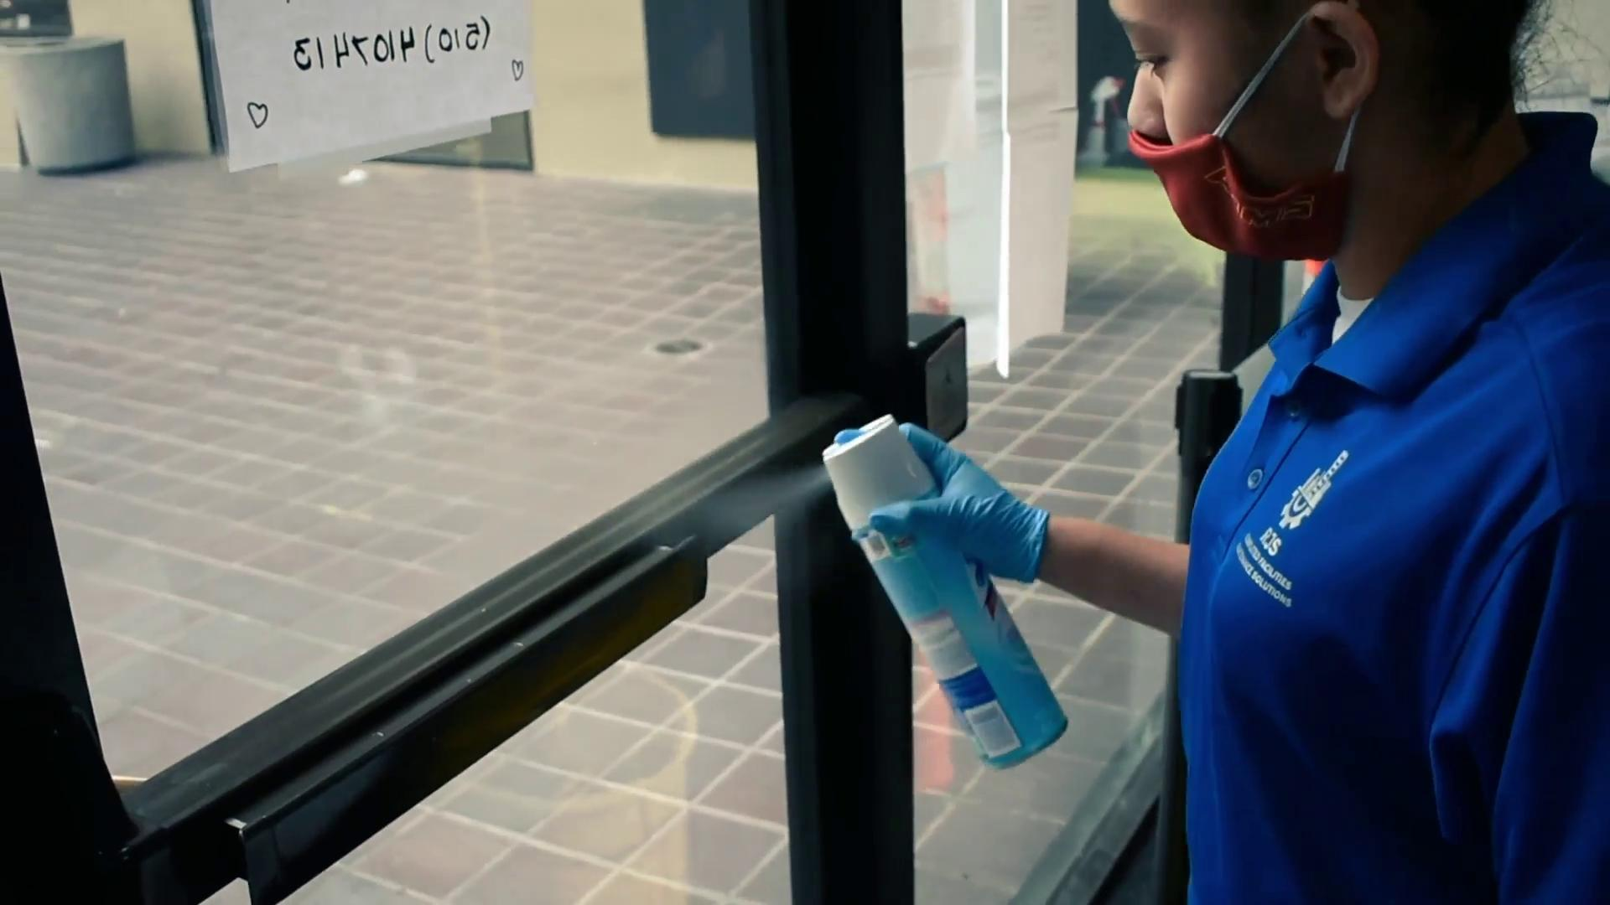
Cleaning and Disinfecting
Cleaning and disinfecting is based on the Centers for Disease Control and Prevention (CDC) recommendations for schools.
Cleaning is happening on a regular basis. Cleaning crew is disinfecting frequently touched surfaces and objects such as:
Door knobs and handles
Stair rails
Classroom desks and chairs
Lunchroom tables and chairs
Countertops
Handrails
Light switches
Equipment
Push-buttons on elevators
Shared telephones
Shared desktops
Shared computer keyboards and mice
In the evening frequently touched surfaces and objects are wiped down with a 10% bleach solution. We are using a fogger machine to disinfect surfaces and objects.

