Slide 1
AIMS K-12 College Bound Kids Reporting Period June 2020
Matthew Gordan, College Bound Kids Coordinator

Slide 2
Established College Bound Priorities
(Overall priorities were discussed last month. The following priorities are immediate.)
*Oversee AP testing
*Make sure Seniors are supported with community college registration
*Working with Juniors to prepare for college application season
*Reviewing Junior transcripts and ensuring students are working on credit recovery

Slide 3
Established Daily/Weekly Schedule for Communicating With Seniors, Juniors
Daily
*Established a log to coordinate individual check-ins via email/Schoology- followed up with phone calls to those who don’t respond within 48 hours.
*Operating open office hours during lunch, after-school, or essentially anytime for students to meet privately via a Schoology conference call or phone to provide more one-on-one assistance.
*Daily interviews with Juniors after school involving Peer Forward team, going over college-related matters and preparing them for the application process.
Weekly
*Most recently were multiple meetings with each grade level regarding the AP exams.

Slide 4
Number of Juniors and Seniors Contacted During The Reporting Period; and The Means of Communication
Seniors: Email/schoology: All 75 senior have been contacted via email at least weekly with an average number of email correspondence 6 times per week
Phone: Have consulted with 4 students via phone call.
Private one on one Schoology conference: 6 students have requested this
Juniors: All Juniors have been contacted directly by me in regards to college planning for next year and AP exam updates. All Juniors have had their Peer Leader interview.
Peer Leader Survey include: Questions to get them thinking about type of campus location they want, size of school, majors/career they’re interested in, introducing the concept of loans, grants, scholarships, making them aware of private schools, etc.
Group emails: Seniors x 12, Juniors x 9, Freshmen/Sophomore x 9. Topics include college admissions, scholarships, AP/SAT updates, sending scores to colleges, Community College information, and other updates.

Slide 5
Waitlist Acceptances Update So Far: UC Davis x 3, UC Berkeley x 2, UC San Diego x 3, UC Santa Cruz

Slide 6
Qualitative and Quantitative Results for FAFSA Completion
*69 students completed the FAFSA
*4 did not
*2 families declined to complete it
*Held two FAFSA workshops in order to complete this task, supplied copious amount of aides and instructions— in written form, list form, and video form— to complete this task, phoned home to remind about this, emailed the students directly several times to finish this, spoke face-to-face with students several times about this…
*Before this year I believe only one student since I’ve been counselor has failed to complete FAFSA.

Slide 7
Qualitative and Quantitative Results for Response to Student Inquiry
Recent Reporting period:
*Over 250 individual email/Schoology messages to students this reporting period
*Average of 15 individual students contacted per day via online this reporting period
*Every Senior is contacted individually at least once a week asking for update and/or reminding them of my presence
Inquiry Topics:
*AP Exam information (vast majority this period)
*Acellus/Credit Recovery
*College admissions
*Scholarships

Slide 8
Scholarship Results
In this current school year, 2020, our students have earned at least $284K in private scholarships (more results are pending) from CAP Bay Area, Posse, and East Bay College Fund.
From 2016-2019, our students earned over $1.44M in private scholarships.
The current 5 year total is at least $1.72M in private scholarships.
AIMS HBCU College Fair had an offer to AIMS students of nearly 5 Million dollars in Scholarships
*Note: I have historically tracked outside scholarships that students receive. While I’m not confident every student has alerted me to their smaller scholarships, I am confident I am fully aware of all sizable awards our students have received. These scholarships include, but are not limited to: Posse Scholarship, Questbridge, East Bay College Fund (now under the umbrella of Oakland Promise but available to all students), CAP Bay Area (Making Waves scholarship), Wa Sung Foundation, and others.
In terms of university-offered scholarships to prospective students, I am unprepared to provide this request for this year. I instruct all the students to formally reject a school when they officially cross them off their list. This is done to expedite the waitlist process for schools and the waitlist status of other students. Thus, when a student rejects a school, they lose access to their portal, which provides the scholarship figures. Moving forward, knowing this is a request, I will definitely install a system to track all of these scholarship offers furnished by the colleges and universities.
Next year, moving college planning back into the classroom, will allow me to again make scholarships part of the Senior curriculum, boosting the number of applications sent out, not to mention better track results, both private and from universities.

Slide 9
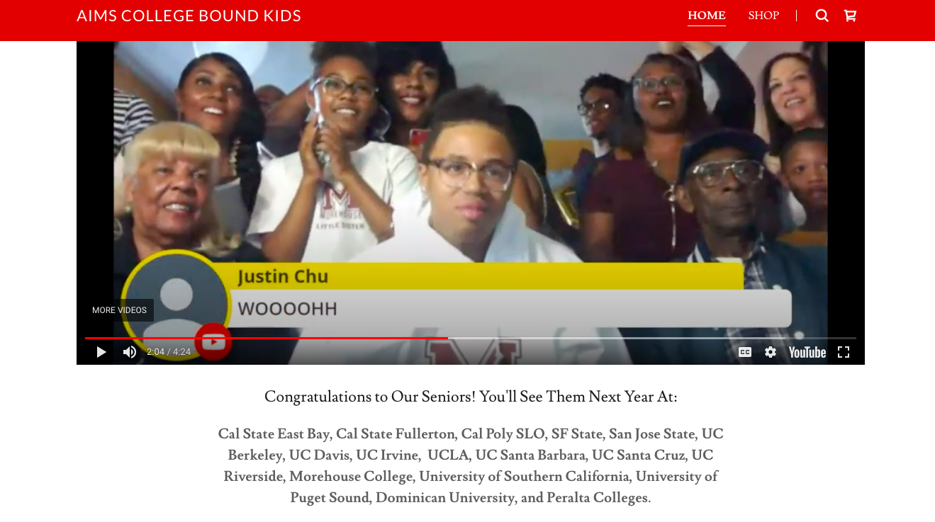
Link To College Acceptance List
https://www.aimsk12.org/hs-college

Slide 10
Link to Signing Day Video Link to AIMS CBK Website

Slide 11
Plans For 2020-2021
High School
*Continue with feedback and personal deadlines for each student to craft at least 3 drafts each of the 4 UC personal essay prompts.
*Continue organizing and overseeing the ordering of AP exams, FAFSA registration, PSAT exams, and SAT/ACT registration.
*Include parents even more by having each family sign off on graduation progress documentation throughout the year.
*Facilitate virtual meetings with admissions officers as opposed to in-person visits, along with virtual tours.
*Take advantage of college planning class with more one-on-one time with students and better scholarship application infrastructure.
*Continue to push students to look at private schools and HBCUs as alternative options more than worth their time.
*Keep track of student transcripts to ensure credit recovery is met in a timely manner.
Middle School/Elementary School
*Facilitate virtual tours of college campuses for each AIMS site.
*Introduce career paths/options; help make connections for them to understand possibilities.
*Stress importance of community service/extracurricular activities, both to the community and themselves.
*Provide information throughout the year for their teachers to share with their families.

Slide 12
Highlights I Want The Board To Know
*This is a one-person department!
*College acceptances at just about every UC and CSU school went up. The few that did not all saw fewer applicants than previous year.
*Every Senior received feedback on three drafts of their four UC personal essays. Over 70 Seniors completed this task, meaning I “touched” over 840 essays (not including private school or scholarship essays).
*This is the 4th straight year we’ve had at least one student receive full college tuition scholarship from a program we nominated them for.
*Oversaw the organization, ordering, and implementation of the AP exams (419 students registered, over 1K exams) and the multiple PSAT exams (9th-11th graders all tested) that occurred on our campus.

