Slide 1
AIMS K-12 Board Report Reporting Period May 2020
Head of School Maurice Williams Jr., AIMS College Prep High School
Head of Schools Peter Holmquist, AIMS College Prep Middle School
Head of School Christopher Ahmad, AIMS College Prep Elementary School

Slide 2
Elementary School Instructional Schedule
K-1: 8:45-3:00
Tutoring: 3:00-4:00
2-5: 8:30-3:30
Tutoring: 3:30-4:30

Slide 3
Elementary School Strategy for Staff Communication
Weekly Staff Meetings
Reminder Emails Daily
Zoom Meetings

Slide 4
Elementary School Online Tools and Portals
Zoom
Seesaw
Google Classroom

Slide 5
Elementary School Method for Monitoring Instruction
Students must have their camera on when there is live instruction
Students must turn in LIVEWORKSHEETS (liveworksheets.com)
Administration frequently pops up in classes to observe

Slide 6
Elementary School Strategy for Communicating With Students and Parents
Parentsquare
Direct parent/student contact via email
Calls from front desk staff daily
Google Classroom Daily Updates

Slide 7
Elementary School Strategy for Addressing Concerns From Parents and Students
Every parent was given the administrator's email address
Tech help line via email
Parents are able to write comments on Parentsquare
Work cell phone given out to parents to contact me directly

Slide 8
The Wellness Practices That Elementary Students Are Encouraged to Employ To Promote Overall Mental and Physical Healthy Well-Being
Brain Breaks
Morning live meetups to connect with the teacher
Zoom is kept on during lunch so students can eat with each other
Wellness activities during PE
Nutrition taught during PE

Slide 9
Elementary School Challenges/Concerns and Method for Resolution
Accurate assessment and testing
We have had some instances where older siblings or parents are helping their child with the work and giving them the answers
students who are generally performing below grade level are excelling
-Solutions:
Meet with parents to show previous work from in-school instruction vs now
Having students take assessments and class in a room by themselves
Setting assessment time slots: 3 students at a time, live, and on camera. The teacher can easily monitor to see if they are cheating or not.

Slide 10
Middle School Instructional Schedule
 |  | Monday |  | Tuesday |  | Wednesday |  | Thursday |  | Friday
Block 1 (90 min) | 9:00 - 10:30 | Yale (ELA) | Harvard (Math) | Yale (Math) | Harvard (ELA) | Yale (ELA) | Harvard (Math) | Yale (Math) | Harvard (ELA) | Yale (ELA & Hist Assessment & Evaluation) | Harvard (Math & Sci Assessment & Evaluation)
 | 10:30 - 11:00 | Break
Block 2 (90 min) | 11:00 - 12:30 | Yale P.E. (Sanchez) | Harvard P.E. (Tina) | Yale (Art) | Harvard (Music) | Yale P.E. (Sanchez) | Harvard P.E. (Tina) | Yale (Spanish) | Harvard (Mandarin) | Yale (Math & Sci Assessment & Evaluation) | Harvard (ELA & Hist Assessment & Evaluation)
 | 12:30 - 1:30 | Lunch
Block A (60 min) | 1:30 - 2:30 | Yale (Math) | Harvard (ELA) | Yale (ELA) | Harvard (Math) | Yale (Math) | Harvard (ELA) | Yale (ELA) | Harvard (Math)
Block B (60 min) | 2:30 - 3:30 | Yale Science | Harvard History | Yale History | Harvard Science | Yale Science | Howard History | Yale History | Harvard Science
Example
6th grade schedule

Slide 11
Middle School Strategy for Staff Communication
Weekly Professional Learning Community meetings (since August 2019)
Weekly Memo - collection of information and announcements
Group Emails as required beyond weekly memo
Individual emails as need arises
Responses to staff emails usually within 2 hours (often immediately)

Slide 12
Middle School Method for Monitoring Instruction
Weekly PLC interactions - grade level meetings
Lesson Plan review
Visitation of online classroom
Request for and review of Zoom class recordings

Slide 13
Middle School Strategy for Communicating
With Students and Parents
Main conduit for communicating with students is Teaching staff
Student emails are responded to the day they are received
Weekly ParentSquare messages from Head of School to families (minimum)
Social Media postings - Instagram, Twitter, Blog
Progress Reports at scheduled times
Phone calls and emails from staff for attendance
Phone calls and emails from teachers for attendance, behavior and grades

Slide 14
Middle School Strategy for Addressing Concerns From Parents and Students
Email responses within 24 hours (usually within 2 hours)
Phone calls responded to within the day (usually within 2 hours)
Teachers are immediately included, usually having immediate and relevant information about the situation
Administrative staff triages content and topics to involve the appropriate administrator to ensure consistency
Head of School is informed to ensure responsibility

Slide 15
The Wellness Practices That Middle School Students Are Encouraged to Employ To Promote Overall Mental and Physical Healthy Well-Being
Teachers are encouraged to check in with every student every two weeks
Teachers are encouraged to ask an emotional check-in question to begin the classroom interaction
Teachers include “icebreaker” activities to build community, trust, and care in the classroom
Administrators begin their meetings with faculty with a brief emotional check-in.
Phone calls, zoom meetings, among staff interactions, often include this emotional check-in.
SEL Counseling for individuals and groups

Slide 16
Middle School Challenges /Concerns and Method for Resolution
Attendance procedures and accuracy
daily phone calls to students as soon as possible after attendance is taken
translation and clarification of any student needs with student and family
support with technology and other resources (internet, housing)
Ongoing pressures of “new” platform skills in tension with teaching skill development
Weekly PLC meetings to practice and discuss strategies
Student and parent feedback
Accuracy and fairness of grading through this online learning platform
Continue to strategize with teachers
Increase teacher skills in use of rubrics & assessment options

Slide 17
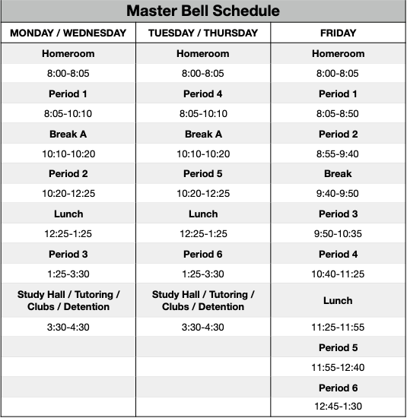
High School Instructional Schedule

Slide 18
High School Strategy for Staff Communication
Slack On Campus Communication System
Schoology Group Communications
Email
Text / Phone Messages
Zoom Conferences
Weekly PDs and Staff Meetings
One on One Meetings As Needed
Daily Announcements from Head of School / Interim Academic Deans

Slide 19
High School Online Tools and Portals
Schoology Conferences
Zoom Conferences
Google Classroom
One Note
Adobe Creative Suite: Photoshop, Indesign, etc.
ALEKS
Rosetta Stone
Learning Ally
Acellus
Khan Academy

Slide 20
High School Method for Monitoring Instruction
Teacher / Student Breakout Rooms
Weekly Assessments
Daily Observations by Academic Deans and Head of School
Weekly Submission of Lesson Plans
Quarter 4 Pacing Guides Based off AP Testing Review and Course Standards

Slide 21
High School Strategy for Communicating With Students and Parents
Front Desk Attendance Clerk and All Staff make phone calls for absent, tardy, and students that are inactive from the computer for 10 mins or more.
Parentsquare communications as needed
Schoology Group Communication
Zoom Conference Parent Meetings
Weekly Grade Level Meetings Via Conferences

Slide 22
High School Strategy for Addressing Concerns From Parents and Students
Email highschool@aimsk12.org
Send Parentsquare Replies to postings
Email teachers and support staff as it pertains to concern type (Absence, Chromebook / Technology Request, Academics)
Staff Member Has Access to AIMS Cell Phone

Slide 23
The Wellness Practices That High School Students Are Encouraged to Employ To Promote Overall Mental and Physical Healthy Well-Being
AIMS HS SGA to plan virtual spirit week and other virtual engagements to increase social connections with students and friends
AIMS HS Virtual Sports Banquet (Saturday, May 16, @ 6PM)
https://www.youtube.com/watch?v=cs3JlBRFc6c
AIMS Senior Signing Day Event (Thursday, May 21, @ 6PM)
https://youtu.be/gNmTbyyv7nQ
Seniors receive letterman jackets as senior gift
https://youtu.be/BgNnxBnEo44

Slide 24
High School Challenges / Concerns and Method for Resolution
Students feeling overwhelmed with the amount of online assignments
Class instruction was reduced to one hour per class
Teachers can use the second hour of instruction provide tutoring or update grading for students
Students can use the second hour to study for their AP exams

