Slide 1
Measure G1
AIMS K-12 College Prep - 1 & 2
2017-2021

Slide 2
AIMS K-12 - Middle School
Objective:
Renew the Measure G1 grant funding
Why?
Required by the grant to have Board action in the yearly application

Slide 3
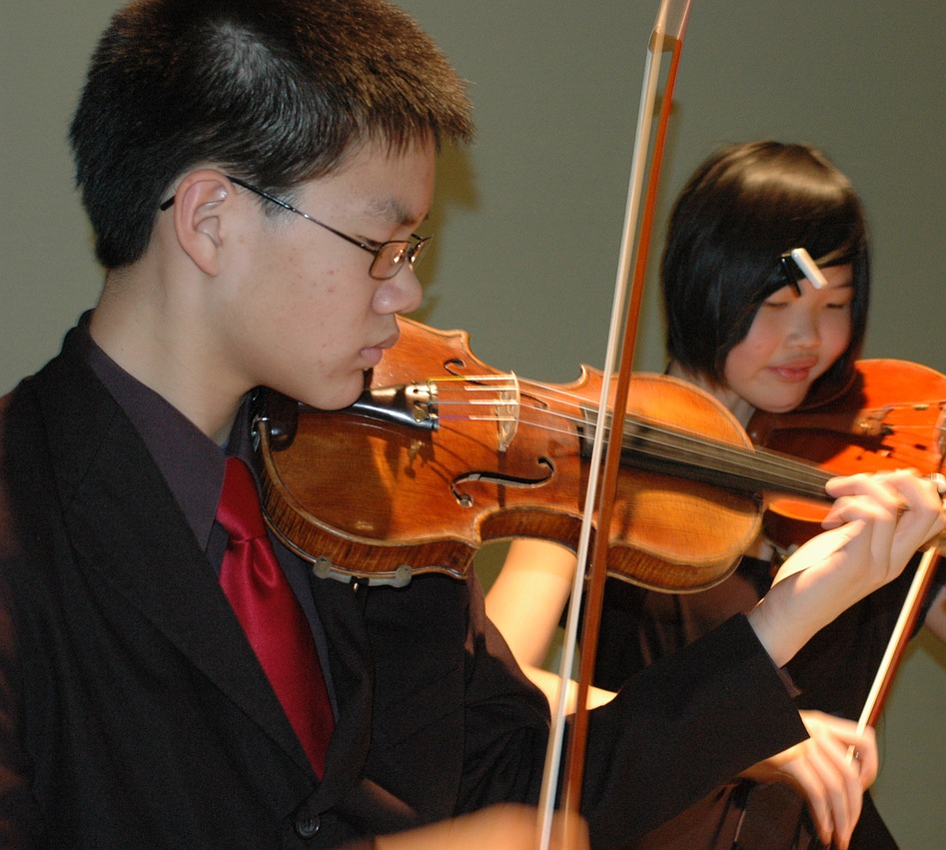
AIMS K-12 - Middle School
What did we say we would do?
MUSIC - We have a music teacher!
We have violins, flutes, saxophones, drums, and more!
Staffing for Visual and Performing Arts, purchase of musical instruments

Slide 4
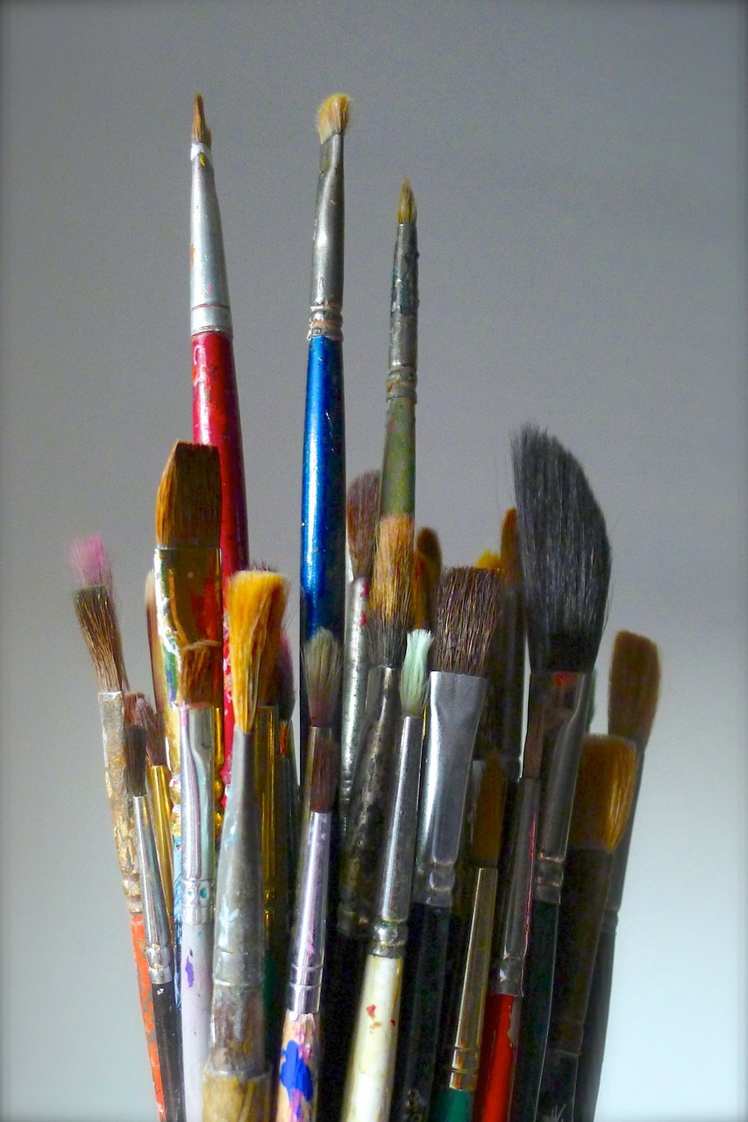
AIMS K-12 - Middle School
ART - We have two teachers who each share their love of art and art skills.
We have supplies for art classes, both digital and on paper.
Purchase of computers and software for graphic arts, art supplies

Slide 5
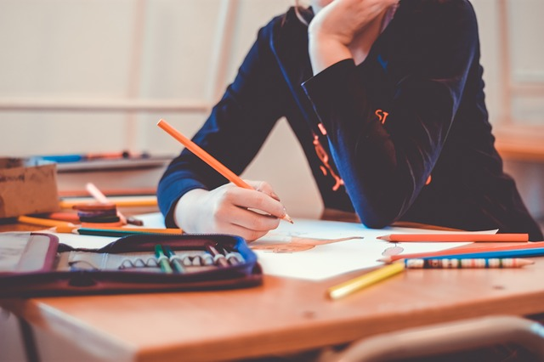
AIMS K-12 - Middle School
Positive Behavior Intervention and Supports (PBIS) is now part of our multi-tiered system of supports (mtss)
Restorative Justice remains a big part of our high support model of supporting students, especially RJ Saturday School.
Soon we will add screen monitoring software to protect students from wandering off key web sites into the WWW.

Slide 6
AIMS K-12 - Middle School
We have accomplished all the things we have said we would do with the grant this year.
Delivery of some of the skills and services, as well as funding the positions are still ongoing.
We look forward to seeing our students demonstrating cultural awareness and content knowledge of core subjects through arts in visual presentations.
Students will show positive outcomes by putting on music recitals as well as recognizing and connecting native competencies, or background (cultural origins) knowledge in the arts.
Specific, grade appropriate Visual and Performing Arts standards will also be assessed.

Slide 7
AIMS K-12 - Middle School
The only change to the application for Measure G1 grant money this coming year will be:
the intention to use the grant to pay the salary of the music teacher!
The rest of the grant monies will be used in the same way as this year.
Thank you!

