Slide 1
AIMS K-12 Board Report
March 17th, 2020
Superintendent Maya Woods-Cadiz
Mr. Christopher Ahmad (AIMS ES Head of School)
Mr. Peter Holmquist (AIMS MS Head of Schools)
Mr. Maurice Williams (AIMS HS Head of School)

Slide 2
PINK BENCHMARK
Class ELA Math Class ELA Math
5a 88% 100% 5b 95% 100%
5c 86% 91% 3A 80% 90%
3B 50% 73%
2A 51% 95% 2B 80% 100%
2C 70% 66% 1A 62% 100%
1B 63% 83% KA 100% 100%
KB KC 50% 84% Failing Classes ELA Math Failing Classes ELA Math
3C 11% 35% 1C 41% 55%
4C 20% 9% 4B 38% 42%

Slide 3
Plans for Virtual Learning
K-5 will be using Schoology for virtual learning
Teachers will create a schedule each day replicating what they taught during the regular school year
Instruction will be all standards based learning
Teachers will teach up to 4 standards per day
Work will be collected through Schoology as well as graded

Slide 4
Fast Forword
Fast ForWord is an evidence-based, adaptive reading and language program that delivers 1-2 years gain in 40-60 hours of use for any struggling learner. Schools choose Fast ForWord because our unique brain-based approach targets the root causes of reading difficulty to deliver lasting results that make better readers and lifelong Fast ForWord is an evidence-based, adaptive reading and language program that delivers 1-2 years gain in 40-60 hours of use for any struggling learner. Schools choose Fast ForWord because our unique brain-based approach targets the root causes of reading difficulty to deliver lasting results that make better readers and lifelong learners..
https://youtu.be/R6J-BCOROo8

Slide 5
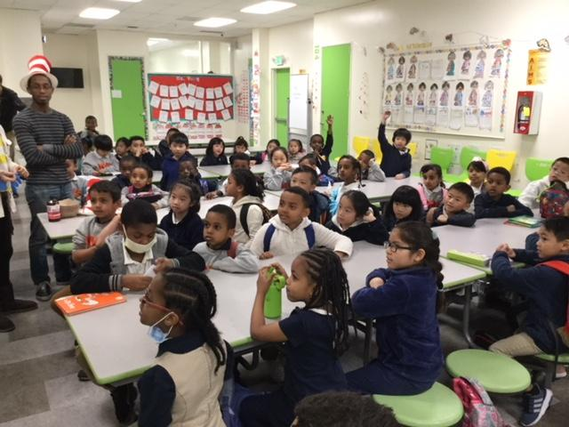
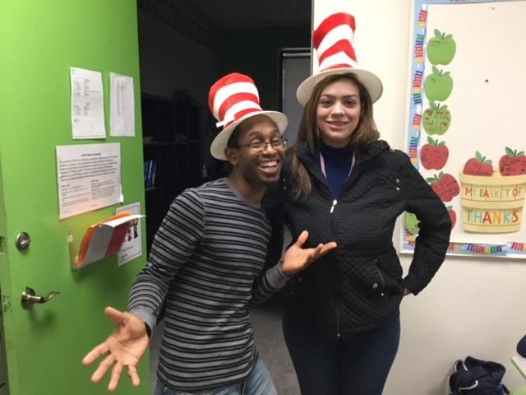
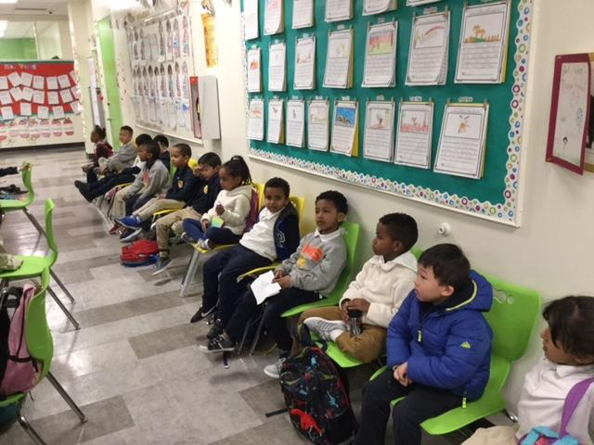
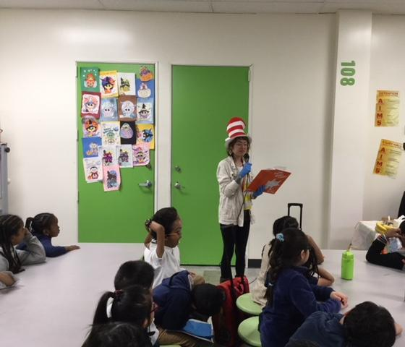
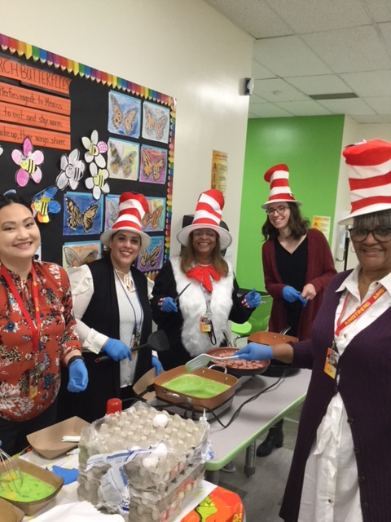
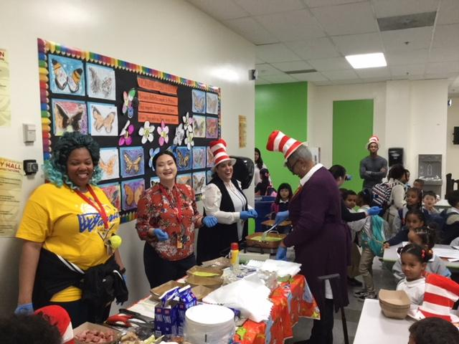
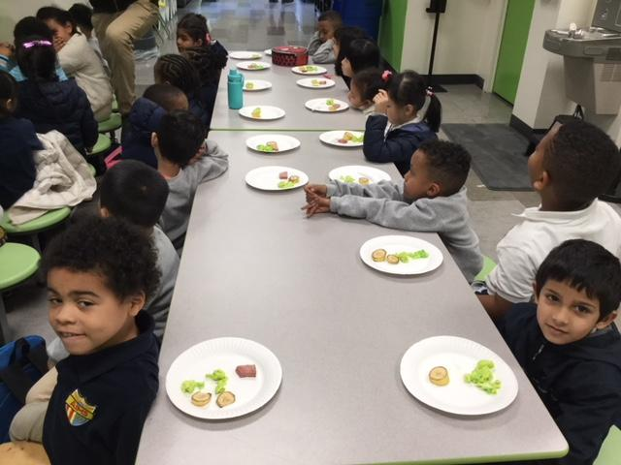
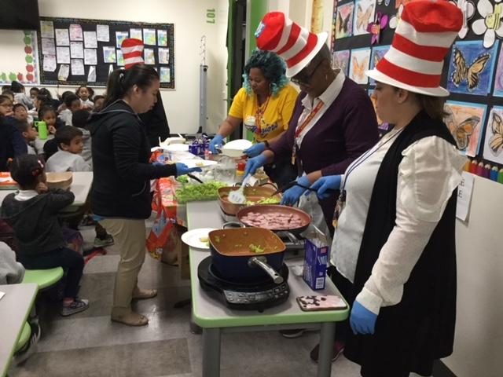
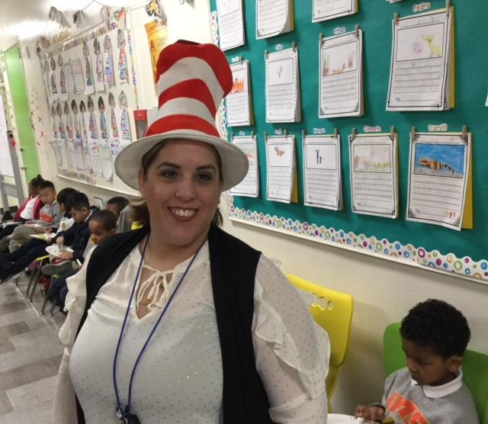
Dr. Seuss Day

Slide 6
Communicating with Parents
A PARENTSQUARE memo was created asking parents for their email addresses. Email addresses were collected and put into a spreadsheet. Parents are contacting parents directing, sharing information, and sending work.

Slide 7
SBAC Interim Comprehensive Assessments
ICA assessments for ELA & Math were administered to all the 6th - 8th students during the week of March 9th.
Teachers were trained to administer the ICA assessments by Operations.
Teachers are being trained for hand scoring the Performance Task Assessments for both Math & ELA.

Slide 8
Middle School
Adminstrators and teachers held robust discussions about scenarios similar to the four suggested by the CDE. Teachers came up with questions and then answers to how to handle the situation in anticipation of closure.
Teachers themselves identified the most beneficial path for the MS was to create not just packets, but lessons which could continue to teach and assess learning while teacher, student and school were not co-locating
Since closure systems of contact with each student, to each family, and general communications or invitations have been put in place.
Teachers contact all home room students in a biweekly rotation.
Weekly parent emails are sent
Technology and musical instruments have been released to students in need of them.
COVID-19

Slide 9
Middle School PLC
Preparing for Virtual & Remote Learning
Preparing Teachers:
Training on how to integrate google apps & google drive with Schoology.
Department & grade level collaboration to prepare students’ work based on the curriculum maps.
Virtual folders for each content are posted on Schoology that can be printed if needed.
Teacher are trained to moderate the work with their students thru built in features in Schoology.
Preparing Students
Students were given an inventory list of their access for Student Online Resources & School Contacts for all the online programs they are currently using as well as teachers/staff contacts.
Students were led through in class activities and tutorials to practice opening virtual folders and completing assignments through Schoology.
Students were asked to take all the textbooks, work books and other instructional materials home the day before closure.

Slide 10
SBAC Interim Comprehensive Assessments
ICA assessments for ELA & Math were administered to all the 6th - 8th students during the week of March 9th.
Teachers were trained to administer the ICA assessments by Operations.
Teachers are being trained for hand scoring the Performance Task Assessments for both Math & ELA.
Handscoring will continue during the closure.

Slide 11
AIMS HS Online Shift to Schoology
AIMS K12 College Prep Charter District has adopted Schoology as its official online learning platform for students
Schoology is compatible with many learning platforms (e.g. Khan Academy, OneNote, TurnItIn, etc.)
Schoology is fully integrated with Powerschool and syncs teacher, staff, and student data with its programs
Teacher Grading and Assignments will Also be synced with Powerschool to reflect in realtime
AIMS HS teachers received 4 hours of online training from Schoology

Slide 12
Shift To Online Learning
Classes will be based on normal bell schedule
(2 Hour Classes - 1 Hour Lecture + 1 Hour Independent Student Break Out Group Meetings)
Teachers will hold virtual break out groups
Assign independent practice work with students and groups
45 Minute Friday Classes
Assessment Based
Timed Assessments
Teachers will hold office hours
Help review work, notify parents of incomplete assignments

Slide 13
Shift To Online Learning
Students must attend classes online
Attendance will be taken (Present, Tardy, Absent) and documented
Parents will receive notifications from staff for absent students
Students must use their own computer / laptop
Students must work in a quiet area / workstation
Students may be removed from class due to inappropriate behavior
Classes Will Be Recorded and Posted In a Secure Portal for Students To Access in Case They Need to Review the Lecture
Students must be visible in class or use a photo of themselves while in class
Parents may opt out of having their child’s likeness used for publication. Students will however be expected to have visual participation in their classes as they would do regularly on the school site.

Slide 14
Shifts In Instruction
AP Classes: All AP Classes will shift their instruction towards review and preparation for the AP Exams
Non-AP Classes: These classes will continue their instruction as normal and adapt it for online learning
Technology Access: Students without chromebook access have the ability to notify any AIMS HS Staff member to obtain one for the duration of the school closures

Slide 15
HS SPED / IEP Services
Services will be provided through the online Study Skills class and one-on-one video tutoring
Class meets Tuesdays and Thursdays at 1:30; and Friday at 12:45, starting April 6
Ms. Pittman is working with classroom teachers to modify assignments as needed
Speech services are being provided online from Mr. Filipe
IEP Meetings will be held over video conference

Slide 16
AP Exam Changes
College Board is developing 45 minute AP exams for students to take online at home. There will be two testing dates for each exam: one sooner, for those who want to take it while material is fresh, and one for the others who want more time.
Material to be included in exams is everything AP teachers were expected to cover by early March. More info on this is available at AP Central.
Students will be able to access exams on a computer, tablet, or smartphone.
The specific test dates and free-response question types will be posted by April 3rd.
Students have access to live-- and then on-demand-- free AP review lesson videos taught by AP teachers. The release of videos on College Board will be ongoing.

Slide 17
AIMS HS Senior Engagements
All AIMS High school activities are suspended likely for the remaining of the school year
The senior trip has been cancelled and we are working with the Finance Office to process family contribution refunds
AIMS HS is in the beginning stages of planning various virtual engagements and acknowledgement ceremonies and gifts for seniors
AIMS HS Graduation Ceremonies were planned for June 18, 2020 at Grand Lake Movie Theater, but is on hold pending further developments with the COVID-19 epidemic

Slide 18
(2020 / 21) The AIMS U College Pathways Planning
AIMS HS is currently in the beginning stages of planning The AIMS U College Pathways program to take place during the 2020-21 Academic School Year
Likely College Pathways will include Pre-Business, Pre-Engineering / Design Media, Pre-Law, and Pre-Med
Students will take community college classes while on campus at high school
Confirmed partnerships with the College of Alameda, Berkeley City College
College Pathways will likely incorporate new bell schedule which will be proposed at a later date

Slide 19
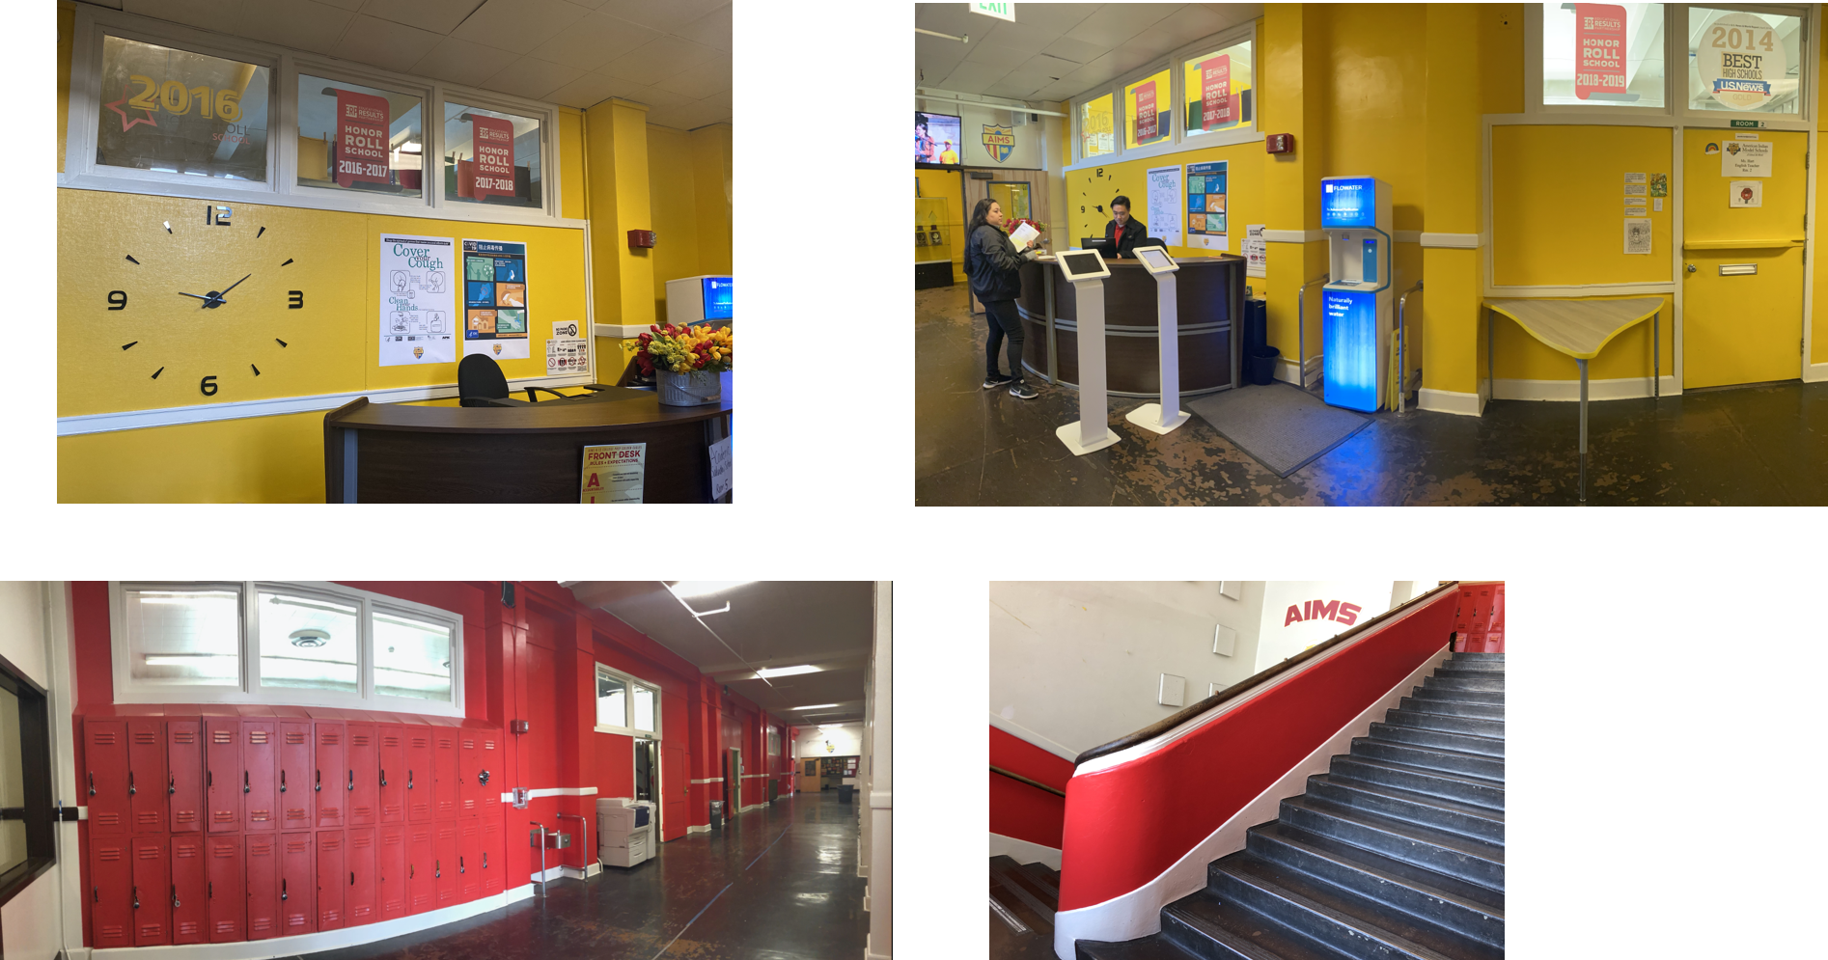
AIMS HS Renovations Updates

Slide 20
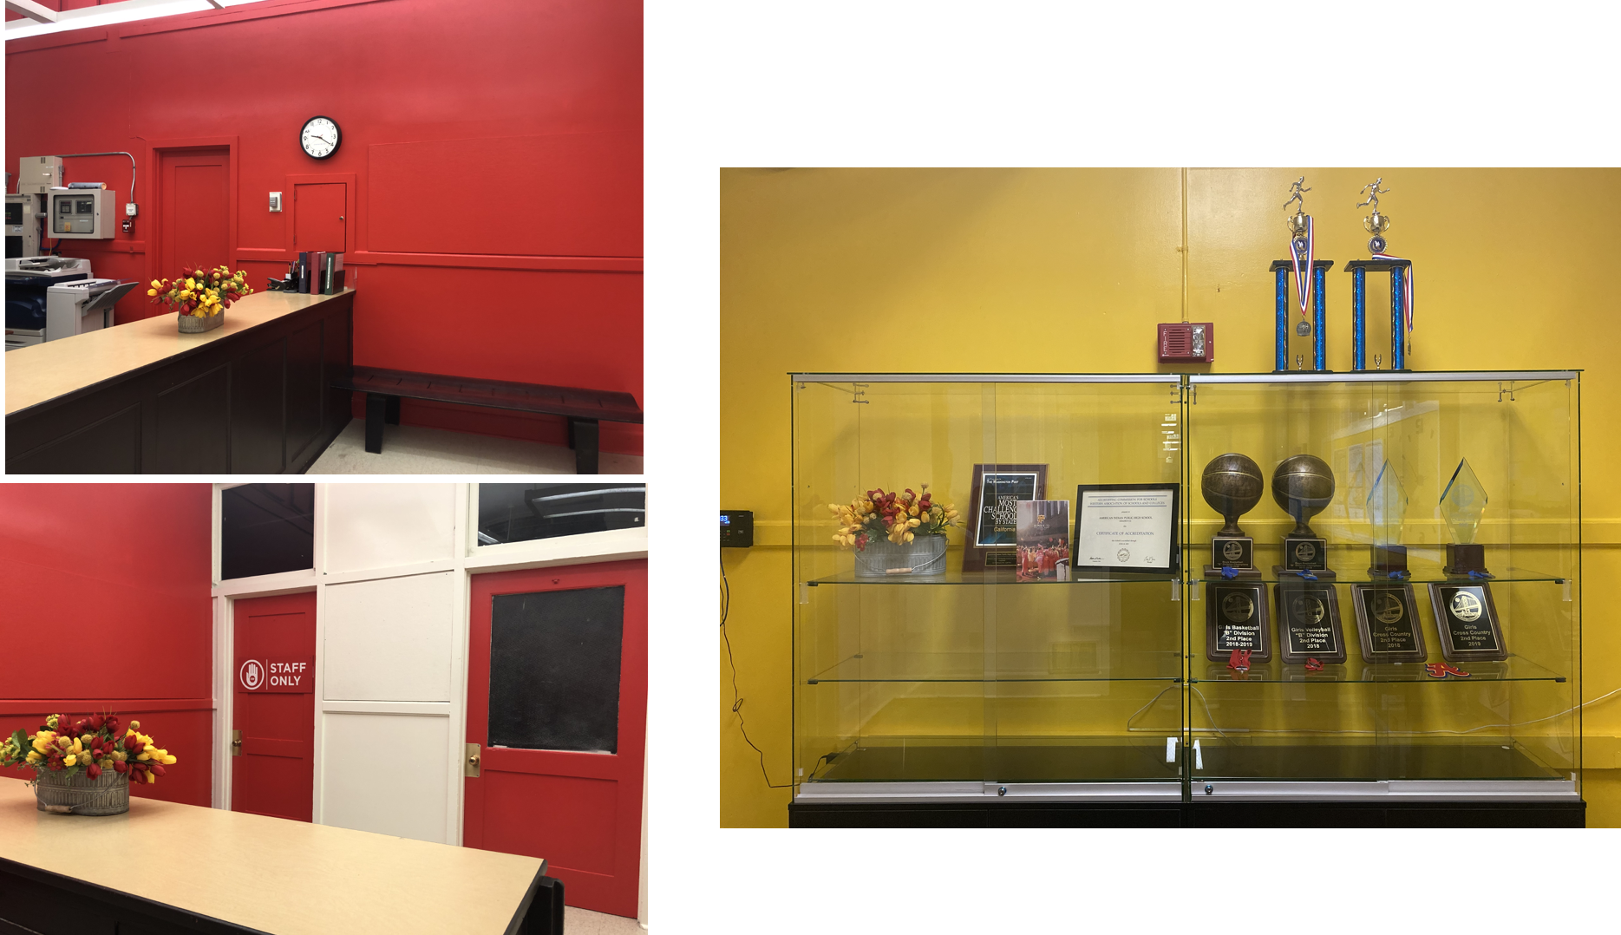
AIMS HS Renovations Updates

Slide 21
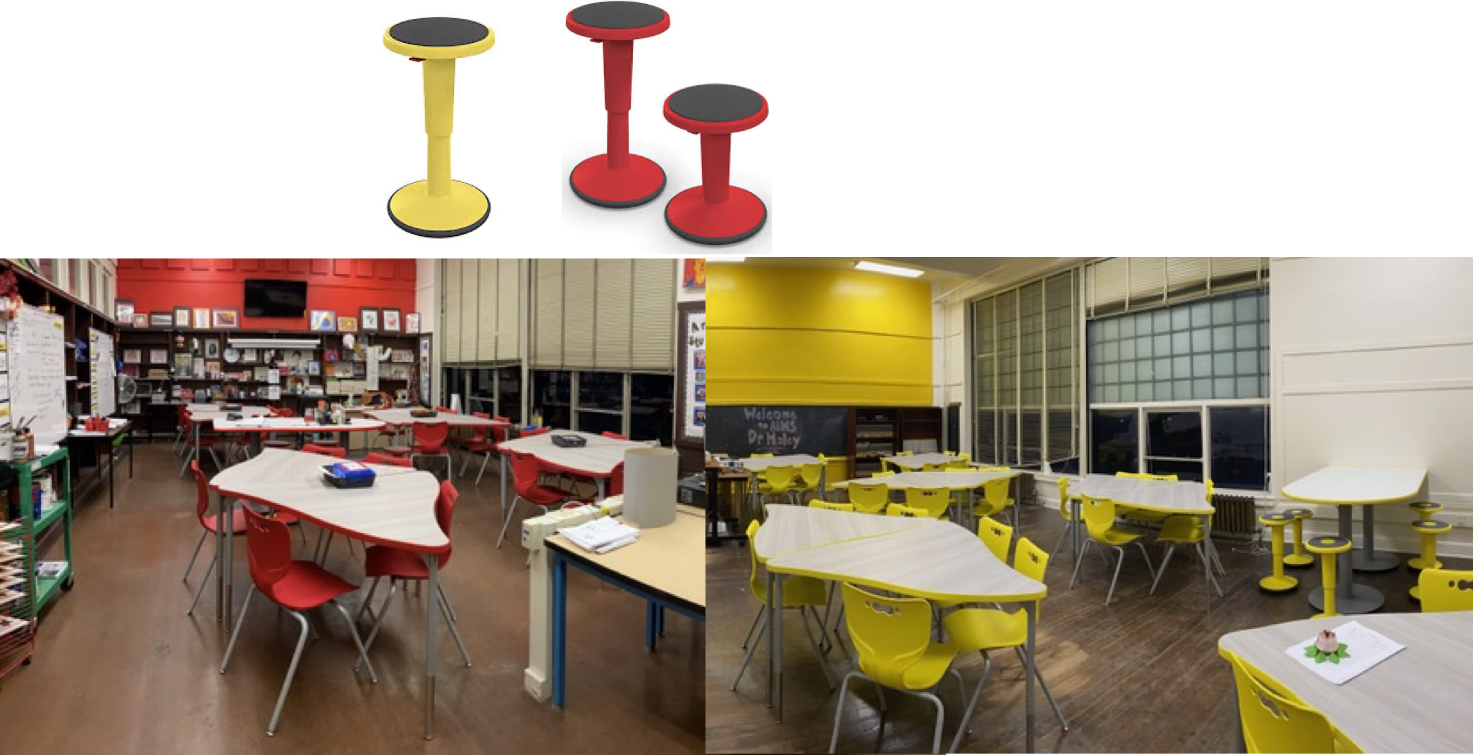
AIMS HS Renovations Updates

Slide 22
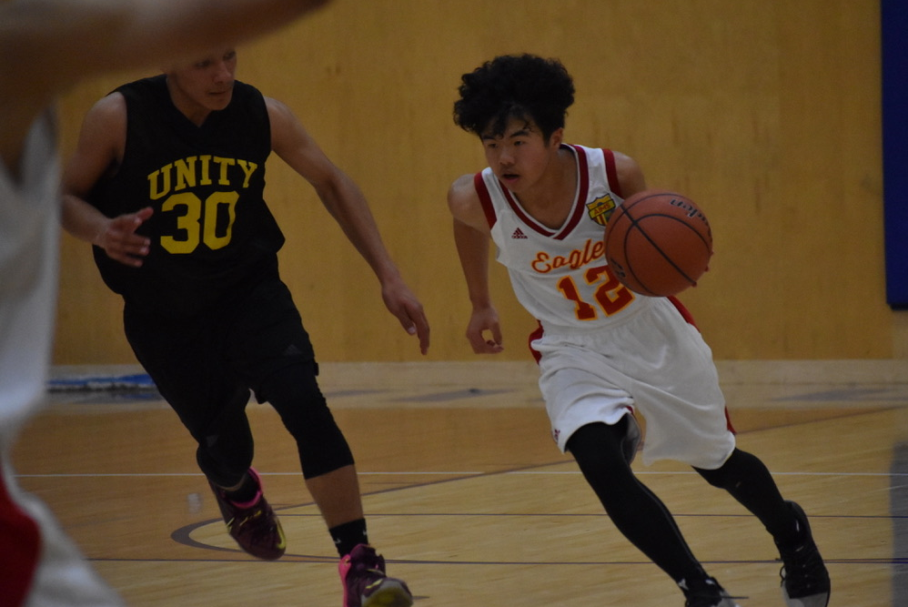
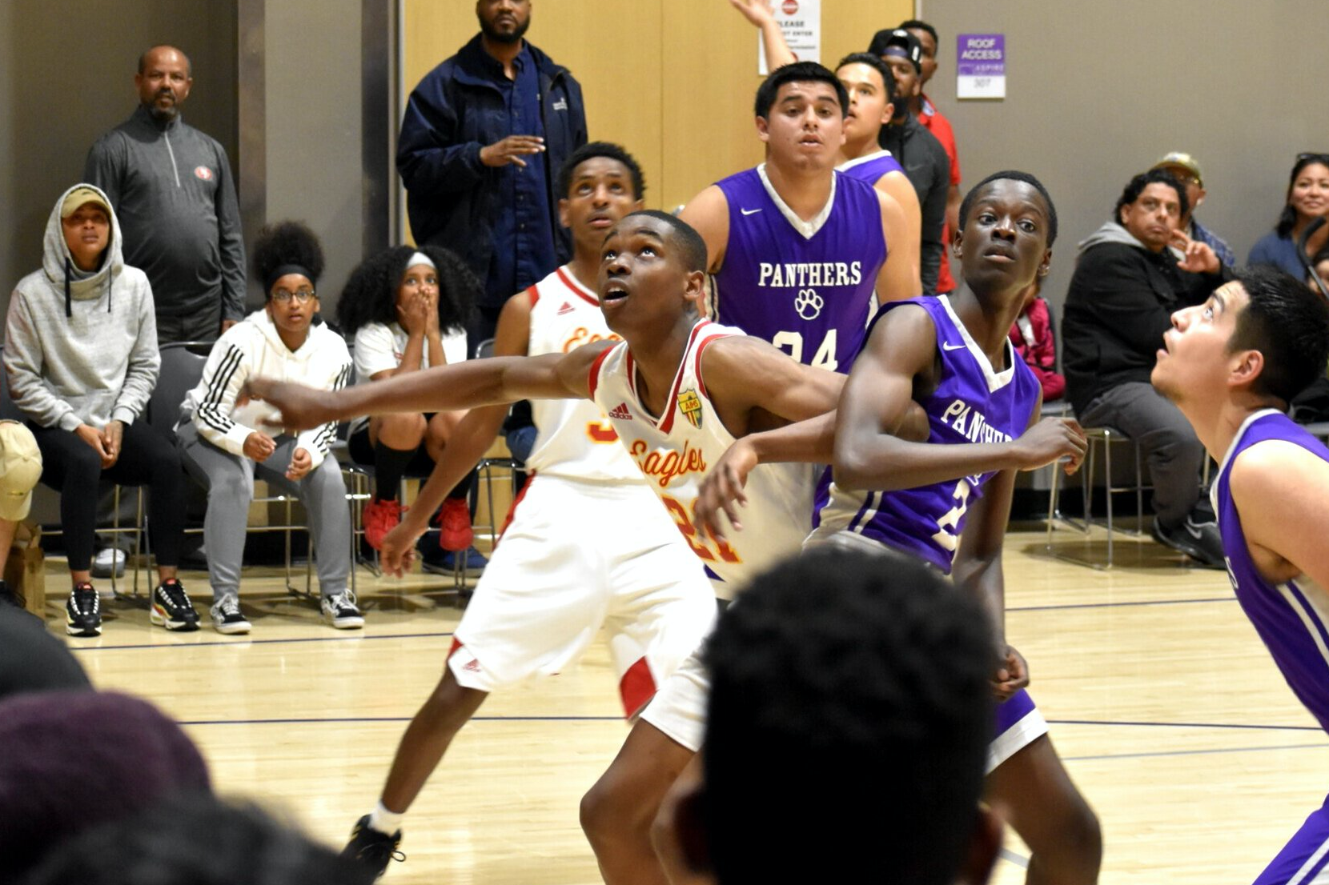
AIMS HS Athletics
Updates
Congratulations to Coach Jermaine Worley and the AIMS HS Boys Basketball team on winning its second consecutive championship. The Golden Eagles defeated Golden State Prep 61-42. Sophomore Wilson Wu, who scored 5 three pointers in the BACSAC Division B Championship was named as the MVP of the Tournament.
Freshman Ubadi Egeonu was ranked by MaxPreps as one of the top 20 rebounders nationally, and finished the season ranked #4 in the of California in rebounds. Ubadi also ranks as one of the top 5 freshmen in California in points, blocks, and steals - all while maintaining a 4.0 GPA for the semester.

Slide 23
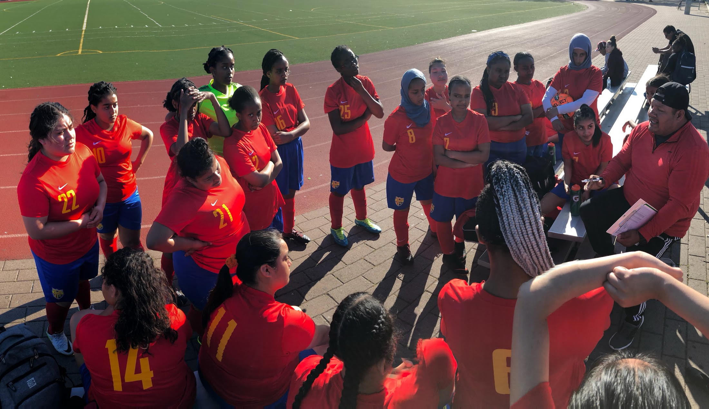
AIMS HS Athletics
Updates
In light of the COVID-19 outbreak, all sports in the State of California are postponed indefinitely
AIMS HS Badminton, Girls Soccer, Boys Volleyball, and Track and Field Will Be Impacted
Athletic Awards Banquets will likely shift to online versions

Slide 24
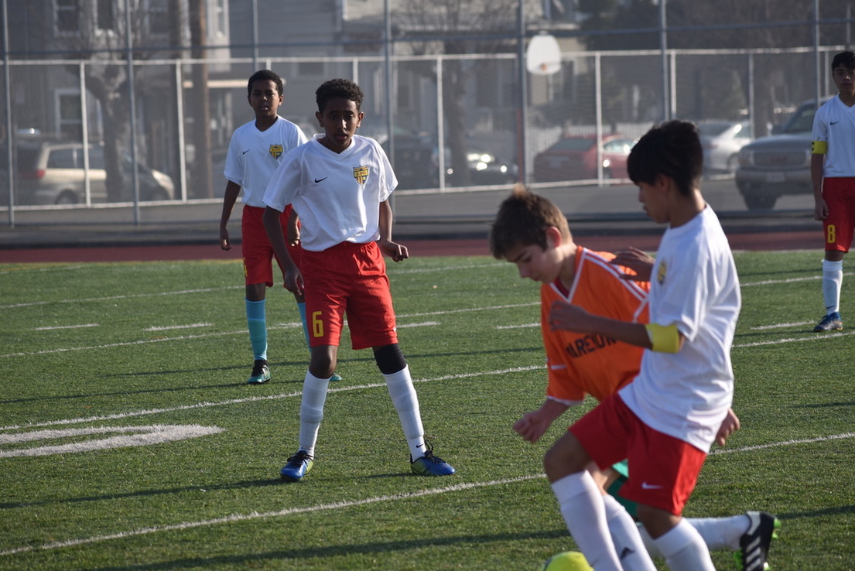
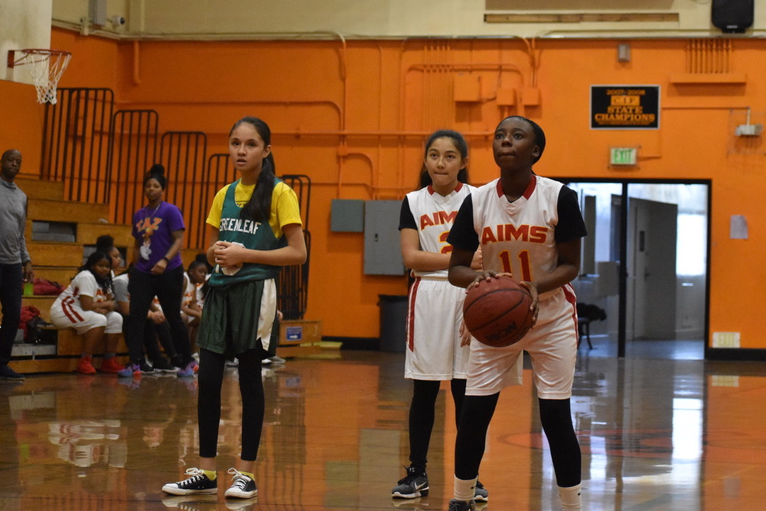
AIMS MS Athletics
Updates
All Middle School Sports Have been postponed until further notice
At season’s end and prior to playoffs, the AIMS MS Boys 8th Grade Basketball team finished undefeated and tied for 1st overall in the MS OAL
Additionally, the Boys Soccer team finished second place overall in the MS OAL with a record of 7-1-1.
Both Middle School Girls Basketball teams, and the Girls Soccer Team also qualified for MS Playoffs

