Slide 1
AIMS OPERATIONS Report
By
Marisol Magaña - Operations Director
Tiffany Tung - Operations Manager

Slide 2
Dates | AIPCS | AIPCS II | AIPHS
8/28/19 to 9/18/19 | 232 | 656 | 420
9/19/19 to 10/9/19 | 234 | 653 | 420
10/10/19 to 11/14/19 | 240 | 652 | 419
11/18/19 to 12/13/19 | 238 | 658 | 417
12/16/19 to 1/10/20 | 235 | 653 | 414
1/13/20 to 2/7/20 | 235 | 651 | 410
2/10/20 to 3/13/20 | 235 | 651 | 411
Enrollment Numbers

Slide 3
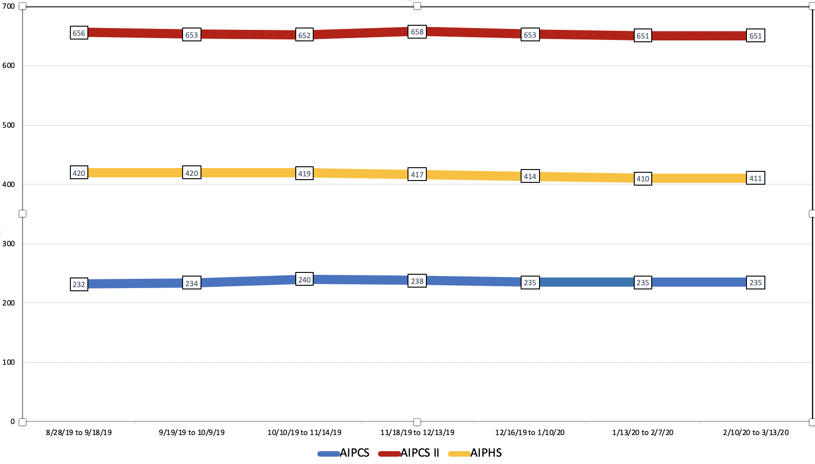
Enrollment Numbers - Graph

Slide 4
AIPCS
Average Daily Attendance (ADA) & Average Daily Attendance % (ADA%)
Dates | ADA | ADA %
8/28/19 to 9/18/19 | 221.80 | 97.65%
9/19/19 to 10/9/19 | 229.20 | 98.54%
10/10/19 to 11/14/19 | 231.77 | 98.35%
11/18/19 to 12/13/19 | 233.20 | 97.59%
12/16/19 to 1/10/20 | 233.10 | 98.88%
1/13/20 to 2/7/20 | 228.85 | 97.38%
2/10/20 to 2/28/20 | 229.50 | 97.66%
**

Slide 5
AIPCS II
Average Daily Attendance (ADA) & Average Daily Attendance % (ADA%)
Dates | ADA | ADA %
8/28/19 to 9/18/19 | 630.93 | 97.44%
9/19/19 to 10/9/19 | 638.18 | 97.86%
10/10/19 to 11/14/19 | 638.96 | 98.27%
11/18/19 to 12/13/19 | 639.25 | 97.54%
12/16/19 to 1/10/20 | 641.90 | 97.84%
1/13/20 to 2/7/20 | 632.75 | 97.3%
2/10/20 to 2/28/20 | 632.07 | 97.09%
*Reporting period April 1, 2019 to April 26, 2019

Slide 6
AIPHS
Average Daily Attendance (ADA) & Average Daily Attendance % (ADA%)
Dates | ADA | ADA %
8/28/19 to 9/18/19 | 385.31 | 92.06%
9/19/19 to 10/9/19 | 394.33 | 94.19%
10/10/19 to 11/14/19 | 403.12 | 96.16%
11/18/19 to 12/13/19 | 402.70 | 96.40%
12/16/19 to 1/10/20 | 403.25 | 97.29%
1/13/20 to 2/7/20 | 396.25 | 96.04%
2/10/20 to 2/28/20 | 390.86 | 95.33%
*Reporting period April 1, 2019 to April 26, 2019

Slide 7
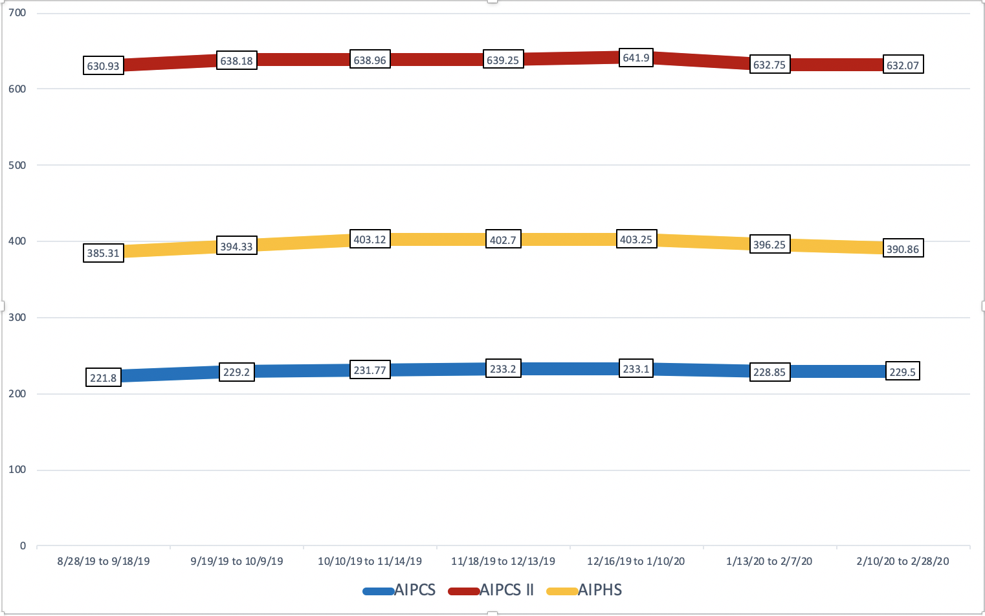
Average Daily Attendance (ADA) - Graph

Slide 8
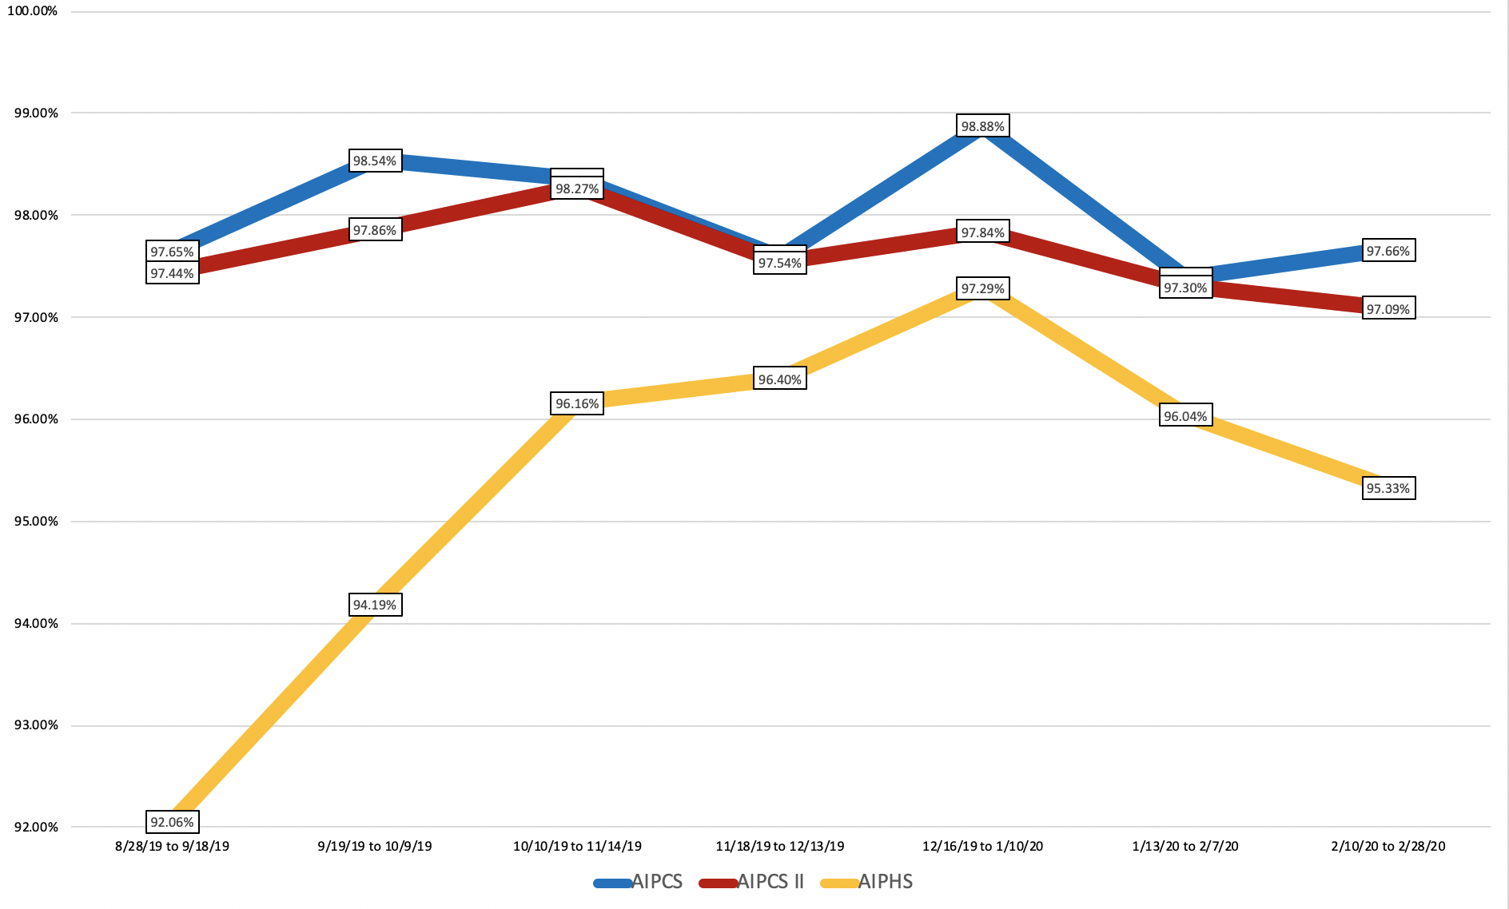
Average Daily Attendance % (ADA%) - Graph

Slide 9
Reporting/Compliance/Operation Management
Currently working on the following reports:
Completed California Longitudinal Pupil Achievement Data System (CALPADS) - Fall 2 - Due Date Originally March 20, 2020 - deadline extended to April 24, 2020.
Completed SchoolMint enrollment registration packet 2020-2021 School year.
Supporting parents with submitting documents for registrations through schoolmint.
Data Management on our Student Information System, and other software platforms.
Mass mailing to families regarding school closure
Supporting school sites w/ virtual learning implementation (student emails, computer check out guidelines)
Creating guidelines for telephone and fax access during school closure

Slide 10
AIMS Public Lottery
Public Lottery was held on Monday, March 9,2020. This year the public lottery was presented virtually through Facebook live.
URL: https://www.facebook.com/AIMSK12CollegePrep/videos/613111539267562/

Slide 11
AIMS Lottery: Accepted Students
American Indian Public Charter School II
K – 70 Students
1st – 2 Students
2nd – 9 Students
3rd – 4 Students
4th – 7 Students
5th – 2 Students
6th – 7 Students
7th – 20 Students
8th – 2 Students
American Indian Public Charter School
6th – 75 Students
7th – 15 Students
8th – 15 Students
American Indian Public High School
9th – 45 Students

Slide 12
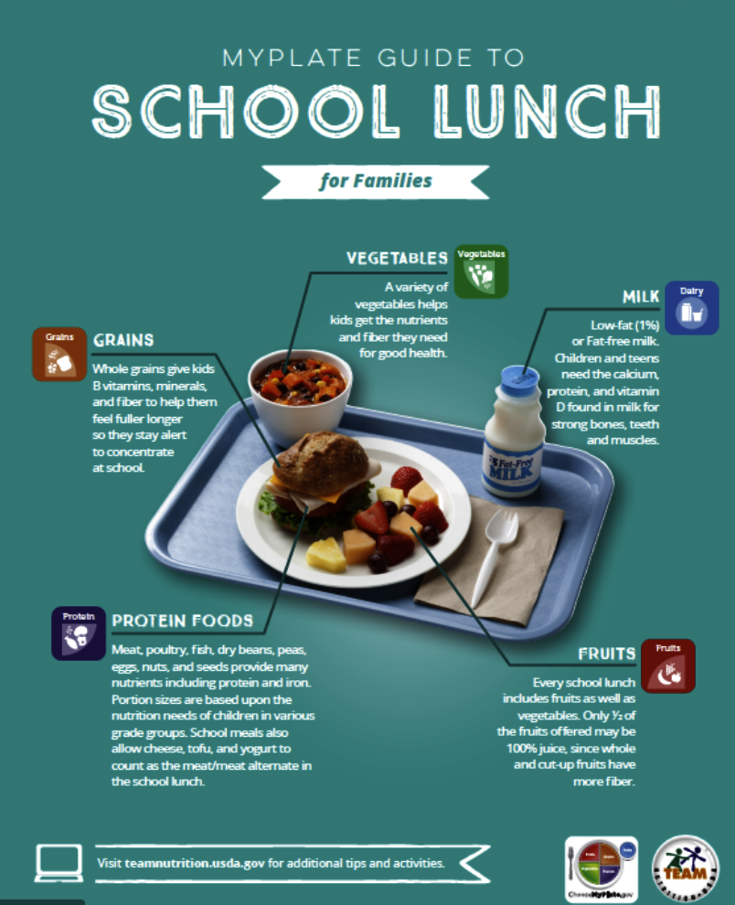
District Lunch & Snack Program Update
12th Street Campus K-8th - 490 students.
AIPHS has served 130 students daily.
Lunch was served for 2 days during school closure due to COVID-19.
Free and Reduced Lunch Data:
AIPCS II Free- 377 Reduced- 115 Paid- 164 Free & Reduced= 75.58%
AIPCS Free- 136 Reduced- 42 Paid- 54
Free & Reduced= 77.38%
AIPHS Free- 249 Reduced- 69 Paid- 103
Free & Reduced= 71.95%

Slide 13
Facilities
12th Street
Deep cleaning of the school in accordance with CDC guidelines
Painting and touch ups
Doing some maintenance to the building
Lakeview
Deep cleaning of the school in accordance with CDC guidelines
Pressure wash certain areas
Doing light paint touch ups
Doing some maintenance to the building

Slide 14
BACR After School Program
After School Education & Safety Program (ASES) - Grant Award
AIPCS: $177,381.64
AIPCS II: $177,381.64
ASES - Site Visit took place in December. The staff from ASES were impressed with what happening at our campus. Especially due to the lack of space.
Submitted first semi-annual attendance report (July 1, 2019–December 31, 2019) for AIPCS and AIPCS II
Submitted Second quarter expenditure report (October 1, 2019–December 31, 2019) for AIPCS and AIPCS II

Slide 15
AIMS Wellness Committee
The district wellness committee provides a way to inform teachers, staff, students and families about the work the school is doing to improve the health, socio-emotional and academic success of its students. The school wellness committee is also a way to ensure that district level wellness policies are implemented at the school site level. CDE Department of Nutrition require that three meetings are held in a school year.
First Wellness Meeting: Wednesday, January 29, 2020
Second Wellness Meeting: Monday, February 24, 2020 Third Wellness Meeting: Wellness resources will be posted online due to school closure. CDE/State has approved this change.
Goals: AIMS TV posting video around nutrition with an Athlete. PD sharing out best ways to take care of yourself due to COVID-19 and signage.Parent Coordinator, holding workshop to discuss healthy eating habits, Saturday.

Slide 16
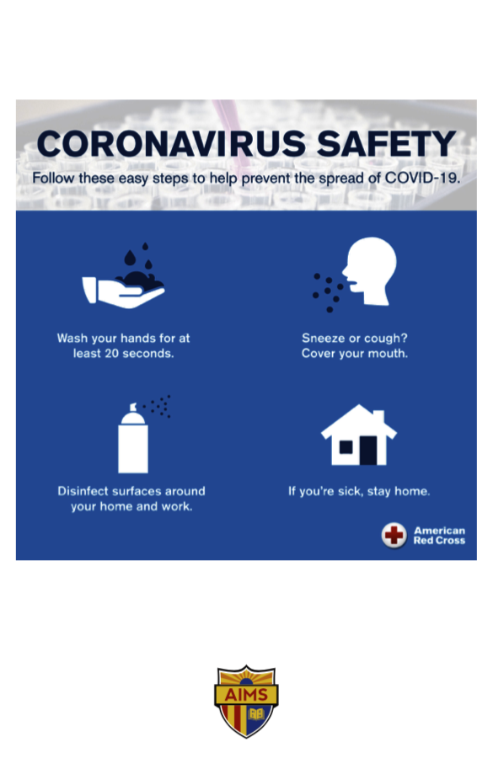
AIMS Wellness Committee
Signage posted throughout each school site to raise awareness around washing hands due to COVID-19.
Operations worked with Communications coordinator to create and post signage.

