Slide 1
California School Dashboard

Slide 2
CA Dashboard
What Is the California School Dashboard?
The California School Dashboard (or the Dashboard) is an online tool that shows parents and communities how schools and districts are performing on test scores, graduation rates, and other measures of student success. These multiple measures of success reflect California’s new accountability system, which is based on the ten priority areas of the Local Control Funding Formula (LCFF) available at http://www.cde.ca.gov/fg/aa/lc/lcffoverview.asp.

Slide 3
Performance Levels Descriptions

Slide 4
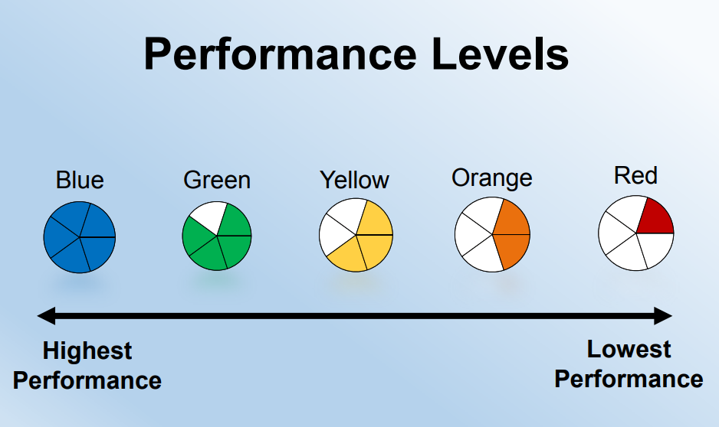
Performance Level

Slide 5
State Indicators for Fall 2019 Dashboard
1. Chronic Absenteeism
2. Suspension Rate (for grades K–12)
3. English Learner Progress (for grades 1–12)
4. Graduation Rate (for high school only)
5. College/Career (for high school only)
6. Academic (for grades 3–8 only)
English language arts/literacy (ELA) Mathematics

Slide 6
Local Indicators
Local indicators are a part of a seamless accountability system that:
Reflects the emphasis on ‘local control’
Enables LEAs to measure its progress using local data
Provides valuable information necessary for stakeholders to engage in meaningful engagement with a holistic understanding of local successes and challenges
Informs the Local Control and Accountability Plan (LCAP) planning process

Slide 7
Local Indicators
Priority 1:
Basic Services and Conditions
Teacher misassignment
Student access to instructional material
Conditions of school facilities
Priority 2:
Implementation of State Academic Standards
Priority 3:
Parent Engagement
Priority 6:
School Climate
Priority 7:
Access to a Broad Course of Study

Slide 8
AIPCS - Priority 1
Priority 1: Met
Teacher misassignment - 0
Student access to instructional material - 100%
Conditions of school facilities - Good
Teacher credentialing continues to be a priority. Several teachers who are in need of clearing their preliminary credential participated in the induction program, a cost for which the school pays.
We ensure all of our students have access to standards-aligned instructional materials for use at home and school.
Facilities are checked and maintained throughout the year. The school created a partnership with an on-site janitorial company to provide daily cleaning and maintenance services. This provided students a healthy and inviting learning environment where they are protected from physical and emotional harm and is essential to the mission of our schools. Safe schools are not just places with advanced security procedures. They are also places that help students develop and that allow them to succeed even in difficult circumstances. We believe safe schools encourage healthy behaviors that help students learn about fitness, nutrition, and healthy choices.

Slide 9
AIPCS - Priority 2
Priority 2: Met
The district conducted several needs assessments in order to determine proper ELA curriculum and teacher training required to build vertical alignment between K-12; the ultimate goal is college-readiness. Schools determined a need for more higher order thinking materials to support a college-ready literacy program. Teachers began to receive training on building higher order thinking literacy protocols to build upon a robust reading comprehension program.
The district conducted additional needs assessments in order to determine better ways to utilize the existing HMH Go Math curriculum. Teachers required additional training in emphasizing Common Core approaches to math in order to supplement the curriculum effectively. Teachers received this training. Professional development towards Next Generation Science Standards implementation began with help from Lawrence Hall of Science. Students were also able to use science kits from Foss Science for a more hands-on experience. Teachers began familiarizing themselves with DBQ for Social Science. Mandarin and Spanish were both offered for students in the middle school.
In addition, the district plans to apply for Measure G1 which will allow students to be provided innovative courses that cover visual and performing arts. We plan that this grant will allow our school district to have the opportunity to excel academically to also have the access to musical and artistic enrichment. We envision a program that will offer a unique combination of rigorous curriculum and artistic immersion.

Slide 10
AIPCS - Priority 3
Priority 3: Met
Parent Engagement
In order to connect with student families as well as connect them to new information, we offered several venues throughout the year, including; grade division specific curriculum meetings for parents. Communicating in a regular manner through SSC and ELAC.
We also conduct annual surveys for students and families to share with us how we are doing and areas that we can improve. Below are the results from the family survey for questions relating to parent engagement .
Family Survey Results (Strongly agree or agree responses)
1: I feel that I have a voice in my child's education. 86%
2: This school encourages me to be an active partner with the school in educating my child. 86%
3: This school keeps me well-informed about school activities. 91%

Slide 11
AIPCS - Priority 6
Priority 6: Met
We conducted an annual survey to get results on school climate. The survey is given to 6th-8th students/families. Below are the results for students and families.
Student Survey (Strongly agree or agree responses)
1: At school I am able to do my work without worrying about my physical and/or emotional safety. 81%
2: I feel I am part of this school. 73%
3: Teachers and other grown-ups at school care about me. 79%
Family Survey (Strongly agree or agree responses)
1: At school my child is able to do his/her work without worrying about his/her physical or emotional safety. 91%
2: This school has a supportive learning environment for my child. 91%

Slide 12
AIPCS - Priority 7
Priority 7: Met
Access to a Broad Course of Study
At AIPCS, all students were enrolled in the following courses:
English Language Arts
Mathematics
Social Studies
Science
Physical Education
Mandarin / Spanish
Visual Performing Arts - Art/Graphic Design, Music
Electives (Friday)
The tools used to track enrollment and access to these courses include enrollment documents, class schedule monitoring (specifically 90-minute blocks for both English Language Arts and Math, as mandated in the AIPCS charter). Additionally, the LEA monitors student access to coursework by teacher gradebooks and the dispersal of progress reports and report cards every three weeks.

Slide 13
AIPCS II - Priority 1
Priority 1: Met
Teacher misassignment - 0
Student access to instructional material - 100%
Conditions of school facilities - Good.
Teacher credentialing continues to be a priority. Several teachers who are in need of clearing their preliminary credential participated in the induction program, a cost for which the school pays.
We ensure all of our students have access to standards-aligned instructional materials for use at home and school.
Facilities are checked and maintained throughout the year. The school created a partnership with an onsite janitorial company to provide daily cleaning and maintenance services. This provided students a healthy and inviting learning environment where they are protected from physical and emotional harm and is essential to the mission of our schools. Safe schools are not just places with advanced security procedures. They are also places that help students develop and that allow them to succeed even in difficult circumstances. We believe safe schools encourage healthy behaviors that help students learn about fitness, nutrition, and healthy choices.

Slide 14
AIPCS II- Priority 2
Priority 2: Met
The district conducted several needs assessments in order to determine proper ELA curriculum and teacher training required to build vertical alignment between K-12; the ultimate goal is college-readiness. Schools determined a need for more higher order thinking materials to support a college-ready literacy program. Teachers began to receive training on building higher order thinking literacy protocols to build upon a robust reading comprehension program.
The district conducted several needs assessments in order to determine better ways to utilize the existing HMH Go Math curriculum. Teachers required additional training in emphasizing Common Core approaches to math in order to supplement the curriculum effectively. Teachers received that training. Professional development towards Next Generation Science Standards implementation began with help from Lawrence Hall of Science. Teachers also began familiarizing themselves with DBQ in Social Science. Mandarin and Spanish were both offered for students in the middle school.
In addition the district plans to apply for Measure G which will allow students to be provided innovative courses that cover visual and performing arts. We plan that this grant will allow our school district to have the opportunity to excel academically to to also have the access to musical and artistic enrichment. We envision a program that will offer a unique combination of rigorous curriculum and artistic immersion.

Slide 15
AIPCS II- Priority 3
Priority 3: Met
Parent Engagement
In order to connect with student families as well as connect them to new information, we offered several venues throughout the year, including; grade division specific curriculum meetings for parents. Communicating in a regular manner through SSC and ELAC.
We also conduct annual surveys for students and families to share with us how we are doing and areas that we can improve. Below please find the results for the family survey. The questions relate to parent engagement and the results.
Family Survey Results (Strongly agree or agree responses)
1: I feel that I have a voice in my child's education. 84%
2: This school encourages me to be an active partner with the school in educating my child. 76%
3: This school keeps me well-informed about school activities. 85%

Slide 16
AIPCS II - Priority 6
Priority 6: Met
Student Survey Results (Strongly agree or agree responses)
1: At school I am able to do my work without worrying about my physical and/or emotional safety. 86%
2: I feel I am part of this school. 86%
3: Teachers and other grown-ups at school care about me. 88%
Family Survey (Strongly agree or agree responses)
1: At school my child is able to do his/her work without worrying about his/her physical or emotional safety. 84%
2: This school has a supportive learning environment for my child. 87%
Providing students a healthy and inviting learning environment where they are protected from physical and emotional harm is essential to the mission of all three of our schools. Safe schools are not just places with advanced security procedures. They are also places that help students develop that allow them to succeed even in difficult circumstances. Safe schools encourage healthy behaviors that help students learn about fitness, nutrition, and healthy choices.

Slide 17
AIPCS II - Priority 7
Priority 7: Met
Within the elementary system (K-5) all students were enrolled in the following courses:
English Language Arts
Mathematics
Social Studies
Science
Physical Education
Mandarin
Within the Middle School System (6-8) all students were enrolled in the following courses:
English Language Arts
Mathematics
Social Studies
Science
Physical Education
Mandarin / Spanish
Visual Performing Arts - Art/Graphic Design, Music
Electives (Friday)
The tools used to track enrollment and access to these courses include enrollment documents, class schedule monitoring (specifically 90-minute blocks for both English Language Arts and Math, as mandated in the AIPCS II charter). Additionally, the LEA monitors student access to coursework by teacher gradebooks and the dispersal of progress reports and report cards every three weeks.

Slide 18
AIPHS - Priority 1
Priority 1: Met
Teacher misassignment - 0
Student access to instructional material - 100%
Conditions of school facilities - Good
AIPHS has an up-to-date AP-aligned textbooks/curriculum and novels for all of our students. Implementation targets were set for redesign of science lab. -
All of AIPHS teachers are credentialed and teach in their corresponding subject in every classroom.
Teachers remain in one classroom for their subject matter teaching, in self contained classrooms, which are cleaned on a nightly basis by custodial staff.
Providing students a healthy and inviting learning environment where they are protected from physical and emotional harm is essential to the mission of all three of our schools. Safe schools are not just places with advanced security procedures. They are also places that help students develop that allow them to succeed even in difficult circumstances. Safe schools encourage healthy behaviors that help students learn about fitness, nutrition, and healthy choices.
To better address student nutritional needs we began the process of establishing a lunch program to serve all students in our high school. Having begun this program for the K-8 site, physical plant preparations, health certifications, and staff training was begun at the high school.

Slide 19
AIPHS - Priority 2
Priority 2: Met
The district conducted several needs assessments in order to determine proper ELA curriculum and teacher training required to build vertical alignment between K-12; the ultimate goal is college-readiness. Schools determined a need for more higher order thinking materials to support a college-ready literacy program.
To ensure that we are providing and achieving academic standards we provide an alignment of School novels with AP List, Exemplars for writing and rubric use, assessment of quality ELD programming and planning for ELD K-12 initiative. In addition our program offered math summer intensive instruction intervention, Rosetta Stone for EL student’s (newcomer program).
We offer a robust AP curriculum framework to ensure students are prepared for college. Advanced placement courses provides our students the college-level opportunities and readiness. New textbooks were purchased in alignment with updated AP standards of focus and rigor.
AIPHS partners with Peralta Colleges to offer concurrent enrollment for its students through the College of Alameda.

Slide 20
AIPHS - Priority 3
Priority 3: Met
Parent Engagement
In order to connect with student families as well as connect them to new information, we offered several venues throughout the year, including; grade division specific curriculum meetings for parents. Communicating in a regular manner through SSC and ELAC.
AIPHS also held a Word Cafe and AIM for the Arts (Art Show)
We also conduct annual surveys for students and families to share with us how we are doing and areas that we can improve. Below please find the results for the family survey. The questions relate to parent engagement and the results.
Family Surveys (Strongly agree or agree responses)
1: I feel that I have a voice in my child's education. 81%
2: This school encourages me to be an active partner with the school in educating my child. 69%
3: This school keeps me well-informed about school activities. 69%

Slide 21
AIPHS - Priority 6
Priority 6: Met
We conducted an annual survey to get results on school climate. The survey is given to 9th-12th students/families. Below are the results for students and families.
Student Survey (Strongly agree or agree responses)
1: At school I am able to do my work without worrying about my physical and/or emotional safety. 71%
2: I feel I am part of this school. 69%
3: Teachers and other grown-ups at school care about me. 76%
Family Survey (Strongly agree or agree responses)
1: At school my child is able to do his/her work without worrying about his/her physical or emotional safety. 91%
2: This school has a supportive learning environment for my child. 65%

Slide 22
AIPHS - Priority 7
Priority 7: Met
All students are part of a course of study which includes rigorous coursework as documented by the variety of AP courses and honors classes which are part of and progress through each grade level. These courses meet and exceed the expectations University of California “A-G requirements” for nearly all students. Students with special needs and ELD students have parallel courses as required by their situation. Students are part of the mainstream classes as fully as possible, and may be altered as required by applicable laws.
All students progress through the course schedule over the course of four years at AIPHS. This progression includes all of the study areas outlined in the California description of the “broad course of study” and the University of California A-G requirements. That the schedule is rigorous is displayed in the percentage of students who score a minimum of 3 on AP tests throughout their tenure in our high school.
In support of this desire for the widest course of study to be available, we continue to cultivate high expectations, college going culture and family spirit of support for all students.
In addition, we have developed a districtwide ELD initiative that supports and follows students throughout their years at AIMS K-12.
We are training our teachers in the AVID college preparatory system to build another secondary school-wide strategy.
We continue to develop college pathways for our students that will allow them to further engage their interests, while offering more supportive and diverse college preparatory classes.

