Slide 1
AIMS K-12
English Language Development
Presentation
October 15, 2019

Slide 2
ELD goals for this year
Focus on improving literacy K-12
Progress Monitor more frequently
Work with teacher in guided reading and using AVID strategies.
2) Monitor current ELs and RFEP students more effectively.
3) Work with teachers on aligning ELA Common Core Standards with ELD Standards. Provide support to mainstream teachers on EL strategies, accommodations and modifications.
4) Finalize an EL Master Plan for AIMS K-12 College Prep Charter District.

Slide 3
Parent Involvement
ELAC/DELAC: Meetings are held every other month on the first Tuesday.
ESL Class: Offered twice a month, taught by our AIMS teacher.
Literacy Night: Showcase students work and opportunity to listen to a book in another language by parents.

Slide 4
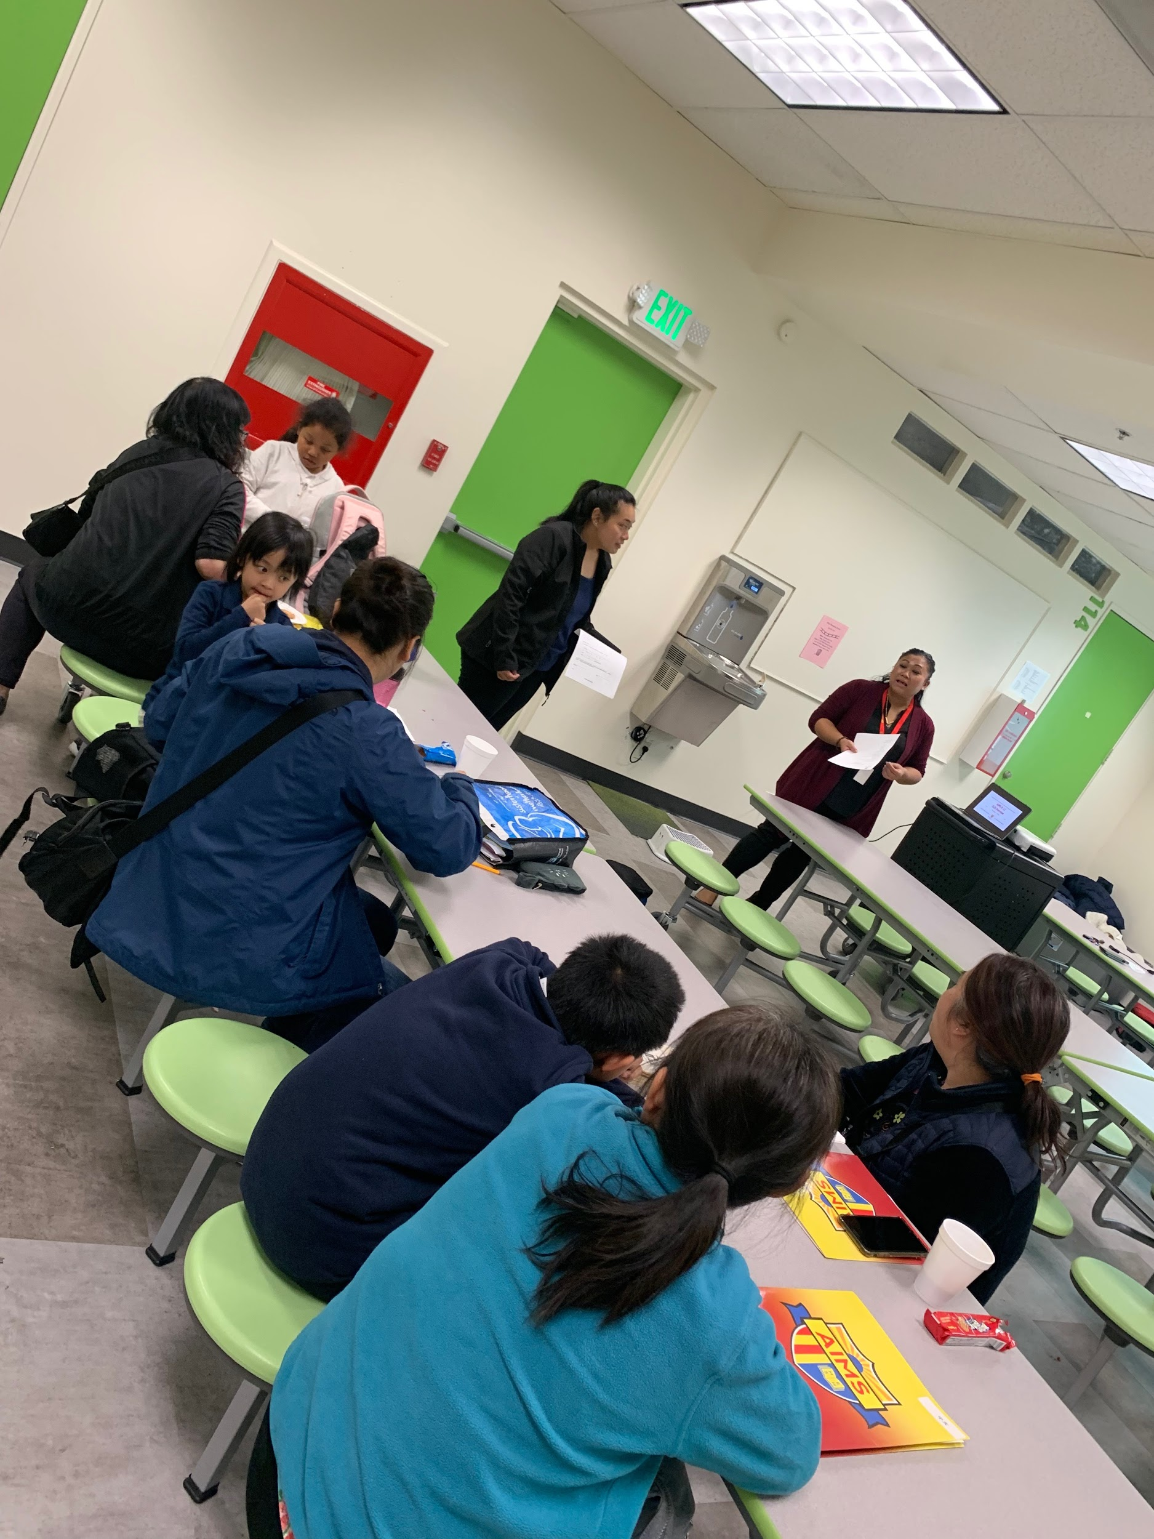
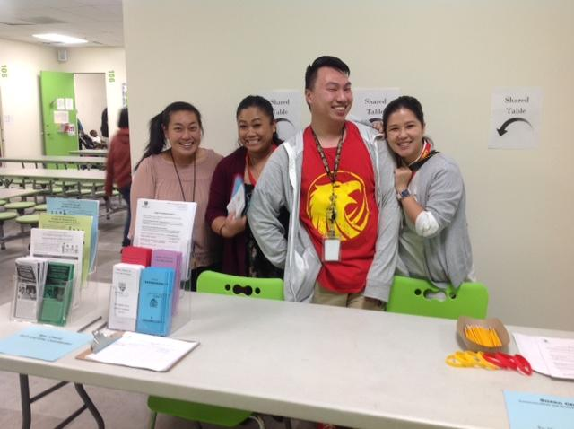
English Language Advisory Committee (ELAC)
First Meeting: Oct. 1, 2019- Agenda
Presented the ELD Program, ELAC roles and responsibilities, purpose of ELAC, etc.
Election for ELAC ongoing until Oct. 15th, memo will be send out Oct. 17th to ELL families to vote.
Back to school nights-Recruiting parents

Slide 5
ESL Class
Starts this Sat. Oct. 12th
Literacy Night
Showcase students work, presentation and parents reading in native language.

Slide 6
Professional Development
ELPAC training Oct. 28th on transition to computer.

