Slide 1
AIMS OPERATIONS Report
By
Ms. Magaña Operations Director
Ms. Tung Operations Manager

Slide 2
Dates | AIPCS | AIPCS II | AIPHS
8/28/19 to 9/18/19 | 232 | 656 | 420
9/19/19 to 10/9/19 | 234 | 653 | 420
Enrollment Numbers
*

Slide 3
AIPCS ADA & ADA %
Dates | ADA | ADA %
8/28/19 to 9/18/19 | 221.80 | 97.65%
9/19/19 to 10/9/19 | 229.20 | 98.54%
*Reporting period April 1, 2019 to April 26, 2019

Slide 4
AIPCS II ADA & ADA %
Dates | ADA | ADA %
8/28/19 to 9/18/19 | 630.93 | 97.44%
9/19/19 to 10/9/19 | 638.18 | 97.86
*Reporting period April 1, 2019 to April 26, 2019

Slide 5
AIPHS ADA & ADA %
Dates | ADA | ADA %
8/28/19 to 9/18/19 | 385.31 | 92.06%
9/19/19 to 10/9/19 | 394.33 | 94.19
*Reporting period April 1, 2019 to April 26, 2019

Slide 6
Reporting & Compliance
Office of Charters (OCS) Student Data Report due 10/24/19
California Basic Education (CBEDS) for AIPCS, AIPCS II and AIPHS due 10/31/19
Immunization Report for grades K and 7th due 11/1/19
CA Dashboard - Local Indicators for AIPCS, AIPCS II and AIPHS due 11/1/19
LCAP Addendum due 11/1/19
Prop 39 Request for AIPCS, AIPCS II and AIPHS due 11/1/19
Supported with Measure G1 - Audit due 11/1/19
CALPADS Fall 1

Slide 7
Reporting & Compliance
(OCS) Office of Charter Report- Student enrollment information as of 10/2 to match information submitted to CDE (California Department of Education).
(CBEDS) California Basic Education- annual collection of district and school information, aggregate data of students and staff.
Immunization Report- (CDPH) California Department of Public Health requires submission of report to ensure all required immunizations have been met.
California Dashboard - The California School Dashboard (or the Dashboard) is an online tool that shows parents and communities how schools and districts are performing on test scores, graduation rates, and other measures of student success.
Prop 39 - We submit a petition asking OUSD to provide us with facilities for our schools. This is to ensure that all public school students share equally in district facilities.
Calpads Fall 1-

Slide 8
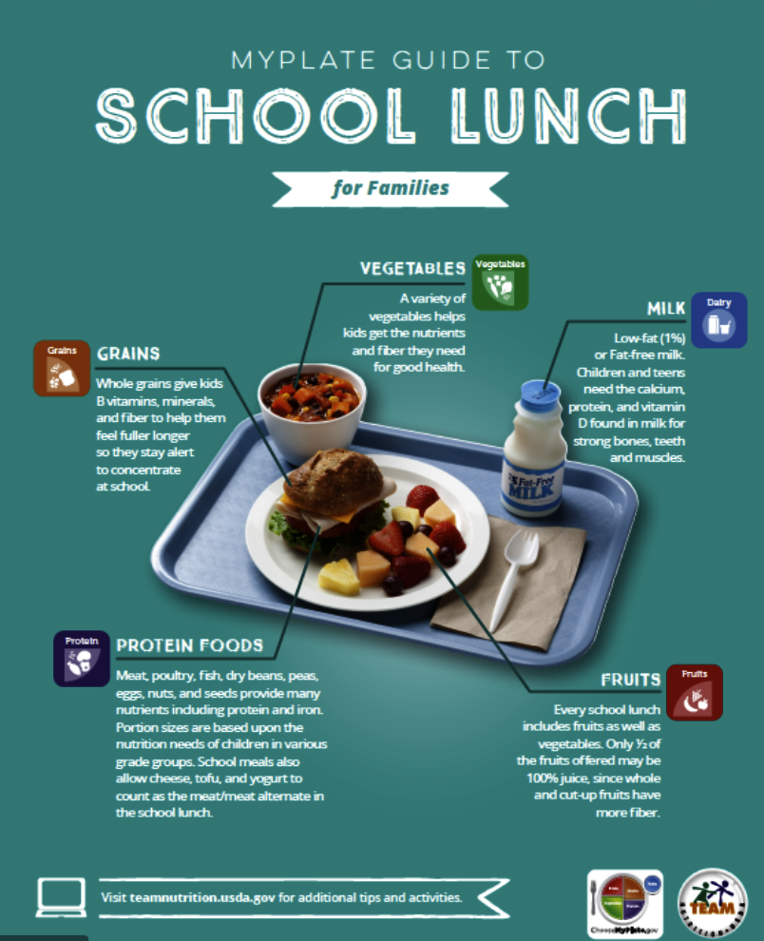
District Lunch & Snack Program Update
12th Street Campus K-8th - Oct. 7 490 students.
AIPHS has served 150 students daily.
Title I Data:
AIPCS II Free- 377 Reduced- 115 Paid- 164 Free & Reduced= 75.58%
AIPCS Free- 136 Reduced- 42 Paid- 54
Free & Reduced= 77.38%
AIPHS Free- 249 Reduced- 69 Paid- 103
Free & Reduced= 71.95%
Started snack for 12th street on 1st day of school, all snacks are 100% reimbursed by federal and state reimbursements.

Slide 9
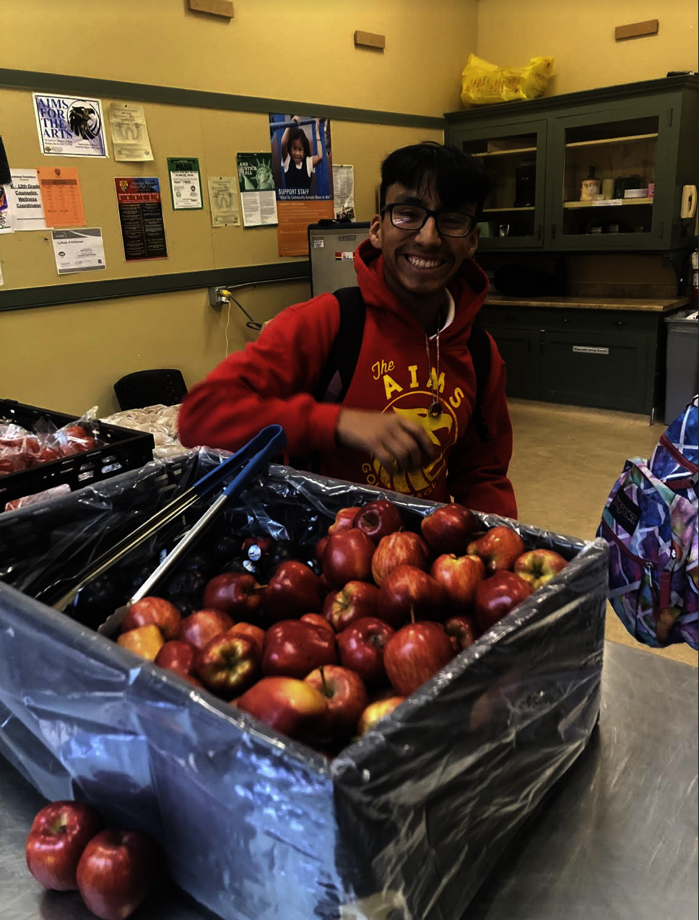
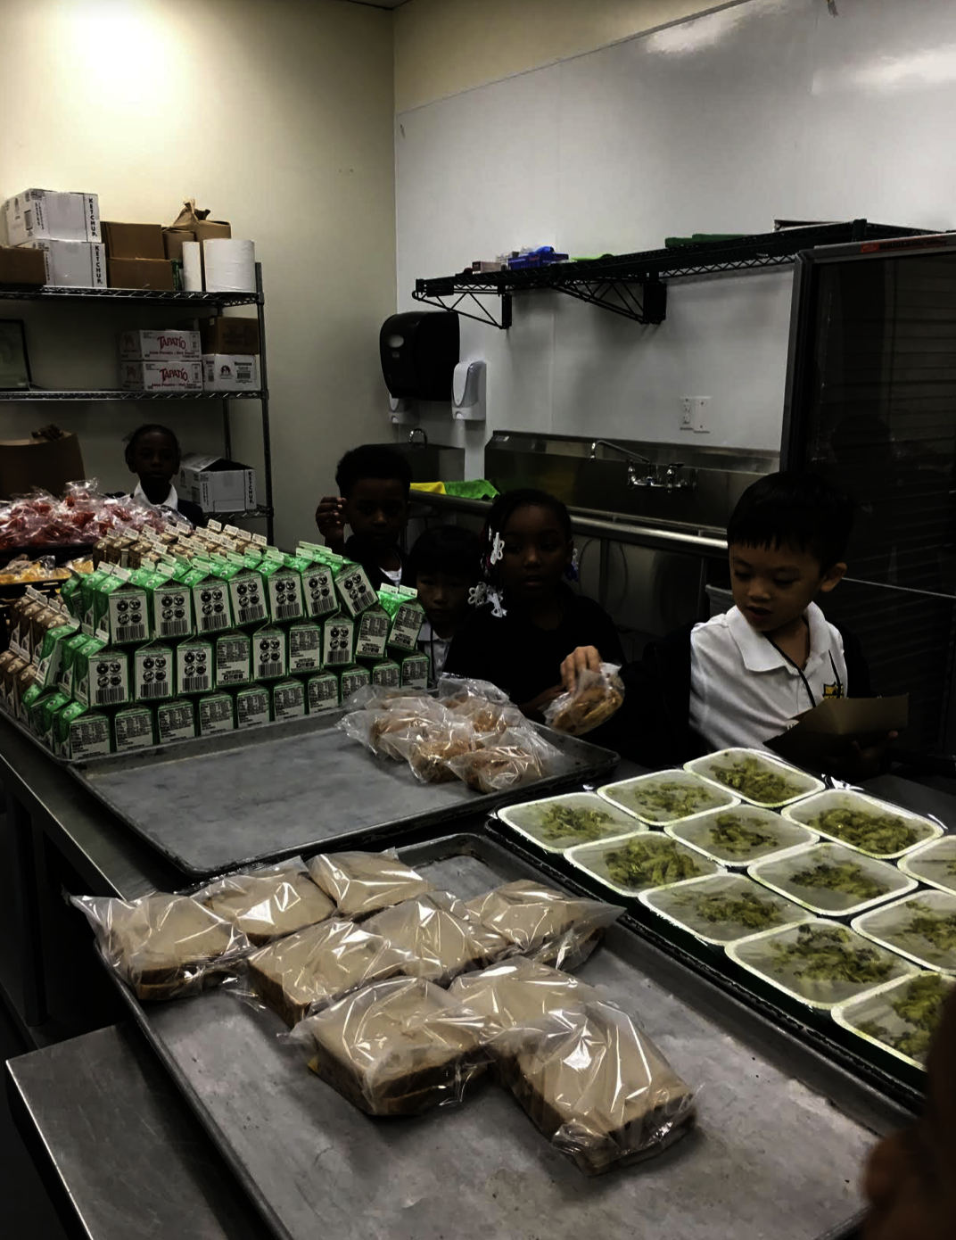
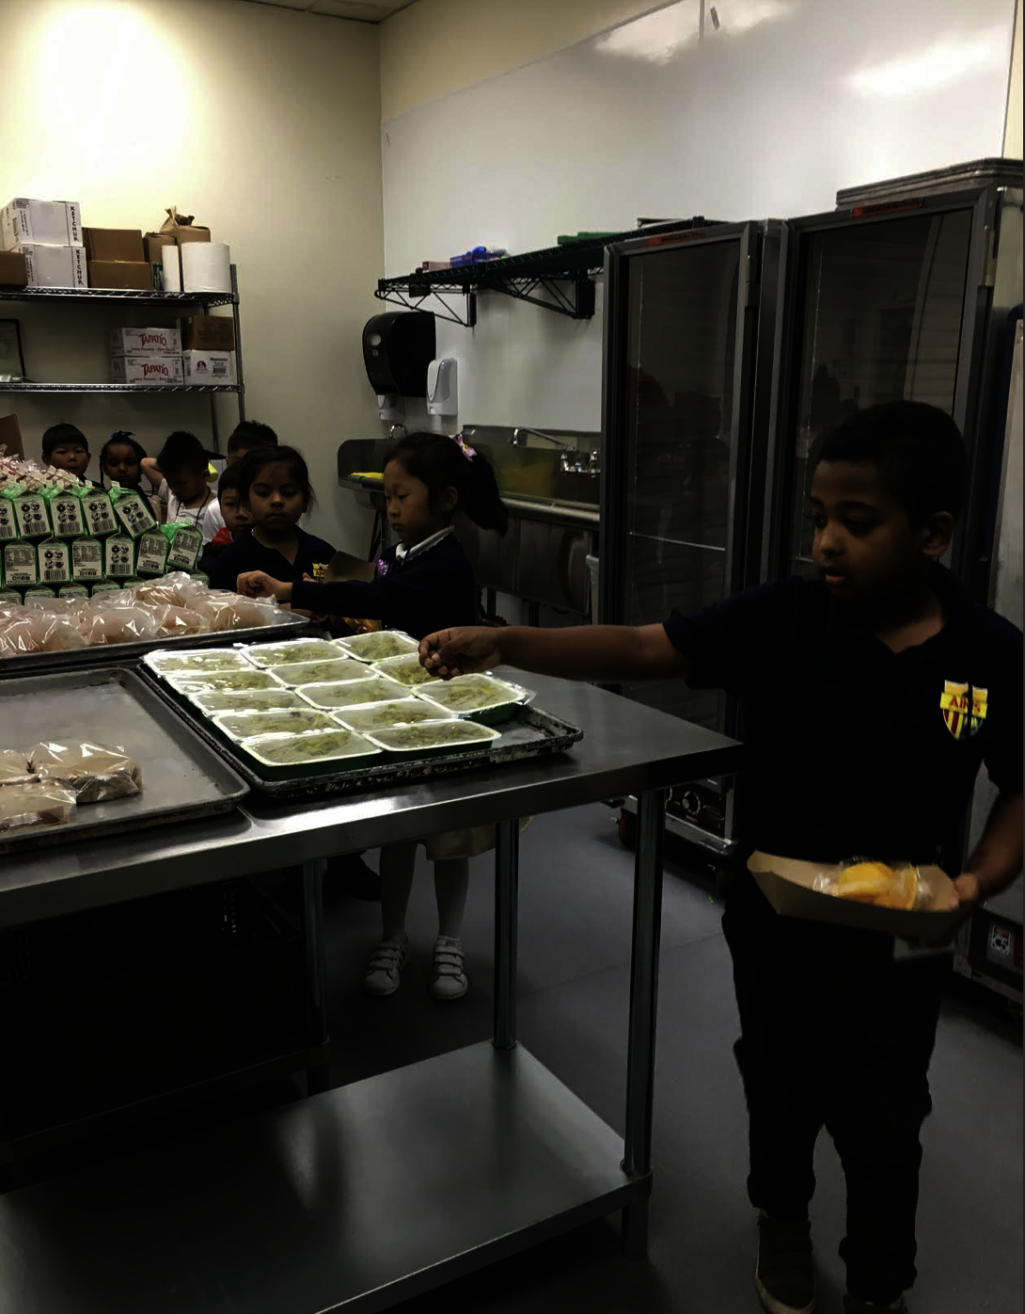
Lunch Program Fun!!!

Slide 10
BACR After School Program
After School Education & Safety Program (ASES) - Grant Award
AIPCS: $177,381.64
AIPCS II: $177,381.64
Enrollment
Elementary - 83
Middle School - 45

