Slide 1
AIMS K-12 Board Report
October 15th, 2019
Superintendent Maya Woods-Cadiz
Mr. Christopher Ahmad (Head of School -Elementary)
Mr. Maurice Williams (Head of Schools - Middle)
Mr. Tareyton Russ (AIPHS Head of School)
Mr. Peter Holmquist (AIPHS Head of Academics)

Slide 2
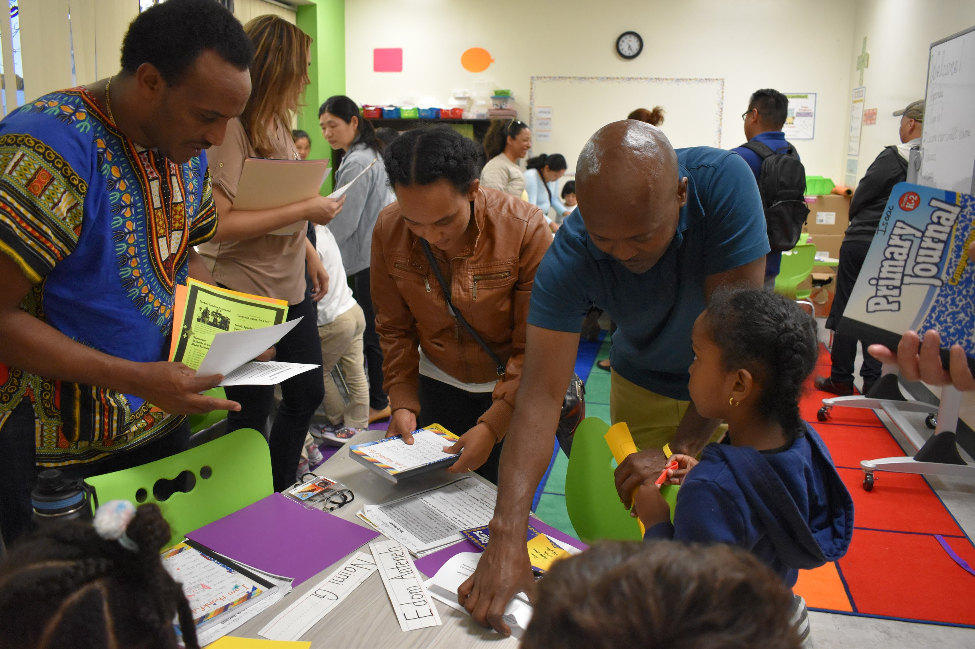
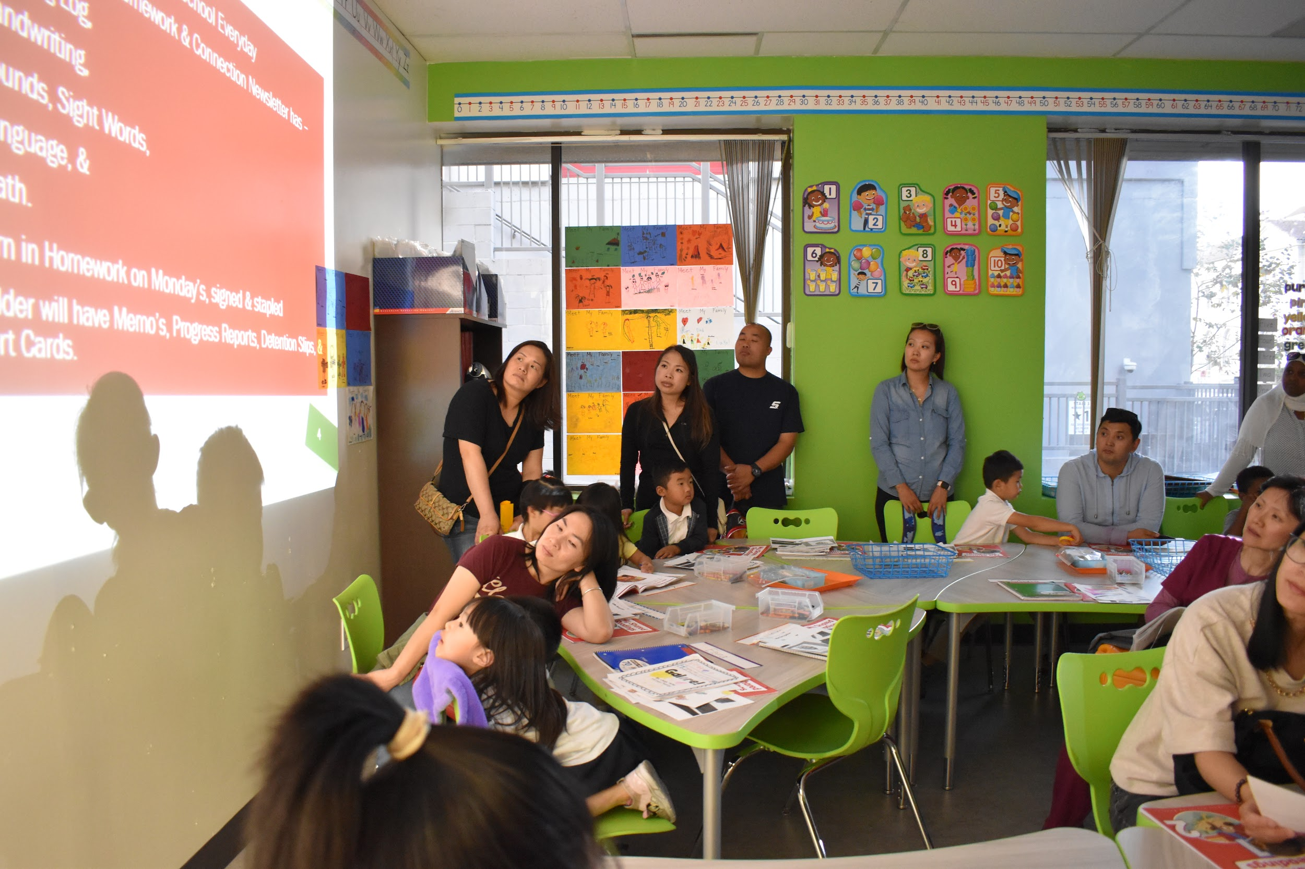
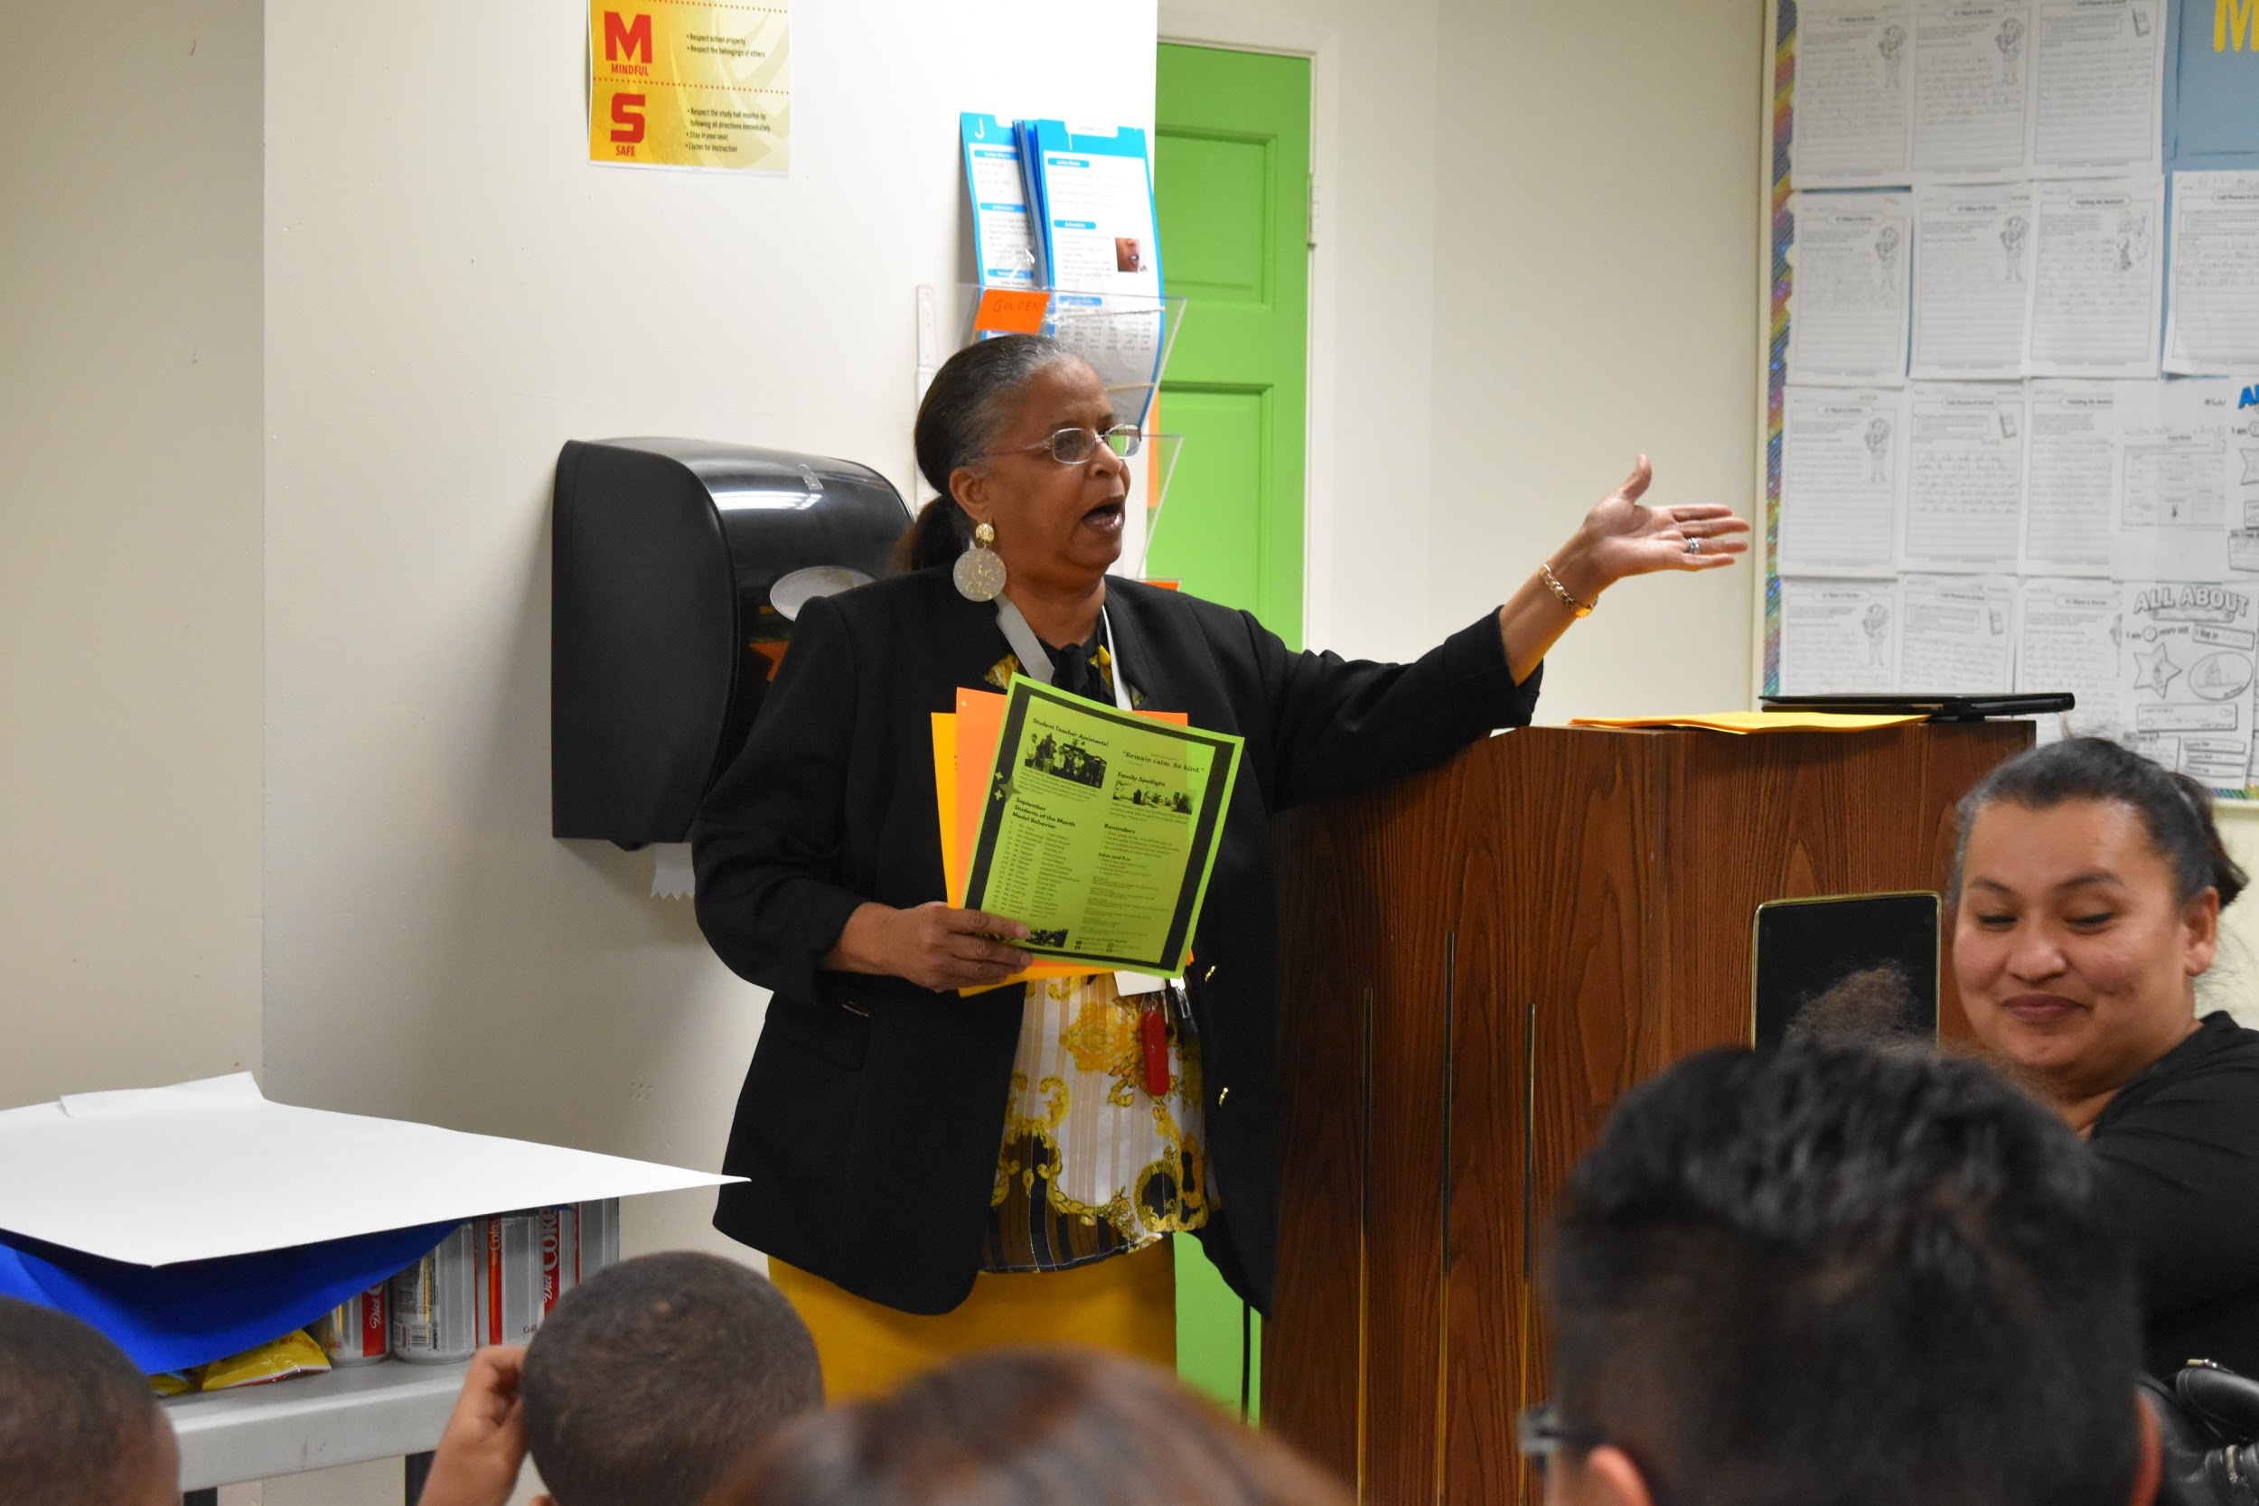
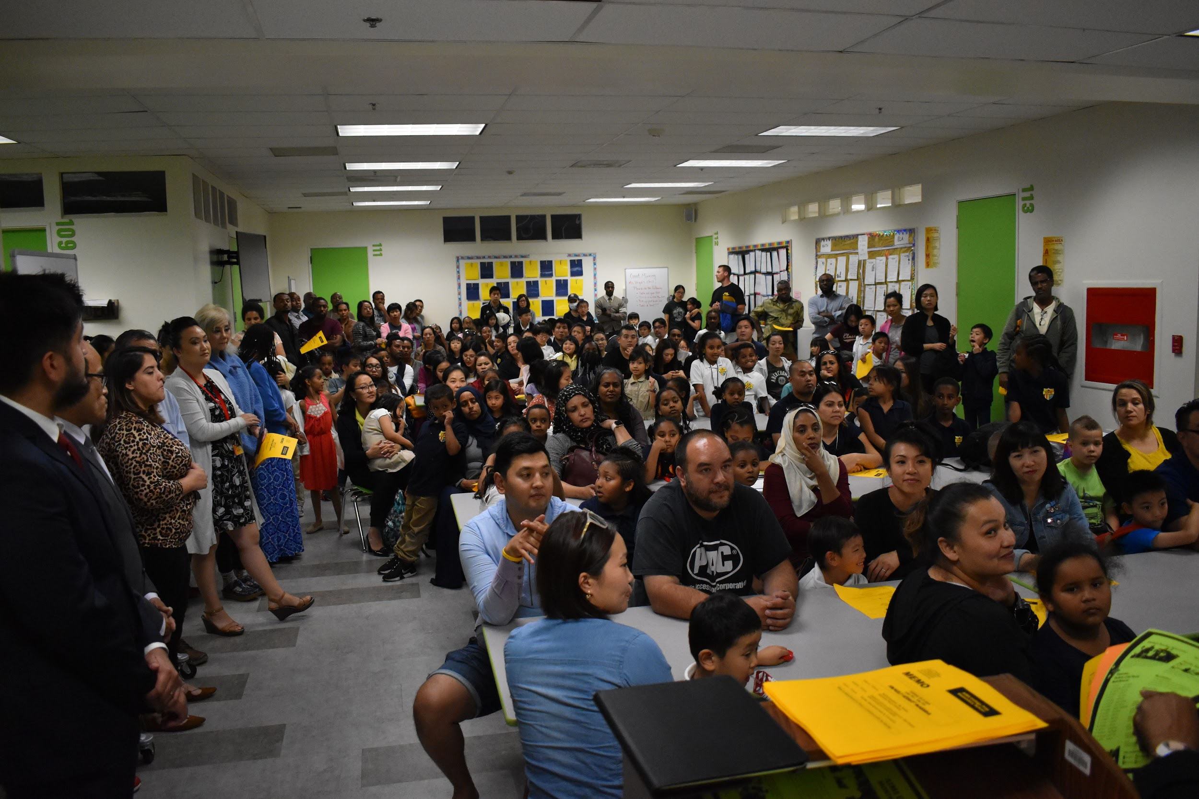
Back to School Night - K-2

Slide 3
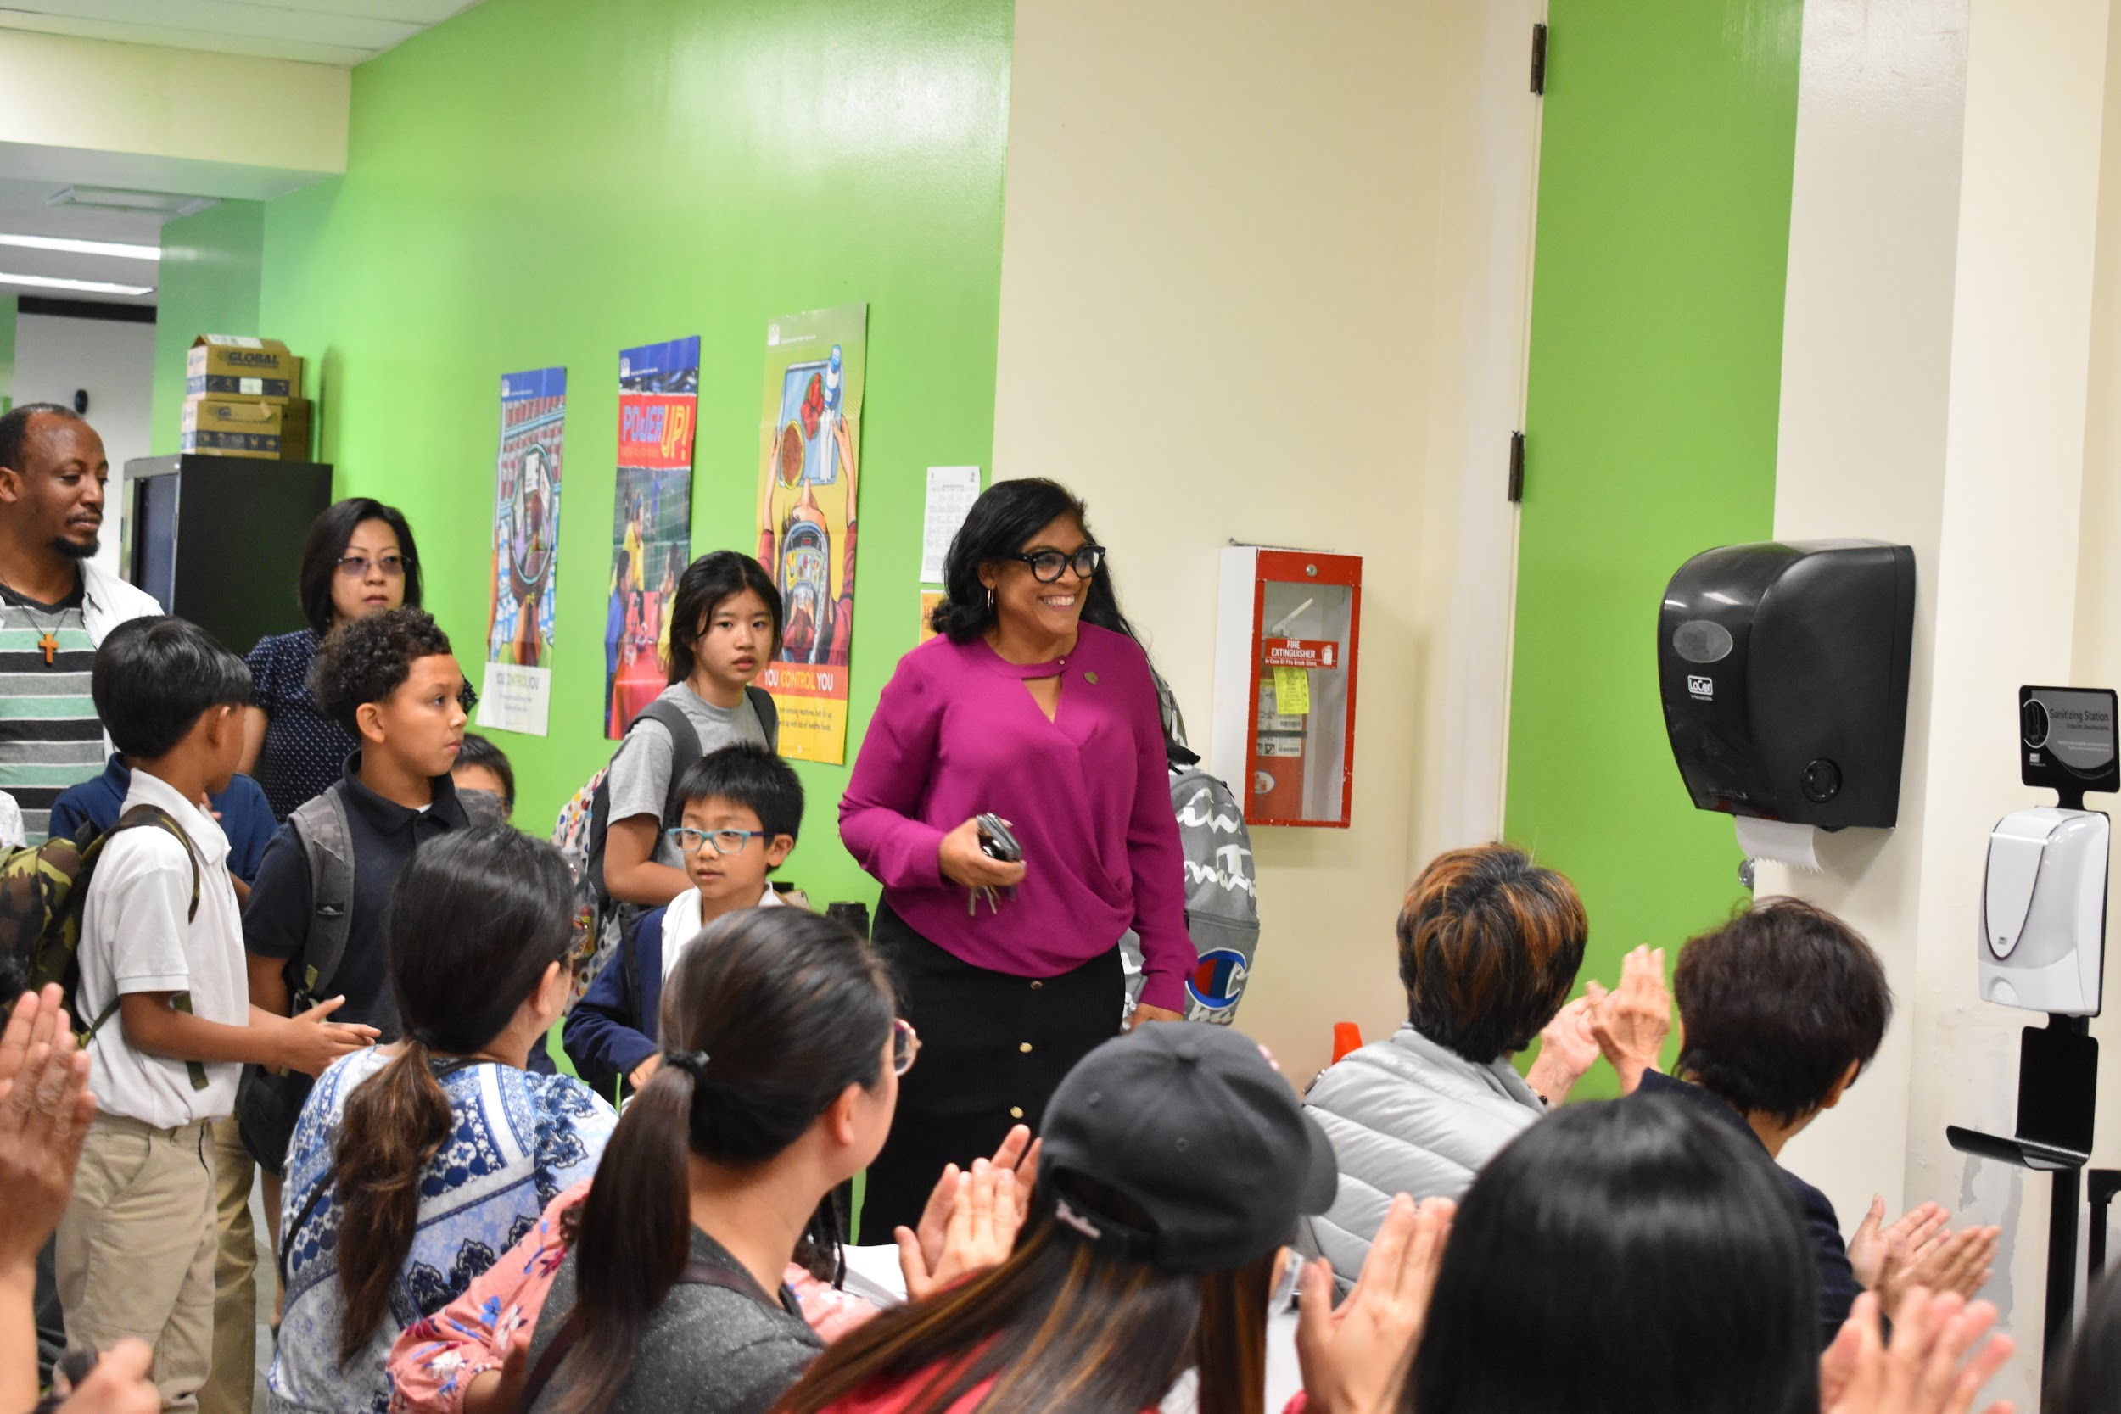
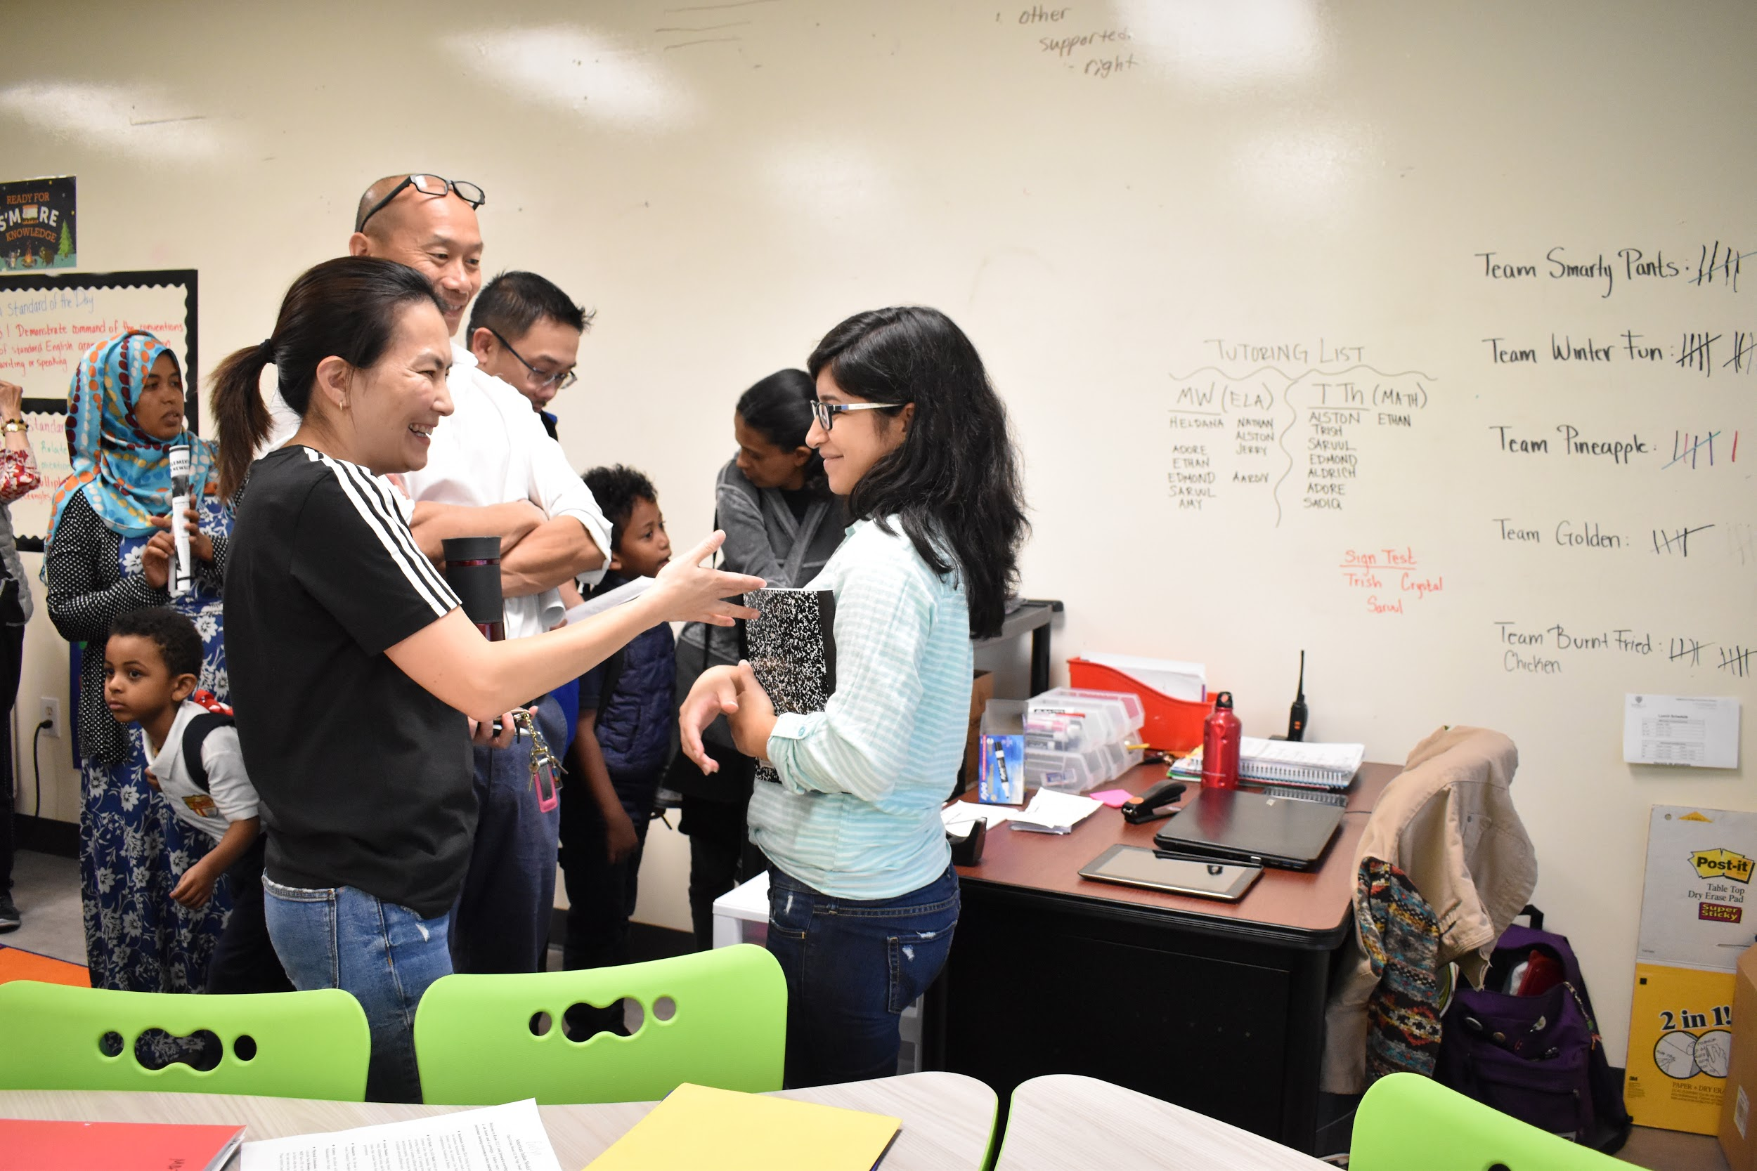
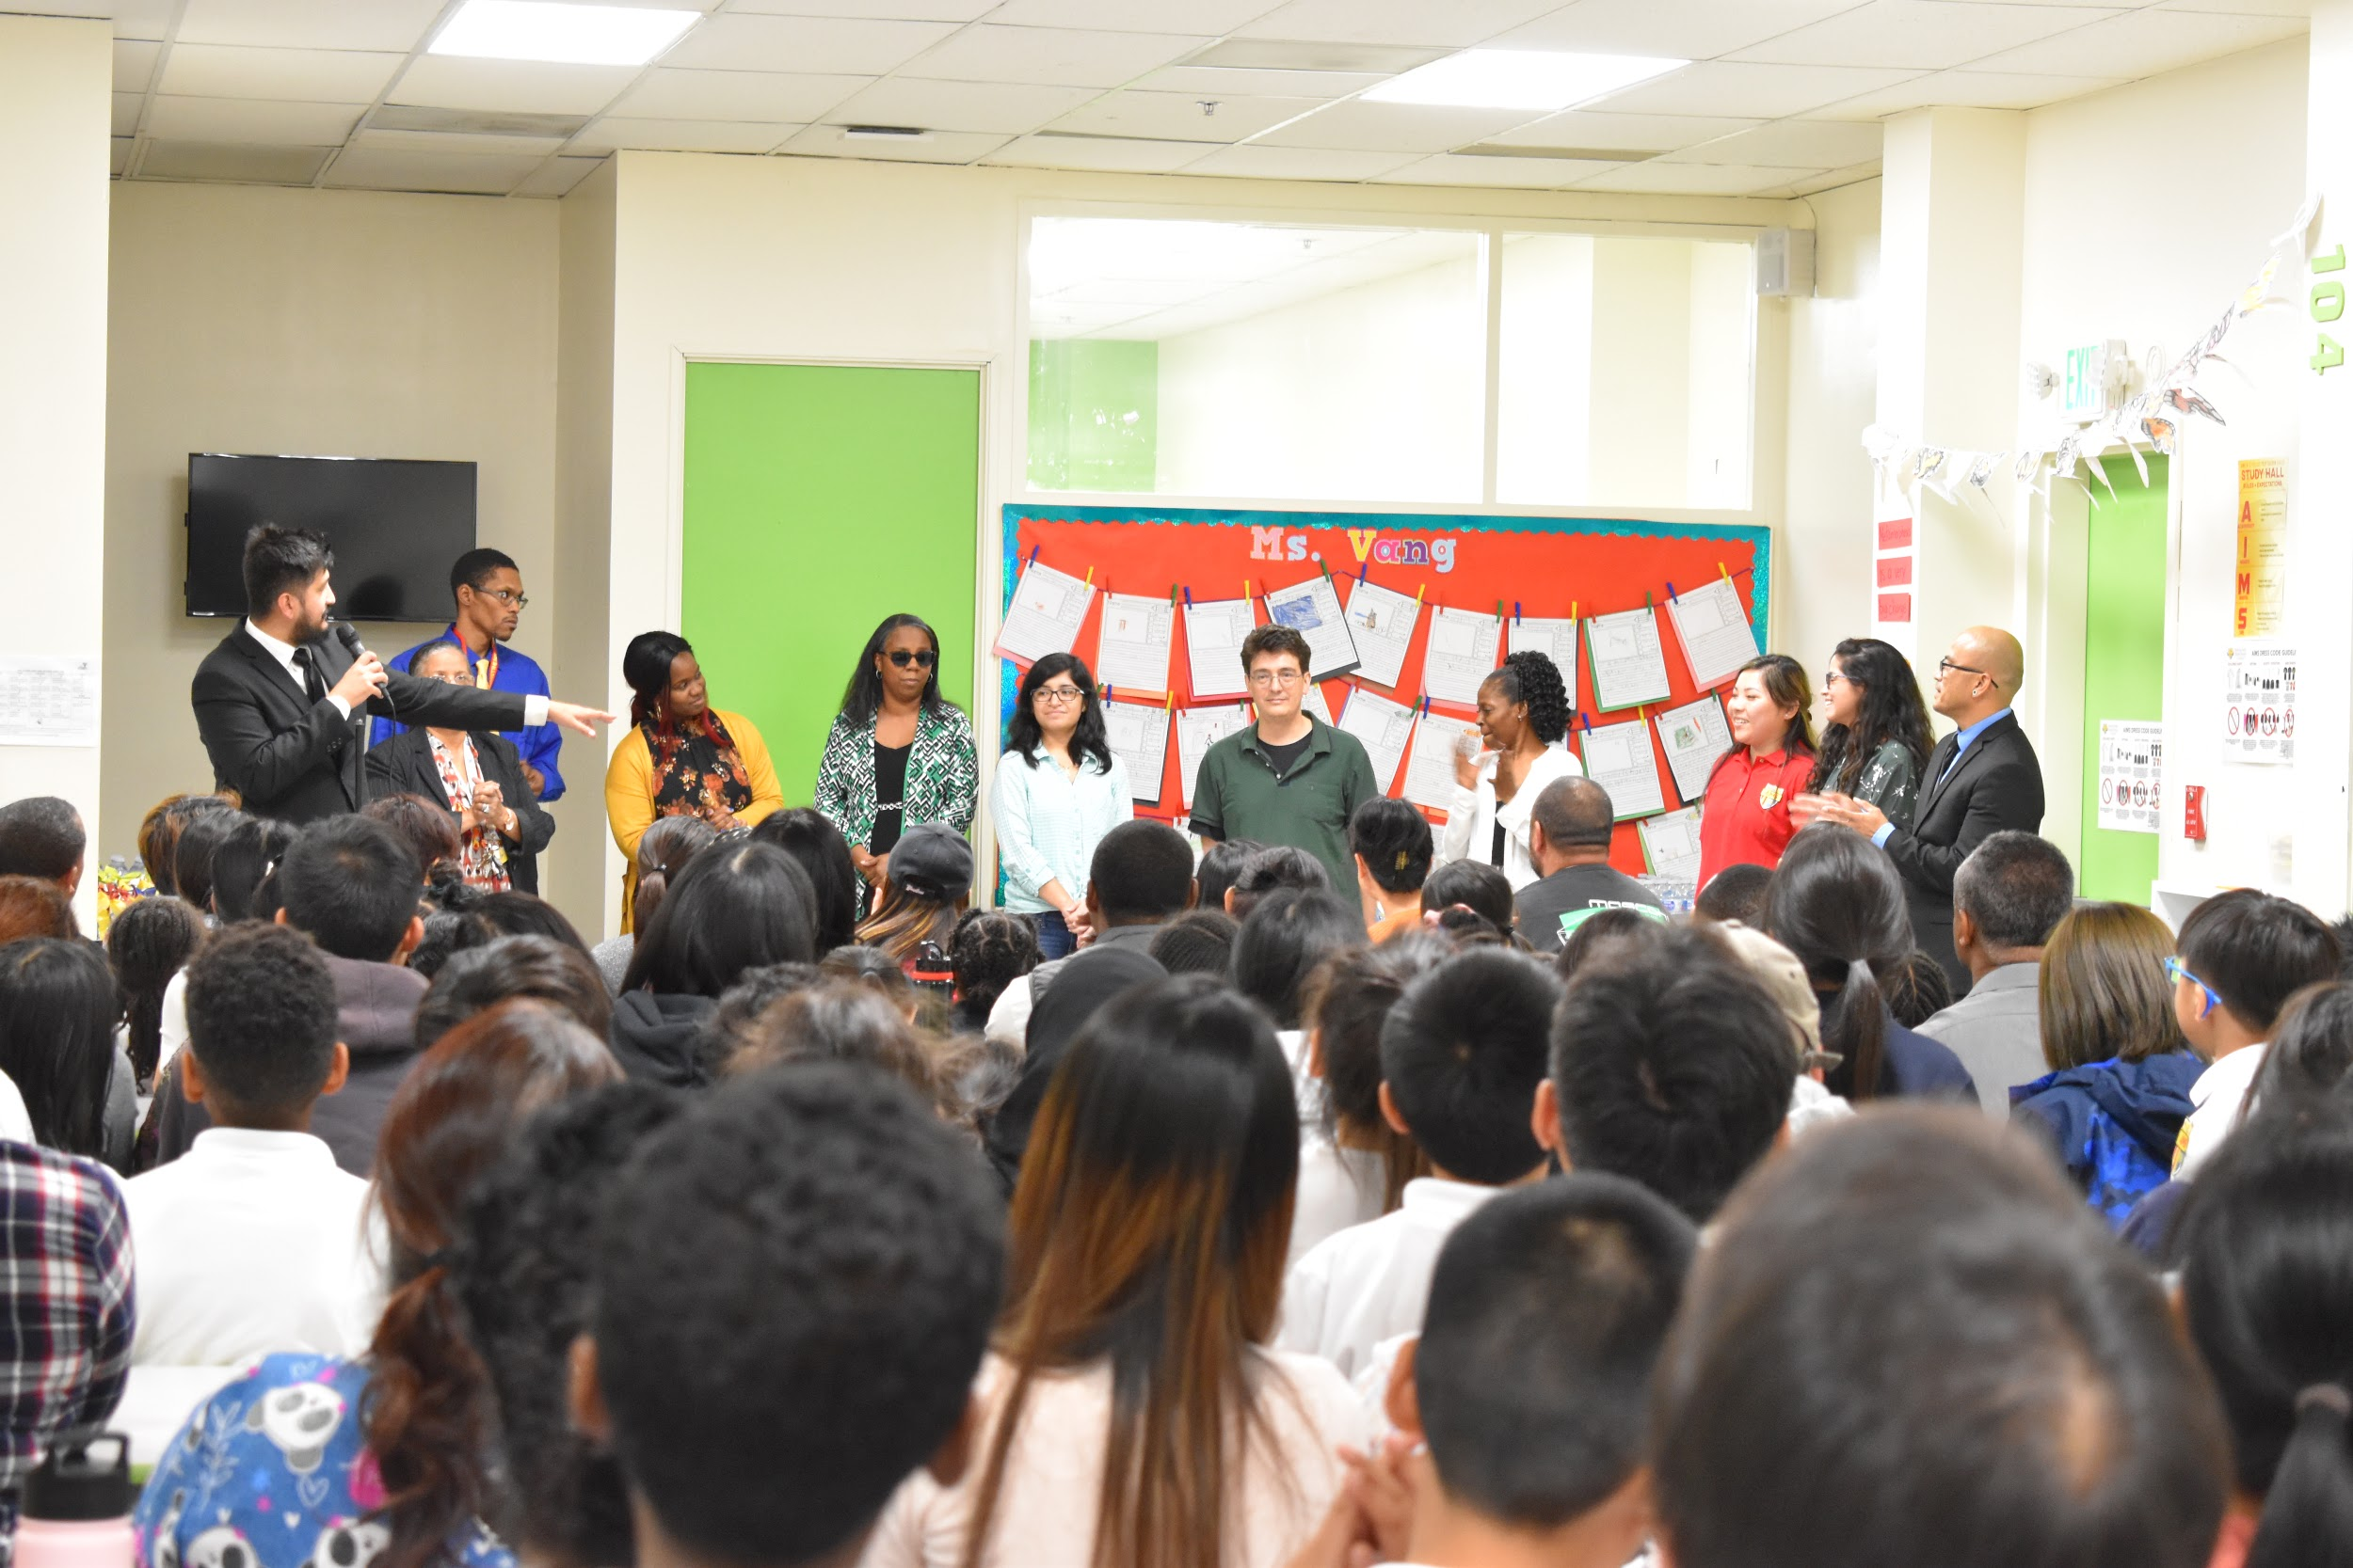
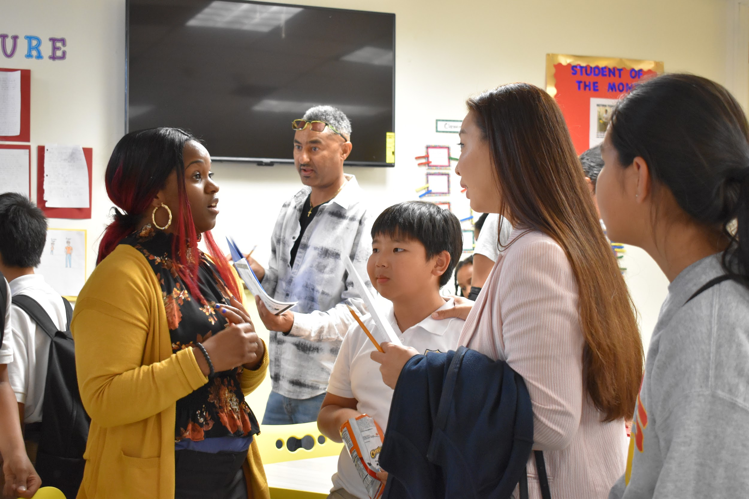
Back to School Night (3-5)

Slide 4
PBIS Rewards
Movie Event
Where: 2nd Floor East Wing
When: September 27, 2019 (Friday)
Includes: drink and popcorn
How Much:
K-2 50 Reward Points
3-5 100 PBIS Rewards Points

Slide 5
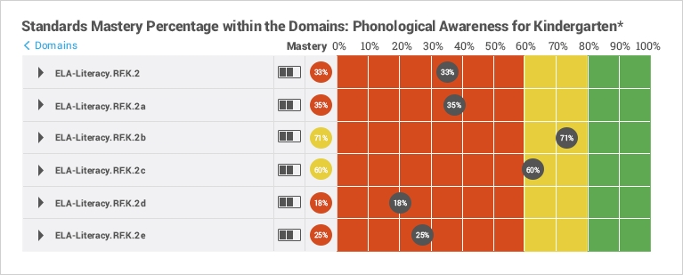
STAR LITERACY - Renaissance Education
Guide your youngest students toward mastery of the early literacy skills directly related to their future success as readers. Renaissance Star Early Literacy®, a component of our Renaissance Star 360® assessment suite, measures students’ vocabulary, phonics, language, and numeracy skills, monitors achievement and growth, and tracks understanding of literacy concepts aligned to your state learning standards.

Slide 6
Site Visit - Merced County Office of Education
Council on African American Student Success
Purpose:
To learn about specific efforts to improve outcomes for African American students and to learn about what works for African American students.

Slide 7
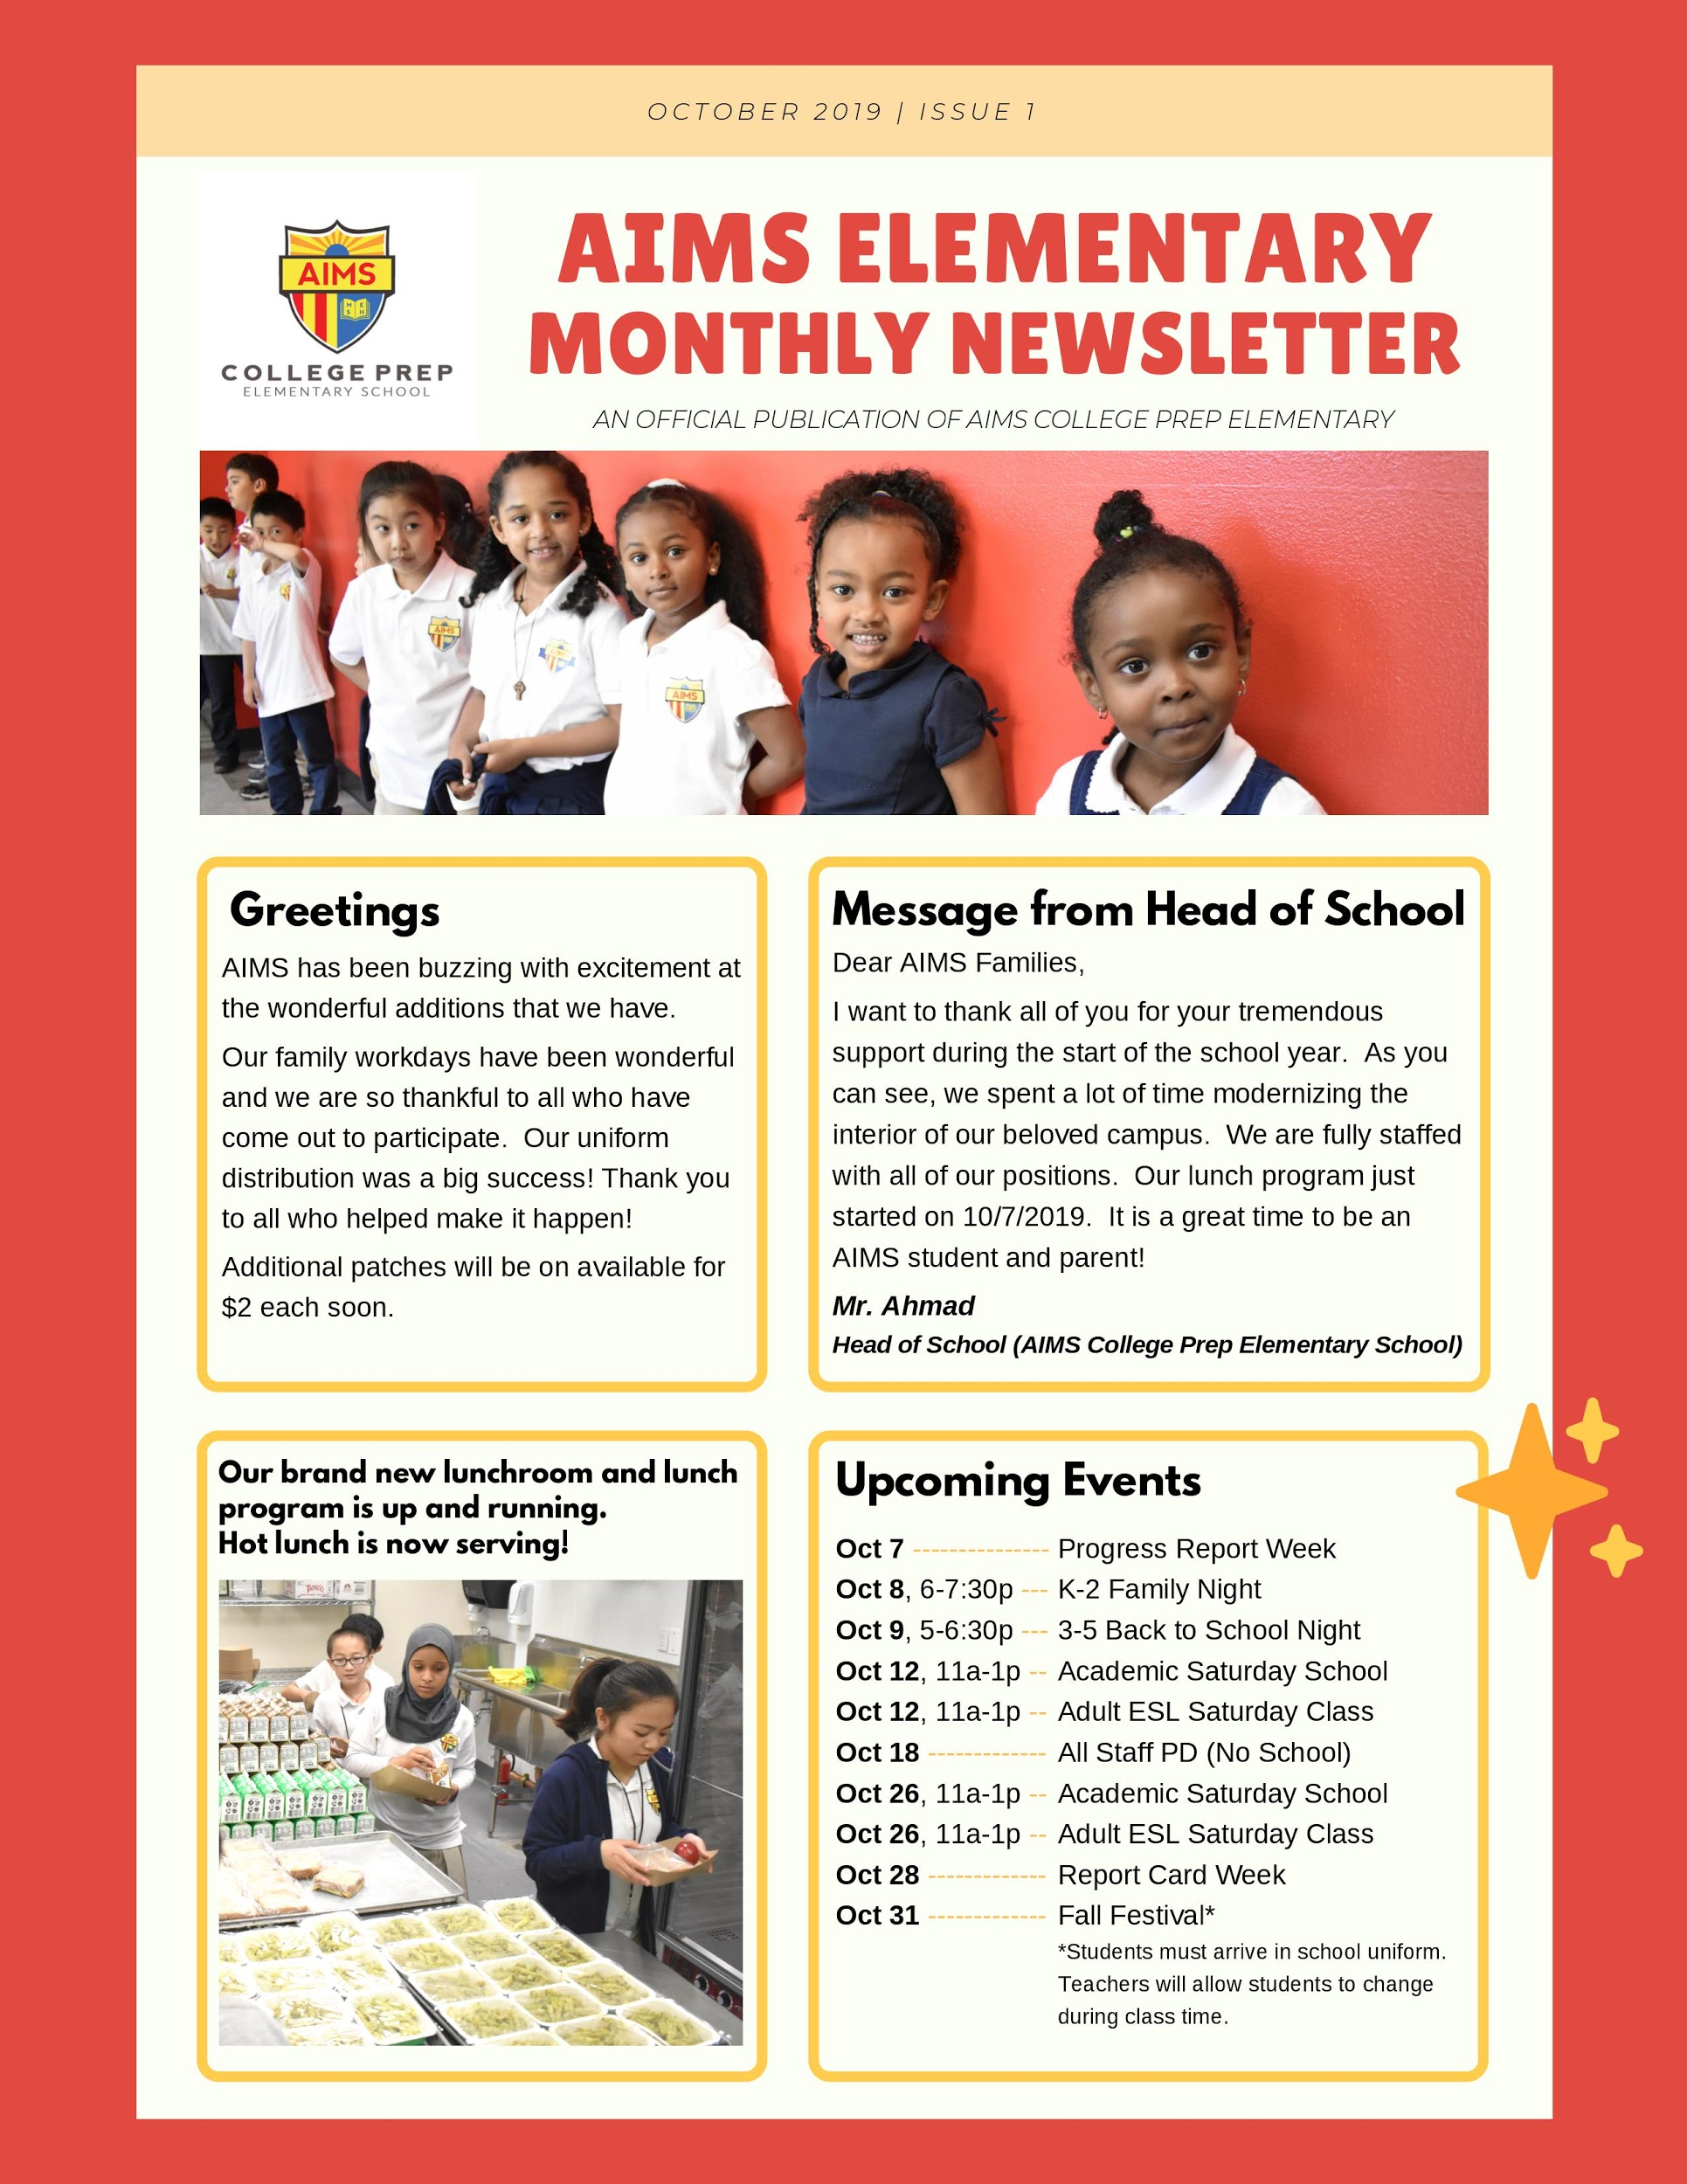
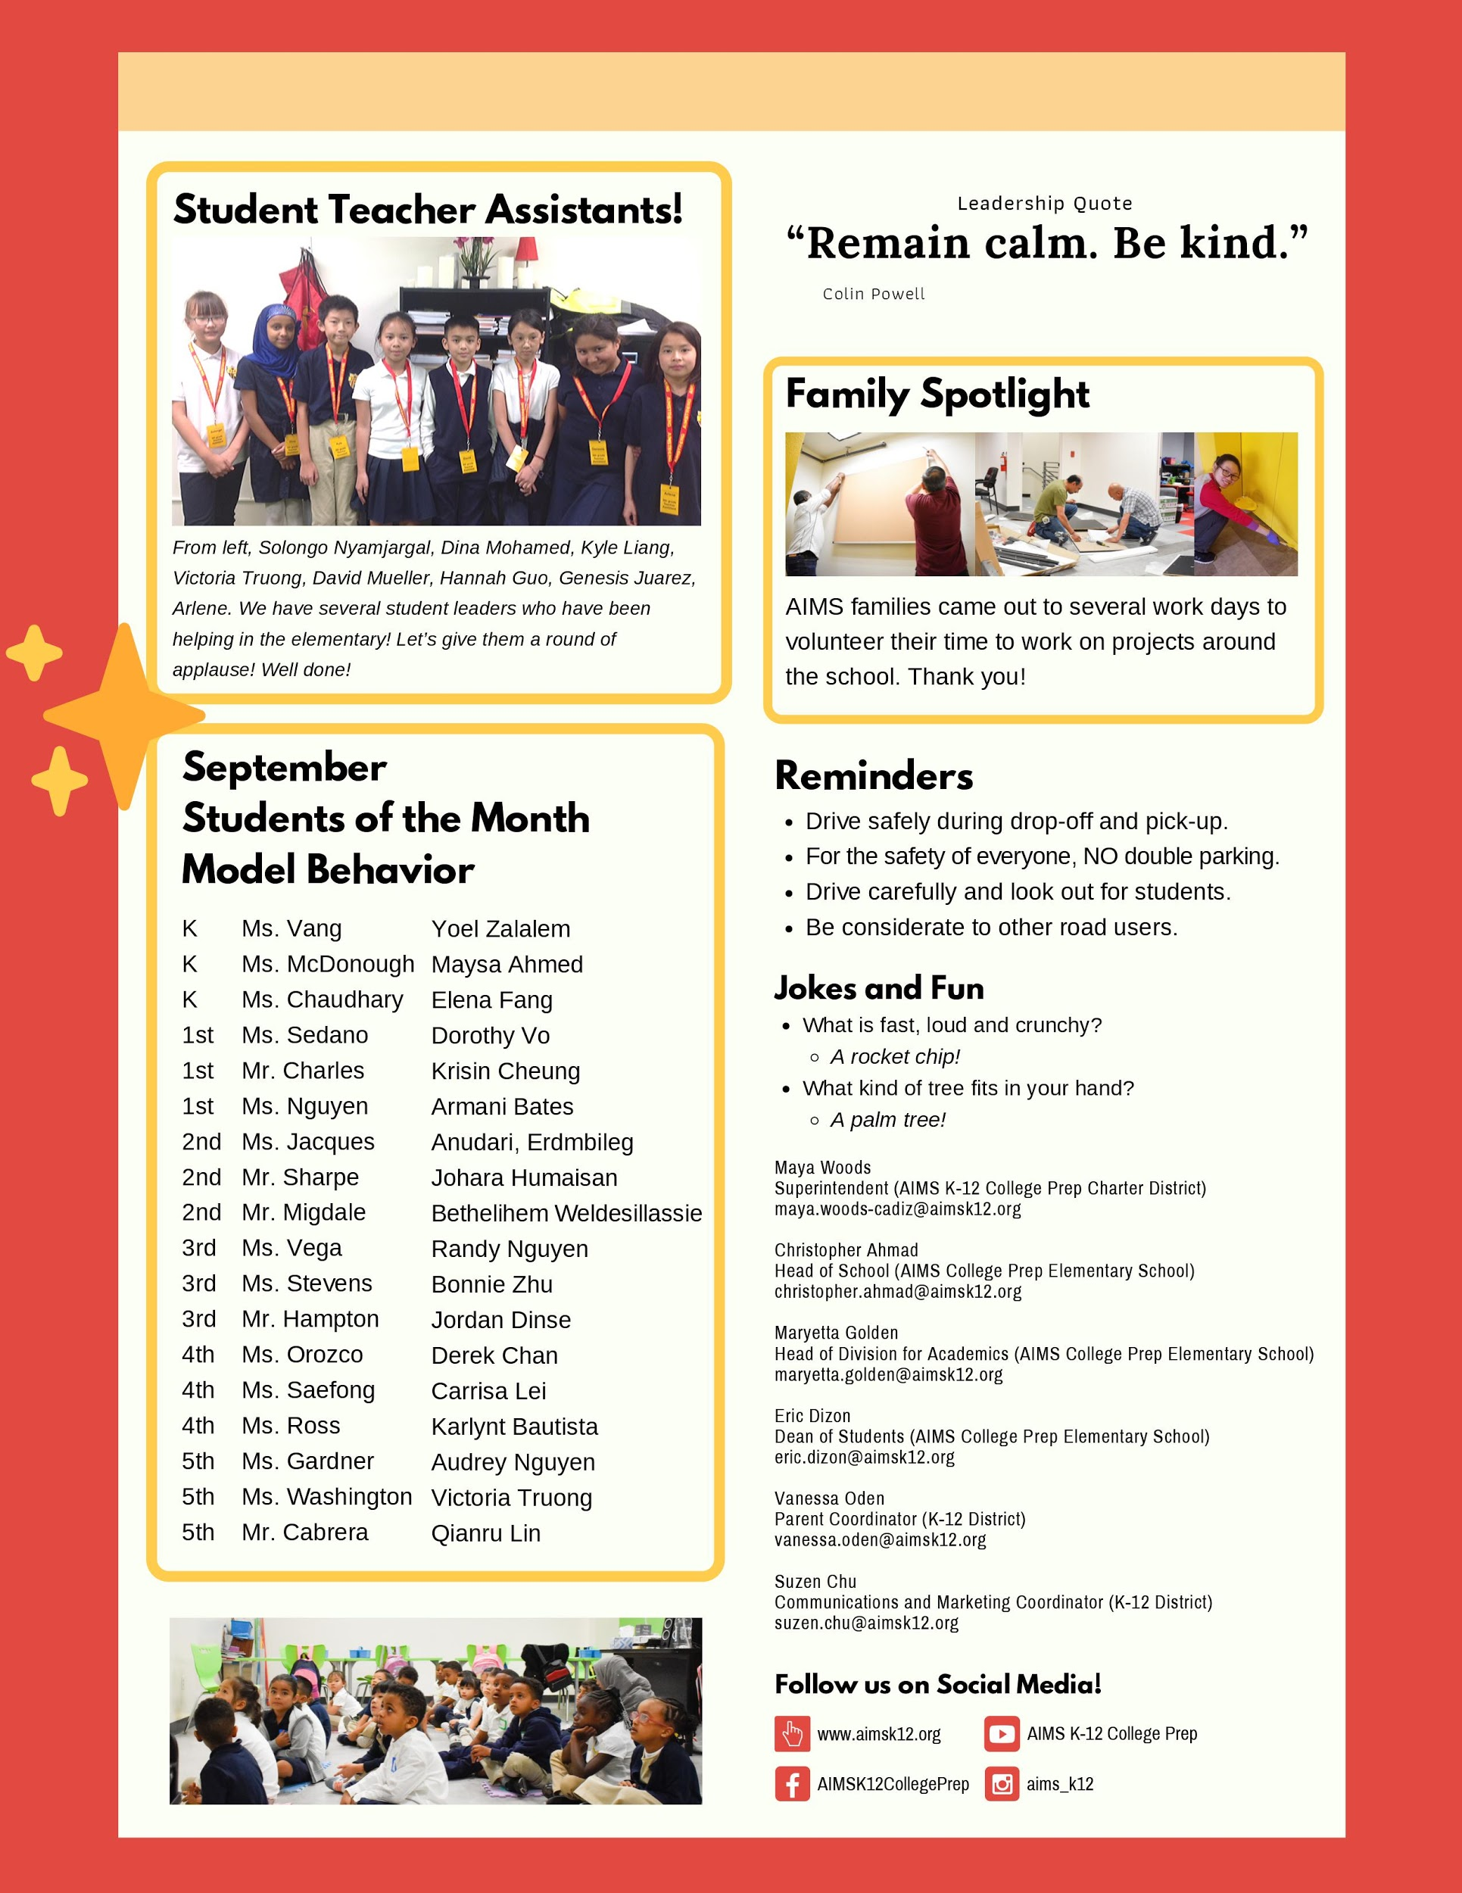
AIMS K-5 Elementary Newsletter

Slide 8
AIMS MS SGA Elections
SGA Executive Council Elections were held on Tuesday, October 8, 2019. Congratulations to our new AIMS SGA Executive Officers.
Ammanuel Walle (President)
Arianna Khalaf (Executive VP)
Rebekeh Zena (VP for Academic Affairs)
Jingyi Ma (VP for Communications)
Elon Alem (VP for External Affairs)
Charity Phan (VP for Student Affairs)
Raylene Shah (Executive Secretary)
Meklit Gebregiorgis (Executive Treasurer)

Slide 9
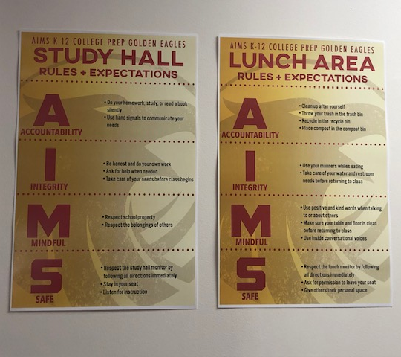
PBIS Poster Signs
PBIS Posters of Rules / Expectations have been ordered and placed in or near areas where students are likely to congregate.
Using the AIMS Acronym, students are expected to be (A)ccountable, have (I)ntegrity, be (M)indful, and (S)afe within these areas on campus.

Slide 10
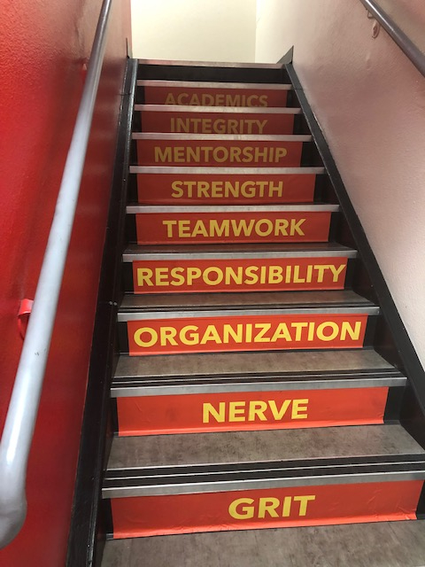
A.I.M.S.T.R.O.N.G. Acronym
The AIMSTRONG acronym was developed last year as a way to codify our popular sports rallying cry in a manner that incorporates the nine essential traits of a model AIMS student. AIMSTRONG appropriately begins with Academics and ends with Grit - a needed trait endurance and persistence to overcome obstacles and achieve success.
Each month, AIMS will select a student of the month based on the designated trait within AIMSTRONG: Academics, Integrity, Mentorship, Strength, Teamwork, Responsibility, Organization, Nerve, Grit.
Increased marketing of the A.I.M.S.T.R.O.N.G. acronym has begun, including placement on our stairs.

Slide 11
Academic Saturday School Updates
We have
Each month, AIMS will select a student of the month based on the designated trait within AIMSTRONG: Academics, Integrity, Mentorship, Strength, Teamwork, Responsibility, Organization, Nerve, Grit.
Increased marketing of the A.I.M.S.T.R.O.N.G. acronym has begun, including placement on our stairs.

Slide 12
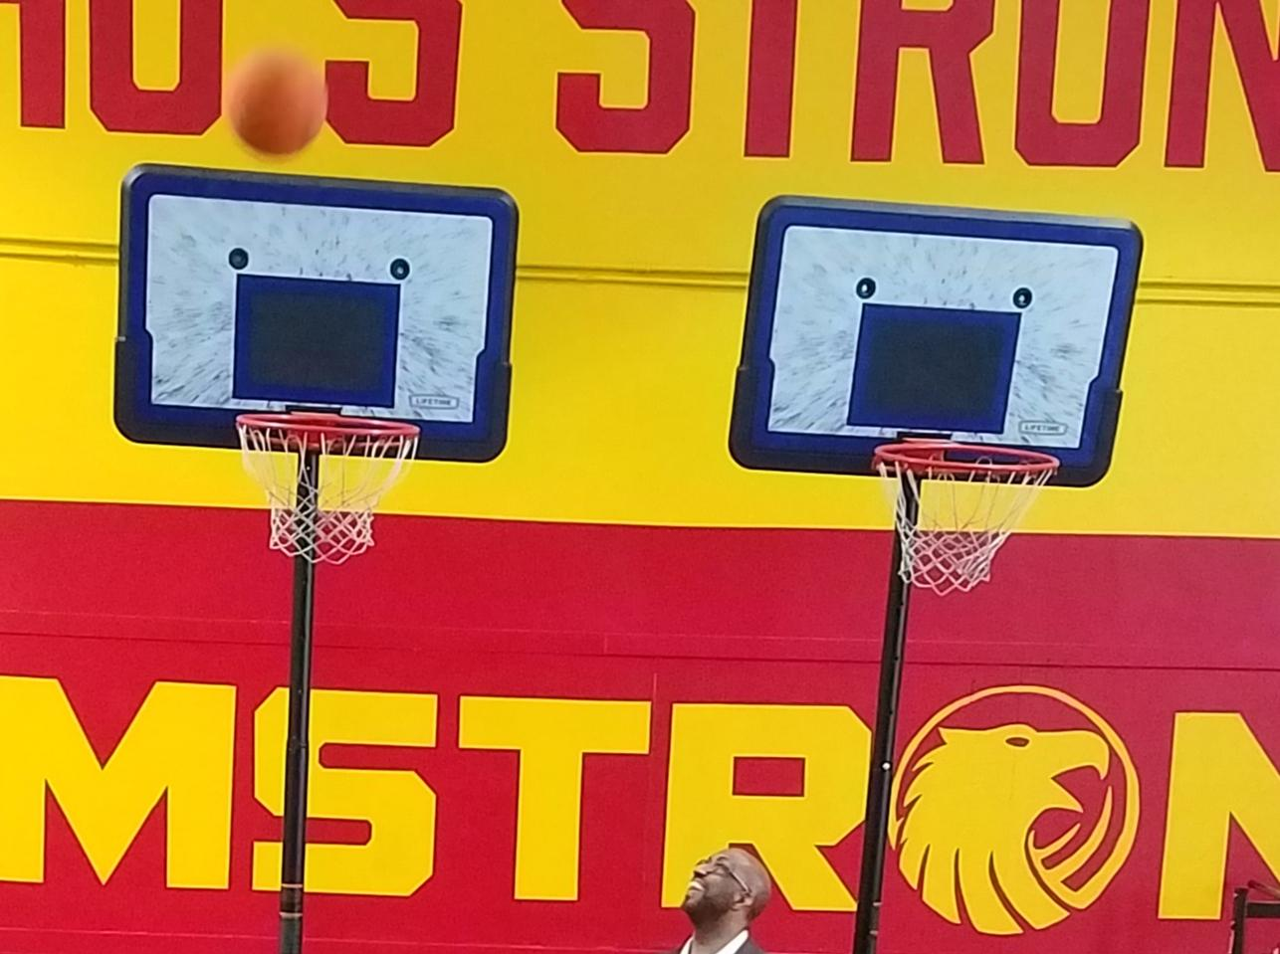
High School
Credit recovery classes
Boot Camp
Beginning of school
Recruitment, screening, scheduling, and interviewing teacher candidates
AP Testing changes
Back to School Night - Oct 16th

Slide 13
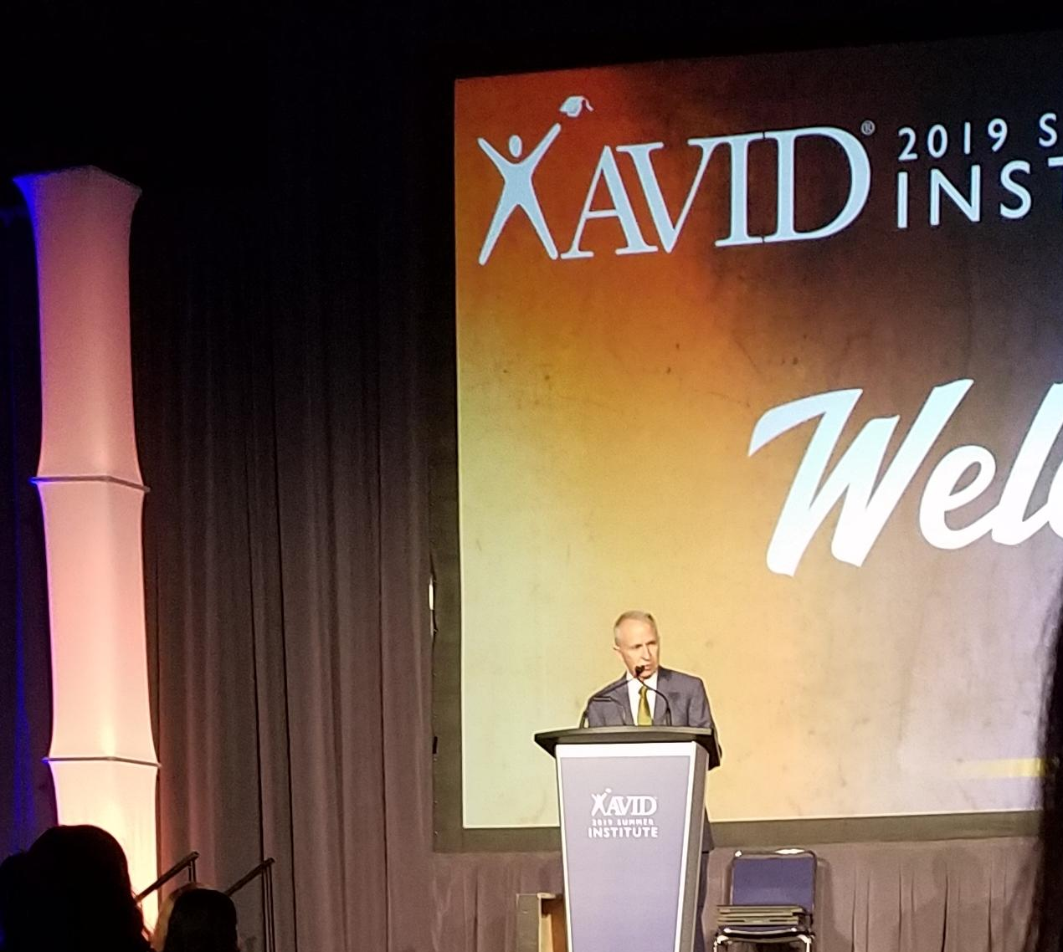
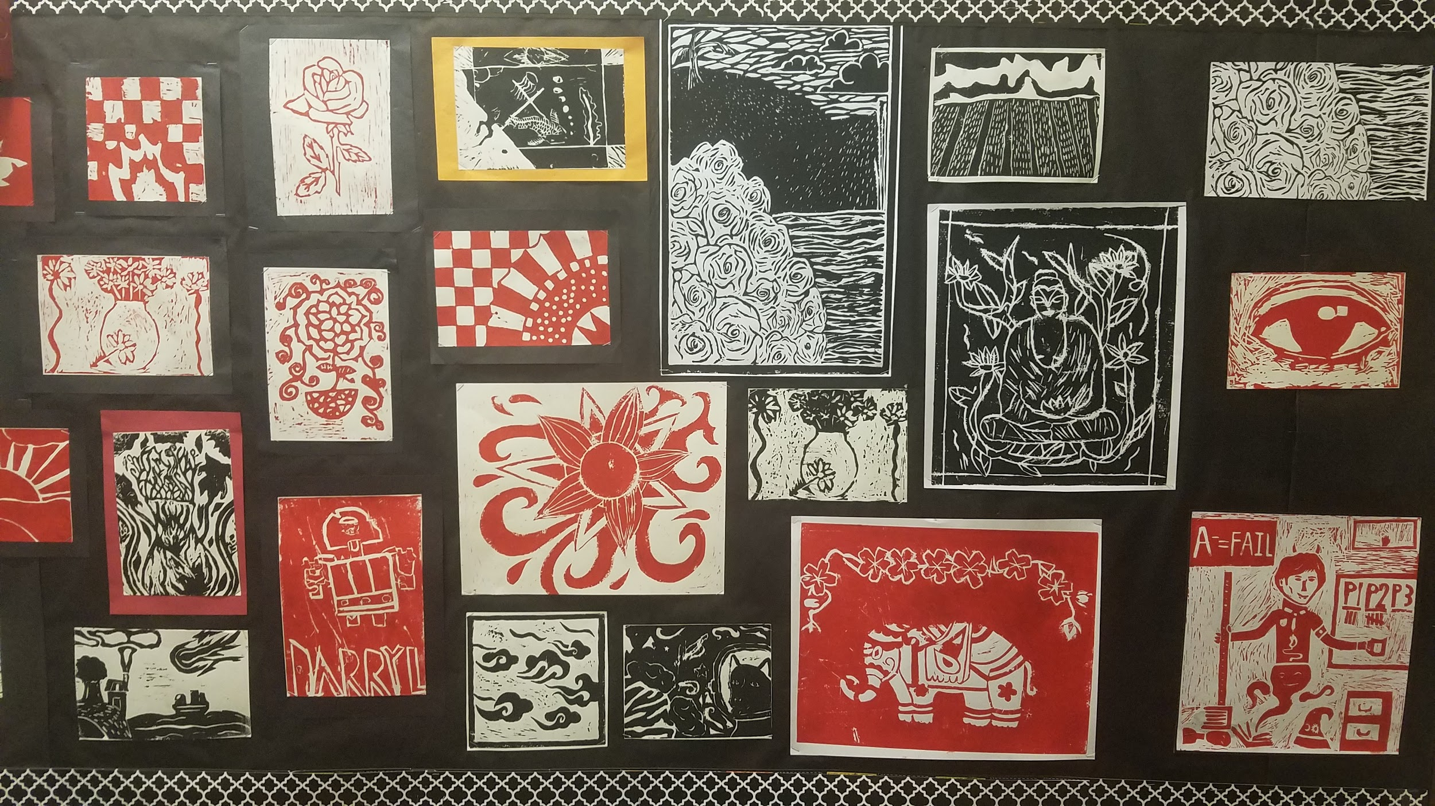
High School
Credit Recovery Students
Work on the topics they missed in the regular year and made up learning which they did not master during the school year over the summer.
Students completed credit recovery and those students added 505 total credits to their cumulative graduation progress.
This means that we will have fewer students taking classes from
9th and 10th grade, or
10th and 11th grade, or
11th and 12th grade.
This hurts the ability of all students to have access to the courses that they need.

Slide 14
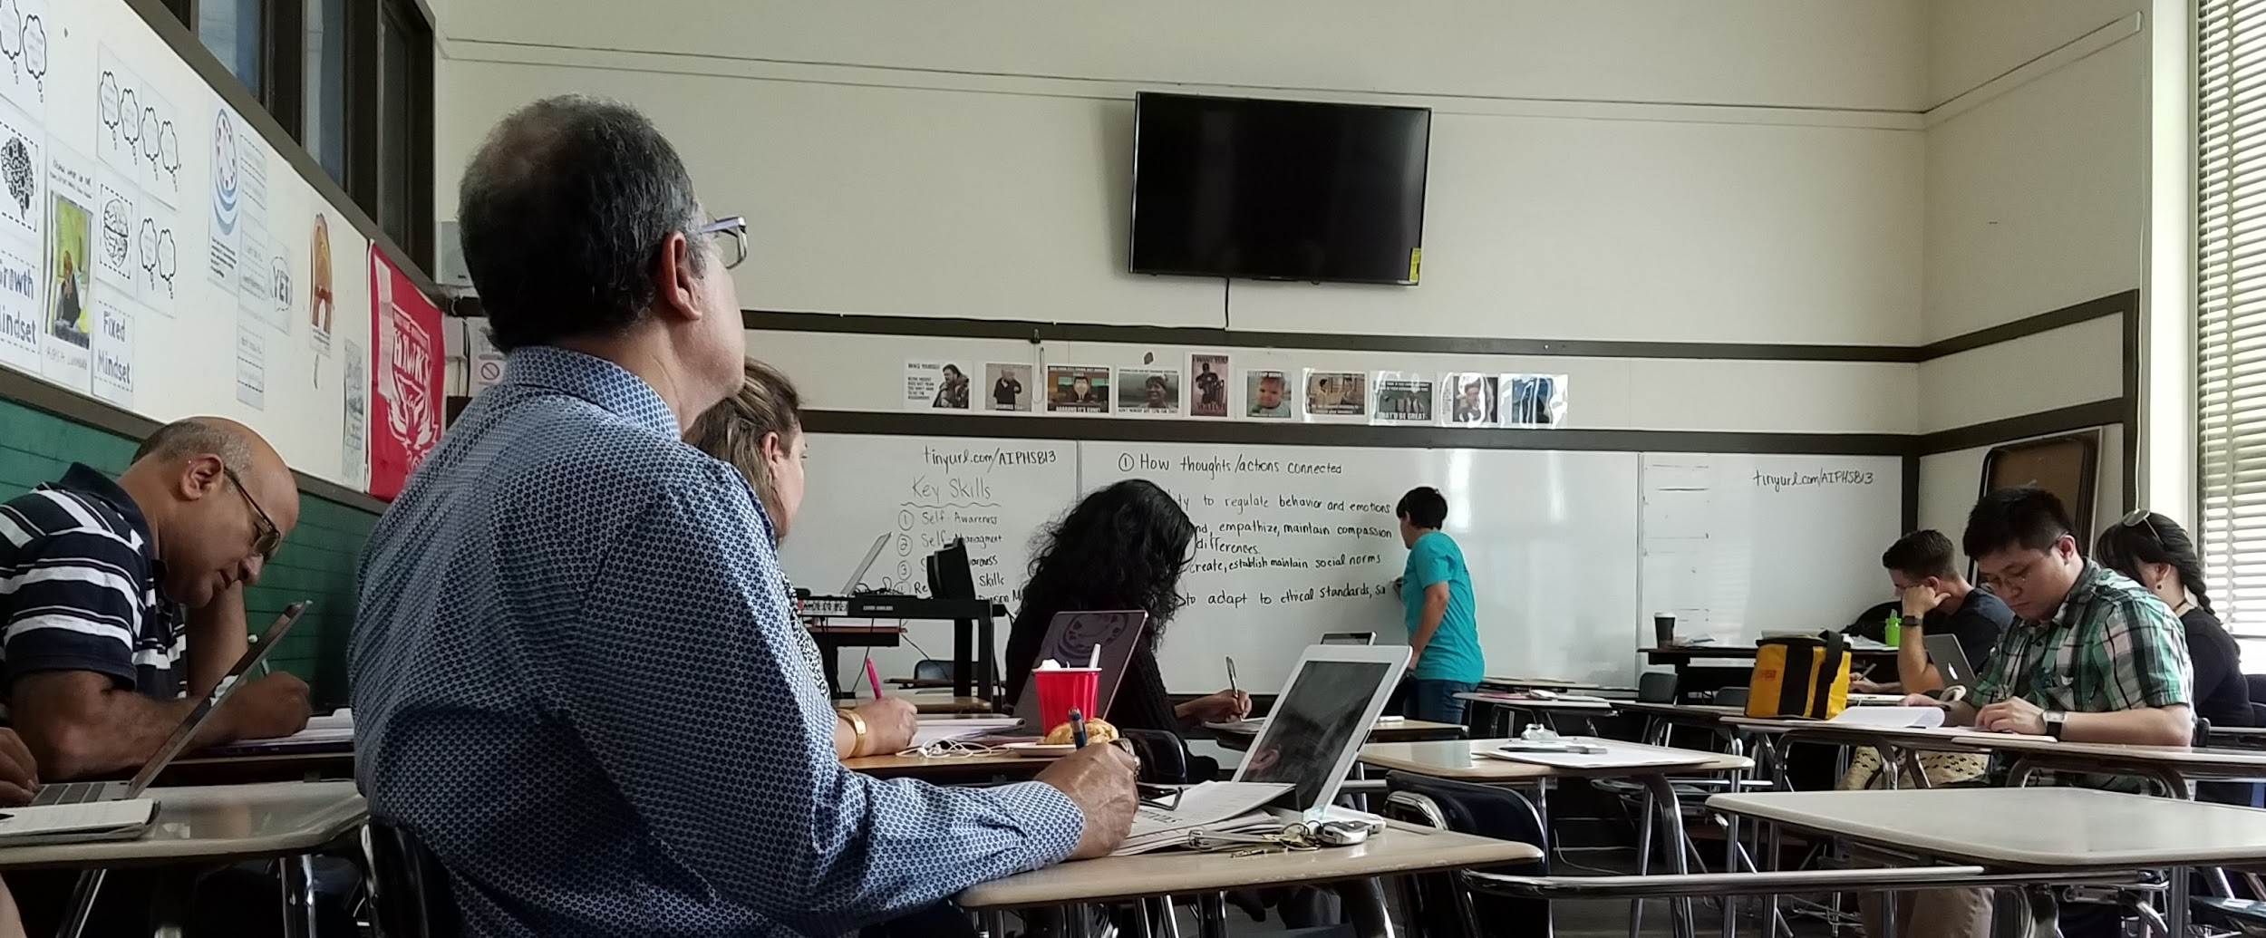
High School
Boot Camp was attended by staff who had been onboarded by those dates.
Several teachers mentioned the explicit covering of AIMS field guide and handbook was helpful.
HS Division PD included STEM, SEL, BBC, Culturally Responsive Teaching, and AVID training.
High School shared the Lakeview campus with the other two divisions during construction days in August.

Slide 15
High School
Recruitment, screening, scheduling, and interviewing teacher candidates
Indeed, EDJoin candidates have been followed up on.
Appropriate candidates have been invited for interviews. Some accepted the interview and later took another position.
Math & Spanish candidates are particularly difficult to find.
Substitute teachers were scheduled for longer terms at the beginning of school, while some staff were as yet unhired, or awaiting required onboarding paperwork.
Longer term substitutes who have been found strong have been approached about being hired.
Credentials are being explored and sought for strong candidates.
HIRING

Slide 16
High School
AP Testing updates
AP classes are now tied to teachers and specific sections of each class
Students sign into their AP accounts with “join codes” for that specific class and period. At that time they update demographic and survey questions - not on testing day.
We currently have 15/17 AP classes authorized
This is the new AP test registration!
Fiscal impact:
test registration must be completed by November 1st.
Late, unused, and cancelled tests now cost $40 (not $15)

Slide 17
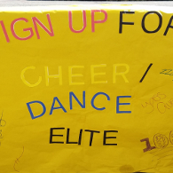
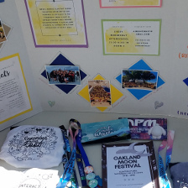
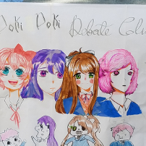
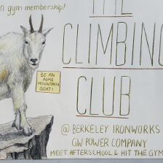
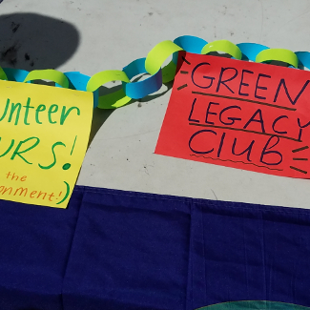
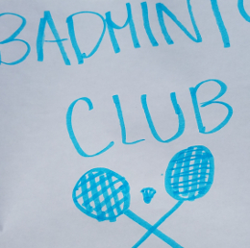
High School
Back to School Night
October 16th, 2019
6:00-8:00 pm

Slide 18
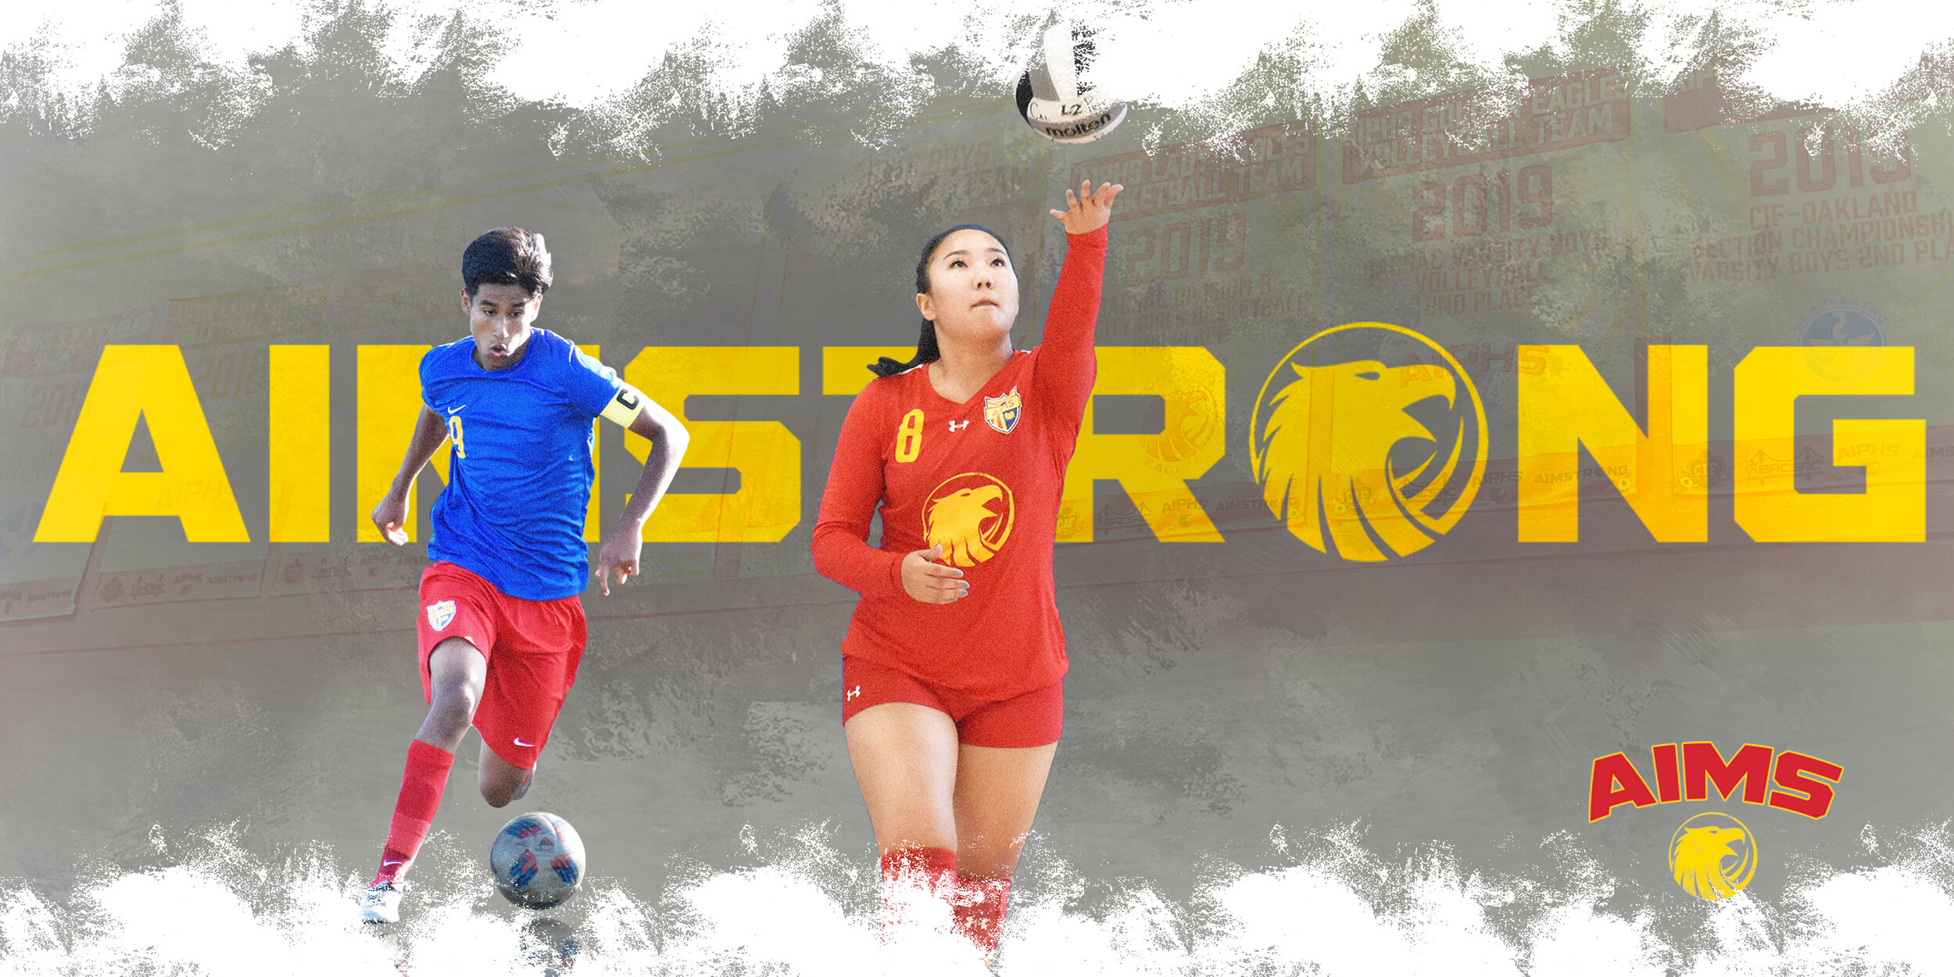
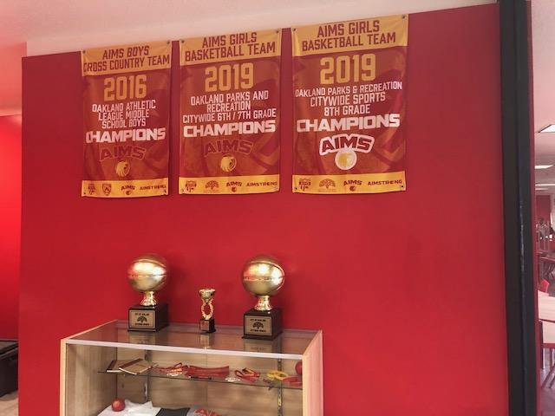
AIMS Athletics
Updates
The AIPHS Lady Eagles Volleyball Team will likely enter the playoffs as the #4 seed when the season ends. Their last game of the season (Senior Night) will be held against rival Oakland Charter, on Monday, October 21 @ 5PM, at Soldier Town Gym.
The Middle School Flag Football season will begin on Saturday October 12. The Middle School Volleyball team’s season will begin within the next 1-2 weeks.

