Slide 1
AIMS K-12 Board Report
September 24th, 2019
Superintendent Maya Woods-Cadiz
Mr. Christopher Ahmad (Head of School -Elementary)
Mr. Maurice Williams (Head of Schools - Middle)
Mr. Tareyton Russ (AIPHS Head of School)
Mr. Peter Holmquist (AIPHS Head of Academics)

Slide 2
New Adminstration Employees and Positions
Christopher Ahmad
Title: Head of School - Elementary
Experience: 5 years teaching + 5 years as admin, 8 years at AIMS
What you will bring to AIMS: Continued success and growth for all students in K-5

Slide 3
New Adminstration Employees and Positions
Maryetta Golden, Master’s in Education and Administrative Credenial
Title: Head of Division for Academics Elementary
Experience: 30+ years as a Principal, Vice Principal, High School Counselor, Teacher, and College Advisor, inclusive, for public, private, and CSUEB
What you will bring to AIMS: A passion, intensity, and love for improving student achievement; consideration and effort to increase family and community collaborations; and accountablity to ensure teacher buy-in in the decision-making process for AIMS K-5.

Slide 4
New Adminstration Employees and Positions
Eric Dizon
Title: Dean of Students Elementary
Experience: 12+ years in elementary education in public and private schools. 7 years military veteran. Over 7 years Restorative Justice training and background. 5 years at AIMS.
What you will bring to AIMS: Student self-growth and discipline through social and emotional learning with a focus on positive behavior. Helping create and maintain strong communities in the classroom using the PBIS Rewards and Restorative Justice Circles.

Slide 5
AIMS K12 College Prep - K-5 Staffing
As of today, AIMS K-5 is fully staffed with teachers.
Kindergarten: Vang, McDonough, Chaudhary
1st Grade: Sedano, Charles, Nguyen
2nd Grade: Jacques, Migdale, Sharpe
3rd Grade: Vega, Stevens, Hampton
4th Grade: Saefong, Orozco, Ross
5th Grade: Gardner, Washington, Cabrera

Slide 6
Additional Support Staff
Intervention Aides: Claire Gilmore, Francisco Reyes, and Corliss Henderson
Tutors: Sabrina Clark
Classroom Aides “C” classes: Carlos Rodriguez, Mohammad Masalmeh, Rachael Kahn

Slide 7
New Curriculum
K-2 - Benchmark Advance ELA, Spectrum Reading Comprehension, Writing, Phonics, Spelling, and Language Arts, and GOMath
K-3 - Renaissance Star Literacy Assessment Program
K-5 - Shell Education’s “180 Days of Social Studies” (includes Civics, Economics, Geography, and History).

Slide 8
New Position - Rotating Science Teacher
Ms. Ajuanna Black - Utilizes FOSS Kits and NGSS standards to do push-in science lessons for grades K-5.

Slide 9
Saturday School K-2 + ESL Classes
Saturday School for K-2 began 9-14.
Saturday School will be held twice a month for K-2
We received an overwhelming response survey from our K-5 parents requesting a need for an ESL class. As a result, Adult ESL classes will begin in 1 week, twice a month.

Slide 10
PBIS - Positive Behavior Intervention System
This year, we are using PBIS as a reward system for those students that make positive behavior choices
Students are awarded points for good behavior
Students earn prizes, food, and parties
Teachers track points via IPAD and big screen TV’s

Slide 11
AIMS College Prep Middle School Staff
Maurice Williams, M.P.P (Head of Schools)
Riffat Akram, M.Ed. (Head of Division for Academics): Middle School Academics
Natalie Glass (Dean of Students): Discipline, School Culture
Makaylah Wright-Proctor (Administrative Assistant to the Head of Schools)
Natasha Young (Front Desk Clerk)

Slide 12
New Middle School Teachers
8th Grade Math / Science - Ms. Zubidah Bakheit, Ms. Crystal Aroma, Mr. Adam Tongi (Onboarding)
8th Grade English / History - Ms. Aleshia Readye, Ms. Pam May (Onboarding, 8th Math / Science)
6th Math / Science: 1 Vacancy
PE - Juan Sanchez, Charnise Jones
Graphic Design: Alison Frost

Slide 13
Middle School Announcements
Back To School Night / Family Potluck: October 10, 2019 (6PM - 8PM)
Middle School Electives: Avid, Advanced Art, Yearbook, Newsletter, Debate (Bay Area Urban Debate League

Slide 14
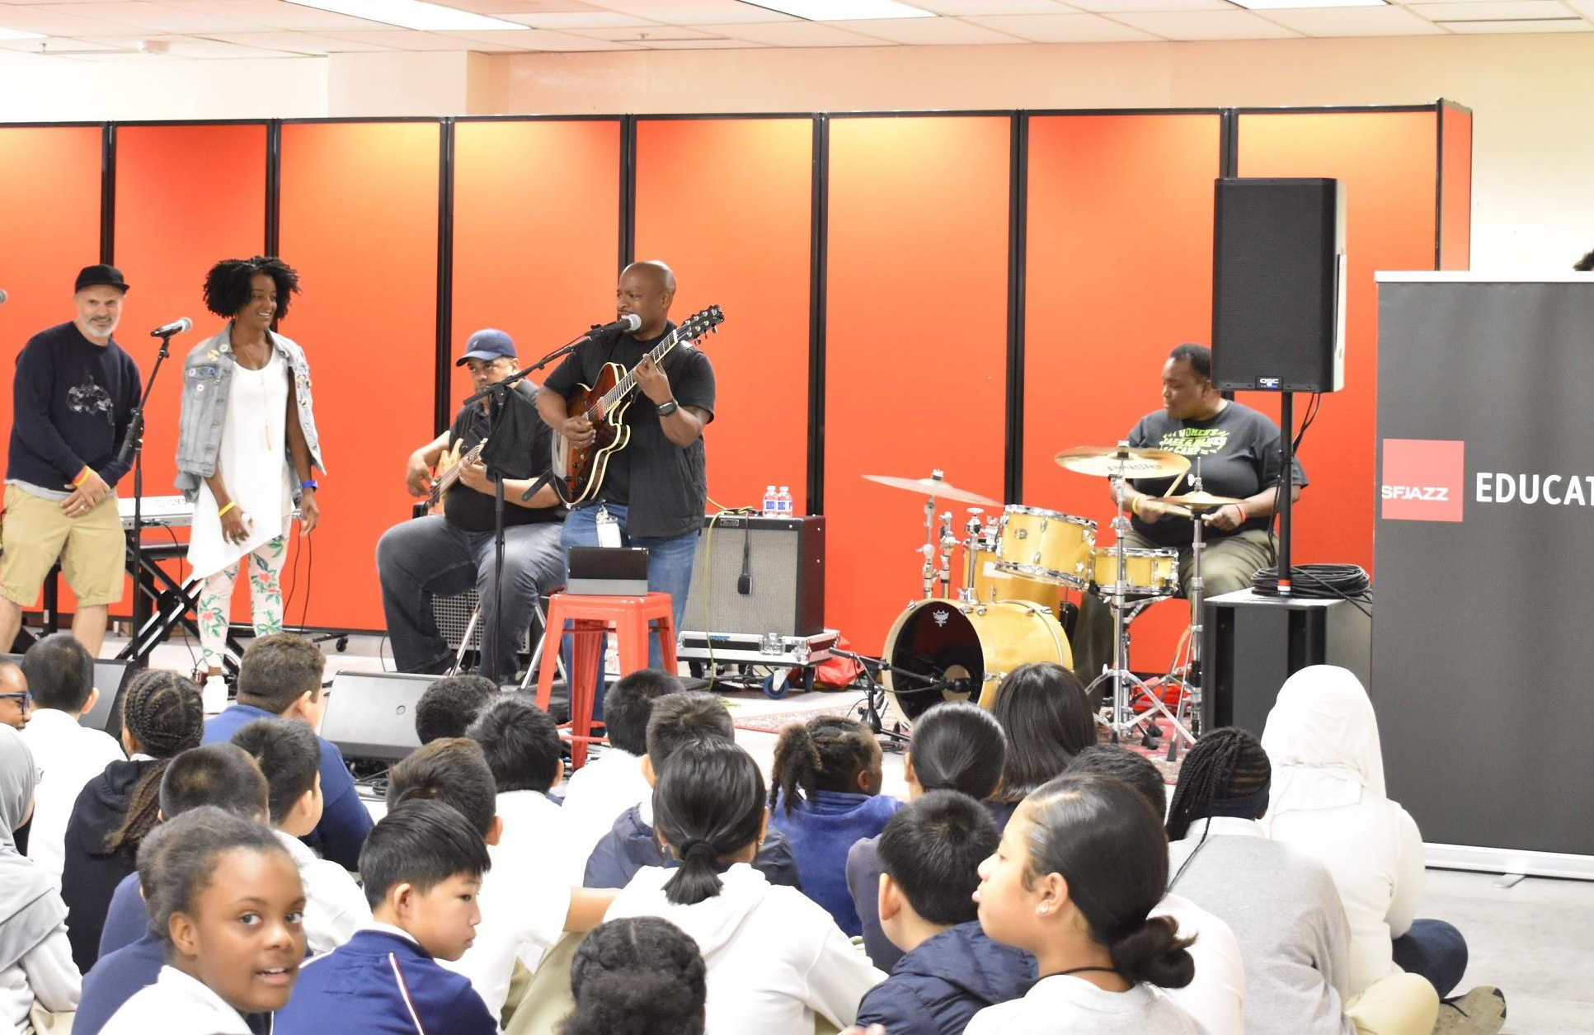
SF Jazz Concert
On September 11, 2019, The SF Jazz Group provided two free concerts to our Middle School as part of their Jazz-Hip Hop Concert Series.
AIMS was the first stop for the SF Jazz Group this school year and will stop at nearly 400 schools to help promote awareness and interest about the roots of hip-hop and jazz.

Slide 15
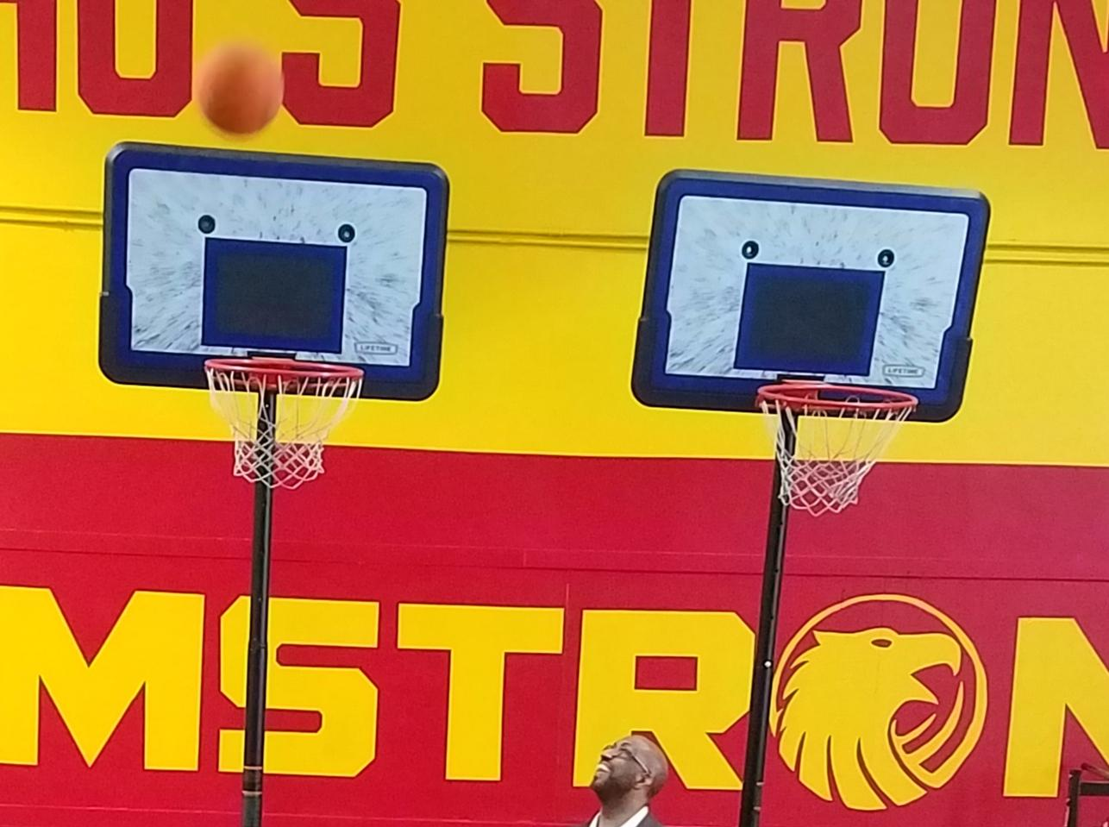
High School
Credit recovery classes
Boot Camp
Beginning of school
Recruitment, screening, scheduling, and interviewing teacher candidates
AP Testing changes
Back to School Night - Oct 16th

Slide 16
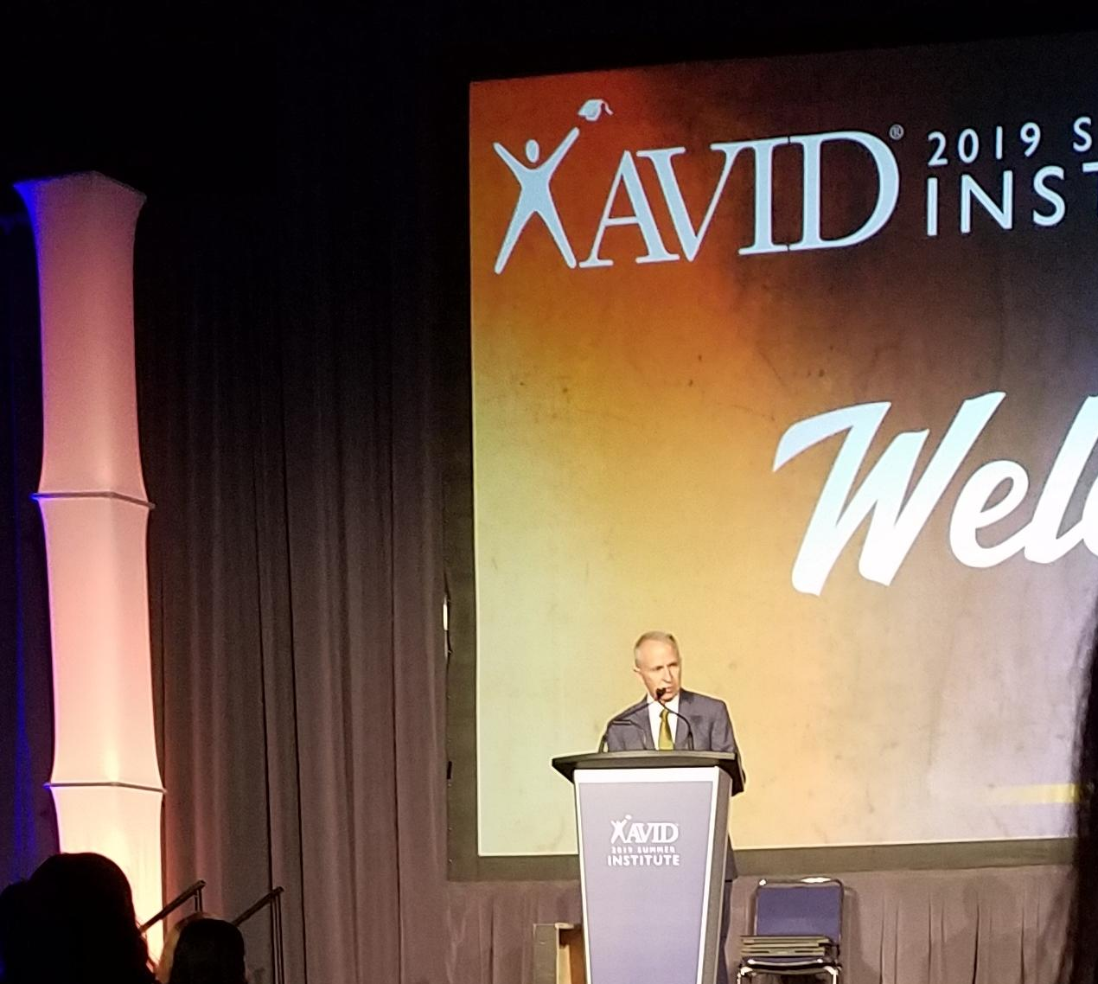
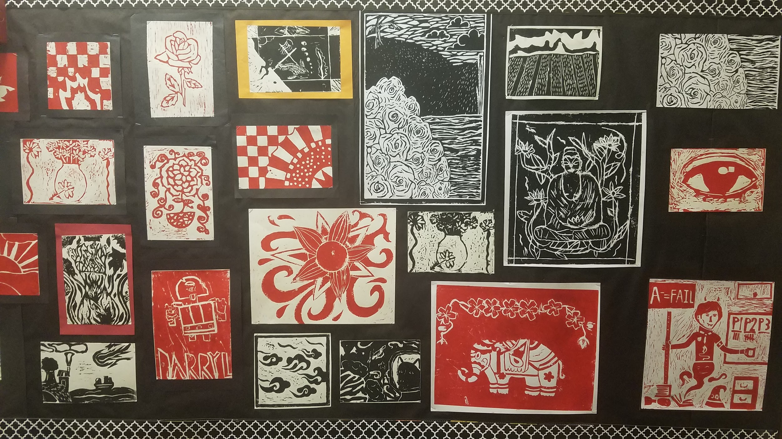
High School
Credit Recovery Students
Work on the topics they missed in the regular year and made up learning which they did not master during the school year over the summer.
Students completed credit recovery and those students added 505 total credits to their cumulative graduation progress.
This means that we will have fewer students taking classes from
9th and 10th grade, or
10th and 11th grade, or
11th and 12th grade.
This hurts the ability of all students to have access to the courses that they need.

Slide 17
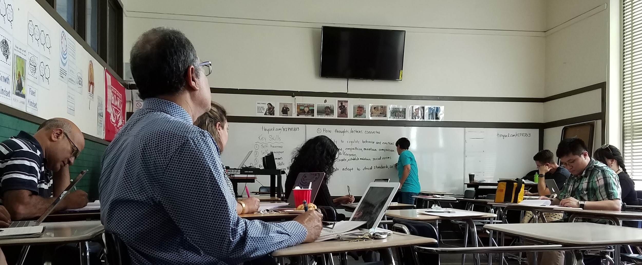
High School
Boot Camp was attended by staff who had been onboarded by those dates.
Several teachers mentioned the explicit covering of AIMS field guide and handbook was helpful.
HS Division PD included STEM, SEL, BBC, Culturally Responsive Teaching, and AVID training.
High School shared the Lakeview campus with the other two divisions during construction days in August.

Slide 18
High School
Recruitment, screening, scheduling, and interviewing teacher candidates
Indeed, EDJoin candidates have been followed up on.
Appropriate candidates have been invited for interviews. Some accepted the interview and later took another position.
Math & Spanish candidates are particularly difficult to find.
Substitute teachers were scheduled for longer terms at the beginning of school, while some staff were as yet unhired, or awaiting required onboarding paperwork.
Longer term substitutes who have been found strong have been approached about being hired.
Credentials are being explored and sought for strong candidates.
HIRING

Slide 19
High School
AP Testing updates
AP classes are now tied to teachers and specific sections of each class
Students sign into their AP accounts with “join codes” for that specific class and period. At that time they update demographic and survey questions - not on testing day.
We currently have 15/17 AP classes authorized
This is the new AP test registration!
Fiscal impact:
test registration must be completed by November 1st.
Late, unused, and cancelled tests now cost $40 (not $15)

Slide 20
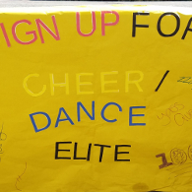
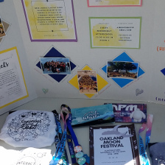
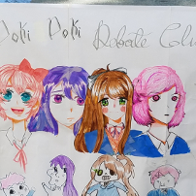
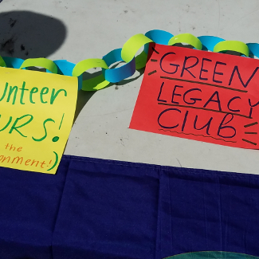
High School
Back to School Night
October 16th, 2019
6:00-8:00 pm

Slide 21
AIMS Athletics
Updates
The AIPHS Cross Country, Boys Soccer, and Girls Volleyball Seasons are Underway
High School Sports Schedules are available online at aimsathletics.com
AIPHS vs. Lighthouse Charter (Homecoming Game) November 7, 2019 @ 4PM, at Raimondi Field
AIMS Middle School Sports Season will take place in Early October
The Middle School fall sports season will consist of a flag football team and two inaugural Middle School Girls Volleyball teams

