Slide 1

AIMS OPERATIONS Report
By
Ms. Magaña Operations Director
Ms. Tung Operations Manager

Slide 2
Dates | AIPCS | AIPCS II | AIPHS
8/28/19 to 9/18/19 | 232 | 656 | 420
Enrollment Numbers
*

Slide 3
AIPCS ADA & ADA %
Dates | ADA | ADA %
8/28/19 to 9/18/19 | 221 | 97.14%
*Reporting period April 1, 2019 to April 26, 2019

Slide 4
AIPCS II ADA & ADA %
Dates | ADA | ADA %
8/28/19 to 9/18/19 | 631.8 | 97.10%
*Reporting period April 1, 2019 to April 26, 2019

Slide 5
AIPHS ADA & ADA %
Dates | ADA | ADA %
8/28/19 to 9/18/19 | 349.85 | 93.41%
*Reporting period April 1, 2019 to April 26, 2019

Slide 6
Reporting & Compliance
Awarded Facilities Incentives Grant for American Indian Public Charter School II: Total 3 Year Grant $276,403.70
Submitted InfoCenter report for Office of Charters (District Authorizers), information submitted consisted of teacher credentialing, school board, general school information.
Finalized audit submission to California Department of Education (CDE) and VTD financial statements related to Title 1, Title III and National School Lunch program funding.

Slide 7

District Lunch & Snack Program Update
12th Street Campus K-8th - Not Serving until kitchen is completed and passed inspection. AIPHS has served 150 students daily.
Title I Data:
AIPCS II Free- 377 Reduced- 115 Paid- 164 Free & Reduced= 75.58%
AIPCS Free- 136 Reduced- 42 Paid- 54
Free & Reduced= 77.38%
AIPHS Free- 249 Reduced- 69 Paid- 103
Free & Reduced= 71.95%
Started snack for 12th street on 1st day of school, all snacks are 100% reimbursed by federal and state reimbursements.

Slide 8

BACR After School Program
After School Education & Safety Program (ASES) - Grant Award
AIPCS: $177,381.64
AIPCS II: $177,381.64
Enrollment
Elementary - 74
Middle School - 45

Slide 9
District Facilities
AIPCS/AIPCS II: 171 12th St.
1st floor staff bathroom complete
Kitchenette space complete, final inspection has been completed.
AIPHS: 746 Grand Ave
Ongoing maintenance and cleaning services provided to school site

Slide 10

Wellness Committee
This year there will be four to five committee meetings will be held to provide our schools district ways to inform teachers, staff, students about the work the school is doing to improve the health and academic success of our students.
The Wellness committee is also a way to ensure that district level policies are implemented at the school site level.

Slide 11

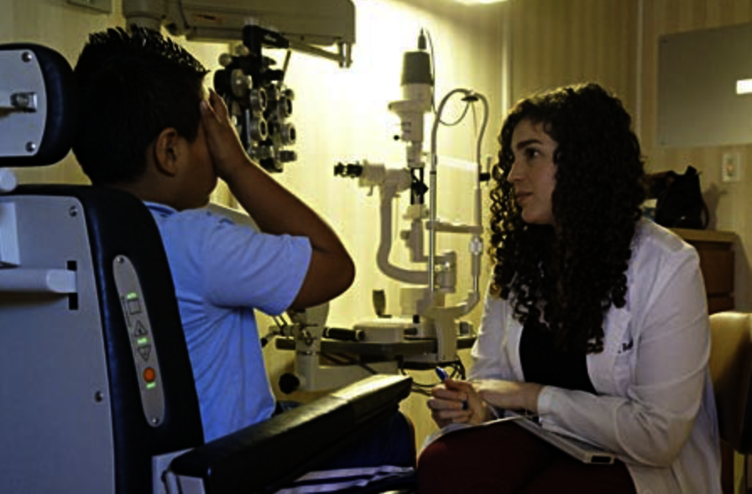
School Events
Operations supported with the planning and managing:
LifeTouch Picture Day - 9/12/19
Vision To Learn: For the fourth year in a row AIMS partnered with Vision to Learn. Vision to Learn provides free vision screening for district and free eye glasses.
AIPCS II - Elementary - 9/8/19
AIPHS- 9/17/19
AIPCS /AIPCS II - Middle School - 9/18/19

