Slide 1
AIMS Demolition & Constructoion Timeline

Slide 2
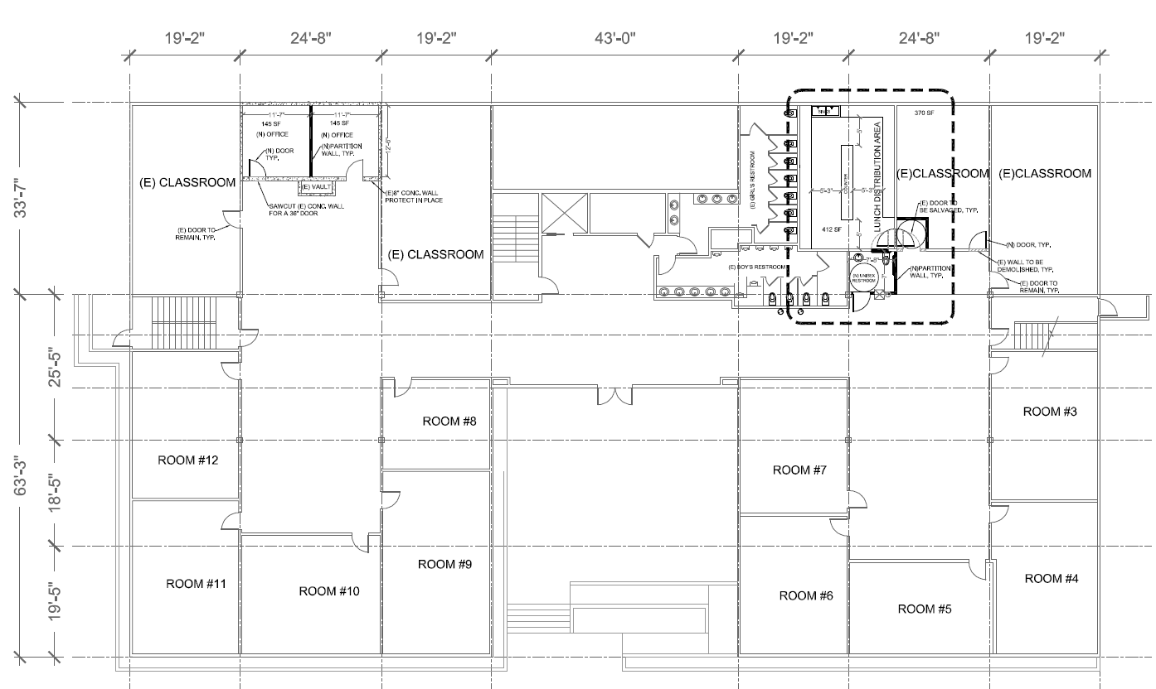
1st Floor

Slide 3
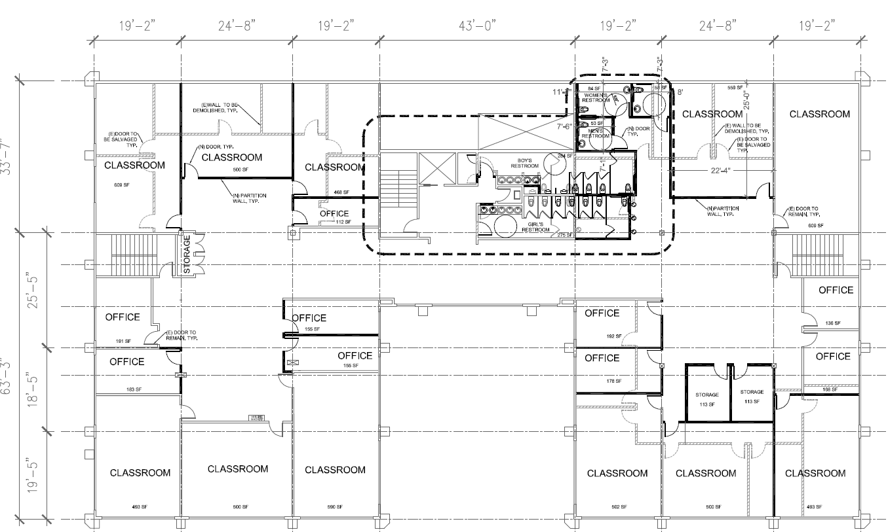
3rd Floor

Slide 4
Timeline Plan A
Phase 1: Demolition | End Date | Phase 2: Construction | End Date
3 Days | Demolition Permit expires June 28, 2019 | Ideal - Simultaneously 1st and 3rd floor | All work done by 8/20/2019
 |  | Construction Permit approved by | TBD
 |  | 1st Floor - Priorities Kitchen Classroom Bathrooms Offices Painting - Aesthetics | All work done by 8/20/2019
 |  | 3rd floor - Priorities Classrooms Bathrooms Offices Painting - Aesthetics | All work done by 8/20/2019
 |  | Flooring 1st-3rd Floor (Luxor Flooring) | All work done by 8/20/2019
 |  | Inspection | TBD

Slide 5
Timeline Plan B
2018-2019
TASK DESCRIPTION
PLAN
START
PLAN
END
TYPE
Phase 1: Demolition | End Date | Phase 2: Construction | End Date
3 days | With RFQ bidding process July 9, 2019 | Permit to Start Construction - Date TBD
Start Demolition July 10, 2019 | Demolition completed July 13, 2019 | Construction | Need at least 4-6 weeks
 |  | Inspection Permits

Slide 6
Building Modernization
Working with Gelfand Architects, provided visioning for building modernization including classroom design, playground creation with current space, painting design and building esthetics.

Slide 7
Flooring
We will be working with Luxor flooring to replace 1st ,2nd, and 3rd floor of 12th St. building.
Flooring company will start work July 8, 2019 and complete work by August 20, 2019. Company will work during construction to ensure completion of work.
Should we add flooring design information?

