Slide 1
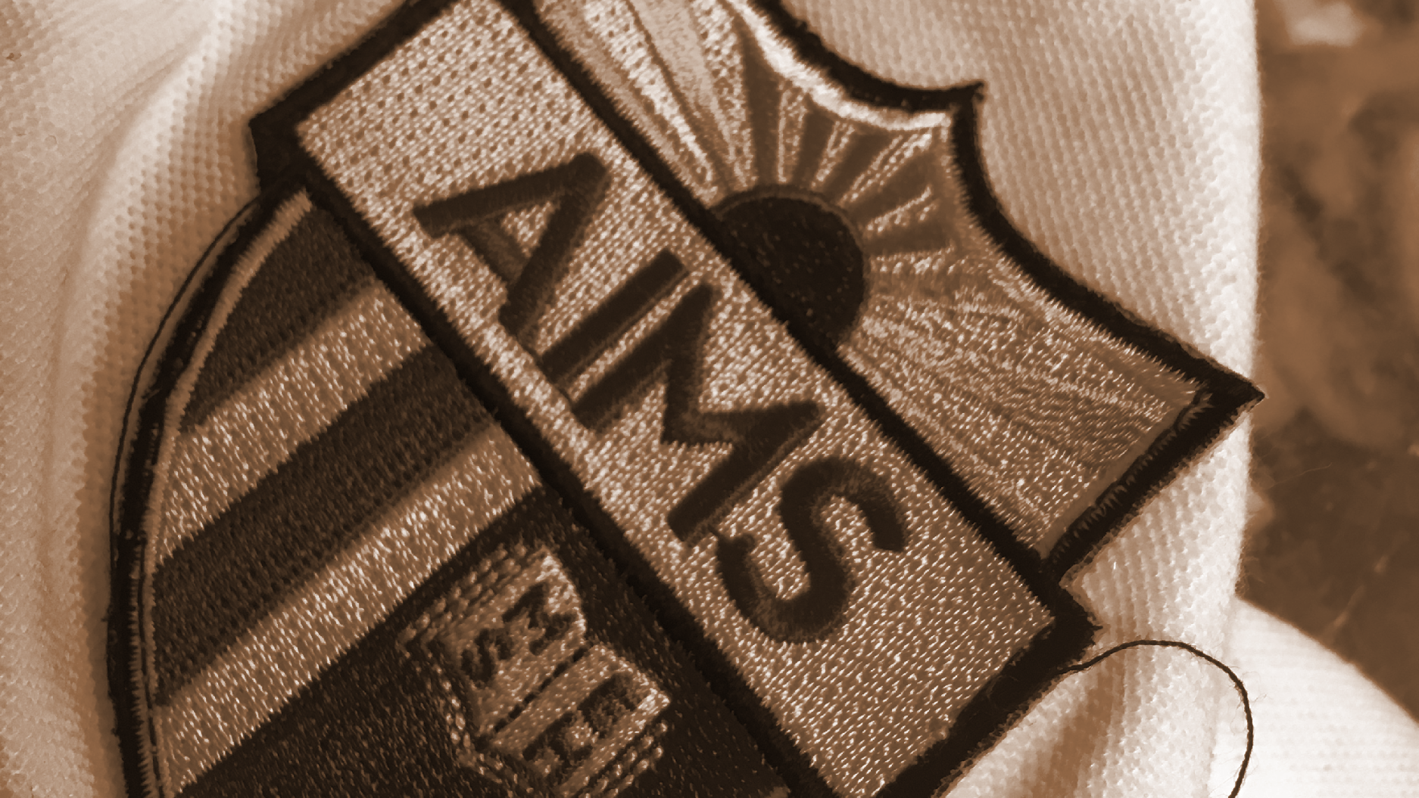
AIMS K-12 Board Report
May 21st, 2019
Superintendent Maya Woods-Cadiz
Mrs. Erin Oh (K-1 Division Head)
Mr. Christopher Ahmad (2-5 Division Head)
Mr. Maurice Williams (Head of Middle School)
Mr. Tareyton Russ (AIPHS Head of School)
Mr. Peter Holmquist (AIPHS Head of Academics)

Slide 2
Month | AIPCS | AIPCS II | AIPHS
Month 1a | 158 | 750 | 410
Month 1b | 162 | 788 | 416
Month 2 | 161 | 798 | 412
Month 3 | 160 | 801 | 410
Month 4 | 160 | 798 | 411
Month 5 | 160 | 797 | 411
Month 6 | 159 | 796 | 403
Month 7 | 159 | 794 | 399
Month 8 | 159 | 793 | 399
Month 9 | 159 | 792 | 396
Enrollment Numbers
*Reporting as of April 26, 2019

Slide 3
AIPCS ADA & ADA %
 | ADA | ADA %
Month 1a | 150.60 | 95.31
Month 1b | 159.28 | 97.85
Month 2 | 158.42 | 98.40
Month 3 | 154.61 | 97.61
Month 4 | 154.70 | 96.69
Month 5 | 157.50 | 97.83
Month 6 | 156.83 | 97.65
Month 7 | 154.29 | 97.04
Month 8 | 153.86 | 96.77
Month 9 | 156.26 | 98.28
*Reporting period April 1, 2019 to April 26, 2019

Slide 4
AIPCS II ADA & ADA %
 | ADA | ADA %
Month 1a | 737.38 | 98.37
Month 1b | 765.72 | 97.58
Month 2 | 775.58 | 97.84
Month 3 | 784.78 | 98.07
Month 4 | 773.60 | 96.94
Month 5 | 769.50 | 96.55
Month 6 | 774.22 | 97.14
Month 7 | 765.24 | 96.36
Month 8 | 772.79 | 97.37
Month 9* | 770.95 | 97.23
*Reporting period April 1, 2019 to April 26, 2019

Slide 5
AIPHS ADA & ADA %
 | ADA | ADA %
Month 1a | 394.5 | 96.21
Month 1b | 393.22 | 93.90
Month 2 | 388.16 | 94.36
Month 3 | 390.53 | 94.91
Month 4 | 384.30 | 93.51
Month 5 | 391.40 | 95.23
Month 6 | 386.44 | 95.20
Month 7 | 380.76 | 95.29
Month 8 | 380.07 | 95.26
Month 9* | 375.96 | 94.81
*Reporting period April 1, 2019 to April 26, 2019
Notes:
This is AIPHS?

Slide 6
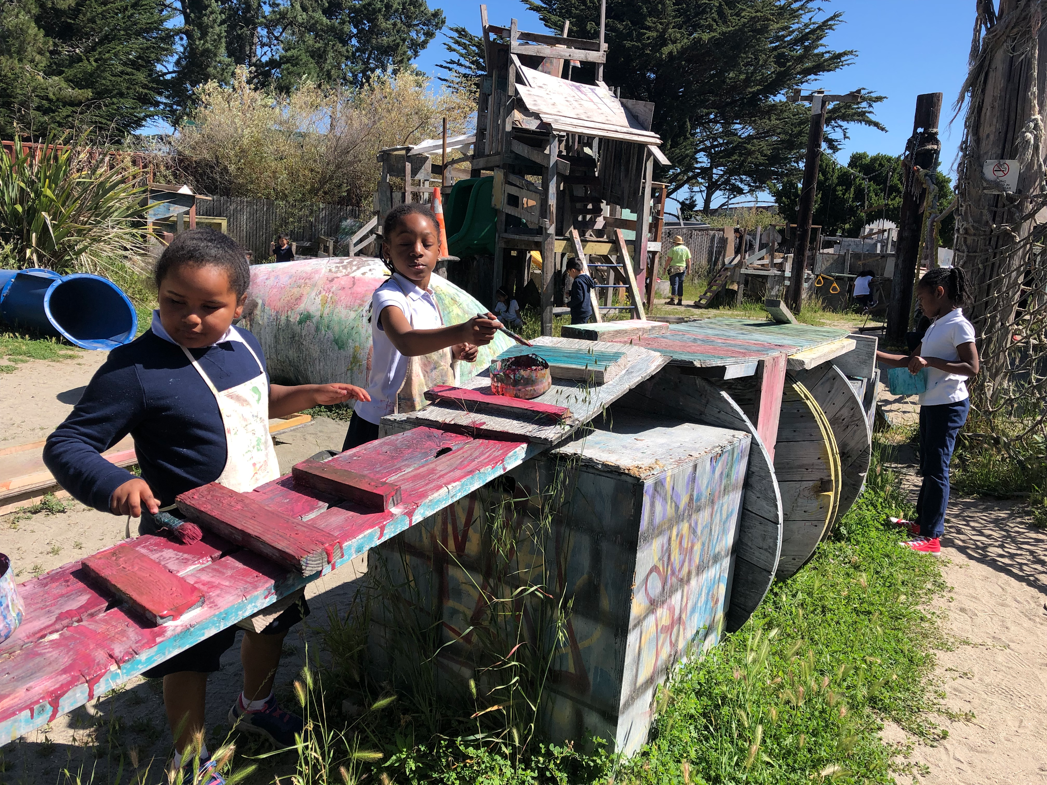
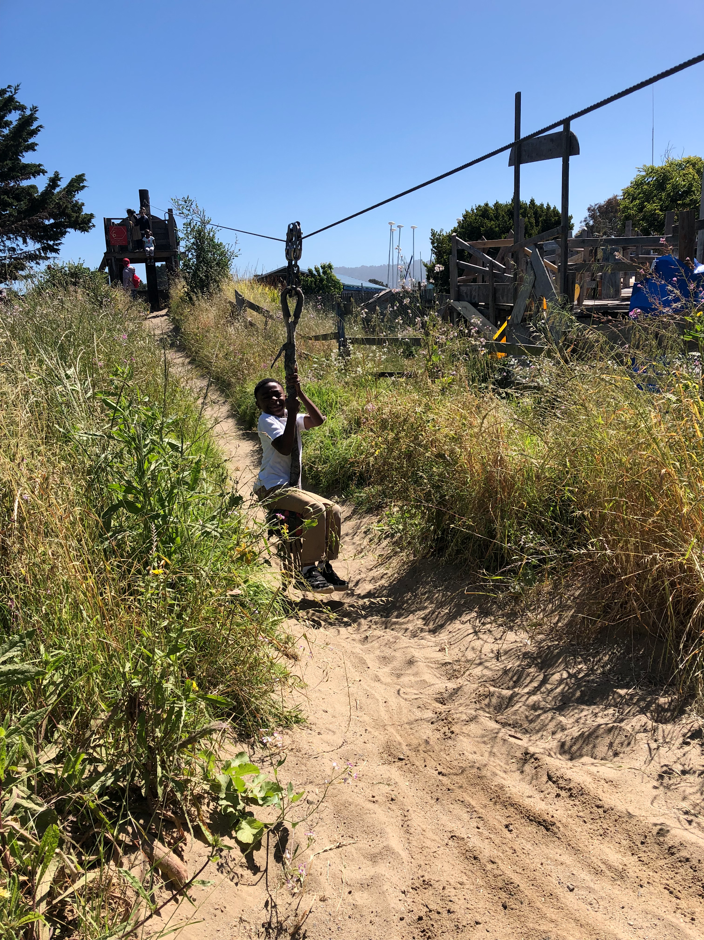
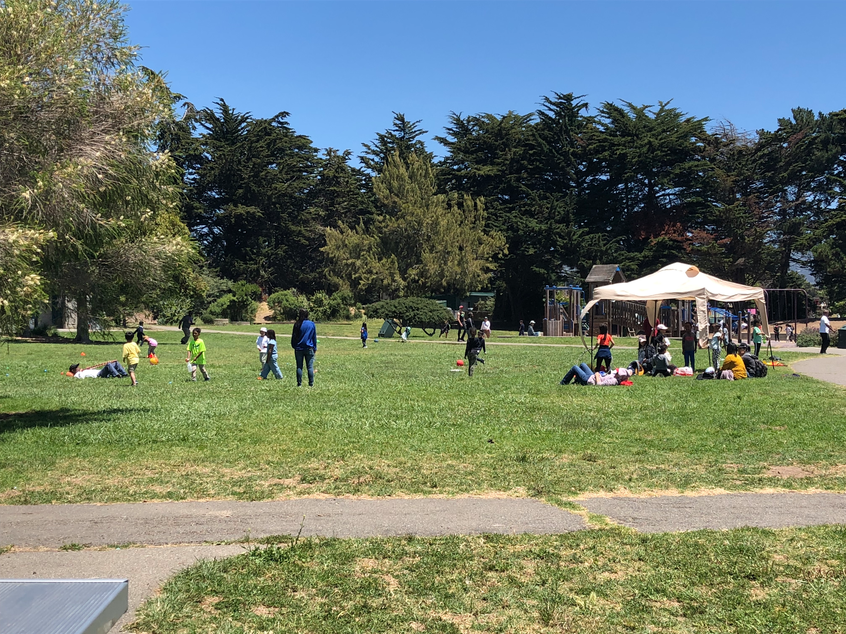
K-1 Satellite Updates: Events
May 24: Family Literacy Tea
May 31: Sing Out Loud Day
June 6: End of the year field trip
June 14: Graduation/Potluck

Slide 7
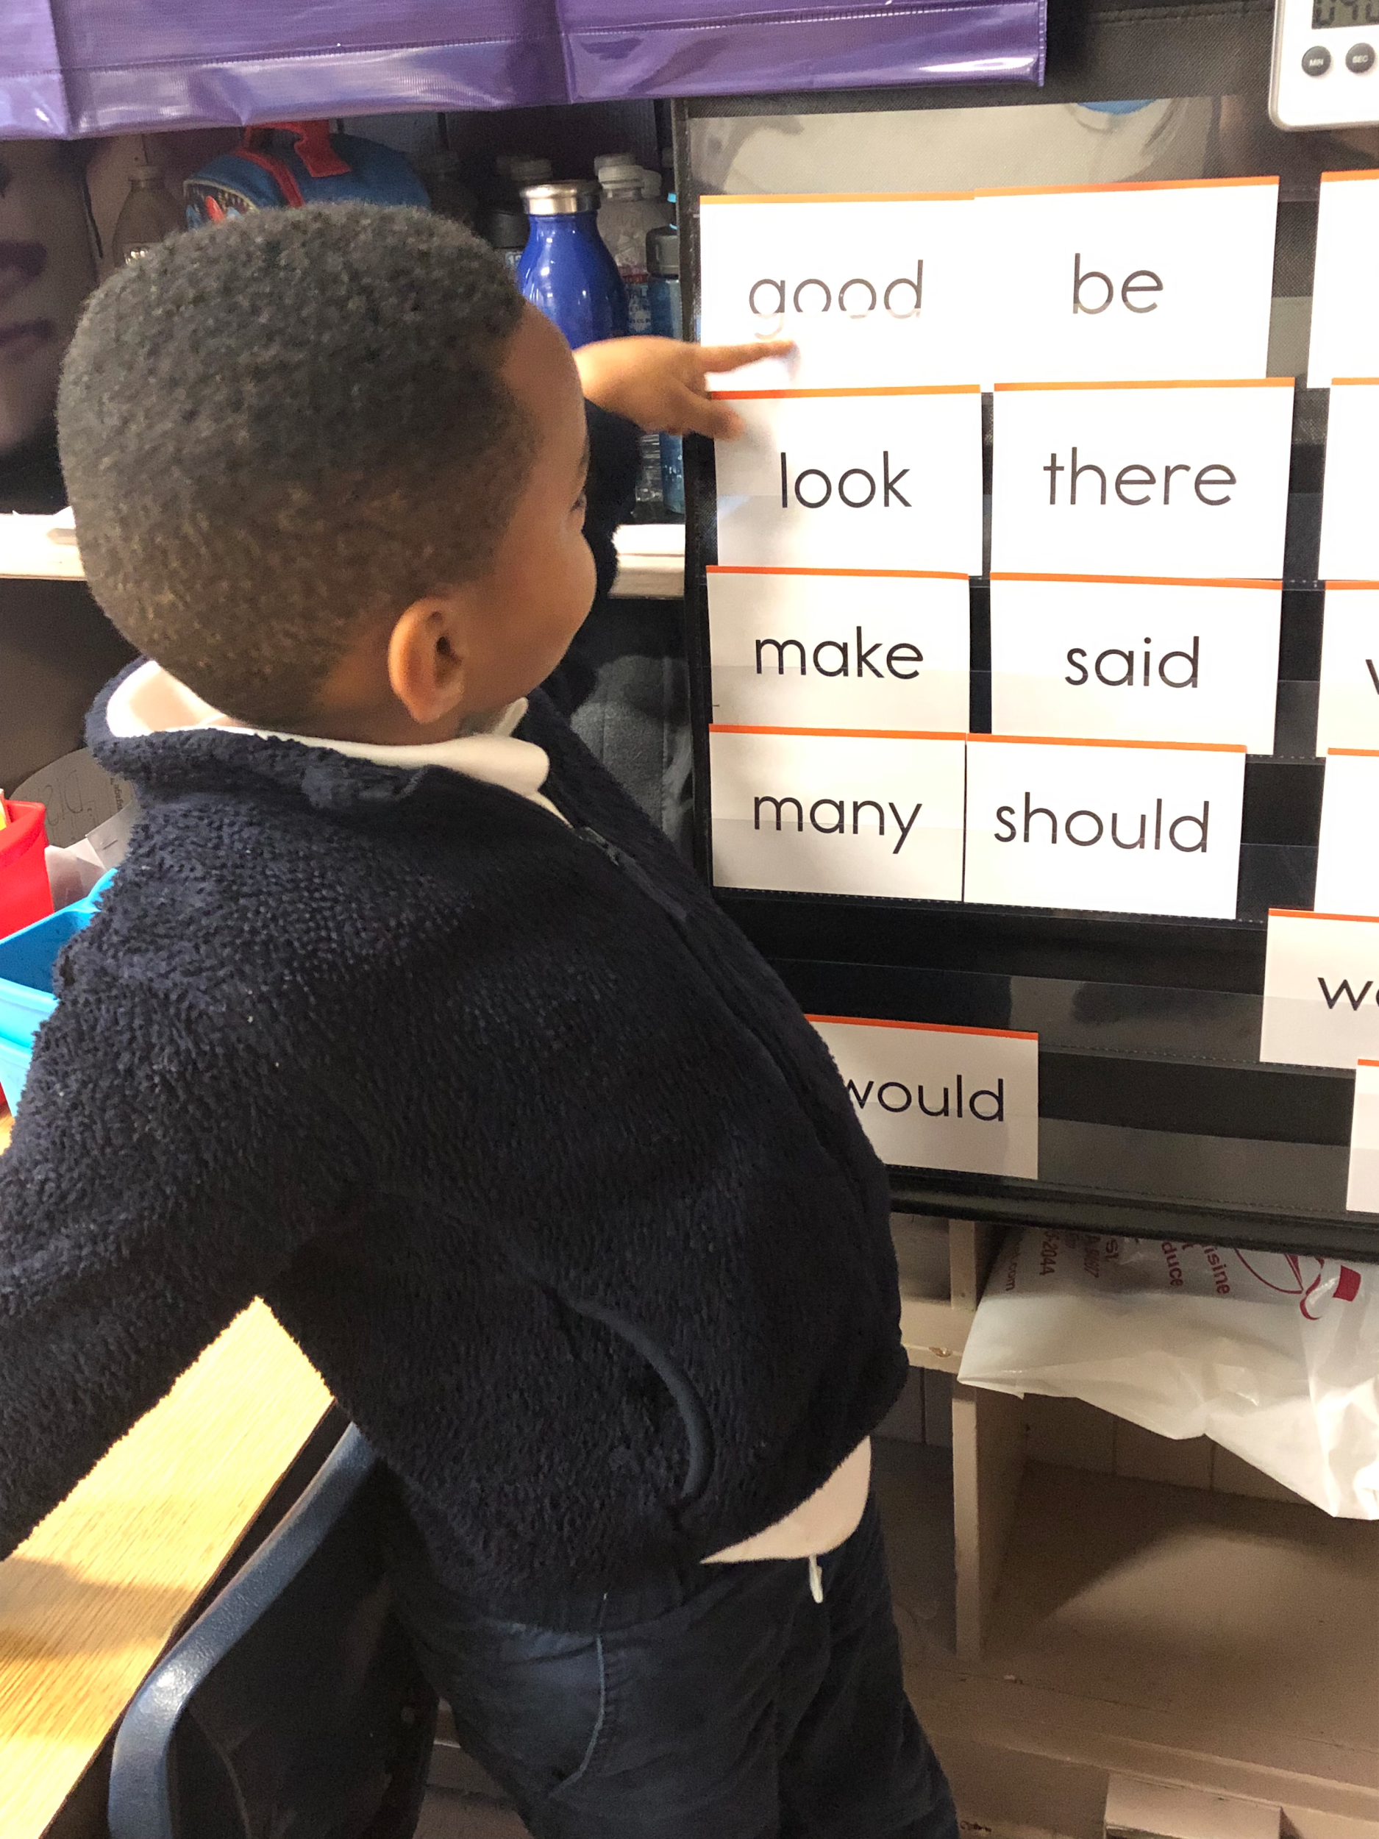
K-1 Satellite: June Priority Report
June Updates
Literacy Overview: strategic literacy plan; disaggregate data
Assessment Calendar: finished indicators to build coherent literacy goals K-5.
RJ: building alignment for age-appropriate practices in discipline.

Slide 8
HOD: Elementary Academics
-Benchmark Advance: integrated with our inquiry blocks
-K-5: Coaching Cycles
-Mandarin Integration: looking for best practices for teaching Mandarin while also meeting core class goals and arts.

Slide 9
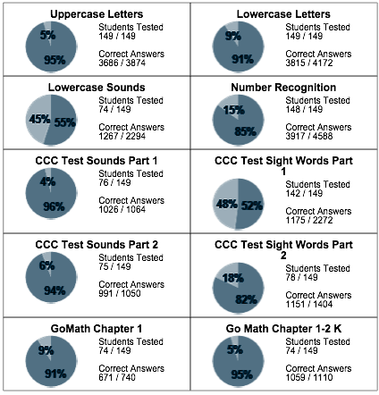
JUNE DATA
Progress Report Growth

Slide 10
2-5 Updates
AIMS PROJECT TREES
“Planting Trees and Shrubs To Beautify Our Campus and Improve Air Quality”
Grant received for $500 from Philanthropic Ventures Foundation, Oakland, CA

Slide 11
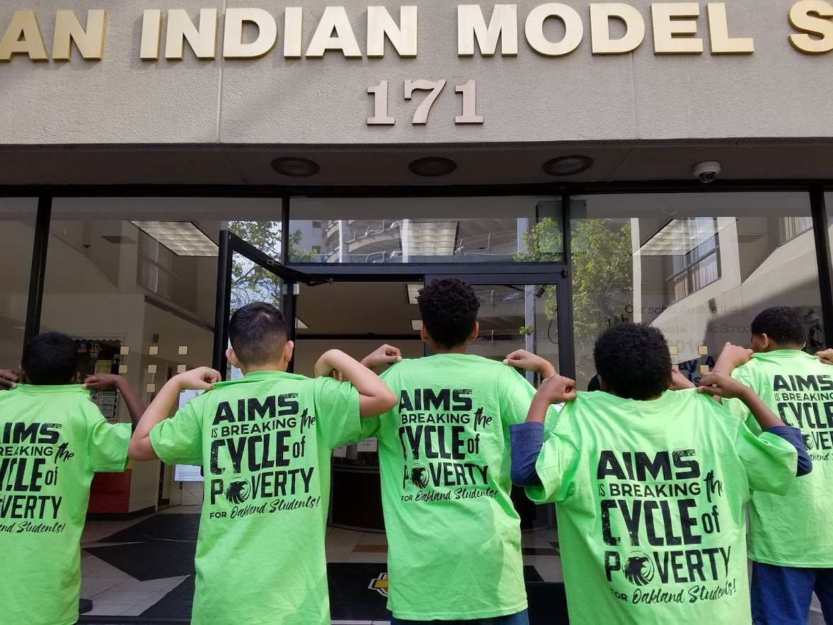
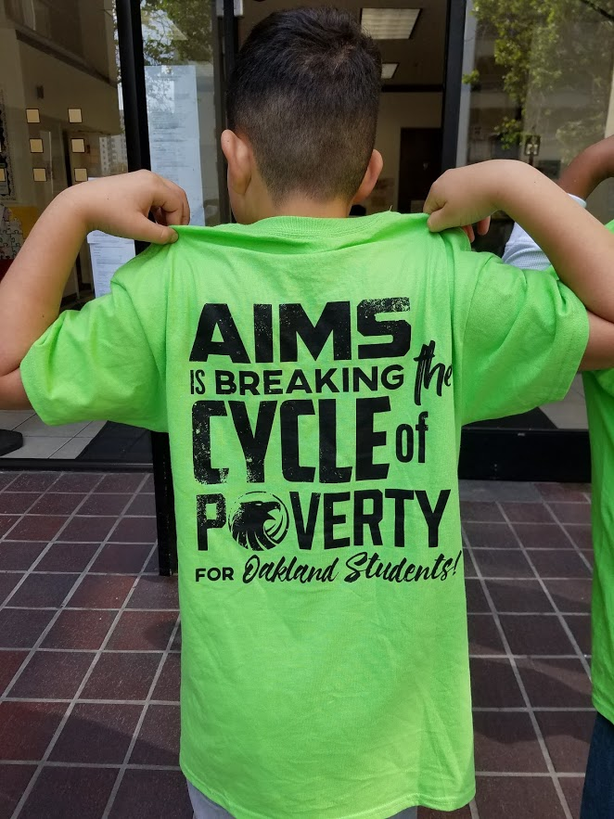
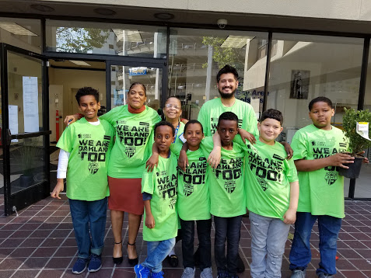
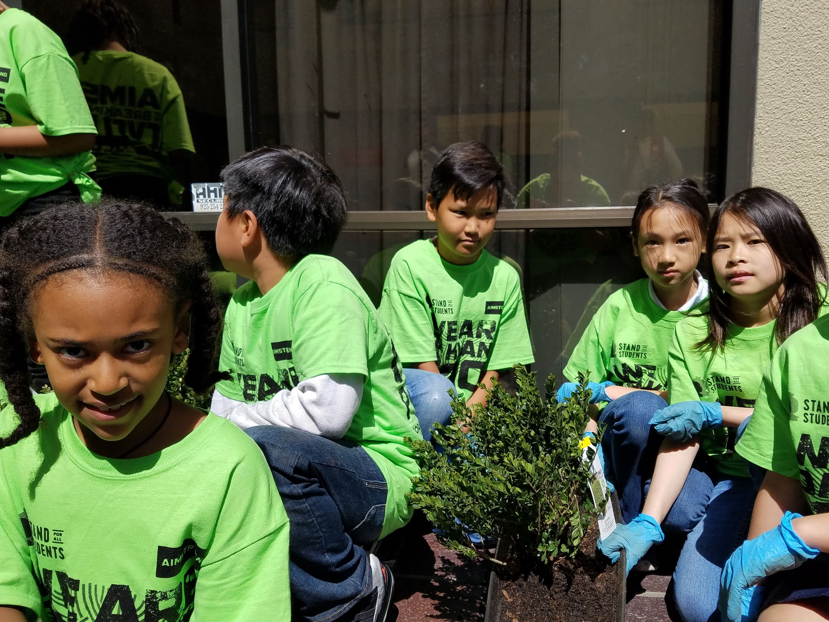
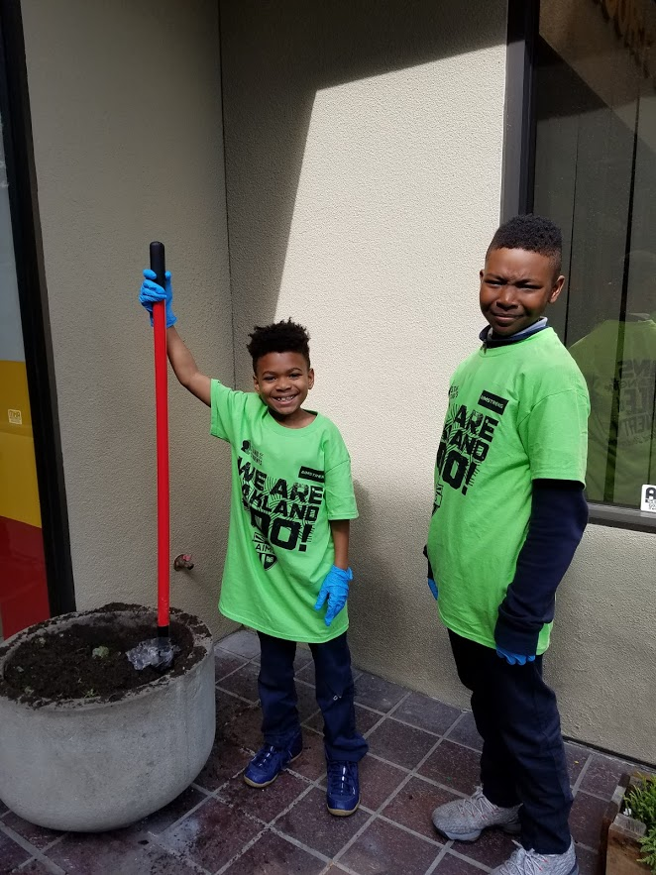

Slide 12
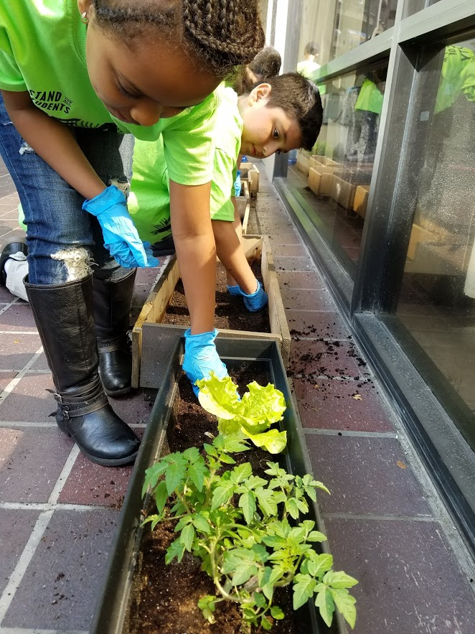
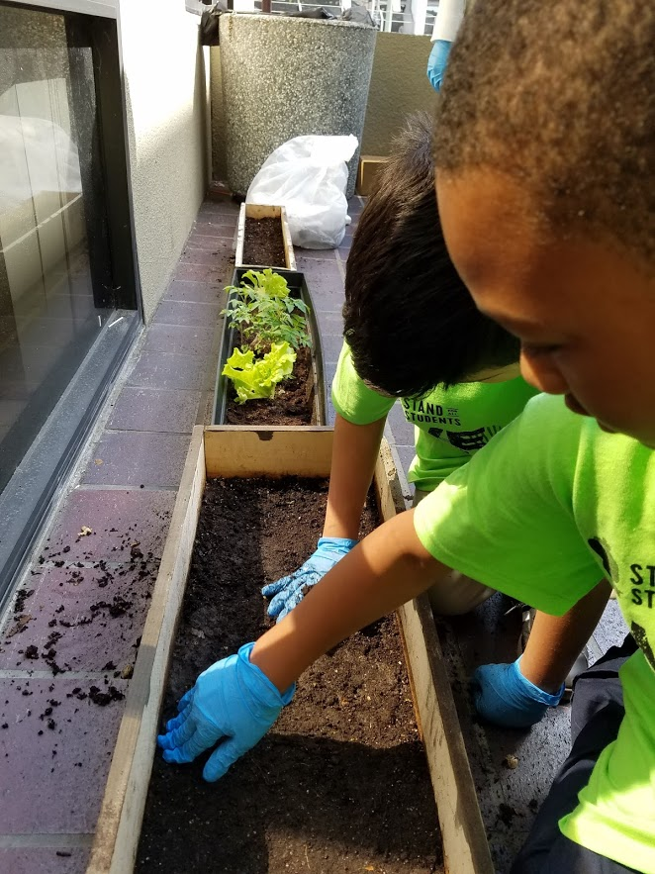
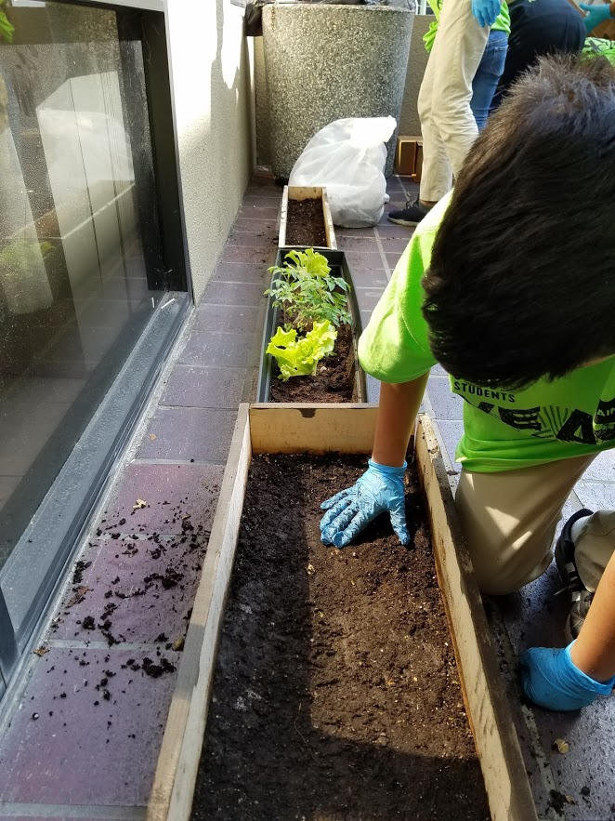

Slide 13
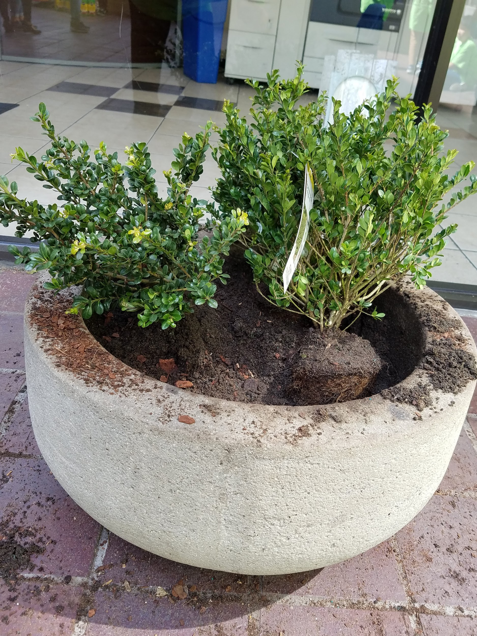
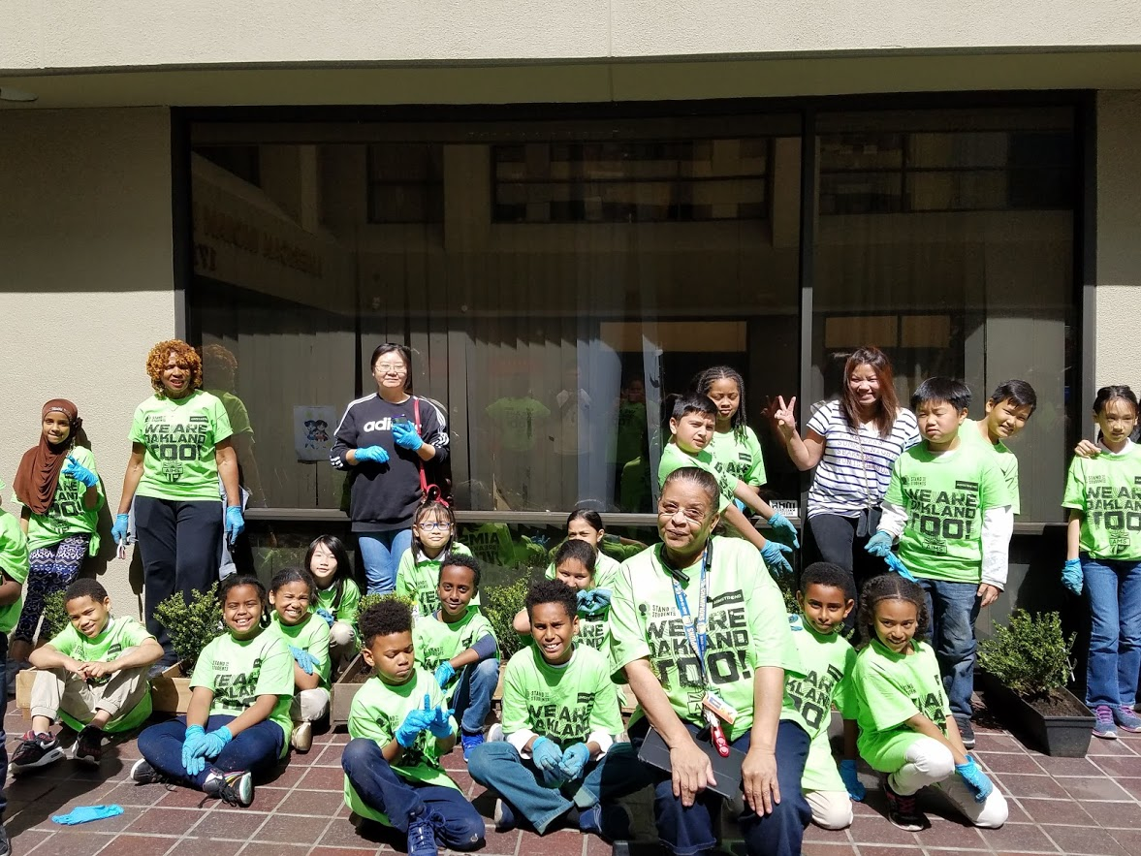
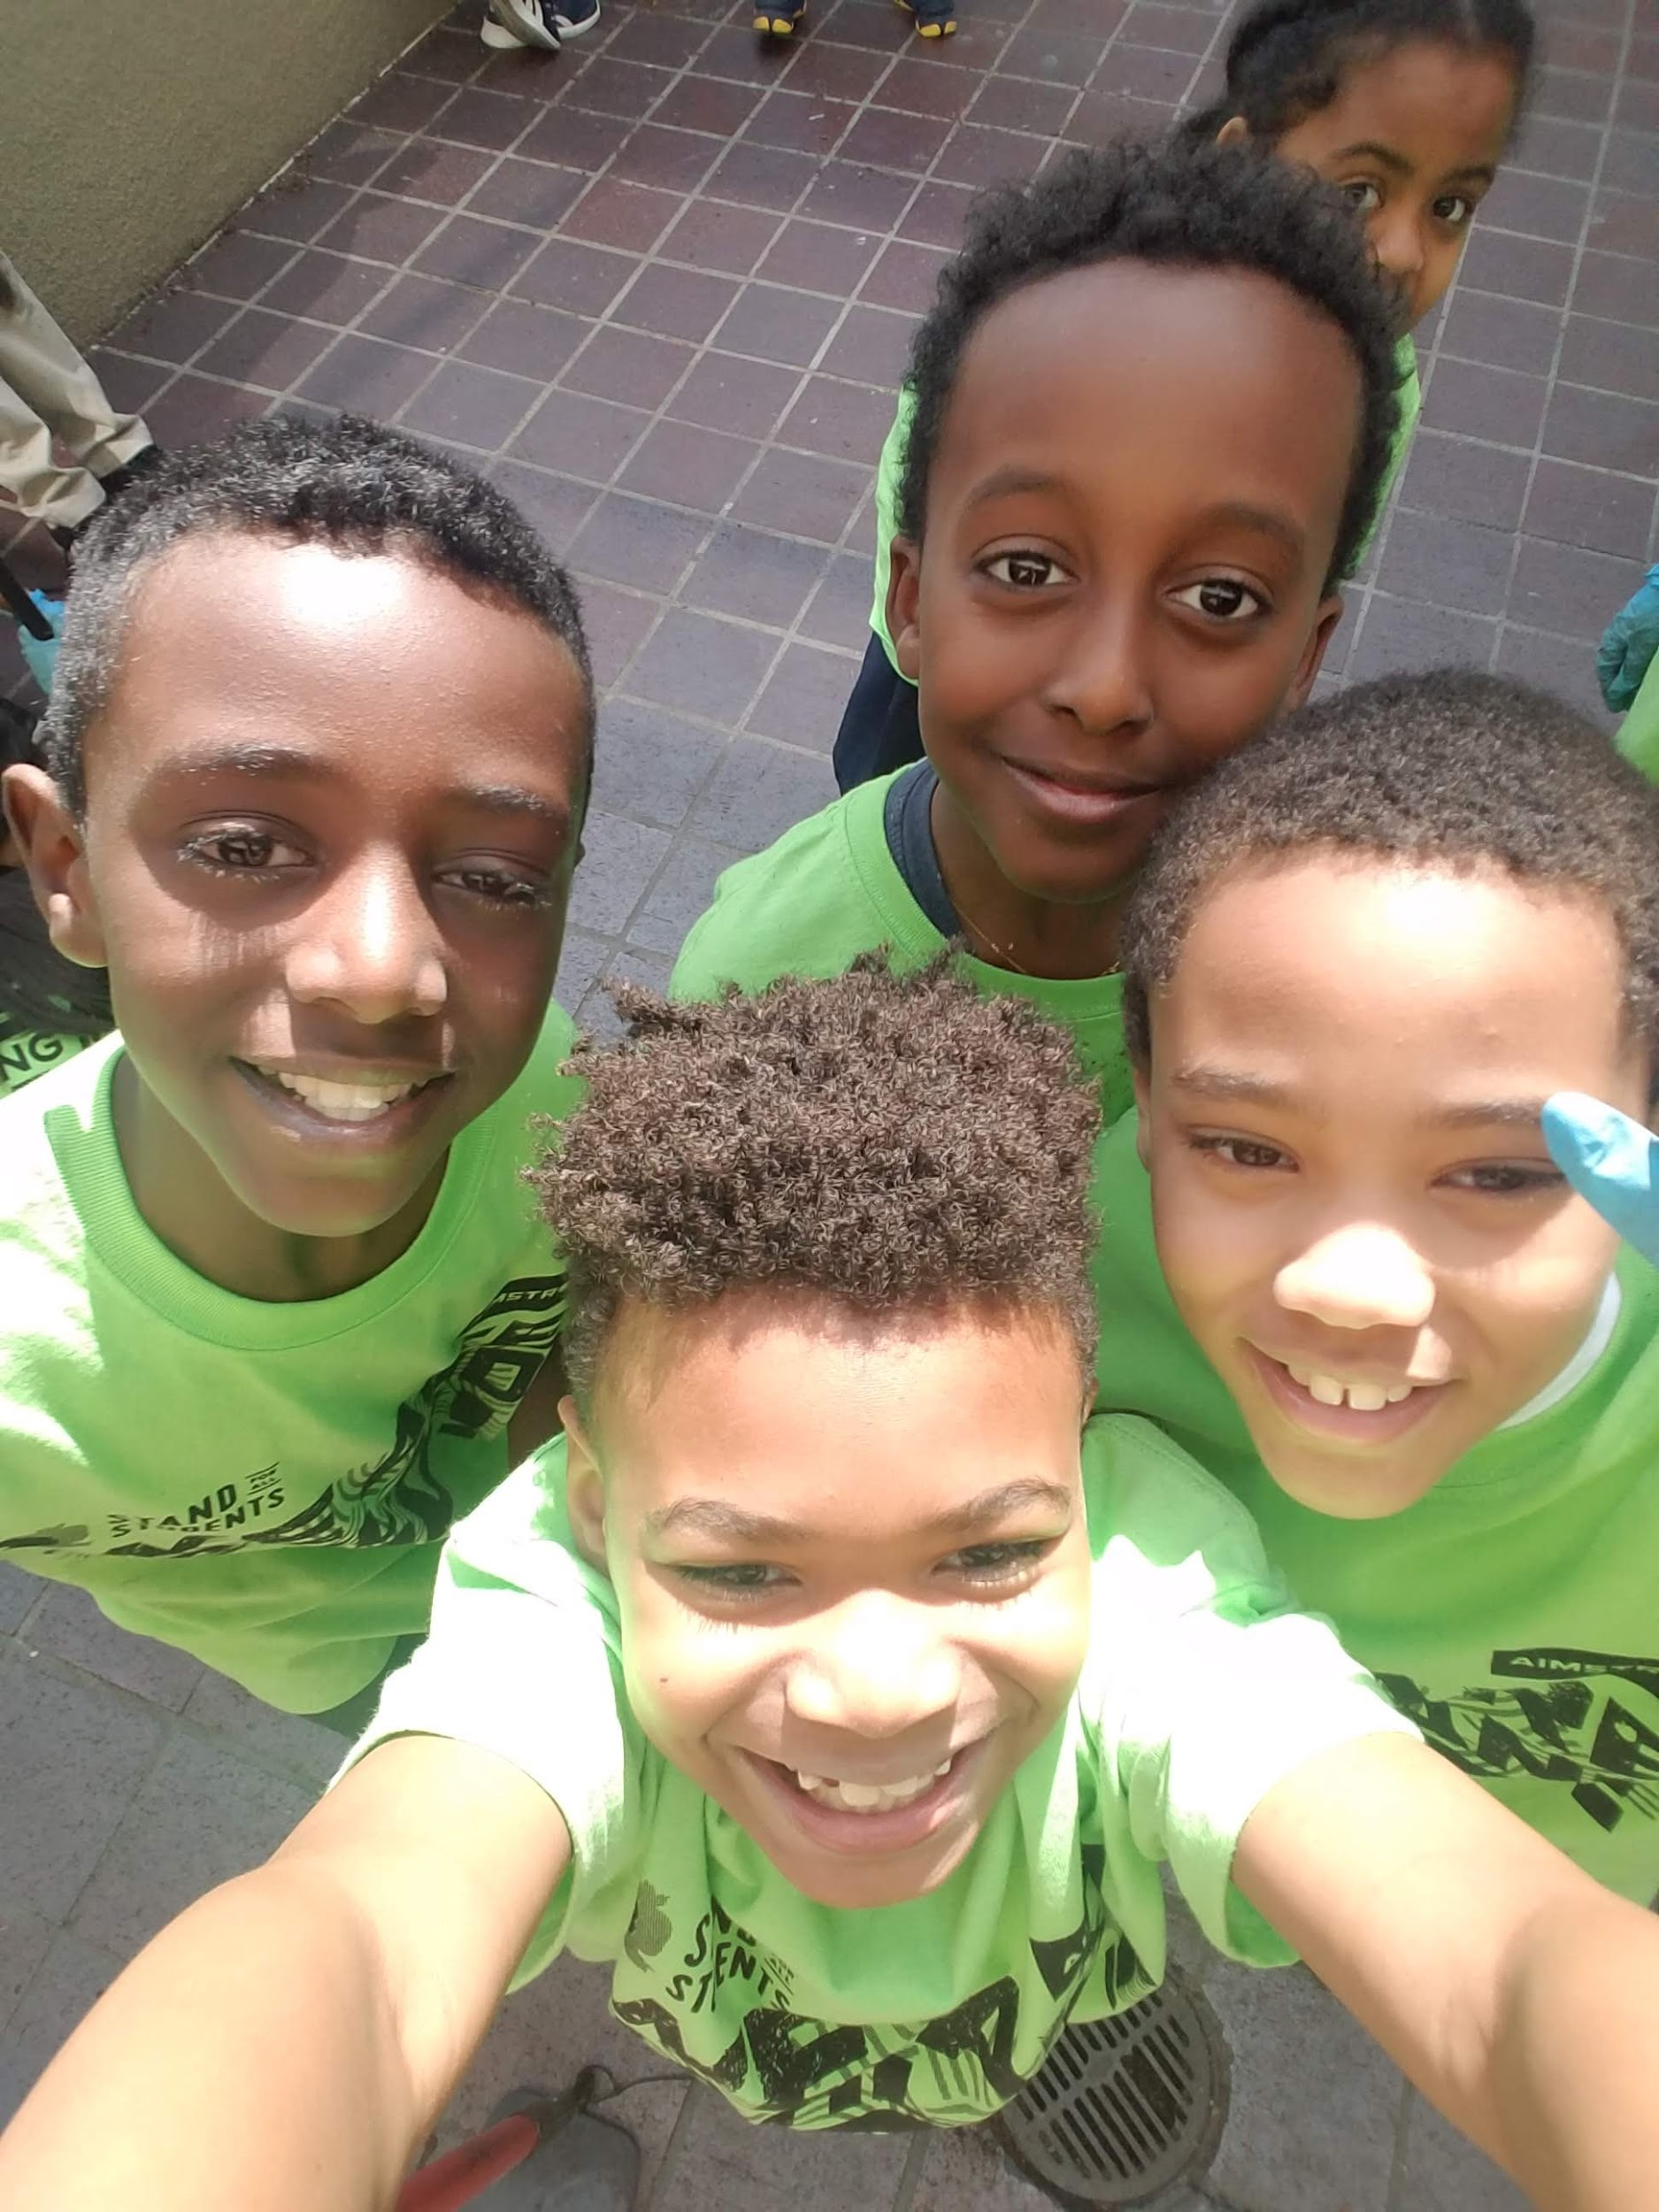
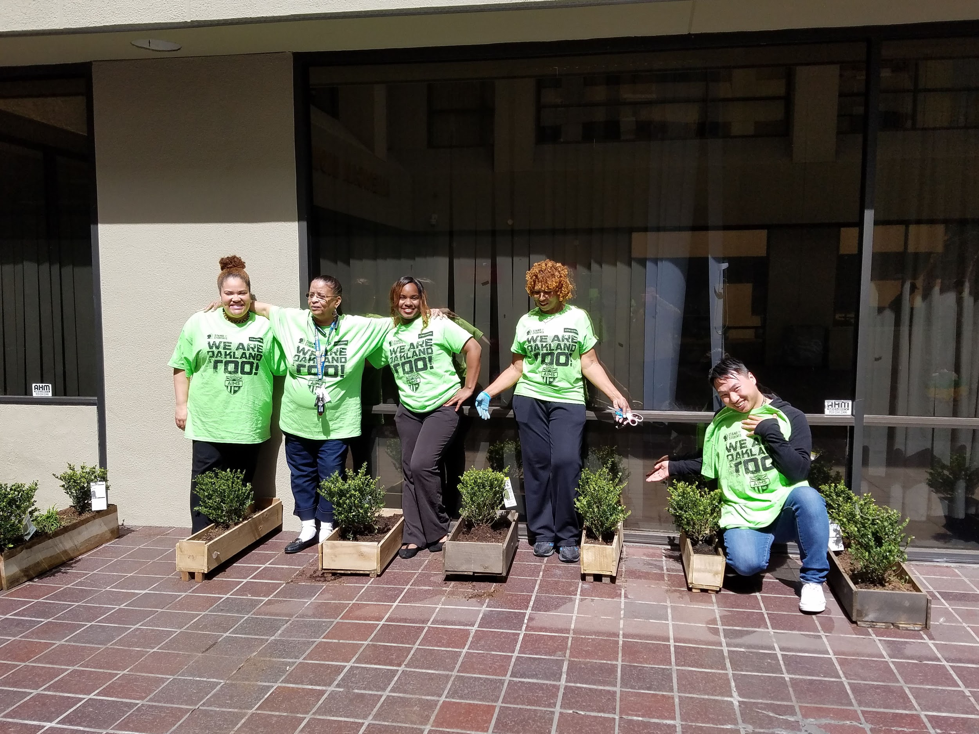
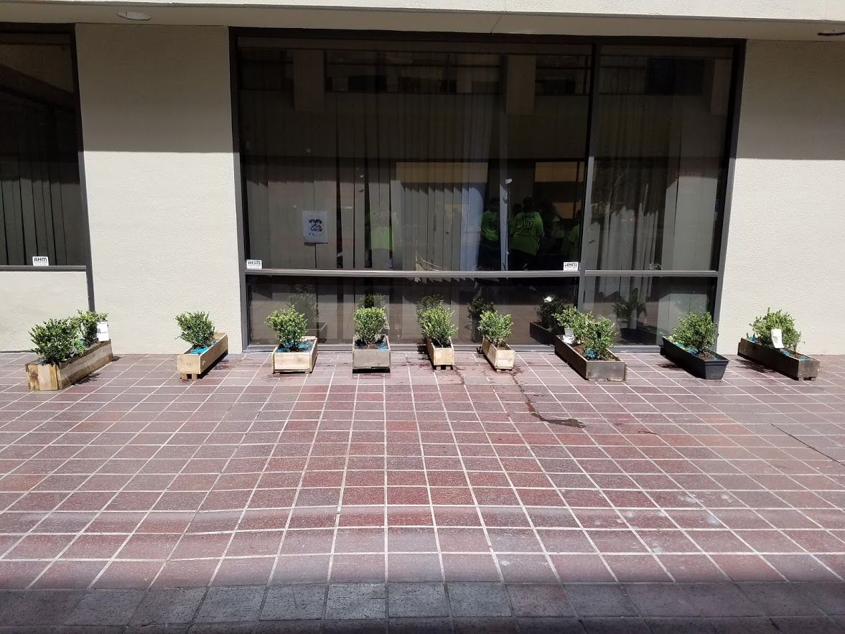


Slide 14
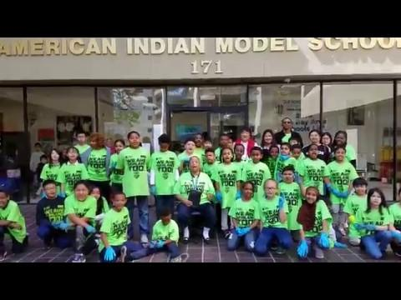

Slide 15
2-5 Updates - Graduation
5th Grade graduation will take place on June 13th, 2019 at 12th St. There is a graduation committee made up of teachers and parent volunteers. We are having a HOLLYWOOD theme.

Slide 16
2-5 Updates - SBAC
Students started the SBAC last week. The first week, students will do the math and math performance task. This week, students will do the ELA multiple choice and performance task. 5th graders will take the science test the week after.

Slide 17
2-5 - Retentions
We plan on retaining 9 students in grades 2-5. Students took multiple assessments during the past few weeks to ensure that this was the right decision.

Slide 18
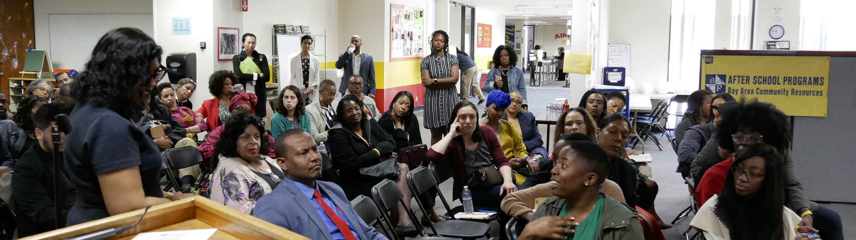
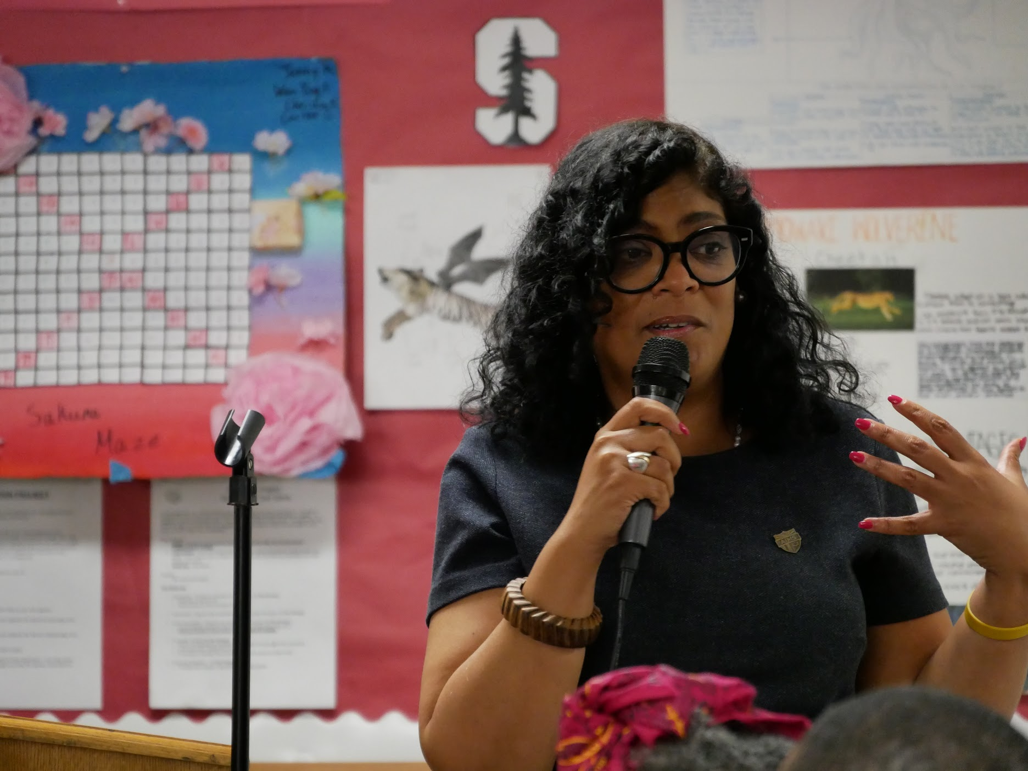
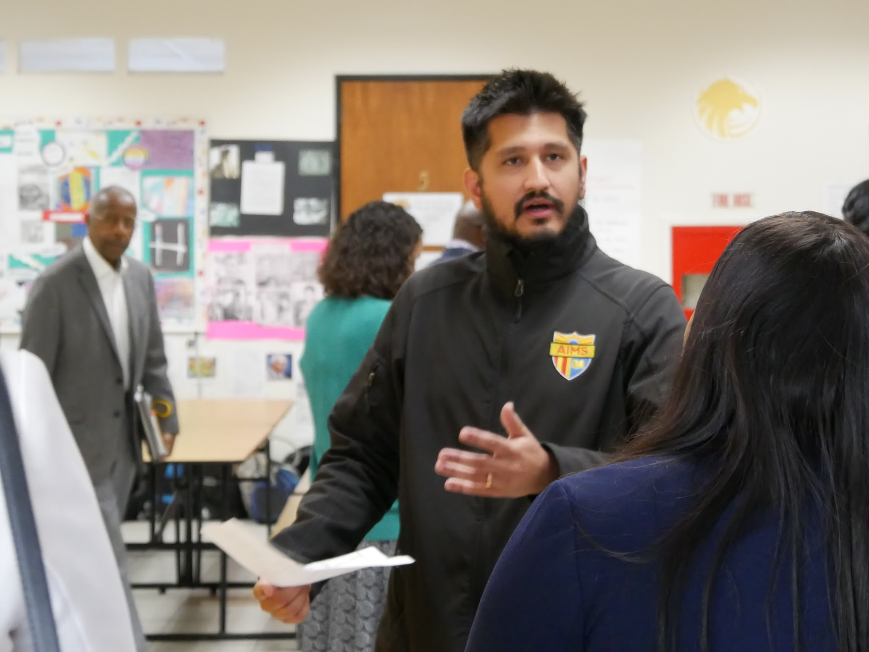
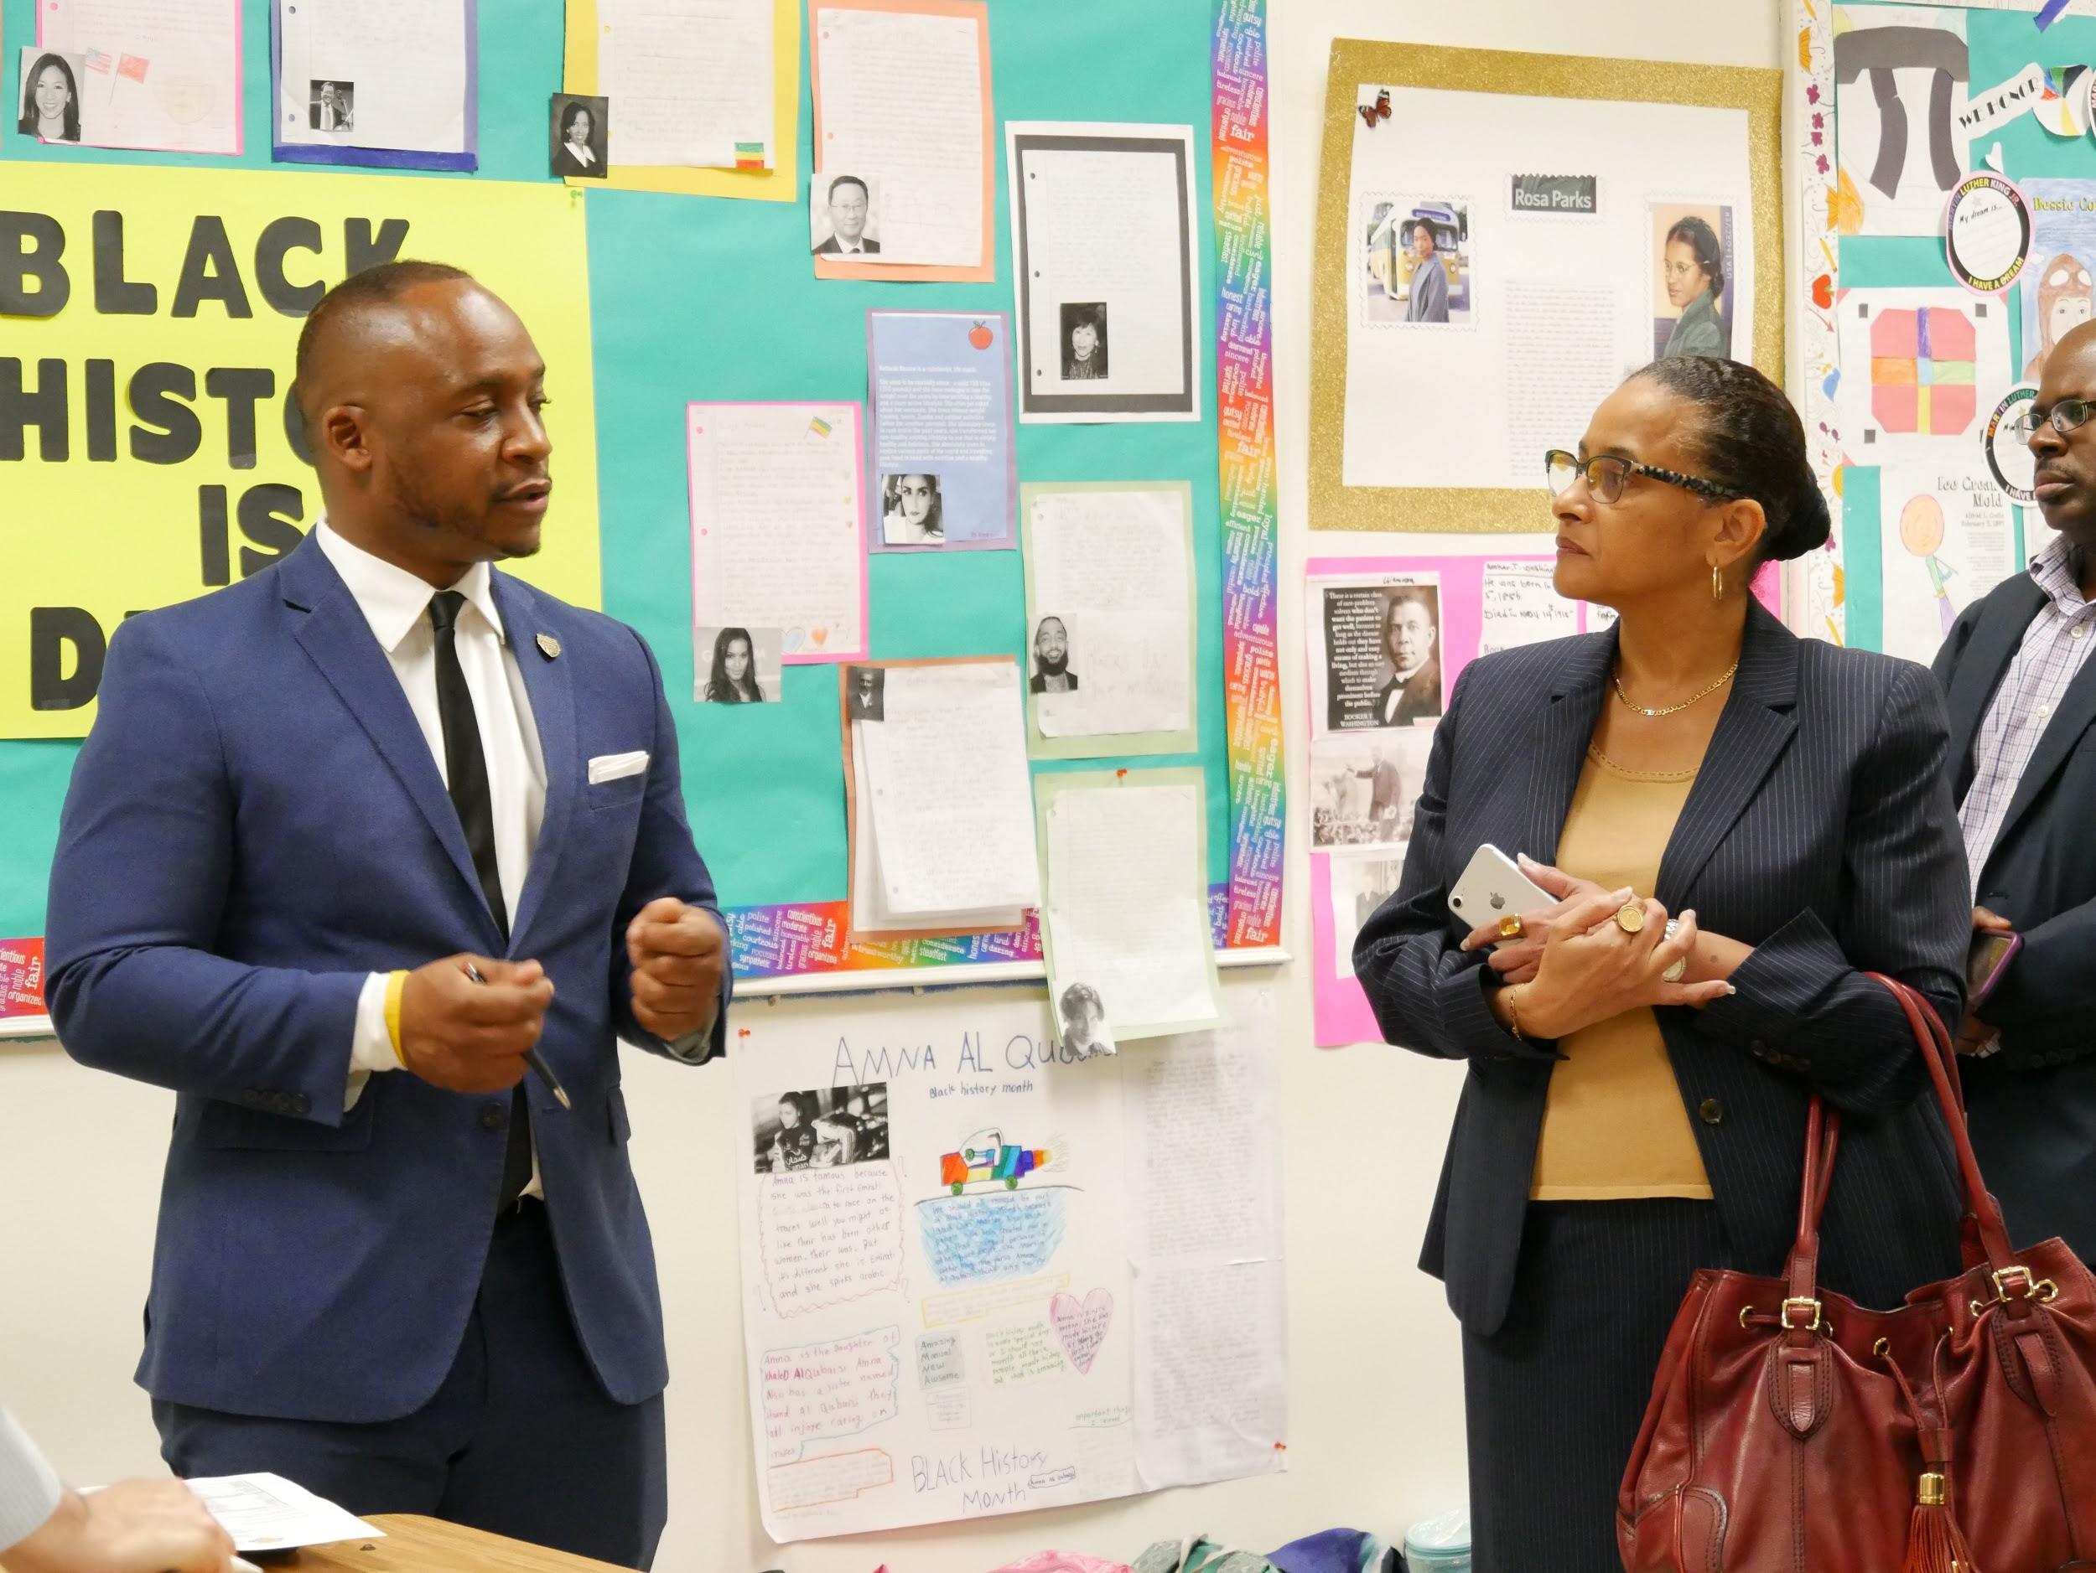
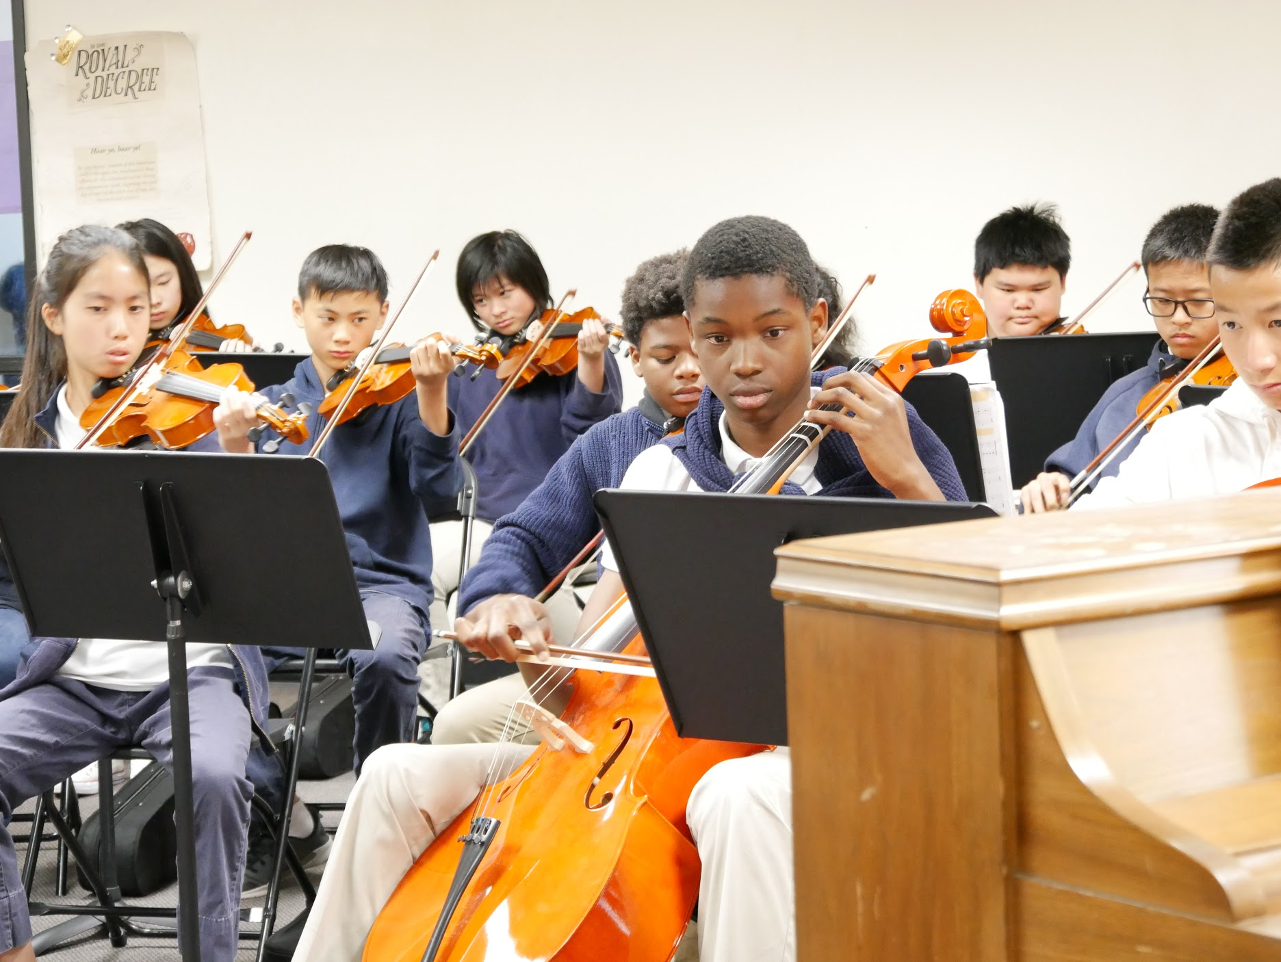
National Charter Collborative Site Visit
On Friday, May 10, nearly 80 CEO’s, Superintendents, Principals, and Charter leaders of color toured the AIMS 12th Street Campus to study our practices.

Slide 19

Middle School Updates
AIMS 8th Grade Promotion Ceremony: 3-time Emmy Award Winner and KTVU Channel 2 news anchorwoman Claudine Wong served as speaker for the Middle School Promotion Ceremony. 163 Students were promoted to high school.

Slide 20
Middle School Updates (Cont.)
No Bullying Schools Presentation: National Youth Motivational Speaker Tom Thelen from No Bullying Schools will spoke to all Middle School grade levels and some 5th grades classes to help promote tolerance and anti-bullying initiatives at the middle school level. AIMS 6-8 has a one year membership in the nobullyingschools.org platform, which will allow students to anonymously report bullying, and access to Tom’s anti-bullying books and curriculum for teachers and students.

Slide 21
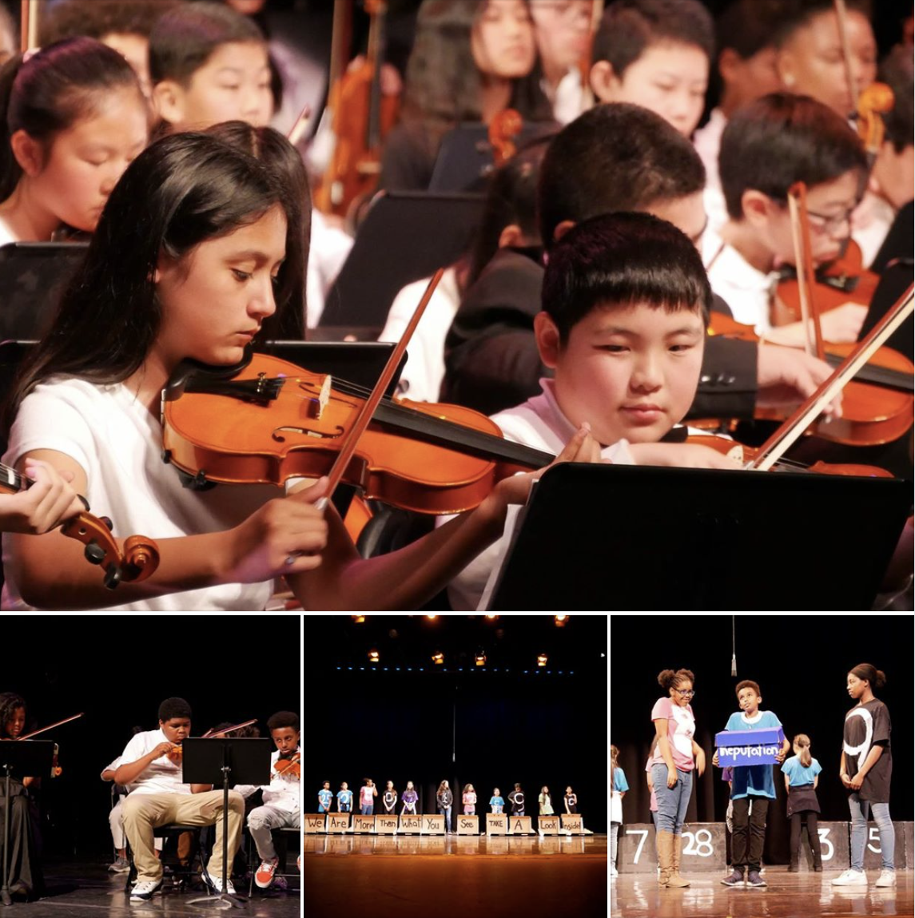
Middle School Updates (Cont.)
VPA Showcase Performances: In May, the AIMS 6-8 VPA Department will held its first annual showcases at the Molanga Center in Oakland, CA (350 seat capacity.) The performance featured musical performances from our Violin classes; a Musical Theater Performance of “Boxes;” and Art and Graphic Art Displays / and silent auctions of student work. The VPA performances exceeded capacity for all three nights and over $1000 was raised in donations, snack sells, and student art purchases.

Slide 22

Middle School Updates (Cont.)
Student Retentions: AIMS 6-8 will have 27 student retentions for the 2019-2020 academic school year (eight 6th graders; fifteen 7th Graders; and three 8th graders.)
10 African-American (8 are first year students); 5 Asian (2 are first year students); 6 Hispanic / Latino (2 are first year students); 4 Middle Eastern (3 are first year students.)
Most retained students are behind several grade levels in Math
All retained students will be required to attend Math / ELA Camp

Slide 23

Middle School Updates (Cont.)
Math / ELA Camp: AIMS 6-8 will offer Math / ELA camp to retained, new, and non-mastery students from Monday, July 8, to Friday, July 26, from 10AM - 3PM. Approximately 210 students attended Math / ELA camp last year.

Slide 24
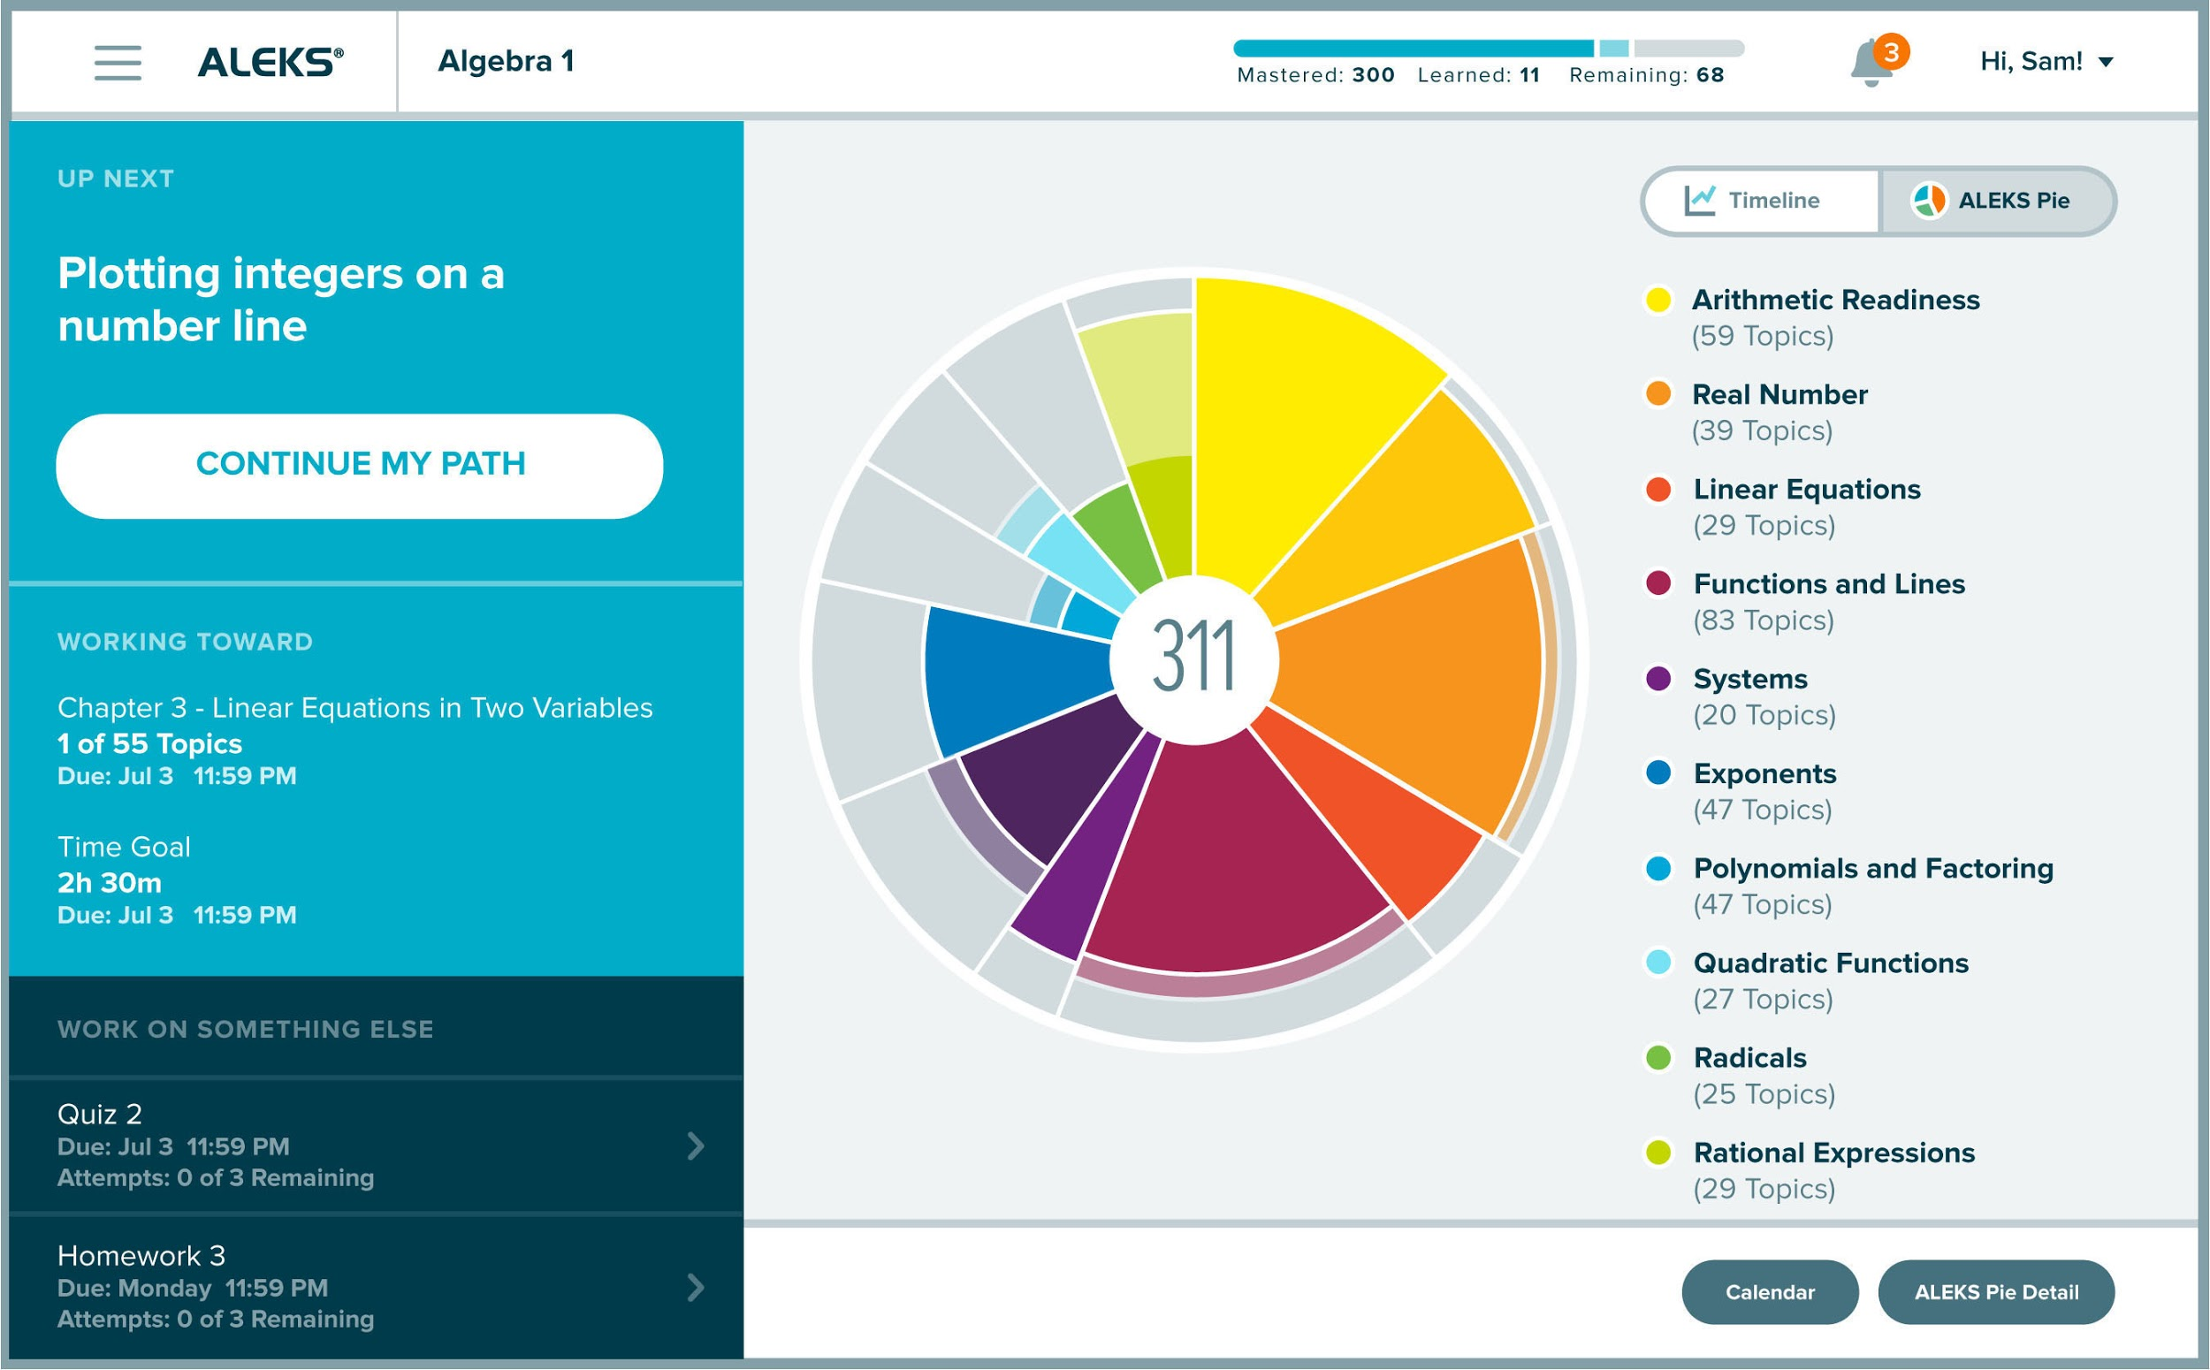
Middle School Updates (Cont.)
ALEKS for Math: For the 2019-2020 academic school year, all Middle School Students will have ALEKS accounts, which is an adaptive learning platform that uses artificial intelligence to create individualized student plans to achieve mastery of skills and standards.
Adoption of ALEKS was inspired by Gilroy Prep Charter School, one of the highest performing charter schools in the state that receives over 85% standard met and exceeded and math annually on statewide assessments.

Slide 25
ALEKS – PERSONALIZED, INNOVATIVE, & RIGOROUS MATH TRAINER
Aleks (Assessment And Learning In Knowledge Spaces) Is An Online tutorial Program:
ALEKS - How it Works
Complete Curriculum Solution - Access To Full Course Library
Artificial Intelligence Targets Gaps In Student Knowledge
ALEKS for Math: For the 2019-2020 academic school year, all Middle School Students will have ALEKS accounts.
Adoption of ALEKS was inspired by Gilroy Prep Charter School, one of the highest performing charter schools in the state that receives over 85% standard met and exceeded and math annually on statewide assessments.
We pilot ALEKS as an intervention tool for two 8th & two 6th grade classes in April & May with significant improvement in students mastery in math.

Slide 26
Standards Plus: Closing the Achievement Gap for ALL
Standards Plus in Action
Standards Plus Intro
It creates a school wide focus by providing all students with structure and daily access to grade level standards
Plan – Development of a calendar or pacing guide
Do-10 to 15 minute daily standards based direction lessons
Check– weekly evaluation or assessment of students
Act – Reteach when necessary

Slide 27
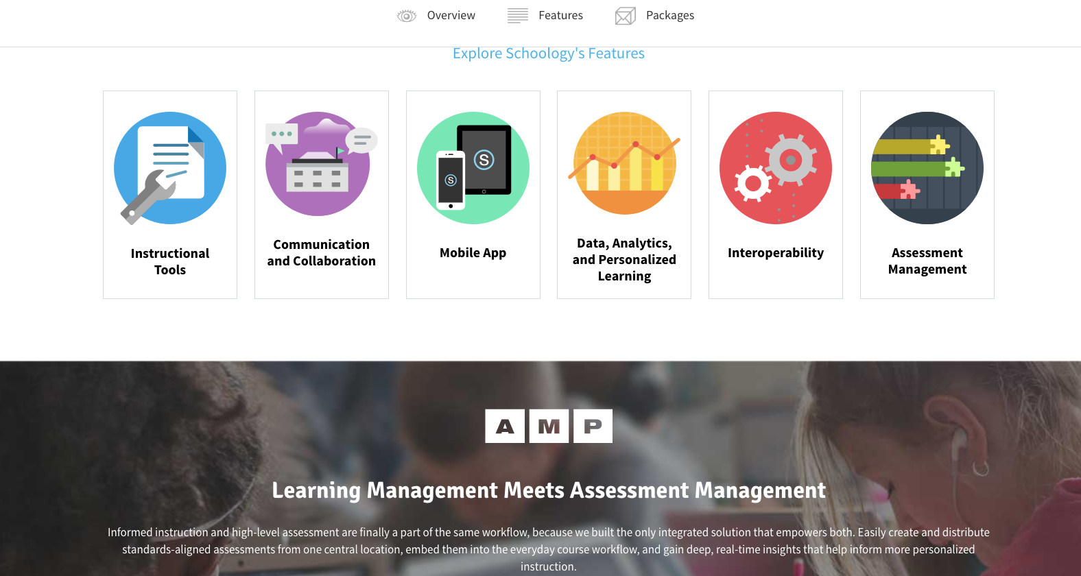
Schoology: An innovative learning management system (LMS)
Schoology Enterprise
LMS using software application for the administration, documentation, tracking, reporting, and delivery of educational courses in every classroom.
Schoolwide implementation of LMS help identify teaching and learning gaps, utilizing analytical data and reporting.

Slide 28

AVID: School Wide
Uniform System of Instructional Practices
AVID—Advancement Via Individual Determination—
fosters a safe, open culture, high expectations for teachers and students, and collaboration in all classrooms.
Creating a schoolwide college readiness culture.
Implementing Train the Trainer Model: Lead teachers for ELA, Math, Science & Social Studies will get AVID content based training during Summer Institute and will train the rest of the teachers .
AVID Schoolwide help students navigate rigorous content, achieve academically, and adequately prepare for College & career.

Slide 29
High School
Prom, Freshman game day, culture day, Junior field day, high school graduation
Scholastic Reading Inventory and benchmarks on Illuminate
SBAC and CAST tested
credit recovery classes set
recruitment, screening, scheduling, and interviewing teacher candidates
AVID forms and data submitted and accepted for h.s.
All of the amazing events of the end of the four year high school experience that students have had culminated in the past couple of weeks.
AIPHS has provided a strong and varied cultural experience of an American high school.
Promposal posters prepared before prom, Freshman video game event, incredible culture day, and finally high school graduation

Slide 30
High School
In California, there is no suggested high school curriculum for ELA.
This makes preparation for state assessments in 11th grade - three years after the last SBAC (8th grade) - a little more difficult.
Our students prepare by participating in the district (standardized) benchmarks on Illuminate and as of this year, the Scholastic Reading Inventory.
Teachers supported students in taking those benchmarks and the reading inventory after the AP testing of early May, which most of the students also participated heavily in.
SBAC and CAST tests were administered.
11th graders took the required English and Math content and Performance tasks SBAC assessments (four tests).
10th and 12th graders took the CAST for the first time officially.

Slide 31
High School
Credit Recovery schedule:
Session 1 Session 2
ELA 9 ELA 9
ELA 10 ELA 10
AP World AP World
Geometry Geometry
There will also be an Acellus lab for credit recovery of classes with fewer than 10 students with C- or below.
Session one is for first semester 18-19, June 19-July 3.
Session two is for second semester 18-19, July 8-19.

Slide 32
High School
AVID forms and data submitted and accepted for h.s.
We do not have a place where the demographic information of our students is broken out in the way AVID asks, that is why it is difficult to accomplish.
Middle School reports will be submitted in consultation with the AVID central office ,since we do not have all the information.
2019-2020 has also been identified as year one for Middle School implementation.
Recruitment, screening, scheduling, and interviewing teacher candidates
Indeed, EDJoin candidates have been followed up on.
Appropriate candidates have been invited for interviews.
Math candidates are difficult to find.

Slide 33
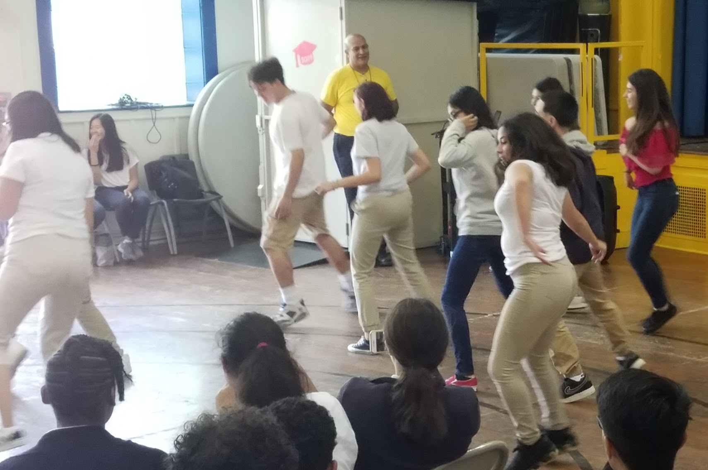
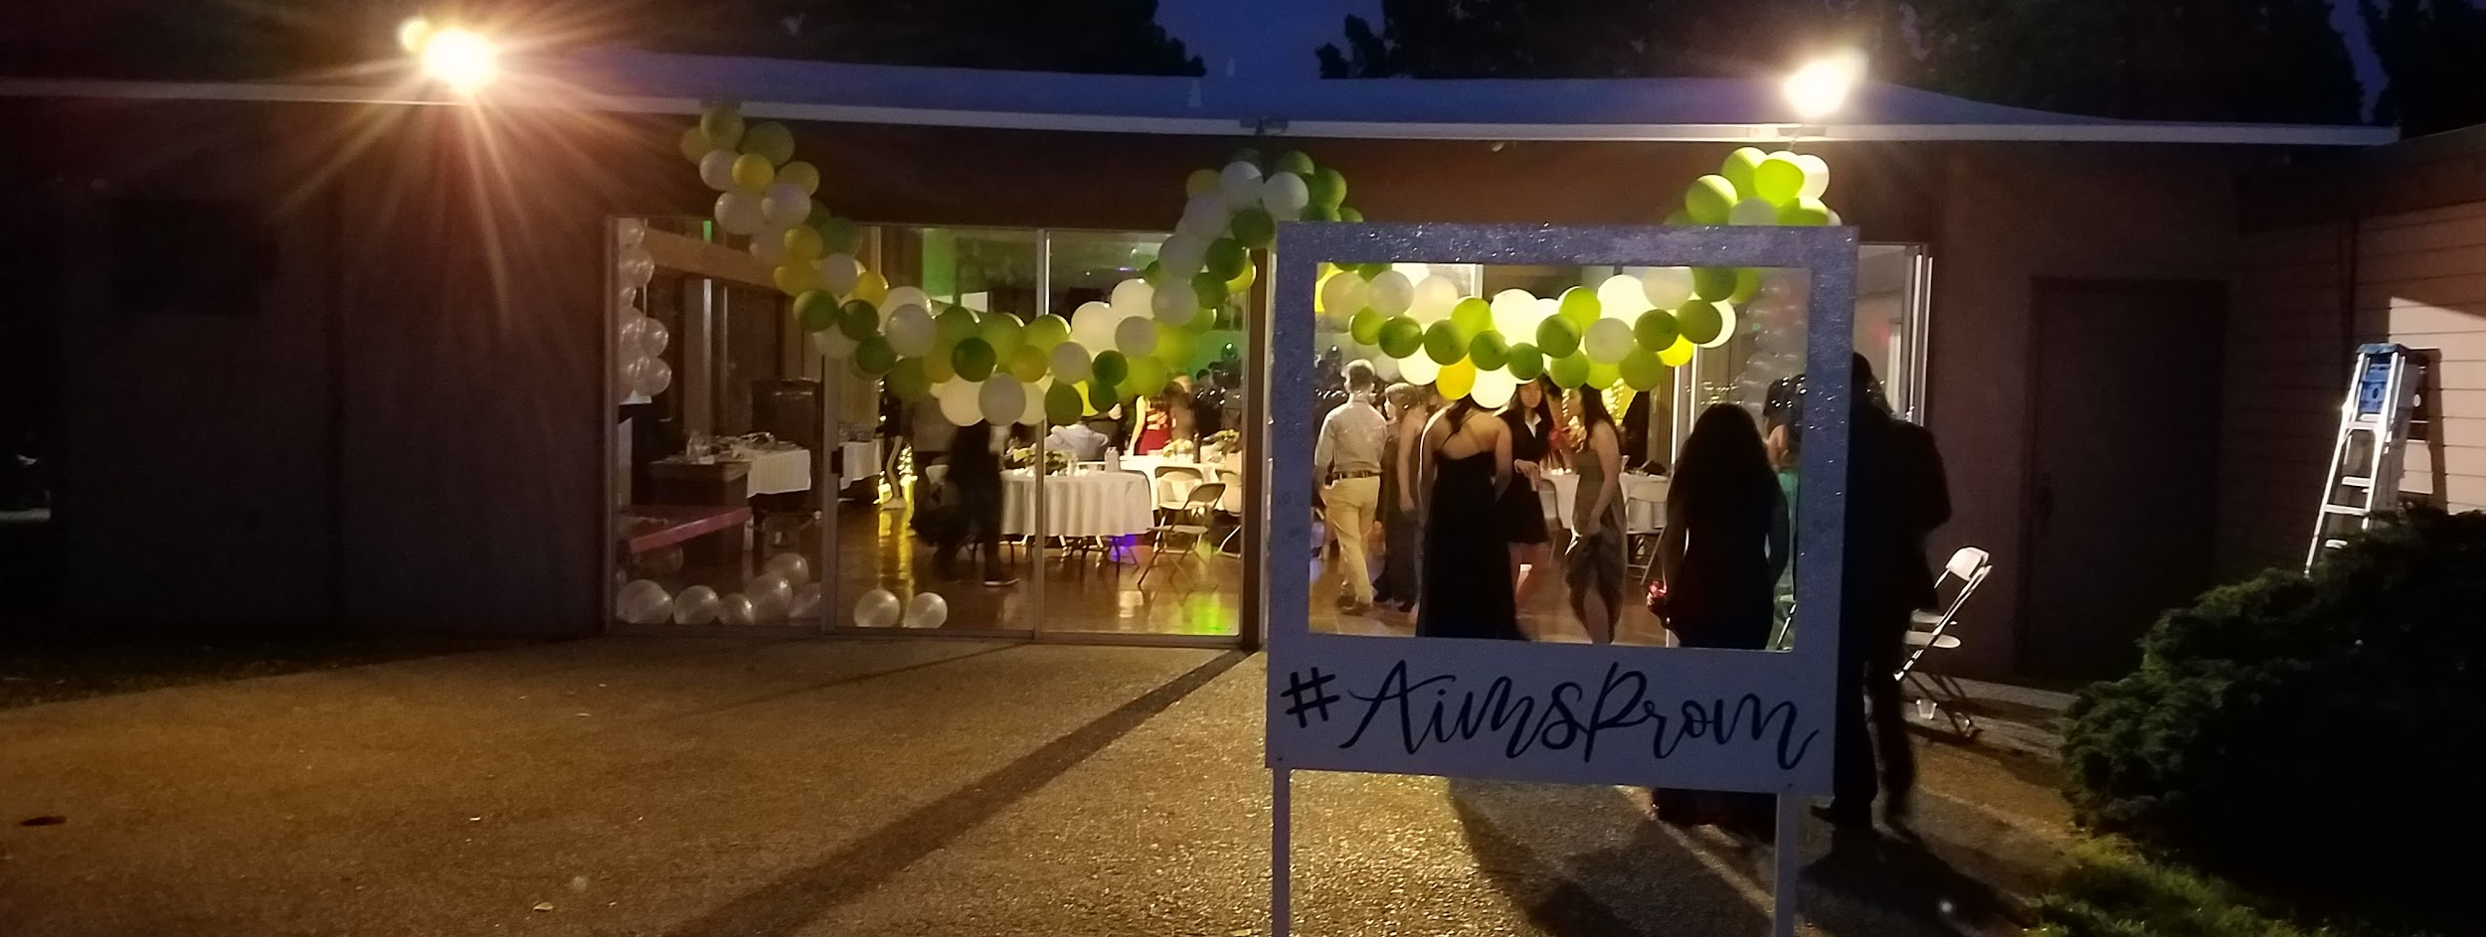
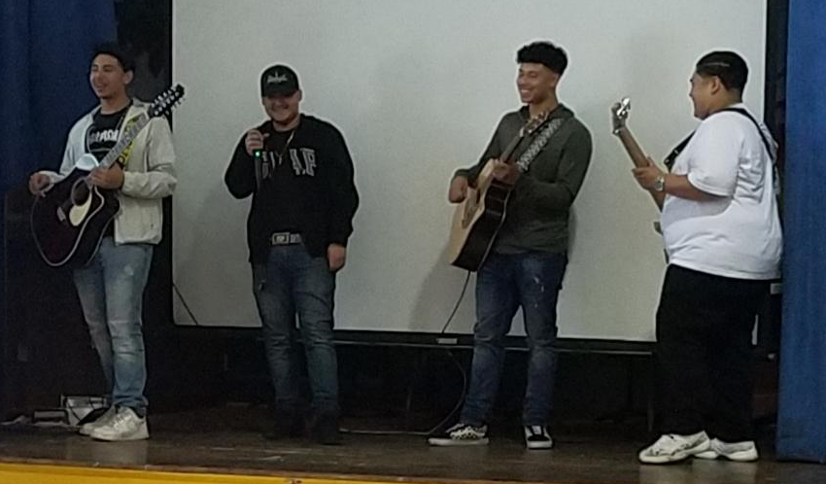
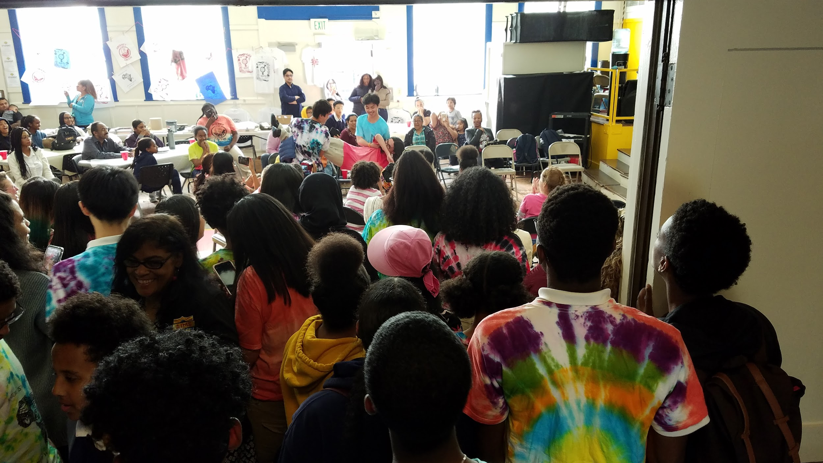
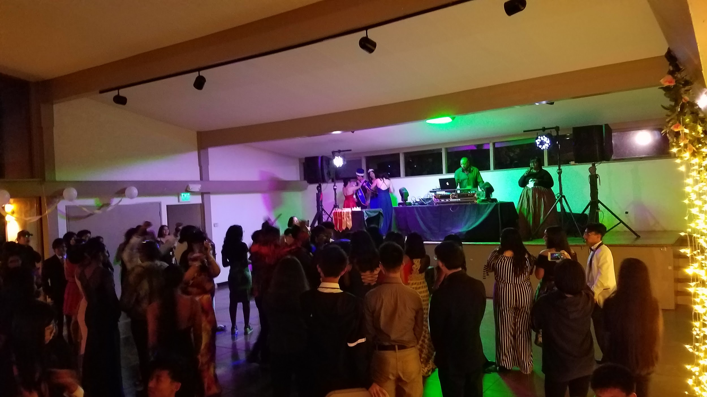
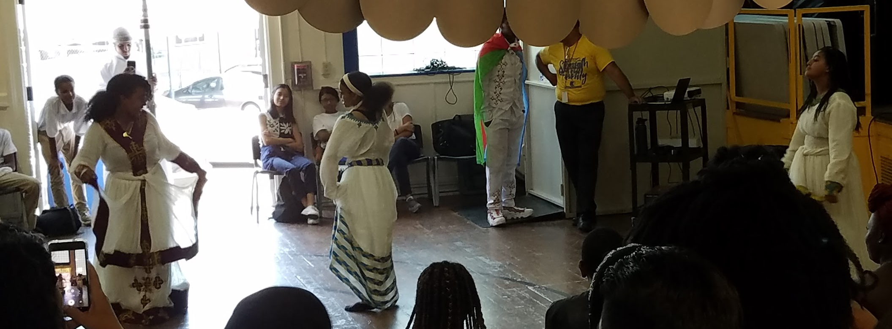
High School
And now some pictures...

Slide 34
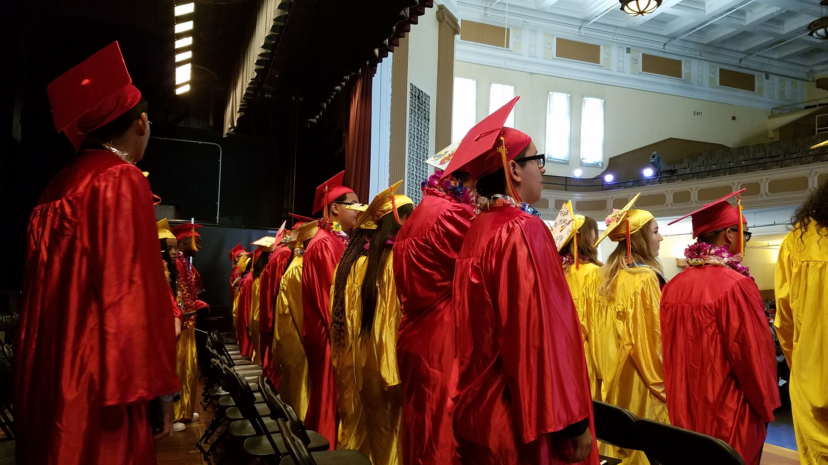
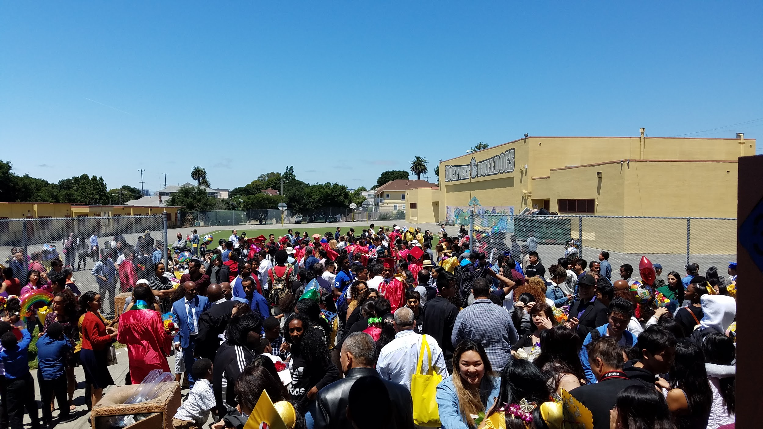
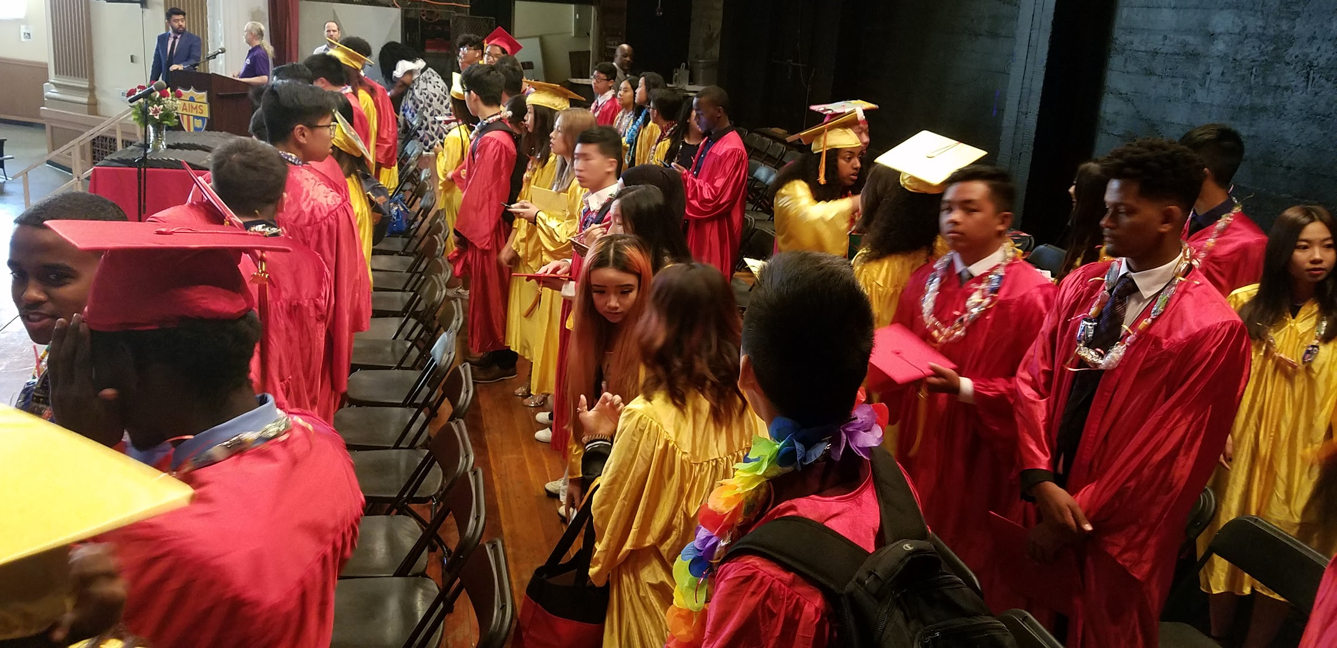
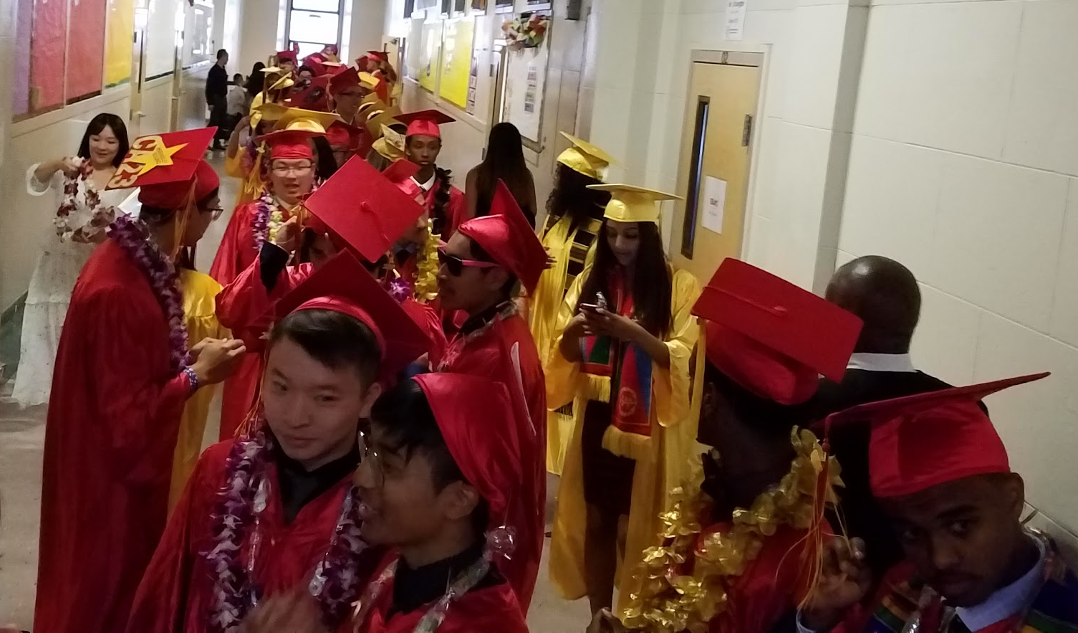

Slide 35

AIPHS Athletics
Updates
Annual Title IX Athletic Participation Survey was submitted in April. The Athletic Department is in the process of creating its own comprehensive Title IX Report which would include various statistics about the athletic program. Among the highlights:
129 Athletes (64 Boys and 65 Girls) participated in sports this year, over 31 percent of the AIPHS student Body.
Overall Sports GPA is 3.58
2 Championship and 5 Runner-Up Banners; 8 State Qualifying Athletes; 3 Max Prep Players of the Week (Overall)

