Slide 1
AIMS OPERATIONS Report
By
Ms. Magaña Operations Director
Ms. Tung Operations Manager

Slide 2
Reporting & Compliance
Report & Compliance
Starting EOY CALPADS report for AIPCS, AIPCS II and AIPHS
Completed and submitted Civil Rights Data Collection Report (CRDC) for AIPCS, AIPCS II & AIPHS.
Submitted Charter School Facilities Incentive Grants (CFDA#84.282D) Round 15 Application for AIPCS II and AIPHS
Received approval for ASES grant, $163,000 for the 2019-2020 school year for AIPCS

Slide 3
District Lunch Program Update
Roosevelt Campus K-1st - 110
FRL Eligibility: Free-53 Reduced-32 Paid-25
12th Street Campus 2nd-8th - 492
FRL Eligibility: Free-309 Reduced-92 Paid-91
High School Campus - 178
FRL Eligibility: Free-119 Reduced-28 Paid-31

Slide 4
Registration & Enrollment
Operations Registration staff has begun setting appointments for registration for the 2019-2020 school year.
Staff is meeting individually with families to ensure that we have all the documents ready for the new school year.

Slide 5
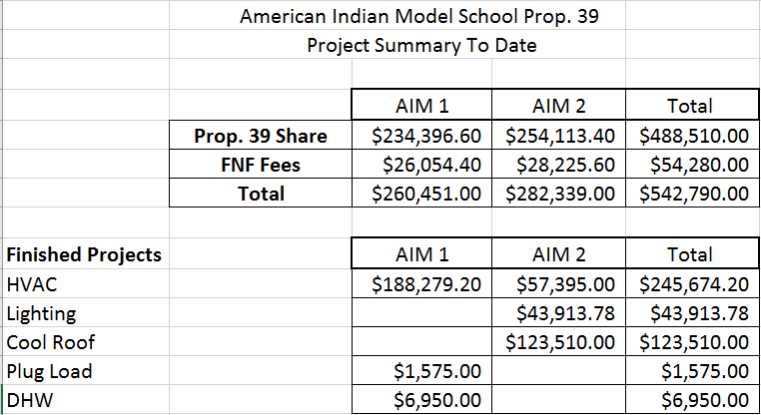
Prop 39 - Energy savings

Slide 6
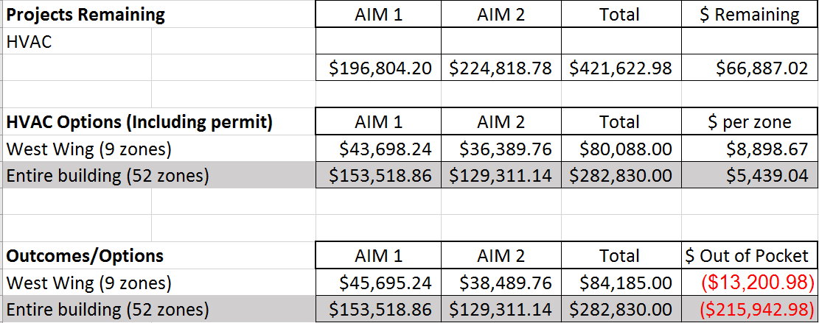
Prop 39 - Energy Savings Proposed work

Slide 7
Prop 39 - Energy Savings Summary
Remaining Balance
AIPCS - $37,592.40
AIPCS II - $29,294.62
Total - $66,887.02
We have until June 30, 2019, to execute a contract that falls under the energy savings plan. Prop-39 Funding that is not encumbered by June 30, 2019, will have to be returned to the California Department of Education.

Slide 8
Wellness Committee
Held our April Wellness Meeting.
March - Review of Wellness Policy and potential changes within policy that can be adopted and implemented for betterment of students wellbeing.
April - Discussion of mandated health and wellness programs within public schools and what that looks like.
May 30th- Overview of school lunch program and review of survey results and current wellness practices K-12th.

