Slide 1
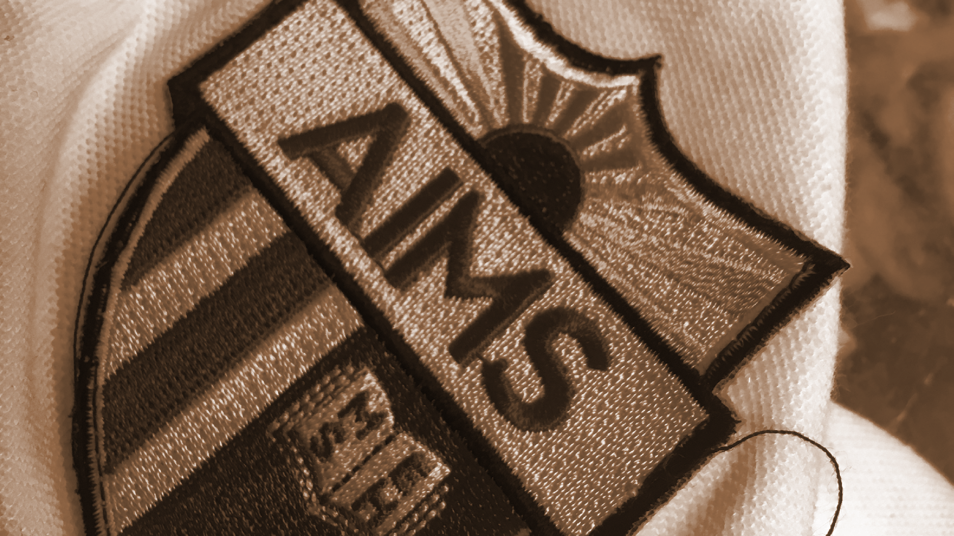
AIMS K-12 Board Report
May 21st, 2019
Superintendent Maya Woods-Cadiz
Mrs. Erin Oh (K-1 Division Head)
Mr. Christopher Ahmad (2-5 Division Head)
Mr. Maurice Williams (Head of Middle School)
Mr. Tareyton Russ (AIPHS Head of School)
Mr. Peter Holmquist (AIPHS Head of Academics)

Slide 2
Month | AIPCS | AIPCS II | AIPHS
Month 1a | 158 | 750 | 410
Month 1b | 162 | 788 | 416
Month 2 | 161 | 798 | 412
Month 3 | 160 | 801 | 410
Month 4 | 160 | 798 | 411
Month 5 | 160 | 797 | 411
Month 6 | 159 | 796 | 403
Month 7 | 159 | 794 | 399
Month 8* | 159 | 793 | 399
Enrollment Numbers
*Reporting as of March 29, 2019

Slide 3
AIPCS ADA & ADA %
 | ADA | ADA %
Month 1a | 150.60 | 95.31
Month 1b | 159.28 | 97.85
Month 2 | 158.42 | 98.40
Month 3 | 154.61 | 97.61
Month 4 | 154.70 | 96.69
Month 5 | 157.50 | 97.83
Month 6 | 156.83 | 97.65
Month 7 | 154.29 | 97.04
Month 8* | 153.86 | 96.77
*Reporting period March 4, 2019 to March 29, 2019

Slide 4
AIPCS II ADA & ADA %
 | ADA | ADA %
Month 1a | 737.38 | 98.37
Month 1b | 765.72 | 97.58
Month 2 | 775.58 | 97.84
Month 3 | 784.78 | 98.07
Month 4 | 773.60 | 96.94
Month 5 | 769.50 | 96.55
Month 6 | 774.22 | 97.14
Month 7 | 765.24 | 96.36
Month 8* | 765.24 | 97.37
*Reporting period March 4, 2019 to March 29, 2019

Slide 5
AIPHS ADA & ADA %
 | ADA | ADA %
Month 1a | 394.5 | 96.21
Month 1b | 393.22 | 93.90
Month 2 | 388.16 | 94.36
Month 3 | 390.53 | 94.91
Month 4 | 384.30 | 93.51
Month 5 | 391.40 | 95.23
Month 6 | 386.44 | 95.20
Month 7 | 380.76 | 95.29
Month 8* | 380.07 | 95.26
*Reporting period March 4, 2019 to March 29, 2019
Notes:
This is AIPHS?

Slide 6
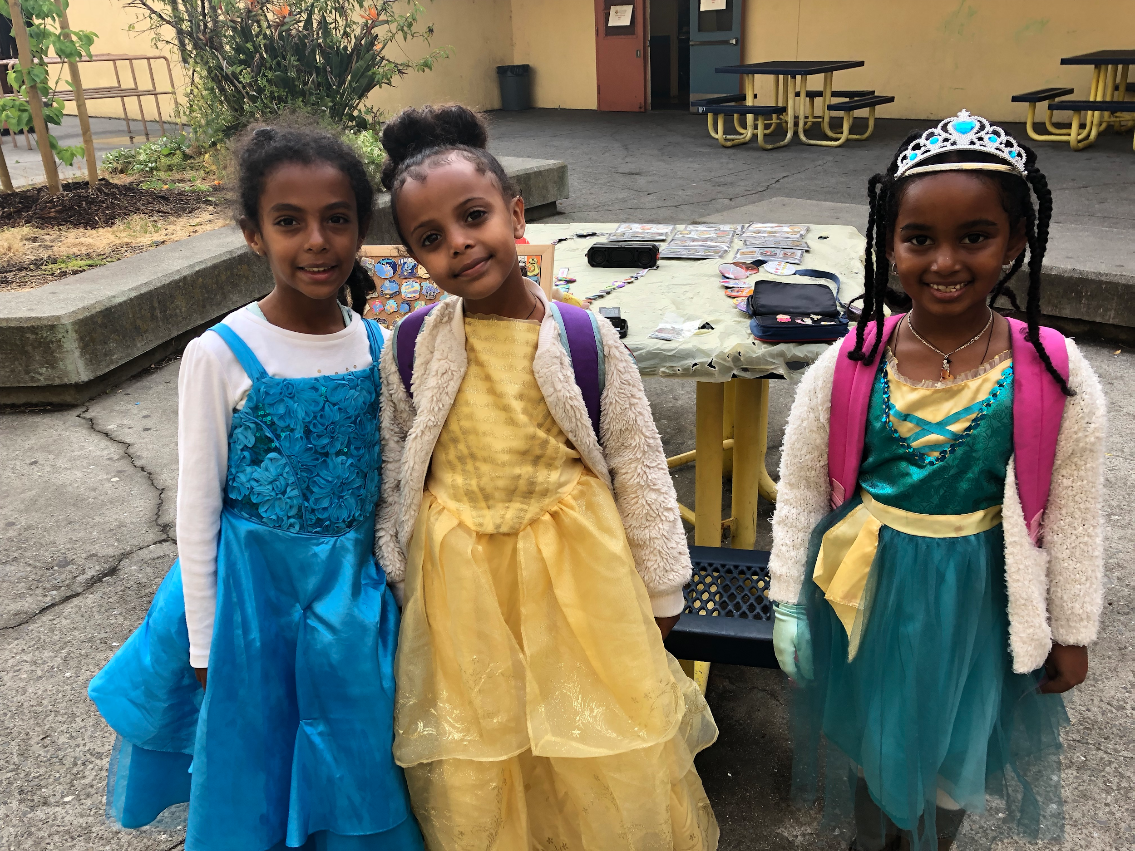
K-1 Satellite Updates: Events
May 24: Family Literacy Tea
May 31: Sing Out Loud Day
June 6: End of the year field trip

Slide 7
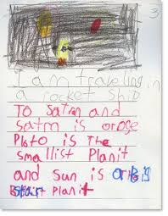


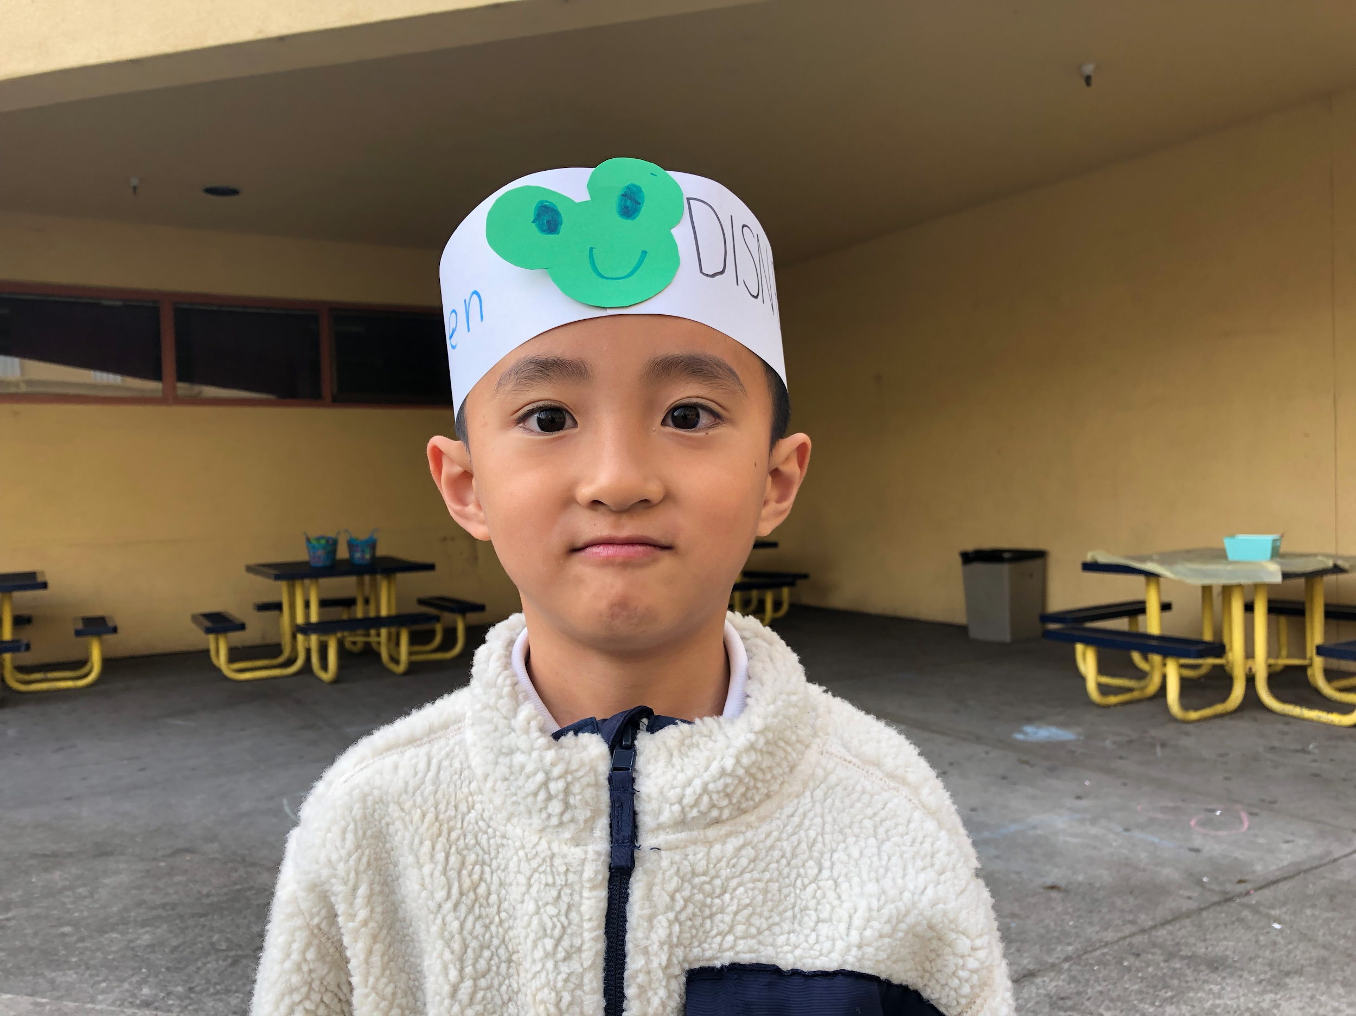
K-1 Satellite: May Priority Report
May Updates
Literacy Overview: strategic literacy plan; disaggregate data
SpEd: services have been coordinated for all students who might be eligible for SpEd.
Common Assessments: teachers are building weekly common assessments
Restorative Practices: we have had zero referrals to the office this week!
Finished CRP and UDL coaching cycles.

Slide 8
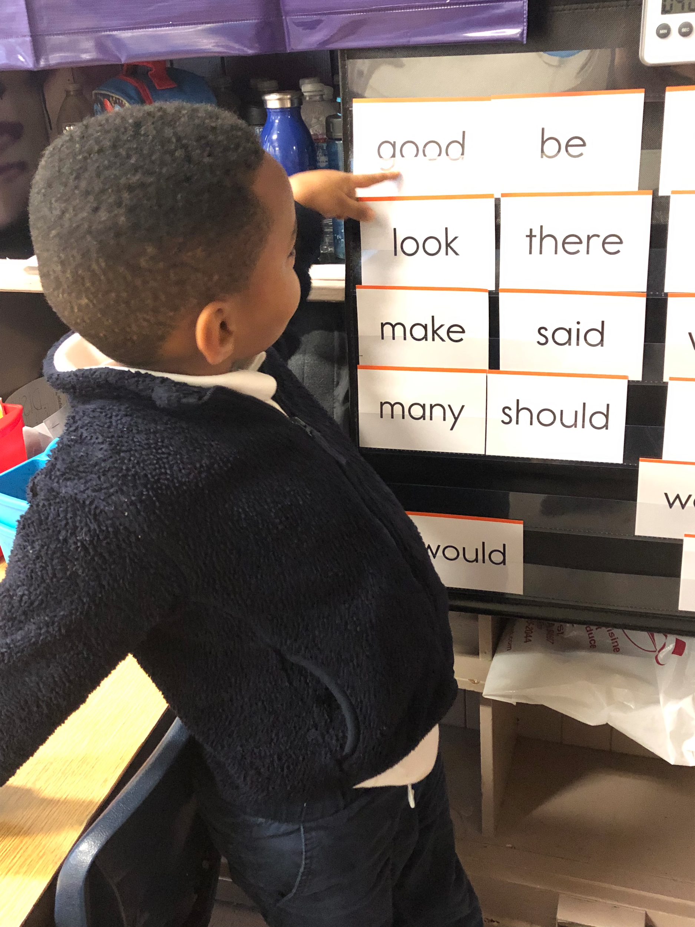
K-1 Satellite: Upcoming Priorities
June Priorities
Assessment Master Plans
Intentional Communities
Data Celebrations
Building Summer Learning Continuity

Slide 9
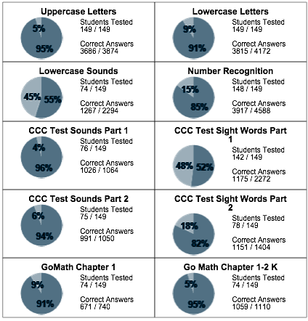
MAY DATA
Progress Report Growth

Slide 10
2-5 Updates
AIMS PROJECT TREES

Slide 11
2-5 Updates - Saturday School Review

Slide 12
2-5 Updates - Graduation

Slide 13
2-5 Updates - SBAC

Slide 14
2-5 - Retentions

Slide 15
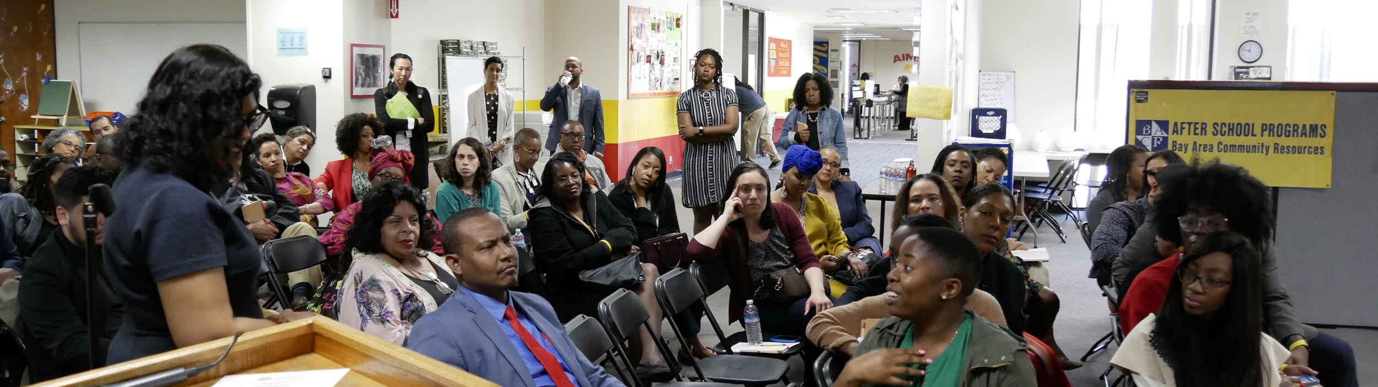
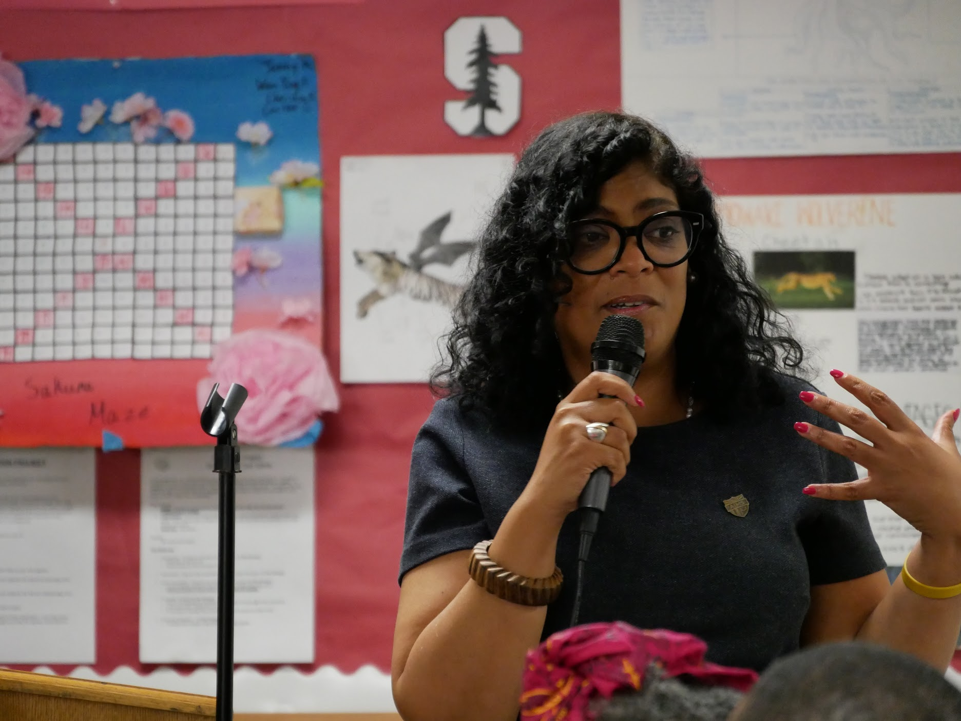
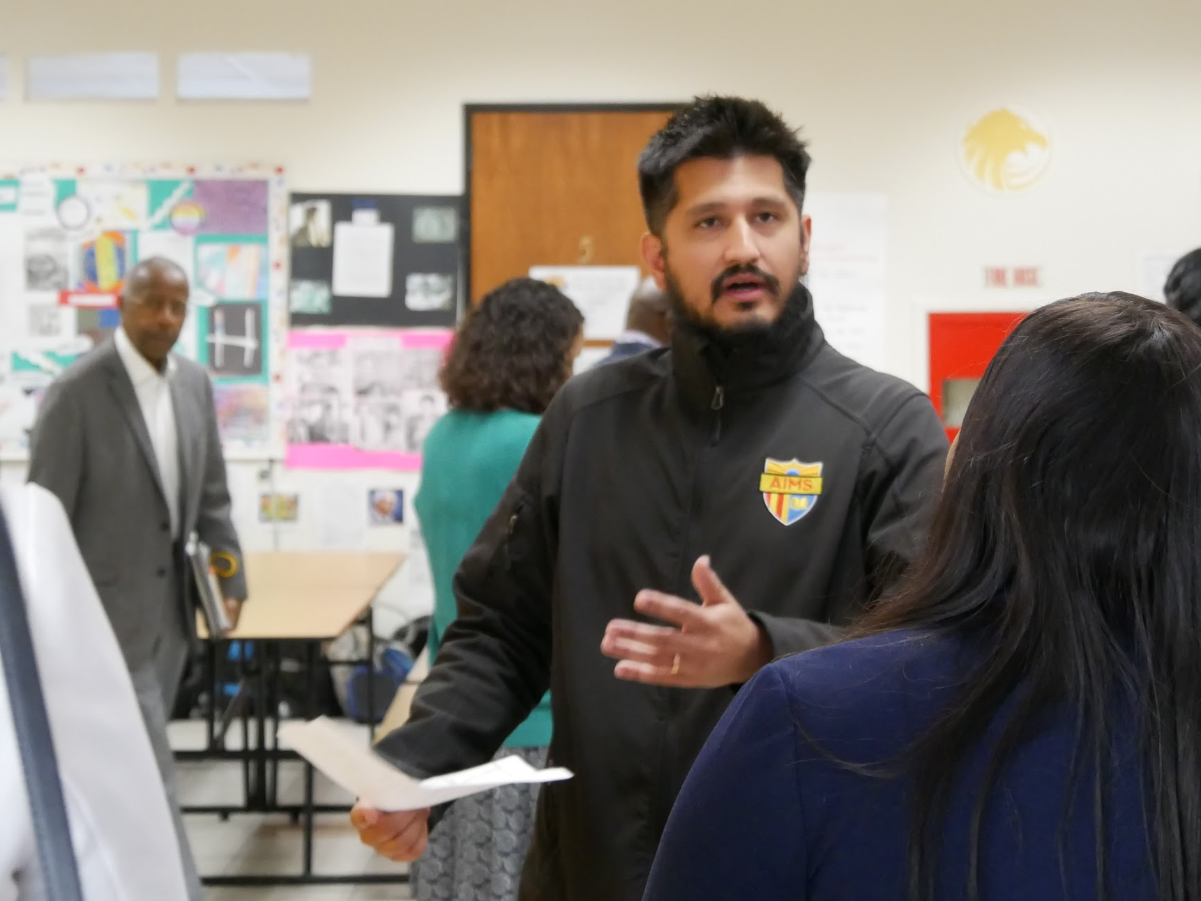
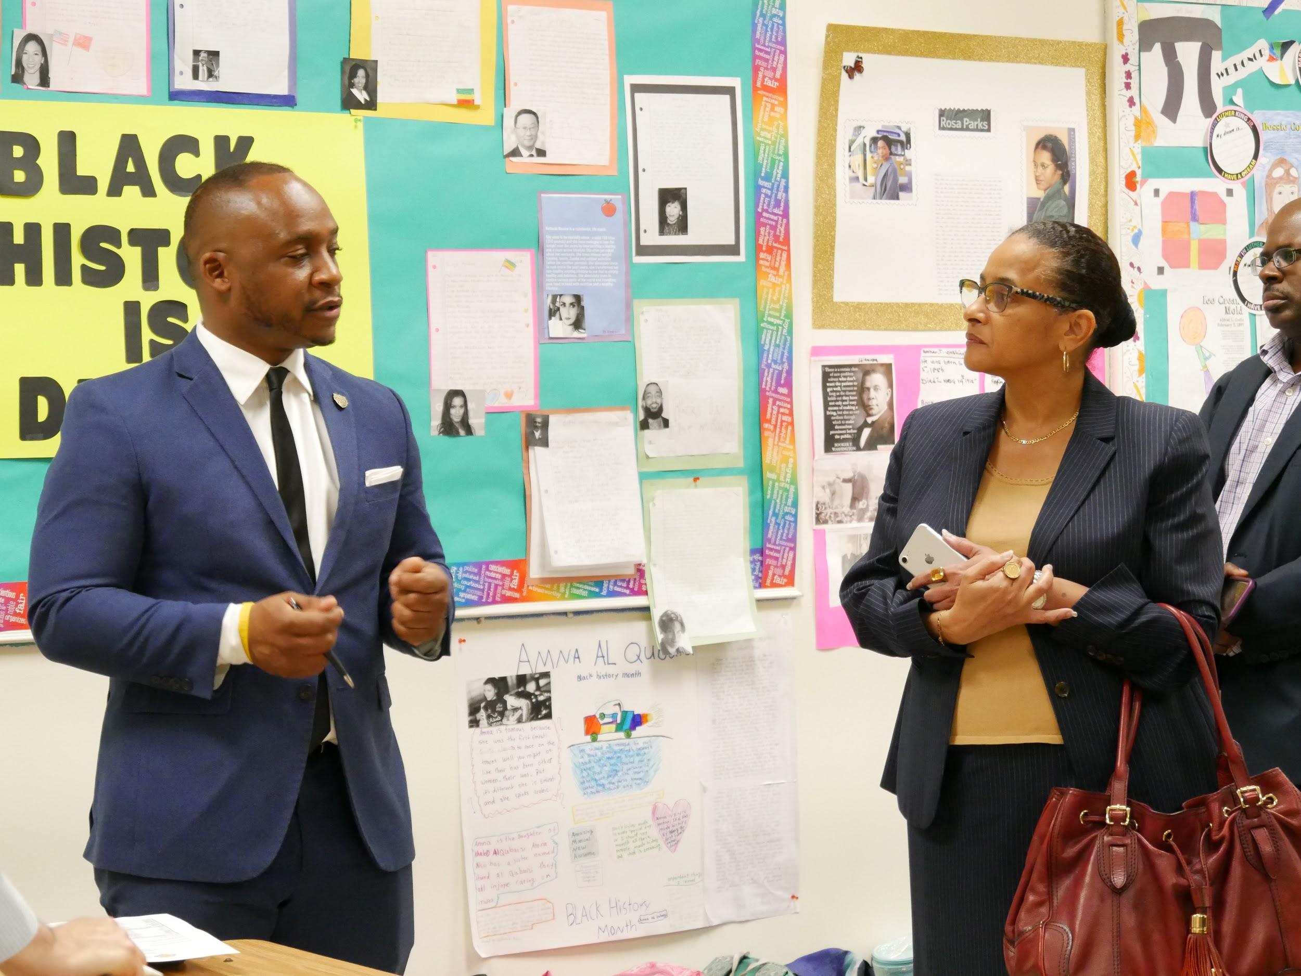
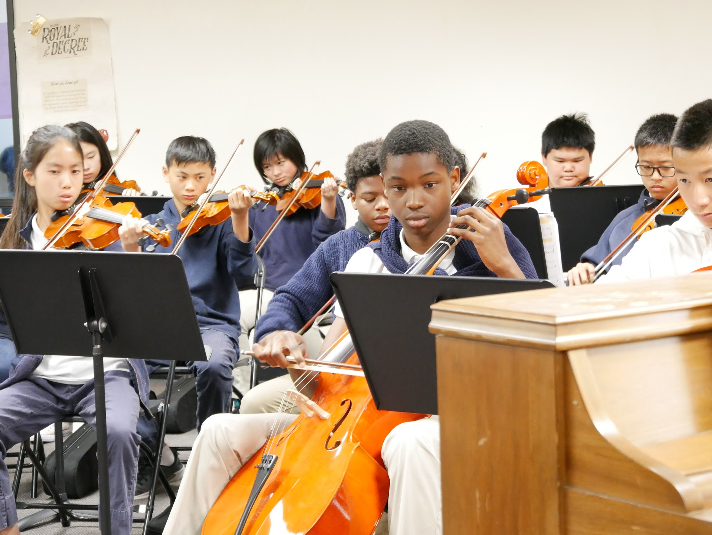
National Charter Collborative Site Visit
On Friday, May 10, nearly 80 CEO’s, Superintendents, Principals, and Charter leaders of color toured the AIMS 12th Street Campus to study our practices.

Slide 16
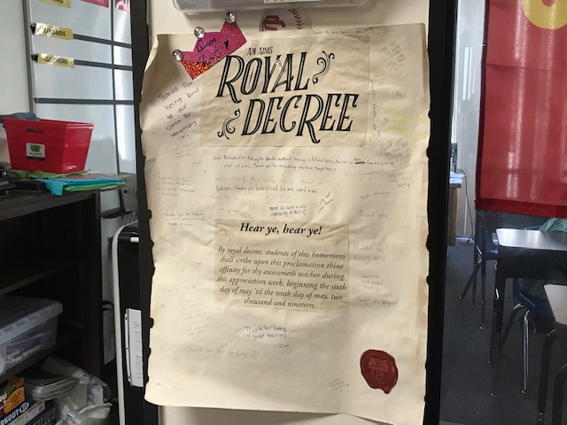
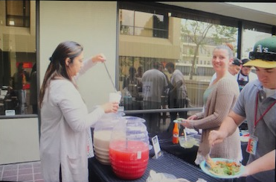

AIMS 2-8 Celebrates Teacher Appreciation Week
Teacher Appreciation Week: During the week of May 6 - May 10, the 2nd - 8th grades at 12th Street Campus collaborated to form a joint Teacher Appreciation Week. Our theme was Teacher Royalty, and each teacher received a custom made “Royal Decree” where students could write words of appreciation to their teachers.
Each day featured special food items including such at Coffee and Bagels, Taco Tuesday, Smoothies, Ice Cream Sundaes, and a Staff Potluck.

Slide 17


Middle School Updates
OUSD African-American Honor Roll: 22 AIMS Middle School students were recognized this year as part of the OUSD African-American Honor Roll. Our scholars were featured on KTVU 2 News. Efforts are underway to plan similar honor roll events for the various ethnic groups within our school by the end of the Academic School Year.
No Bullying Schools Presentation: National Youth Motivational Speaker Tom Thelen from No Bullying Schools will give a presentation to AIMS next month, in order to help promote tolerance and anti-bullying initiatives at the middle school level.

Slide 18
Middle School Updates
AIPCS I SBAC - Interim Comprehensive Assessment (ICA)
SBAC ICA Math Scores (Percentage)
Grade Level | Standard Not Met | Standard Nearly Met | Standard Met | Standard Exceeded
6th * | N/A | N/A | N/A | N/A
7th | 6% | 24% | 32% | 38%
8th | 10% | 20% | 32% | 38%
SBAC ICA ELA Scores (Percentage)
Grade Level | Standard Not Met | Standard Nearly Met | Standard Met | Standard Exceeded
6th | 23% | 32% | 26% | 17%
7th | 34% | 29% | 20% | 15%
8th** | 10% | 23% | 40% | 26%
* Missing 6th grade Math data due to long-term teacher vacancy. Test was administered recently and results are forthcoming
** Data from one class is missing

Slide 19
Middle School Updates
AIPCS II SBAC - Interim Comprehensive Assessment (ICA)
SBAC ICA Math Scores (Percentage)*
Grade Level | Standard Not Met | Standard Nearly Met | Standard Met | Standard Exceeded
6th | 7% | 10% | 35% | 46%
7th | 23% | 36% | 23% | 17%
8th | 3% | 22% | 24% | 50%
SBAC ICA ELA Scores (Percentage)*
Grade Level | Standard Not Met | Standard Nearly Met | Standard Met | Standard Exceeded
6th* | 18% | 22% | 38% | 20%
7th | 10% | 29% | 43% | 16%
8th | 13% | 19% | 37% | 29%
* Partial data

Slide 20
Middle School Updates
SBAC - ICA (cont.)
Added iAs Support
  Each ELA & Math class is provided additional 60 - 90 min/week with instructional aids during regular instructions M-F.
Two Additional After School SBAC Prep Study Halls
  Math & ELA SBAC Prep Study Halls: M-Th
Two Additional SAS SBAC Review Sessions
  Math & ELA SBAC review & practice sessions: Saturday 8:00AM - 12 Noon.

Slide 21
Middle School Announcements
Strength in Kindness: Kenneth Ung (Grade 6), Dayana Aguilar (Grade 7), and Samiyah George (Grade 8) were rewarded Golden State Warriors tickets for best exemplifying kindness. 7th Grade teacher Ms. Solis accompanied the students. Special thanks to Mr. Logan Wallace (7th Grade) for supplying the tickets to the game.
Middle School Promotion Speaker: KTVU Channel 2 news achorwoman Claudine Wong has been confirmed as our speaker for the Middle School Promotion Ceremony. The promotion ceremony will take place on June 14 @ 2:30, at Roosevelt Middle School.

Slide 22

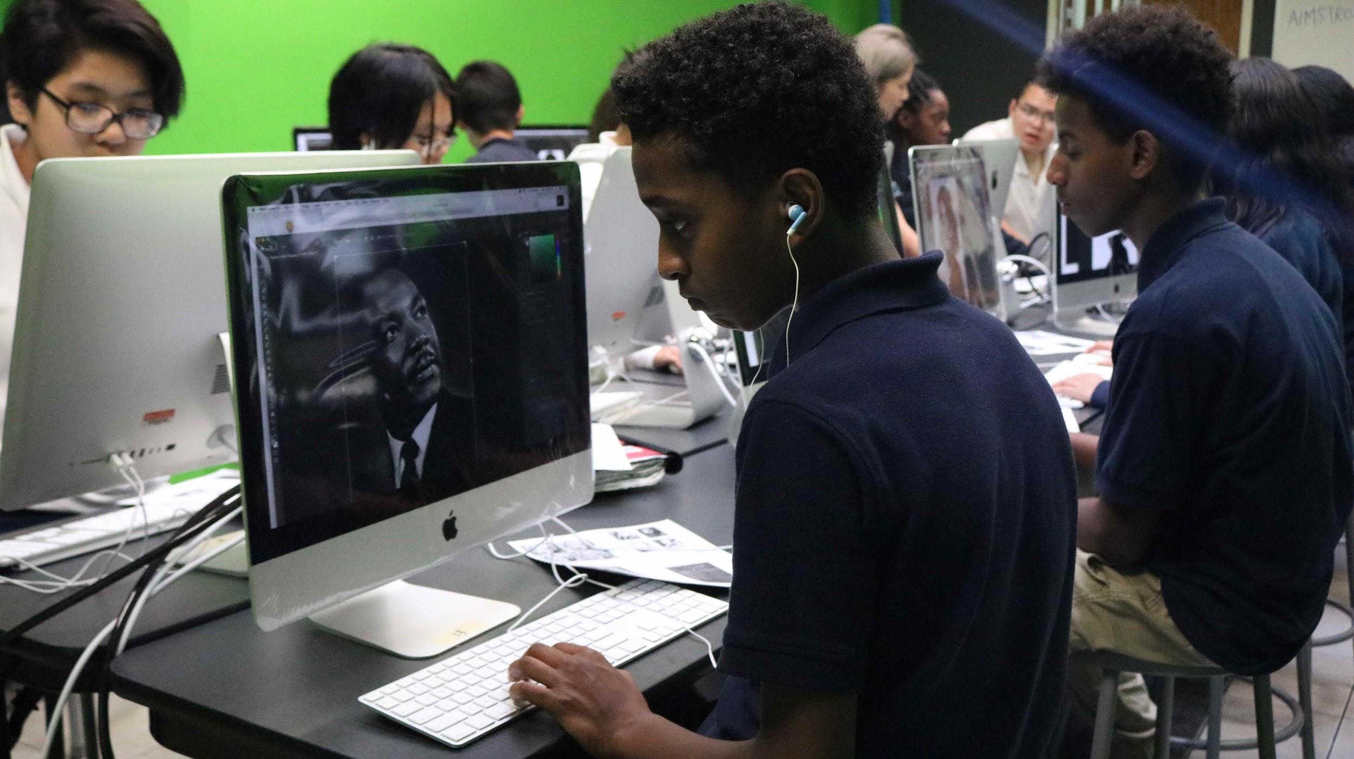
Measure G1 Updates
iMac Computer Lab: On Monday, April 8, the 8th Grade Graphic Design classes held its first classes of the semester in the new iMac Computer Lab. The lab currently holds 22 iMacs and is outfitted with the Adobe Creative Suite (Photoshop, Adobe Premiere, Illustrator, etc.) The lab is also painted with green screen paint which can be used for green screen projects within the classroom. Approximately 80 students take the graphic design class during regular instructional hours. Additional iMacs will be purchased for the lab next school year.

Slide 23

Measure G1 Updates (Cont.)
VPA Showcase Performances: In May, the AIMS 6-8 VPA Department will hold its first annual showcase at the Molanga Center in Oakland, CA (350 seat capacity.) The performance will feature musical performances from our Violin classes; a Musical Theater Performance of “Boxes;” and Art and Graphic Art Displays / and silent auctions of student work.
Performance Dates and Prices: Wednesday, May 22 @ 11:00AM & 2:00PM: (School Only). Thursday, May 23 and Friday, May 24, ​@ 6:30PM: Open to parents, family, and general community. Tickets are free to students and community member admittance is with donation.

Slide 24


Measure G1 Updates (Cont.)
2019-2020 Grant Proposal: Next academic school year, AIPCS I and AIPCS II is slated to receive nearly $150,000 in Measure GI grant funds.
Allocations for grant funding include:
  $60K in Music Instruments for the creation of an advanced Orchestra class for 8th grade Middle School Students
  $18K in purchasing Rosetta Stone Accounts for all Middle School students for World Languages. Each account includes 25 World Languages.
  $5K to purchase GoGuardian, an internet monitoring and suicide prevention software for student laptops
  Nearly $10K in Culturally Responsive PD’s, trainings, and awareness events

Slide 25
High School
WASC HS visit was more successful!
Recruitment efforts
160 lunches / day
14 different AP tests have been given over the past two weeks
This week, 11th grade is taking the SBAC in English and Math.
This week, 10th and 12th grade is taking the CAST.
Next week, 9th and 10th grade is taking the blue benchmark.
All grades will be taking the SRI beginning May 24th.
"The Accrediting Commission for Schools, Western Association of Schools and Colleges (ACS WASC) announces the action taken at the Spring 2019 Commission Meeting. The ACS WASC Commissioners have determined American Indian Public High School (9 - 12) meets the ACS WASC criteria for accreditation.
This accreditation status is based on all of the information provided by the school, including the school’s probationary progress report, and
the satisfactory completion of the on-site accreditation visit.
"It is the decision of the Commission to remove Probation and restore accreditation status. The accreditation status continues through June 30, 2023."

Slide 26
High School
The school has had many significant changes and developments since the last WASC visit in 2017. The third change in school site leadership over the past six years occurred in 2017 when Mr. Tareyton Russ was named Head of Schools and a new administrative position, Division Head of Academics, was filled by Mr. Peter Holmquist. Self-described “thinking-partners”, the two have overseen the implementation of new programs, rolled out professional development, and hired staff to meet the needs of students.
Adding personnel has had a positive impact on the school. The school credits the full-time college advisor with an increased number of students being awarded scholarships and accepted into UCs, CSUs, and Ivy League schools. Surveys of staff and students show progress in overall school climate and overall well being of students after adding counseling groups with a social-emotional counselor.
The expansion of the role of the Dean of Students has led to a decrease in the number of detentions and suspensions. Adding a full-time Resource Specialist and Instructional Aide has led to 80% of SPED students increasing their GPA by at least 1.00 point from last year to this.
In interviews, teachers, students, and parents report: changes over the past two years have substantially improved school climate.
Staff, administration, and parents report: school lunch program has had a positive impact on student attitudes and preparation for the rest of the day.
Teachers report: 1) having students rotate from class to class has increased the amount of student projects and group work, 2) makes it easier for faculty to provide a blackboard configuration in the classroom and start class on time; 3) being able to personalize the space with student work, and 4) having their own space makes it easier to have consistent classroom procedures like spots for students to turn in work.
Students enjoy: benefits of a small school and access the traditional high school experiences like sports, clubs, and dances.
Parents say their students are less stressed and are more well-rounded and better prepared for college because of the choices available to students now such as sports, an additional foreign language option, and more electives.

Slide 27
High School
Secondly, in order to fill the pool of potential teachers, high school staff & administrators have been:
Sending out emails from the platform (EdJoin, Indeed)
Screening applicants
Scheduling appointments for interviews
Conducting interviews
Conducting reference checks
Three candidates (ELA, Social Science, Science) were offered positions and chose to take a job elsewhere.

Slide 28
High School
TESTING Season...
14 AP tests have been given. Test takers ranged in number from 4 in French to 120 taking World History.
This week:
11th grade is taking the SBAC in English and Math; and
10th and 12th grade is taking the California Science Test (CAST).
Next week:
9th and 10th grade is taking the blue ELA and Math benchmarks, and
All grades will be taking the SRI beginning May 24th.
In addition, multiple teachers are giving final projects or final exams.

Slide 29
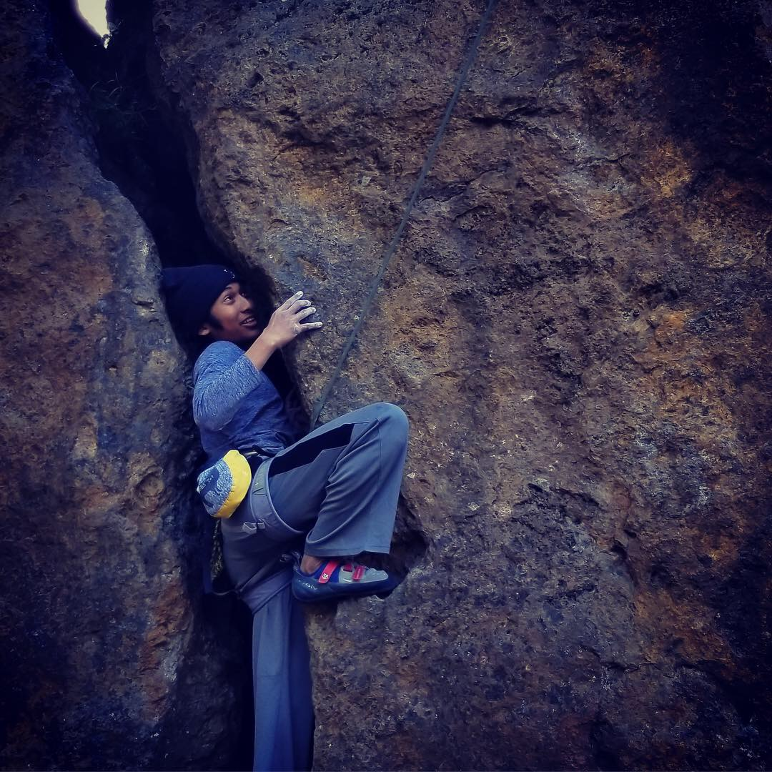
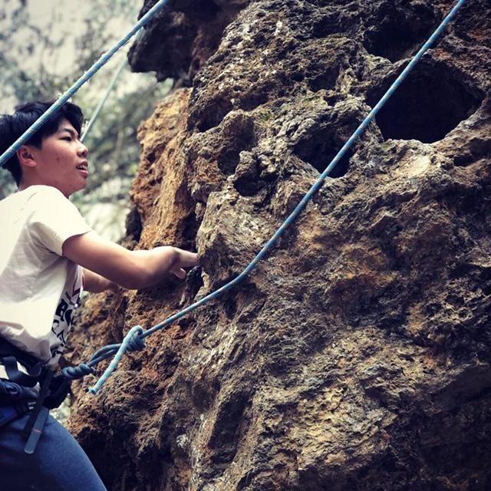
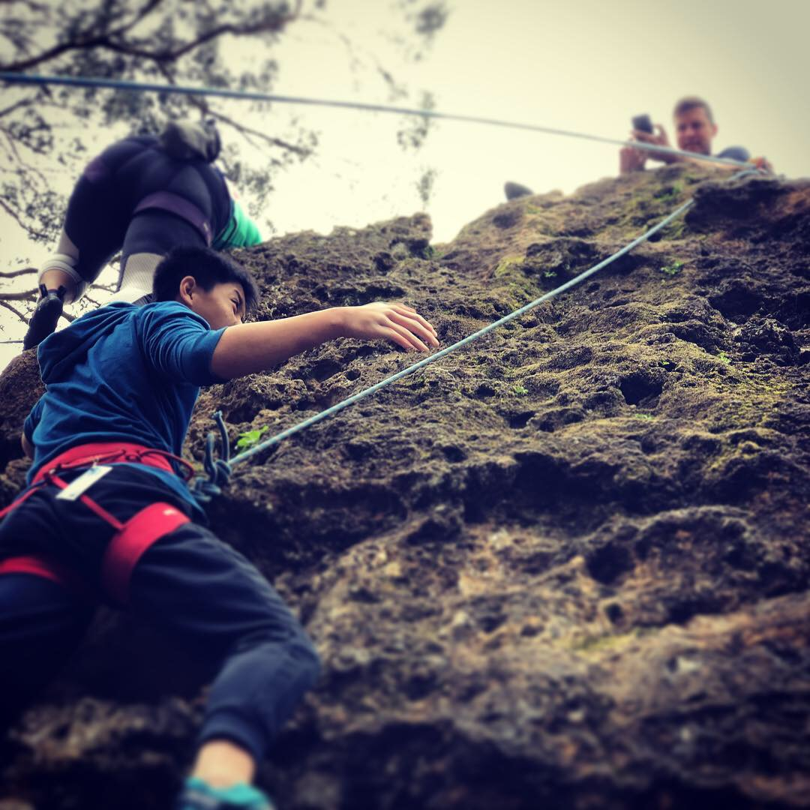
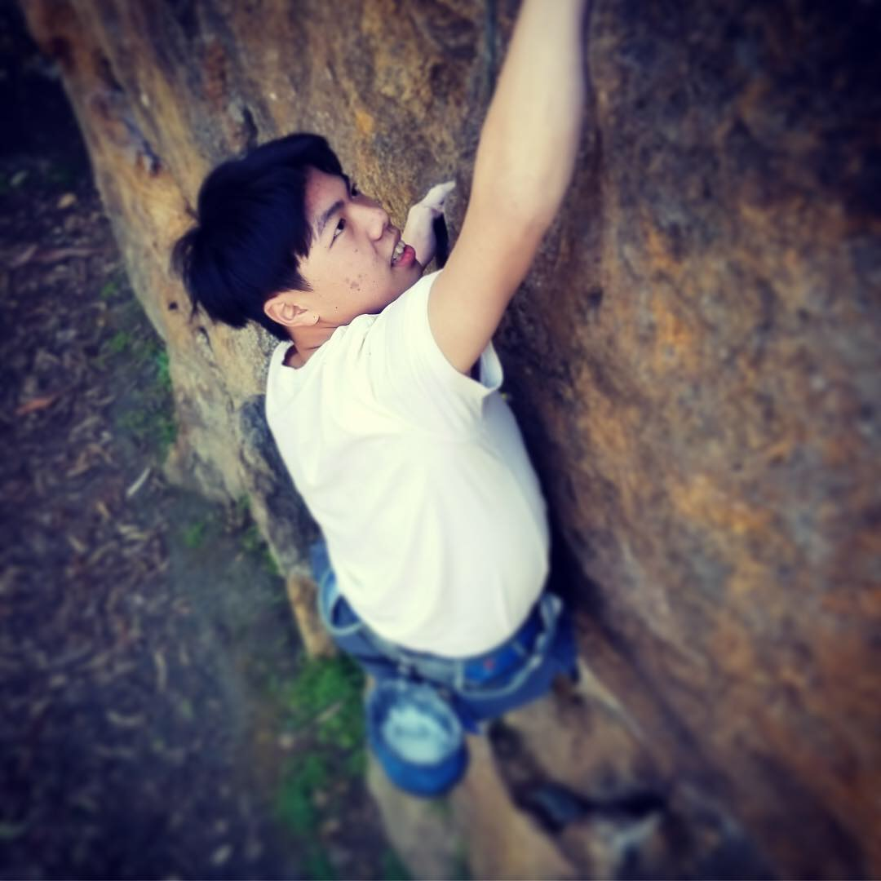
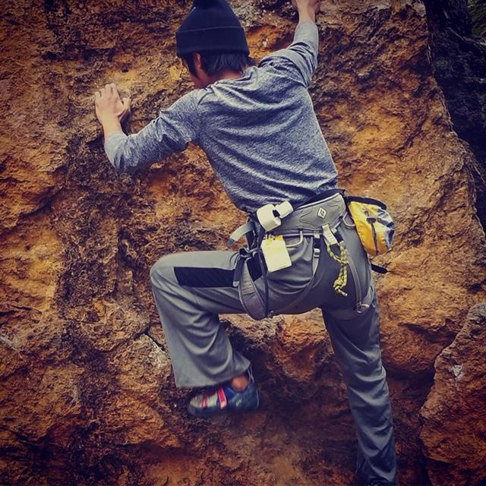
High School
The Rock Climbing Club has been out and about...

Slide 30

AIPHS Athletics
Updates
Annual Title IX Athletic Participation Survey was submitted in April. The Athletic Department is in the process of creating its own comprehensive Title IX Report which would include various statistics about the athletic program. Among the highlights:
129 Athletes (64 Boys and 65 Girls) participated in sports this year, over 31 percent of the AIPHS student Body.
Overall Sports GPA is 3.58
2 Championship and 5 Runner-Up Banners; 8 State Qualifying Athletes; 3 Max Prep Players of the Week (Overall)

Slide 31
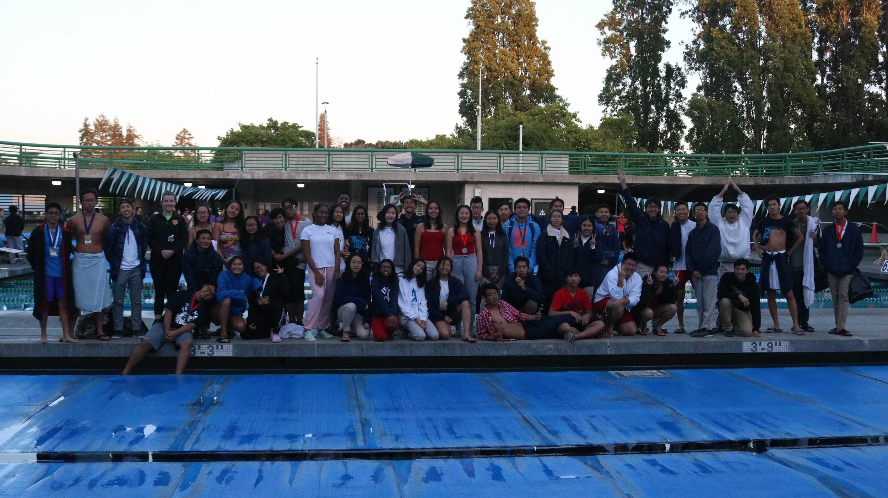
AIPHS Athletics
Updates
The AIPHS S.E.A. Eagles Varsity Boys Team placed 2nd in the CIF-Oakland Section Championships, while the Girls Varsity team placed third. The S.E.A. Eagles JV Boys won 1st place and our JV girls placed 2nd.
Additionally, five AIMS Athletes participated in the CIF State Championships in Corvis, CA: Freshman Josephina Martinez became the first AIMS Female and Freshman State Qualifying Athlete; Emerson Velasquez became the first American Indian Model Schools student to qualify for state in two different sports; Freshman Yufei Ma became the first AIMS Freshman male state qualifying athlete; and Sophomores Felix Tran and Alvin Peng also qualified for state.

Slide 32
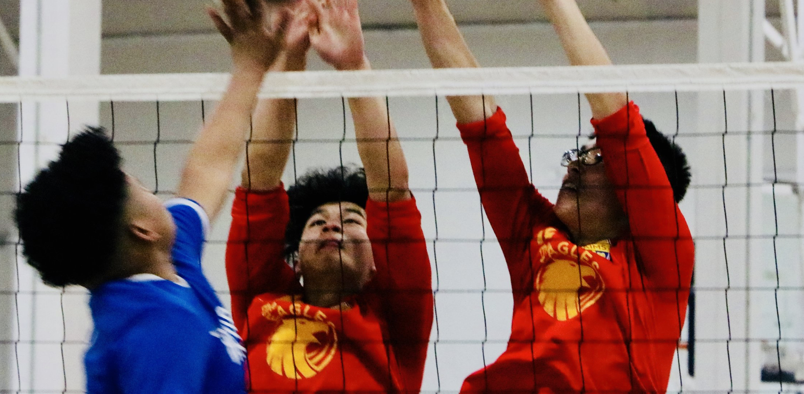
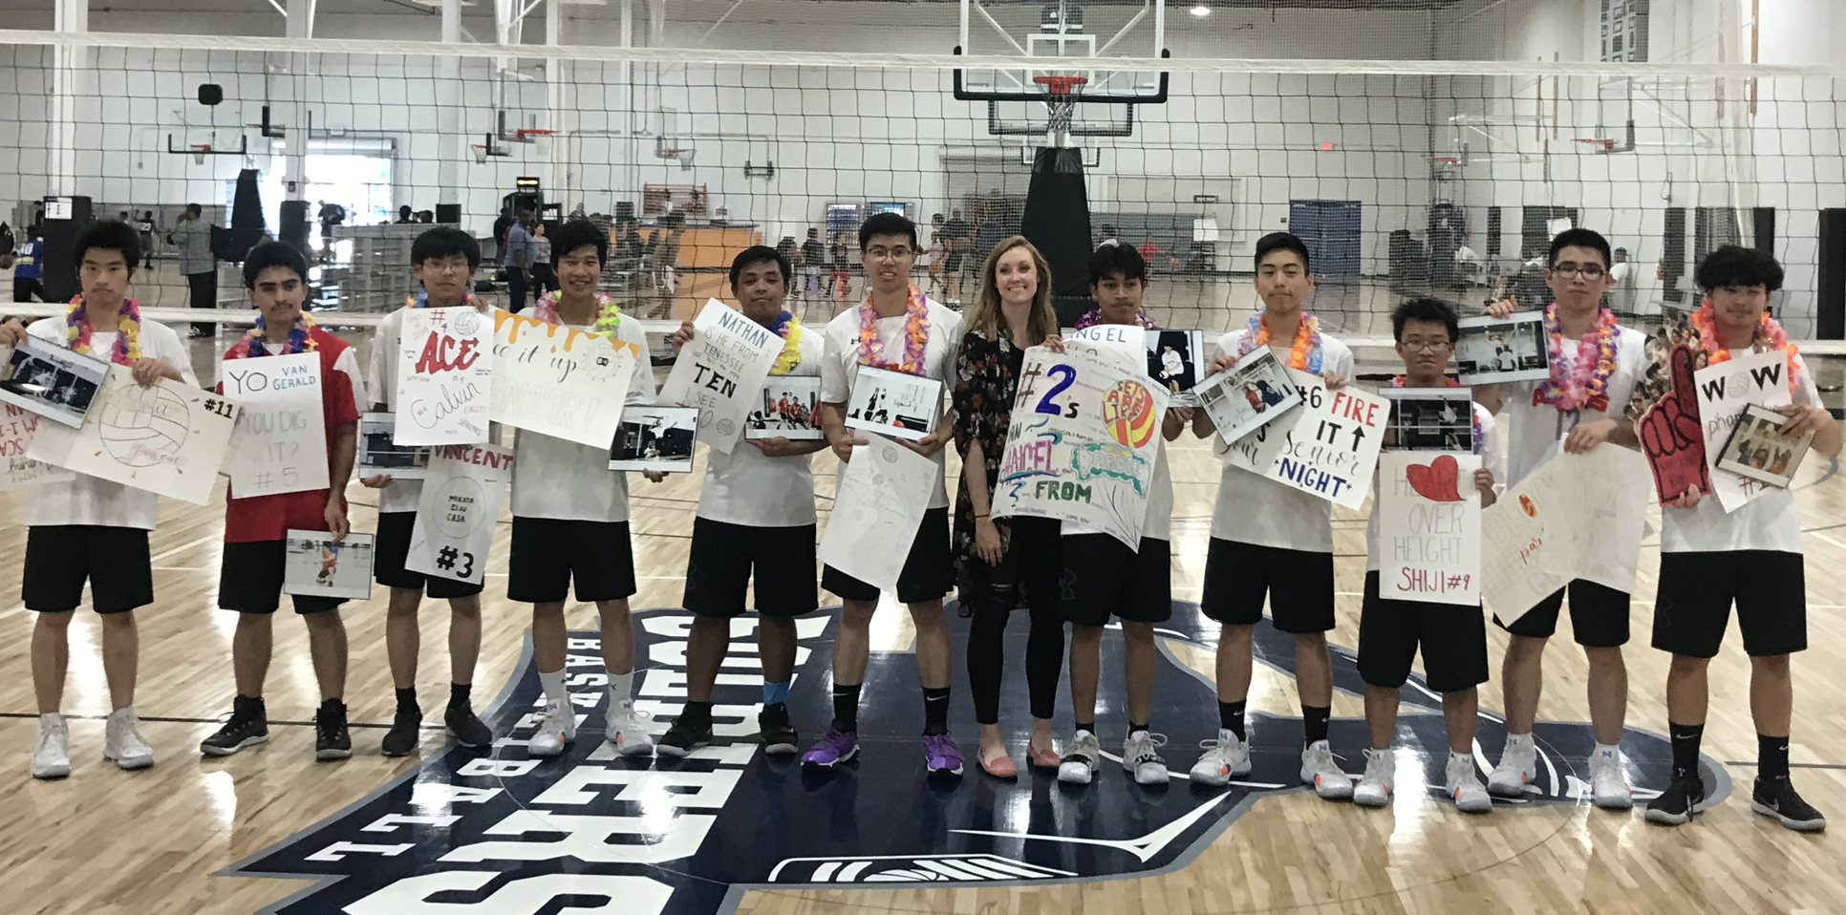
AIPHS Athletics
Updates
The AIPHS Volleyball Team finished team finished 7-6 overall, 2nd overall in our charter school conference, and went 4-2 against traditional Oakland Public Schools - including wins over Oakland Tech and Oakland High.
The Boys team advanced as the #3 seed in the CIF-Oakland Section Playoffs before losing to Skyline High School.
Congrats to Coach Cassandra Choi, on being selected as the CIF Oakland Section Boys Volleyball Coach of the Year, and Eric Huang (1st Team) and Weston Cao (2nd Team) on being selected on the All League Teams.

Slide 33
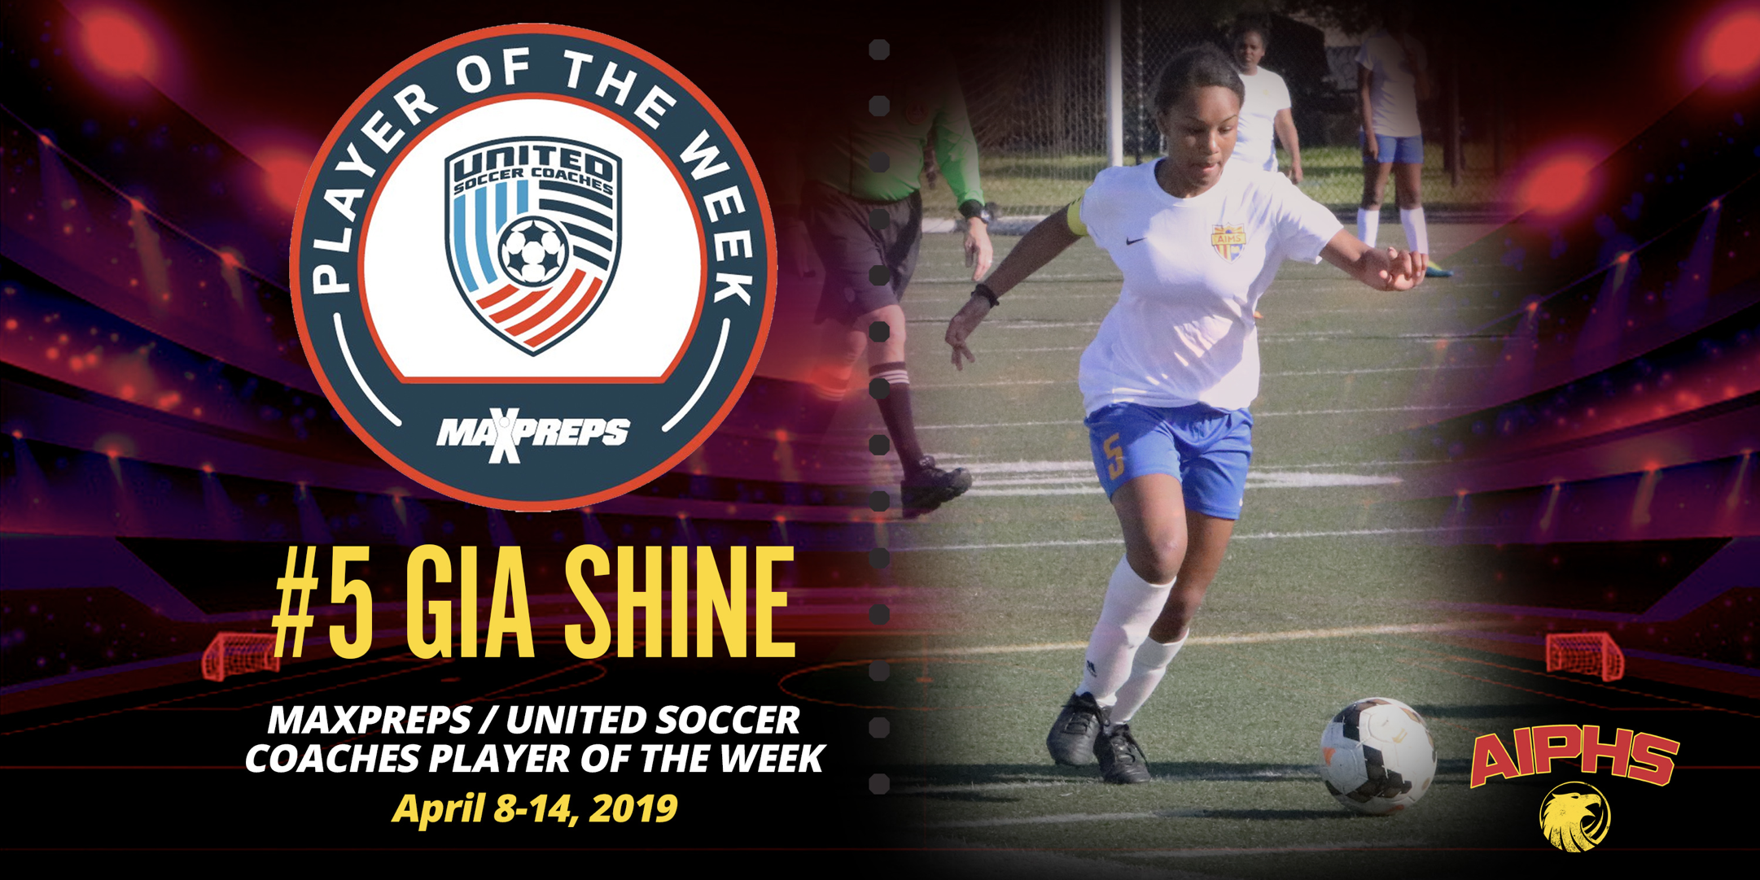
AIPHS Athletics
Updates
The AIPHS Soccer team season ended with a 2-7 record overall. Sophomore Gia Shine was recognized as the MaxPreps / United Soccer Coaches player of the week for the state of California, the third AIPHS Soccer Team Athlete to receive the reward in two years of AIPHS Sports. Gia Shine finished 6th in the state of California for goals scored during the Spring Soccer Season (15), and the second highest goal per game average.

Slide 34


AIPHS Athletics
Updates
AIMS District Athletic Director, Maurice Williams was appointed by BACSAC to represent on the OUSD / CIF Oakland Section Policy Committee for Sports.
The AIMS Athletic Department will be creating a Sports Handbook over the summer
Upcoming Events:
Gatorade G-Day Experience: Tuesday, May 21 - Wednesday, May 23.
Winter / Spring Sports Banquet: Tuesday, June 11, at 6PM.

