Slide 1
AIMS OPERATIONS Report
By
Ms. Magaña Operations Director
Ms. Tung Operations Manager

Slide 2
Reporting & Compliance
Report & Compliance
Submitted ASES grant for AIPCS/AIPCS II
Submitted Fall 1 CALPADS report for all three schools
Working on Fall 2 CALPADS reporting
SchoolMint data cleanup-preparation for public District Lottery, March 8th
Submitted School Accountability Report Card (SARC) for AIPCS, AIPCS II, AIPHS

Slide 3
District Lunch Program Update
Roosevelt Campus K-1st - 110
FRL Eligibility: Free-53 Reduced-32 Paid-25
12th Street Campus 2nd-8th - 492
FRL Eligibility: Free-309 Reduced-92 Paid-91
High School Campus - 178
FRL Eligibility: Free-119 Reduced-28 Paid-31

Slide 4
Facilities
Continued supporting with construction to damaged areas
Carpet was replaced on 2nd and 3rd floor damaged areas

Slide 5
Prop 39 - Energy savings
Water heater was replaced on 12/15/18
Inspection for water heater occurred on 1/4/19
Plug load installation occurred on 1/14/19

Slide 6
Prop 39 Facilities Request
OUSD responded with objections to our ADA projection numbers for AIPCS II and AIPHS on 12/1/18
We sent our response on 1/2/19
OUSD issued Preliminary offer letters om 2/1/19
We are preparing to respond by 3/1/19

Slide 7
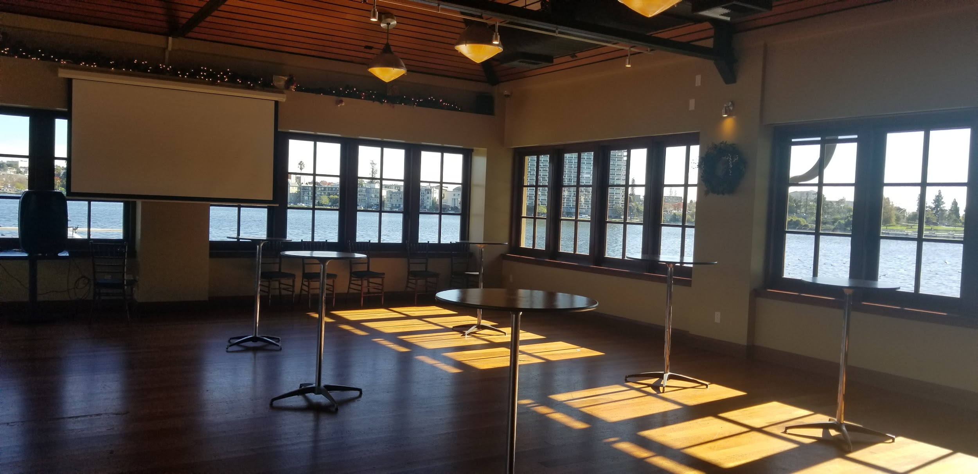
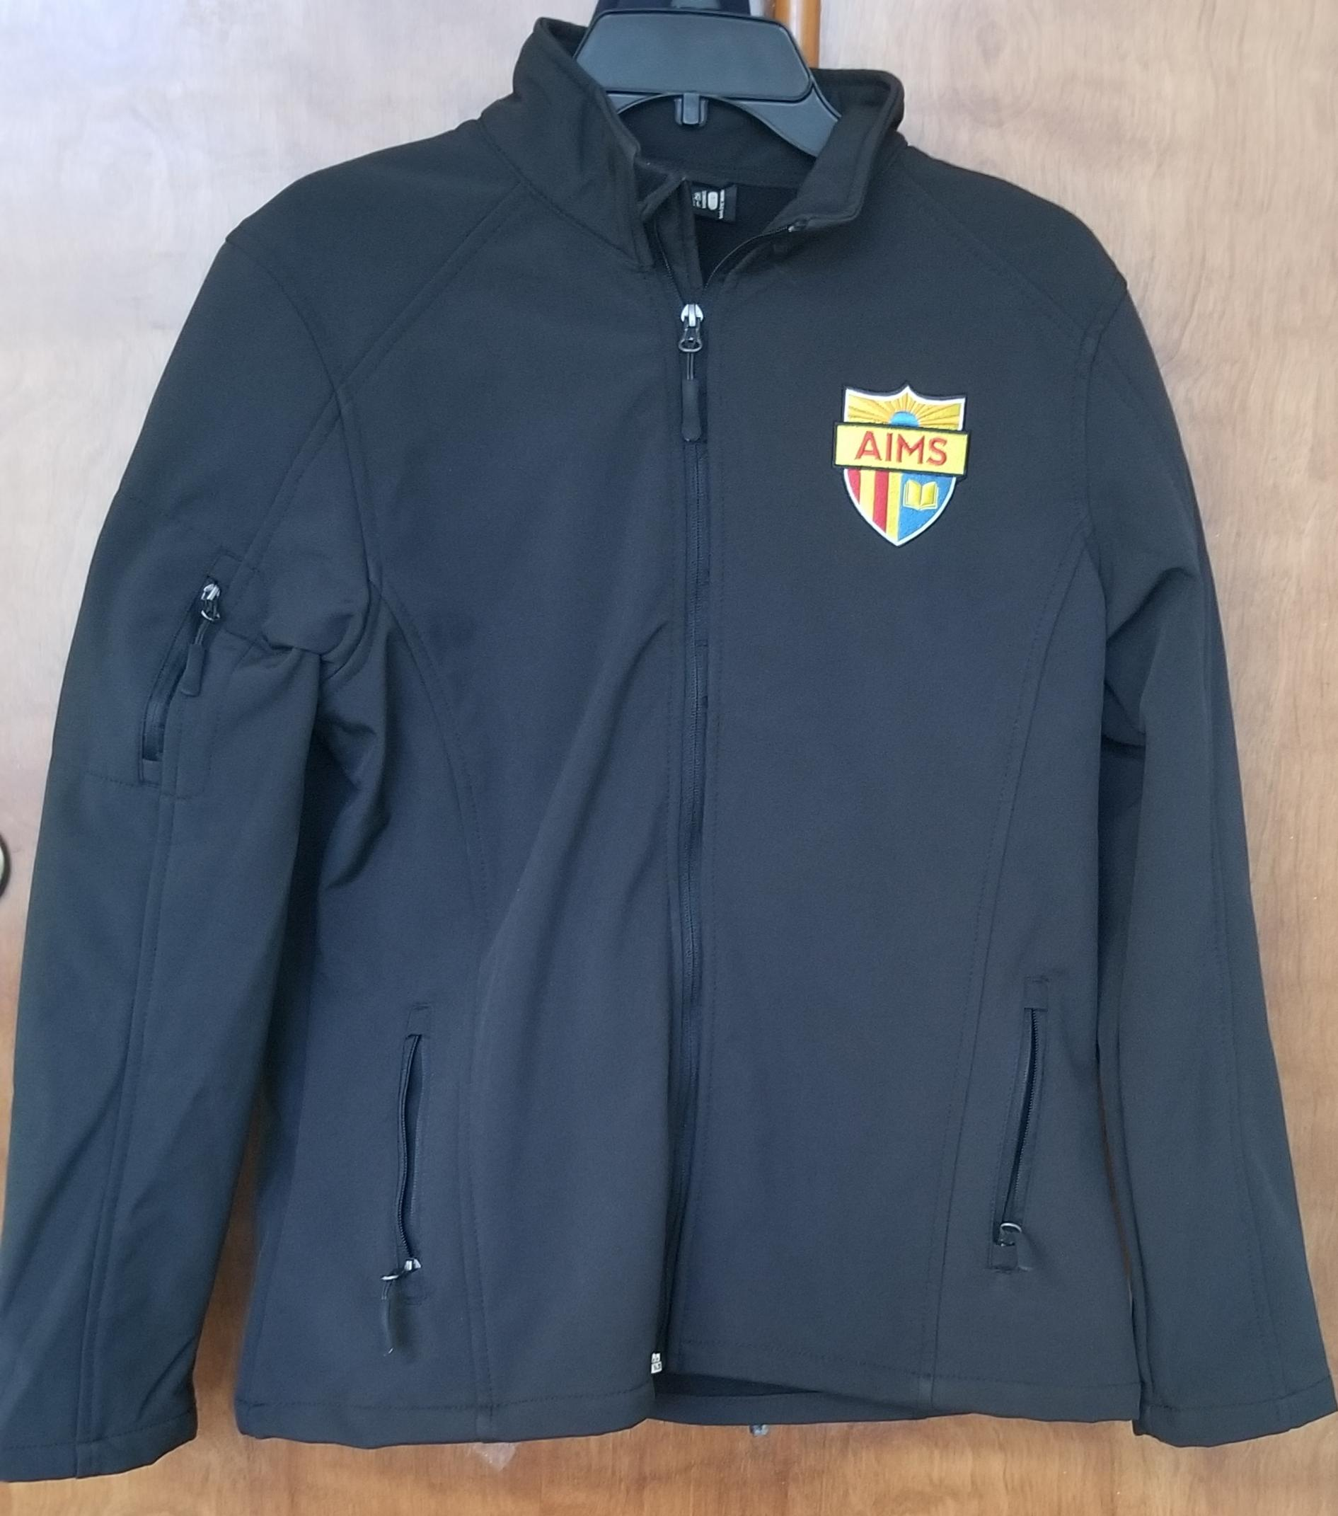
7th Annual Staff/Teacher Appreciation Dinner
Where: Lake Chalet Banquet Room
Total Attended: 120 Across the District
Teachers were given AIMS jackets, t-shirts, and gift cards.
We also had raffle prizes.

Slide 8
7th Annual Appreciation Dinner Donors
AIMS Thanks the following individuals/organizations for their generous donations.
AIMS Families
Eden Plaza Café
Lagos Grill
Mo’Joe Café
Target Corporation
Trader Joe’s

Slide 9
Wellness Committee
This year four Wellness committee meetings will be held:
February- Resources for families and referrals for mental health support, invitation will be sent home to families, staff to seek potential committee members.
March - Review of Wellness Policy and potential changes within policy that can be adopted and implemented for betterment of students wellbeing.
April - Discussion of mandated health and wellness programs within public schools and what that looks like.
May- Overview of school lunch program and review of survey results and current wellness practices K-12th.

Slide 10
Purpose of AIMS District Wellness Committee
Childhood obesity is one of the most serious health epidemics facing America today. The American Medical Association now recognizes obesity as a disease. According to the U.S. Centers for Disease Control and Prevention, about one third of children and teens in the United States are overweight or obese. Childhood obesity is leading to a range of health problems that previously were not generally seen until adulthood, including high blood pressure, type II diabetes and elevated blood cholesterol levels.
At AIMS believe we have a responsibility to improve the health and well-being of our children. Experience shows that schools can be powerful places to make behavioral and environmental changes for students and staff. To make our school environment healthier, our school formed a School Wellness Committee. The purpose of the committee is to bring together representatives from the school and community who can help us address issues facing the health and socio-emotional well-being of our children and youth.

Slide 11
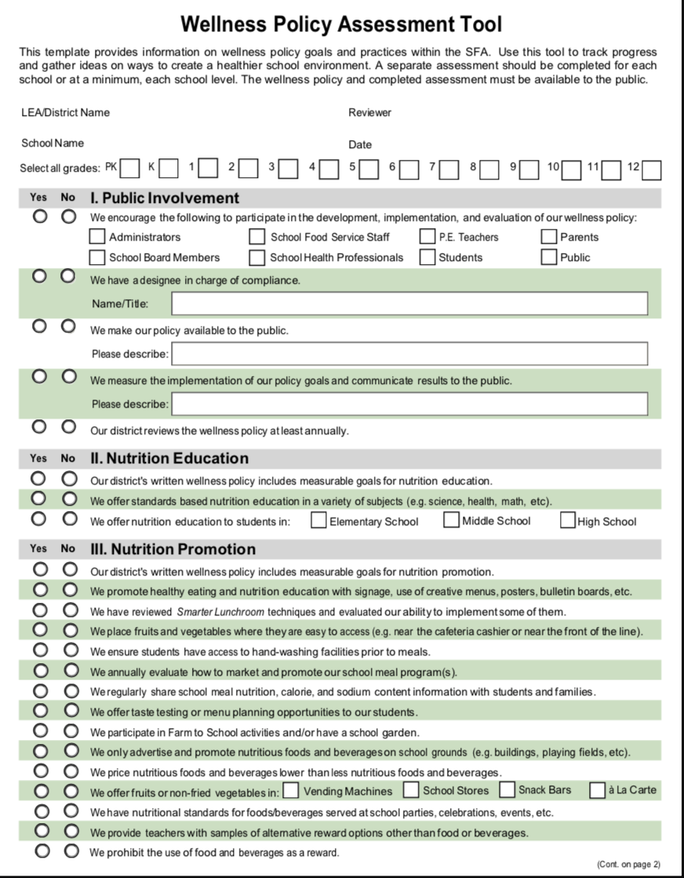
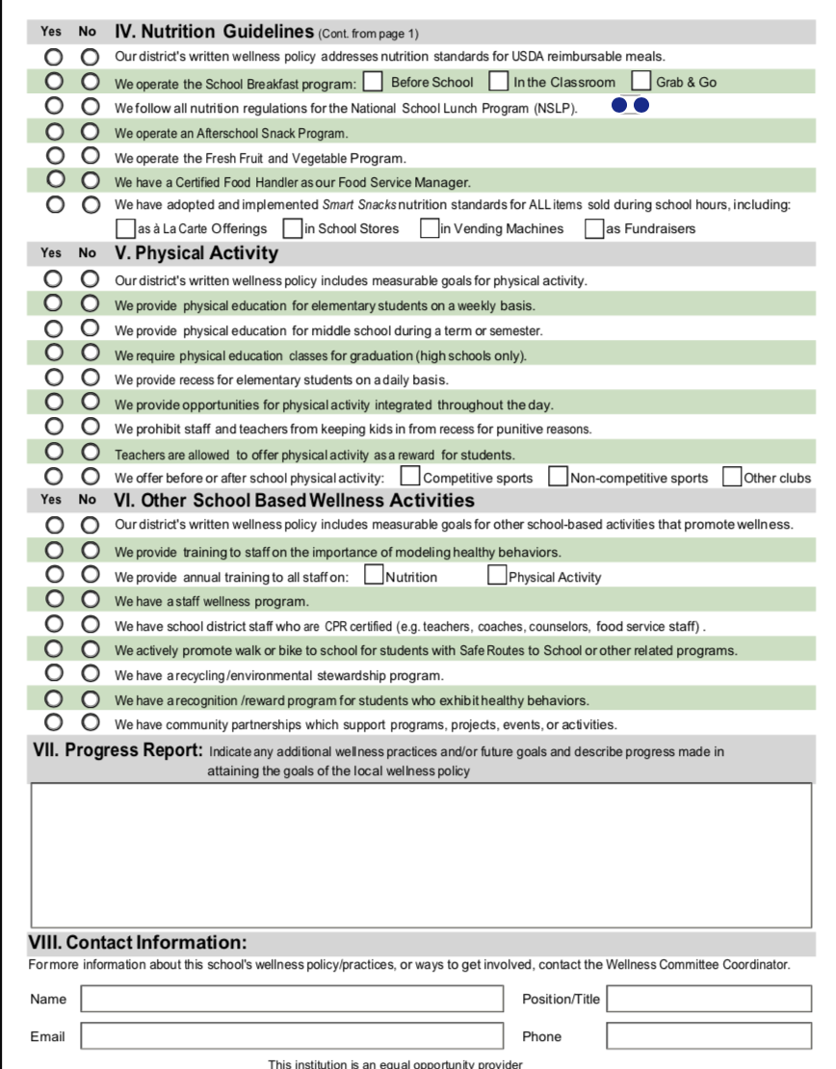
Wellness Policy Assessment Tool
Purpose of assessment tool is to examine which wellness activities we currently have and what additional activities can be implemented to support the wellness of our students.
2) Wellness committee members
will work collaboratively to
complete assessment tool.
3) All ideas proposed will be
provided to head of division and to board for final approval if implementation of programming is needed.

