Slide 1
SUPERINTENDENT’S K-12
BOARD REPORT
February 2019

Slide 2
Finance
VTD Audit Completed
First Interims submitted to OUSD
Second Interims submitted to
OUSD

Slide 3
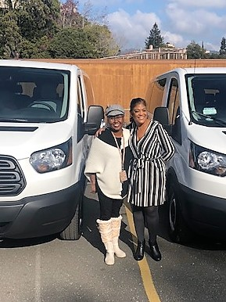
Site Update
Water Flood Restoration
Continued construction to flood damaged areas.
Arrival of 2 Vans

Slide 4
Community Engagements
Finance Committee Meeting
Facilities Committee Meeting
Governance Committee Meeting
Saturday School tutoring group
Oakland Steering Committee Meeting
SSC Meetings
7th Annual Appreciation Dinner
8th Grade Field Trip
AIPHS and Middle School Fall Sports Banquets
AIPHS Boys and Girls Basketball games

Slide 5
Promoting AIMS
ExcelinEd 2018 National Summit
Washington, D.C.
The annual National Summit on Education Reform is the nation’s premier gathering of education reformers. It provides state and local policymakers, education leaders and advocates with comprehensive information on evolving laws, new trends, successful policies and the latest innovations that are transforming education for the 21st century.
CSDC Leadership Update Conference
San Francisco
Presenter: AIMS K-12 Success
Chinese Consulate Visit
Oakland
Board Members Steven Leung and Benson Wan
Oakland Rotary Showcase Mixer
Summit Bank, Oakland

Slide 6
Promoting AIMS
Meeting with EBay Rep
Oakland
Board Member Toni Cook
HBCU /Oakland NAACP Visit
AIPHS
The Oakland NAACP Branch in collaboration with the Oakland Promise and the Oakland Unified School District hosted a HBCU Luncheon with three Historically Black Colleges & Universities: Paul Quinn College, Wiley College, and the University of Arkansas at Pine Bluff.
One of the objectives was to strategize with HBCU presidents, clergy and community members on ways to increase HBCU engagement in Oakland and how to support students on making a HBCU their college choice.

Slide 7
Promoting AIMS
OUSD Board of Education Meeting
Support for charter schools, addressing:
In Oakland, 30% of public students attend a charter school. This past year, OUSD was not able to make up a $34.7 million deficit in their budget and was at risk of going into state receivership (state controlled and operation of the district). Fortunately for the district, Governor Brown chose to bail out OUSD, eliminating the risk. However, the school board is now actively hiring a lobbyist to eliminate what they perceive to be the threat to their fiscal solvency, Charter Schools.
Celebrity Pajama Night Read-A-Thon
AIPCS II – Grades 2-5
“The purpose is to let kids know “reading books” can open up a world of new adventures for them!”

Slide 8
February Engagements
February 2 – NAACP 110th Anniversary Celebration
The mission is to Engage, Educate, Empower, and Inspire Hope to build a better Oakland Bay Area.
February 14 – Tipping Point Community Site Visit
Tipping Point supports organizations that produce strong academic outcomes, such as literacy, high school graduation, college attendance and post-secondary degrees.
February 19-20 - CSDC CBO Training
An intensive training that delves into the key fiscal management skills required of California charter school directors, business officers, governing board treasurers, and charter-granting agency staff members who have significant financial management and/or oversight responsibilities.
February 28 – K-1 African American Read-In
Celebrating Black History Month with guest readers. Focused on exposing our students
to the strong and varied African-American authors whose works might expand
children’s future reading.

