Slide 1
AIMS K-12 Board Report
February 2019
Superintendent Maya Woods-Cadiz
Mrs. Erin Oh (K-1 Division Head)
Mr. Christopher Ahmad (2-5 Division Head)
Mr. Maurice Williams (Head of Middle School)
Mr. Tareyton Russ (AIPHS Head of School)
Mr. Peter Holmquist (AIPHS Head of Academics)
Ms. Marisol Magaña (Operations Director)
Ms. Tiffany Tung (Operations Manager)

Slide 2
Month | AIPCS | AIPCS II | AIPHS
Aug | 158 | 750 | 410
Sept | 162 | 788 | 416
Oct | 161 | 798 | 412
Nov | 160 | 801 | 410
Dec | 160 | 798 | 411
Jan | 160 | 797 | 411
Feb* | 159 | 798 | 403
Enrollment Numbers
*Reporting as of February 1, 2019
Notes:
In HS, a few students tried out another school and returned to AIMS recently, partial cause for increase of 6 students.

Slide 3
AIPCS ADA & ADA %
 | ADA | ADA %
Aug | 150.60 | 95.31
Sept | 159.28 | 97.85
Oct | 158.42 | 98.40
Nov | 154.61 | 97.61
Dec | 154.70 | 96.69
Jan | 157.50 | 97.83
Feb* | 156.83 | 97.65
*Reporting period January 7, 2019 to February 1, 2019

Slide 4
AIPCS II ADA & ADA %
 | ADA | ADA %
Aug | 737.38 | 98.37
Sept | 765.72 | 97.58
Oct | 775.58 | 97.84
Nov | 784.78 | 98.07
Dec | 773.60 | 96.94
Jan | 769.50 | 96.55
Feb* | 774.22 | 97.14
*Reporting period January 7, 2019 to February 1, 2019
Notes:
This is AIPCS II?

Slide 5
AIPHS ADA & ADA %
 | ADA | ADA %
Aug | 394.5 | 96.21
Sept | 393.22 | 93.90
Oct | 388.16 | 94.36
Nov | 390.53 | 94.91
Dec | 384.30 | 93.51
Jan | 391.40 | 95.23
Feb* | 386.44 | 95.20
*Reporting period January 7, 2019 to February 1, 2019
Notes:
This is AIPHS?

Slide 6
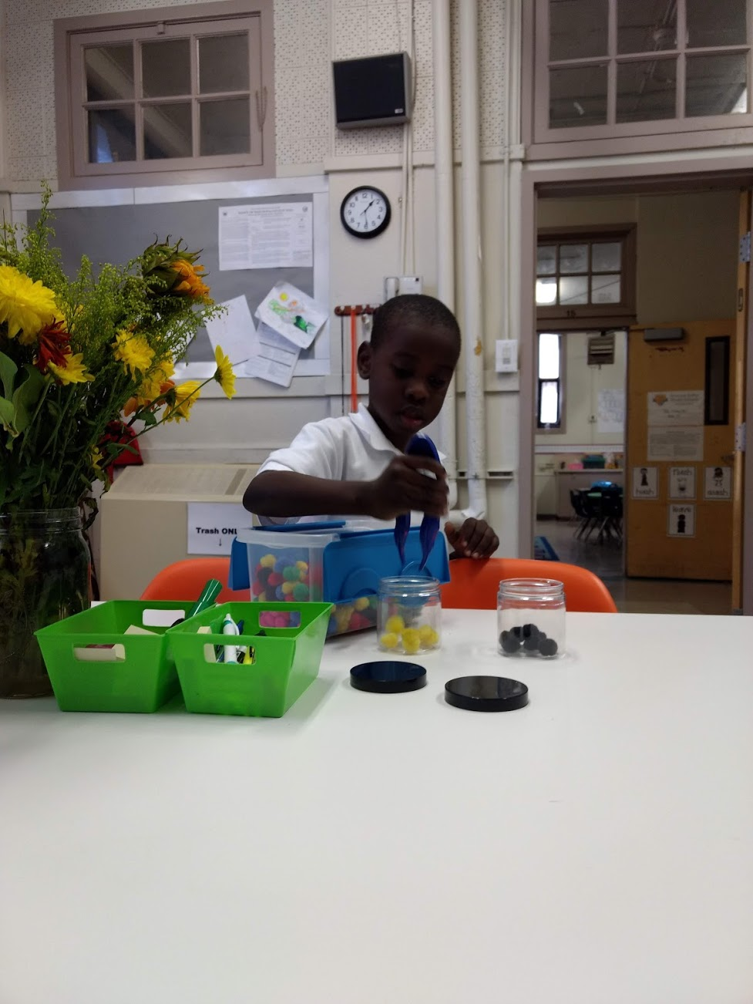
K-1 Satellite Updates: Events
1/23-- K2C: Kindergarten to College parent info session
1/24-- 100th Day of School
1/25-- Math Coaching

Slide 7
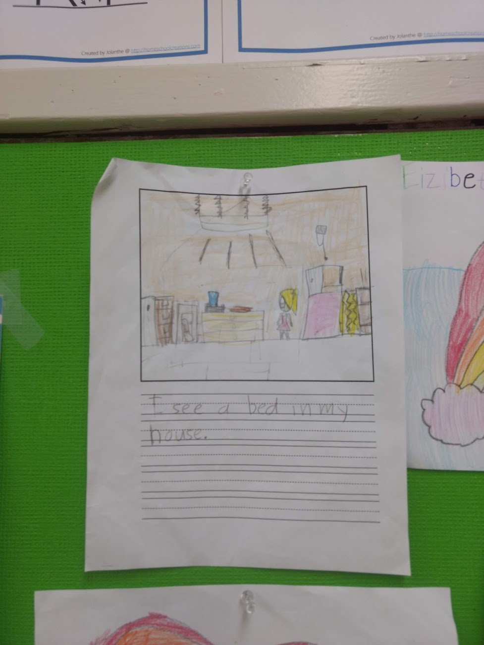
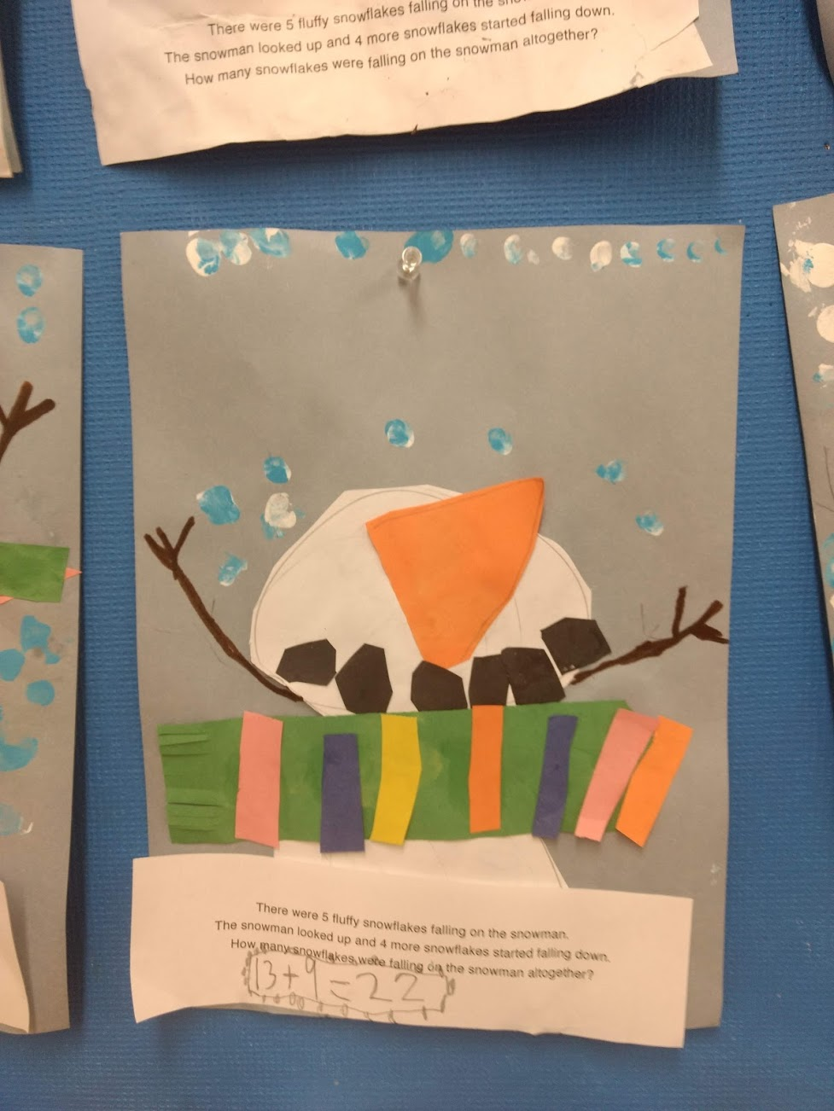
K-1 Satellite
December Priority Report
December Updates
Intervention has been restructured towards S.M.A.R.T. goal grouping, instead of being provided in equal blocks for each class
2. Art was integrated into literacy blocks, specifically to address penmanship and dexterity.
3. Vacancy: 1st Grade Teacher

Slide 8
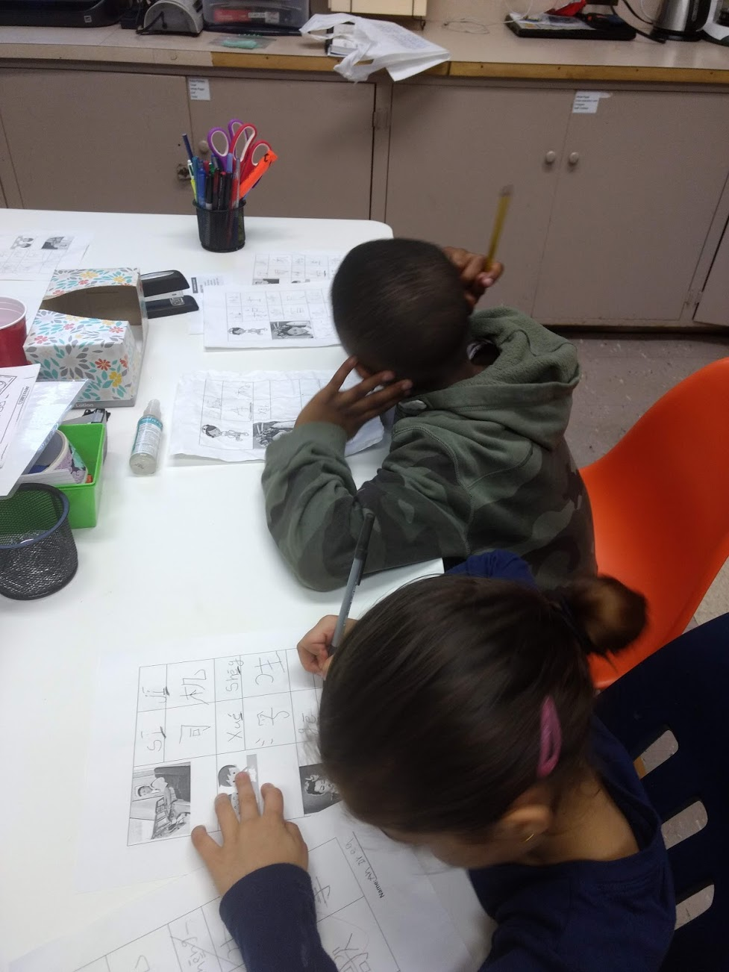
K-1 Satellite: Upcoming Priorities
February Priorities
Celebration: African-American read-in, Lunar New Year Celebration, cultural showcase
College Readiness: integrating college into Social Studies objectives
Conferences: providing time coverage so that all teachers can finish mid-year conferences by the end of February.
Behavioral Therapy: MOU with La Clinica

Slide 9
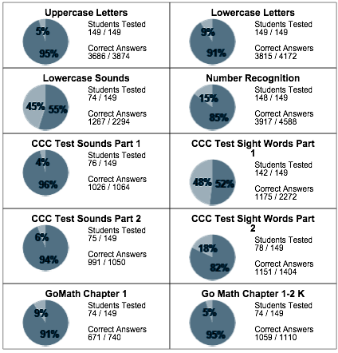
DATA:
Progress Report Growth

Slide 10
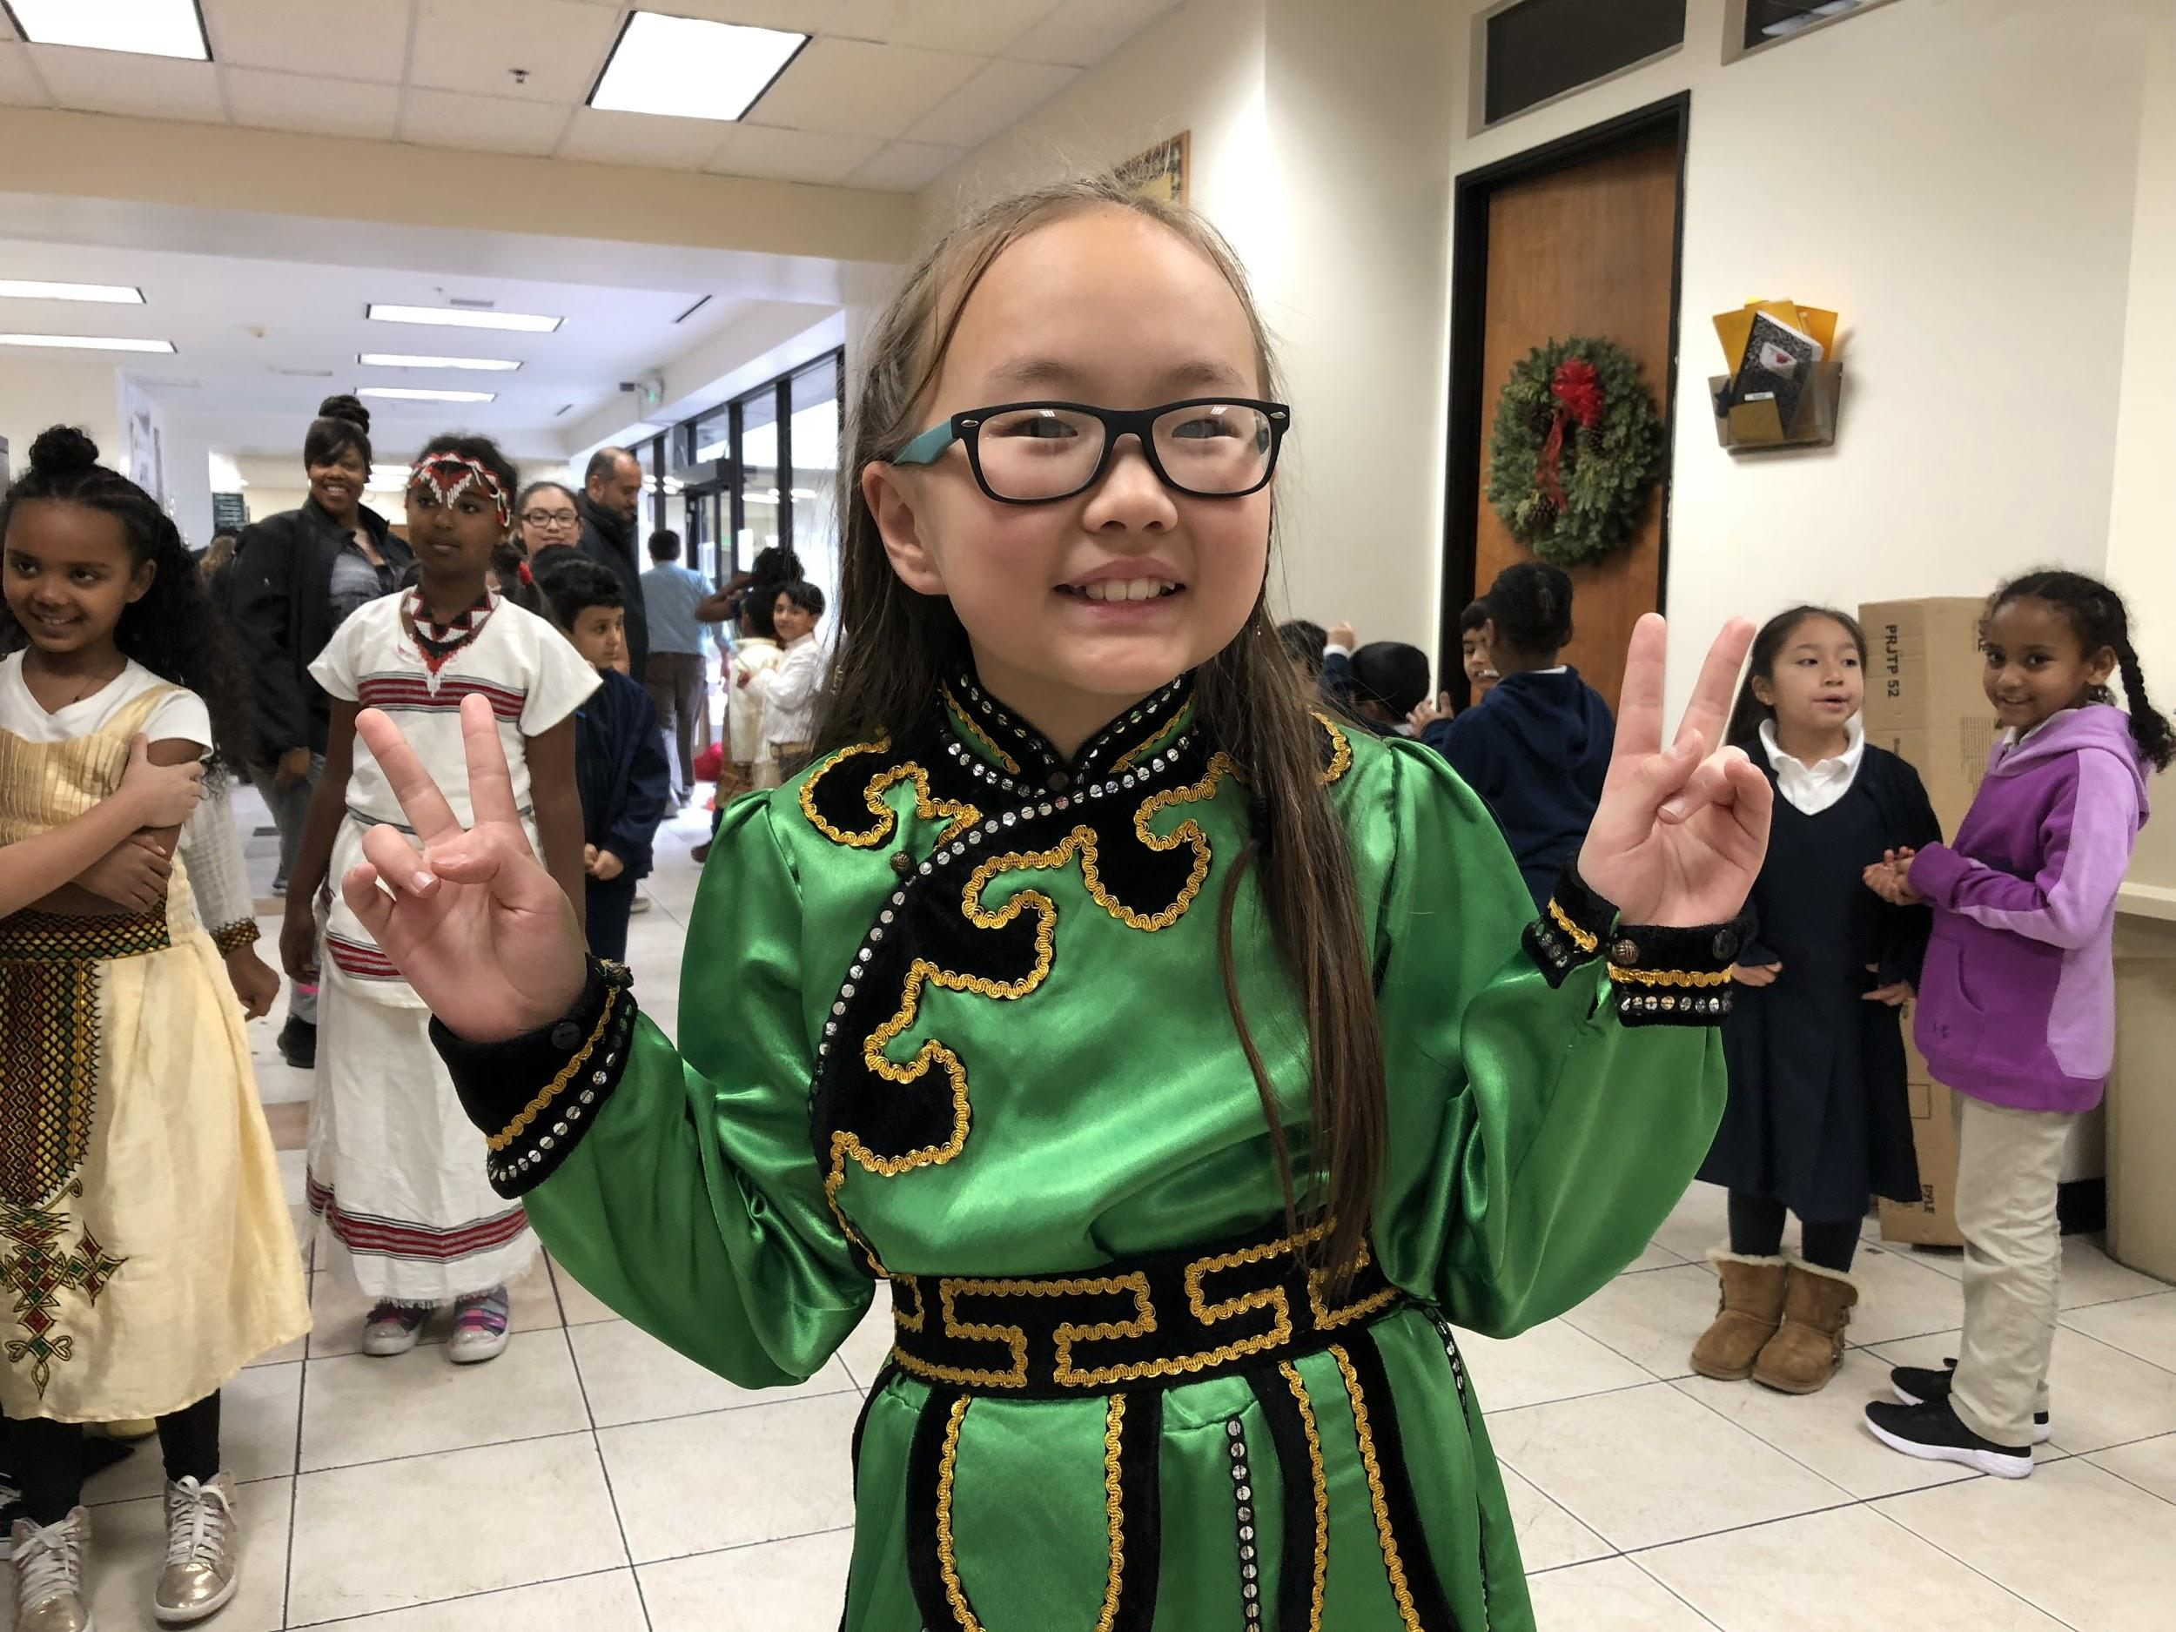
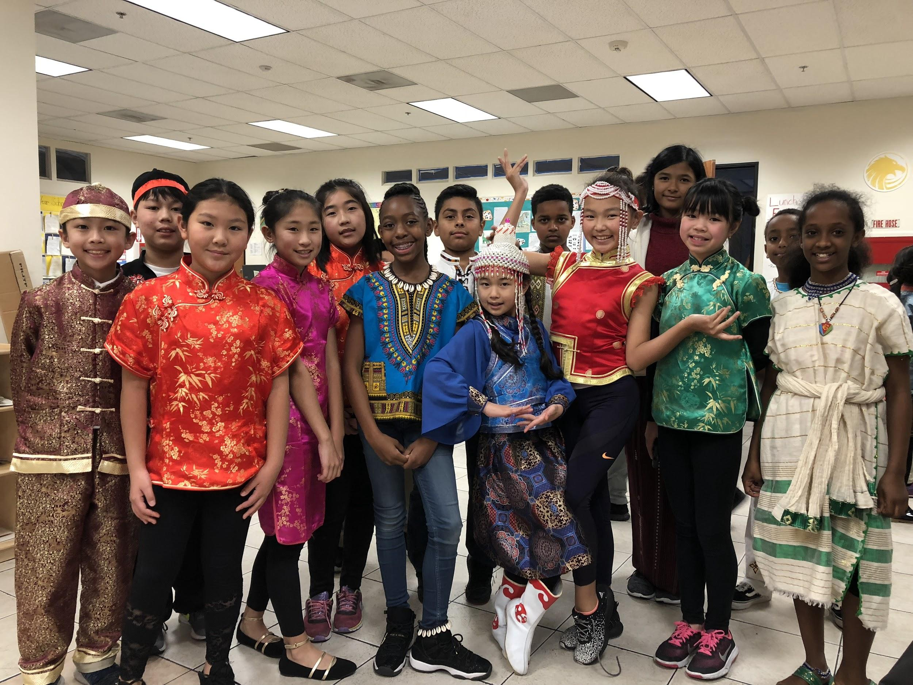
Cultural Day

Slide 11
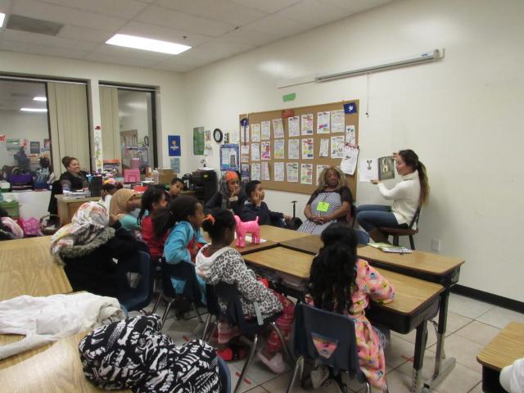
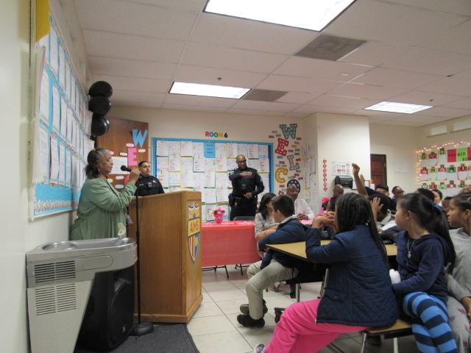
Pajama Read-a-Thon

Slide 12
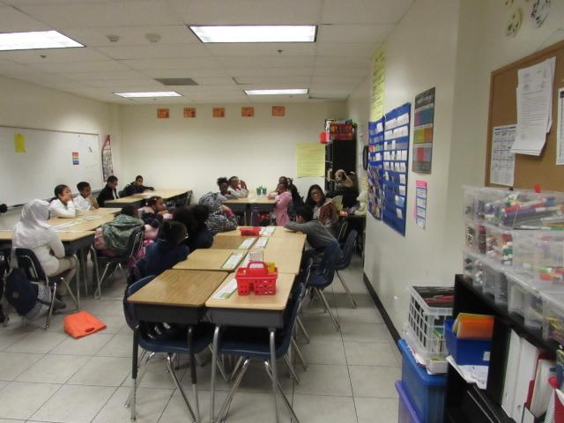
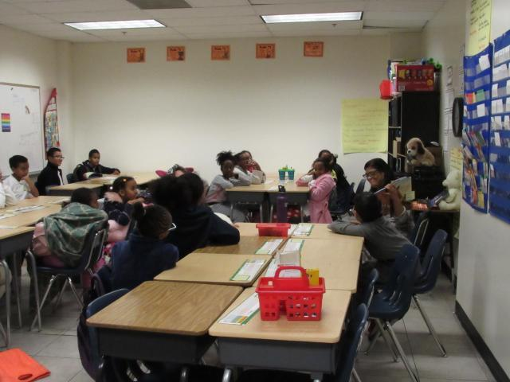
Pajama Read-a-Thon

Slide 13
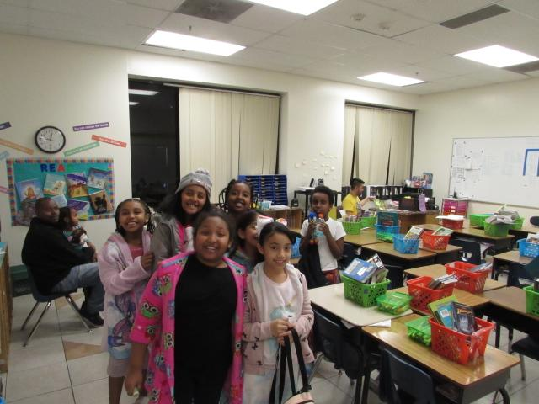
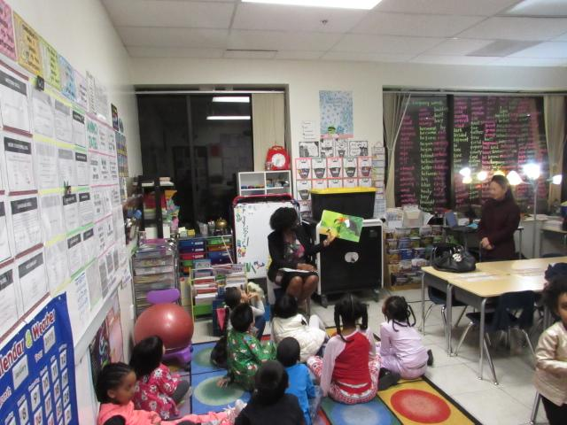
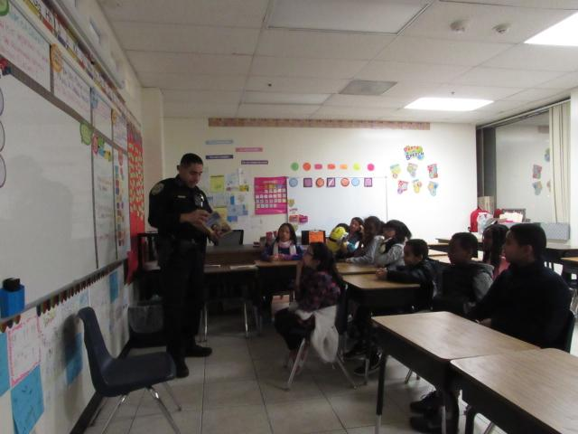
Pajama Read-a-Thon

Slide 14
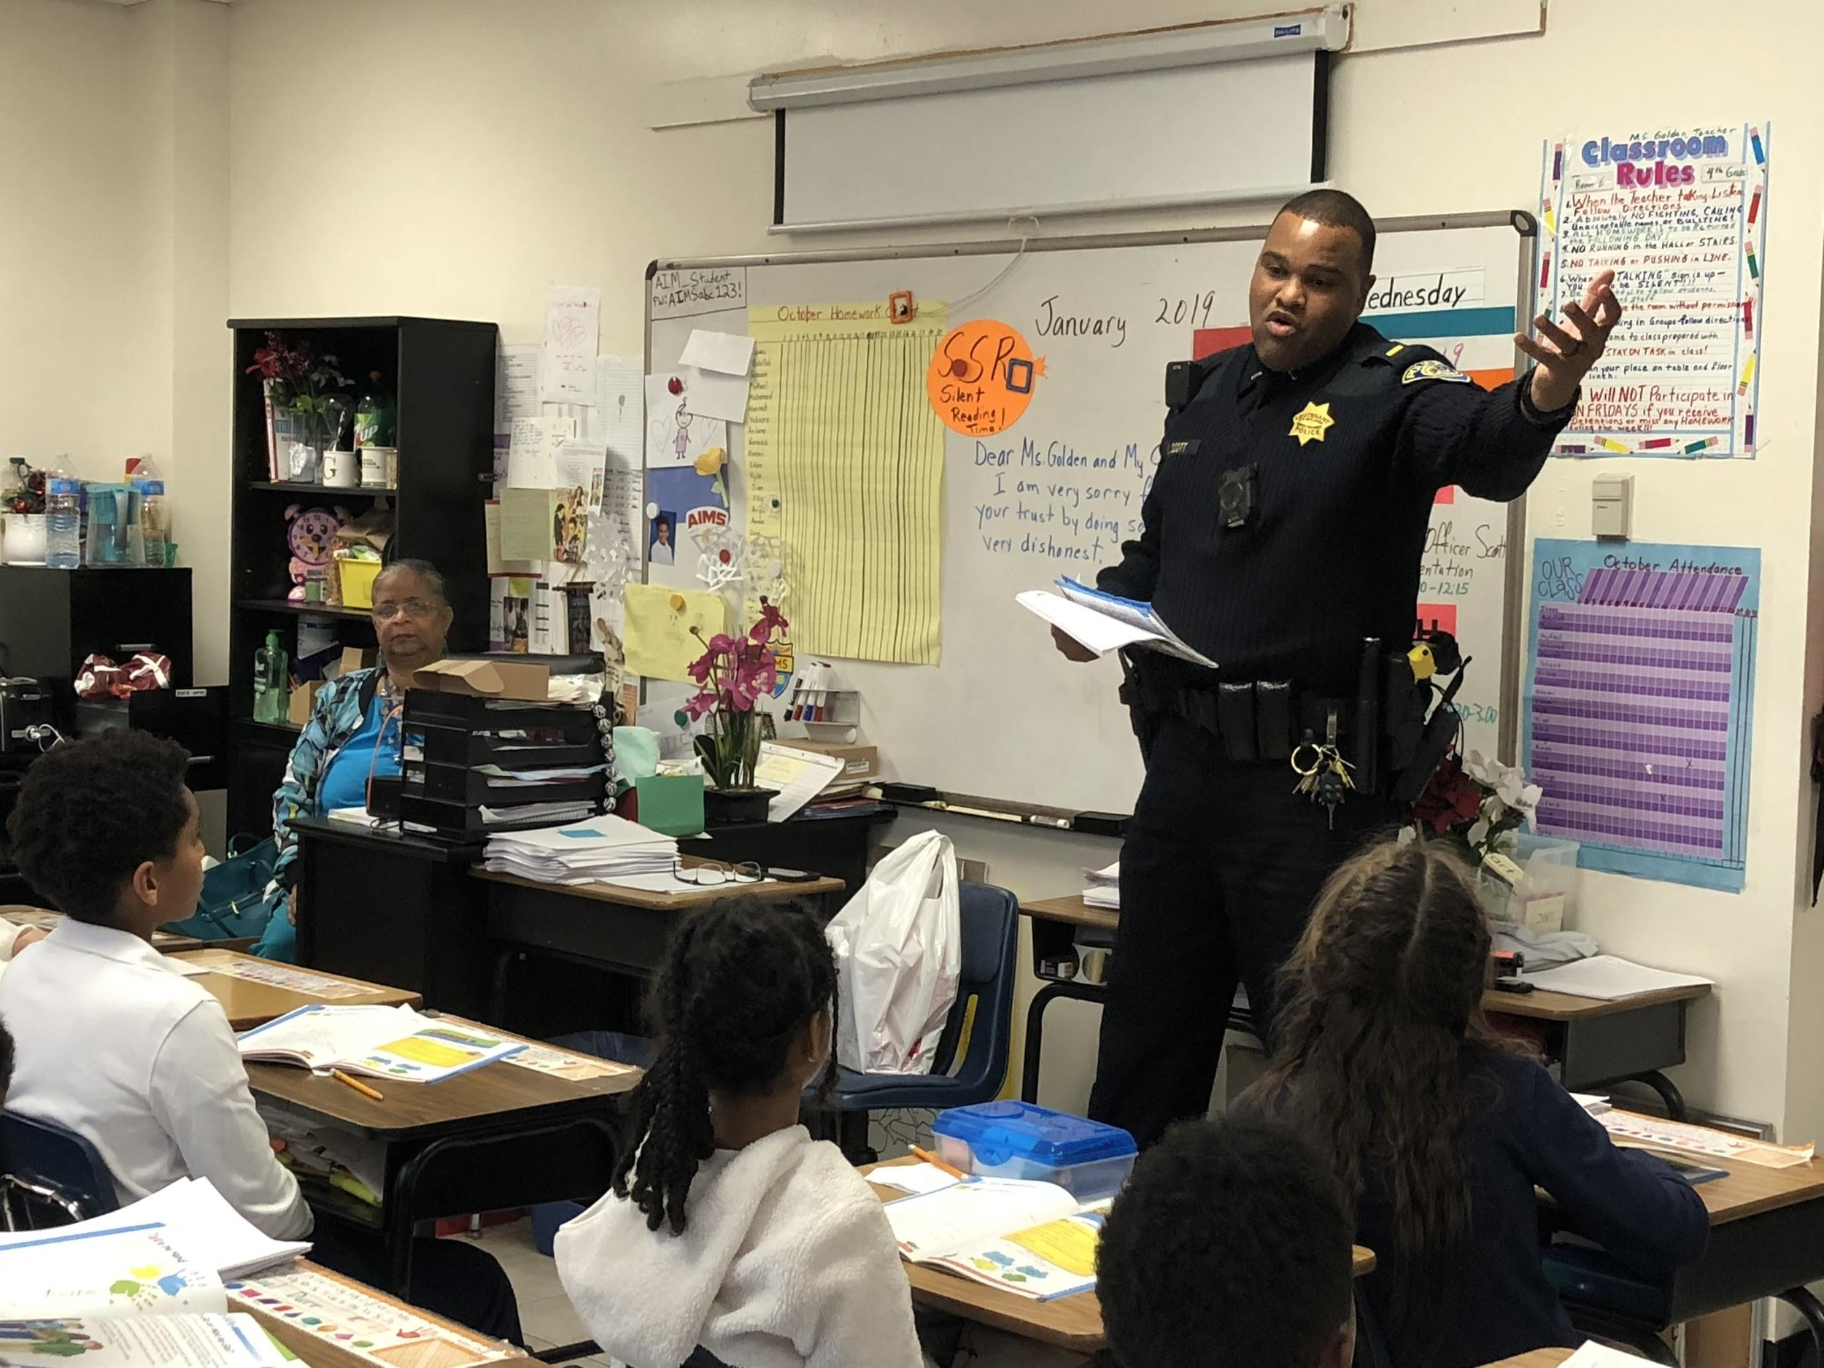
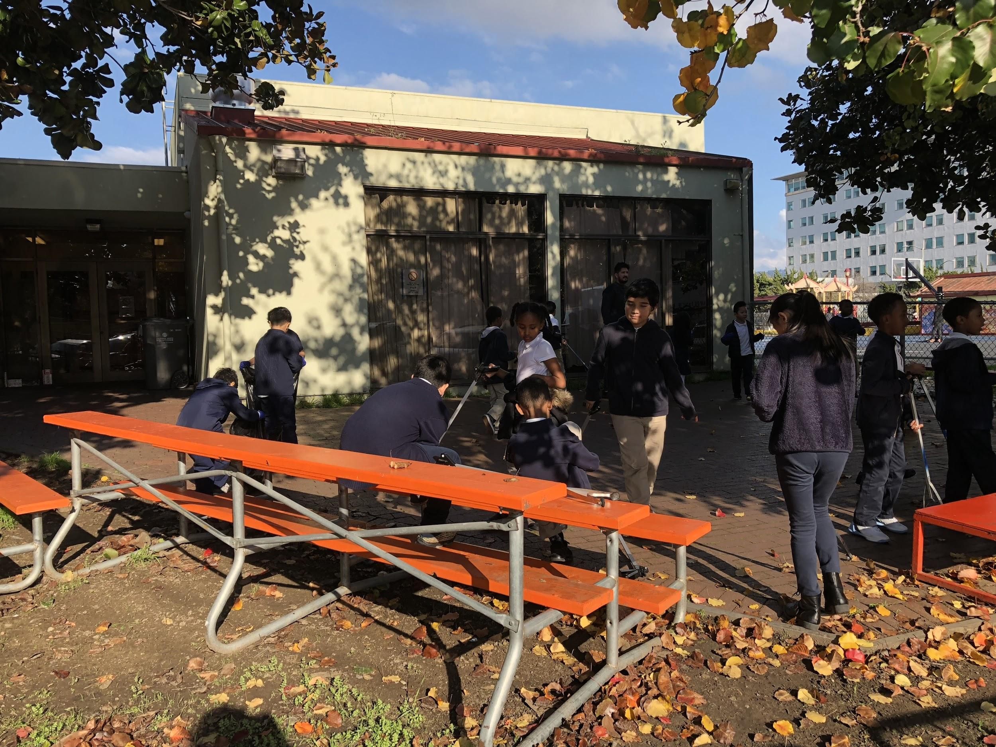
WORKING WITH THE COMMUNITY

Slide 15
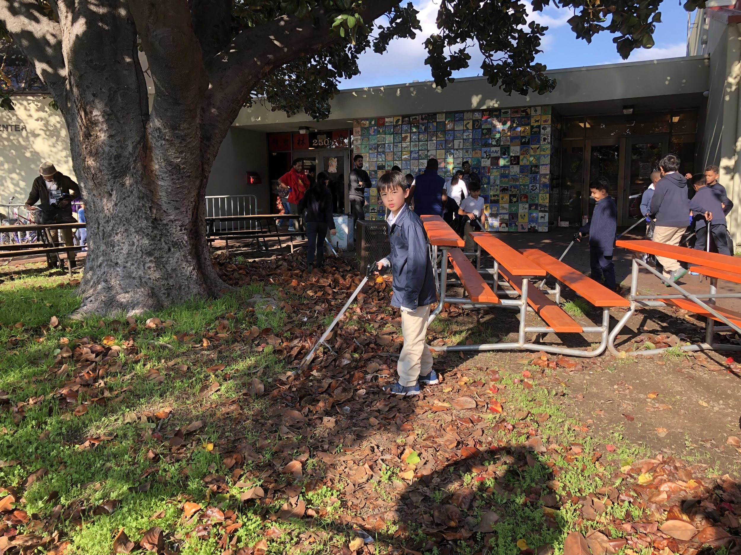
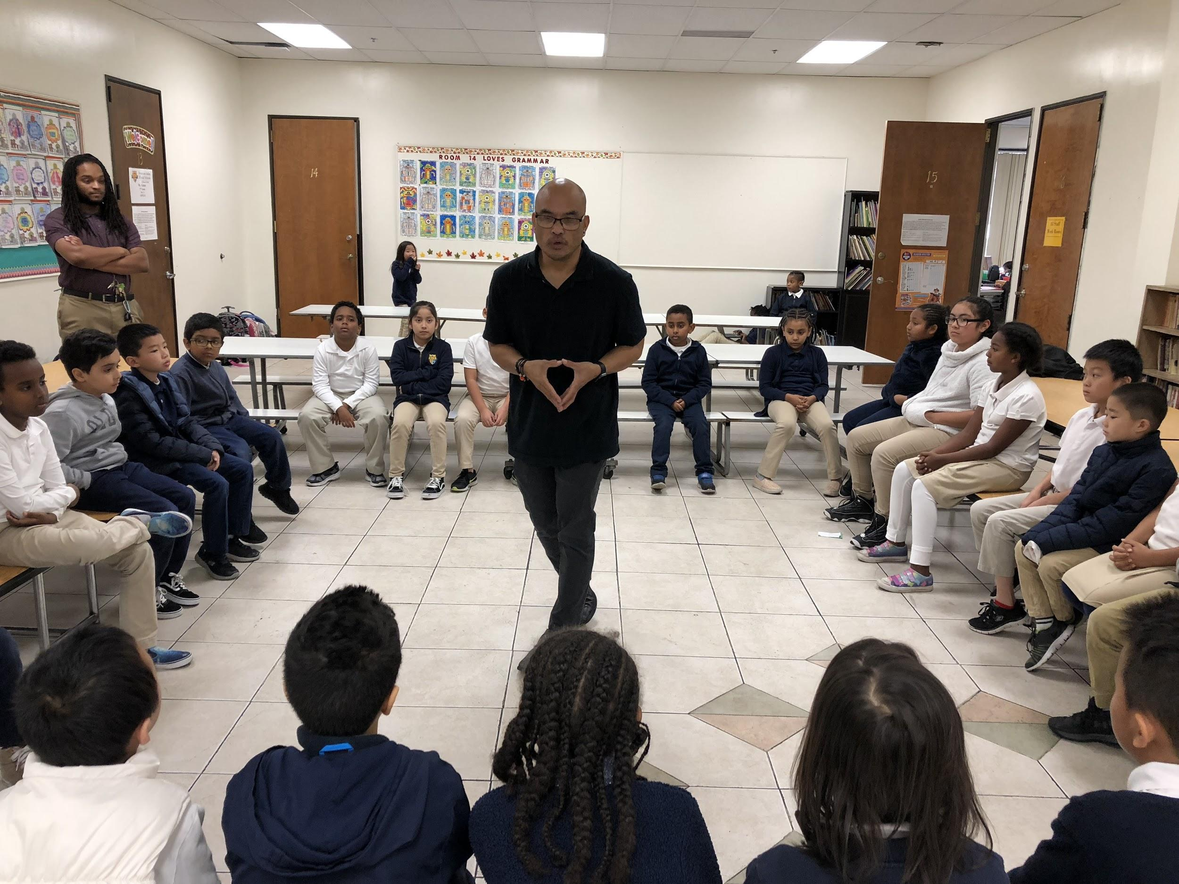
RESTORATIVE JUSTICE SATURDAYS

Slide 16
Teacher Action Plans
Each teacher received an action plan on what to do for struggling students
Each planned action was tailored to their class needs
Extra reading programs were purchased for classes with low-performance
Teachers were also given an opportunity to collaborate and create a team plan based on raising student performance in ELA

Slide 17
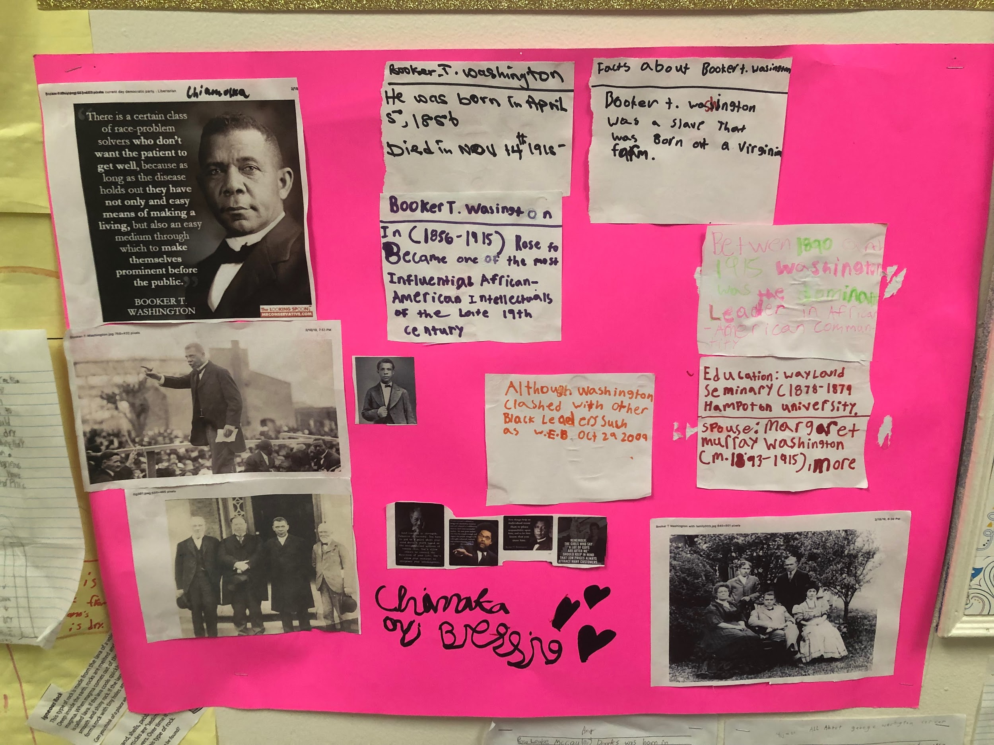
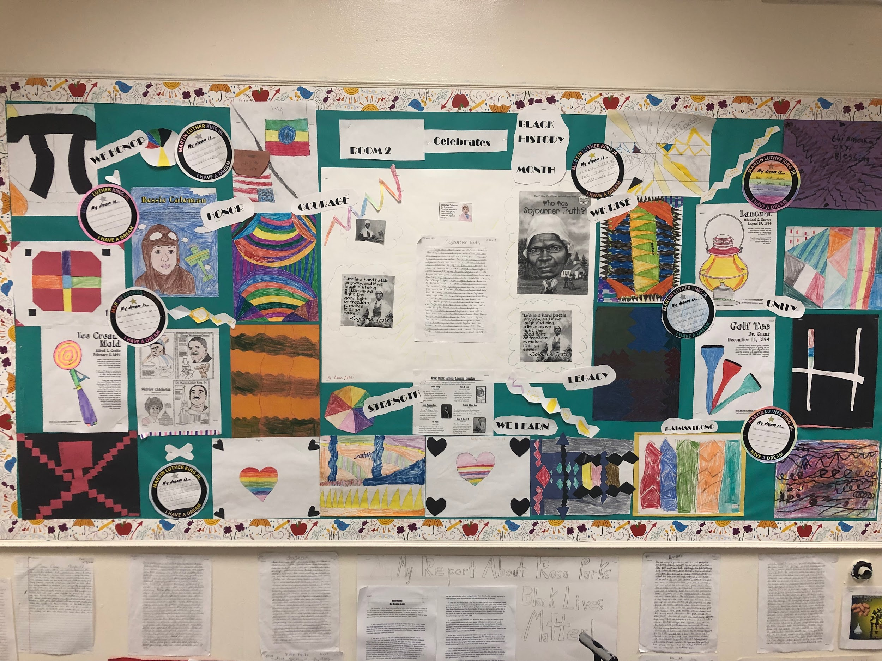
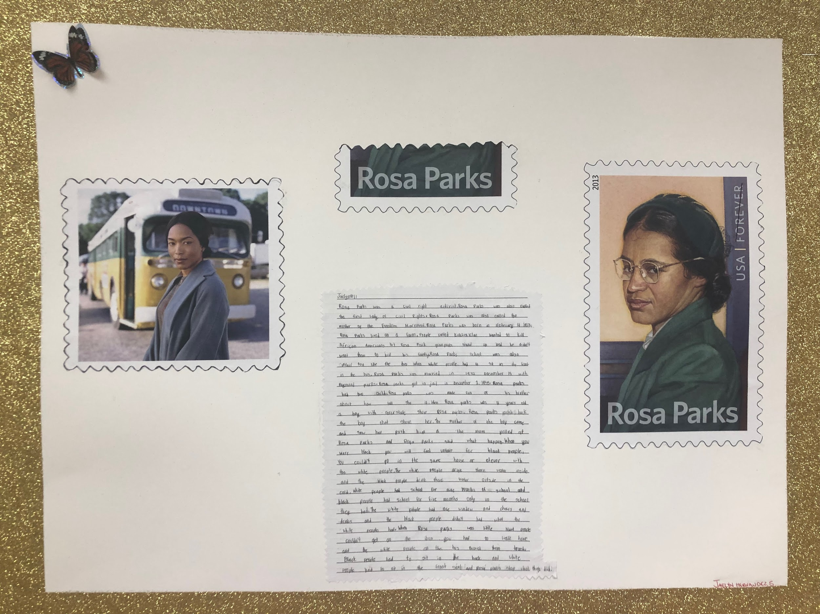
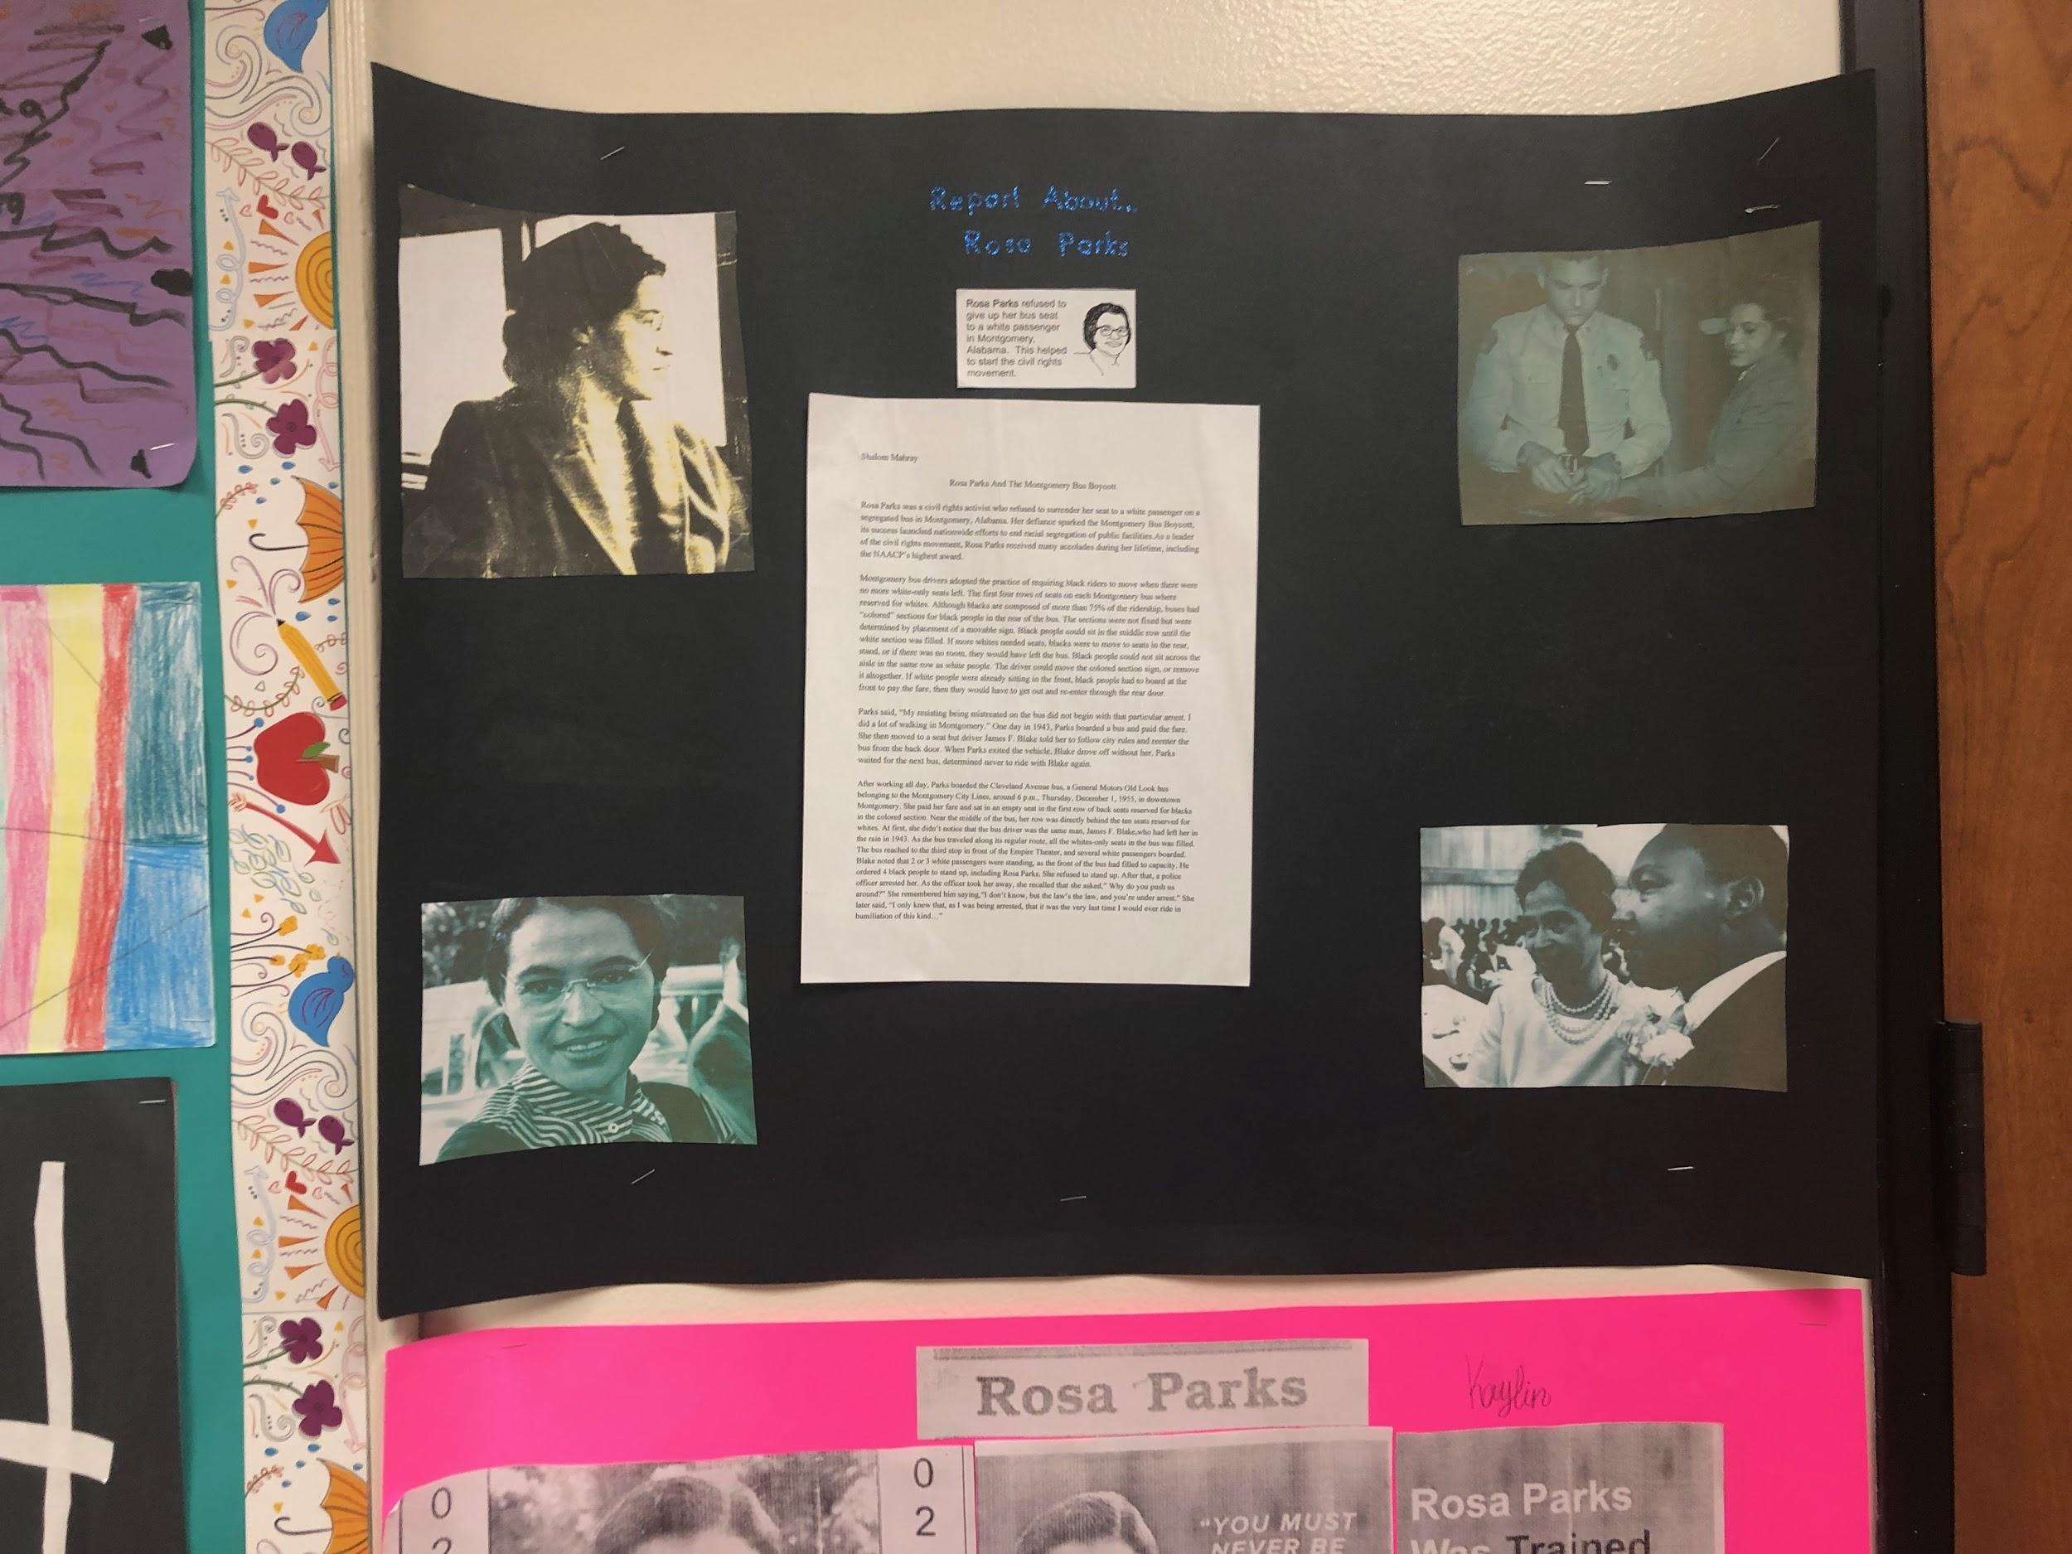
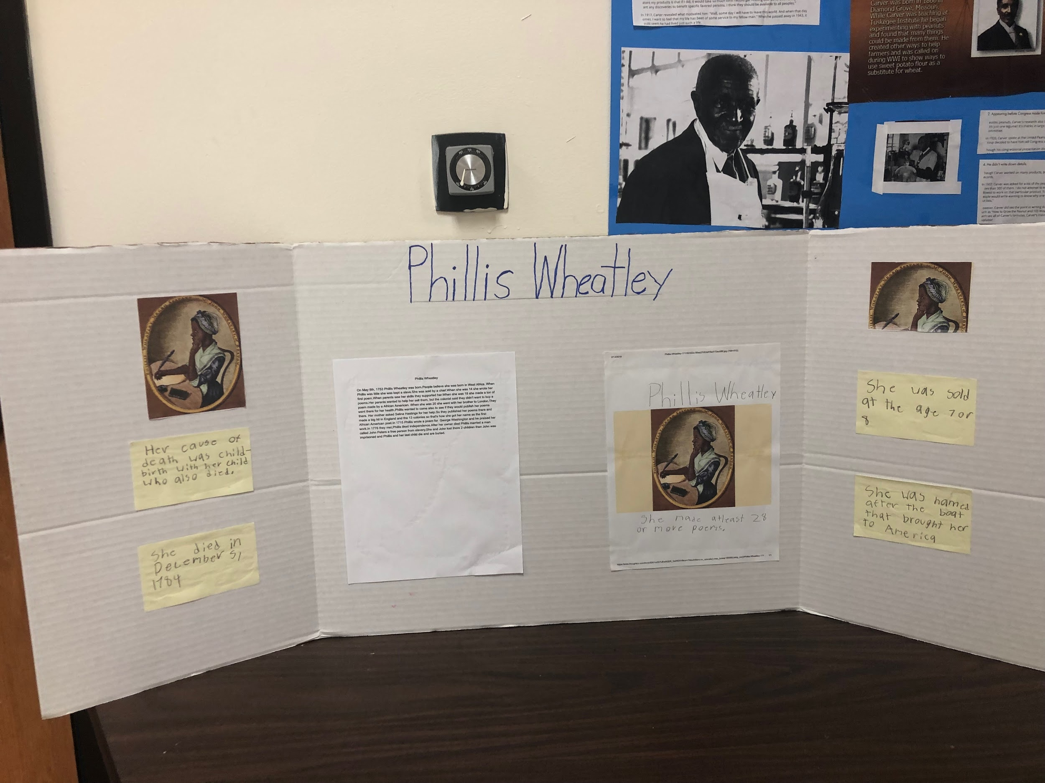
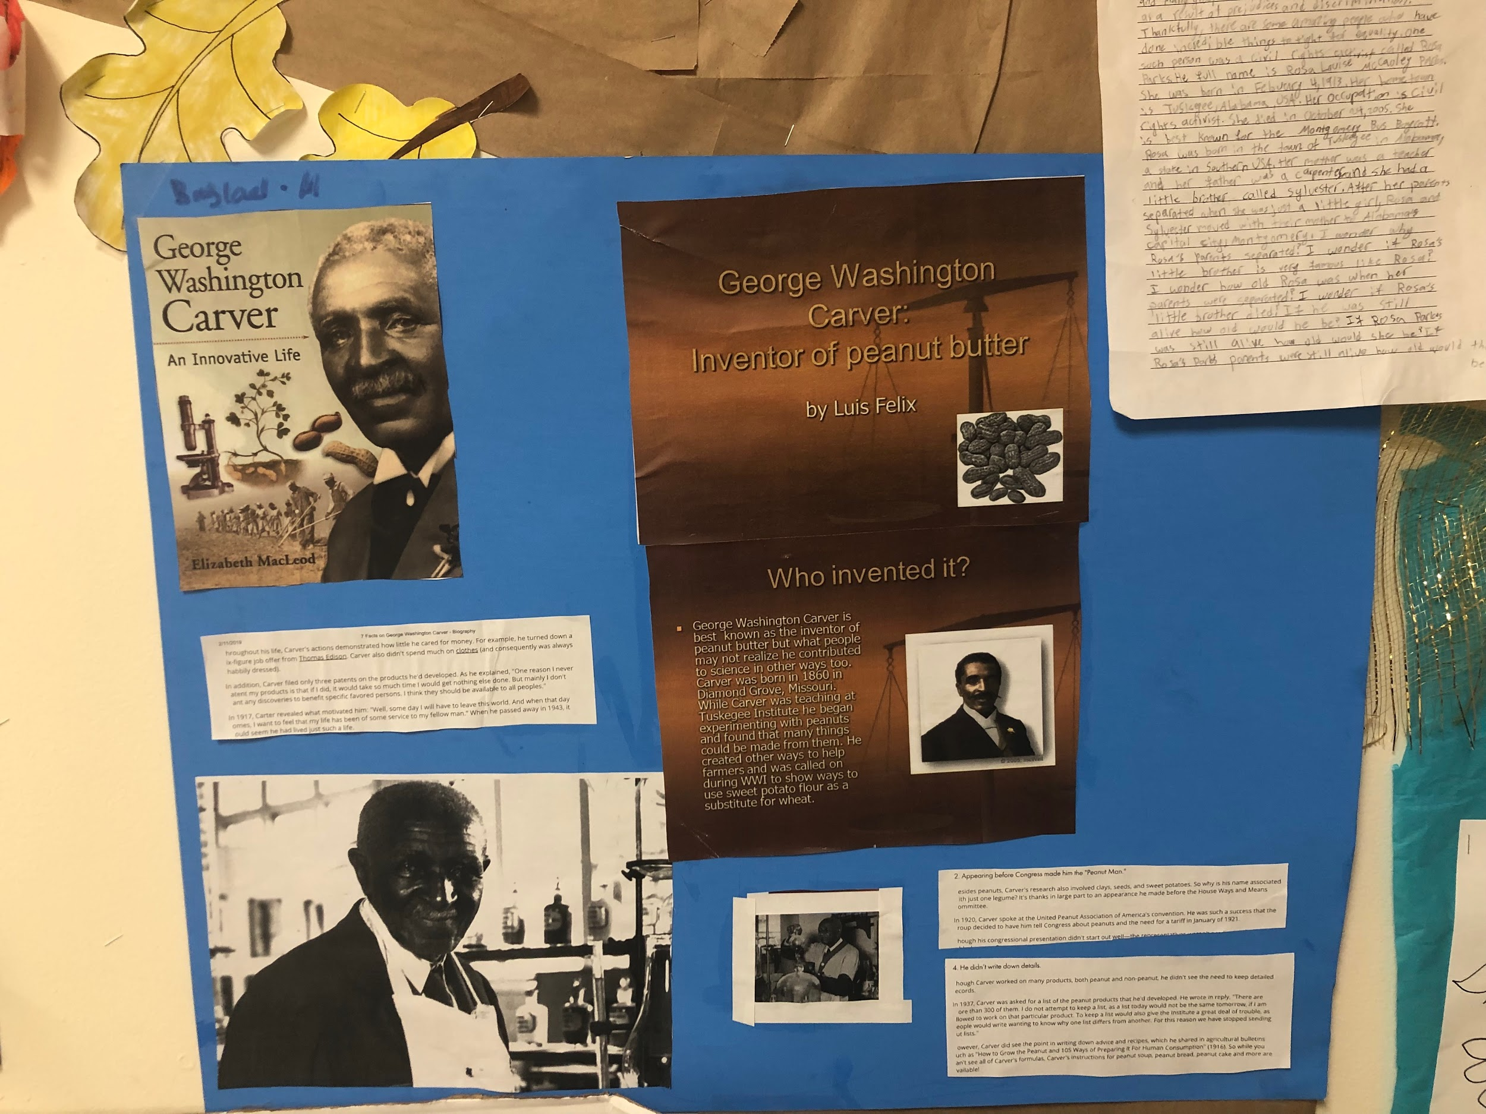
Black History Month

Slide 18
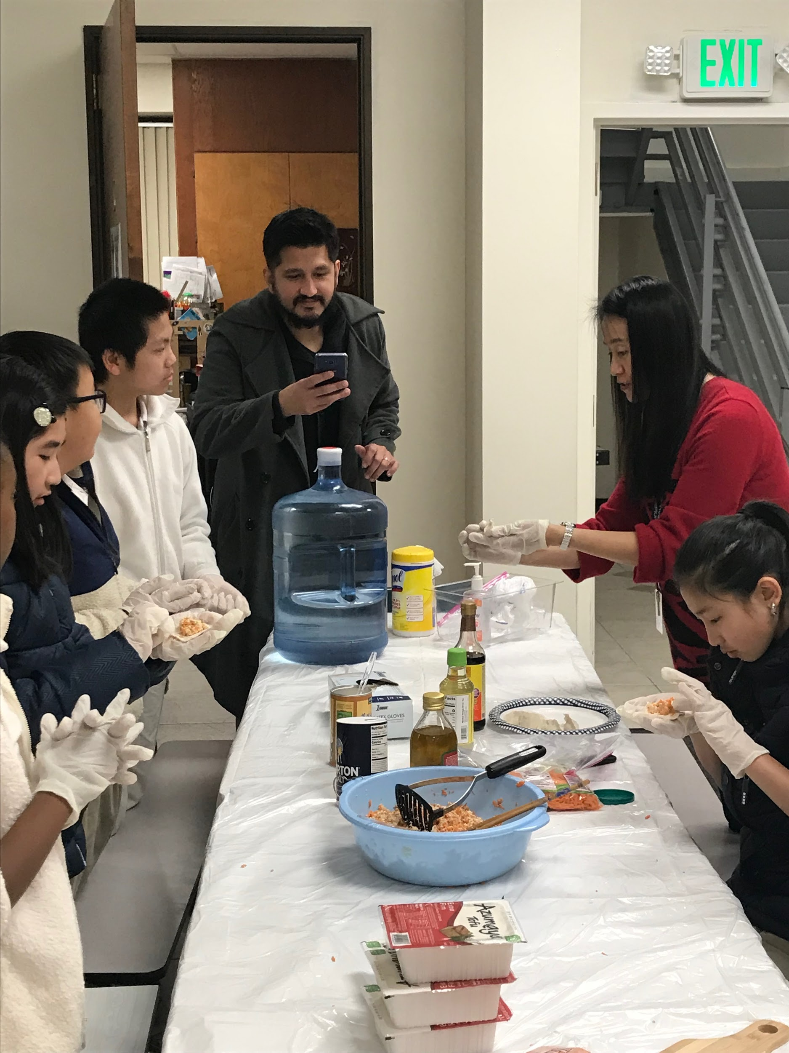
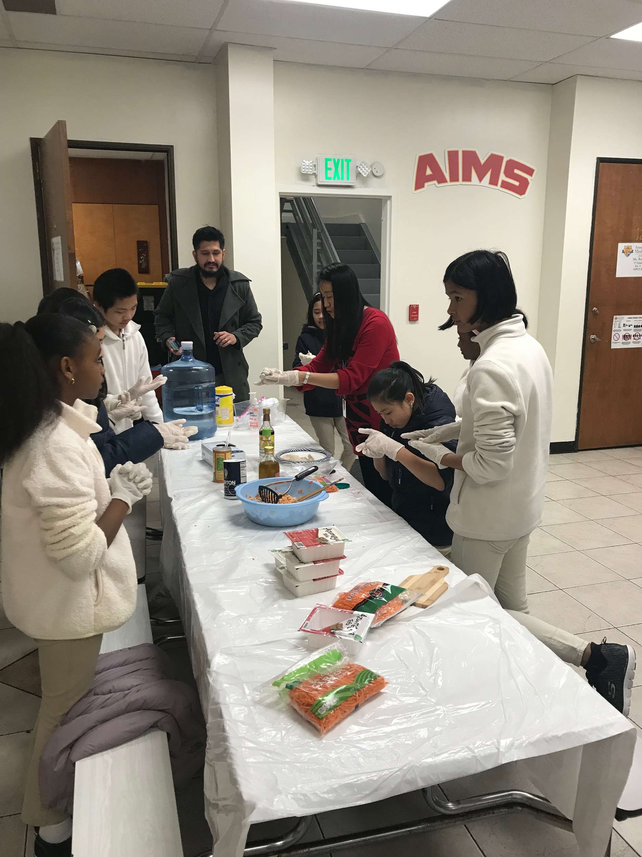
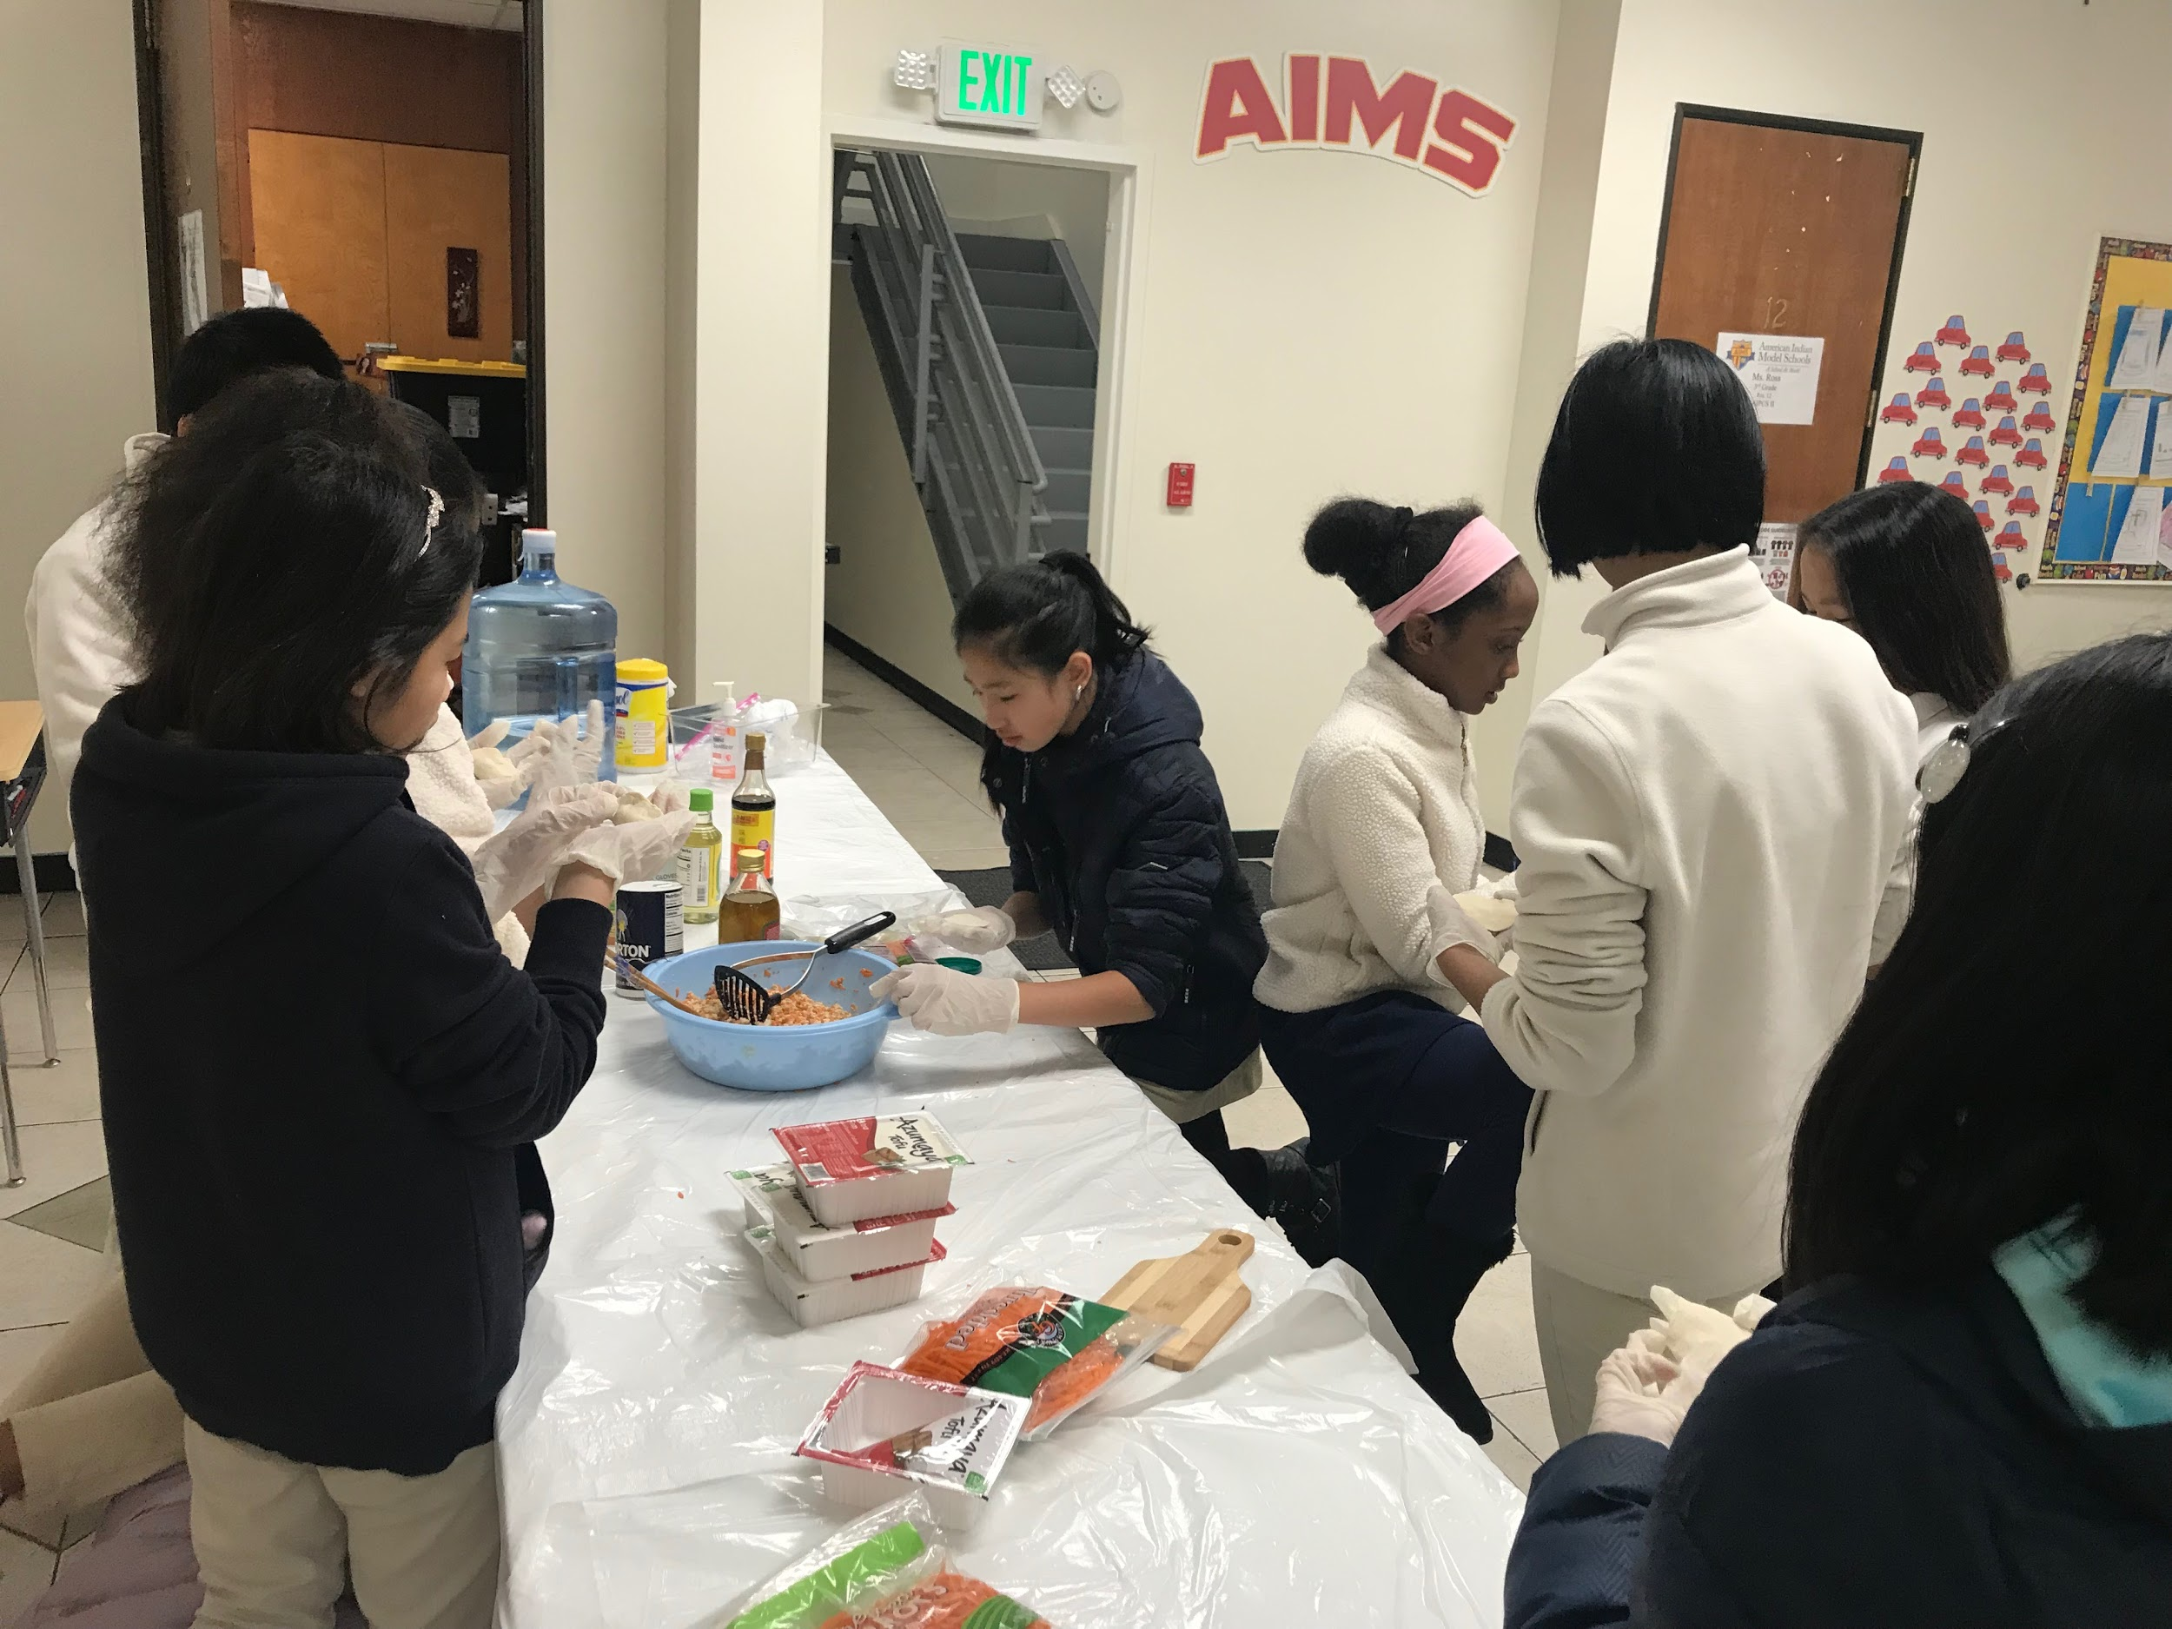
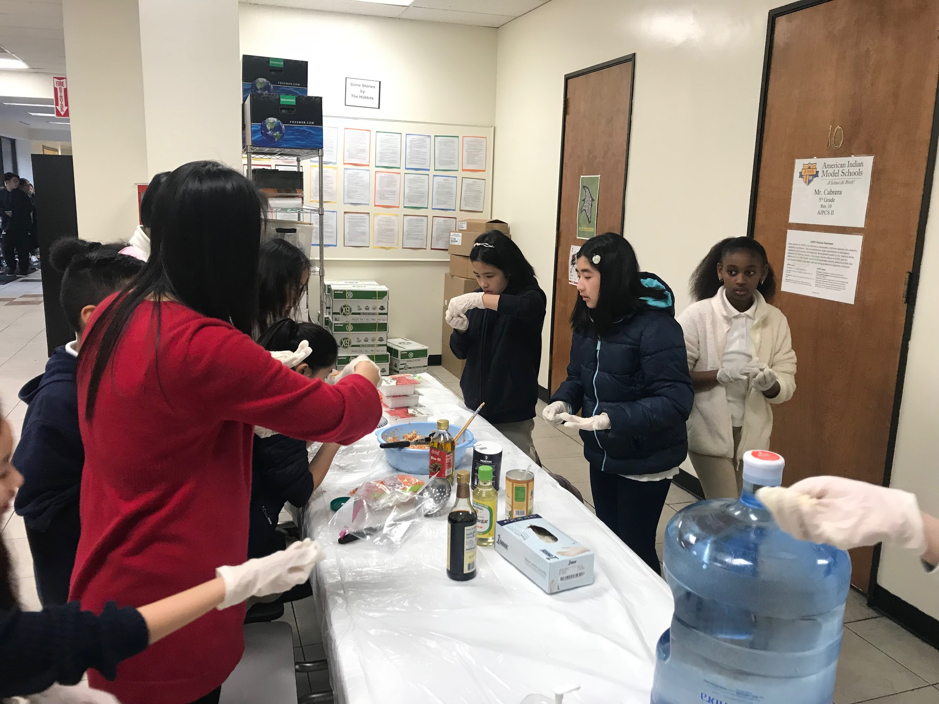
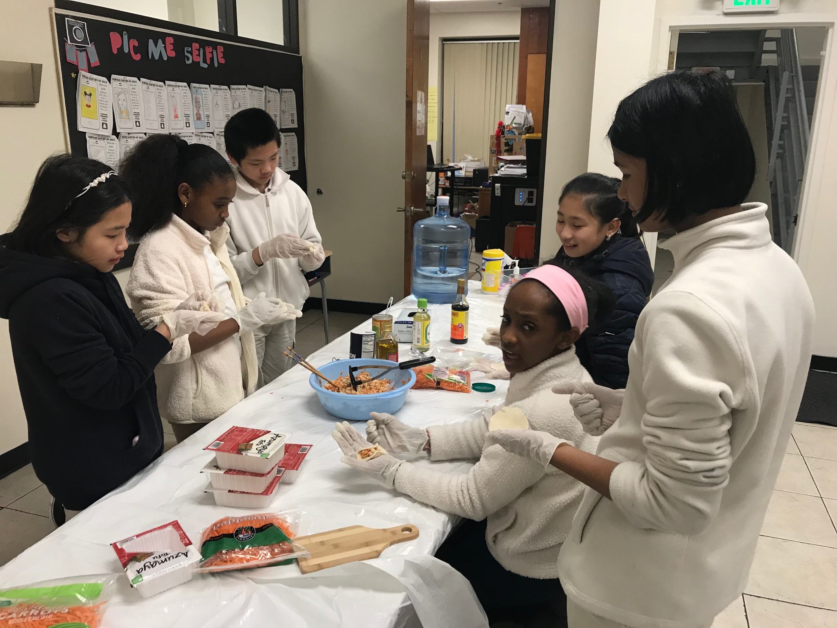
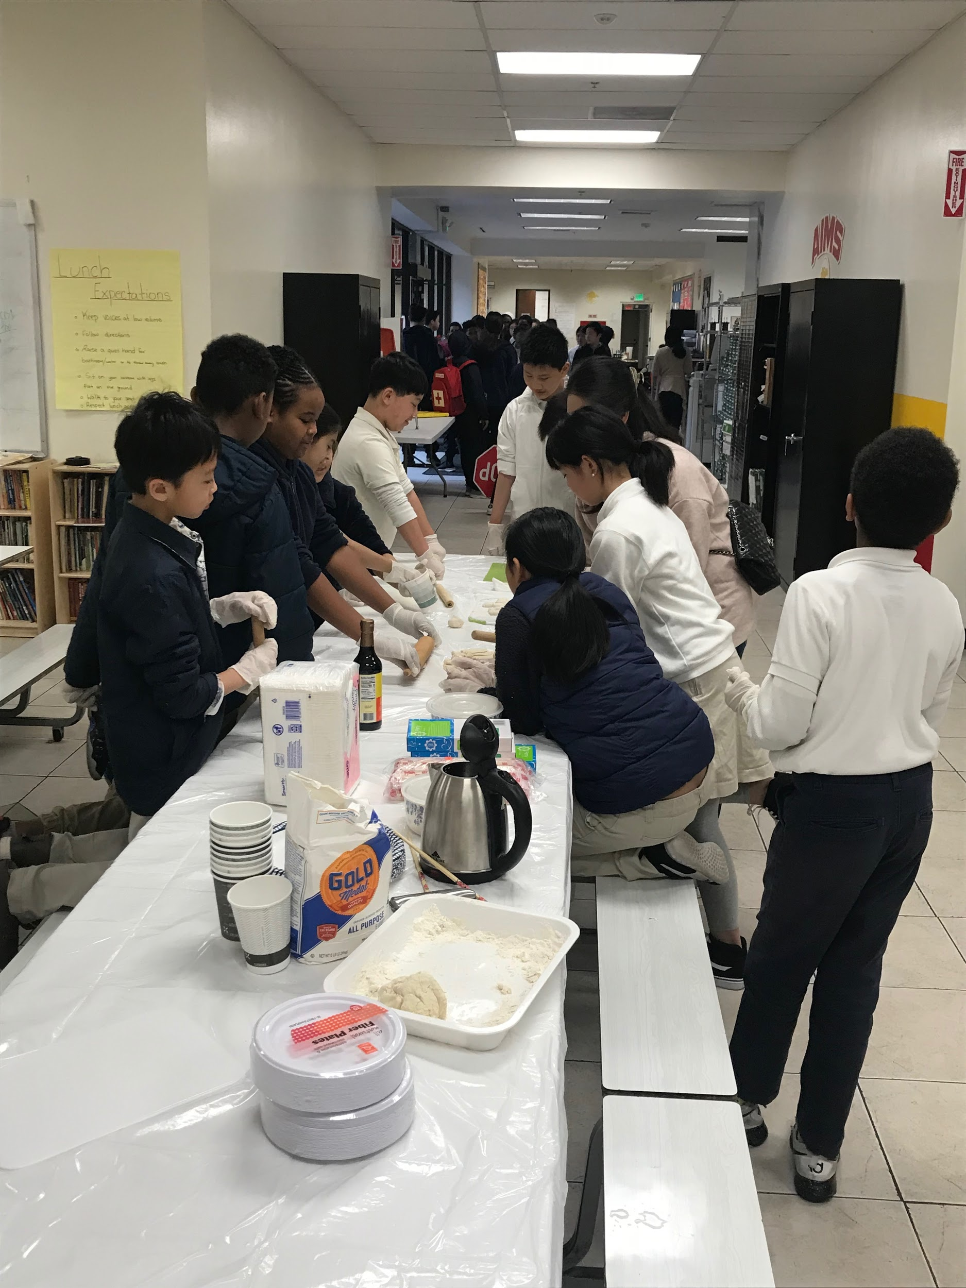
Lunar New Years

Slide 19
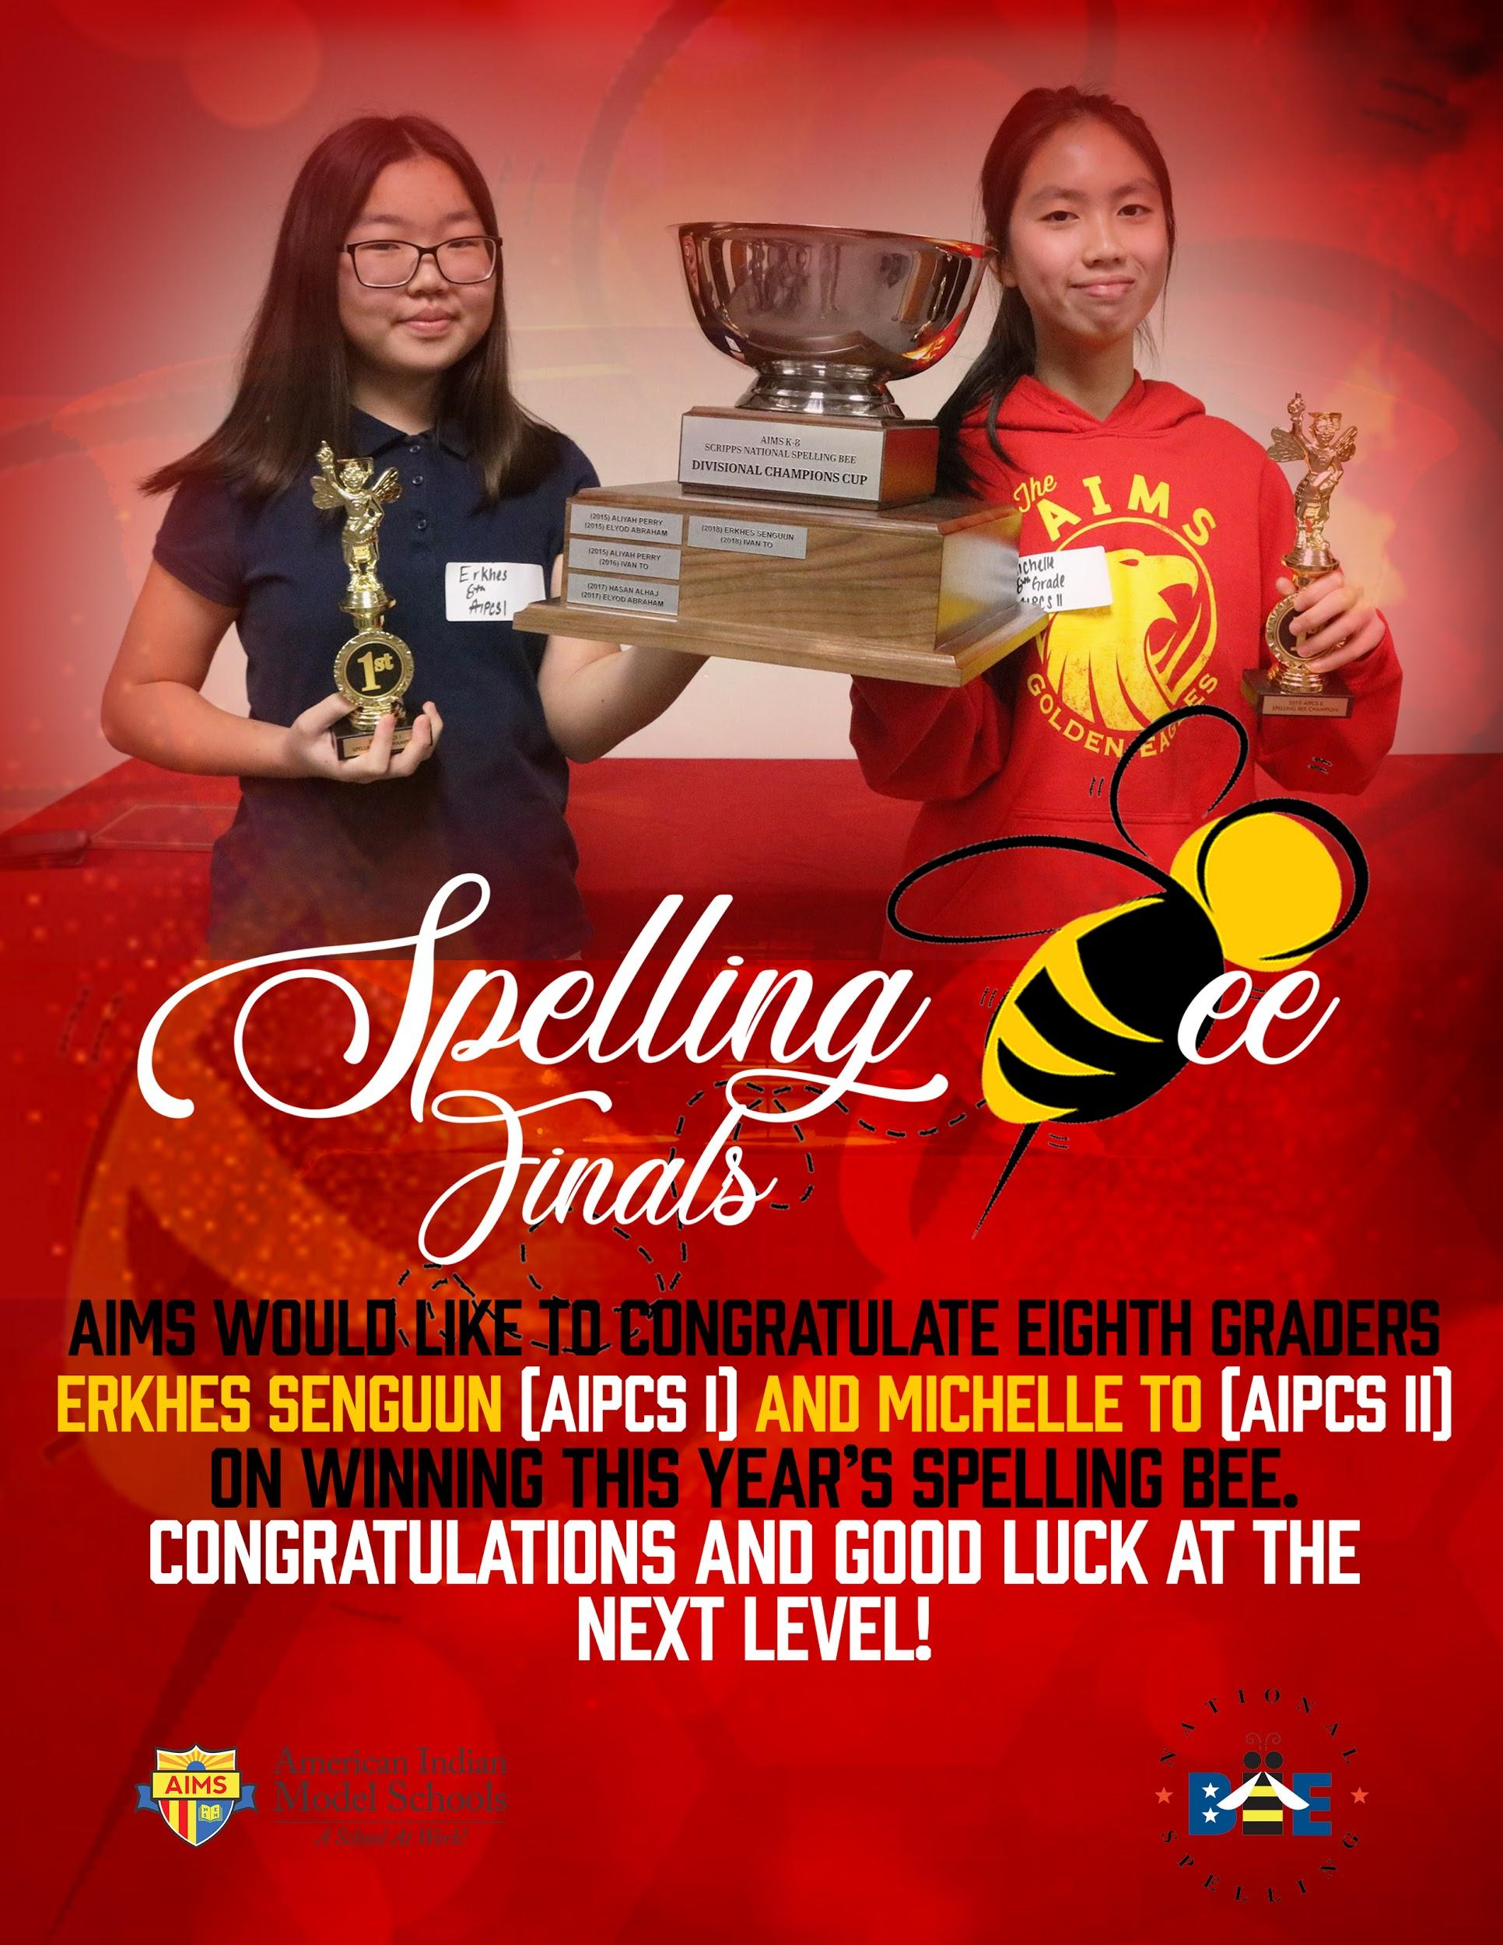
AIMS Spelling Bee Winners
Eighth graders Erkhes Senguun (Two-Time Winner) and Michelle To won this year’s Spelling Bee and will advance to the next round. Erkhes and Michelle’s names will be placed on our new AIMS Spelling Bee Cup of Champions, which lists our AIPCS I and AIPCS II winners since the 2014-2015 Academic School Year.

Slide 20
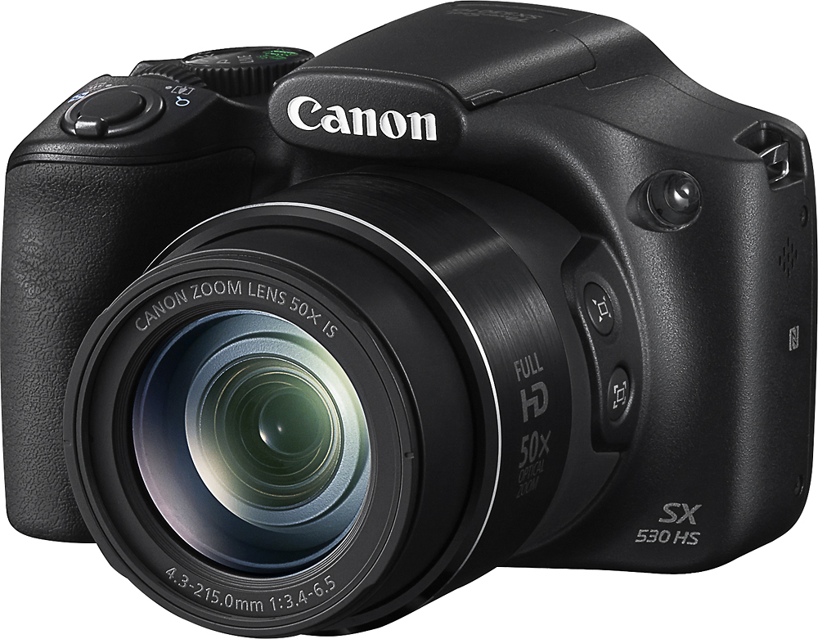
2017-2018 Measure G1 Grant
Update
Our order for a 22 iMac Computer lab has been processed and iMacs are slated to arrive by the end of this week at the earliest. Painting for the iMac computer lab will be completed by the first week of February.
About 85-90 8th grade students are currently taking our new Graphic Design class as part of their regular curriculum. Taught by Mrs. Suzen Chu, our 8th grade students will utilize the iMac lab exclusively for their graphic design class.
10 of 30 cameras for Measure G1 have been purchased for the film / photography elective class.

Slide 21
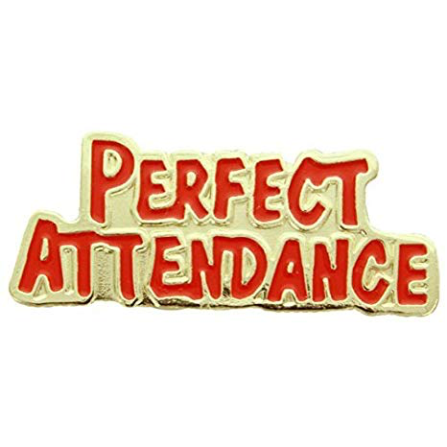
Other News
Khan Academy Competition: For the month of February, and to kick-off our SBAC Test Prep Season, AIMS 6-8 will hold a Khan Academy Classroom Challenge, to encourage all students to complete 100% of their grade level in KhanAcademy.
Perfect Attendance Challenge: In efforts to help increase our school attendance rate, AIMS 6-8 will hold a perfect attendance challenge for the month of February and beyond. The classrooms with the highest attendance and attendance rate increases will win prizes.

Slide 22
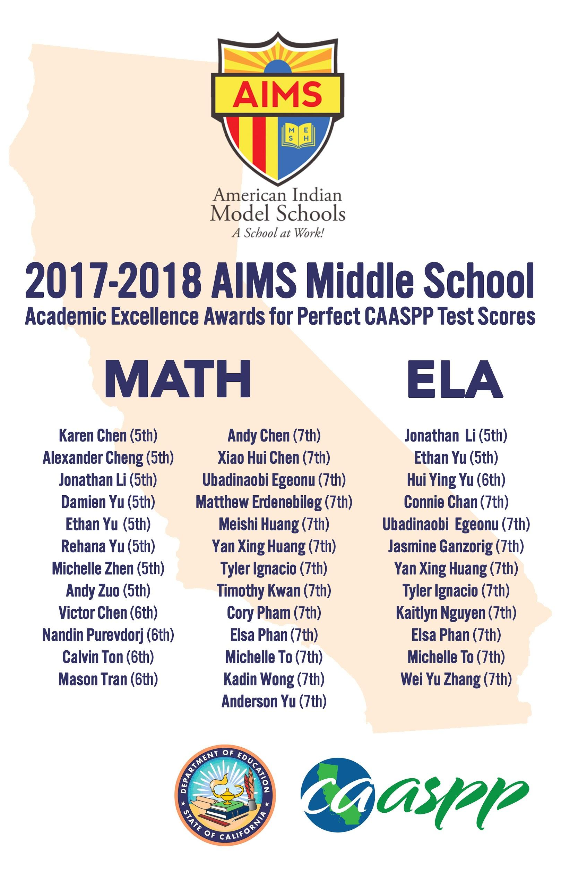
Other News (Continued)
SBAC Awards Ceremony: AIMS 6-8 Will recognize students that earned perfect SBAC scores in a ceremony this Friday, February 1, @ 10AM. Students with perfect SBAC Scores will receive medals and have their names listed on a banner.

Slide 23
2018-2019 AIMS 6-8 S1 Pass / Fail Data
(2018-2019) AIMS 6-8 S1 Fail / Pass Rates (Core Math / ELA Subjects Only) |  | (2018-2019) AIMS 6-8 S1 Fail / Pass Rates (All Subjects)
876 Instances | (91.25%) Instances of Passing Grades (Core Subjects) | 3115 Instances | (93.9%) Instances of Passing Grades (All Subjects)
85 Instances | (8.75%) Instances of Failing Core Grades | 205 Instances | (6.1%) Instances of Failing Grades
11 Students | (2.29%) MS Students are failing both core subjects | 47 Students | (9.79%)MS Students failing more than one subject
64 Students | (13.33%) MS Students are failing only one core subject | 79 Students | (16.46%)MS Students failing only one subject
75 / 480 Students | (15.63%) MS students are failing at least one core subject | 126 / 480 Students | (26.25%) of MS students are failing at least one subject
405 / 480 Students | (84.37%) of MS students are not failing any core subjects | 354 / 480 Students | (73.75%) of MS students are not failing any subjects

Slide 24
35 6th, 28 7th, and 22 8th Grade students have failed at least Math / ELA in S1.
Of these students, 47 are deemed the most critical (D and below in Math / ELA):
19 6th Graders, 17 7th Graders, 11 8th Graders. Preliminary Data suggests that most of the critical students have been at AIMS for less than 1-1.5 years.

Slide 25
Next Steps
All instructional Aides have increased their push-in / pull out schedules to target those that are most in need. Two additional staff members (5 total) are providing push-in / pull out support twice a week
Administration will begin issuing weekly Math / ELA benchmark assessments per grade level standard to help increase overall test preparedness / mastery of the Common Core standards
Saturday School efforts have increased to include more accountability for students to attend and careful monitoring of assigned work

Slide 26
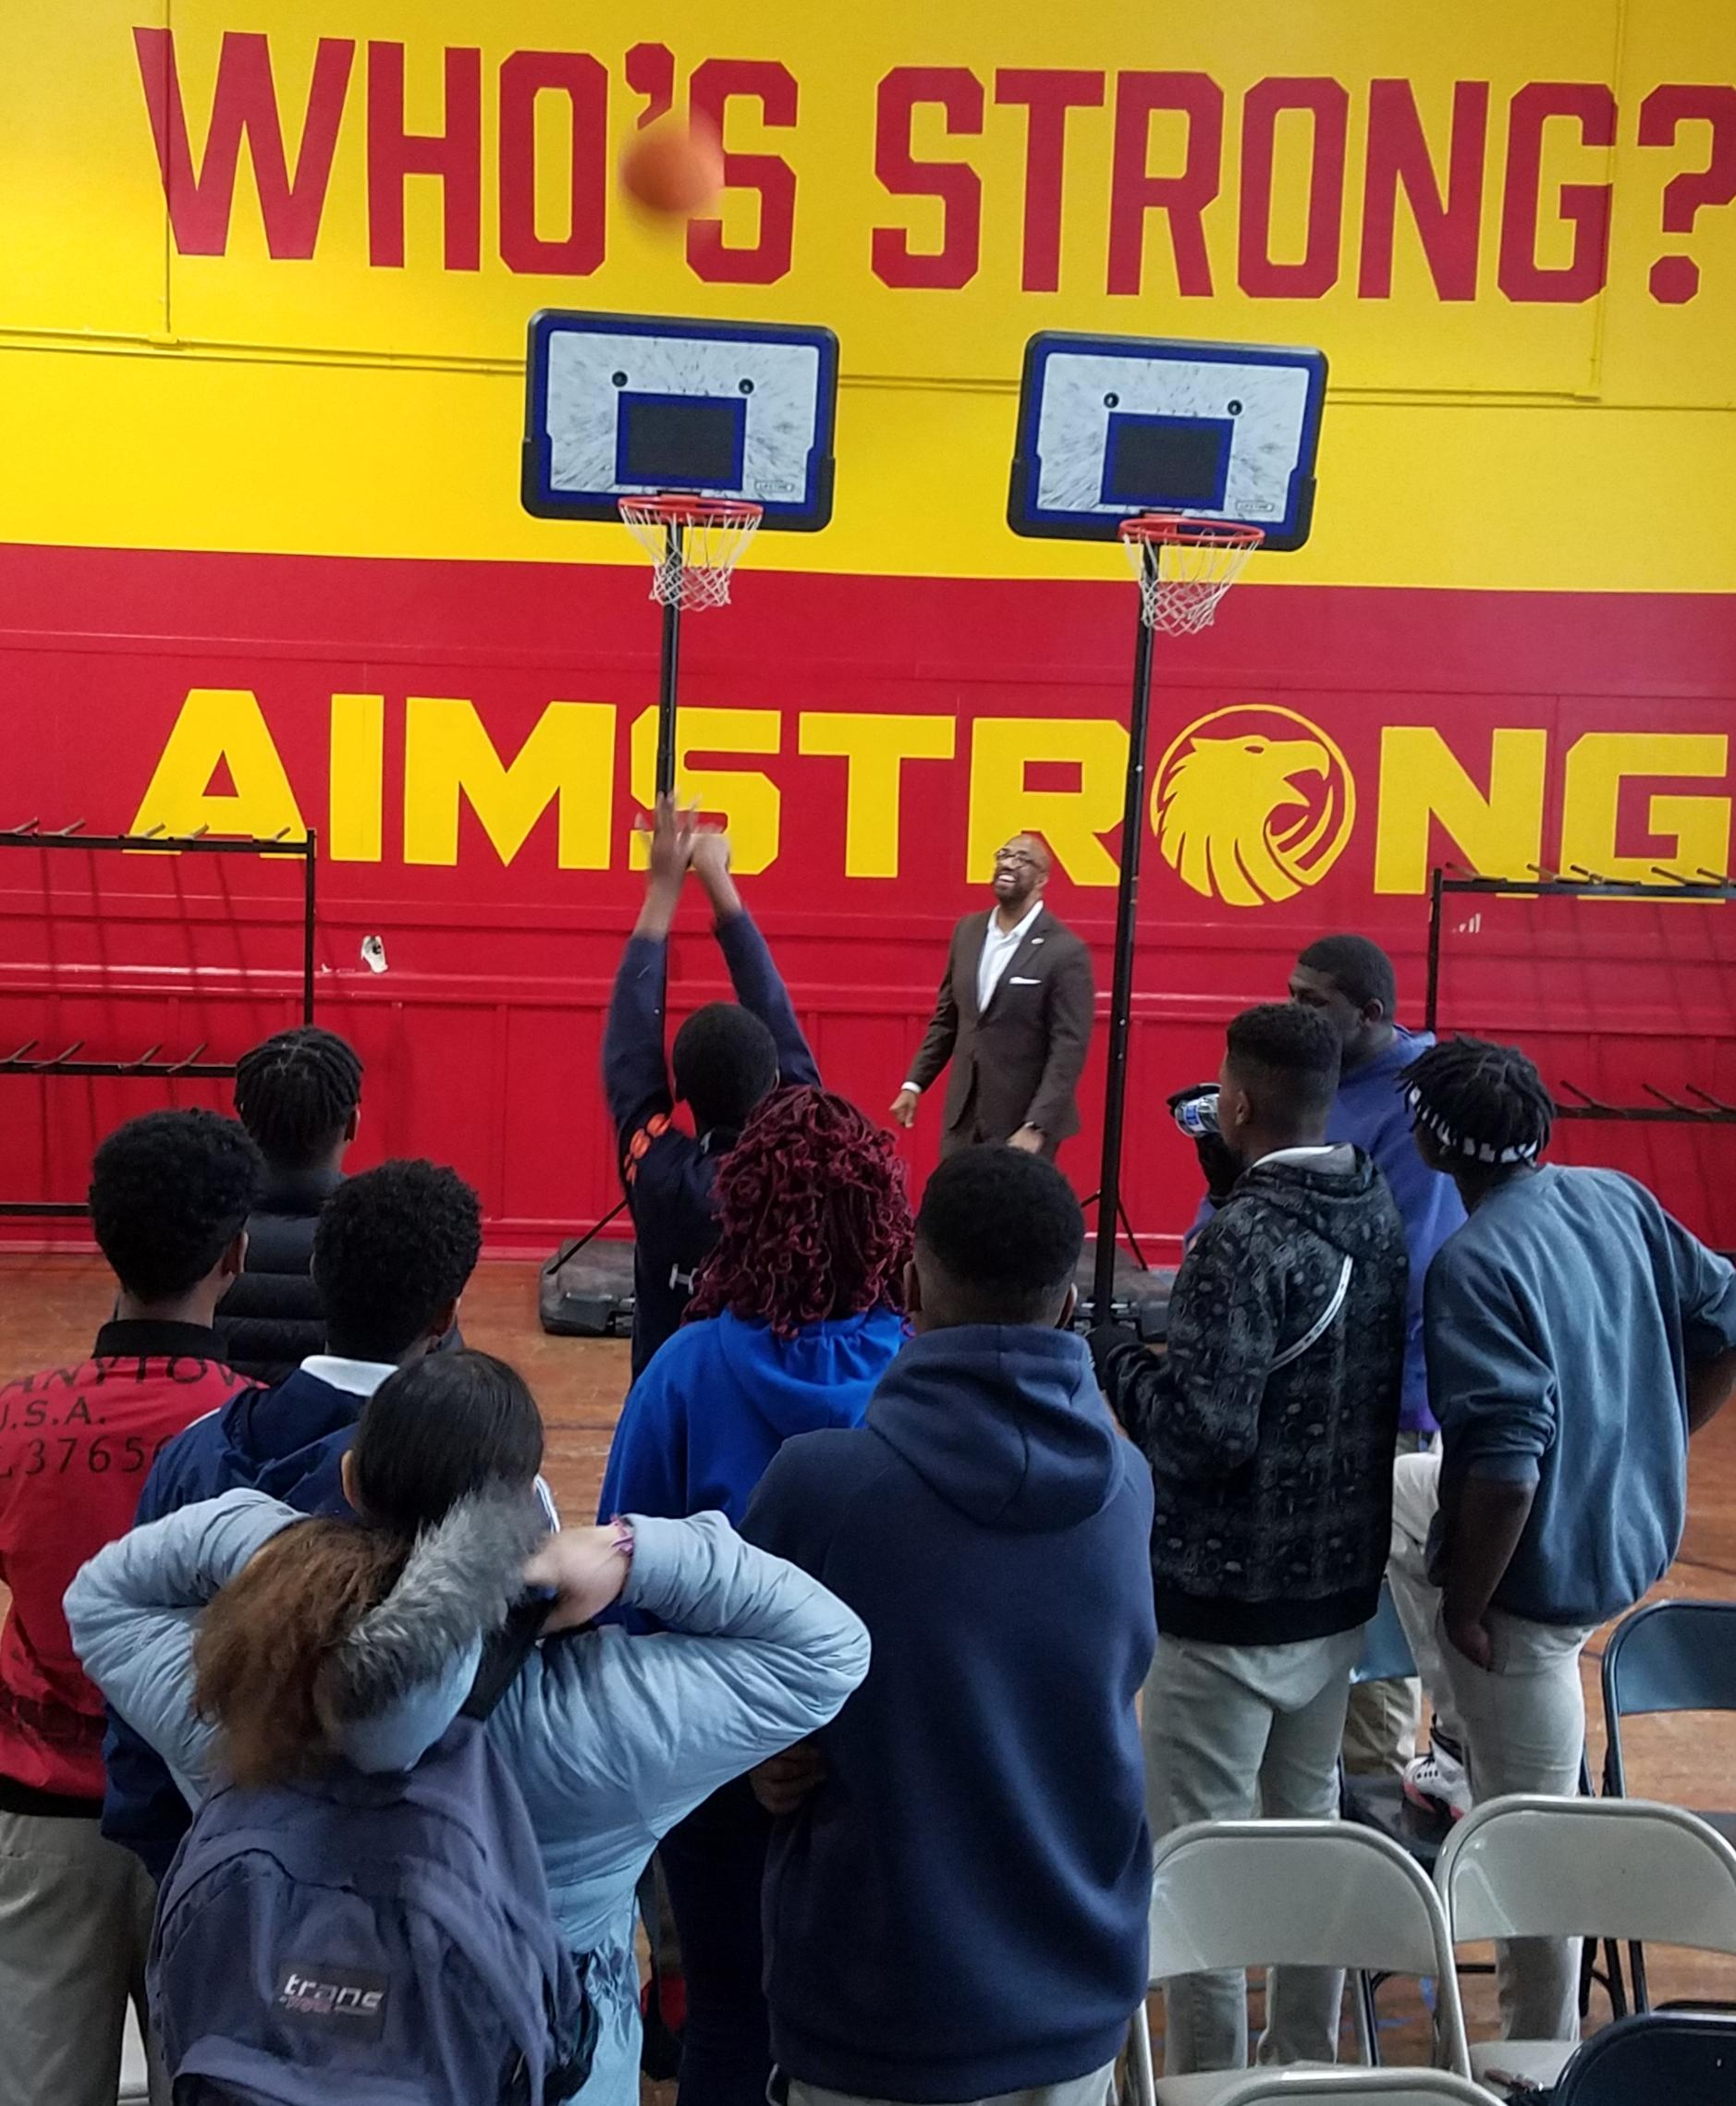
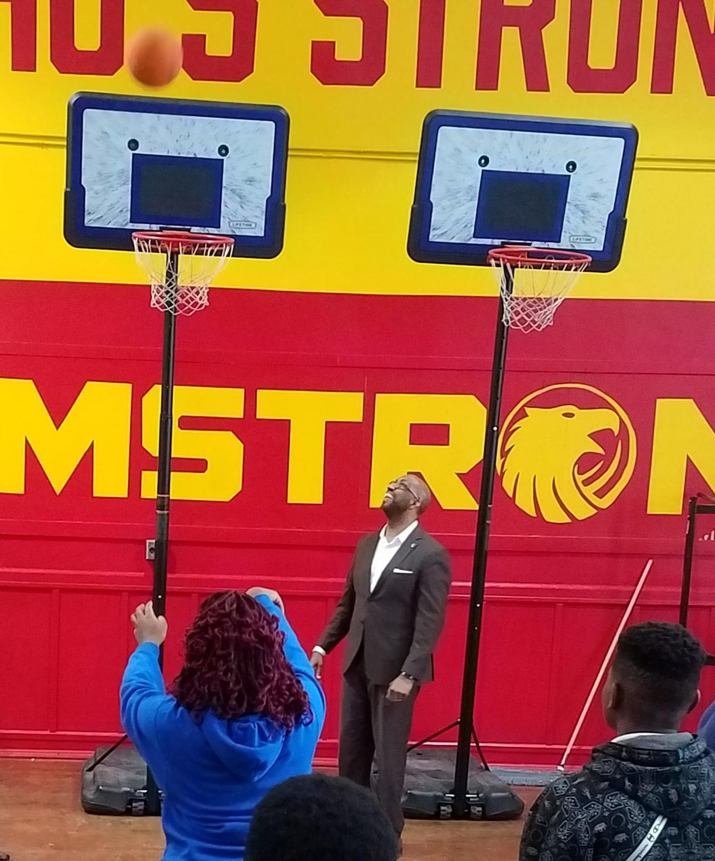
High School
While we are preparing for the WASC visit, we have been working on surveys and gathering data and evidence of completed requests from the WASC Committee. The next pages include several data charts.
We also had a visit from an HBCU President, Dr. Michael Sorrel, from Paul Quinn College (Dallas, TX). He spoke with a large number of Juniors and some Seniors. He also had a few of them prove their points literally at the basketball hoop. That is the kind of introductions he required of each student.

Slide 27
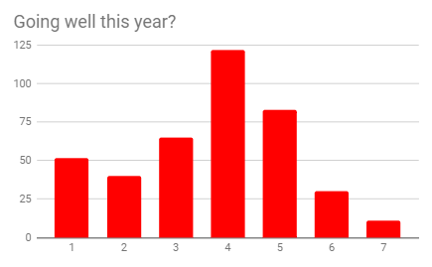
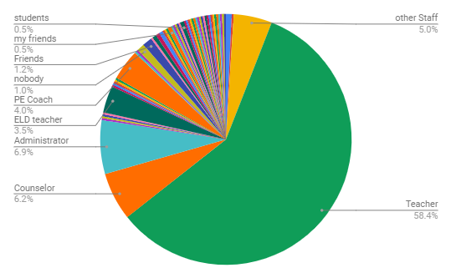
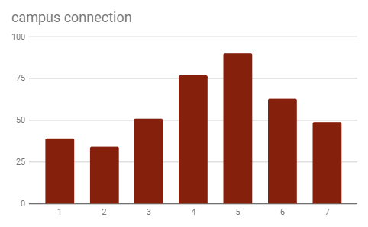
High School
These are some charts showing student response data for the 403 students who participated.
Notes:
Student Surveys - 403 respondents

Slide 28
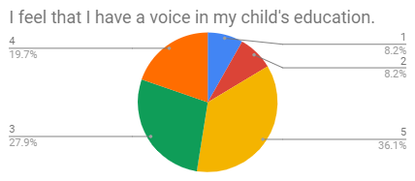
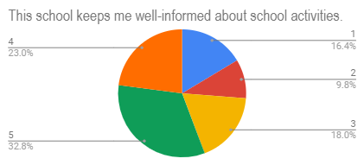
High School
These are a few charts from the parent survey questions.
Notes:
Parent surveys - 65 respondents. This survey was sent out by email and parent square. It was translated into Chinese, Arabic, Spanish, and Amharic.

Slide 29
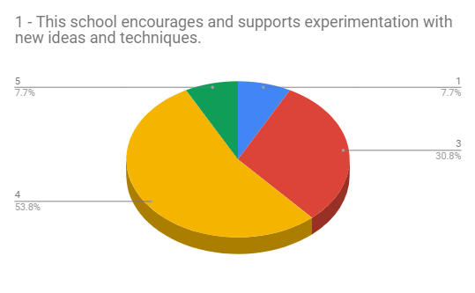
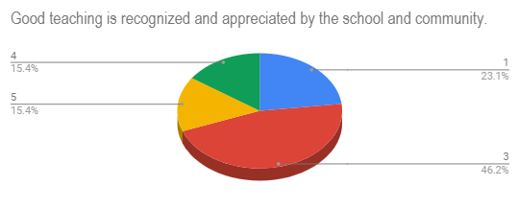
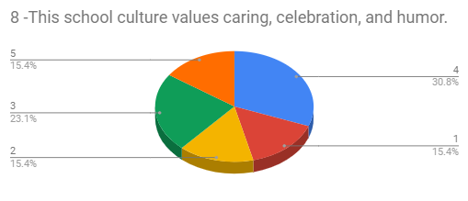
High School
These are a few charts from the teacher survey questions.
Notes:
Teacher surveys - There were 14 respondents.

Slide 30
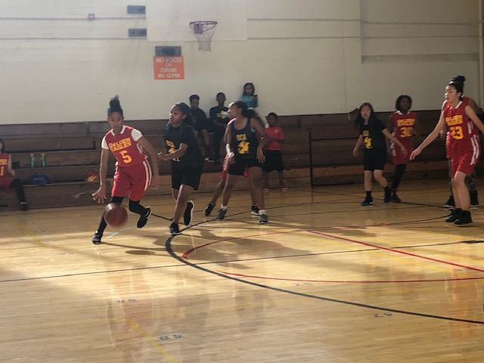
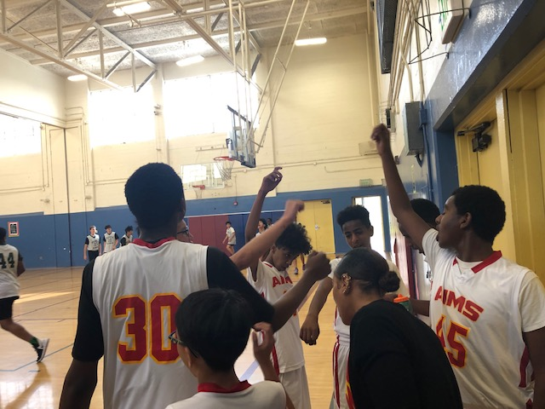
AIMS Middle School
Athletics Updates
AIMS Middle School’s first Basketball Season kicked off this past weekend as part of the City of Oakland’s Parks and Recreation League.
Of our 6 basketball teams, The 8th Grade A-Team defeated Downtown Charter Academy 63-24 and The 8th Grade Girls Team lost against Downtown Charter Academy 19-23. Our 6th/7th grade girls team defeated Green Leaf 20-19 in double overtime.

Slide 31
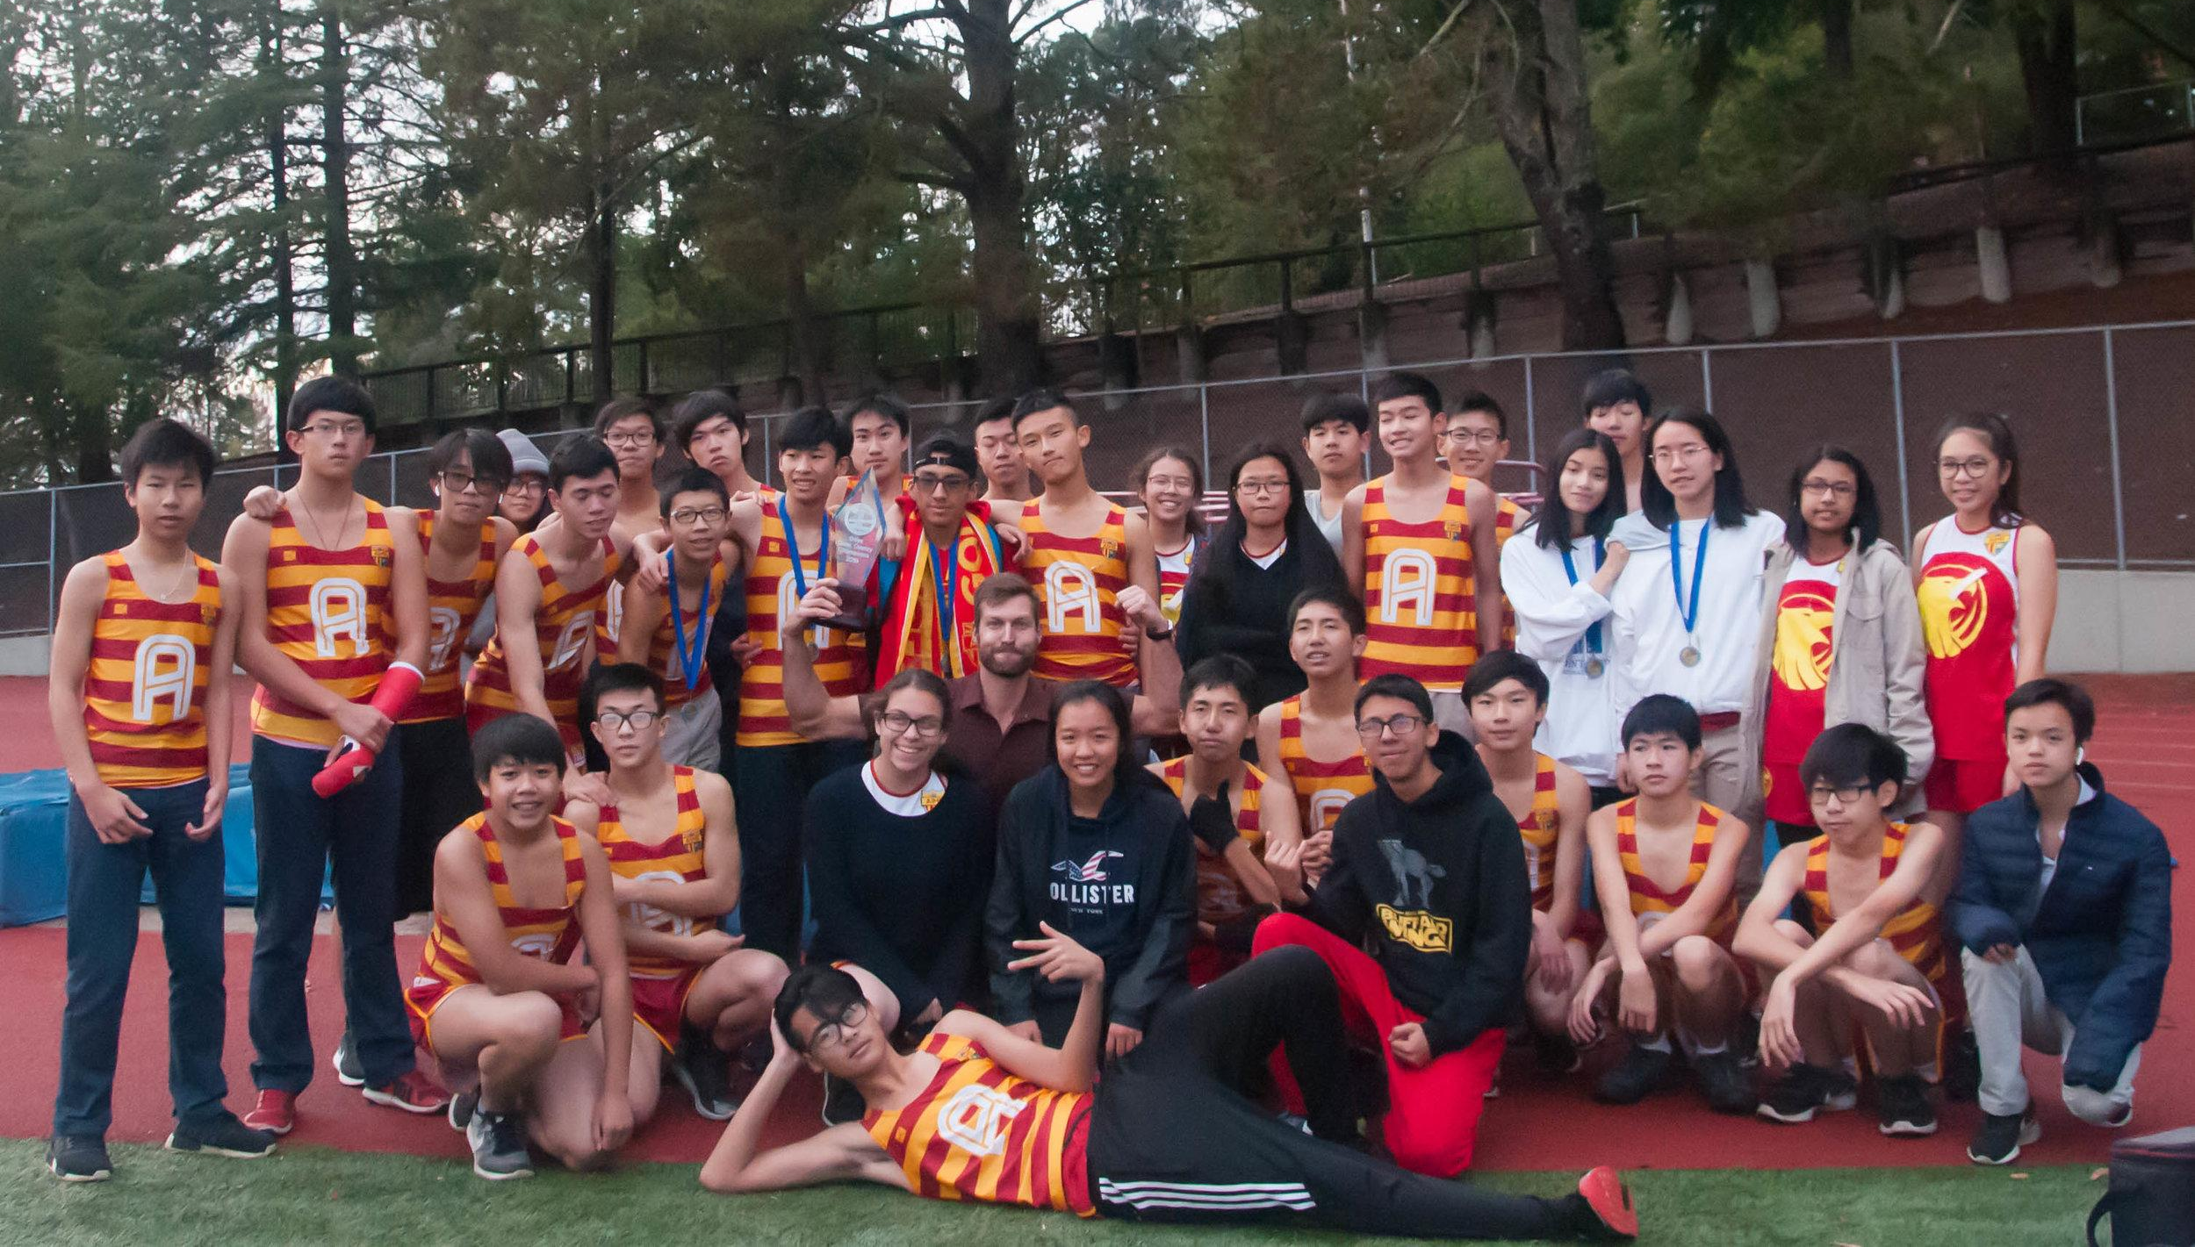
AIMS Athletics
Updates
Congratulations to the AIMS Boys Cross Country Team on Winning the BACSAC Championship.
The Girls Cross Country Team placed second in the championships.
5 AIPHS students received all-league honors in Cross Country, including Sophomore Xin Huang, who finished as the fastest female runner in the BACSAC Cross Country Championship.
The Cross Country Championship Banner, and the runner-up banners for the Girls Cross Country and Volleyball teams arrived and will be displayed in the AIPHS auditorium.

Slide 32
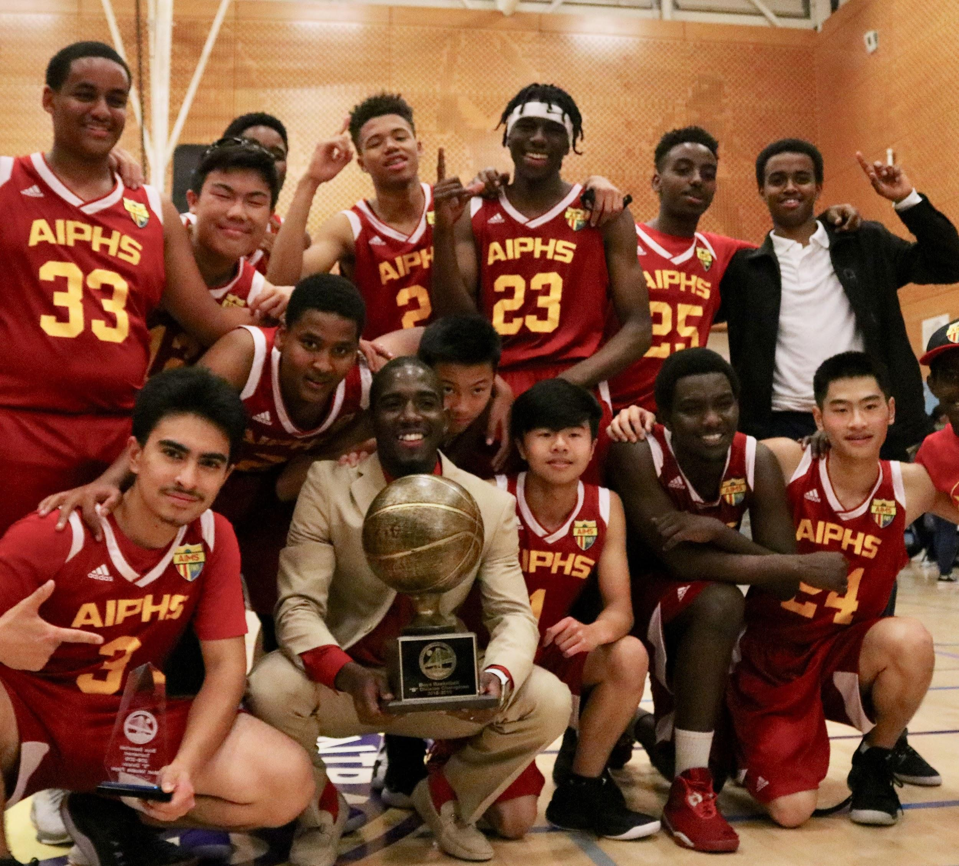
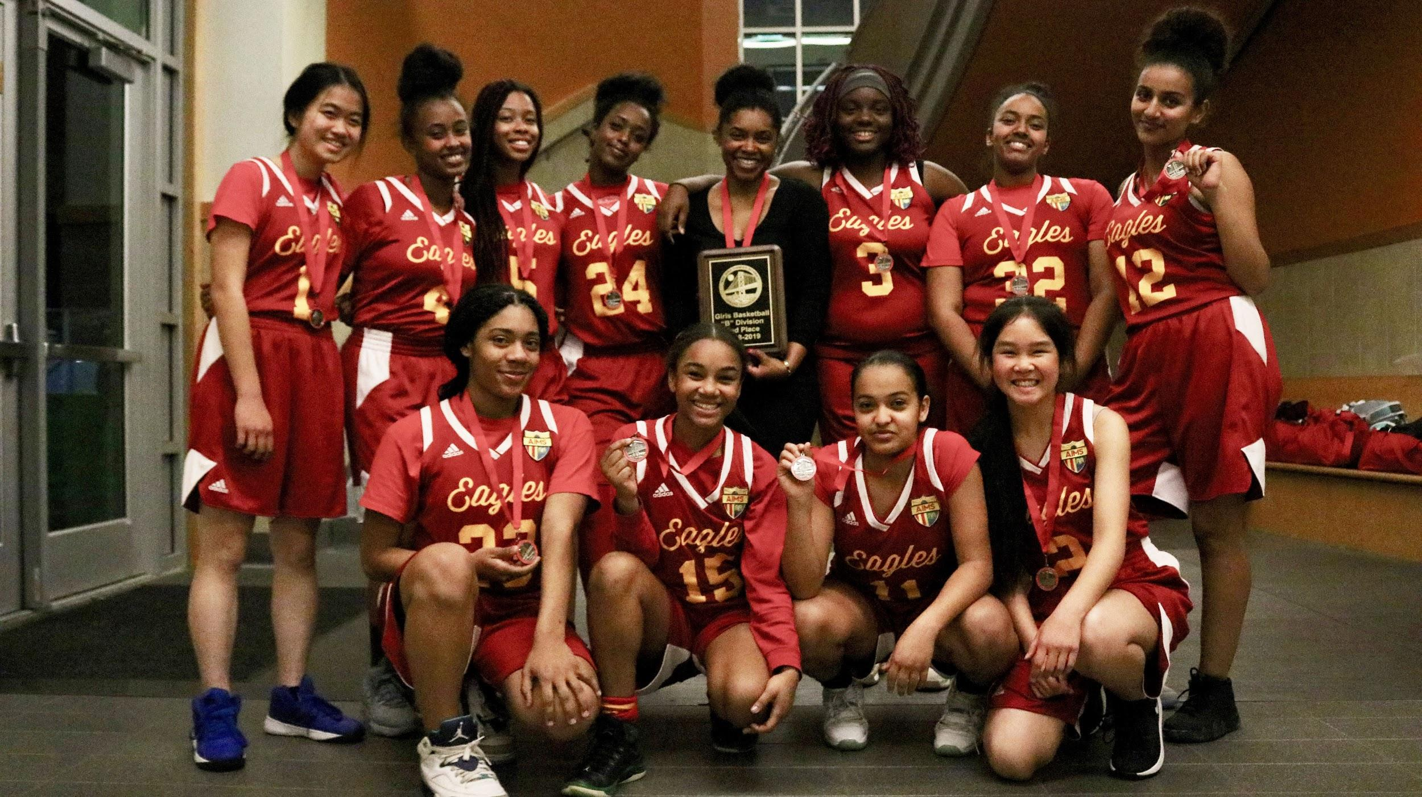
AIMS High School
Athletics Updates
The AIPHS Golden Eagles Basketball team capped their historic first season by defeating Richmond Cal Prep 77-57 to win the BACSAC Division B Championship. AIPHS Senior Van Gerald Del Valle was named the Tournament’s MVP for scoring 40 points in the playoffs, including a 20 point (6 three pointers, 1 field goal) performance in the Championship.
The Lady Eagles Basketball team advanced to the BACSAC Division B Championship, but finished in second place after losing to LPS Richmond 51-44.
Both the Boys and Girls teams will advance to the A Division next season.

