Slide 1
TEACH Las Vegas
FY2024 Tentative Budget Presentation – April 2023

Slide 2
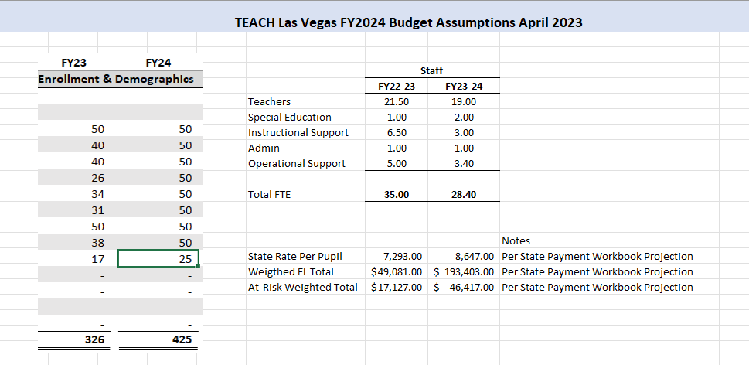

Slide 3
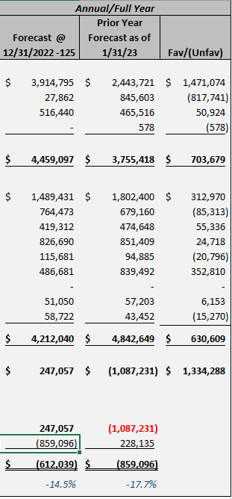
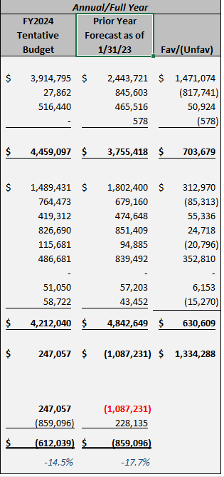

Slide 4
