Slide 1

ECR Marketing Presentation
Becky Rodriguez
02-15-2018

Slide 2
Background Building Blocks
Campus Action Steps
Community Action Steps
Collaborate with Administrators
Speak to ECR Staff
Meet with Student Council
Get to know the school & programs
Build Relationships (Board, Tech Team, Business Team, Deans, etc.)
Become familiar with community served
Meet neighborhood business owners
Identify potential resources
Connect with FOECR
Support Parent Engagement Activities

Slide 3
What is Marketing at ECR?
Marketing at the school site includes the following components:
Marketing is everything done to recruit.
Marketing encompasses student retention.
Marketing includes positive messaging.
Marketing can also involve philanthropic investments and requests.

Slide 4

Marketing Action Steps
Branding
Specific school colors used
  consistently
  Develop site letterhead
  Unify email signature
Recruitment Advertising
  Daily News Focus on Education
  52,000 Paid Circulation
  290,000 Readership
  Direct Mailers 3,000 local residents

Slide 5
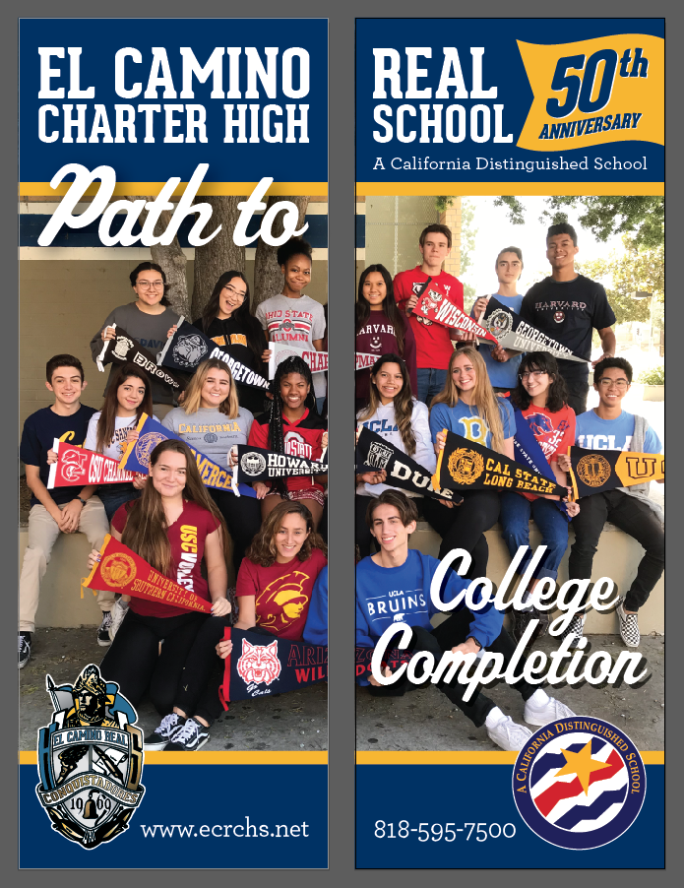


Recruitment & Messaging
Street Pole Panels

Slide 6
Recruitment Action Steps
Flyer to distribute to community businesses
Newsletter (weekly distribution via email)
Banners to Display in parking lot & inside campus
Total Recruitment Distribution | Non-Duplicated Distribution
27,775 | 6,555

Slide 7
Retention Action Steps
Student Centered Activities
  Grade Level Specific
  School Wide Engagement
  Student Clubs Involvement
Development of Parent Involvement
  Grade Specific Parent Summit/Event
  Leadership Development (ELL Parents, etc.)
  ECR Newsletter
Spirit Building Events
  Art Contest
  Cooking Contest
50th Anniversary Celebration
  Off site Gala
  On site Fair

Slide 8
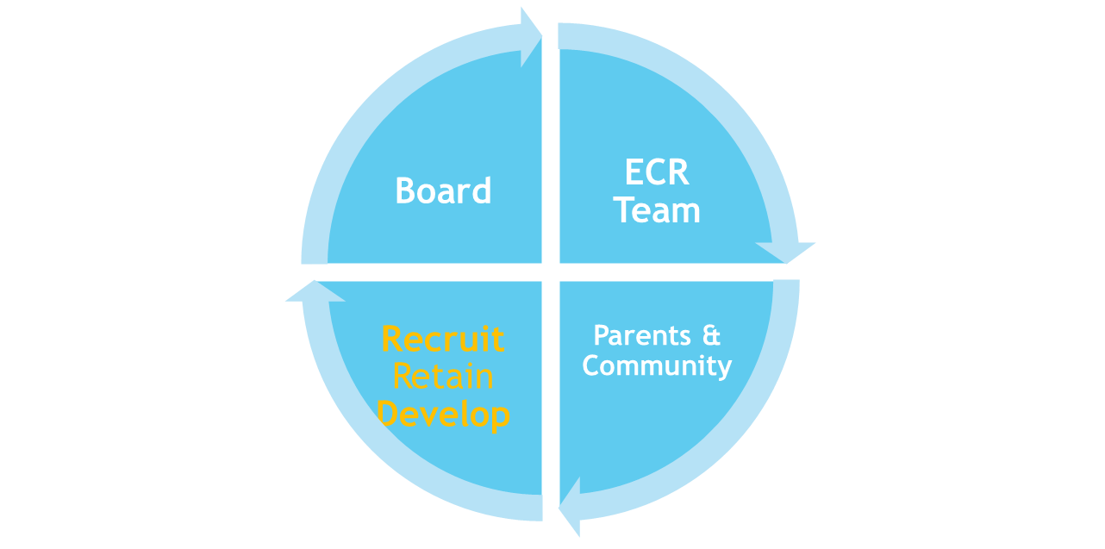
Funds Requests and Development
Board Collaboration and Connections
Organizational Donations
Endowments
Planned Giving
Marketing at ECR is a multi-dimensional approach that involves everyone

