Slide 1
El camino real alliance
Financial Audit Presentation
Fiscal Year Ending June 30, 2023
Presented By: vanessa pineda, senior director
01/25/2024

Slide 2
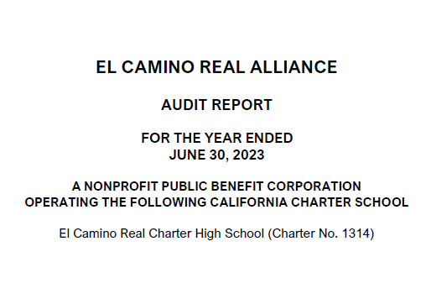
Audit Report
El Camino Real Alliance

Slide 3
Financial Statements
Financial Statements (with comparative totals from prior year)
Statement of financial position (balance sheet)
Statement of activities (income statement)
Statement of functional expenses
Statement of cash flows
Notes to financial statements
Supplementary Information
LEA Organization Structure – list administration and board of trustees
Schedule of average daily attendance (ADA)
Schedule of instructional time
Reconciliation of Annual Financial and Budget Report (Unaudited Actuals) with Audited Financial Statements
Schedule of Expenditures of Federal Awards

Slide 4
Audit Report
The Organization’s responsibilities:
Design and maintain effective internal controls
Preparation and ownership of financial statements
Prepare and manage the financials for continued operations
The Auditors’ responsibilities:
Provide an Opinion – reasonable assurance that financial statements are free from material misstatements
Reasonable assurance is a high level of assurance but not absolute assurance

Slide 5
Independent Auditors’ Report
Unmodified Opinion (Best Opinion Possible)
Page 1 of Audit Report (Paragraph 2) -
In our opinion, the financial statements referred to above present fairly, in all material respects, the financial position of El Camino Real Alliance as of June 30, 2023, and the changes in its net assets and its cash flows for the year then ended in accordance with accounting principles generally accepted in the United States of America.

Slide 6
Internal Control Over Financial Reporting
Financial Statements, Internal Control Over Financial Reporting with Government Auditing Standards:
Unmodified Opinion (Best Opinion Possible)
Our procedures include testing over Cash, Accounts Receivable, Capital Assets, Accounts Payable, Long-Term Debt and Journal Entry Process
Significant deficiencies – None Reported
Material weaknesses – None
Page 27

Slide 7
Additional Independent Auditors’ Report - Federal
Report on Compliance for Each Major Federal Program:
Unmodified Opinion (Best Opinion Possible)
Significant deficiency – None reported
Material Weakness – No

Slide 8
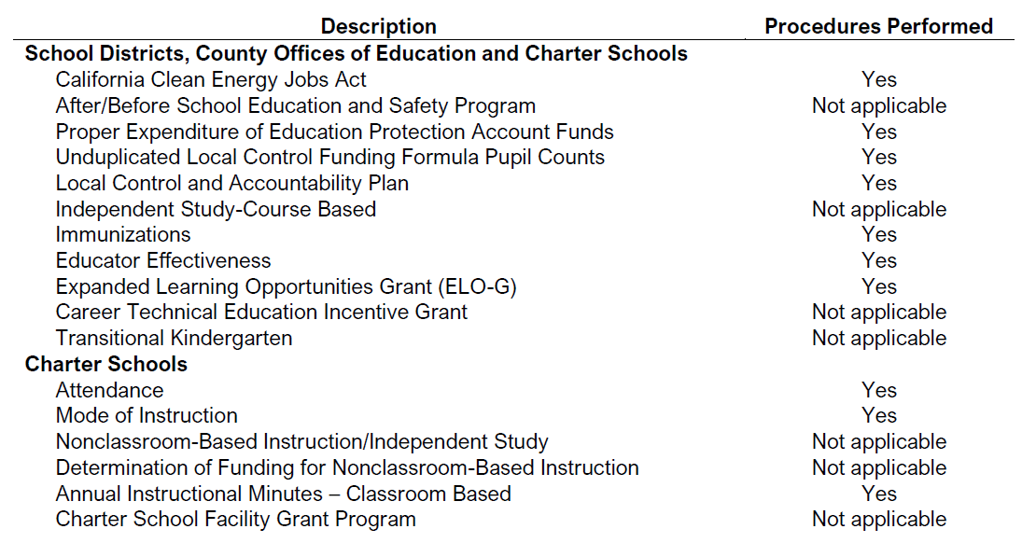
Additional Independent Auditors’ Report - State
Report on State Compliance:
Unmodified Opinion
(Best Opinion Possible)
Significant deficiencies – None Reported
Material Weaknesses – No
Any audit findings disclosed that are required to be reported in accordance with 2022-23 Guide for Annual Audits of California K-12 Local Education Agencies? - No
Page 33

Slide 9
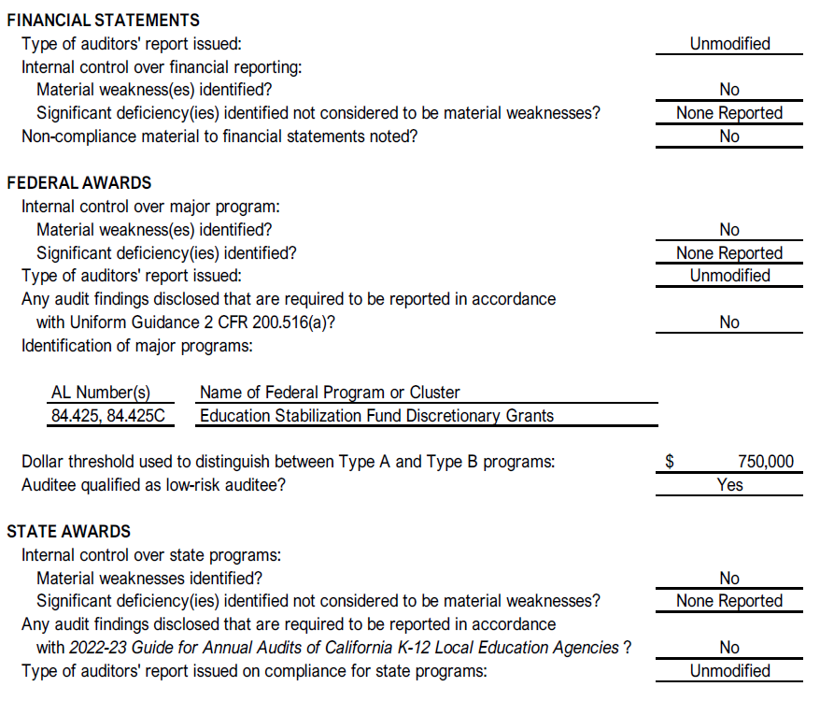
Summary of Auditors’ Results
Page 35

Slide 10
Other Key Points
Accounting Estimates – management’s estimate on useful life of depreciable assets and discount rates used for long-term contributions receivable
Sensitive Disclosures –net assets on Notes 7
Audit Adjustments – none noted
Difficulties, Disagreements, or Audit Findings/Issues – none
Management Representation – obtained a letter from management before finalizing

Slide 11
Thank you!
We appreciate the hard work put in by El Camino staff to complete the audit process!

