Slide 1
El Camino Real Alliance Healthcare Trust
March 23, 2023
U.S Bank Institutional Trust & Custody
Notes:
#usbankpresentations

Slide 2
Agenda
Introductions
Our commitment
Your Relationship Team
Trust and Custodial Services
Trustee Services
Pivot. Your Online Client Portal
U.S. Bank | Public Information

Slide 3
Our commitment to El Camino Real Alliance Healthcare Trust
We are deeply committed to your evolving needs and seek to expand our valued partnership through specialized support and strategic solutions to help you achieve your goals.
We will closely collaborate to deliver industry best practices, provide quality service and foster innovation to drive you forward — today and tomorrow.
3

Slide 4
Your relationship team
April Beauchamp
Vice President | Relationship Manager
415.246.6310
april.Beauchamp@usbank.com
Jeannette Simmons
Assistant Vice President/Account Manager
415.677.3681
jeannette.simmons@usbank.com

Slide 5
Trust and custodial services

Slide 6
Custody portfolio: Education
We’ve designed specialized custodial services to navigate the investment environment for educational institutions.
 | 171 | clients
 | $18.6B | total assets
 | $109.1M | average asset
 | $42.6M | median asset
 | $1.3B | max asset
$4.3B
market value for top five clients
Data as of 9/27/2022.
See end disclosures.

Slide 7
Trust services at a glance
Directed or Discretionary trustee services
.2
ERISA Pension and Health & Welfare
Reinsurance Trusts
Rabbi (Executive Deferred or Supplemental Compensation) Trusts
Governmental Trusts: Pension, VEBA, and OPEB
Environmental Remediation Trusts

Slide 8
Trustee Services
A trust is a standalone legal entity separate and apart from the plan sponsor. Primary responsibility of the Trustee is to hold plan assets in the best interest of plan participants and their beneficiaries
As a Directed Trustee, US Bank does not have investment discretion but rather relies on investment direction from the plan sponsor (with support from an investment consultant) or its investment managers while safeguarding plan assets in the interest of participants and beneficiaries.
Directed Trustee has defined fiduciary responsibility – adherence to terms of the Trust Agreement along with ERISA and IRS requirements for asset control for exclusive benefit of plan participants.
We are dedicated to fulfilling our fiduciary responsibilities in line with the following core principles:
Act in the sole interest of participants and beneficiaries
Act prudently and manage risk
Follow the terms of plan documents
Avoid conflicts of interest
Avoid engaging in transactions that benefit interested parties as a conflict of interest
Treat beneficiaries with impartiality
All assets must be registered in the name of and controlled by the Trustee (ownership and control safeguard)
An institutional trustee has the legal, risk, and compliance infrastructure to properly execute its responsibilities in a changing regulatory and market landscape. Individuals or Boards of Trustees assume personal fiduciary responsibility for their actions as trustees.
An institutional trustee has insurance and the financial strength of the bank to support its efforts
8

Slide 9
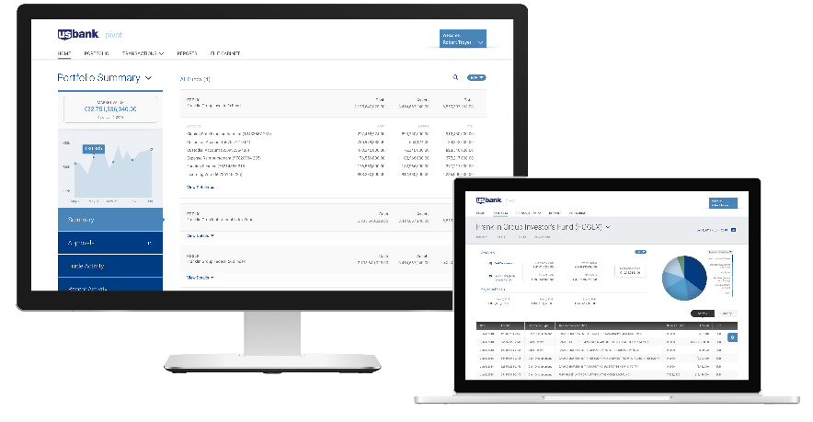
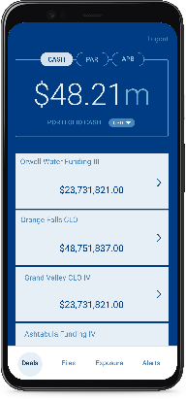
Pivot. Your online client portal
Delivering an unmatched user experience through customized data and analytics that helps you make critical decisions with confidence
[U.S. Bank is] arguably the most forward-thinking major financial institution in the United States.
As described by
Bank Innovation
Adaptive
Digital workflows
Real time activity
Data transparency

Slide 10
Thank you

Slide 11
Important disclosures
U.S. Bank National Association is a wholly-owned subsidiary of U.S. Bancorp.
U.S. Bank does not provide legal or tax advice. Furthermore, this document is not intended to provide legal, tax, or investment advice; does not take into account your particular situation or needs; and should not serve as a primary basis for any decision you might make. While it may illustrate banking services, this document is not a service contract or even an offer to enter into a service contract. If you have questions about your fiduciary, tax, investment, or other duties under state or federal law, including under the Employee Retirement Income Security Act of 1974, as amended, or under securities law, or about entering into a service contract in connection with such duties, you should consult your legal counsel.
Important Information about Procedures for Opening a New Account: To help the government fight the funding of terrorism and money laundering activities, federal law requires all financial institutions to obtain, verify and record information that identifies each person who opens an account. What this means for you: When you open an account, we will ask for your name, address, tax identification number, and other information that will allow us to identify you. We may also ask for identifying documents.
Deposit products offered by U.S. Bank National Association. Member FDIC.
Investment products are:

