Slide 1
El Camino Real Charter
High School
Governance Training
Presented by: Jerry W. Simmons
jsimmons@mycharterlaw.com

Slide 2
Overview
Areas Covered:
Compliance with the Brown Act and SB 126 (Ed. Code 47604.1) requirements
Compliance with conflict of interest laws (Government Code 1090 and Political Reform Act)
What Board members need to know about Public Records Act requests
Best governance practices
Major board duties under nonprofit law
Financial issues/use of public funds
Q & A
2

Slide 3
Disclaimer
This webinar cannot substitute for personalized legal advice.
Presenters may be working from home and apologize in advance for any child or canine interruptions. Thank you for your patience.
Our advice is based upon the latest available guidance which is subject to change in this ever-evolving landscape.
During the webinar and after we are happy to answer questions as time permits.
Sign up for our legal alerts on our website to receive updated information on the topics discussed today: www.mycharterlaw.com.
3

Slide 4
Education Code Section 47604.1

Slide 5
Education Code 47604.1
Charter School Transparency Law
Effective January 1, 2020
Charter schools and entities managing/operating charter schools must comply with Public Records Act, Brown Act, Political Reform Act, and Government Code 1090.
5

Slide 6
Education Code 47604.1
Location for charter school board meetings:
Single charter school: shall meet within the boundaries of the county in which the charter school is located.
6

Slide 7
Education Code 47604.1
Allows an employee of a charter school to be on the charter school board as long as they abstain from voting on or influencing or attempting to influence another member of the governing body regarding, all matters uniquely affecting that member’s employment.
But extreme caution required due to vague way that statutory language was crafted and the need to comply with other laws.
7

Slide 8
Understanding the Brown Act

Slide 9
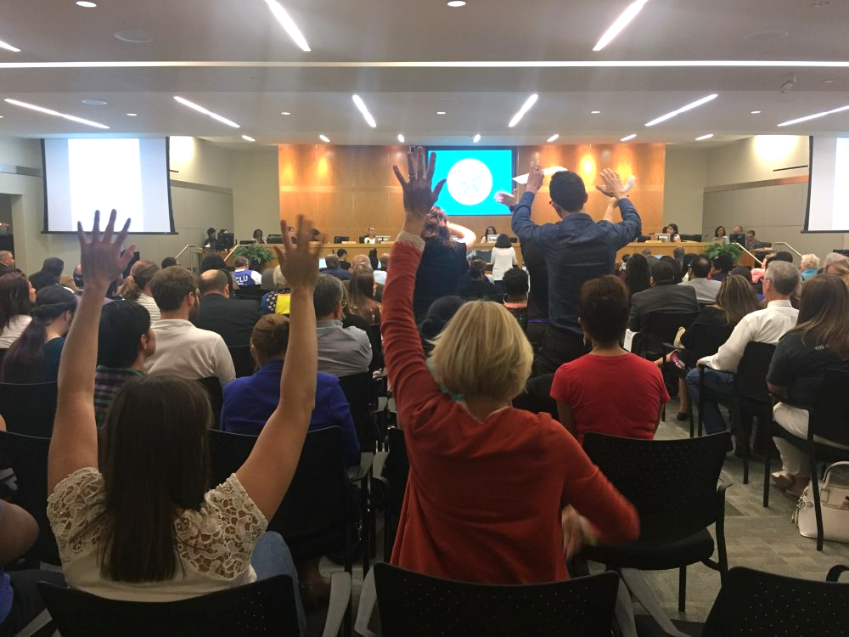
Purpose of The Brown Act
What Is the Purpose of the Brown Act?
To Foster Broad Public Access
“. . . The people of this State do not yield their sovereignty to the agencies which serve them. The people, in delegating authority, do not give their public servants the right to decide what is good for the people to know and what is not good for them to know. The people insist on remaining informed so that they may retain control over the instruments they have created.”
9

Slide 10
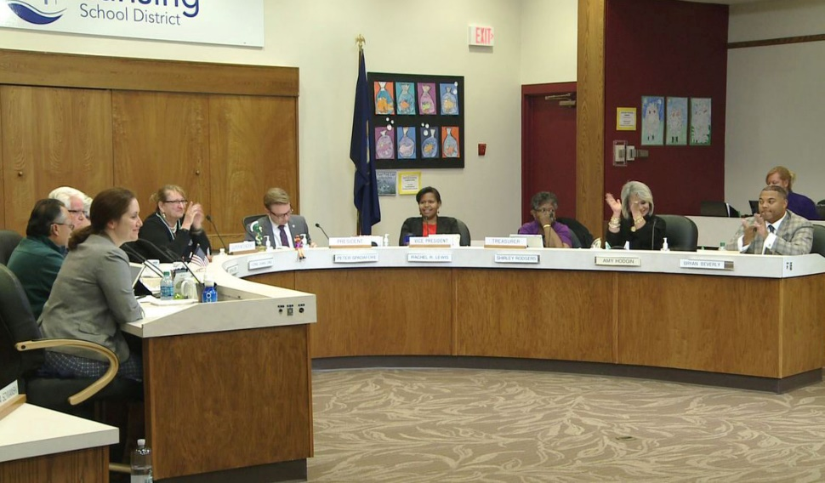
Meetings
Brown Act Applies to Meetings of the Board
Basic Definition
When any congregation of a majority of the members of the body meet to hear, discuss, deliberate, or take action on any item of Charter School business
10
10

Slide 11
Meetings
Board Committees - Nearly all Committees Must Comply with the Brown Act
Exception
A Committee that is all of the following:
Advisory (not decision making)
Composed of only Board members
Less than a quorum of the Board
Must not be a standing committee
11

Slide 12
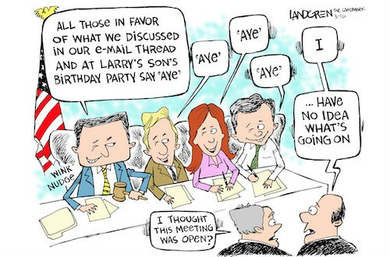
Meetings
Serial Meetings
Serial Meetings Are Prohibited
Majority of Board members
Engaging in a series of communications
Outside Board meeting
Through direct communications or intermediaries or technology
To discuss, deliberate, or take action on any item of business (including relaying comments or position of other Board members)
12

Slide 13
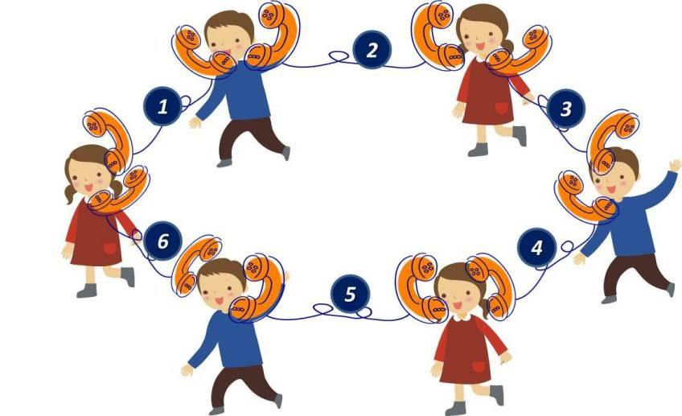
Meetings
Serial Meetings
Hub or Chain
Technology may result in meetings at times you might not expect
E-mails
Text messages
Social media
Website postings
Online forums
Telephone calls
Faxes
13

Slide 14
Meetings
Serial Meetings
Limit on One-Way Communications
While an employee or official may engage in separate conversations or communications with other members of the Board in order to answer questions or provide information regarding a matter of Charter School business, that person may not communicate to members of the Board the comments or position of any other member or members of the Board.
14

Slide 15
Meetings
Teleconference Meetings
Six Additional Requirements:
Agenda must be posted at all teleconference locations.
2. Each teleconference location must be identified in the notice and agenda of the meeting.
15

Slide 16
Meetings
Teleconference Meetings (cont’d)
3. All votes taken must be by roll call.
4. Each teleconference location must be accessible to the public. (ADA-compliance required.)
5. Members of the public must be able to hear and must have the right to address the Board directly from each teleconference location.
6. A quorum of the Board must participate from within the Charter School’s “jurisdiction.” For Visions, this would be Sacramento County.
16

Slide 17
AB 361
Pursuant to AB 361 (October 1, 2021), a charter school board may continue to hold teleconference meetings without adhering to some of the traditional requirements of the Brown Act. If certain conditions are met, a charter school board may continue to meet virtually with the following flexibilities:
The agenda does not need to provide notice of each teleconference location nor do agendas need to be posted at each location;
A quorum of board members do not need to be located within the Charter School’s jurisdiction; and
Governing board members may participate in a teleconference meeting from places that are not publicly accessible.
17

Slide 18
AB 361
A charter school board may continue to hold teleconference meetings without adhering to all of the traditional requirements of the Brown Act under the following circumstances:
During a proclaimed state of emergency; and
State or local officials have imposed or recommended measures to promote social distancing; or
The charter school board determines that meeting in person would present imminent risks to the health or safety of attendees.
18

Slide 19
AB 361
If meeting pursuant to AB 361, the board must:
Protect the statutory and constitutional rights of the parties and public appearing before the board.
Give notice and post agendas as otherwise required under the Brown Act.
Allow members of the public to access the meeting (e.g., Zoom) and describe the manner in which the public can offer public comment.
Not require members of the public to submit comments in advance of the meeting. The public must be able to participate in real time.
Provide a timed or a reasonable period for public comment.
If there is a technical disruption in the meeting broadcast, take no further action on items in the agenda until public access is restored.
19

Slide 20
AB 361
In order to continue holding meetings pursuant to AB 361, the board must make the following findings by majority vote every 30 days:
The charter school board has reconsidered the circumstances of the state of emergency.
Any of the following circumstances exist:
The state of emergency continues to directly impact the ability of the members to meet safely in person.
State or local officials continue to impose or recommend measures to promote social distancing.
20

Slide 21
Notice Requirements
Notice and Agendas
General Rule: The agenda shall be posted properly in advance of a meeting and must include a brief description of items to be transacted or discussed.
With a few exceptions, if an item is not on the agenda, the Board cannot discuss it.
21

Slide 22
Notice Requirements
Contents
Brief description = usually not more than 20 words
How to request disability-related accommodation
Location for inspection of docs distributed to Board
22

Slide 23
Notice Requirements
When?
Regular meetings – 72 hours notice
Special meetings – 24 hours notice
Emergency meetings – 1 hour notice (rare)
Where to Post?
Physically at a publicly accessible location within the jurisdiction during the entire posting period
On the website homepage with a prominent, direct link
23

Slide 24
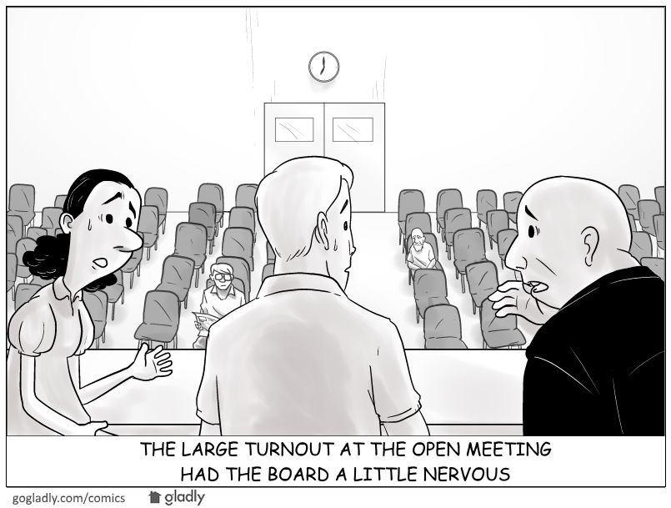
Rights of the Public
Rights to Enable Access and Participation
Give oral testimony at meeting
Time limits
Addressing disruptive speakers
New law (SB 1100)
Virtual meetings and best practices (stay in control of your meeting!)
Audio record and broadcast
24

Slide 25
Rights of the Public
Rights to Enable Access and Participation (cont.)
Limitations on conditions of public attendance
Non-discriminatory facilities (reasonable accommodations under ADA)
Copies of agendas and other public writings
25

Slide 26
Closed Sessions
What Are the Permissible Closed Sessions?
Pending/Anticipated Litigation (conference with legal counsel)
Personnel (appointment, employment, evaluation, discipline, dismissal)
Caveat: 24-hour written notice to employee is required if Board will hear complaints and/or charges
26

Slide 27
Closed Sessions
What Are the Permissible Closed Sessions? (cont.)
Conference with Real Estate Negotiator
Conference with Labor Negotiator
Public Security
Pupil Discipline (Education Code)
27

Slide 28
Closed Session
Requirements
Use “Safe Harbor” agenda language (GC 54954.5)
Prior to Closed Session:
Board Must Make a Public Announcement of Reasons for Closed Session Prior to Closed Session
Public Must Have an Opportunity to Comment
After Closed Session:
Board Must Make a Public Report of Action Taken in Closed Session and Vote or Abstention of Every Board Member
Attendance only for necessary personnel
Confidentiality is required
28

Slide 29
Executive Compensation
Executive Compensation
Approval of CEO/Executive Director’s compensation must occur at a regular (not special) meeting
Govt. Code 54953: Prior to final action, Board must orally report a summary of the recommendation for final action, including the salary, salary schedule, and fringe benefits, during the open meeting where final action will be taken.
Final action in open session
29

Slide 30
Enforcement
Complaints and Challenges
Notice of Concern
Often brought by Charter Authorizer
Short turnaround to respond
Seek advice from legal counsel on response
Notice and Demand for Cure or Cease and Desist
Can be brought by DA or member of the public
Board must cure/respond within 30 days
Seek advice from legal counsel on response
30

Slide 31
New Legislation Pending
Additional potentially significant changes to teleconferencing requirements passed by Legislature and on Governor’s desk (AB 2449). In some respects they are more lenient than the “normal” rules. In some respects they are more restrictive.
Will update school leaders via our legal alert system if signed by the Governor.
31

Slide 32
Enforcement
Complaints and Challenges
Notice of Concern
Often brought by Charter Authorizer
Short turnaround to respond
Seek advice from legal counsel on response
Notice and Demand for Cure or Cease and Desist
Can be brought by DA or member of the public
Board must cure/respond within 30 days
Seek advice from legal counsel on response
Public Records Act

Slide 33
Public Records Defined
Public Records
“Includes any writing containing information relating to the conduct of the public's business prepared, owned, used, or retained by any state or local agency regardless of physical form or characteristics.” (Govt. Code § 6252)
33

Slide 34
Public Records Defined
Writing
“Any handwriting, typewriting, printing, photostating, photographing, photocopying, transmitting by electronic mail or facsimile, and every other means of recording upon any tangible thing any form of communication or representation, including letters, words, pictures, sounds, or symbols, or combinations thereof, and any record thereby created, regardless of the manner in which the record has been stored. ” (Govt. Code § 6252)
34

Slide 35
Exceptions to Disclosure
Pending Litigation (Gov. Code Section 6254(b)):
Only During Ongoing Litigation
More than Just Privileged Information/ Documents
35

Slide 36
Exceptions to Disclosure
Personnel, Medical, or Similar Files (Gov. Code Section 6254 (c)):
Drafts of Memorandum Not Kept for Business (Gov. Code Section 6254(a))
36

Slide 37
Exceptions to Disclosure
Records Exempted by Federal or State Law (Gov. Code Section 6254(k)):
HIPAA
Privileged
FERPA
37

Slide 38
Exceptions to Disclosure
Catchall Exception (Gov. Code Section 6255(a)):
Weighing test: The Public Interest of Disclosure vs. the Importance of Confidentiality
38

Slide 39
Records Not Exempt
Public Employment Contracts
Public Employee’s Name and Salary
Most Email Communication
39

Slide 40
Waiver of Exemptions
Whenever a local agency discloses a public record which is otherwise exempt from disclosure, to any member of the public, this disclosure shall constitute a waiver of the exemptions specified in Sections 6254, 6254.7, or other similar provisions of law. (Govt. Code § 6254.5)
40

Slide 41
Response to Public Records Act Request
Timeline
Response Within 10 Days from Receipt of the Request
10-Day Deadline Can Be Extended Up to 14 Additional Days in “Unusual Circumstances
Must Make Reasonable Effort to Elicit Additional Clarifying Information to Identify Records
41

Slide 42
Ten-Day Letter
Must Include
Whether the Request, in Whole or in Part, Seeks Copies of Disclosable Public Records in the Possession of the School
The Date When the Records will be Made Available (Reasonable Time)
42

Slide 43
Ten-Day Letter
Determining Time Frame
Do You Need to Search For and Collect Records?
Is There a Large Volume of Records Being Requested?
Do You Need to Consult with Attorneys?
Do You Need Time to Compile Data?
43

Slide 44
City of San Jose v. Superior Court (Smith)
Landmark California Supreme Court Opinion In March 2017
“Employees’ communications about official agency business may be subject to the CPRA regardless of the type of account used in their preparation or transmission.”
44

Slide 45
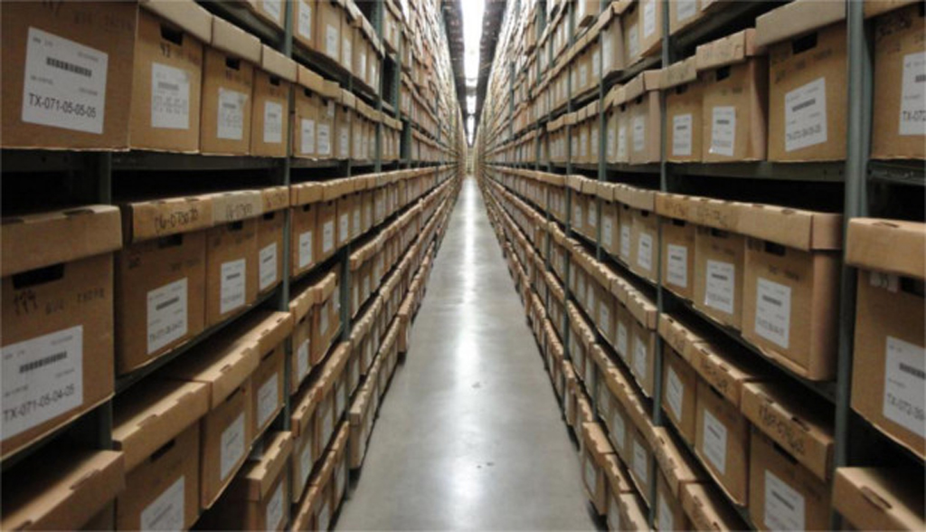
Relating to the Conduct of the Public’s Business
Must relate in some substantive way to the conduct of the public’s business. It often depends on the context. The court gave us factors to consider…
45

Slide 46
Factors
Content
Context and Purpose
Audience to Whom it was Directed
Was it Prepared by an Employee Acting or Purporting to Act within the Scope of His or Her Employment?
46

Slide 47
Board Best Practices
47

Slide 48
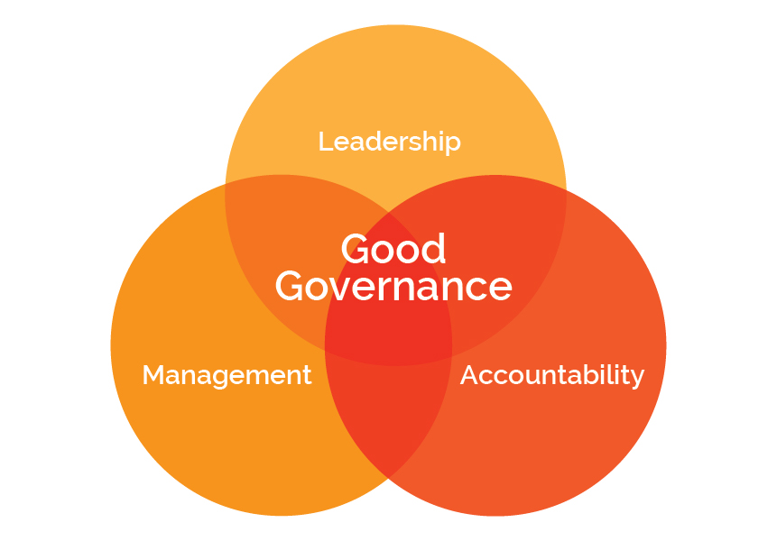
Why is Governance Important in Charter Schools?
Charter Schools are overseen by Authorizing School Districts and must be renewed to continue to operate and can be closed down if not operated correctly.
Charter Schools must operate at a certain level to be renewed.
Charter Schools use public funds to educate students.
Despite successes, Charter Schools still receive extreme scrutiny and unfounded criticisms.
48

Slide 49
Board Duties v. Executive Director Duties
The Board of Directors GOVERNS while the Executive Director MANAGES.
The purpose of governance is oversight of the Executive Director.
The purpose of managing is to make the school perform, on a day-to-day basis, at the highest possible level.
How WELL is the school performing? v. How WILL decisions get made?
49

Slide 50
Case Study
BOARD MEMBER WHO IS AN HR EXPERT VISITS THE SCHOOL SITE AND PROVIDES POINTERS TO TEACHER DURING CLASSROOM VISIT.
50

Slide 51
An Effective Board
The Board uses a single point of delegation and accountability for operations (Executive Director).
Board members are independent of the Executive Director and are responsible for oversight.
Board members are aware of and adhere to board policies, the bylaws, and the charter.
51

Slide 52
Case Study
PARENT SUBMITS COMPLAINT ABOUT TEACHER TO INDIVIDUAL BOARD MEMBER.
52

Slide 53
An Effective Board
Recognizes that every Board member is one vote, and no decision is made individually.
No Board members’ vote is worth more than another’s.
Chairperson has procedural authority.
Every Board member owes a duty of loyalty to the corporation – which means the vote of the majority of the Board.
53

Slide 54
Case Study
BOARD MEMBER WHO WAS OUT-VOTED ON STUDENT UNIFORM POLICY SETS UP ANTI-UNIFORM PETITION DRIVE IN FRONT OF LOCAL MARKET.
54

Slide 55
The Board as a Team
When is it appropriate for a single Board member to act on behalf of the Board?
What do individual Board members say when questioned about the Board’s actions?
55

Slide 56
Utilize Time Effective and Efficiently
How do agendas get prepared?
What do you spend most of your time doing at your meetings?
How do you prepare for meetings?
How do you know if you are a healthy board?
56

Slide 57
Financial Issues/Use of Public Funds
57

Slide 58
Money Matters
All public funds must be utilized to support a “public purpose”
Reasonably determined and must be of a benefit to your students
Watch out for private inurement
LCFF supplemental and concentration grant funds must be spent in accordance with each school’s LCAP plan
Charter schools (and their staff and Board members) are held accountable for the use of funds, and misuse can result in serious penalties – possible revocation of charter and in some cases, criminal charges.
58

Slide 59
Potential Criminal Liability
Watch out for potential criminal liability or media/authorizer criticism arising from expenditures of public funds for these types of activities:
First or Business Class Travel
Wine, Beer or Alcohol
Expensive Meals, Hotels, entertainment
Expenditures Not Directly Related to School Purposes
59

Slide 60
Potential Criminal Liability
Travel for Staff or Board Members Not Directly Related To School Purposes
Gifts
Purchasing Personal Items (Clothes, jewelry)
Large employee expense accounts can sometimes lead to trouble
Bonuses paid to employees in the form of gift cards
Payments to vendors with familial ties to charter school employees
60

Slide 61
Internal Controls
One key to fraud detection and deterrence is proper internal controls
Opportunity is created when internal controls are weak, there is a lack of oversight, or ineffective governance
Consult with your independent auditor regarding best practices
Obtain legal review, as well
Ensure Board knows it is ultimately responsible for everything that happens in the school
Conduct training for Board members and employees
61

Slide 62
Developing Appropriate Safeguards
The Top Ten Internal Controls Your School Must Have
Checks and balances through proper segregation of duties
Reconciliation reports should be issued and reviewed/approved timely by management.
Do not allow school credit cards, or strictly control them
Board of Directors oversight, especially of Executive Director/Principal expenses
Fiscal policies and procedures
62

Slide 63
Developing Appropriate Safeguards
Limits on use of school assets
Strict controls on petty cash funds and other cash funds
Protect checks against fraudulent use
Protect cash and check collections through solid internal controls
Avoid related party transactions
63

Slide 64
Understanding Conflict of Interest Laws
64

Slide 65
Conflicts of Interest
Broad Definition
A conflict of interest arises when an individual who has a private financial interest in the outcome of a corporate contract or a public decision, participates in the decision-making process or influences or attempts to influence others making the contract or decision.
In short, a conflict of interest is a clash between an individual’s duty to his or her office and his or her personal interests.
65

Slide 66
Non-Financial Conflicts-of-Interest
Prohibition Against Conflicts of Interest
Public official engaging in transaction or influencing decision.
Creating an appearance of impropriety (financial interest not necessarily required)
Doctrine of Incompatible Offices
Public official holding two public offices simultaneously
Offices are incompatible with each other (creating divided loyalties); overlapping jurisdictions
66

Slide 67
Financial Interests
Common Types of Financial Interests Regulated by Conflict Laws
Ownership or investment in business entity
Investment in real property
Source of income
Source of gifts
Effect on personal finances
Financial interests of immediate family members of Board Members and employees typically are covered.
67

Slide 68
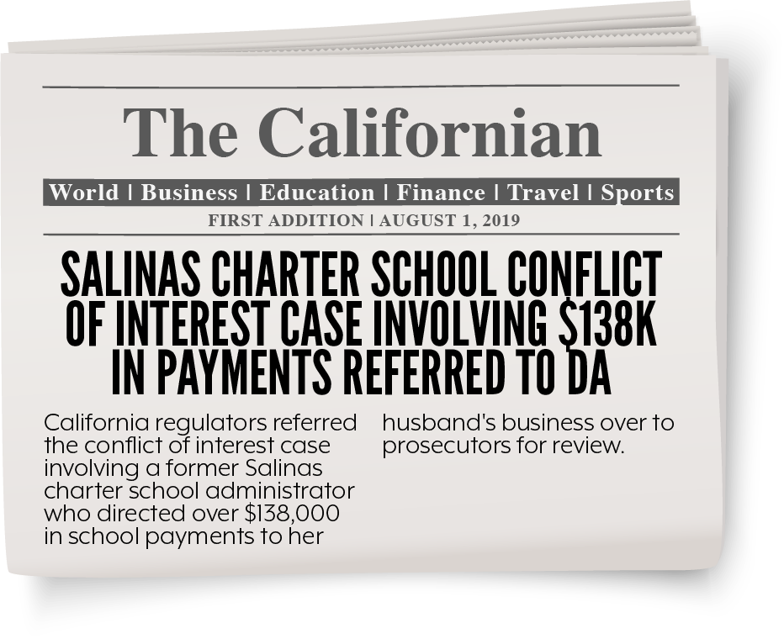

Slide 69
Government Code Section 1090
Elements
Public official (officer, board member, or employee)
Making a public contract (for sale or purchase)
Public official has a financial interest in the contract
69

Slide 70
Government Code Section 1090
What you need to know about Section 1090
If board member has financial interest, the entire board is prohibited from entering into the contract; even if it is with the best vendor at the best price and the interested board member abstains. (Unless an exception applies.)
Making a public contract is defined very broadly! Applies to earliest discussions, planning, solicitation for bids, etc., not just vote.
Thus, this statute is, in most respects, the toughest standard to meet.
Violation of GC 1090 is a felony and the contract void!
70

Slide 71
Political Reform Act

Slide 72
Political Reform Act
Big Picture
Public official
Participating in or attempting to influence a governmental decision
Public official has qualifying financial interest (Includes spouse and children)
Financial interest is material
The Official Must Recuse Him or Herself from
All Parts of the Decision-Making Process
Lots of very detailed regulations have also been adopted by FPPC.
72

Slide 73
COI Code
Conflict of Interest Code
States who must file the Form 700
Assigns disclosure categories
73

Slide 74
Understanding the Form 700
74

Slide 75
Types of Form 700 Filings
Assuming Office: File within 30 days of starting employment or being sworn in; includes information for the past 12 months.
Annual Statement: Normally by April 1st; includes information for the prior calendar year. (If you start employment/assume office between October 1 – December 31, you do not need to fill out an Annual Statement until the following year.)
Leaving Office: File within 30 days of your last day; includes YTD information.
75

Slide 76
Form 700
Form 700 includes:
Cover Sheet
Schedule A-1 (General Investments)
Schedule A-2 (Interest in Business Entities/Trusts)
Schedule B (Interest in Real Property)
Schedule C (Income and Loans)
Schedule D (Gifts)
76

Slide 77
Political Reform Act
“Financial Interest” for Form 700
Investment in business entity of $2,000 or more
Real property investment of $2,000 or more
Income of $500 or more
Business position in entity
Gift of $50 or more
77

Slide 78
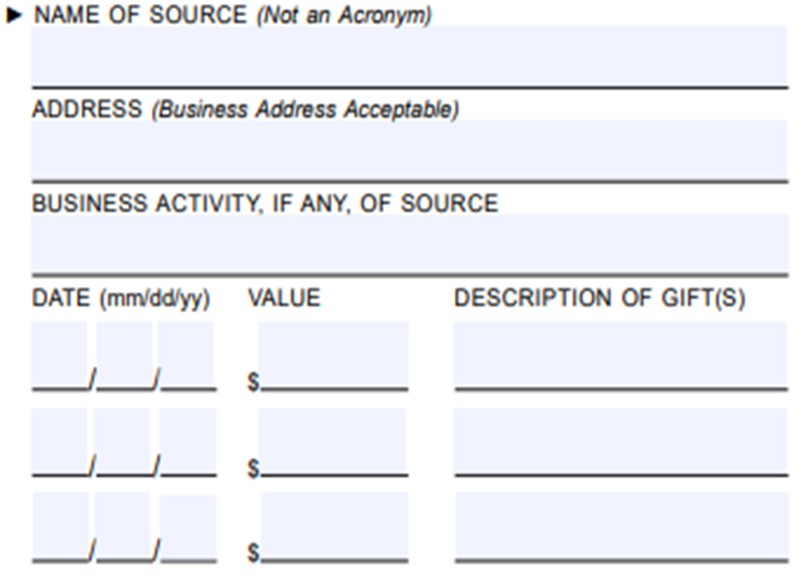
Form 700
SCHEDULE D
General rule is that you cannot accept more than $500 from one source in a calendar year.
General rule is that gifts worth more than $50 must be reported (one gift or aggregate gifts from same source in a calendar year).
78

Slide 79
Form 700: Gifts
Many exceptions to both general rules, the most common being:
Special Occasions: Birthdays, Holidays:
Can be gifts from anyone (other than lobbyists) so long as the gift giving and taking is proportional.
Inheritance
Family Members:
Spouse (or former spouse), child, parent, grandparent, great grandparent, grandchild, brother, sister, current or former parent-in-law, brother-in-law, sister-in-law, aunt, great aunt, uncle, great uncle, niece, great niece, nephew, great nephew, first cousin, or first cousin once removed, or the spouse of any such person. (other than a lobbyist)
79

Slide 80
Form 700: Gifts
“BFF’s”- Long-term friendships:
Friends for a “period of time” and gift giving and taking must be proportional. (other than a lobbyist)
Dating – “bona fide” relationship (other than a lobbyist)
Returning or Donating Gifts vs. Reporting
80

Slide 81
Form 700: Penalties
Late filers: $10 a day up to $100
Filing Officer collects fine and deposits in charter school general fund
If FPPC brings action, fine goes to the State
Filing Officer and FPPC can waive fine if
Late filing was not willful, and
Fine would not further purpose of PRA
81

Slide 82
New Legislation Pending
If signed, Assembly Bill 2158 will require ethics training for charter school board members.
Currently on Governor’s desk.
If signed, training requirement would become effective January 1, 2025.
82

Slide 83
Duty of Care and Loyalty
83

Slide 84
Duty of Care and Loyalty
1. Duty of Care
2. Duty of Loyalty
84

Slide 85
QUESTIONS?
THANKS FOR ATTENDING TODAY

