Slide 1
Executive Director’s Report
May 2022

Slide 2
Agenda
01
02
03
Enrollment
Vista Ordering
Return Date for Teachers

Slide 3
Enrollment Update
All current Winship students were offered a spot in Feather River through a Jot Form survey. Students who indicated that they wanted to be enrolled have successfully completed the enrollment. Thank you to our enrollment and student information teams for helping with this.

Slide 4
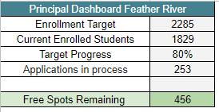
Enrollment Update
A special thank you to our amazing Sequoia Grove Enrollment Team!!!

Slide 5
New Ordering System Launched for Pre-Ordering!
A great big thank you to Stephanie and Ryan for helping with the build and implementation!

Slide 6
Notes:
Allie

Slide 7
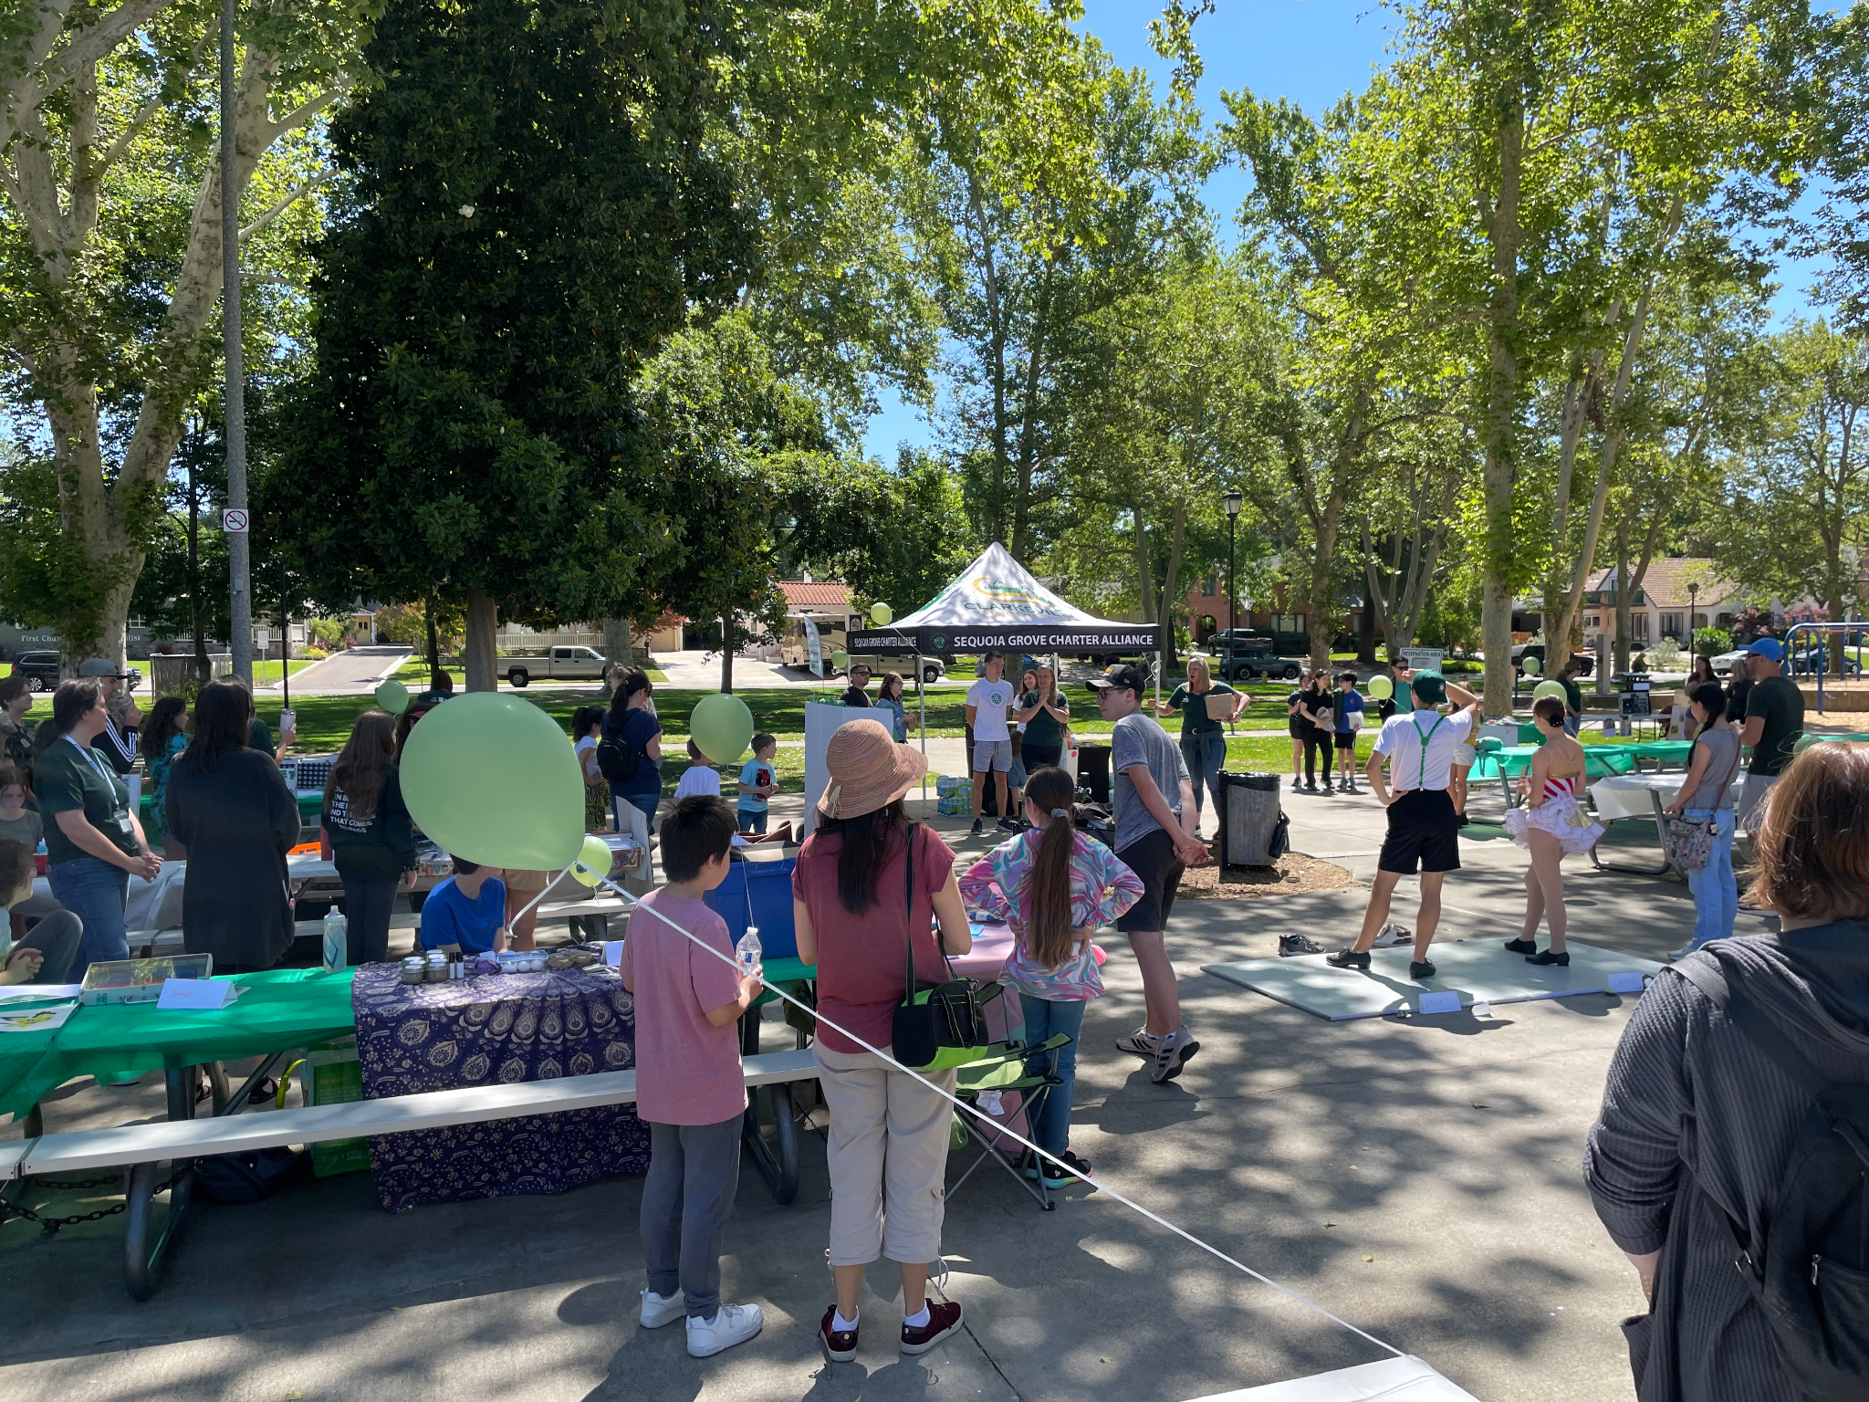
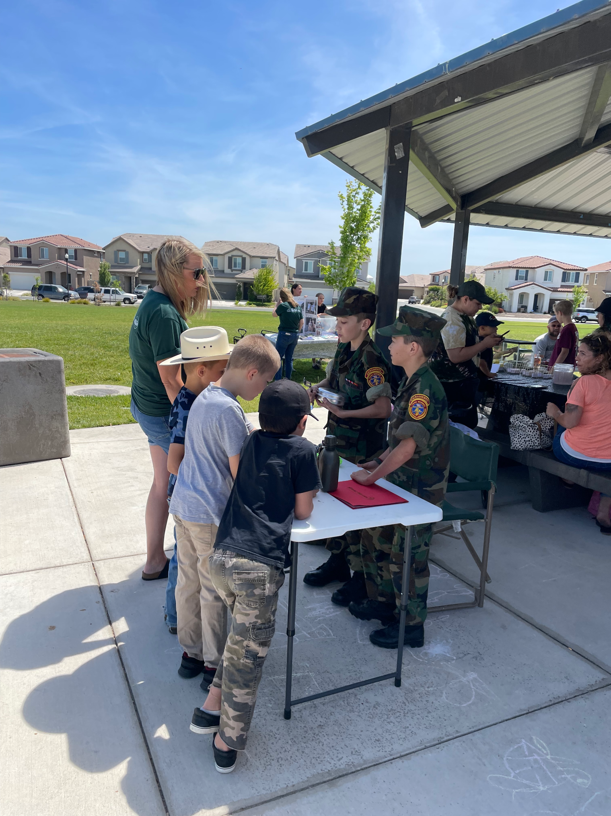
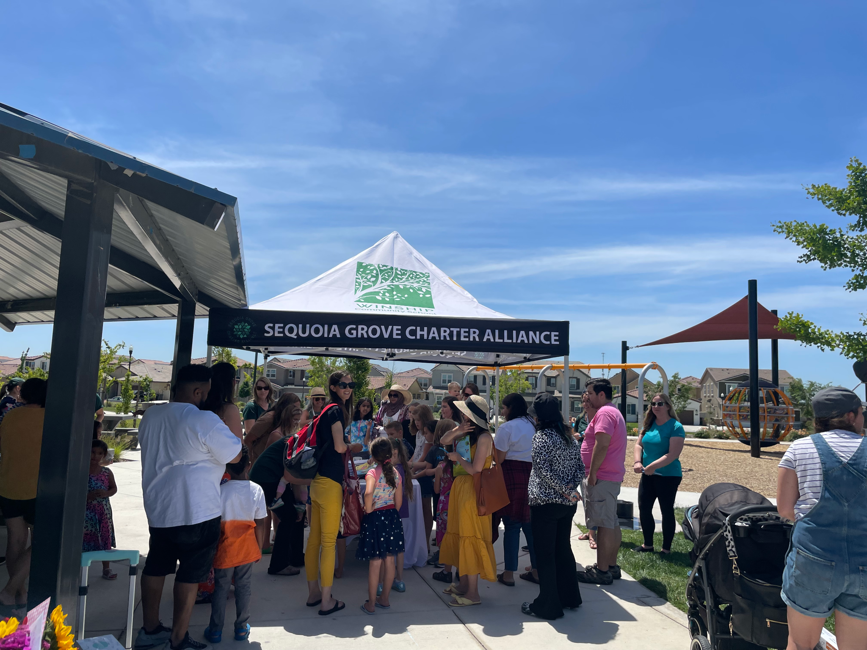
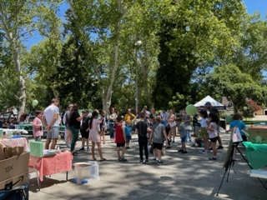
Student Showcase Success!
Our students are so talented!
Notes:
Allie

Slide 8
We made it to the end of our first year as Sequoia Grove.
It has been quite a journey and we look forward to continuing to serve our homeschool families well in the future.
Thank you to all of our school staff, the CSO staff and our boards for making this year a success.
Teachers will return August 1

Slide 9
Thank you so much
For all you do to encourage, inspire, motivate and guide your teams! The work you do is amazing! You are much appreciated.

