Slide 1
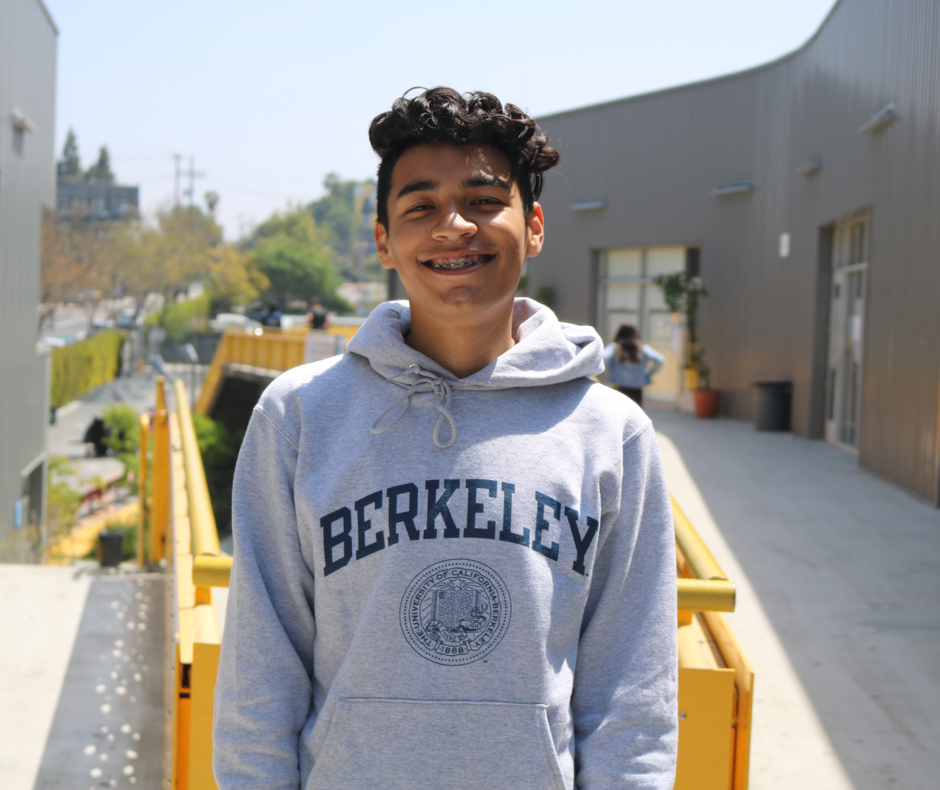
CEO Update
October 2021

Slide 2
Employee Vaccination Policy Update

Slide 3
Board approved policy approved 9/14/21
All employees will be required to receive the COVID-19 vaccination by November 15th.
2 exemption options were provided – medical and religious.

Slide 4
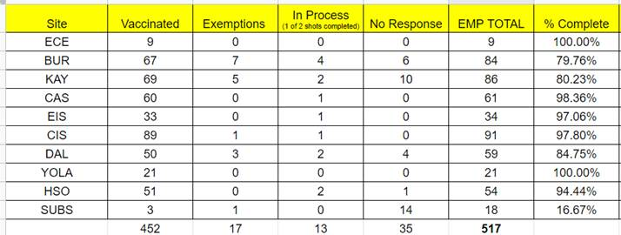
Employee Vaccination Update:

Slide 5
TK Legislation: Universal TK

Slide 6
What is TK?
TK stands for Transitional Kindergarten. It was an answer to legislation that changed the qualifying birthdates for Kindergarten.
Its meant to prepare students for Kindergarten. Entering K at an older age is one of the early predictors for long-term student success.
Provides students with time to develop social emotional skills that will help them enter the academic world of Kindergarten.
How many TK students does CNCA currently have?
School | Student Count
BUR | 15
CAS | 13
CIS | 11
KAY | 12
Total | 51

Slide 7
How many applications per year do we receive for TK?
71 applications for TK in 20-21
94 applications for TK in 21-22
16 early applicants for 22-23
SB 130 Trailer Bill – Transitional Kindergarten Roll Out
 | Enrollment Requirement | Class Size
Current: | 5th birthday between September 2 and December 2* | N/A
2022–23 | 5th birthday between September 2 and February 2 | one adult for every 12 pupils
2023-24 | 5th birthday between September 2 and April 2 | one adult for every 10 pupils
2024-25 | 5th birthday between September 2 and June 2 | one adult for every 10 pupils
2025-26 | 4th birthday by September 1 | one adult for every 10 pupils
Notes:
We are not fully taking advantage of the TK population for enrollment and creating a TK-8 pipeline for families.

Slide 8
What revenue is associated with the SB 130 Trailer Bill to implement Universal TK?
Planning for TK expansion approximately $100,000 per site
ADA funding per K-12 model approximately $14,000 per student
How can SB 130 TK legislation positively impact CNCA TK-8 schools?
Ongoing under-enrollment – increase by 1 TK class:
Kayne
CAS
CIS
Opportunity for expansion:
BUR
Notes:
22-23 have flexibility to increase up to 20%
For more than 1 year.
December policy change: 3-5 months for MR.
Could implement for 22-23 with the 20% overage.

Slide 9
Questions?

