Slide 1
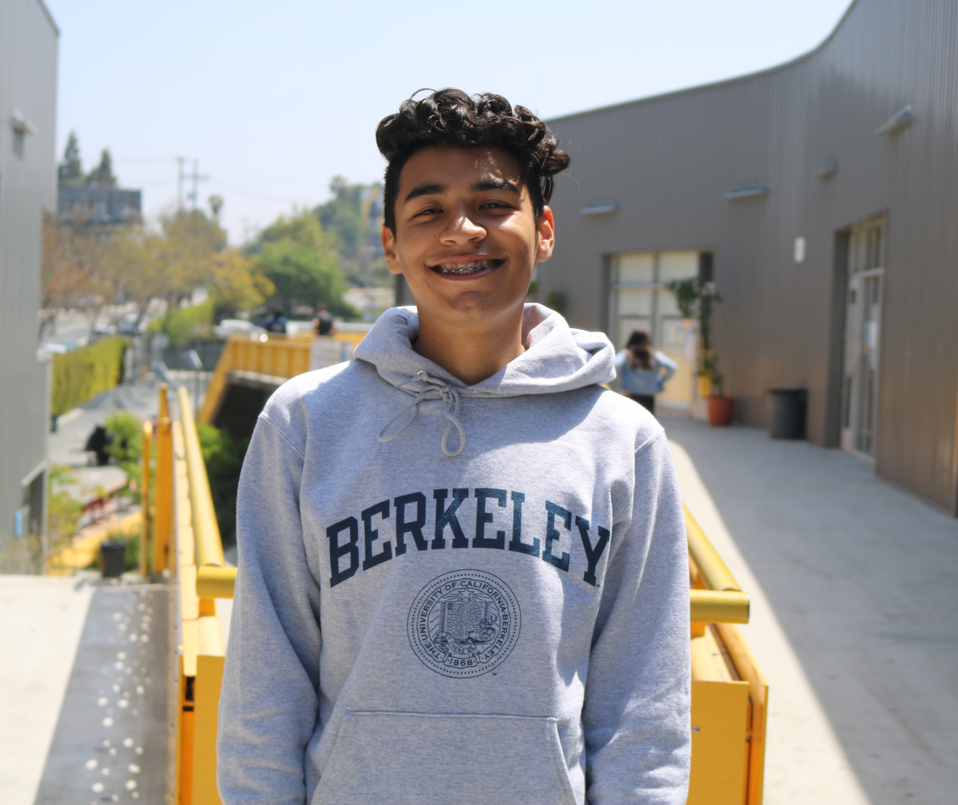
CEO Update
May, 2021

Slide 2
LAUSD Oversight Reports 2020-2021

Slide 3
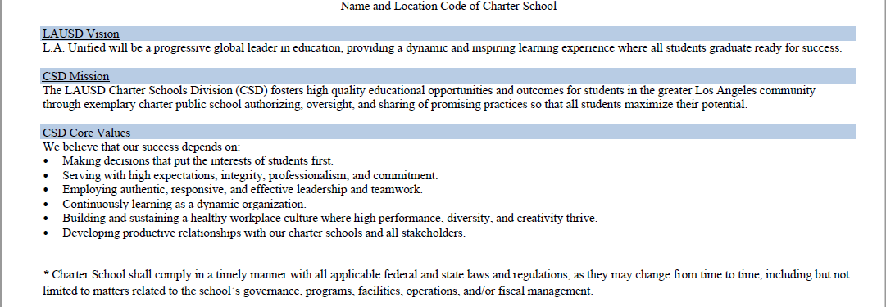
LAUSD Oversight – Annually

Slide 4
Burlington – Oversight Results

Slide 5
Miramar – Oversight Results

Slide 6
Kayne Siart – Oversight Results

Slide 7
CAS/EIS – Oversight Results

Slide 8
Cisneros – Oversight Results

Slide 9
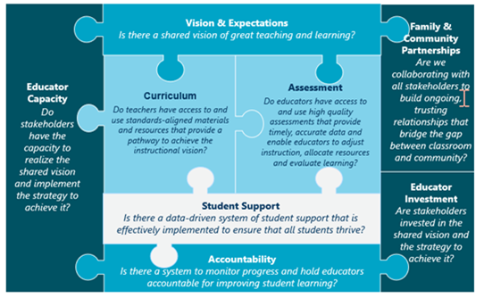
School Site Review – All Schools

Slide 10
School Site Review – All Schools
-Differentiated approach to school leadership support from VP of
Schools, VP of Curriculum & Instruction and Content Team.
- Identifying org-wide needs – PD, coaching, technology,
curriculum, assessment.
-Strategic plans for each school – Green, yellow and red tiers.
-Improvement Plan – CAS/EIS – Leadership team is working to identify the root causes and the strategies for
improvement. VP of Schools, VP of C&I with Content team
will support taking the draft to finalized report (renewal 2024)

Slide 11
Miramar Facilities

Slide 12
CSFA Agreement for Prop 1D Funding
Next Steps:
1. LAUSD settlement

Slide 13
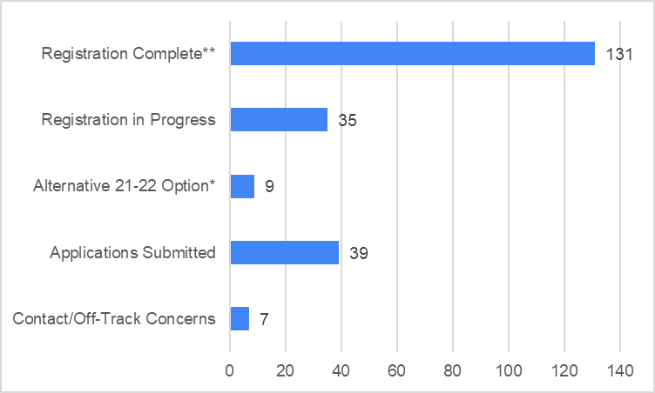
MIR Student Update
11 caseworkers
Caseload status updates over the next 2 weeks
Granting extension for 3-4 caseworkers until EOY for
Additional applications
Registration support
*on-track to graduate, or enroll at Adult School
**including transferred students
NOTE: data as of 4/9/21

Slide 14
MIR Staff Update
Update on Match Meetings:
CNCA has held 15 match meetings since January
8 staff members have accepted positions at other CNCA sites (2 offers are pending)
1 acceptance rescinded
We continue to host match meetings as positions become available
End of Year Close Out
The HR Team will begin to schedule exit meetings with MIR staff the week of May 17th.
All feedback will be collected through the exit meeting process.

