Slide 1
Spring Excellence Update
The Exploris School
June 2020

Slide 2
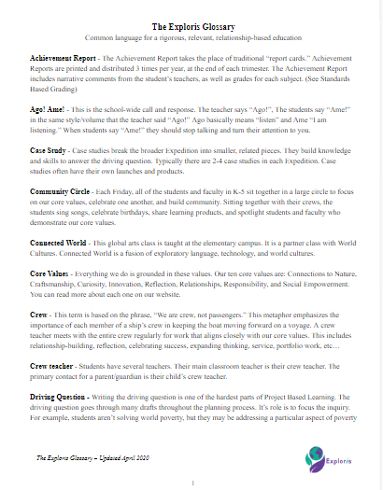
The Exploris Glossary
Notes:
Amanda & Michelle fluidly

Slide 3
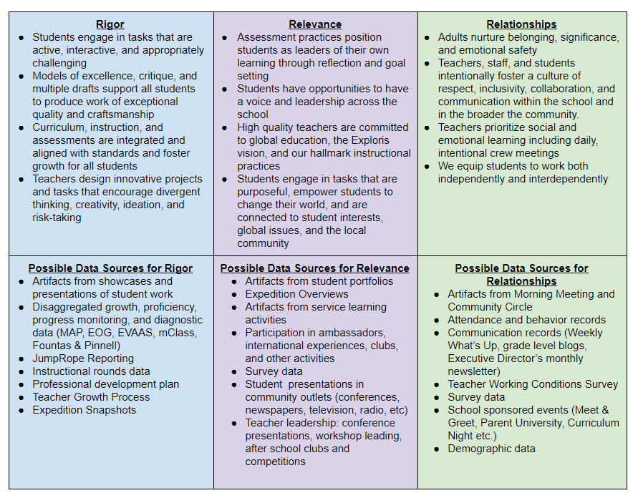
Measures of Educational Excellence
Notes:
Amanda & Michelle fluidly

Slide 4
Rigor
Students engage in tasks that are active, interactive, and appropriately challenging
Models of excellence, critique, and multiple drafts support all students to produce work of exceptional quality and craftsmanship
Curriculum, instruction, and assessments are integrated and aligned with standards and foster growth for all students
Teachers design innovative projects and tasks that encourage divergent thinking, creativity, ideation, and risk-taking
Notes:
Amanda & Michelle fluidly

Slide 5
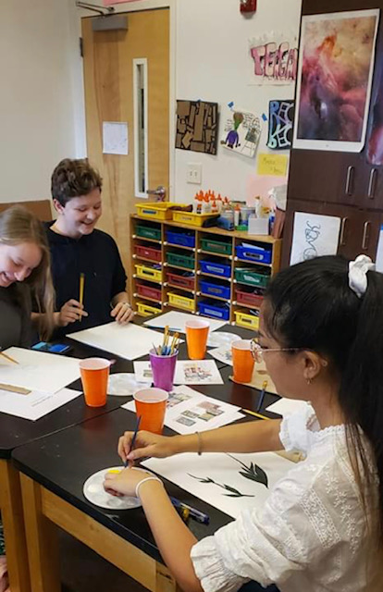
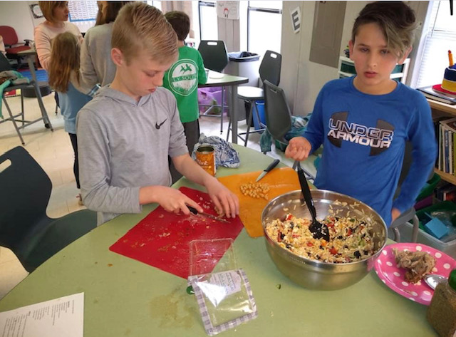
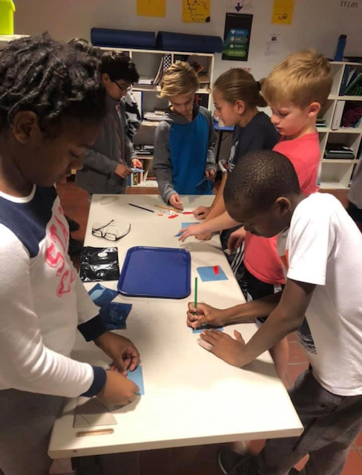
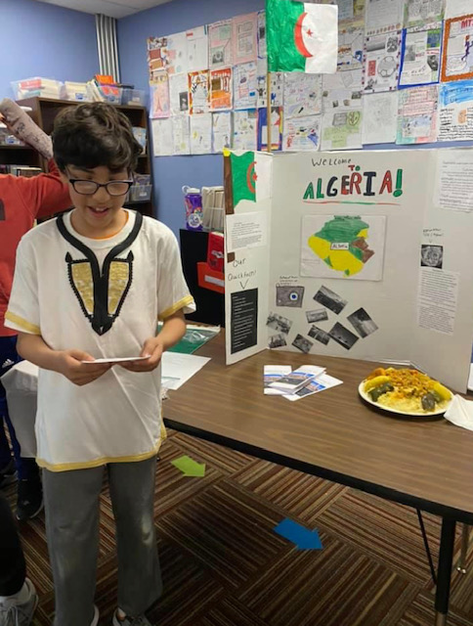
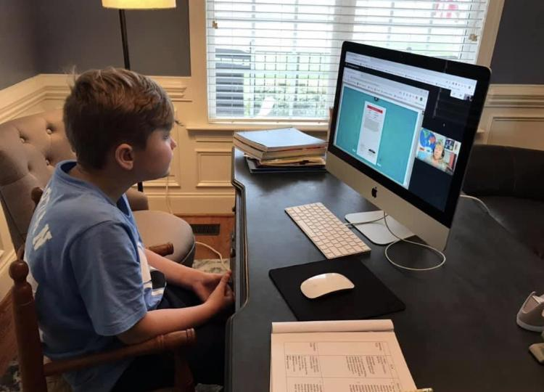
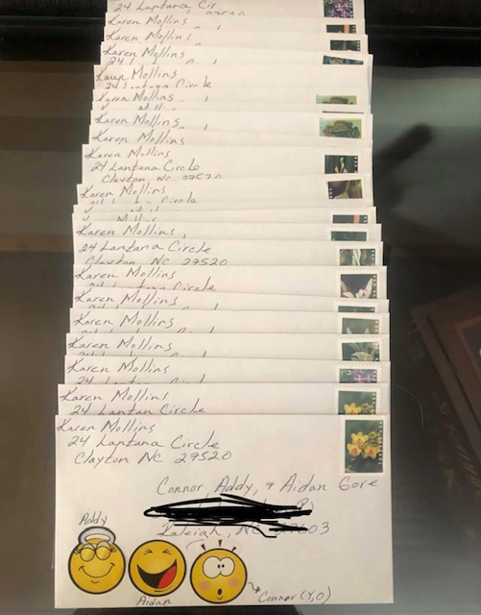
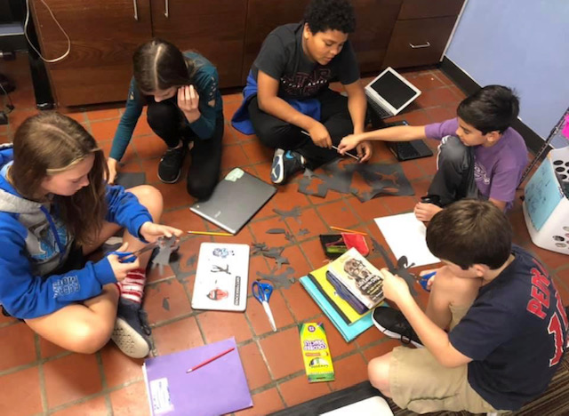
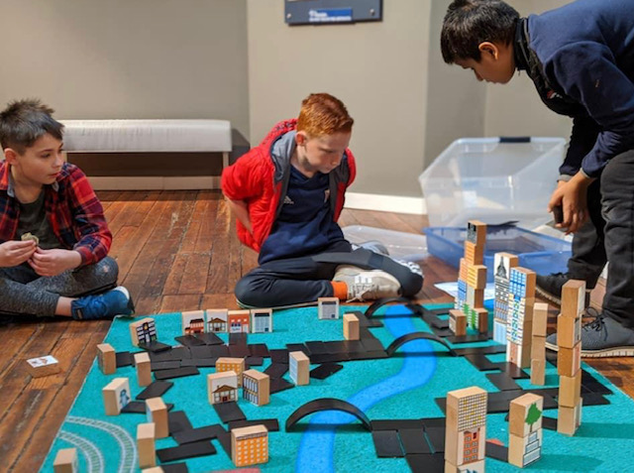
Rigor Data: 2019-2020
Notes:
Amanda & Michelle fluidly

Slide 6
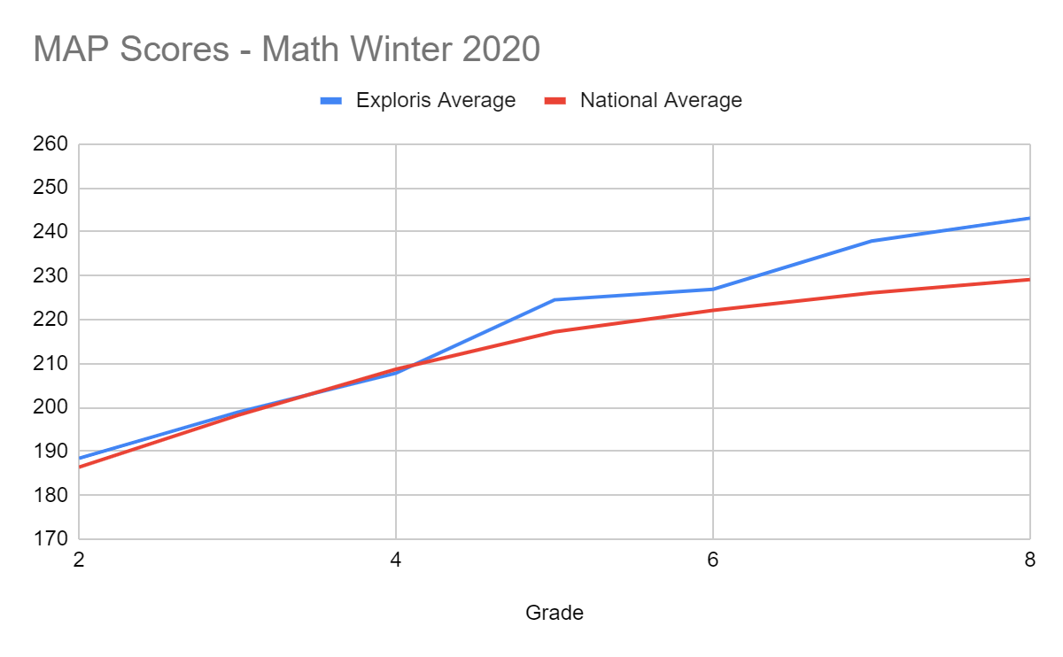
Winter MAP - National Norm Comparison, Math
Notes:
Amanda & Michelle fluidly

Slide 7
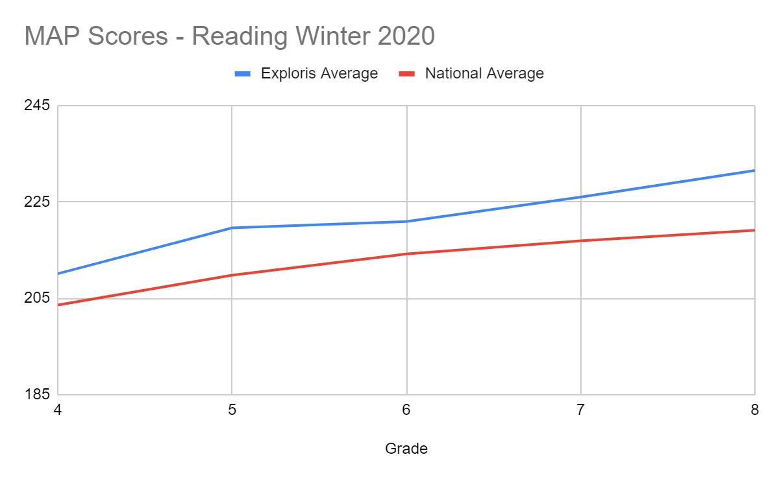
Winter MAP - National Norm Comparison, Reading
Notes:
Amanda & Michelle fluidly

Slide 8
Rigor Data: Grade Level Proficiency Notes
Side note 1: MAP National Norms are based on testing in the 20th week. Our students take winter MAP between the 16th & 18th weeks.
Side note 2: “NWEA does not consider winter assessments to be an official growth point due to the limited number of instructional weeks. Winter assessments should be viewed in this light.”
~ Understanding Negative Growth
Notes:
Amanda & Michelle fluidly

Slide 9
Rigor Data: 2019-2020
Instructional Rounds Data
Conducted October 24, 2019
Problem of Practice: “What does classroom management look like in our school?”
8 classrooms observed by a team of 15 teachers and staff
Professional Development conducted with space donated by Transfer Co. Food Hall
Six patterns observed
Notes:
Amanda & Michelle fluidly

Slide 10
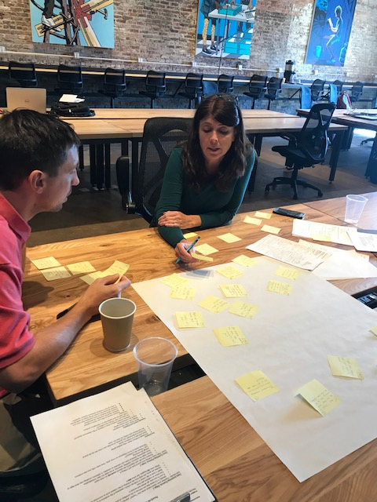
Rigor Data: 2019-2020
When smaller increments of time for a task are explicitly named by the teacher(s), on-task behavior increases
Students follow the routines with visual and nonverbal support from the teachers, which reduces classroom disruptions
Verbal comments were the most frequent for of redirection
Notes:
Amanda & Michelle fluidly

Slide 11
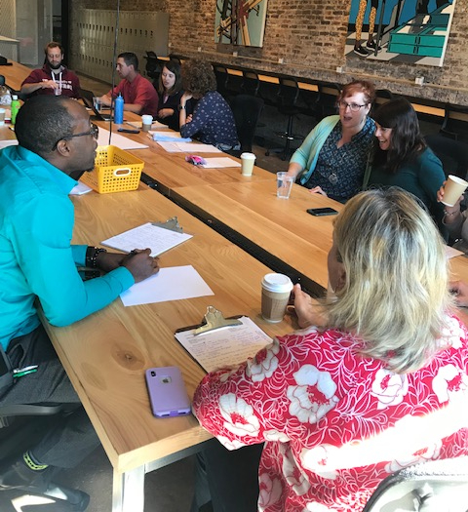
Rigor Data: 2019-2020
4. When smaller groups of students are created (using furniture, staff, and/or task differentiation), there is a higher level students on task
5. Organized physical space, paired with known routines, results in less teacher time spent managing behaviors
Notes:
Amanda & Michelle fluidly

Slide 12
Rigor Data: 2019-2020
Professional Development Schoolwide
New Teacher Orientation
New BT Support Handbook for Mentors
Discipline to Support Growth and Responsibility
Multi-Tiered Systems of Student Support (MTSS)
Support LGBTQ students and families
Notes:
Amanda & Michelle fluidly

Slide 13
Rigor Data: 2019-2020
Professional Development for Individuals and Groups
PBL Fellows
Design for Change
Kenan Fellows
Instructional Strategies for Students with Mild Intellectual Disabilities
Peaceful Schools NC Conference
Purposeful Coaching
How to Reduce Anger, Anxiety, and Avoidance
Purposeful Coaching
Foundations of Autism
Color of Education Summit
Foundations of Autism
Color of Education Summit
How to Reduce Anger, Anxiety, and Avoidance
Restorative Practices in Education
DRIVE Summit
Notes:
Amanda & Michelle fluidly

Slide 14
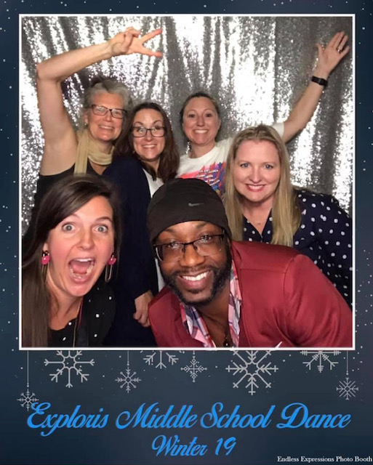
Rigor Data: 2019-2020
Formal Teacher Growth Process
Professional Growth Plans for each teacher
(BOY & EOY check-ins)
2-4 formal observations depending on new/veteran teachers
Due to COVID-19, third trimester observations and summative sessions were canceled
Notes:
Amanda & Michelle fluidly

Slide 15
Relevance
Assessment practices position students as leaders of their own learning through reflection and goal setting
Students have opportunities to have a voice and leadership across the school
High quality teachers are committed to global education, the Exploris vision, and our hallmark instructional practices
Students engage in tasks that are purposeful, empower students to change their world, and are connected to student interests, global issues, and the local community
Notes:
Amanda & Michelle fluidly

Slide 16
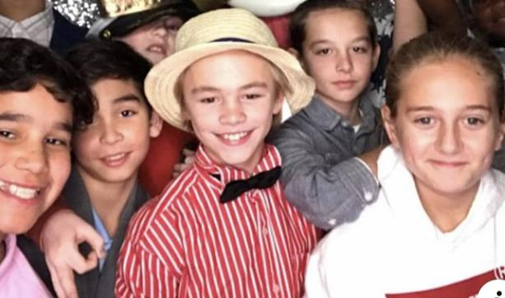
Relevance Data: 2019-2020
Participation in ambassadors, international experiences, clubs, and other activities
Ambassadors led 20 tours
(An average of nearly 1 per week)
International exchange with Shinonome Junior High School in Hiroshima, Japan
Middle School Clubs (22 clubs)
Notes:
Amanda & Michelle fluidly

Slide 17
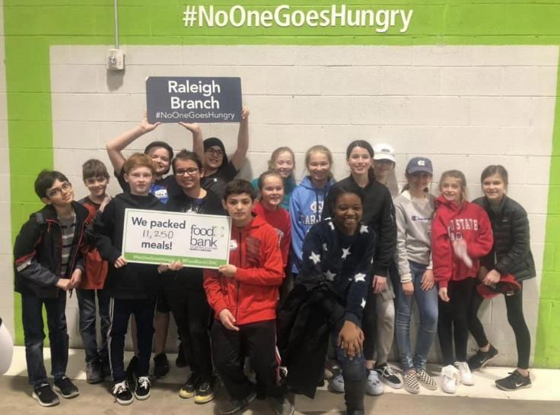
Relevance Data: 2019-2020
Connections to community outlets
State immigration writing contest winner
MathCounts Regional Competition
Articles in N&O, EducationPost, NC Health News, The Technician
Notes:
Amanda & Michelle fluidly

Slide 18
Relevance Data: 2019-2020
Teacher Leadership: conference presentations, workshop design & facilitation, after school clubs and competitions
PBL Fellows
Educators of Excellence
Science Olympiad competitions
Kenan Fellows
Design for Change Fellowship
NCCAT Charter School Connections Conference Leaders
School Reform Initiative Leadership Fellows
Governor’s Teacher Advisory Council
Numerous after school clubs
Notes:
Amanda & Michelle fluidly

Slide 19
Relationships
Adults nurture belonging, significance, and emotional safety
Teachers, staff, and students intentionally foster a culture of respect, inclusivity, collaboration, and communication within the school and in the broader the community.
Teachers prioritize social and emotional learning including daily, intentional crew meetings
We equip students to work both independently and interdependently
Notes:
Amanda & Michelle fluidly

Slide 20
Relationships Data: 2019-2020
Devices loaned to students needing a computer: 75
Risk assessments conducted: 12
Referrals to outside counseling: 10
Suicide Risk Screening Assessments: 10
Referrals Through SaySomething: 6
Transition to High School Families Supported: 42
Students Receiving Counseling During COVID: 54
Parents Receiving Counseling Support During COVID: 36
Overall my school is a good place to work and learn: 74% (down from 94% last year)
Notes:
Amanda & Michelle fluidly

Slide 21
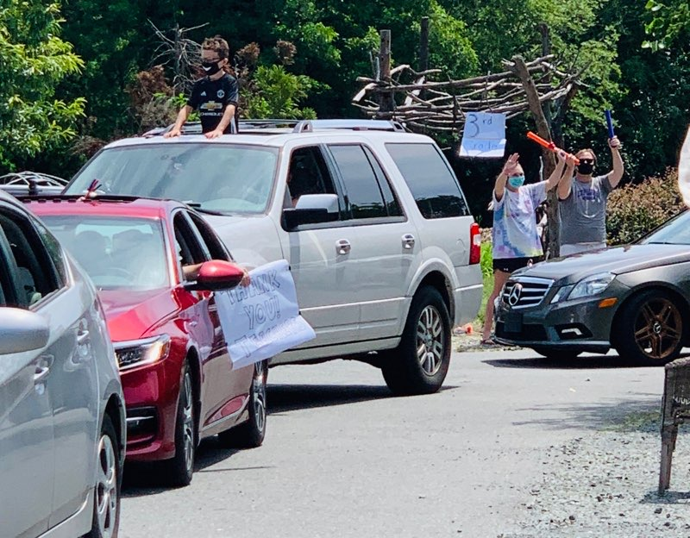
Relationships Data: 2019-2020
School sponsored events
PTO Fall Picnic
1 PTO Sponsored MS Dance
Parent University: High Schools
Parent University: Screenagers
3 Family Meet-Ups with Counselors
End of Year Drive-By Party
Recruitment Event with Mop Top
Passage Portfolio attendance in virtual format
Notes:
Amanda & Michelle fluidly

