Slide 1
Interim Leadership Team Report
The Exploris School
Board Meeting June 16, 2020

Slide 2
Personnel
Board approval is requested to accept the resignation of kindergarten teacher, Valerie Contreras, effective at the end of the 19-20 school year.
Board approval is requested to accept the resignation of teaching partner, Harry Huntley, effective at the end of the 19-20 school year.
Board approval is requested to approve the appointment of all returning staff for the 2020-2021 school year

Slide 3
3 Operation Issues
Update on Interim Leadership Team
Update from the Re-opening Task Force
Update on the custodial contract

Slide 4
Interim Leadership Team
Transfer is nearly complete of all passwords and accounts
The ILT has has established regular weekly meeting times and other informal communications
Each member has been assigned specific roles and tasks in keeping with their current roles and areas of knowledge
Deb: OCS, Middle School, RTF
Amanda: Jumpstart Summer Readiness, Elementary School, Academic Excellence
Michelle: Licensure, Communications, teacher support
Koren: Budget & Finance; Insurance, audit
Leah: Facilities, MS liaison
Tom: Foundation, ES liaison
We are working on communications plans for regular connections to staff and community
The team crafted a statement that was shared with the Exploris community condemning recent racial violence; responses have been very positive
We are ready to work with the C&C to guide Exploris to our new future

Slide 5
Updates from the Re-opening Task Force
The RTF has been meeting since late April
Began by soliciting all questions & concerns
Strong representation from school community
Making good progress in several key areas
Review of the new state guides shows we are well aligned and positioned

Slide 6
RTF Update
4 Workflows
Using our Physical Space
measuring & planning
signs, entry plans, water movement patterns
cleaning, etc
Responding to sick students & staff
screening
on site quarantine
sick leave policies, etc
Scheduling
created and analyzing family survey
planning options for blended model
Digital Learning & Teaching
collecting data and feedback from staff
figuring out best practices
getting PD ideas

Slide 7
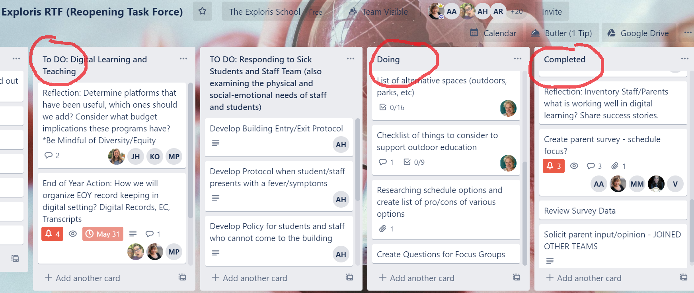
Workflow Tasks

Slide 8
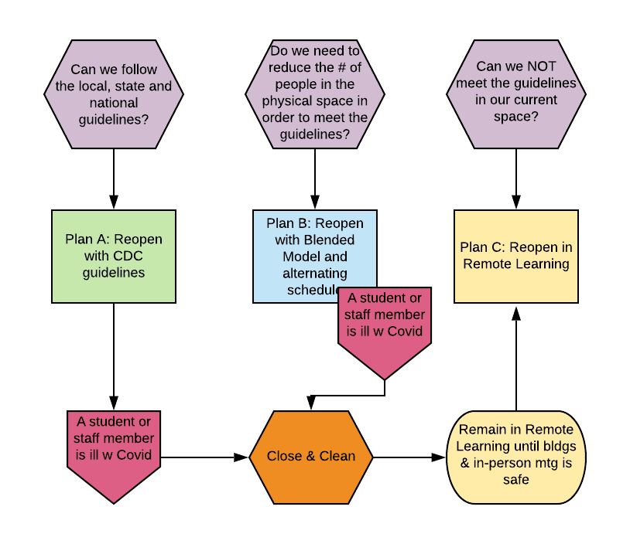
3 Main Scenarios

Slide 9
Next Steps
Focus groups to get more family input
Looking at grants & options for any anticipated additional expenses
Designing viable scheduling plans based on family and staff input
Examining the newly released state guidelines on reopening
What does WCPSS do?
Governance committee reviewing w attny. any needed policy updates
How will ADM be counted if we use a blended or remote form?
What does the world look like by mid summer?
Determine our Go/No-Go point
Remote Learning Response Plan due by mid July

Slide 10
Operation Issues
We have received bids from 4 companies for a cleaning/ custodial contract
We will consider these bids and make recommendations next month
A deep clean of both campuses is scheduled for later this summer
We reached out to Hedgehog during the recent Raleigh curfews to inquire about securing the middle school building, and we took some additional precautionary measures to protect that campus.

Slide 11
Academic Updates
The spring report on academics will be given by the Academic Excellence Committee
Elementary Explorations 3-5 went digital w great success; working to keep the experiential, expeditionary and service aspects of our program, even in remote learning
Spring Achievement Reports
Comments from crew teachers, academic teachers, and Global Arts teachers
All featured universal language in keeping with state guidelines:
Crew: Promoted to the next grade. During this global pandemic, students participated in virtual learning. No formal grades were collected after March 13, 2020, in alignment with state guidelines. Unfortunately, this prevented grades from being updated to show further growth. Typically, the end of year Achievement Report reflects learning for the entire year and students are not expected to achieve an Accomplished score until the end of the year. Please refer to the Crew Comments for evidence of growth. The grades below reflect where students were at the end of the second trimester, and not where they are currently.
Every subject: The grades below reflect where students were at the end of the second trimester, and not where they are currently.

Slide 12
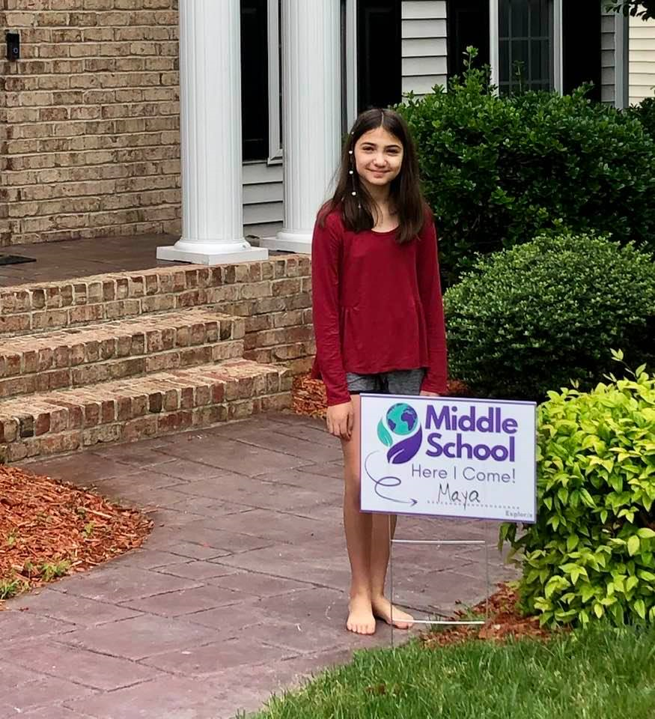
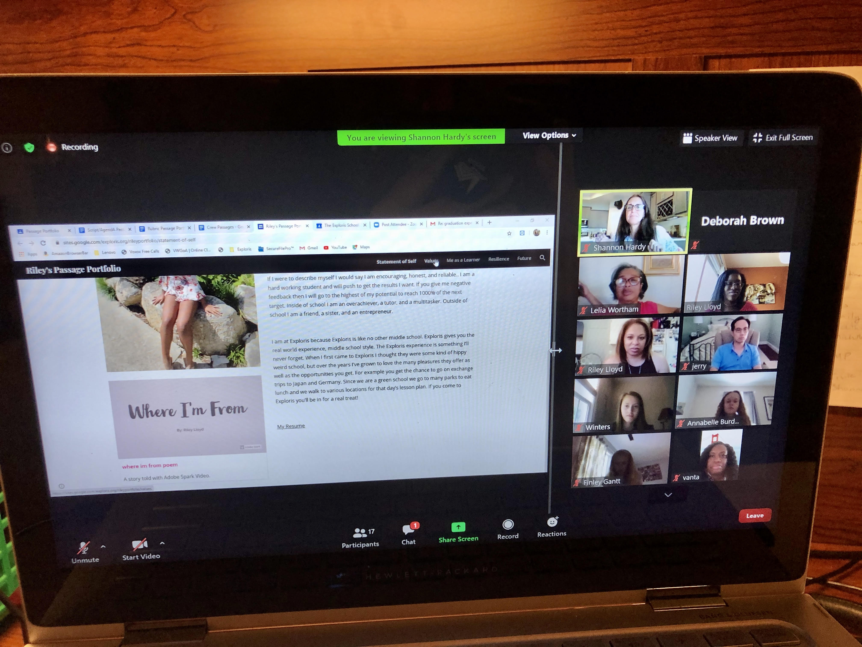
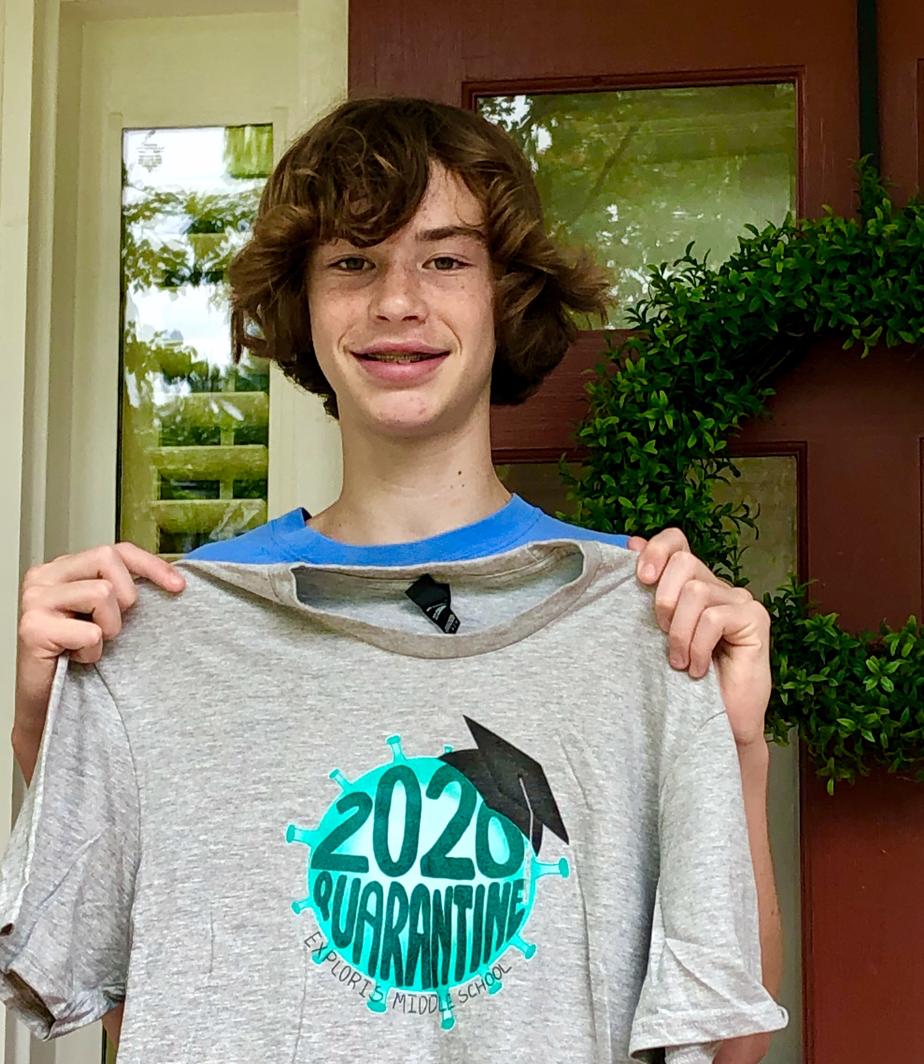
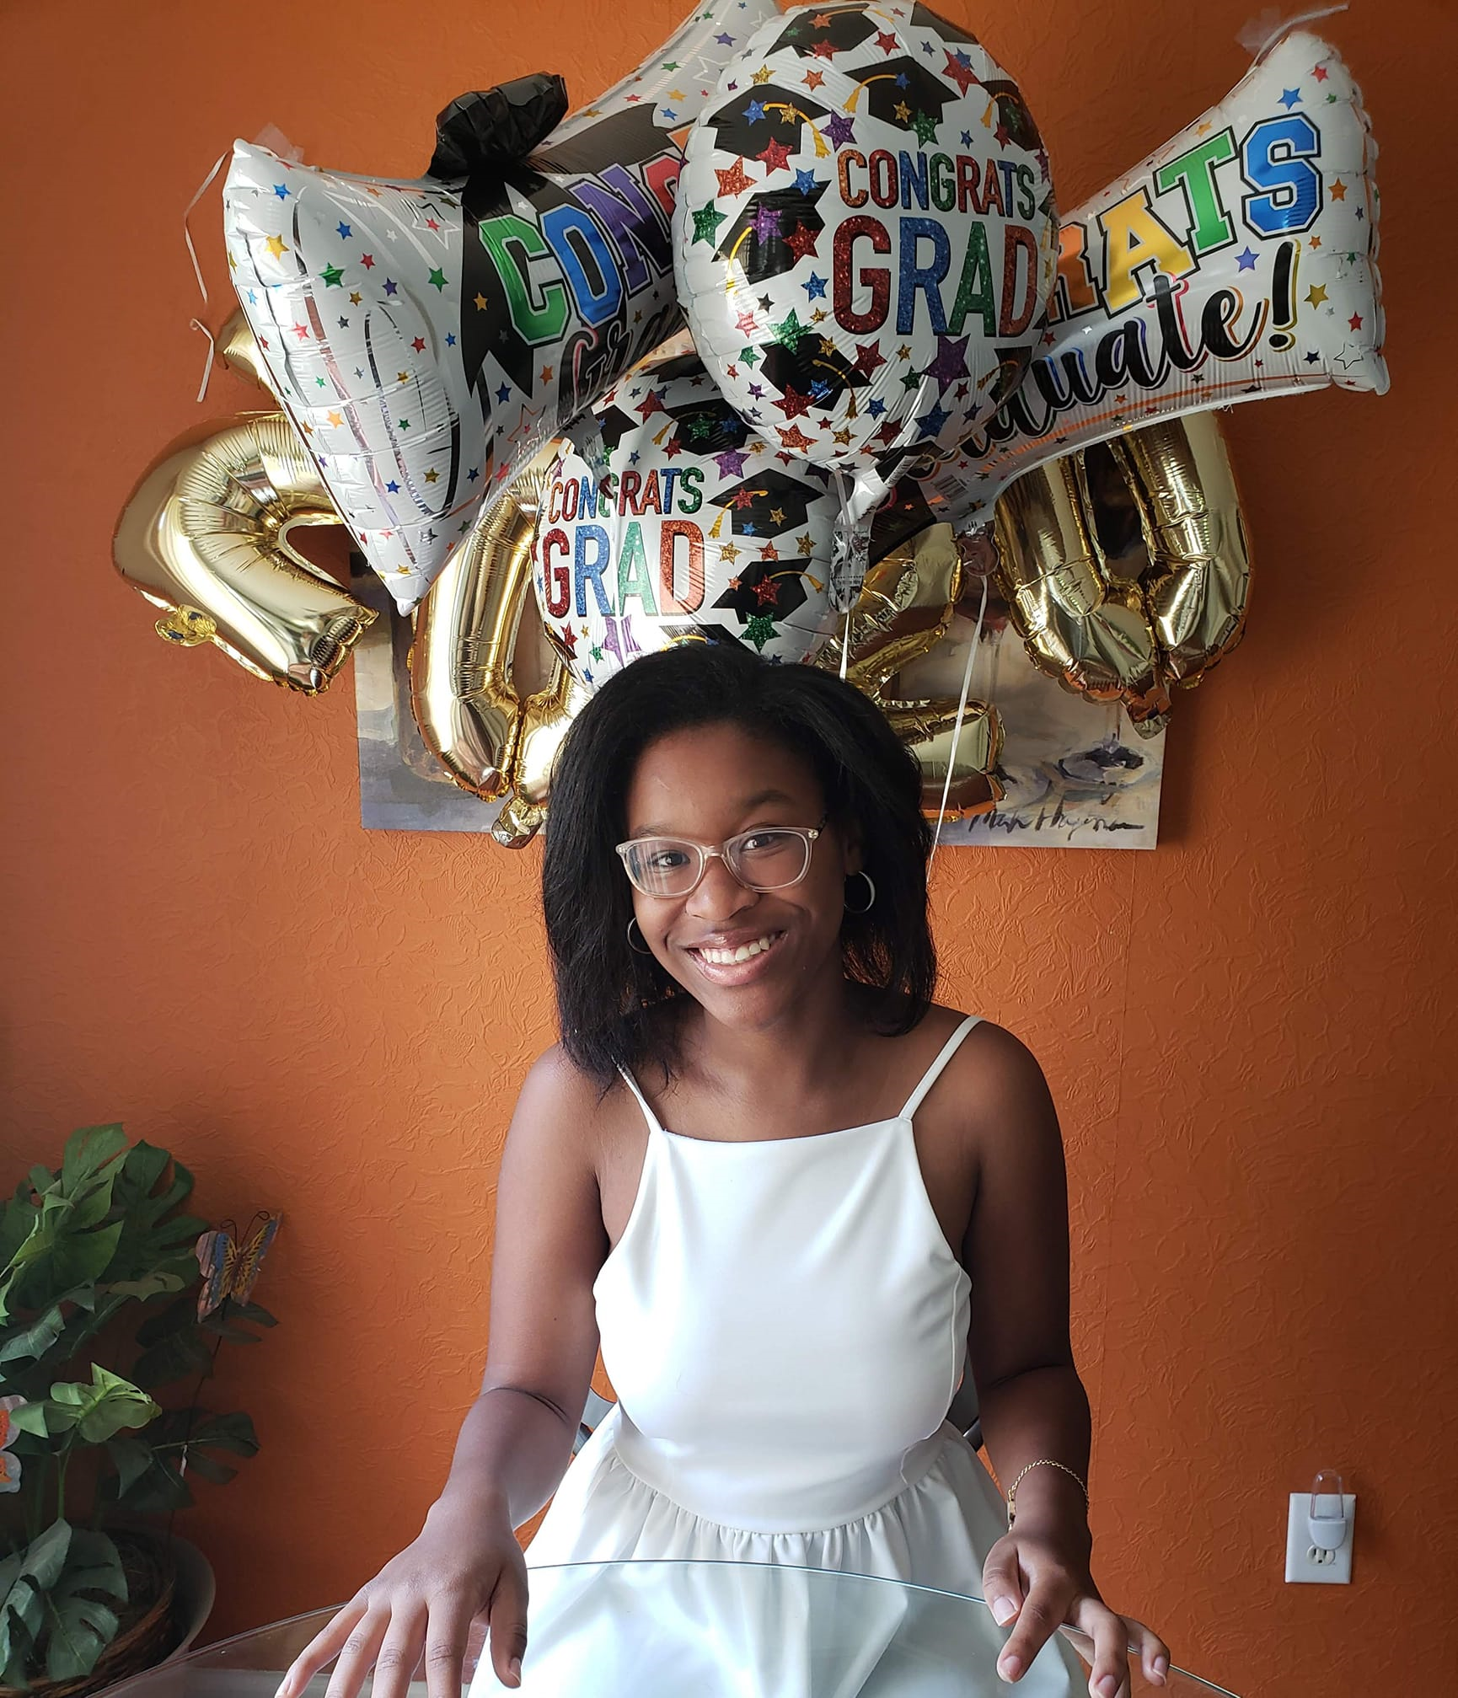
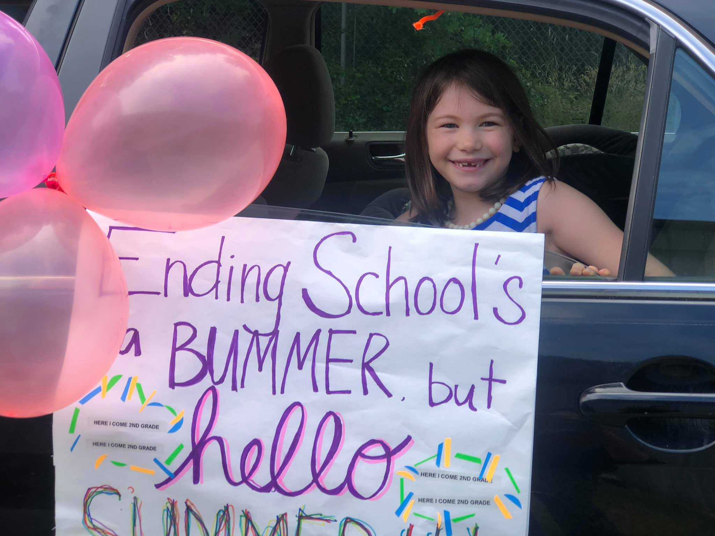
Academic Updates, continued
8th Grade completed Passage Portfolios with outstanding community participation due to the digital format
End of Year Celebrations:
8th grade graduation
5th graders recognition
Elementary drive-by party

Slide 13
Financial
The Finance Committee met on Thurs. June 11 to review the year to date revenue and expenditures. They began making preliminary plans for the close out of the 19-20 fiscal year as well as plans for the 20-21 fiscal year.
Based on year to date activity, the end of year balance is projected to be $357,992.81. The large increase is due to projections being updated in the benefits categories of retirement, retirement contingency, social security, and unemployment.
ILT suggests further discussion for July on using the balance for reserves and for anticipated expenses in facilities, staff compensation, and Covid related expenses for that balance.
The balance sheet and income statement along with the YTD budget report are attached for your review.

Slide 14
Respectfully submitted,
Deborah Brown & Amanda Northrup,
on behalf of the
Exploris Interim Leadership Team

